Slide 1


SPIN 2016, Champaign-Urbana, IL
Sept. 25 - 30, 2016
12 GeV CEBAF: Accelerator Systems and Polarized Beams
Matt Poelker
with help from A. Freyberger, C. Hovater, R. Kazimi, L. Harwood, A. Lung, J. Creel, K. Dixon, R. Geng, and many others

Slide 2
Outline
Overview of 12 GeV CEBAF
Specific Systems
  new cryoplant, beamlines, magnets, accelerating cavities, separators, lasers
Recent Experience
Future Focus
  Reliability
  Gradient
  Injector Upgrade
  Injector Test Facility

Slide 3
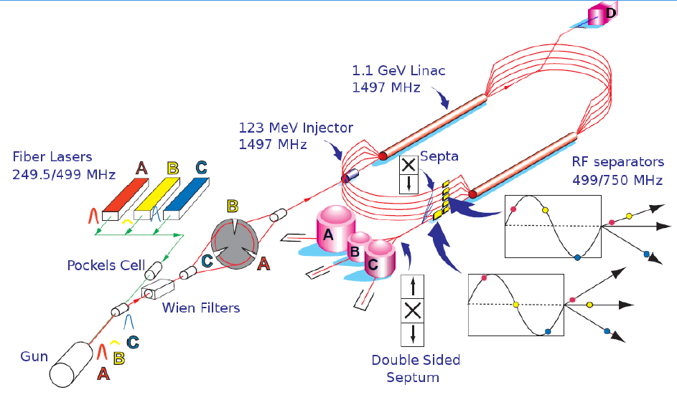
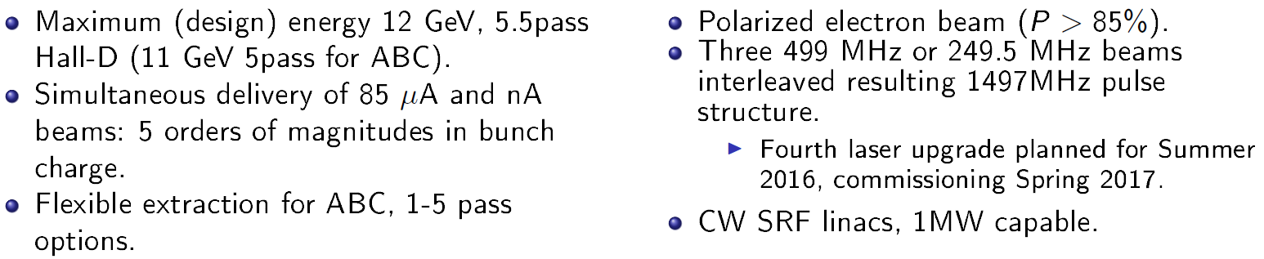
CEBAF Overview

Slide 4
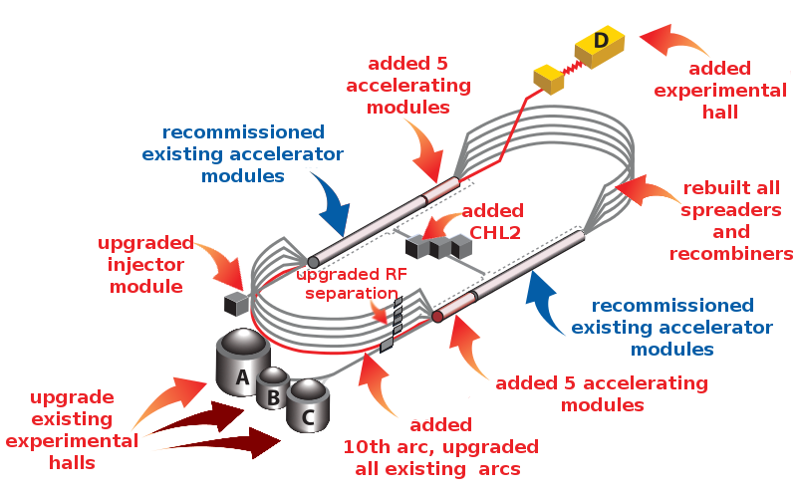
12 GeV Upgrade Overview
Notes:
A similar picture as presented to describe the 6GeV CEBAF.
The upgrade impacted the entire machine.
The injector energy had to be doubled to match the doubling of CEBAF energy.
5 new cryomodules were added to each linac.
The spreaders and recombiner section were completely removed, floor swept clean, and the new 12GeV spreader/recombiners were installed.
All the arcs had to be upgraded and a tenth arc was added.
RF separation was upgraded not only for the increase in energy but also in capability to support 4-hall operation.
A new extraction line and Hall-D were added
A new CHL2 was installed and commissioned.
The one system that was not modified was the existing 41 cryomodules, but time was taking to recommission them to establish a complete SRF baseline for 12GeV CEBAF.

Slide 5
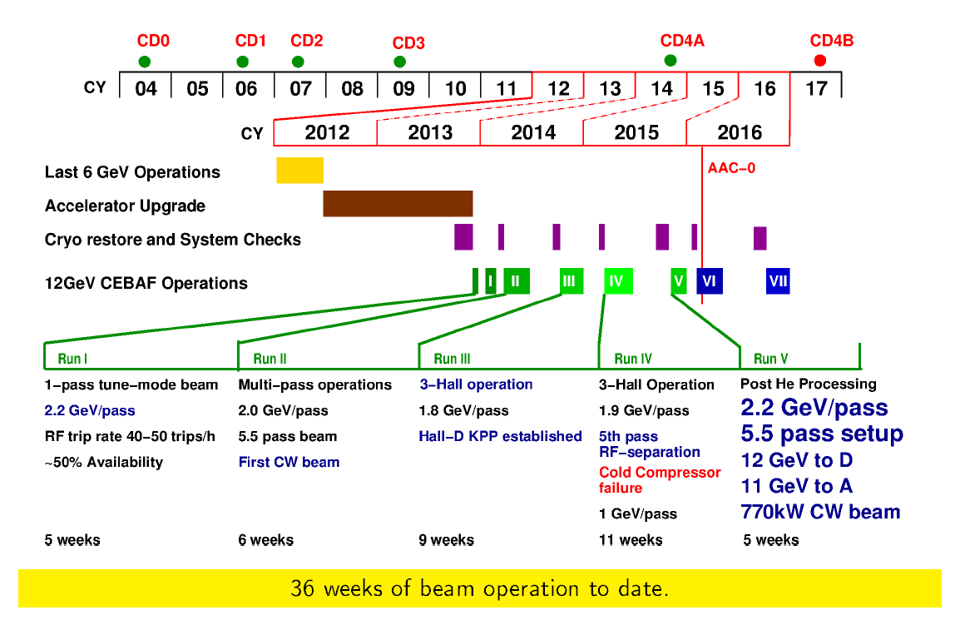

CEBAF 12 GeV Upgrade Schedule

Slide 6
New CHL2
Improved CHL1
Additional sub-atmospheric 2K cold box
Improved purifier skid
420,000 scf He gas storage
40,000 gal LN₂ storage
Improved guard vacuum
Modifications to original 2K Cold Box:
  LN₂ gravity fed cooling
  Removed unreliable, large linac return valve
  Added flow straighteners and increased volumes between compressors
  Increased heat exchanger size
Helium screw-compressors
Oil removal system
10,000 liter helium dewar
4 K cold box system
Integrated computer process control system
Instrument air system, 60 scfm
Motor control centers, 4160V/480V
Gas management and distribution piping
77’x 62’ building for helium compressors
2 x 5MVA , 4160V substation
Cooling tower system

Slide 7
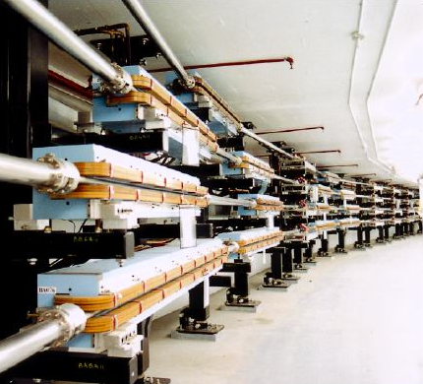
Beamlines
(magnets, power supplies, beam diagnostics, vacuum lines)
Recirculation and transport to Halls A, B and C
    357 major Dipoles (1-3m long)
    730 Quads (30x30x30cm)
    > 2000 power supplies
    > 700 beam diagnostics
    > 5 km of vacuum line
Arc 10
    32 major dipoles (4m long)
    40 quads (35x30x30cm)
    81 power supplies
    32 beam diagnostics
    0.3 km of vacuum line
Transport to Hall D
    4 major dipoles (4m long)
    32 quads (35x30x30cm)
    97 power supplies
    44 beam diagnostics
    0.3 km of vacuum line
Reused almost all
6 GeV beamlines
All items are copies or variations of previous hardware

Slide 8
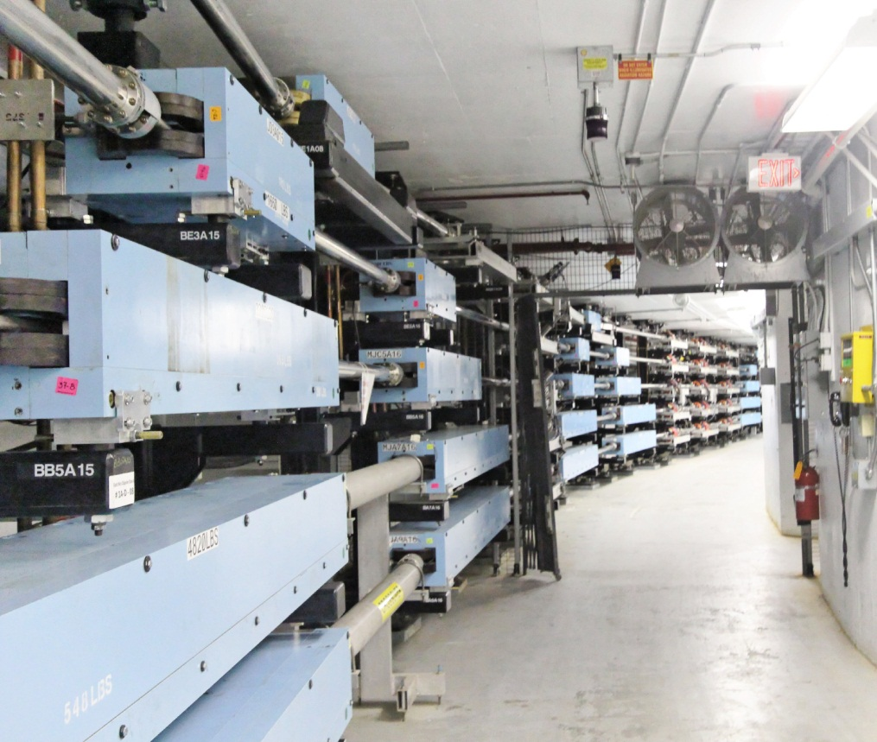
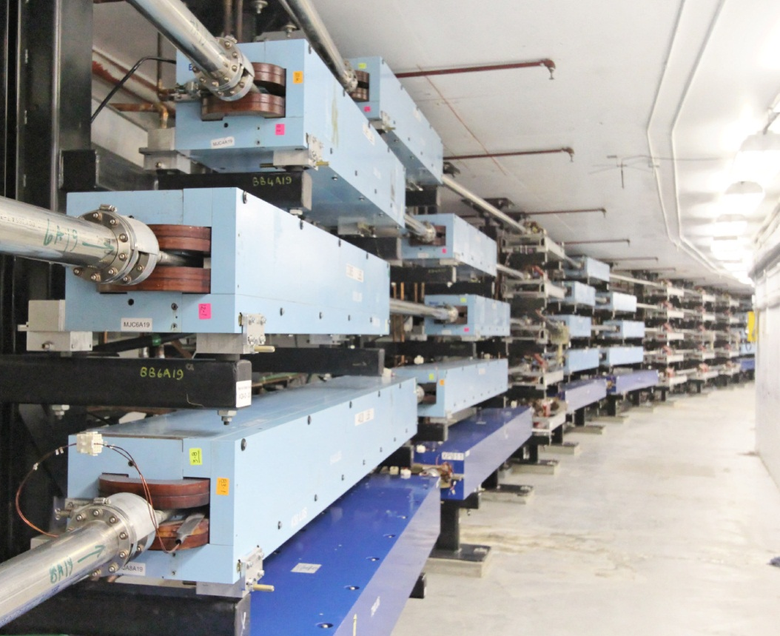
Beam Transport: East and West Arcs
Arc 10
All dipoles changed from “C” to “H”
Installation occurred during both shutdowns

Slide 9
Beam Transport
Upgraded 5 km of beamline and added ½ km of new beamline
256 arc dipoles removed, rebuilt, and re-installed
All spreaders/recombiners and extraction chicanes fully removed (“broom clean”), reconfigured (including modifying the dipoles), and reinstalled with new stands
New arc 10 and beamline to Hall D tagger vault
Above included purchase, mapping, and installation of 230 quadrupoles and 50 new dipoles
Beamline in Hall D tagger vault plus electron beam dump in tagger vault

Slide 10
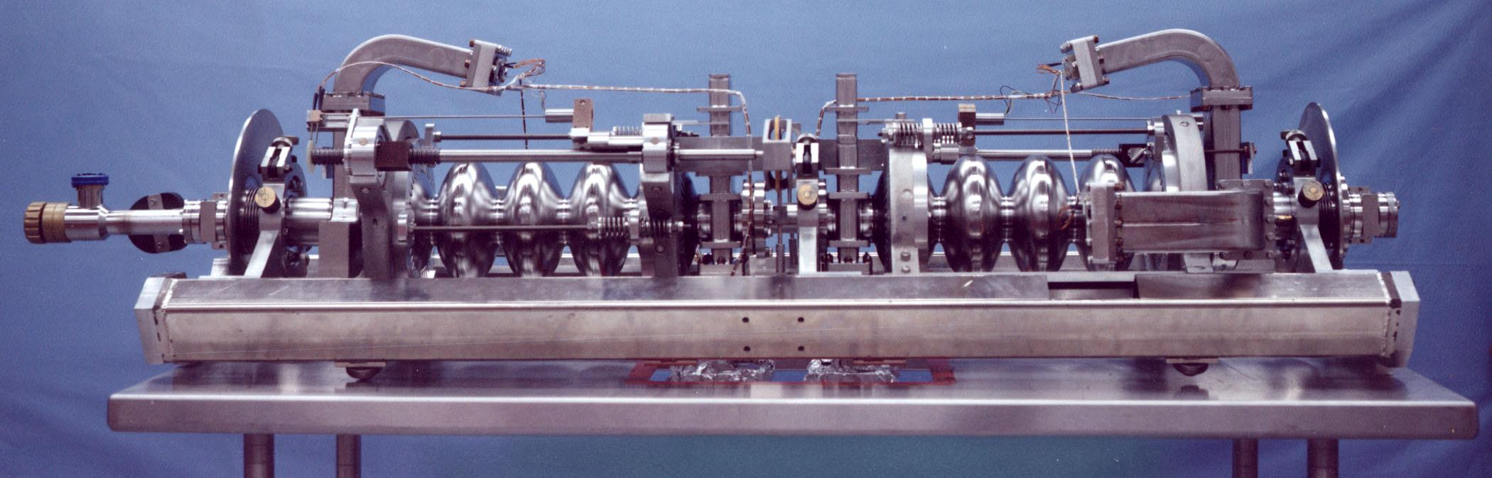
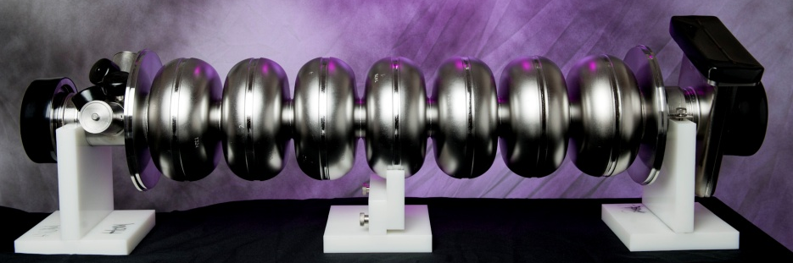
Accelerating Cavities at CEBAF
We use both types for 12 GeV nuclear physics
Original CEBAF 5 cell cavity
CEBAF upgrade cavity
5-cell, Cornell-Type
338 cavities in 42-1/4 modules
Design
    Ea=5 MV/m
    Q₀=2.4×10⁹ @ 5 MV/m
Achieved after Helium Processing
    <Ea>=7.5 MV/m, <Q₀>=5×10⁹@ 5MV/m
Achieved after Refurbishing
    <Ea>=12.5 MV/m, <Q₀>=5×10⁹ @ 5MV/m
Total energy 2 x 600 MV
5 kW 2K cooling power
5 MW liquefier operation power
7-cell, Low-Loss Shape
80+8 cavities in 10+1 modules
Design
    Ea=19.2 MV/m
    Q₀=7.2×10⁹ @ 19.2 MV/m
Achieved
    <Ea>=22.2 MV/m
    <Q0> @ 8.1×10⁹ @ 19.2 MV/m
Total energy 2 x 500 MV (+100 MV)
Requires additional ~ 5 kW 2K cooling power
Requires additional ~ 5 MW liquefier operation power

Slide 11
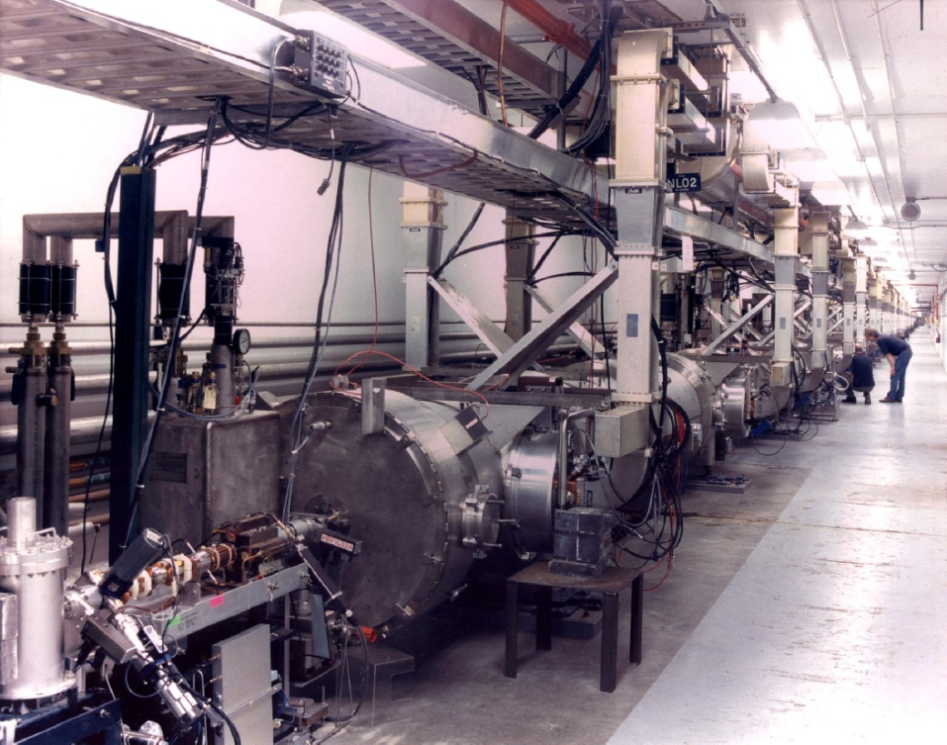
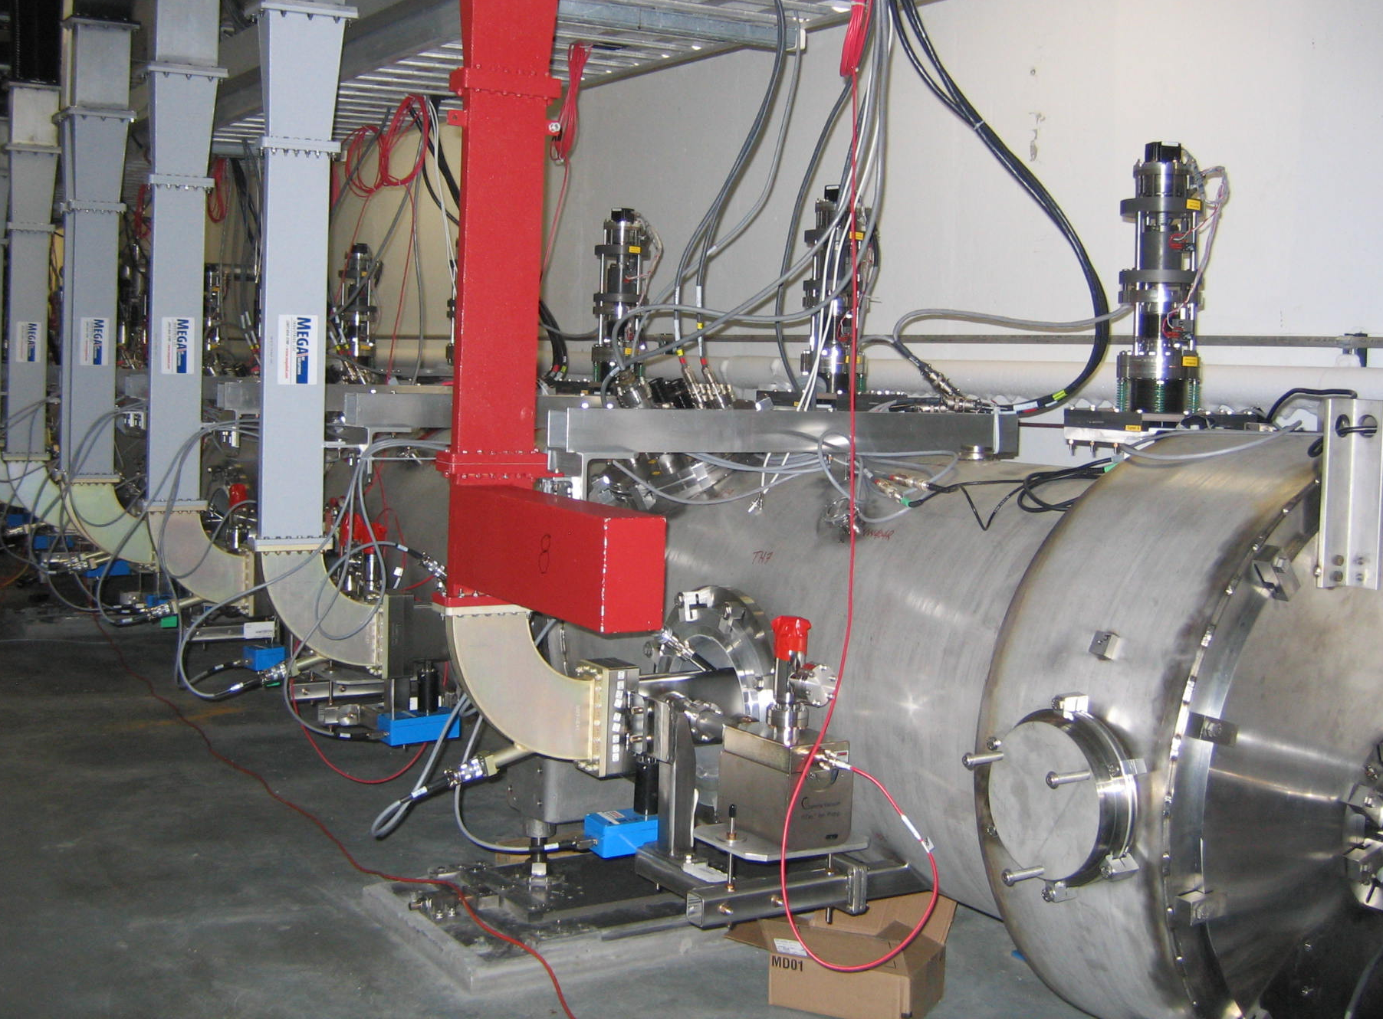
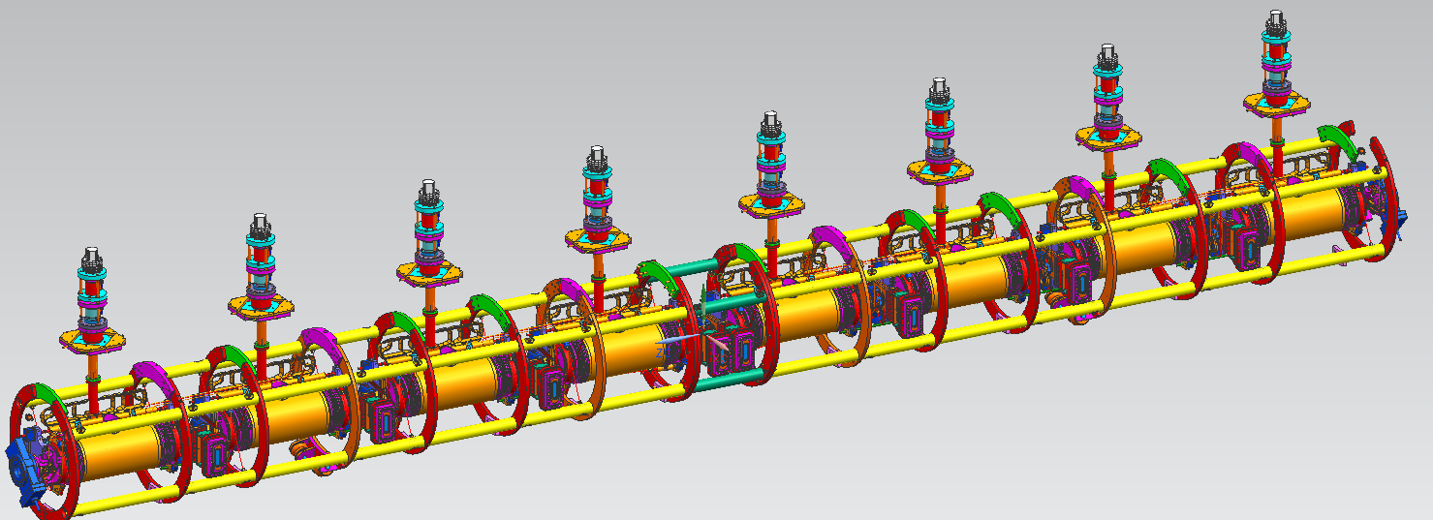
C100 Cryomodules
C20/C50
C100
Eight 7-cell cavities, same cryomodule footprint
Cavity string suspended within space frame by nitronic rods (think bicycle spokes)
Different tuners, different response to microphonic resonances
Higher power klystrons, different low level RF control boards
Smaller cryostat, different Heat Load/Temperature/Pressure interplay
Higher levels of field emission
SPIN 2016, Champaign-Urbana, IL Sept. 25-30, 2016
11

Slide 12
First test

Slide 13
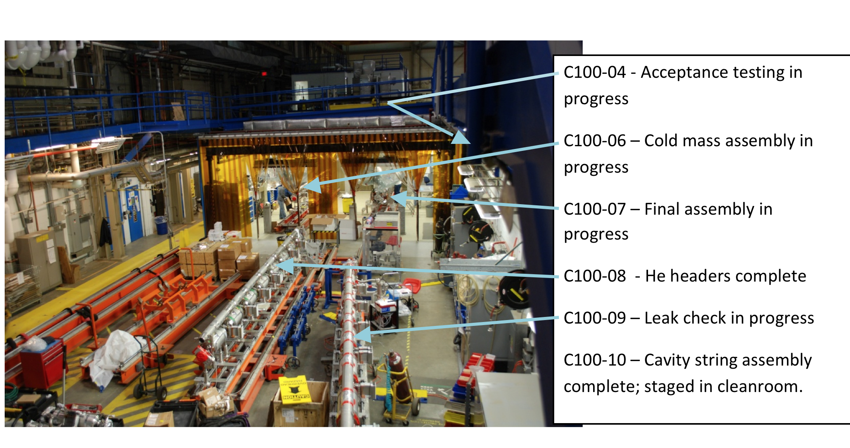
C100 Cryomodule Construction
C100-1 and C100-2 in operation; C100-3 and C100-5 in the tunnel (safe storage)

Slide 14
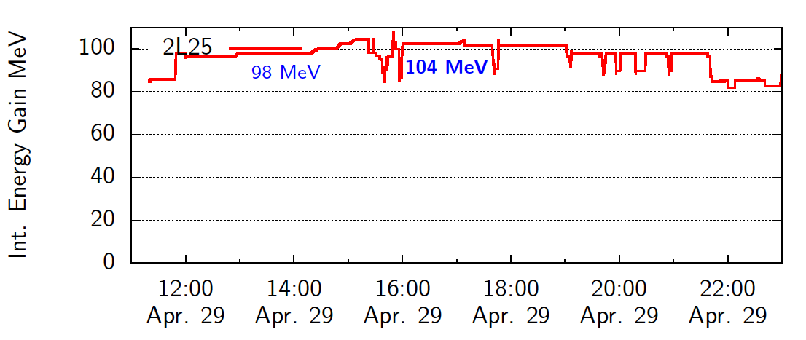
C100 Performance Demonstration
Current through module = 465 μA
Two C100 cryomodules installed during 6-month down
Operated at nominal specifications during Qweak experiment

Slide 15
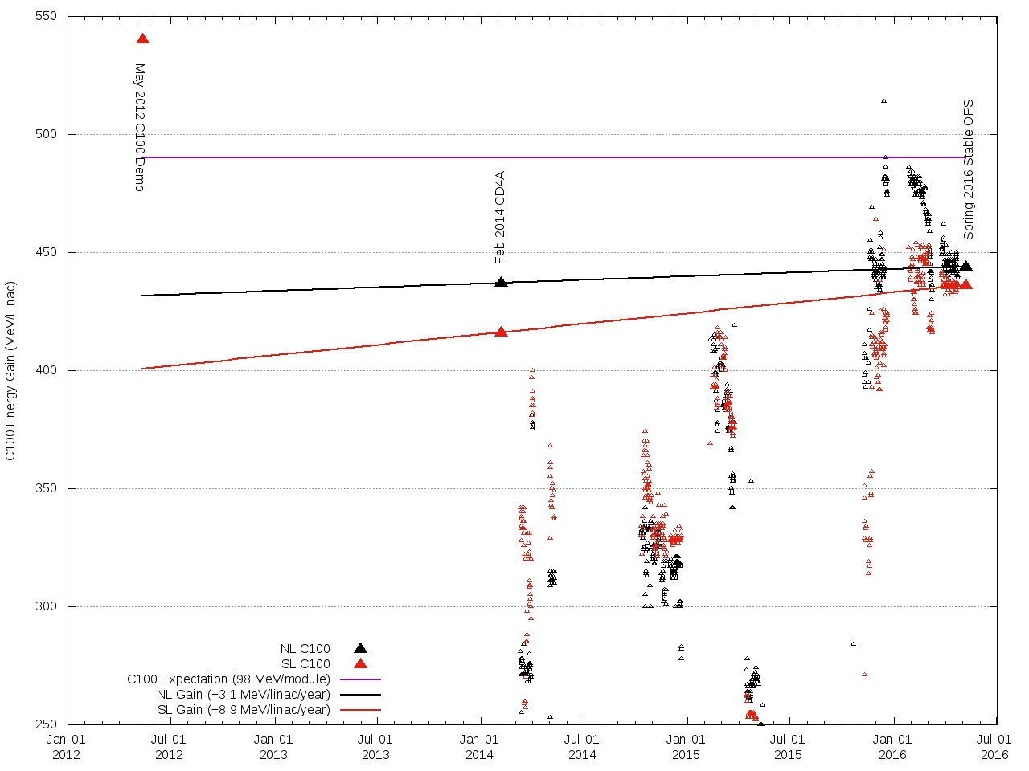
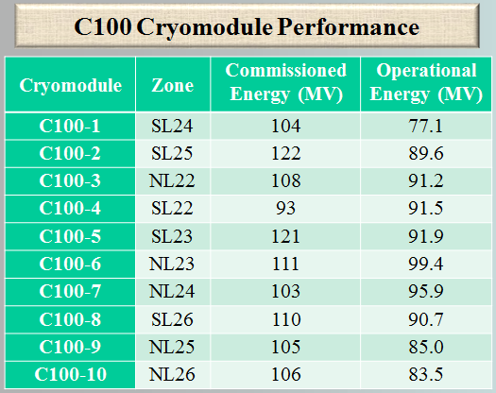
C100 Operational Performance with Beam
Suggested performance based on experience with two C100’s
Notes:
this plot that shows the C100 performance since 2012, The purple line represents 98 MeV per C100. The small dots are the energy gain for an 8h period with CW beam delivery. The large points are the operational point for the three periods chosen. The plot shows several things:
We tried to push the C100s hard between 2014 and 2016, especially Fall2015 and Spring2016.
The push to high gradient is followed by a retreat, unfortunately.
The South linac shows a modest improvement, probably due to all the C100s being Helium processed. North Linac only NL22 was HeProc.

Slide 16
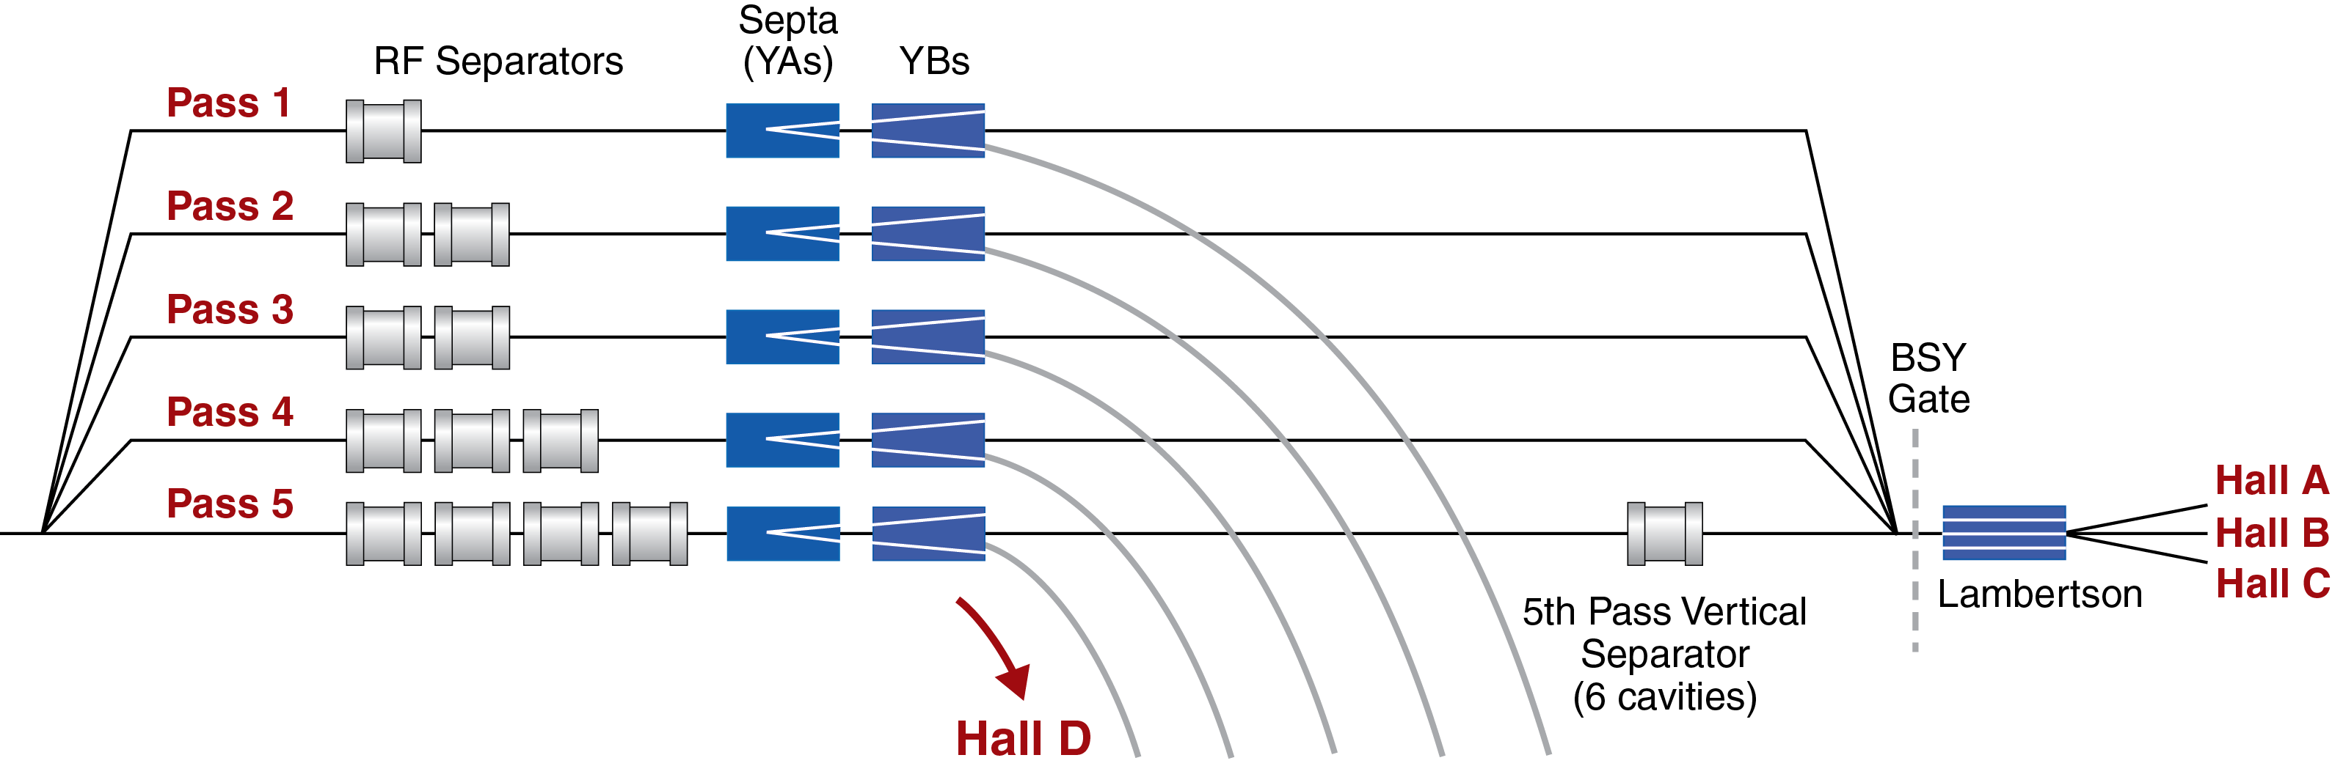
5th Pass RF Separation Hardware
Horizontal 5th Pass Separator (kicks out Hall D for 5.5 pass)
Vertical 5th Pass Separator (Halls A,B,C)
D+2: 500 MHz
D+3: 750 MHz
16

Slide 17
RF Separation – “D + 2”
A/B/C separator is located downstream
Beam to Halls
B
B
C
B
C
B
C
C
Beam
B
C
C
D
D
B
A
B
C
A
D
A
Accelerator
Frequency
1500 MHz
D
A
D
D
D
A
A
A
Beam to Hall D
Lasers at
500 MHz
5th Pass RF Separator Cavity
500 MHz
Hall D replaces Hall A
(limited to 3-hall operation)

Slide 18
RF Separation – “D + 3”
A/B/C separator is located downstream
Beam to Halls
A
A
C
C
B
B
A
A
Accelerator
Frequency
1500 MHz
C
C
A
A
B
B
C
A
B
C
D
C
A
B
D
A
A
Hall Lasers
Hall A: 250 MHz
Hall B: 250 MHz
Hall C: 250 MHz
C
C
B
B
C
D
C
B
B
A
A
C
C
B
B
Hall D
Beam
Hall D: 250 MHz
5th Pass RF Separator Cavity
750 MHz
Four-Hall Operation!
(D+3)
New Hall D laser fills empty buckets at 250 MHz
Notes:
The majority of the experiment proposals are for full 5-pass energy in Halls A,B &C. In order to support simultaneous 5-pass operation to the old end-stations while also supporting beam to Hall-D (5.5passes) a new 5-pass separator was conceived, designed, installed, commissioned and operated.
In order to squeeze a four beam into the 1497MHz machine frequency, the Hall beam structure was changed to 249.5MHz (allows for 6-halls, was 499MHz) and the separator cavity frequency is now 750MHz.

Slide 19
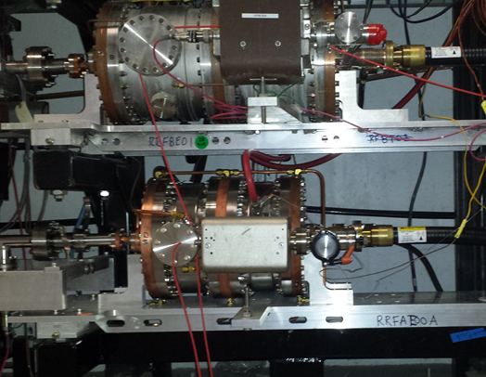
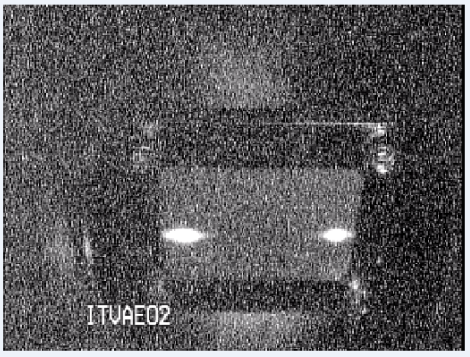
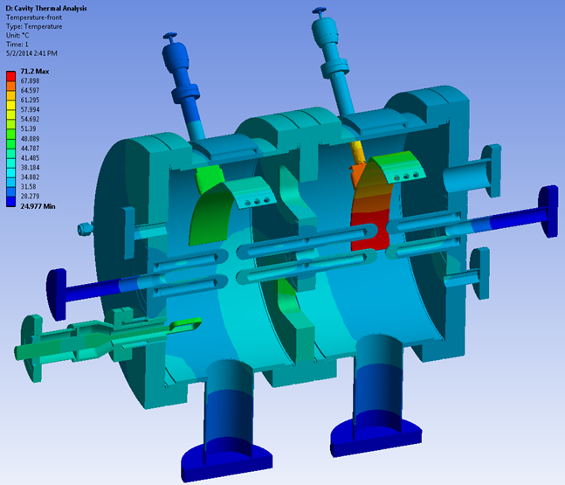
750MHz Separation
500MHz
A & D beams separated on 5th pass at 9.6 GeV.
750MHz
11 GeV maximum beam energy
Improvements were implemented Summer 2016 to increase beam separation:
Proper cavity placement relative to Lambertson magnets (9% gain in separation)
Increase IOT power and cooling controls (10% gain)
Notes:
The new 750MHz cavity on 5th pass below the 500MHz 4th and 3rd pass separators which remain at 499MHz.
And the separated beams on the beam viewer.
OK, so we’re sitting pretty. Machine optics are the on design and well tuned. RF separation is complete. CEBAF is ready for the users.
The “lights go out”. An off-site power event results in CEBAF loosing power for several hours. CHLs trip and prove to be difficult to recover.
Turns out 2K cold box one, the original 2K cold-box has a seized cold compressor and will take months to repair.
Reconfigure Cryo to support CEBAF at 2K on one Cryo plant and change CEBAF energy to 500MeV/linac.

Slide 20
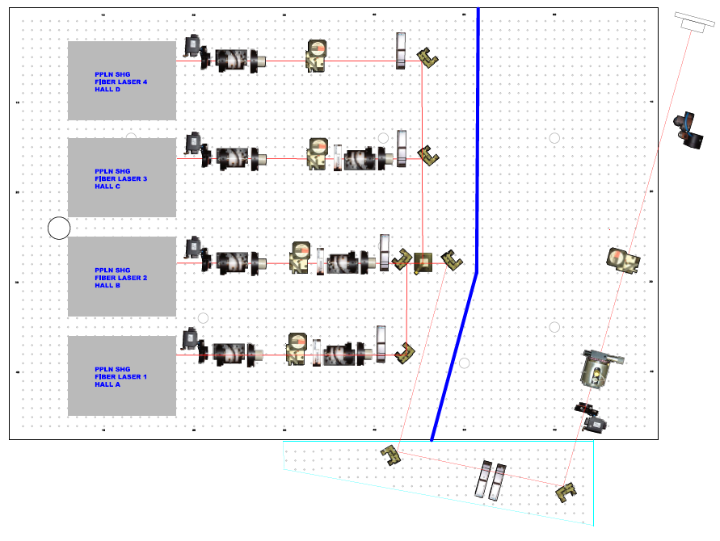
12 GeV Laser Table: Summer 2016
Tune Mode Generator
Beamline vacuum window
IA
RWP
Pockels Cell
IHWP
New 4-laser configuration
Gain-switched diode lasers + Fiber Amps + Frequency Doublers

Slide 21
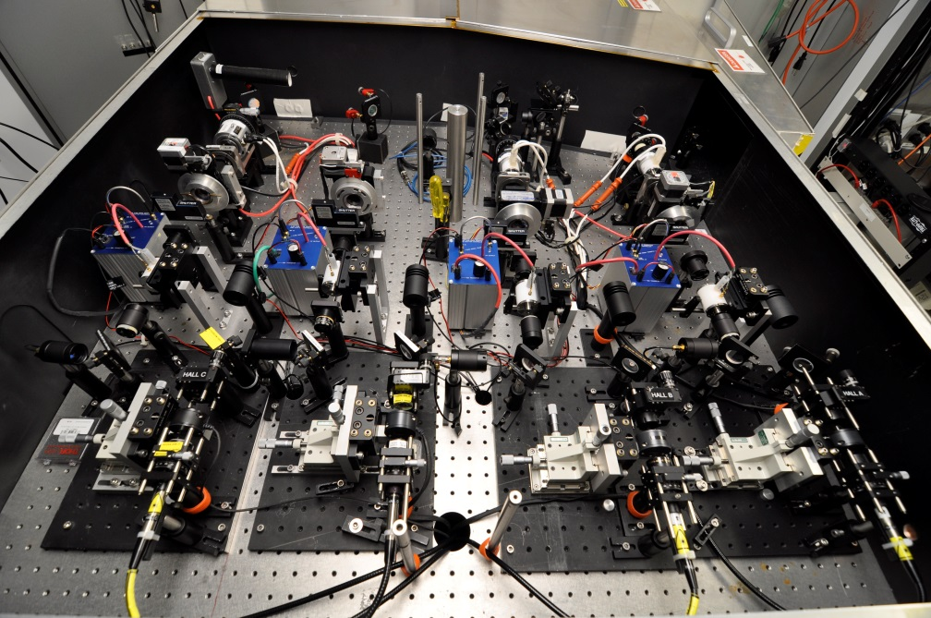
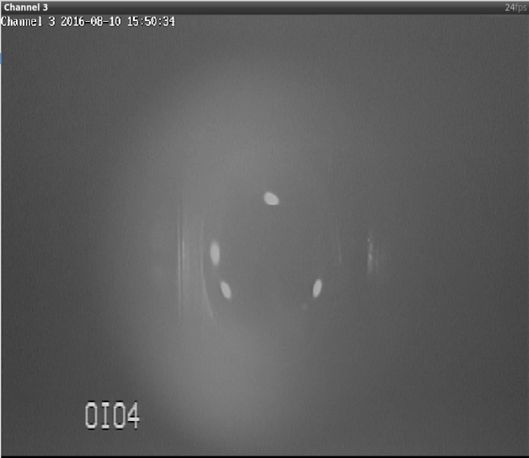
Four Laser Upgrade for CEBAF
Fall 2015 – Spring 2016
Simultaneous 3-beam operation with either 250/499 MHz rep rate
Clever firmware solution allowed this with standard 499 MHz laser-RF system
Summer 2016
Rebuilt laser system, added 4th laser
Four beams from polarized electron source (chopper photo, right)
Winter 2016
Planned installation of final 4-laser RF system
Quick switch between rep rates from MCC, full 360 degree phase adjust
Spring 2017
Planned 4-beam delivery to 4 Halls
8/10/16 - First ever 4 beams at CEBAF!!!
(one revolution is 2 nanoseconds)

Slide 22
CEBAF 12 GeV Upgrade Schedule

Slide 23
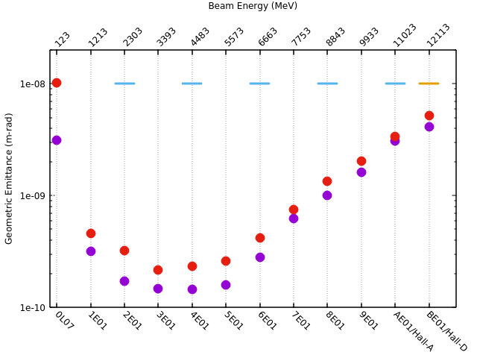
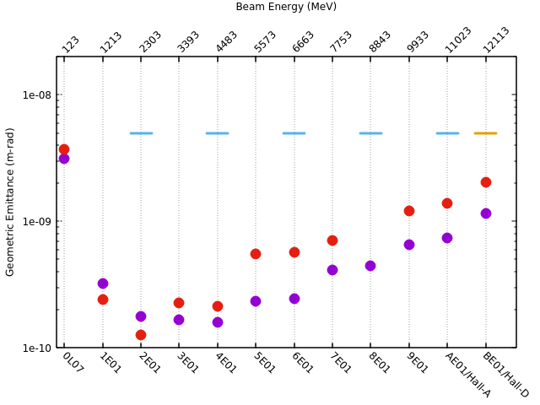
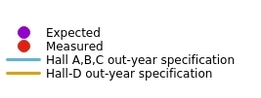
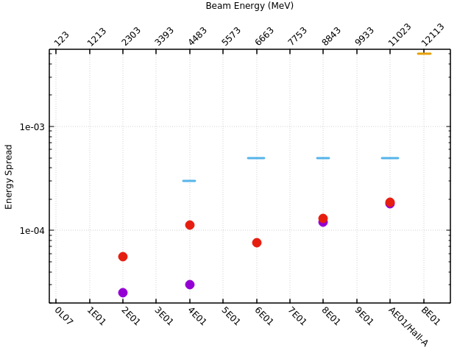
Beam Parameters at 12 GeV (2.2 GeV/pass)
Vertical Emittance
Horizontal Emittance
Energy Spread
Beam parameters at 12 GeV meet out-year specification
Growth in emittance/energy spread due to synchrotron radiation - agrees with expectations

Slide 24
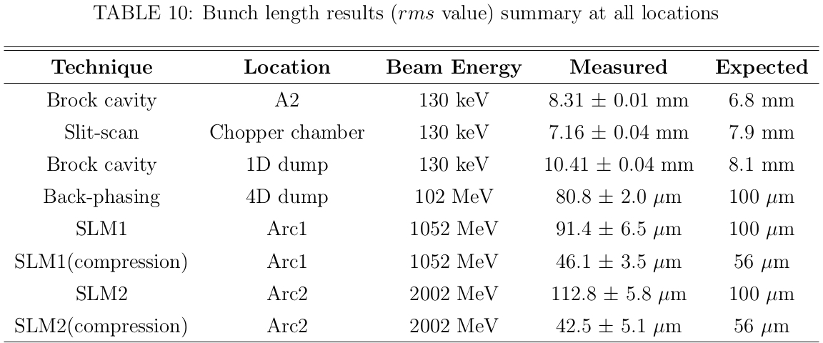
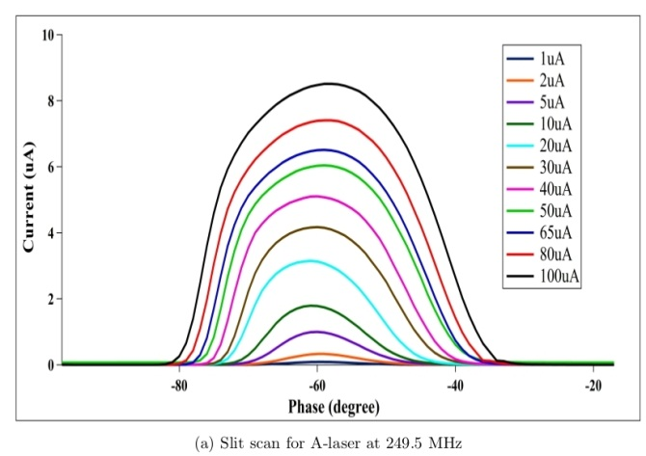
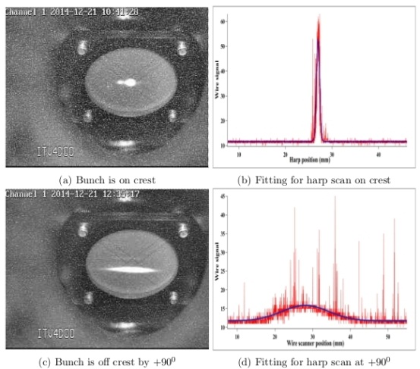
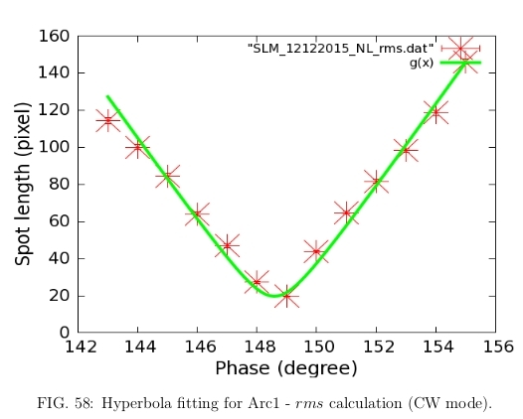
Bunchlength Evolution at 12 GeV
Slit Scan @ 130 keV
RF Phase Shifts @ 102 MeV
RF Phase Shifts @ 1050 MeV

Slide 25
FY16 Beam Operations Summary
Fall 2015
5 weeks of beam operations at design energy: 12 GeV
  Measured transverse emittance: 12 GeV CEBAF meets out-year spec
  Helium Processing in Summer 2015 helped achieve the design energy
    Insufficient energy reach margin for reliable operations
  5th pass RF separation at design energy established (new 750 MHz separators)
Spring 2016
11 weeks planned, 10 weeks actual of beam operations at design energy: 12 GeV
  DVCS/GMp experiment in Hall-A (passes 2,4,5) polarization ~ 89%
  GlueX engineering run in Hall-D (pass-5.5) COMPLETED
  HPS experiment in Hall-B (pass-1)
Reliability issues (RF systems, Cryo), more details on next slides
Summer 2016
5.5 weeks low power, one CHL configuration at ~50% of design energy
  PRad experiment in Hall-B (passes 1 & 2) COMPLETED
  Hall-C Beamline checkout (pass 2) COMPLETED

Slide 26
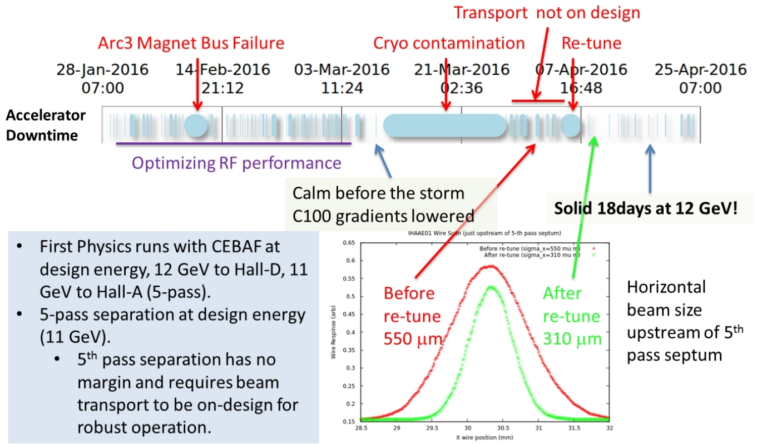
Spring 2016 Beam Operations

Slide 27
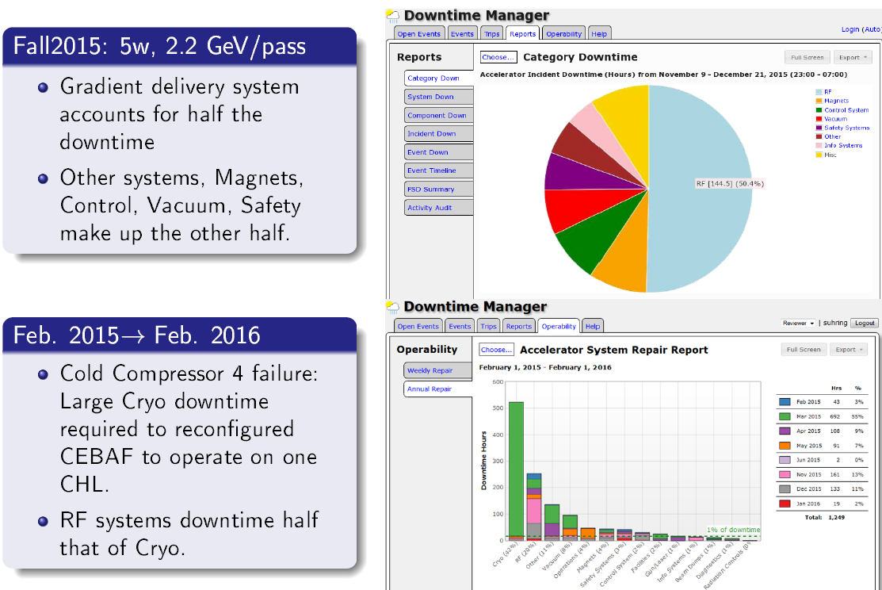
Some Challenges

Slide 28
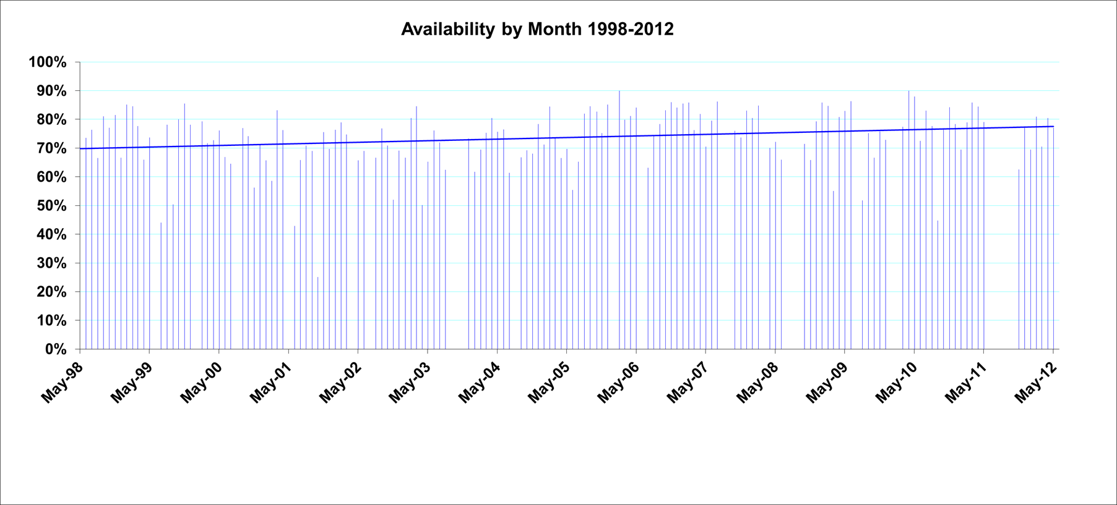
4/6GeV Availability Trend
“the good ol’ days”

Slide 29
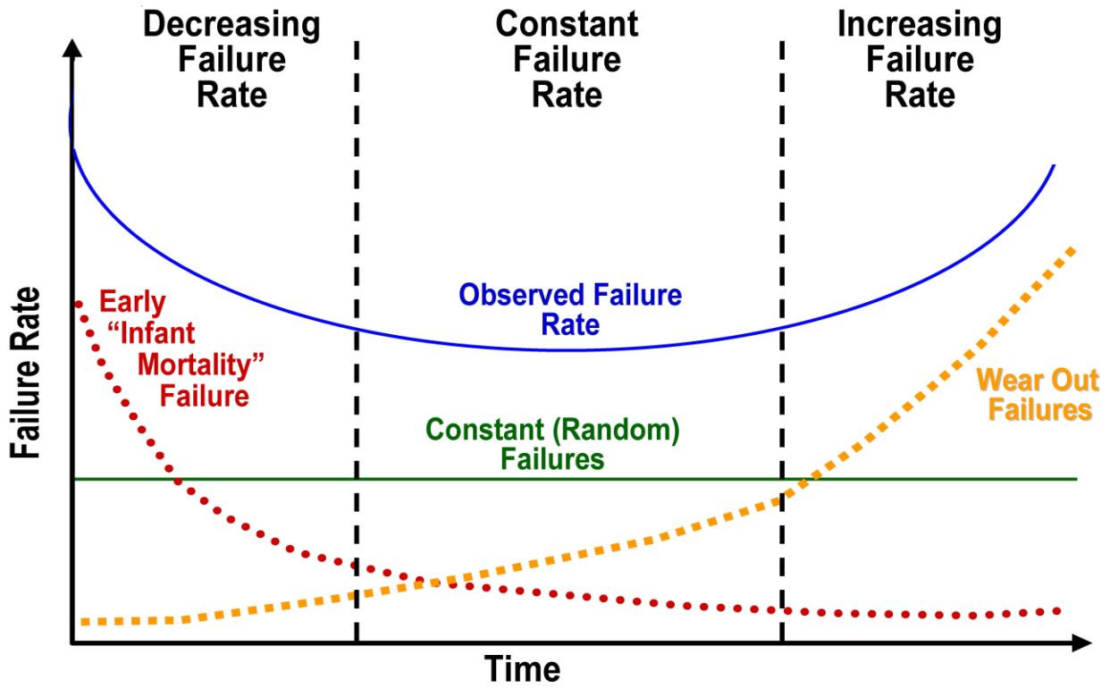
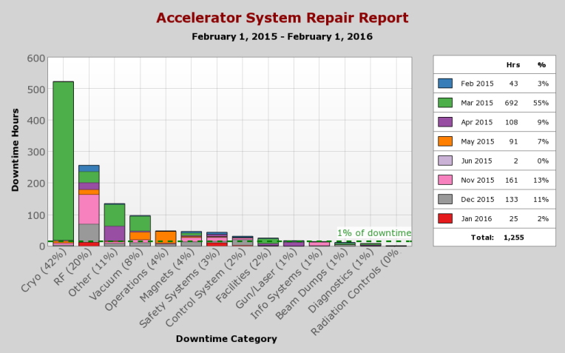
Reliability of Complex Systems
12 GeV CEBAF is a combination of new and old systems: Both sides of the “bathtub curve” - Reliability Team formed
All downtime events greater than 5 minutes in duration are tracked
Downtime statistics are presented, reviewed and discussed weekly
Downtime statistics are used to prioritize near term work and develop annual work plan

Slide 30
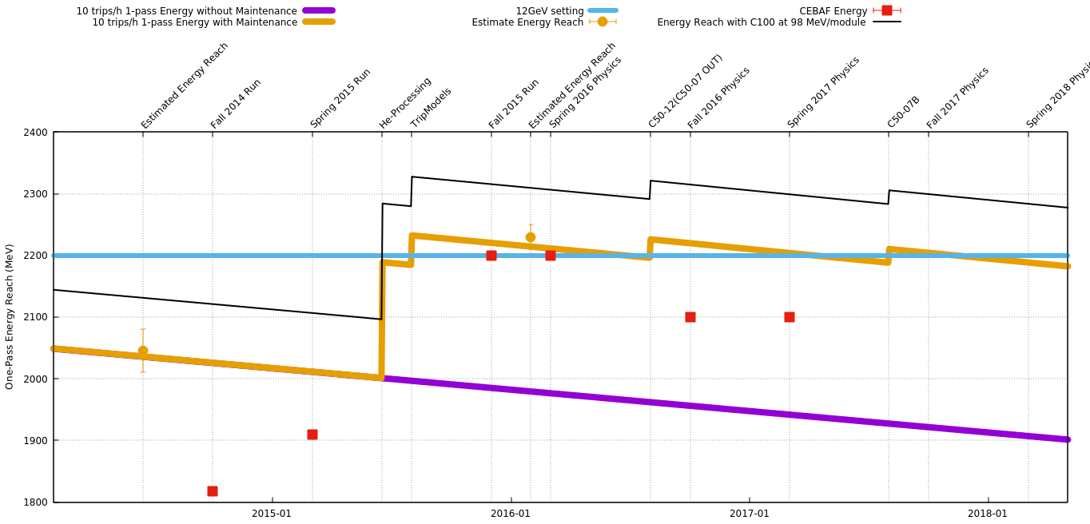

Energy Reach
Mitigation:
Helium Processing
Optimized gradient setpoints
Cavity refurbishment
Root cause ???
Loss rate: 34 MeV/pass-year.
based on operations data since 1995
We are here

Slide 31
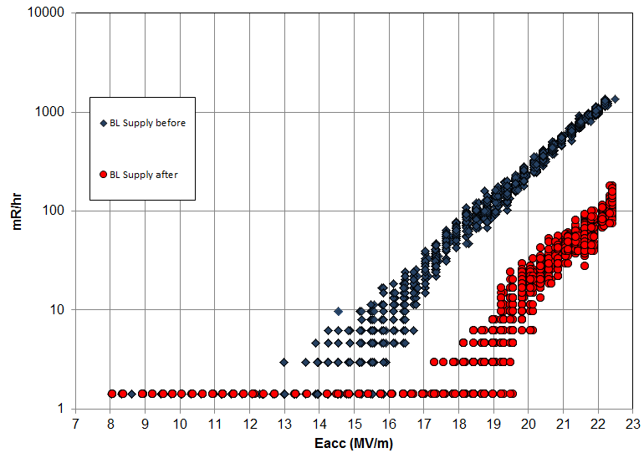
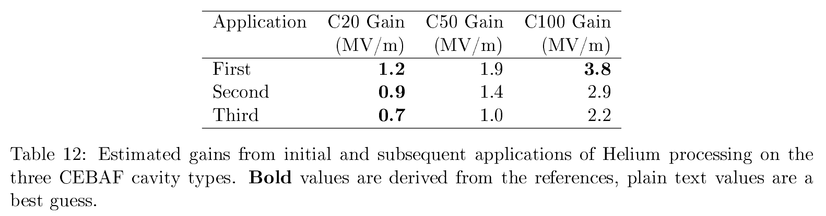
Helium Processing
Utilized during 6 GeV era to improve maximum operating gradient of SRF cavities
Add small amount of gaseous He into the cavity
Process cavity with RF power, watch for the radiation signature to drop (field emitters extinguished)
Warm up the cavity to remove the He
Determine the new maximum operating gradient
Before He Proc
Representative gain (~4 MV/m) on one C100 cavity recently Helium processed
After He Proc

Slide 32

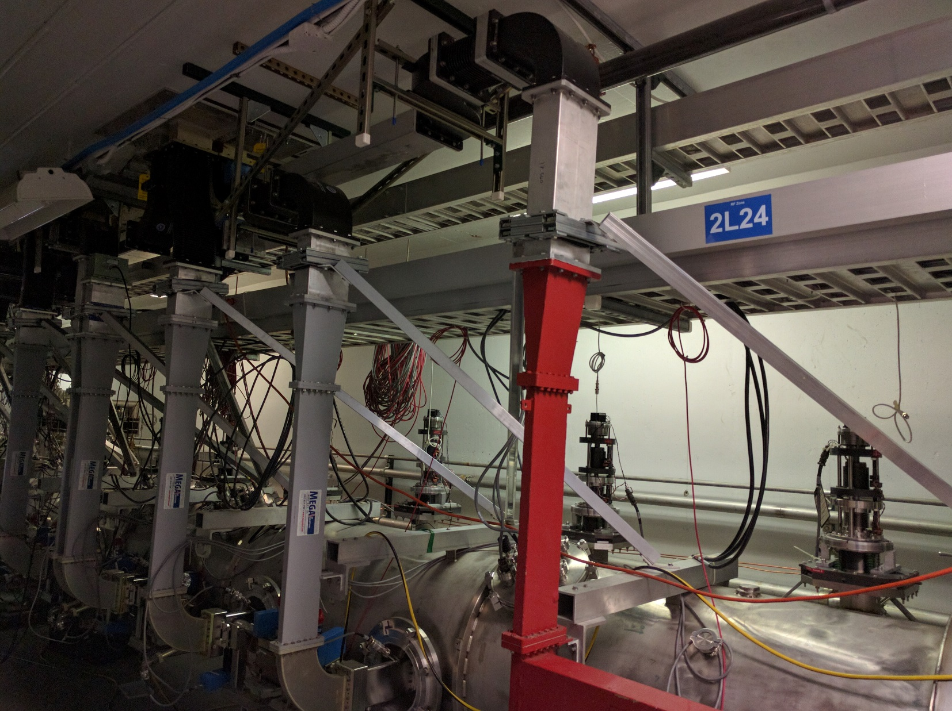
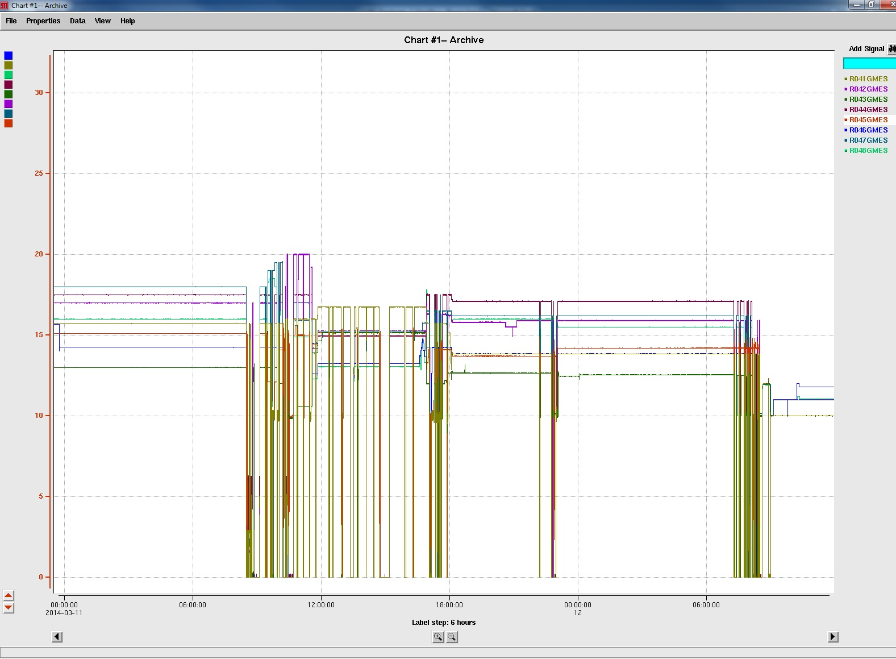
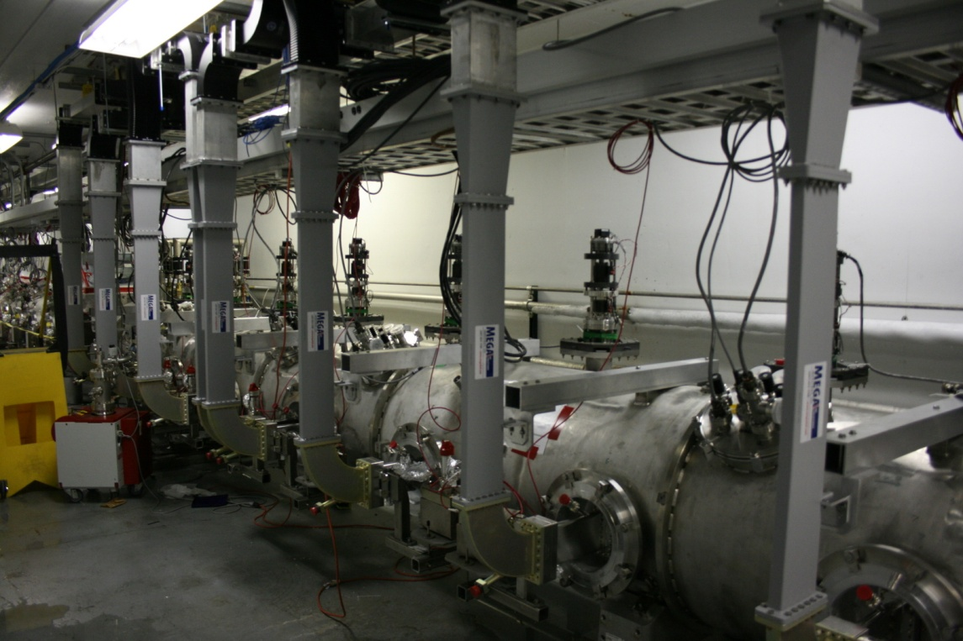
C100 Susceptibility to Microphonics
C100 Cavity gradients
The drops in figure below show the cavity faulting OFF during the day due to construction and truck traffic (or any low frequency acoustic noise, e.g., fan)
ESH&Q Building construction halted
Reason: RF Power could not compensate for the rapid cavity detuning
Added waveguide supports, Stiffened the tuners….
day
night
C100 - 0 Cavity Gradients

Slide 33
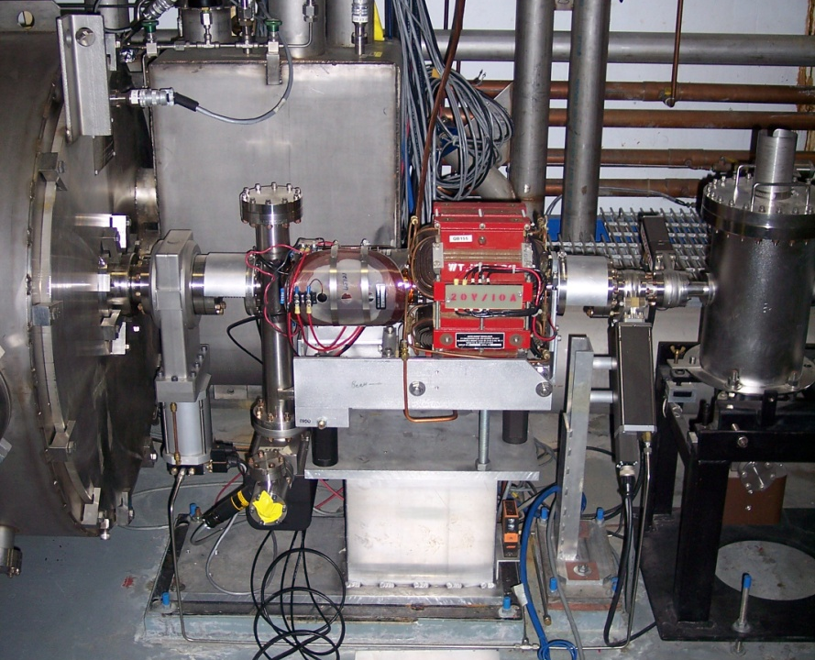
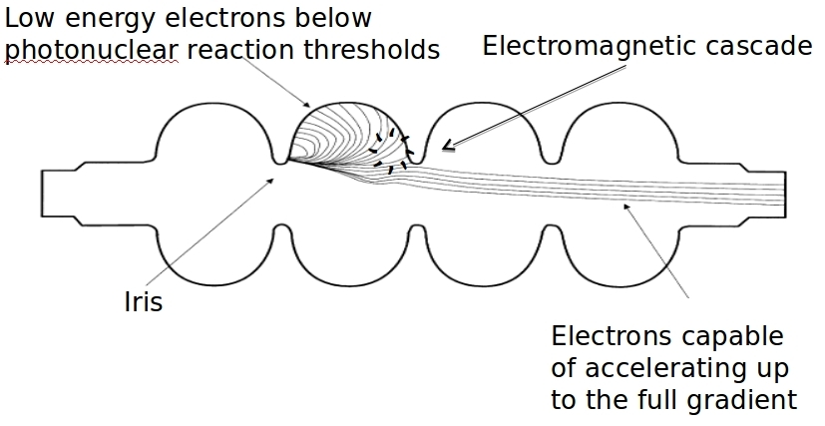
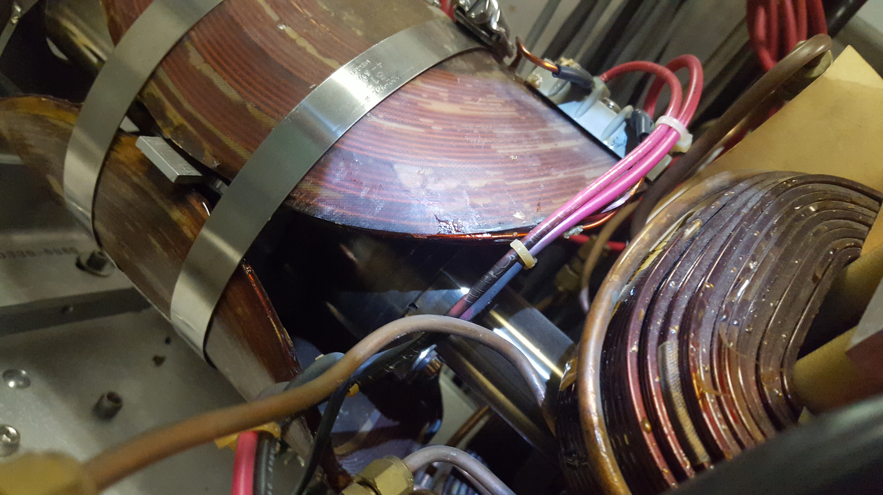
C100 Operational Experience - Field Emission
H&V nested Air Core correctors over BPM
Field emission heats nearby beamline, stimulates gas desorption
Vacuum pump faults
Vacuum interlock drops cryomodule out of RF
Can damage equipment and activate material
Viewer & pump drop cross
Quad
Radiation Damage

Slide 34
Energy Reach
Gradient insufficient to support reliable 12 GeV operations
  Average C100 performance below design
    Gradient Team to solve the problem
Gradient Degradation (~34 MeV/pass/year)
  Accumulation of new field emitters, particulate on the cavity surface
    Identify source of particulate (in progress)
    Mitigate: Develop the plan, approve the plan, implement
  C20 refurbishment program (C50->C75) in place until degradation is mitigated
Radiation Damage of components
  C100 gradient large enough to accelerate field emitted electrons to energies above Neutron threshold (~10 MeV)
    Optimize C100 gradient/field emission ratio (Gradient Team)
    Helium process to reduce field emitter sites
    Improve particulate control, maintain low FE state post HeProc

Slide 35
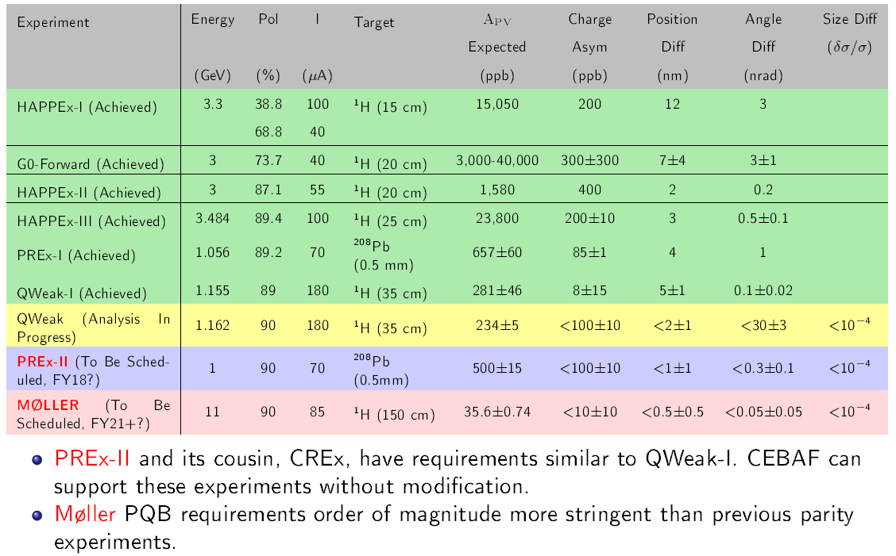
CEBAF Parity Violation Experiments

Slide 36
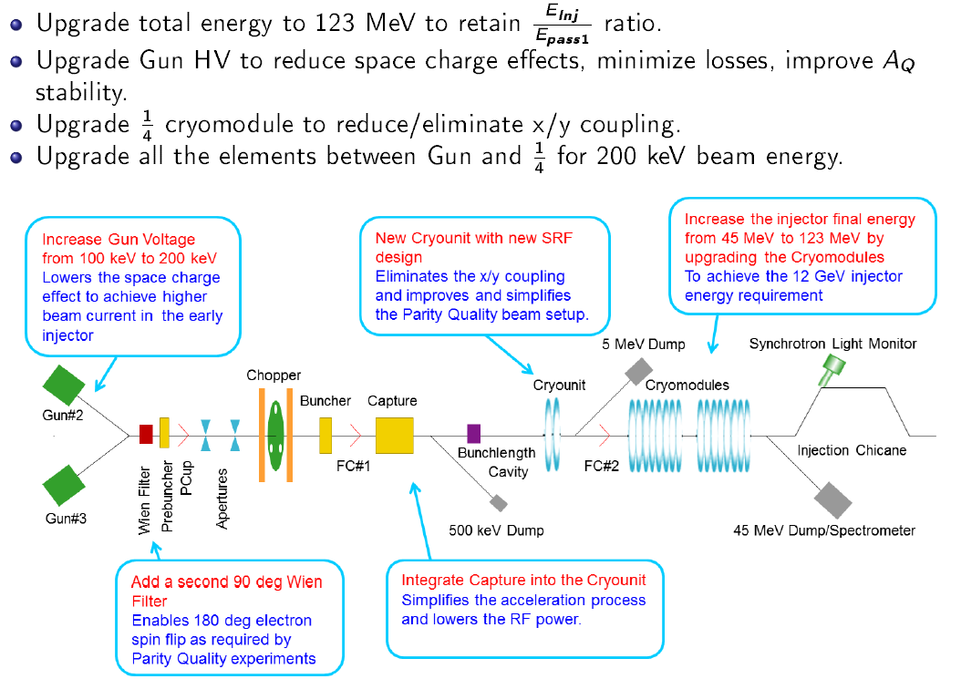
CEBAF Injector Upgrade
SPIN2016, Champaign Urbana, IL, Sept. 25 – 30, 2016

Slide 37

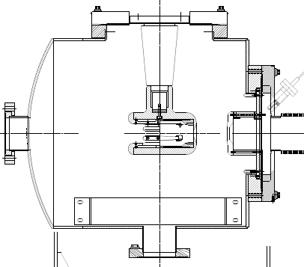
CEBAF – ILC 200 kV Inverted Gun
Developed and ready for installation
Commissioned at Test Cave to 225 kV w/o field emission
Large Grain Niobium electrode
But prefer a bit more voltage headroom….
insulator
light in
e- out
photocathode

Slide 38
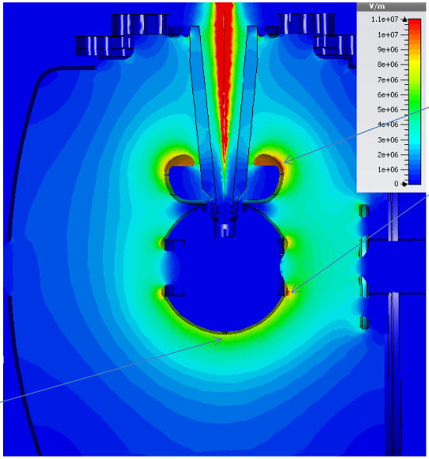
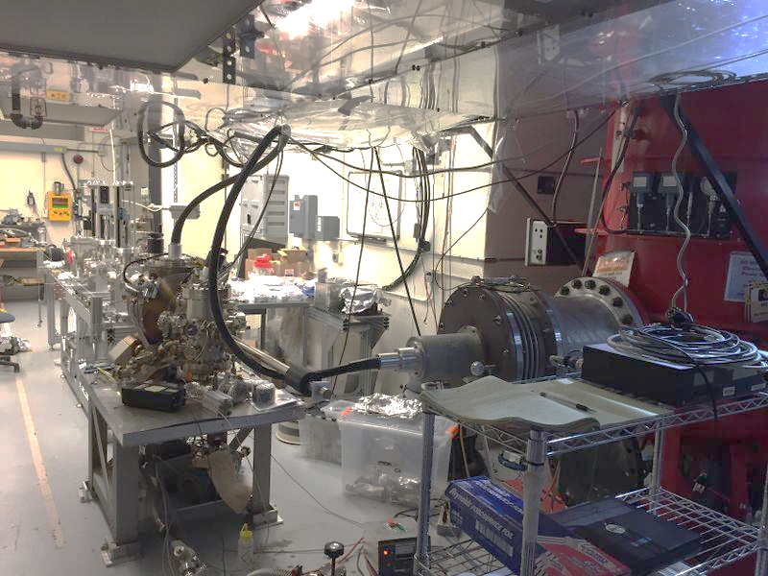

Testing > 300 kV Inverted Guns
Magnetized beam generation – for electron cooling
11 MV/m
8 MV/m
Commissioned to 325 kV

Slide 39


CEBAF Injector Upgrade Status
Fabrication Complete
ready for testing

Slide 40



Injector Test Facility
INVERTED GUN
NEW ¼ CRYO UNIT
HDIce
200KV WIEN FILTER
10 MeV accelerator
Commission HDIce and the new CEBAF injector
Expect keV operations soon
New gun and 200 kV Wien Filters at CEBAF during Summer 2017

Slide 41

Thank You
CEBAF Polarized Electron Beams - it started at University of Illinois!
Bruce Dunham, Larry Cardman, Charlie Sinclair

Slide 42
Backup Slides

Slide 43
JLab SPIN topics
More SPIN contributions by JLab source group members and collaborators:
Wednesday Sept. 27, 9:00, Parallel Session, Yoshitaka Taira, JLab, “High energy X-ray vortex generation using inverse Compton scattering”
Wednesday Sept. 27, 16:10, Parallel Session VI, Wei Lui, JLab and University of Chinese Academy of Sciences, “Record-level quantum efficiency from high polarization strained GaAs/GaAsP superlattice photocathodes with Distributed Bragg Reflector”
Thursday, Sept. 29, 15:05 Plenary Session, Joe Grames, Jlab, “Production of Highly Polarized Positrons Using Polarized Electrons at MeV Energies”
Tuesday Sept. 26, 15:20 Parallel Session, Adeleke Adeyemi, Hampton University, “PEPPo: The Calibration of the PEPPo Polarimeter”
Parallel Session, Tim Gay, UNL, “High-Precision Mott Polarimetry at the JLab Injector”
Parallel Session, Charles Hanretty, JLab, “eHD at Jefferson Lab”
Parallel Session, Richard Talman, Cornell University, “The CEBAF Injection Line as Stern-Gerlach Polarimeter”

Slide 44

6 GeV Laser Table
Beamline vacuum window
Tune Mode Generator
IA
RWP
Pockels Cell
IHWP
3-laser
configuration

Slide 45

CEBAF Polarized Electron Injector
Comprehensive measurement and control of the electron beam during helicity reversal remains the critical strategy
During Summer 2016 the source laser table will be configured with an additional laser, enabling simultaneous 4-Hall capability
Completion of the Injector Upgrade includes a higher voltage gun and improved cryounit to better retain the PQB generated at the source

Slide 46

  Issues? Any polarization dependencies?
Both cancel with helicity reversal
Notes:
References:
1. A Spin-Light Polarimeter for Multi-GeV Longitudinally Polarized Electron Beams.
P. Mohanmurthy and D. Dutta, IEEE TRANSACTIONS ON NUCLEAR SCIENCE 61, 528 (2014).
http://dx.doi.org/10.1109/TNS.2013.2291114
2. An observation of the spin dependence of synchrotron radiation intensity.
S. A. Belomesthnykh et al., Nucl. Instrum. Methods, 227, 173 (1984).
http://dx.doi.org/10.1016/0168-9002(84)90119-0
3. https://wiki.jlab.org/ciswiki/index.php/PQB_Meeting_April_30,_2015

Slide 47


World Record High Polarization Photocathode
6.4% QE & 84% polarization at 776 nm from strained GaAs/GaAsP superlattice photocathode with GaAsP/AlAsP Distributed Bragg Reflector (DBR)
The highest QE & FOM of any reported high polarization photocathode
Possible to improve both QE & Pol
SBIR partnership
Photo-cathode
DBR
Substrate
Paper ready for SPIN and APL submission: W. Liu, S. Zhang, M. Stutzman, M. Poelker, Y. Chen, W. Lu, and A. Moy

Slide 48





Magnetized Beam
Rebuilding
the alkali-antimonide photocathode deposition chamber
Magnetizing solenoid
slits used to evaluate magnetization
Solenoid installed in front of gun table
Beam with mechanical angular momentum

Slide 49


…DC Light = bleedthrough…
A B C A B C….
Beam Current
DC beam = bleedthrough
111ps
1497 MHz
Gain switched laser systems generate some DC light, which bleeds into adjacent chopper slits (and into Hall D bucket). Modelocked lasers generate less bleedthrough, but very reluctant to revisit them….
RF Chopper
Sets Bunchlength

Slide 50
12 GeV Bleedthrough
Same as 6 GeV bleedthrough – DC beam bleeding through neighboring chopper slits…
…and now with 249.5 MHz lasers, bleedthrough can pass through the same slit (what Joe calls self-leakage) producing a bleedthrough bunch 2ns behind “good” bunch.
Halls expecting 249.5 MHz beam also get beam at 499 MHz
New 12 GeV bleedthrough problem: Hall D gets beam when their laser is OFF, problematic when radiator is inserted or retracted, can’t just close slit
Solution: turn OFF ALL lasers or insert a beam dump

Slide 51
Bleedthrough “Conclusions”
Bleedthrough electrons originate at the injector chopper, and are delivered to an unintended hall
Bleedthrough electrons are produced at the photocathode by DC laser light
Bleedthrough electrons pass through neighboring chopper slits (“old” 6 GeV bleedthrough)
Now in 12 GeV era with 249.5 MHz lasers, bleedthrough electrons can also pass through the intended hall slit, producing a bleedthrough bunch delayed by 2ns from “good” bunch

Slide 52
Bleedthrough “Conclusions” continued
Mostly, bleedthrough is a problem for Hall B – polarization dilution. Solve this problem by extracting ~ 10uA for Hall B and “neck down” their slit
For 249.5 MHz lasers, the bleedthrough beam that is produced by A, B and C lasers will be delivered to Hall D. Only a problem when Hall D wants to insert or retract their radiator
Hall D’s bleedthrough beam will go to the hall of shared chopper slit., i.e., Hall A or Hall C

Slide 53


RF Separation – Proposed (750 MHz)
A
B
C
Existing
Frequency
Proposed
Frequency
A/B/C separator is located downstream
C
A
B
C
A
B
C
A
B
Turn on RF separator
Beam to Halls
500 MHz
750 MHz
A
A
C
C
B
B
A
A
A
C
B
A
C
A
C
B
A
C
A
C
B
A
C
C
A
C
A
C
B
A
A
A
C
Beam
A
C
B
A
A
C
A
C
B
A
A
B
A
C
B
A
B
A
C
B
A
B
A
C
B
B
A
C
B
A
C
B
A
B
A
B
C
D
C
B
C
A
C
C
C
C
C
C
B
C
A
C
B
A
C
C
A
B
C
A
B
C
A
B
C
A
C
A
B
C
A
B
C
A
B
B
C
C
A
A
B
B
C
B
A
C
B
A
C
A
A
B
A
C
A
C
B
A
C
B
A
D
A
C
B
A
A
C
A
C
B
A
C
B
A
C
B
C
B
Hall Lasers
Hall A: 250 MHz
Hall B: 250 MHz
Hall C: 250 MHz
C
Accelerator
Frequency
1500 MHz
C
B
A
C
B
C
B
C
B
C
C
A
C
B
C
A
B
C
C
B
A
C
B
B
C
B
A
C
B
B
B
B
C
B
A
C
B
B
C
B
A
C
B
C
B
A
C
B
C
D
C
B
B
A
A
C
C
B
B
Hall D
Beam
(existing hall lasers run at 500 MHz)
Hall D: 250 MHz
Separator frequency is 1/2 of the fundamental frequency
5th Pass RF Separator Cavity
750 MHz
Empty Buckets – Cutting the laser pulse rate for each hall in half (from 500 MHz to 250 MHz) leaves “empty buckets”, which are directed to Hall D
Every other “bucket” goes to Hall D
Four-Hall Operation!
(D+3)
New Hall D laser fills empty buckets at 250 MHz
A
B
C
A
B
C
A
B
C
A
B
C
A
B
C
A
B
C
A
B
C
A
B
C

Slide 54



Beam Transport: Spreaders and Recombiners
East Spreader
Spreaders and Recombiners, one each per linac
Critical CEBAF components, completely rebuilt
Space constrained, very complicated

Slide 55





Beam Transport: Beamline to Hall D Tagger Vault
Hall D Complex
Hall D Tagger Magnet/Dump
Beam

Slide 56
12 GeV CHL Maximum Capacity
Old 6 GeV (CHL1)
  Load: 4.25 kW @ 2.1K, 11.65 kW @ 35K
  Capacity: 4.6 kW @2.1K, 12 kW @ 35K
  10 g/s liquefaction @ 4.5K
New 12 GeV (CHL1 + new CHL 2)
  Load: 7.4 kW @ 2.1K, 14.65 kW @ 35K
  Capacity: 8.8 kW @ 2.1K, 24 kW @ 35K
  10 g/s (CHL 1) plus 15 g/s (CHL 2) of liquefaction

