Slide 1
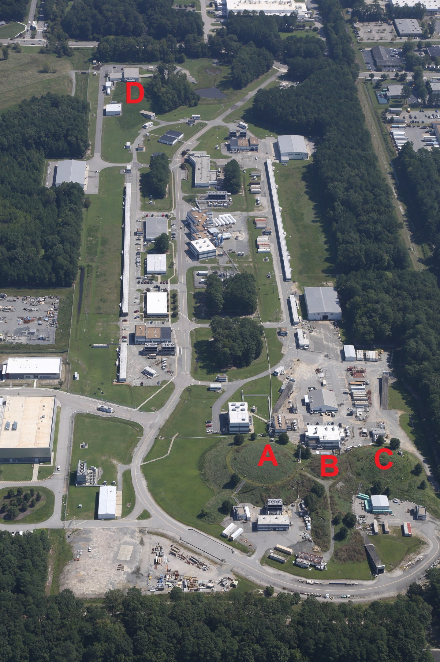
The Future of CEBAF
Reza Kazimi
Injector Group Leader
Operations
Accelerator Division
Jefferson Lab
DIS2022:
XXIX International Workshop on Deep-Inelastic Scattering (DIS) and Related Subjects May 2 – 6, 2022

Slide 2
Outline
Introduction to CEBAF
The Future CEBAF upgrades being considered for 2030 and beyond:
  Luminosity increase
  Positron beam addition
  Energy increase
The Future of CEBAF - Reza Kazimi (DIS2022 May 3)
2

Slide 3
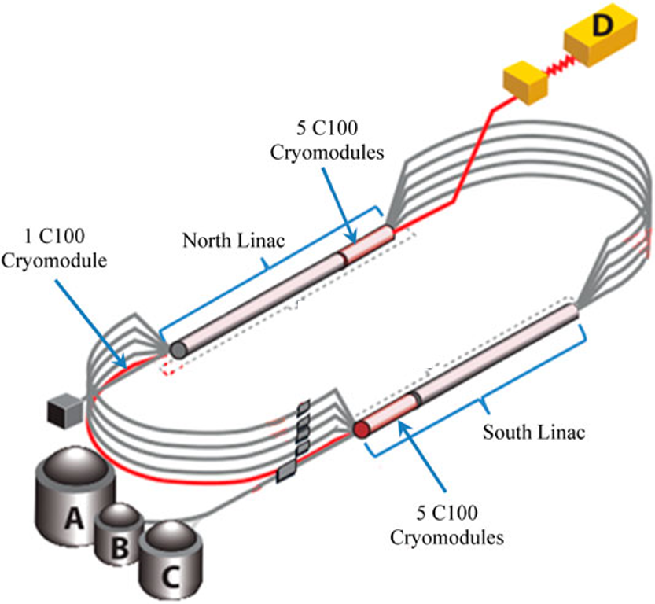
Introduction to CEBAF Accelerator
High duty factor / CW beam
1.1 GeV design per Linac (FY22 1.05 GeV)
Recirculating Up to 5 Passes (5.5 to Hall D)
Lower pass extraction possible
Current (design) | Up to 85μA @11GeV Hall A + Hall C total Max 82 μA each
Energy (design) | 11 GeV to A, B, or C 12 GeV to D

Slide 4
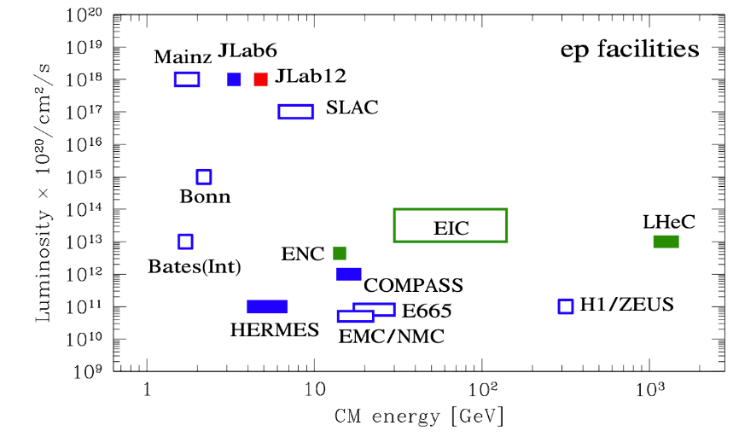
Introduction
Luminosity vs Center of Mass Energy
CEBAF will remain the prime facility
for fixed target electron scattering at the
luminosity frontier
parameters.
But we also need to look in to the future especially beyond 2030.
From Patrizia Rossi talk, J-Future
March, 2022, Messina, Italy

Slide 5
Luminosity Increase
Assuming existing klystron power, What Can We Do?
  We can gain luminosity by optimizing the Loaded Q of cavities without klystron upgrade.

Slide 6
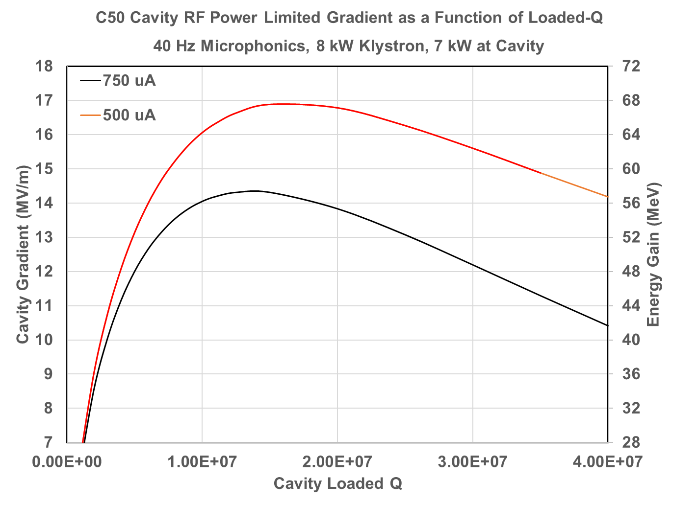
Luminosity Increase
The Loaded Q generally needs to be moved higher for C25/C50 cavities
(For both currents)
Present
Average
0.61E+7
Courtesy of Tom Powers

Slide 7
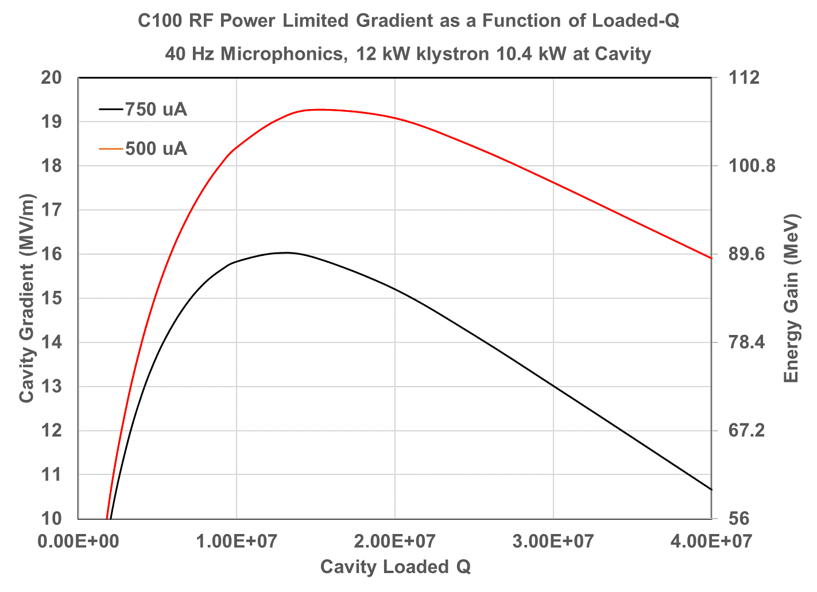
Luminosity Increase
The Loaded Q generally needs to be moved Lower for C100 cavities
(For both currents)
Present
Average
2.3E+7
Courtesy of Tom Powers

Slide 8
Luminosity Increase
How much increase?
Delivering up to 140 uA total to Halls A and C (70 uA each) at 11 GeV, may be possible with existing klystron power, after optimizing loaded Q.
Includes 25 kW to B and 60 kW to D.
The total beam power would be up to 1.625 MW.
This requires an upgrade to the LCW cooling for the A and C dumps and beam testing for possible BBU instability in the cavities.
Physics motivates an increase only up to 1.1 MW at this time.

Slide 9
Ce+BAF : Positron Beams at Jefferson Lab
The interest is there:
Physics side
  Positron physics workshops at JLab in 1999, 2009 and 2017
  Recent EPJA issue dedicated to e+ physics at Jefferson Lab
  Today, two conditionally approved PAC (Program Advisory Comm) proposals exist
Accelerator side
  PEPPo experiment
  JLAAC recommendations (JLab Accel Advisory Comm)
  Positron LDRD (Laboratory Directed Research & Development)
Physics interest in e+ limited to 12 GeV

Slide 10
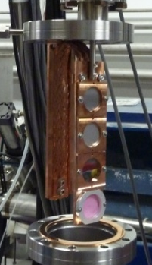

Ce+BAF: PEPPo Experiment
PEPPo @ CEBAF
PEPPo (Polarized Electrons for Polarized Positrons) => demonstrate feasibility of using bremsstrahlung radiation of MeV energy Polarized Electrons for production of Polarized Positrons.
W (1mm)
<10 W beam
8 MeV, 1μA, 85% polarization

Slide 11


Ce+BAF
Polarization and Intensity Trade Off
The Yield (e+/e-) depends on the beam power
Beam Energy x Beam Current
High Pol
Low Yield
Polarization transfer curve is universal whether the electron beam is 10 MeV, 100 MeV, 1 GeV, etc…
_{Yield scales with Beam Power}
High Yield
Low Pol
A
C
B
IP² ~ E(max)/2
0
_{e+ energy}
E_{(max)}=7, 123, 1090, etc

Slide 12
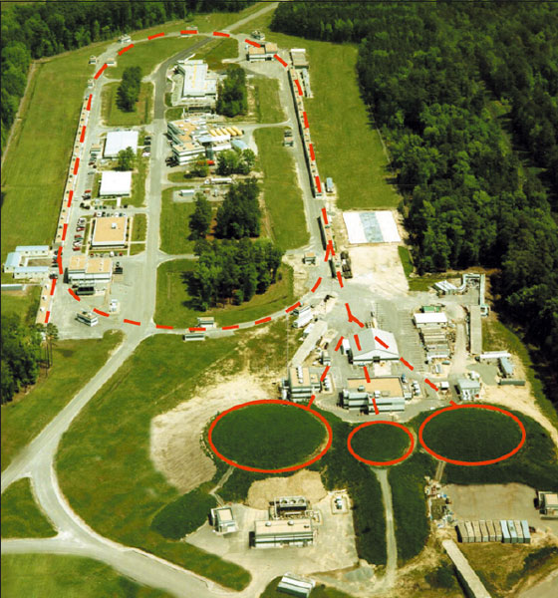
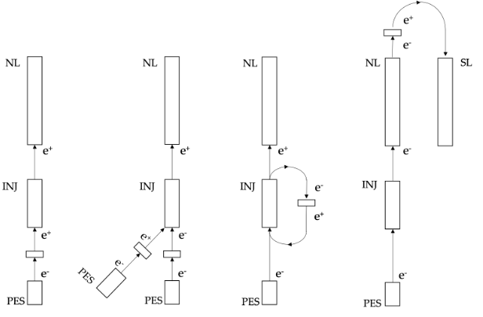
Ce+BAF
3 Possible Configurations for e+ Production
Today’s 12 GeV e- energies
D
1090 MeV
1090 MeV
123 MeV
7 MeV
123 MeV
7 MeV
C
B
A
C
A
B

Slide 13
Ce+BAF
PEPPo approach is a new approach vs. others
”Conventional” unpolarized bremsstrahlung positron sources
SLAC – Stanford Linear Accelerator Center (US)
HERA – Hadron Electron Ring Accelerator (Germany)
BELLE/KEK – National Laboratory for High Energy Physics (Japan)
CESR – Cornell Electron Storage Ring (US)
VEPP – Budker Institute of Nuclear Physics (Russia)
BEPCII – Beijing Electron Positron Collider (China)
PEPPo builds upon this
e+ polarization/intensity configurable
CW (all prior machines are pulsed)
Milliamp polarized e- source
Integrates to 12 GeV CEBAF…
C
B
A

Slide 14
Ce+BAF
We consider building an e+ source prototype
  350 kV polarized electron gun with 1000 C lifetime
  8 MeV, 1 mA electron beam
  Optics model of the positron source including especially the positron distribution downstream of target and capture/bunching sections
  e- and e+ beamline layout
  Positron production target that can take >10 kW
  Solenoid magnet, >0.5 T, positron spatial capture
  RF cavity, positron temporal capture
  e+ diagnostic beamline (Low current)
Goal: >100 nA unpolarized or >10 nA polarized positron beams
C
B
A

Slide 15
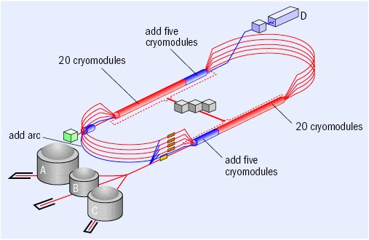
Energy Increase
How did we increase energy reach last time? By adding more accelerating RF cryomodules to the ends of the two Linacs.
1.1 GeV per Linac
Adding more cryomodules is not an option any more.
Costly and no more room.

Slide 16
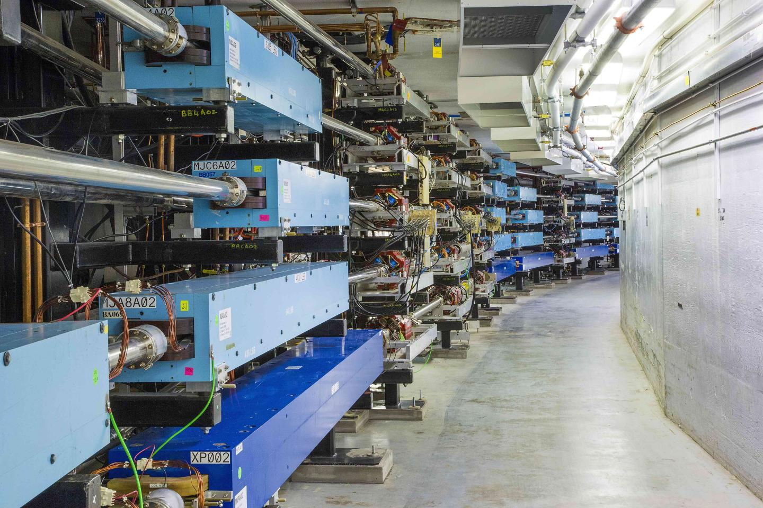
Energy
How about more recirculation through the Linacs?
The recirculating arcs are already from ceiling to floor.
Solution: Recirculate more in the same beam pipe using FFA Permanent magnets.
*FFA (Fixed Field Alternating-Gradient)

Slide 17

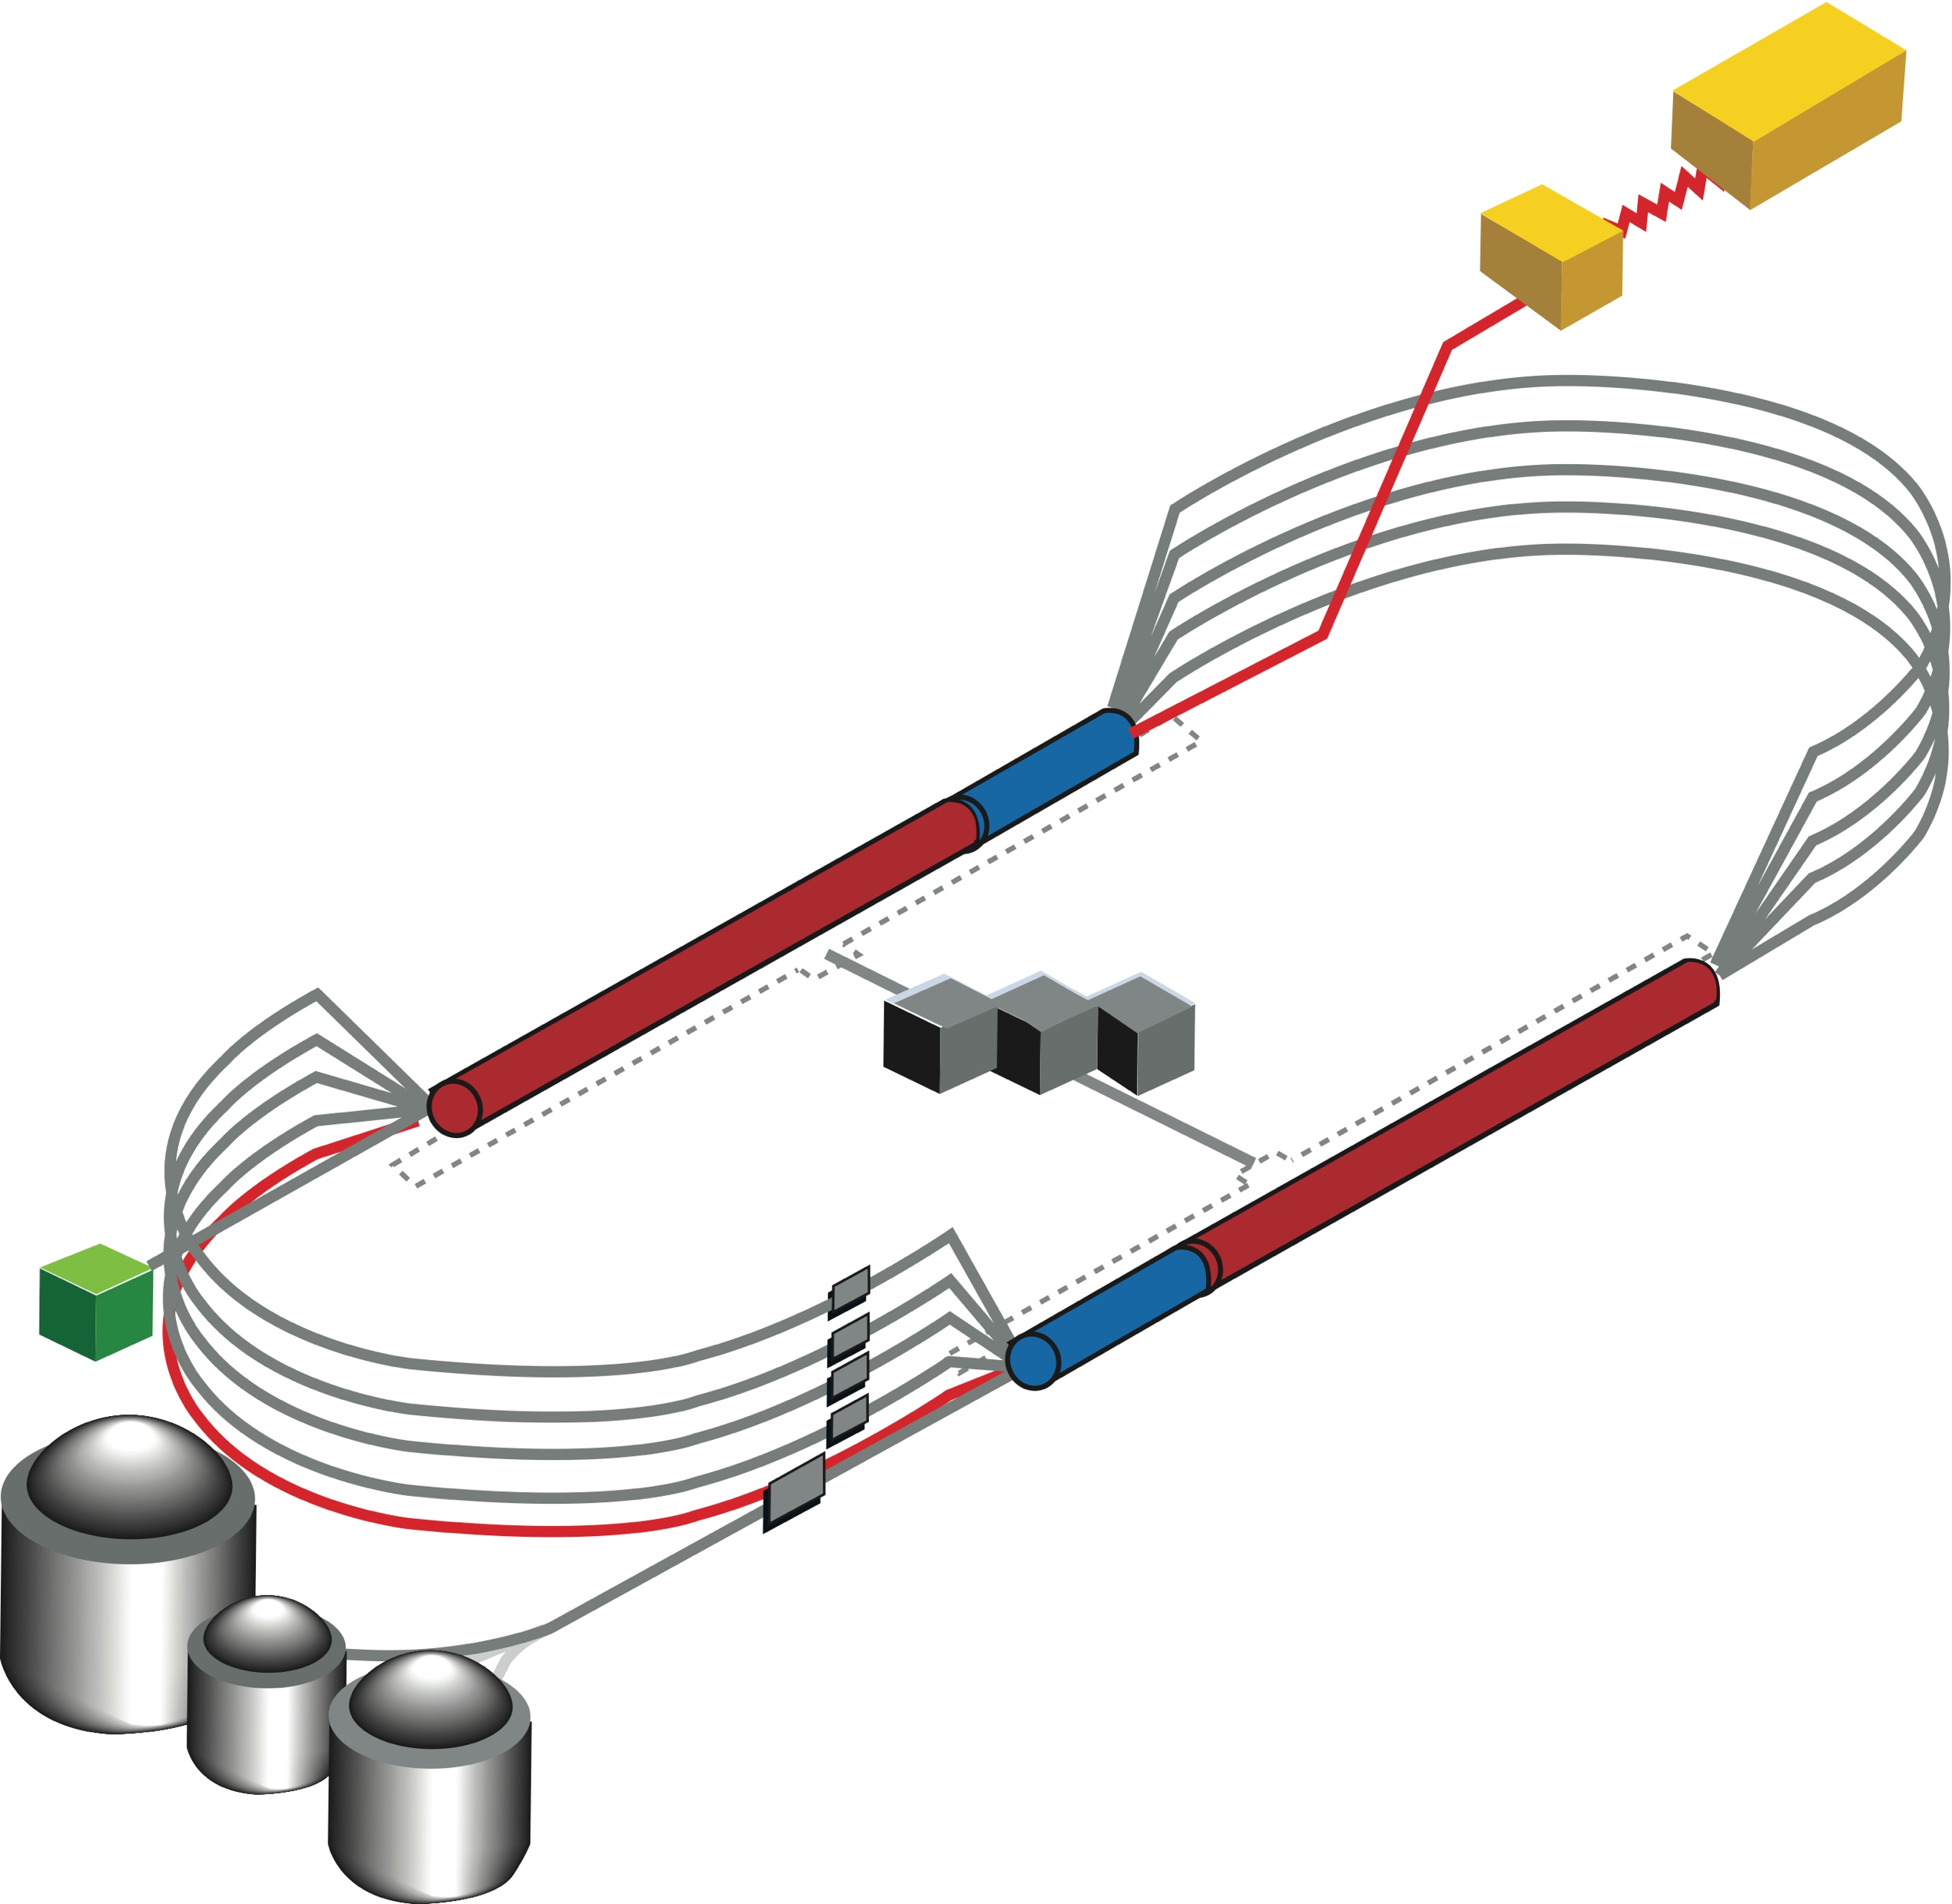
Energy:
Starting with 12 GeV CEBAF as a baseline
NO new SRF (1.1 GeV per Linac)
Remove the highest two recirculation passes and replace them with two pairs of FFA arcs including time-of-flight chicanes
Recirculate 11 times to get to 22-24 GeV
1 (pass 1)
1 (pass 2)
1 (pass 3)
4 (passes 4,5,6,7)
4 (passes 8,9,10,11)
Total = 11 passes
FFA Arcs
TOF
TOF
TOF
3 passes through EM arcs
4 passes through 1st FFA arcs
TOF
FFA Arcs
4 passes through 2nd FFA arcs

Slide 18
Energy: How Does FFA Work? Compact FODO Cell
Large momentum acceptance FFA cell, configured with combined function magnets capable of transporting multiple energy beams through the same string of permanent magnets (beams with energies spanning a factor of two)
1 T
50 T/m

Slide 19
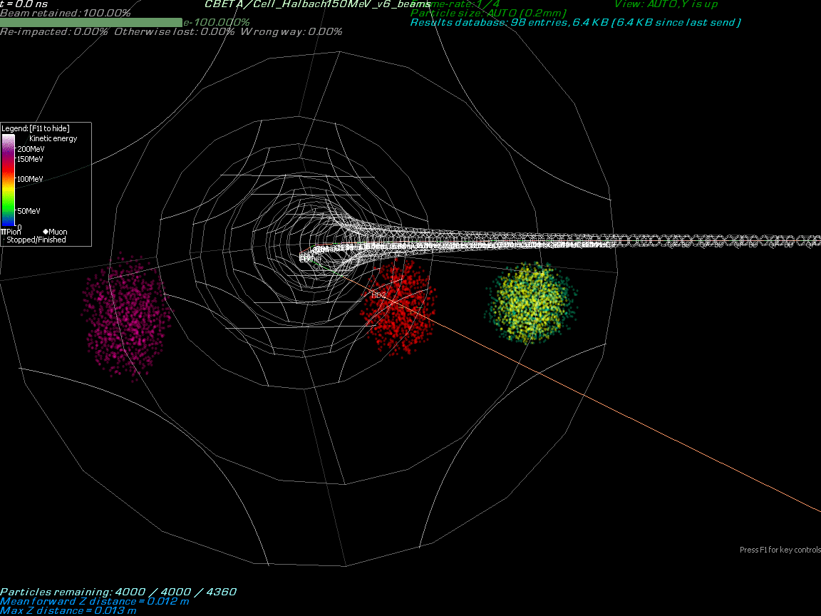
Energy: Four Different Energy Beams Bending in One FFA Line
Four beams from different passes Bending in the Arc through one FFA beamline.
Passes 4,5,6, and 7
in one pipe
FFA Arc
Courtesy
Stephen Brooks

Slide 20
Recap
 | Present Design | Possible | Challenges
Luminosity increase | Hall A & C @11GeV Total < 85 μA (< 82 μA Each dump limit) | Hall A & C @11GeV Total < 140 μA (< 82 μA Each dump limit) | RF Beam Loading Dump Cooling BBU Instability
Positron option | Not Yet an Option | >100 nA Unpolarized Or >10 nA Polarized e+ | Target Design e+ Collection Beam dynamics, Injector and Main High Intensity e- Beam (~1 mA) Need Production Energy Choice and Design Gaining Experience
Energy increase | Up to 11 GeV to A, B, or C 12 GeV to D | 20 – 24 GeV | Scaling Up FFA Optics to Several GeVs Dump Cooling & Enviro. Evaluation Injector Energy increase ~ factor 4. BBU instability

Slide 21
Some Final Thoughts
CEBAF accelerator offers unique advantage in terms of luminosity among the Nuclear Physics machines even beyond 2030.
Very active R&D is underway on three different fronts: Luminosity, Energy reach and Positron capability.
In some of these fronts, we are ready to develop prototypes or make incremental advances.
I mentioned some of the Challenges we face in every front.
These efforts also depend on the level of funding, prioritization of projects and scheduling the upgrades with busy nuclear physics use of the accelerator.
Project prioritization will be driven by physics motivation.

Slide 22
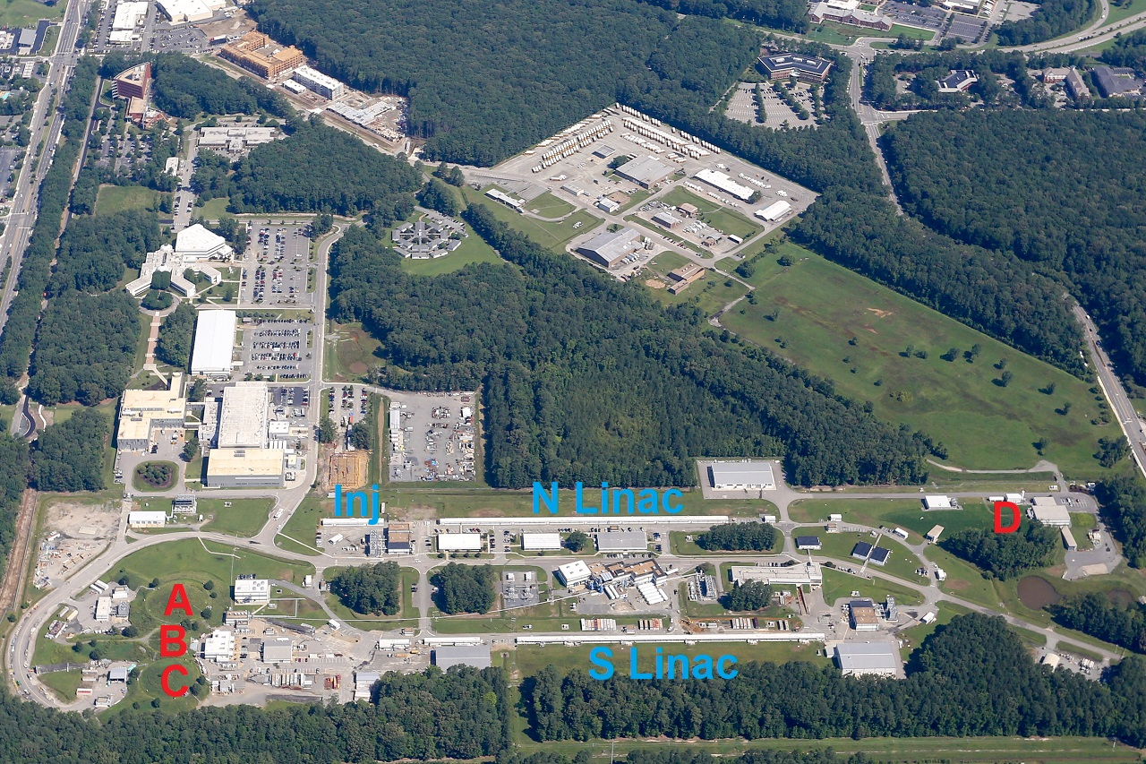
Thank You!

