Slide 1
Magnetized Beam LDRD
Md Abdullah Mamun
Jefferson Lab Accelerator Advisory Committee Mtg., September 13-15, 2017

Slide 2
JLEIC High Energy Electron Cooler
High Energy Electron Cooler
ion beam
Magnetization flip
ion beam
cooling solenoid (B<0)
cooling solenoid (B>0)
beam dump
linac
injector
fast extraction kicker
circulating bunches
fast injection kicker
Circulator Cooler Ring
ERL Ring
injected bunches
exchange
septum
extracted bunches
dechirper
vertical
bend
to CCR
vertical
bend
into ERL
rechirper

Slide 3
Magnetized Bunched-Beam Electron Cooling
Ion beam cooling in presence of magnetic field is much more efficient than cooling in a drift (no magnetic field):
Electron beam helical motion in strong magnetic field increases electron-ion interaction time, thereby significantly improving cooling efficiency
Electron-ion collisions that occur over many cyclotron oscillations and at distances larger than cyclotron radius are insensitive to electrons transverse velocity
Long cooling solenoid provides desired cooling effect:
Counteracting emittance degradation induced by intra-beam scattering
Maintaining ion beam emittance during collisions and extending luminosity lifetime
Suppressing electron-ion recombination
but putting the electron beam into the cooling solenoid represents a challenge

Slide 4
Magnetized Cooling Schematics
Electron beam suffers an azimuthal kick at entrance of cooling solenoid. But this kick can be cancelled by an earlier kick at exit of photogun. That is purpose of cathode solenoid
Electrons born in strong uniform B_{z}
Upon exit of Cathode Solenoid
Upon entering Cooling Solenoid
r_{e}= 0.7 mm
B_{cool} = 1 T
$a_{0}$= R_{laser} = 3.14 mm
B_{z} = 0.5 kG
= 36 µm

Slide 5
JLEIC Magnetized Source Requirements
Bunch length | 60 ps (2 cm)
Repetition rate | 43.3 MHz
Bunch charge | 2.0 nC
Peak current | 33.3 A
Average current | 86.6 mA
Transverse normalized emittance | <19 microns
Cathode spot radius – Flat-top ($a_{0}$) | 3.14 mm
Solenoid field at cathode (B_{z}) | 0.5 kG
Cornell University demonstrated 65 mA and 2 nC, but not at same time, and non-magnetized
Fermilab Magnetized Photoinjector Laboratory:
Pulsed NCRF gun with Cs₂Te photocathode and UV laser (λ=263 nm)
Bunch charge: 0.5 nC and bunch length: 3 ps
0.5% duty factor (average current: 7.5 μA)
Bunch frequency: 3 MHz
Macropulse duration: 1 ms
Number of bunches per macropulse: 3000
Macropulse frequency: 5 Hz

Slide 6
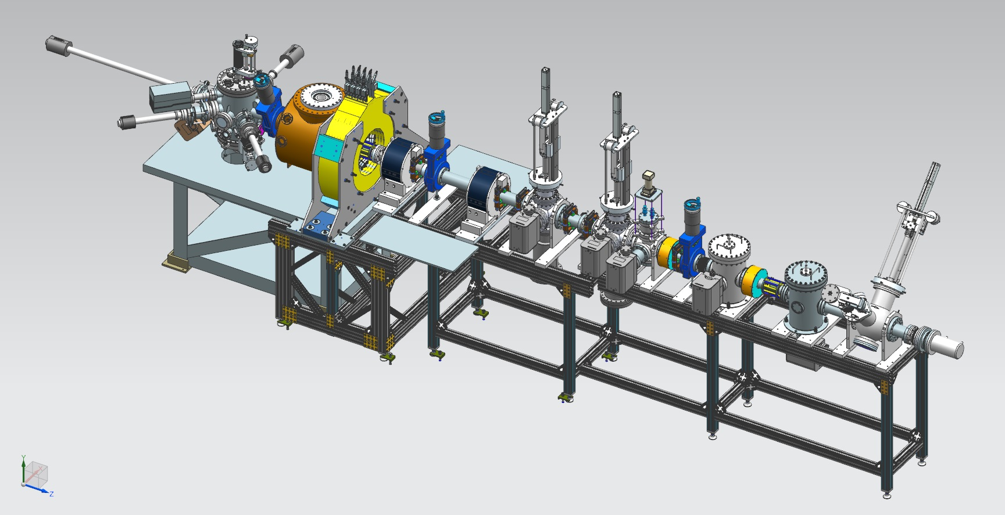
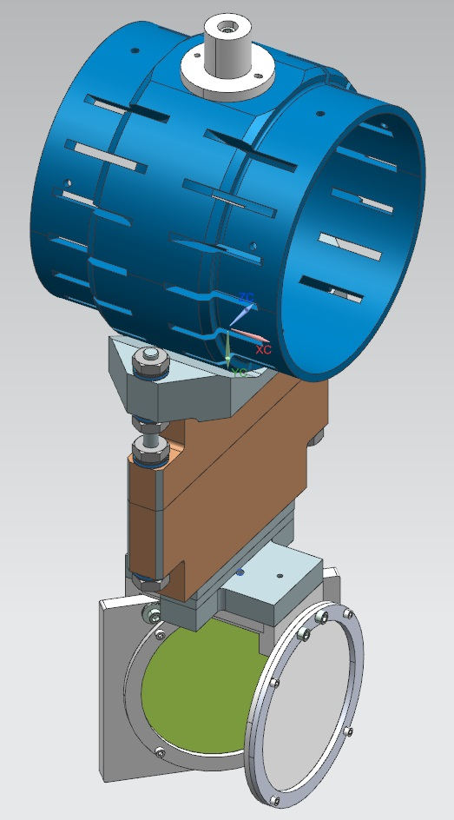
Magnetized Source Schematics
Gun HV Chamber
Photocathode
Preparation
Chamber
Beamline
Gun Solenoid
Shield Tube
Viewer 3 Screen
Beam Dump
Slit
Viewer Screen

Slide 7
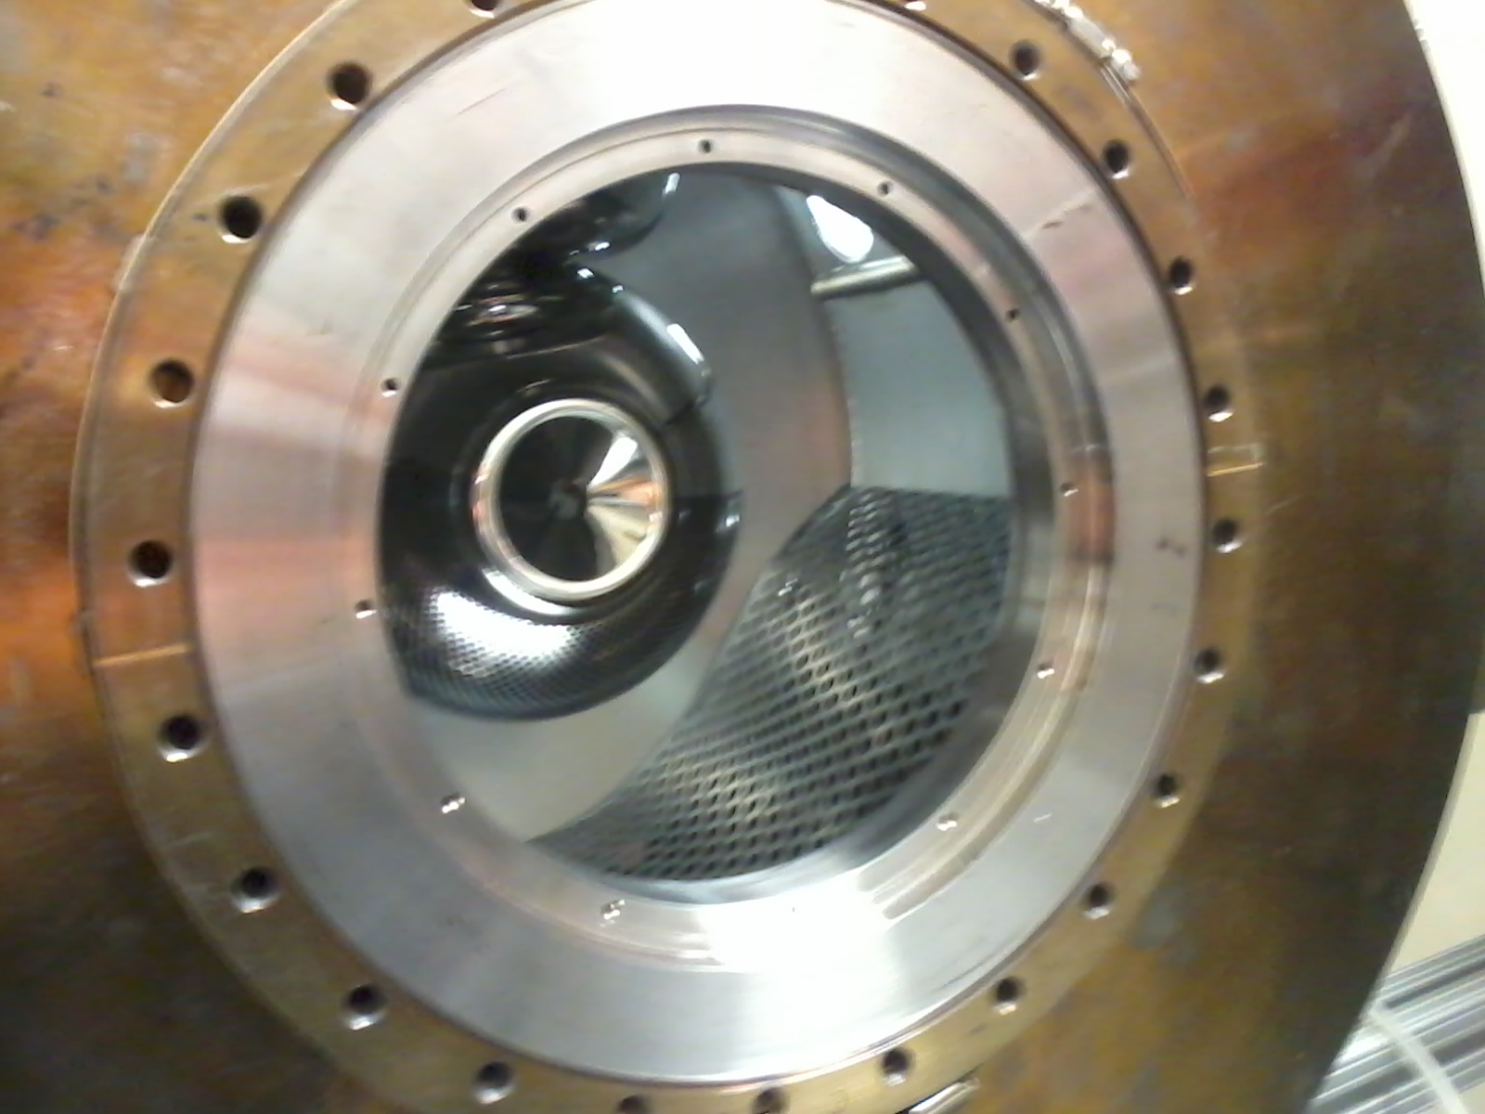
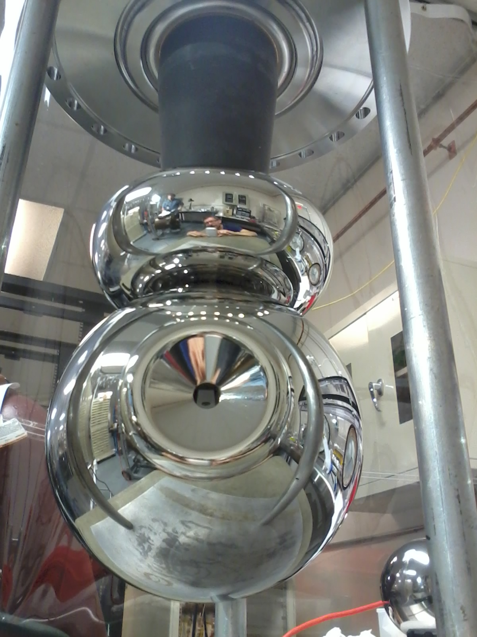
Gun HV Chamber
Upgraded HV Chamber with new doped-alumina insulator and newly designed triple-point-junction shield, to lower gradient from 12 MV/m to 10 MV/m at 350 kV
Photogun now operating at 300 kV with gun solenoid at 400 A

Slide 8
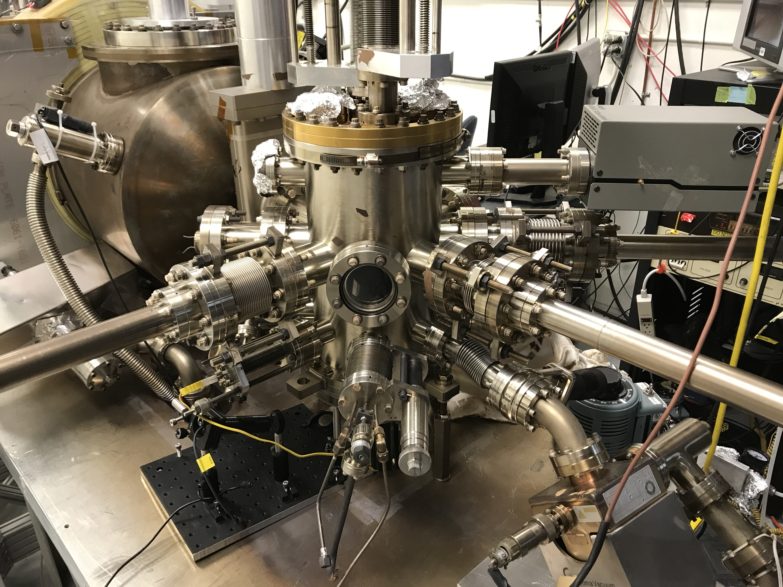
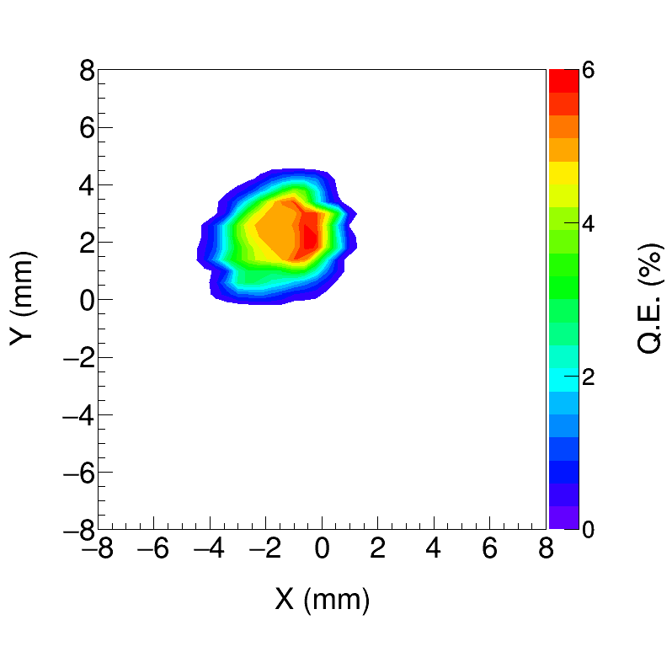
Photocathode Preparation Chamber
K₂CsSb grown with a mask – limit photocathode active area (3 mm diameter) to reduce beam halo, minimize vacuum excursions and high voltage arcing, prolong photogun operating lifetime
Active area can be offset from electrostatic center
Entire photocathode can be activated too
JLab now in the alkali-antimonide business!

Slide 9
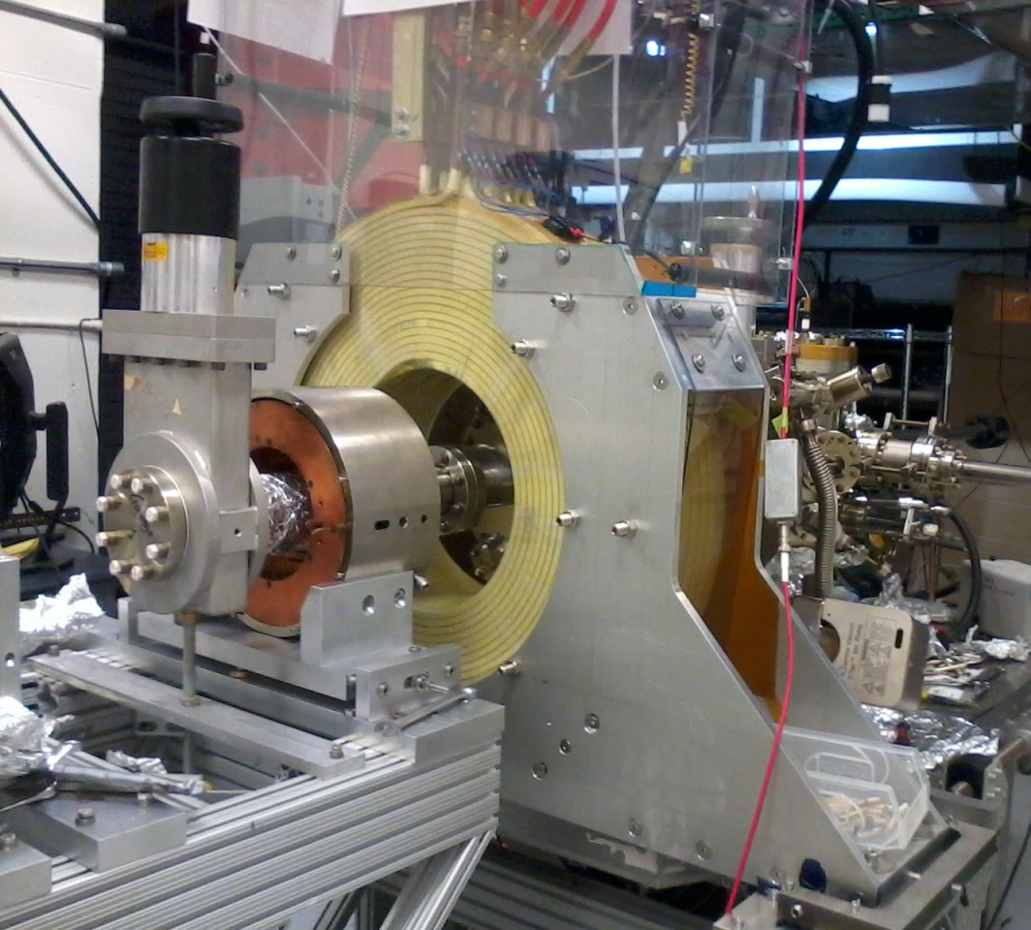
Gun Solenoid
Size | 11.811" ID, 27.559" OD, 6.242" Z
Conductor | L=500 m, A=0.53 cm² 16 layers by 20 turns
Coil Weight | 254 kg (560 lbs)
Resistance | 0.198 Ω
Field at Photocathode | 1.4 kG
Voltage | 79 V
Current | 400 A
Using spare CEBAF Dogleg magnet power supply (500 A, 80 V)
Learned that gun solenoid can influence field emission
First trials with gun at high voltage and solenoid ON resulted in new field emission and vacuum activity
Procedure to energize solenoid without exciting new field emitters

Slide 10
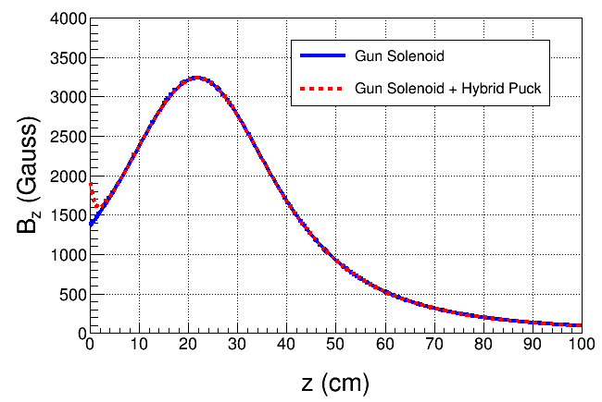
New Steel Photocathode Holders
Molybdenum
Steel
New steel holders (pucks) to enhance field to 2.0 kG at photocathode. Two types:
Molybdenum and carbon steel hybrid puck
Carbon steel puck
Steel

Slide 11
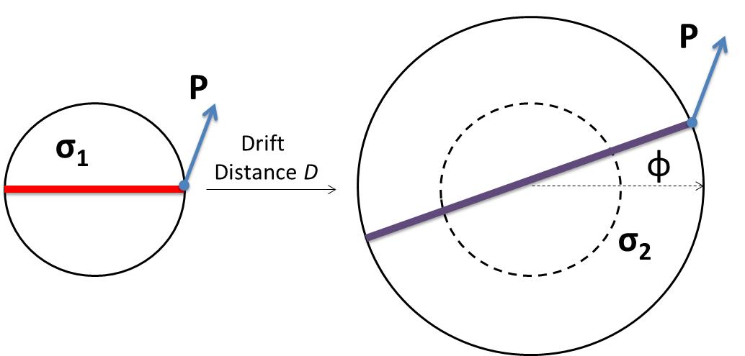
Measuring Electron Beam Magnetization
Use slit and viewscreens to measure mechanical angular momentum:
$B_{z}$: solenoid field at photocathode
$a_{0}$: laser rms size
φ: rotation (sheering) angle

Slide 12
Slit and Viewscreen Measurement
0 G at photocathode
1450 G at photocathode

Slide 13
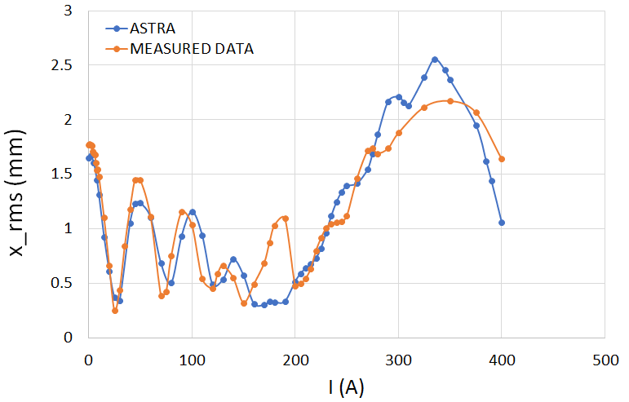
Beam Size Oscillation
at the beamline viewer

Slide 14
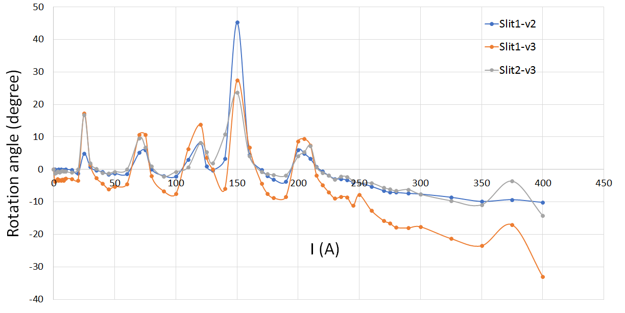
Beam Size Oscillation
…introduces magnetization/rotation oscillation

Slide 15
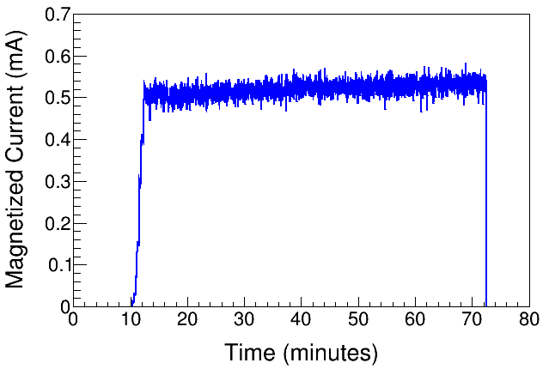
High Current Magnetized Beam
1450 G
Delivered 3 mA DC magnetized beam
Investigating the efficacy and necessity of installed dc ion-clearing electrodes to stop ions in beamline from reaching gun and causing HV arcs

Slide 16
Summary
K₂CsSb Photocathode Preparation Chamber, Gun, Solenoid and Beamline are all operational
Photogun operates reliably at 300 kV
Cathode solenoid can trigger field emission but we have learned how to prevent this
Have successfully magnetized electron beam and measured rotation angle
Preparing to install a modelocked drive laser, to generate mA magnetized beam with RF structure
Then switch to 32 mA 225 kV HV power supply….
Thanks to: P. Adderley, J. Benesch, B. Bullard, J. Grames, J. Guo, F. Hannon, J. Hansknecht, C. Hernandez-Garcia, R. Kazimi, G. Krafft, M. A. Mamun, Y. Wang, S. Wijiethunga, J. Yoskovitz, S. Zhang
ODU Graduate Students, Postdoc

Slide 17
Backup Slides

Slide 18
Magnetized Beam LDRD
Three-year project (FY16 – FY18):
Generate magnetized electron beam from dc high voltage photogun and measure its properties
Explore impact of cathode solenoid on photogun operation
Simulations and measurements will provide insights on ways to optimize JLEIC electron cooler and help design appropriate source
JLab will have direct experience magnetizing electron beams at high current

Slide 19
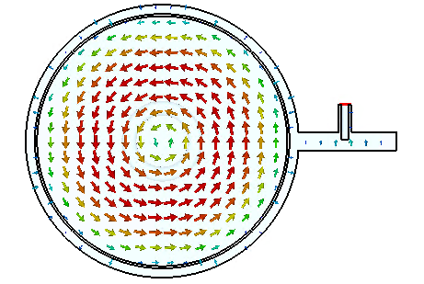
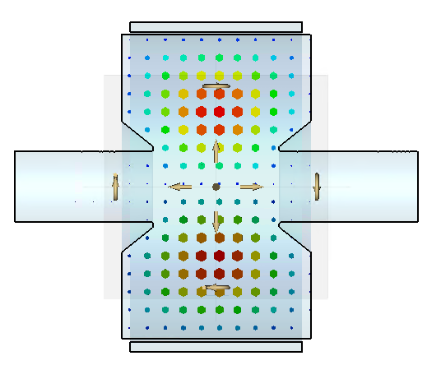
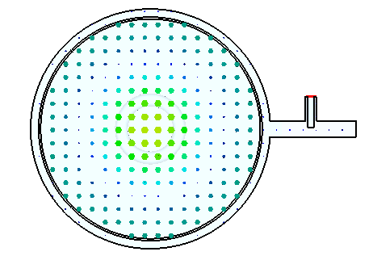
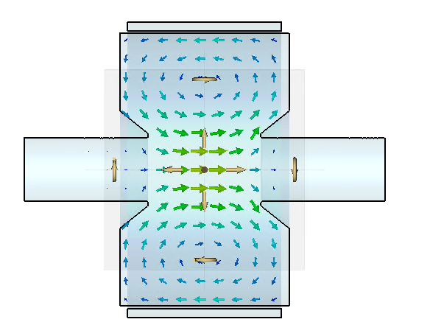
TE₀₁₁ Cavity: Non-invasive Technique
New non-invasive technique to measure electron beam magnetization
E-field: only in azimuthal direction
H-field: only in longitudinal and radial direction
Working with J. Guo, H. Wang, R. Rimmer to design and build the cavity

