Slide 1
750 MHz BPM Test Plan Results
Reza Kazimi
From test performed on 10/28/2016

Slide 2
Beams through choppers
A B C A B C
1497 MHz
60 degrees

Slide 3
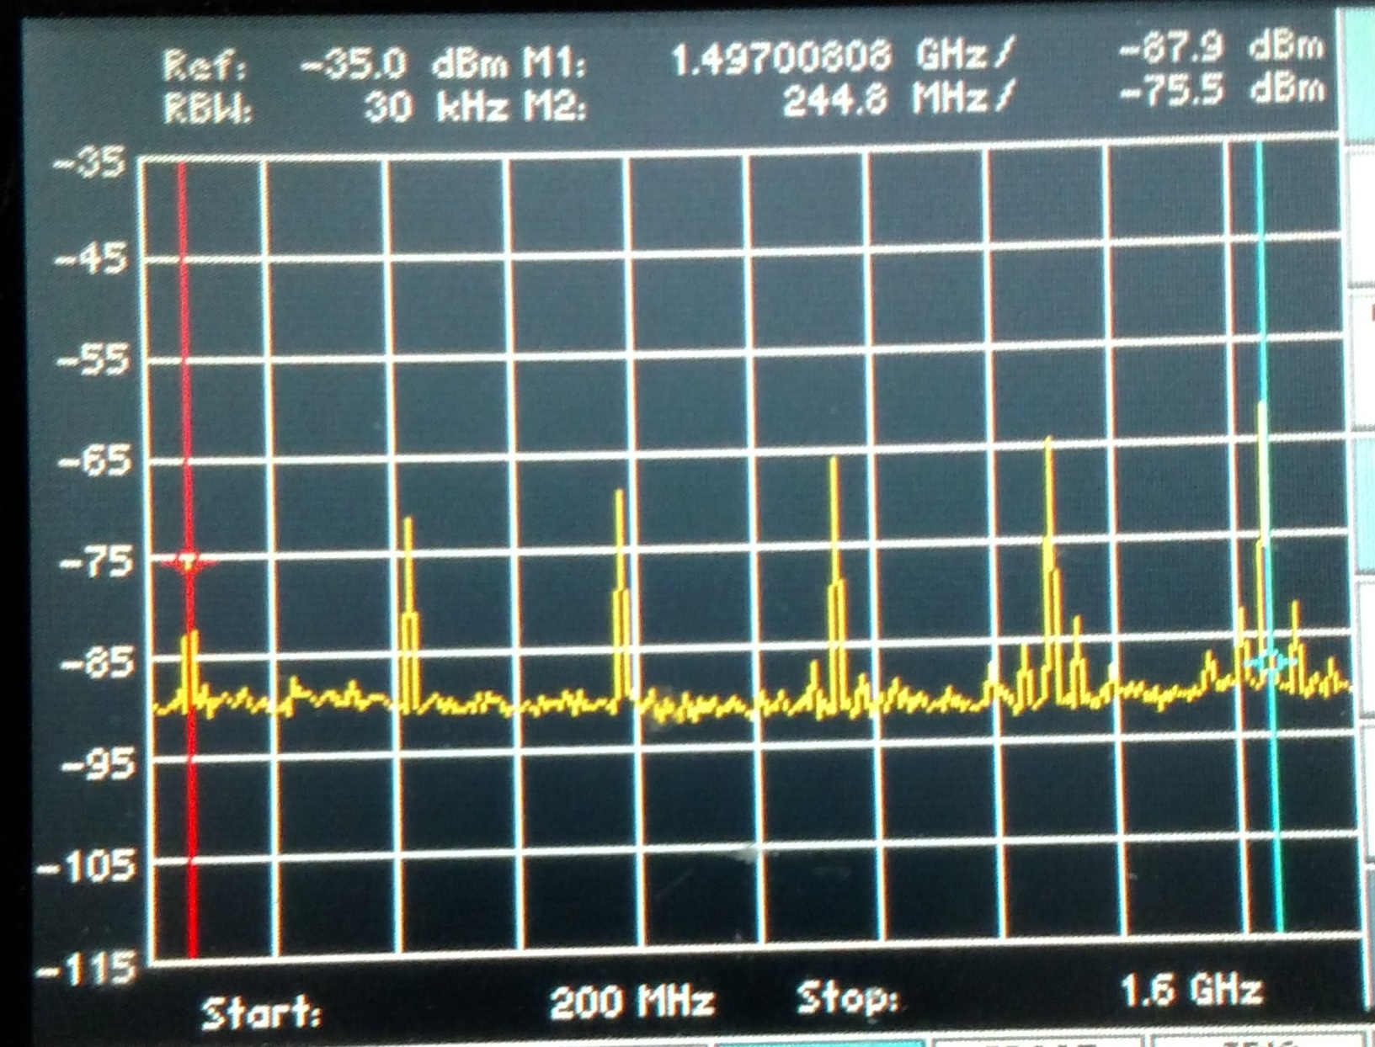
A 250 MHz beam, 10μA

Slide 4
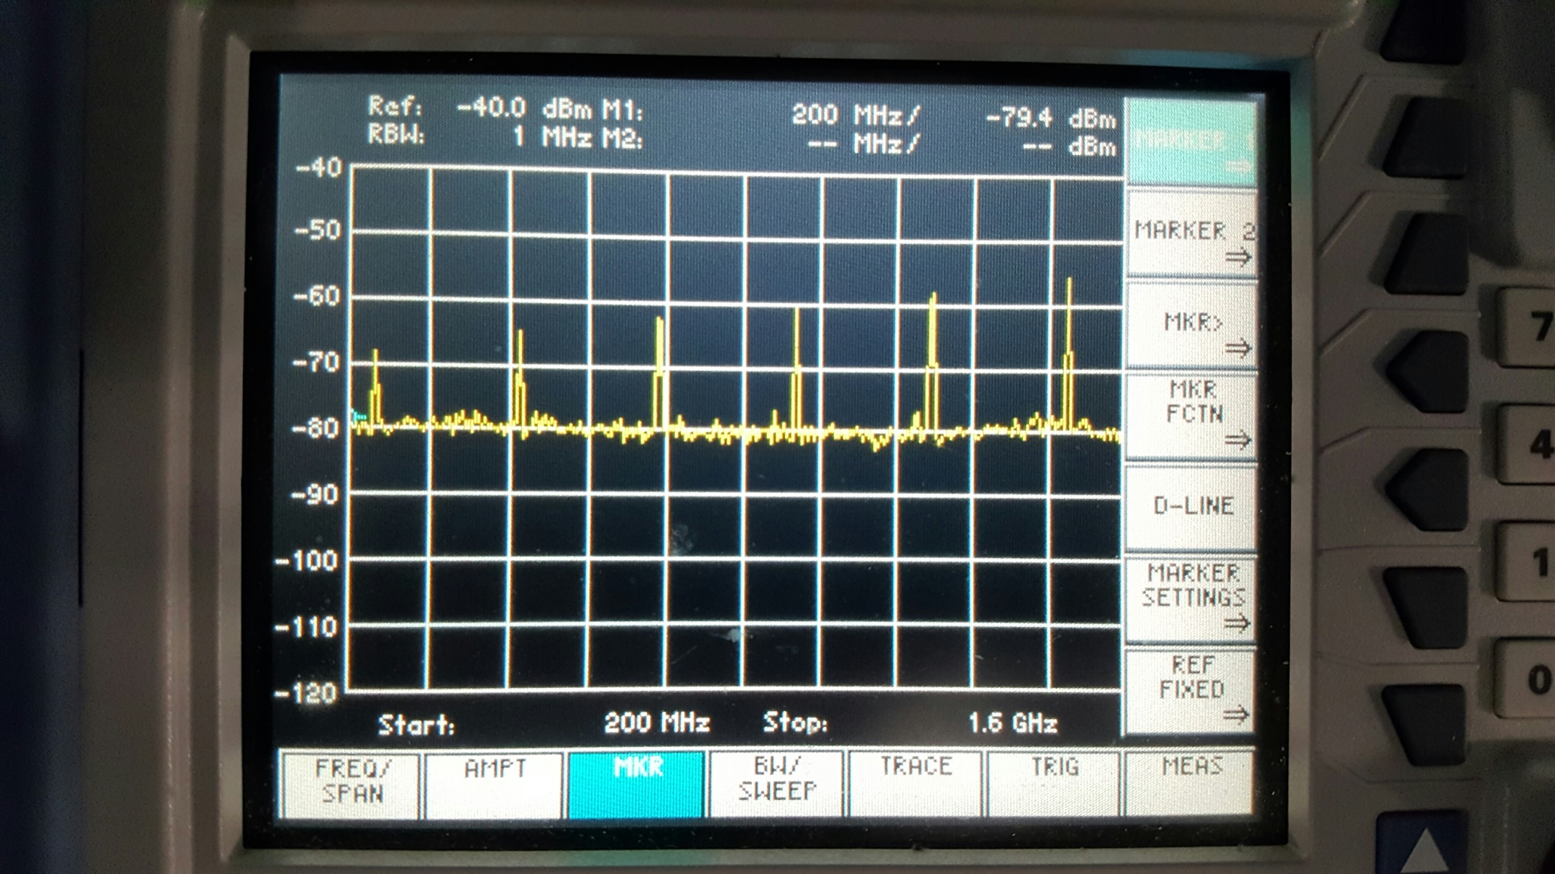
B+D in Phase each 250 MHZ, 10 μA

Slide 5
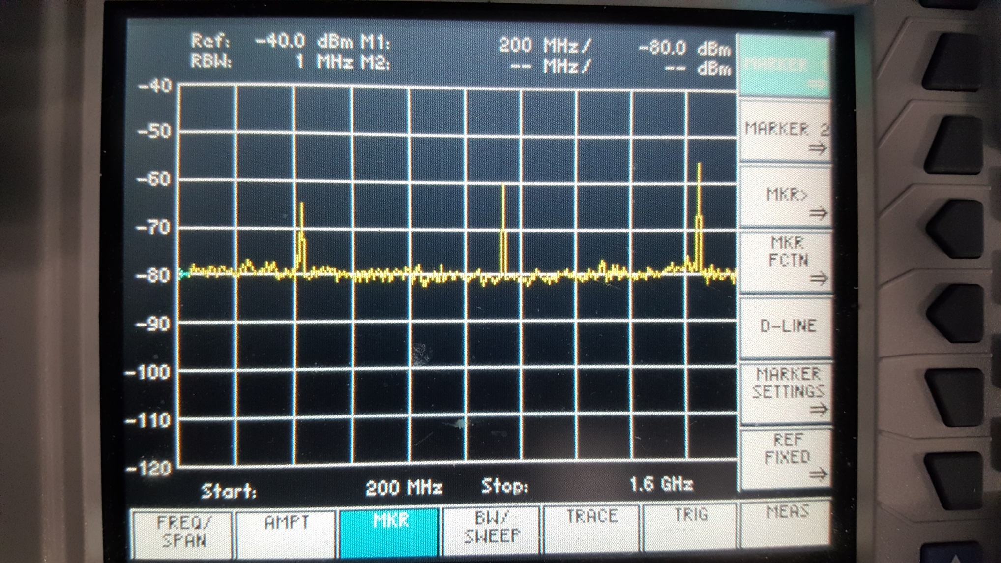
B+D out of Phase

Slide 6
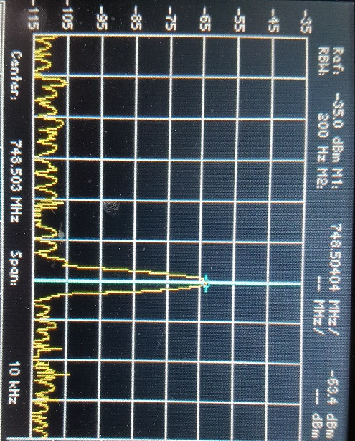
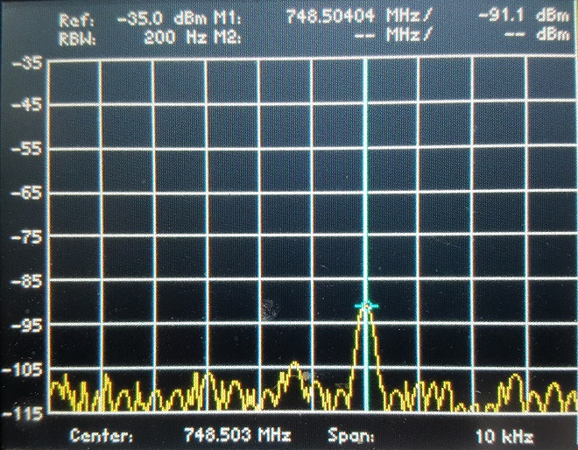
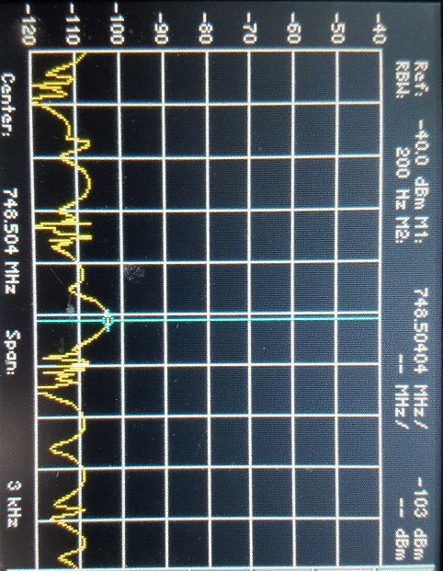
B+D in phase
B+D out of phase

