Slide 1
Spintronics and Polarized Positrons

Slide 2
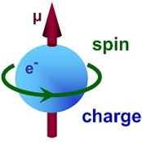
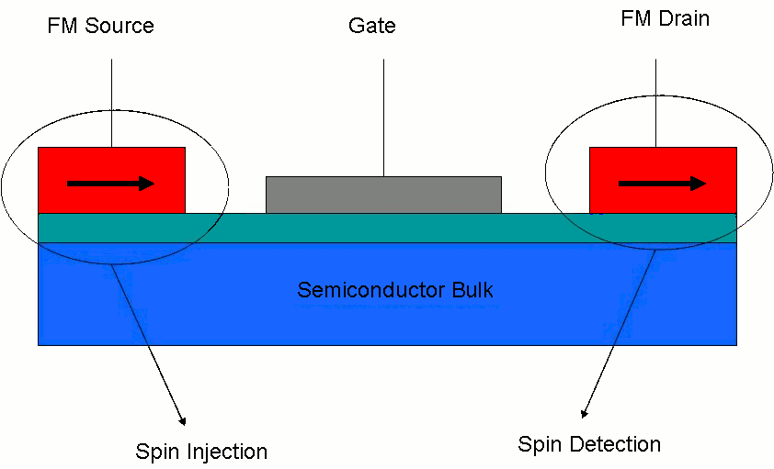
Spintronics
exploit the spin of the electron as well as its charge
.
the spin of the electron can be switched much faster than removing the charge leading to
devices with much faster
response and less heat than
current microelectronic devices
Spin transistor
Appl. Phys. A 80, 565 (2005)

Slide 3
Spin based devices and applications
Pearton et al., Materials Science and Engineering R 40 (2003) 137

Slide 4
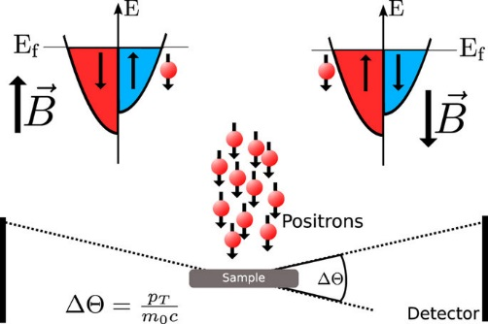
spintronic devices require
Spin injection
Spin modulation
Spin detection
Still big problem
Polarized positrons is the perfect tool

Slide 5
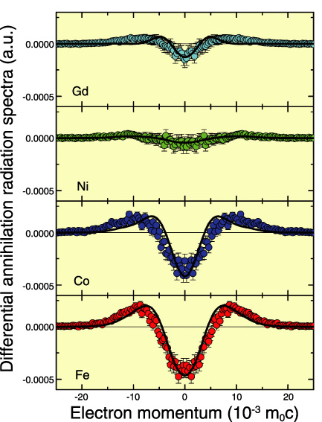
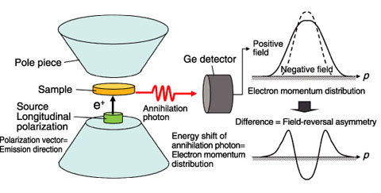
Detection of Electron Spins Using Spin-Polarized Positron
Physical Review B 83, 2011, p.100406-1.

Slide 6
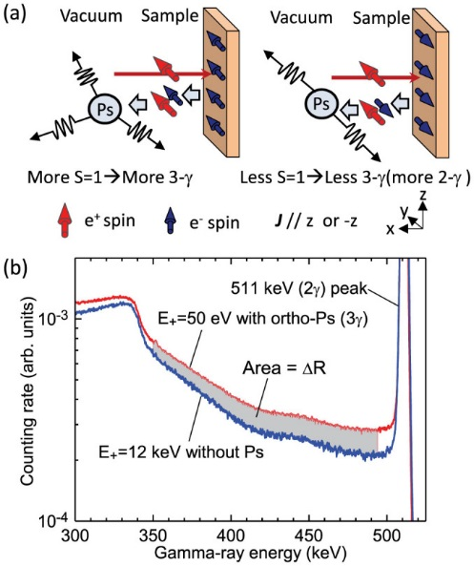
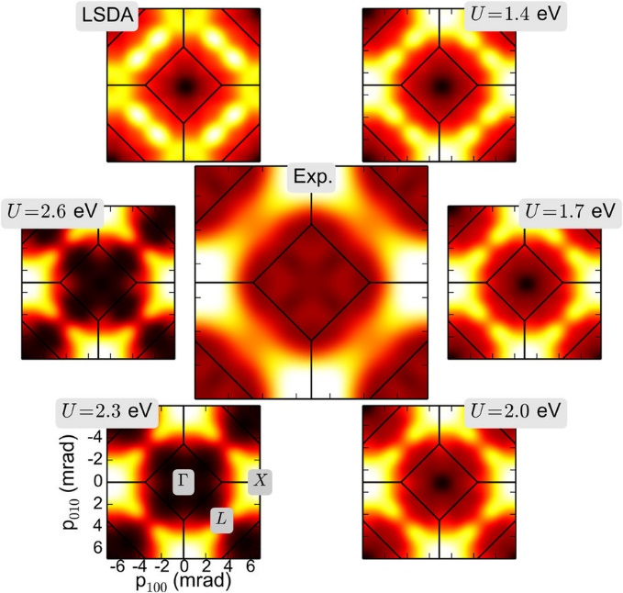
Sensitivity of Postronium formation and annihilation to the electron spin
Angular correlation of annihilation radiation measurements
Study of Local electron-electron interactions
in ferromagnetic materials
probe for current-induced spin polarization
Scientific Reports 4: 4844, 2014
Scientific Reports 6, 20898, 2016

