Slide 1
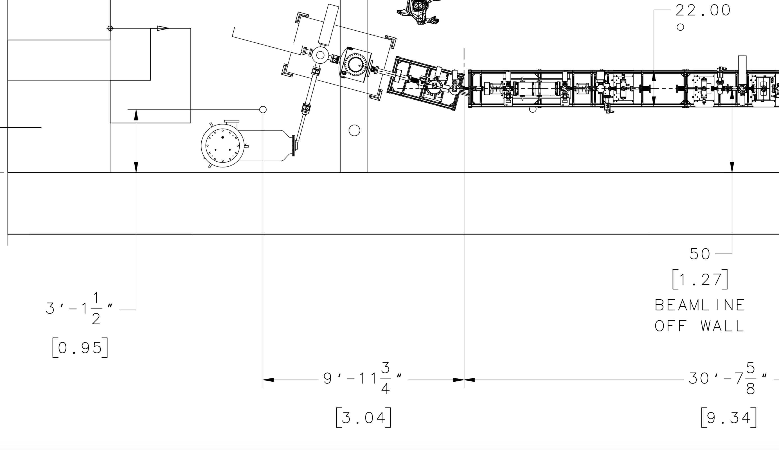
ME Start Point
Y-Chamber Flange
X=10.31750 m
Y=21.06680 m
Z=32.12725 m
Survey
Reference
Monument
X=10.0 m
Y=20.0 m
Z=30.0 m
Beam line elevation 42”
X
Right-Handed
Y
Z

