Slide 1

CEBAF Source/Injector Update
PREX/CREX Collaboration Meeting
February 26, 2018
Joe Grames
Center for Injectors and Sources

Slide 2
Outline
CEBAF Polarized Source
  Simultaneous 4-Hall operation
  Source performance
Summer SAD 2018
  200 kV Gun
  350 kV HVPS
  NEG tube
Summer SAD 2019 and beyond…
  200 keV Wien filter
  Beamline Redesign
  Booster

Slide 3
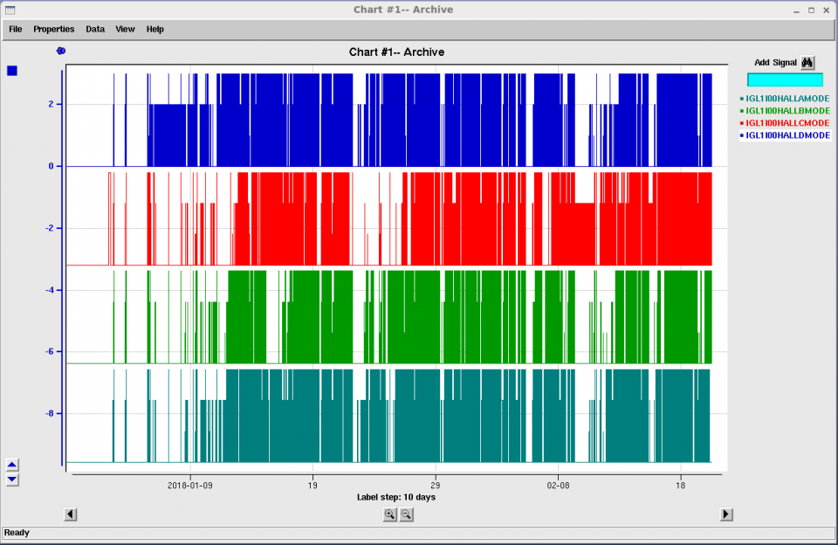
Recent CEBAF/Source Operation
4-Hall Operations & D+3
  All lasers now operating at 250 MHz
  December : B (0-10 nA) + D (0-100 nA) sharing narrow B-slit
  January-Now : A (22.5 uA) + D (25-400 nA) sharing open A-slit
  Since January : D+3(ABC) at highest energy 5.5 + (555)
D
C
B
A
3

Slide 4

CEBAF Gun 2 (130kV)
CEBAF Polarized Inverted Load Lock Gun (Spring 2017)

Slide 5
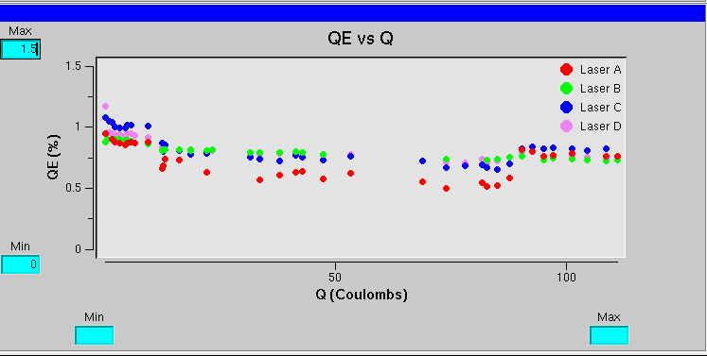
Polarized source recent performance
Photocathode
  Strained Superlattice GaAs/GaAsP #5756-4
  Polarization 85-87% typical (Mott and Hall B Moller)
  QE after activation typical (>1%), lifetime very good (>300 C)

Slide 6
Outline
CEBAF Polarized Source
  Simultaneous 4-Hall operation
  Source performance
Summer SAD 2018
  200 kV Gun
  350 kV HVPS
  NEG tube
Summer SAD 2019 and beyond…
  200 keV Wien filter
  Beamline Redesign
  Booster

Slide 7
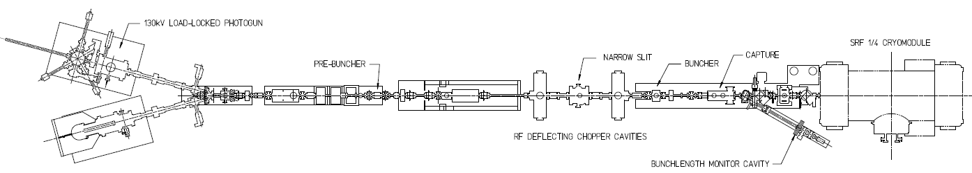
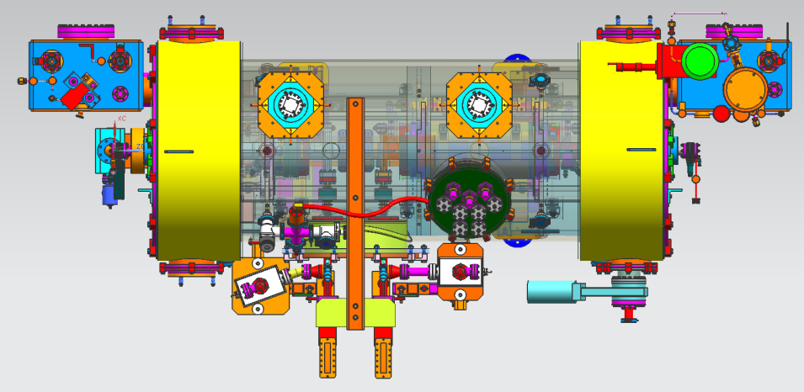
Injector Upgrade
200 kV
Increase gun voltage and Wien filters for 200kV operation
Locate Wien filters (energy filter) upstream of pre-buncher cavity
New SRF booster eliminates warm capture, RF deflection and x/y coupling
Our new “1/4 cryomodule”:
2 cell capture section + 7 cell cavity,
should provide 10 MeV beam and introduce no x/y coupling, allow better matching, more adiabatic damping

Slide 8
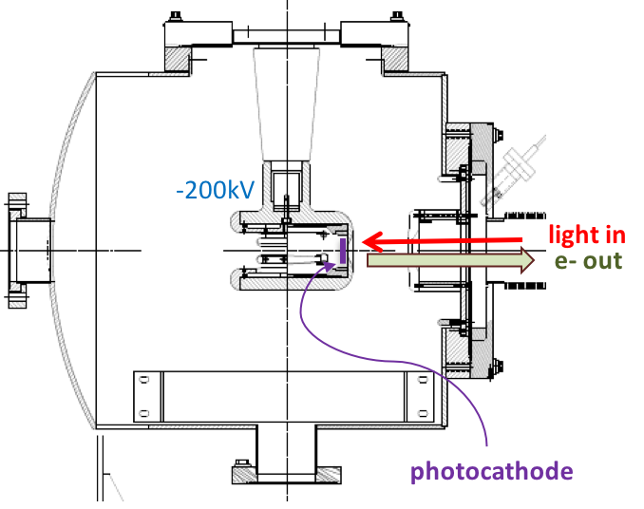

200 kV Gun Design Goals
Modify spare CEBAF/ILC gun for reliable 200 kV operation
  Retain extreme high vacuum (XHV) 1E-12 Torr
  Reliable 200 kV operation w/o field emission
Work of G. Palacios, C.H. Garcia

Slide 9
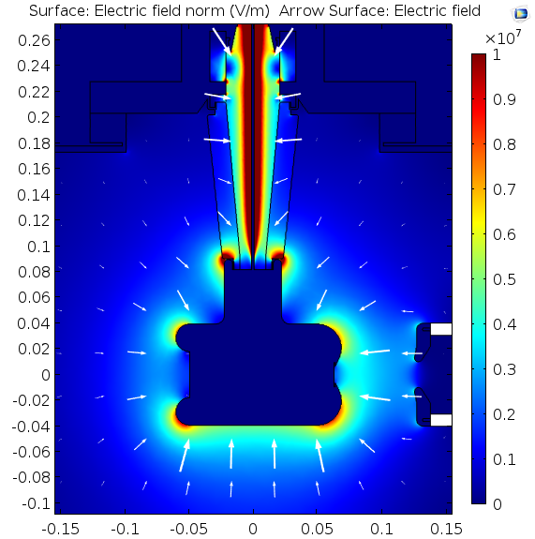
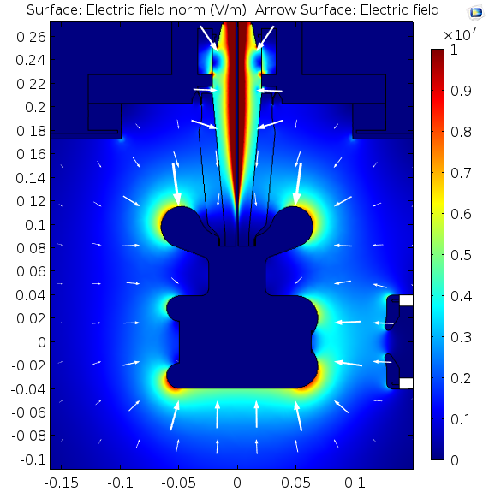
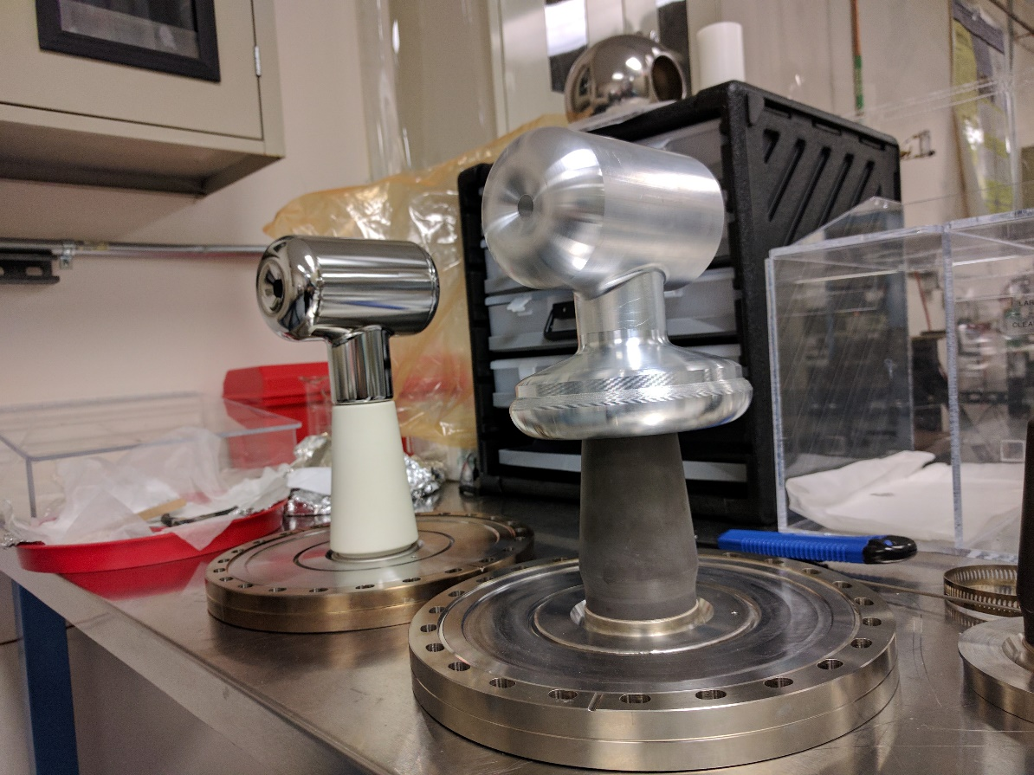
COMSOL model of gun improvements
White Conductivity of 2E-14 S/m
Black Conductivity of 2E-12 S/m
6.66 [MV/m]
5.68 [MV/m]
7.78 [MV/m]
7.75 [MV/m]
4.83 [MV/m]
4.81 [MV/m]
Work of G. Palacios, C.H. Garcia

Slide 10
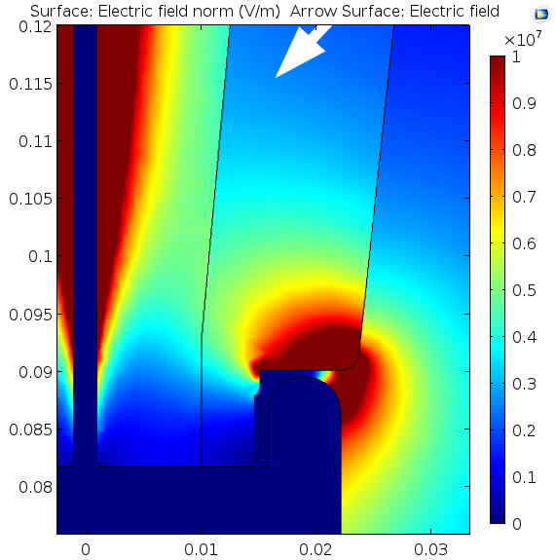
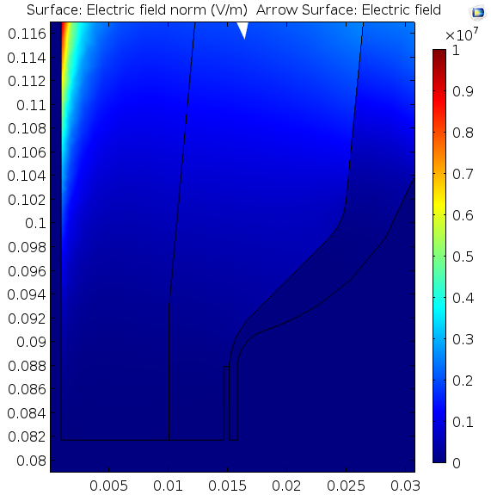
Triple point
White Conductivity of 2E-14 S/m
Black Conductivity of 2E-12 S/m
|E|=146.9 [V/m]
Ey=-139 [V/m]
|E|=1.16 [V/m]
Ey=-1.14 [V/m]
Work of G. Palacios, C.H. Garcia

Slide 11
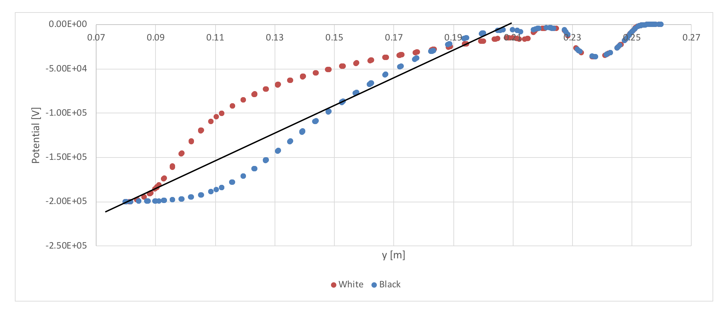
Rubber plug-insulator interface
Work of G. Palacios, C.H. Garcia

Slide 12
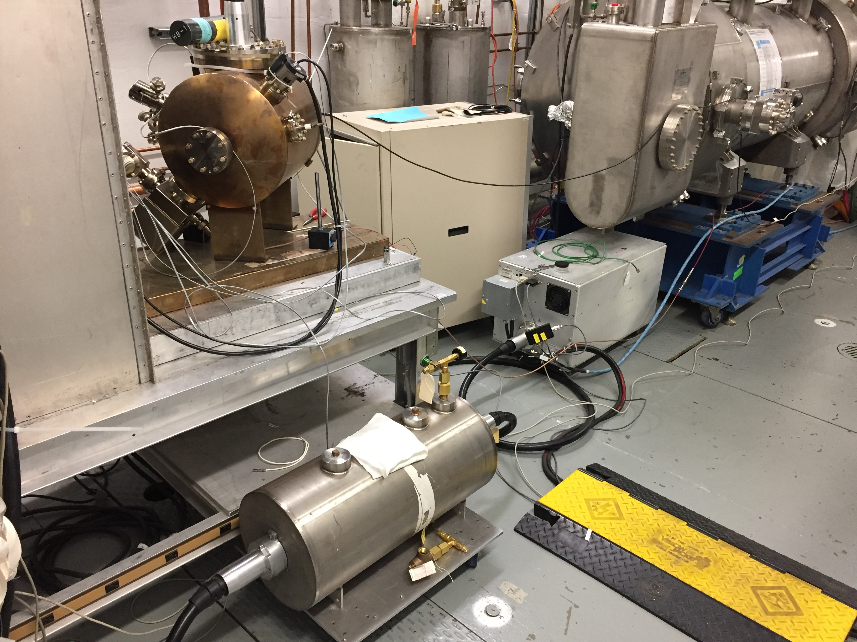
Conditioning the 200 kV gun at UITF (June 2017)
Gun assembled and baked successfully.
HV conditioned at the UITF using available with 225kV HVPS (Spellman) and SF6
Small, yet measurable on-set of field emission above 200kV – requires conditioning > 225kV to process

Slide 13
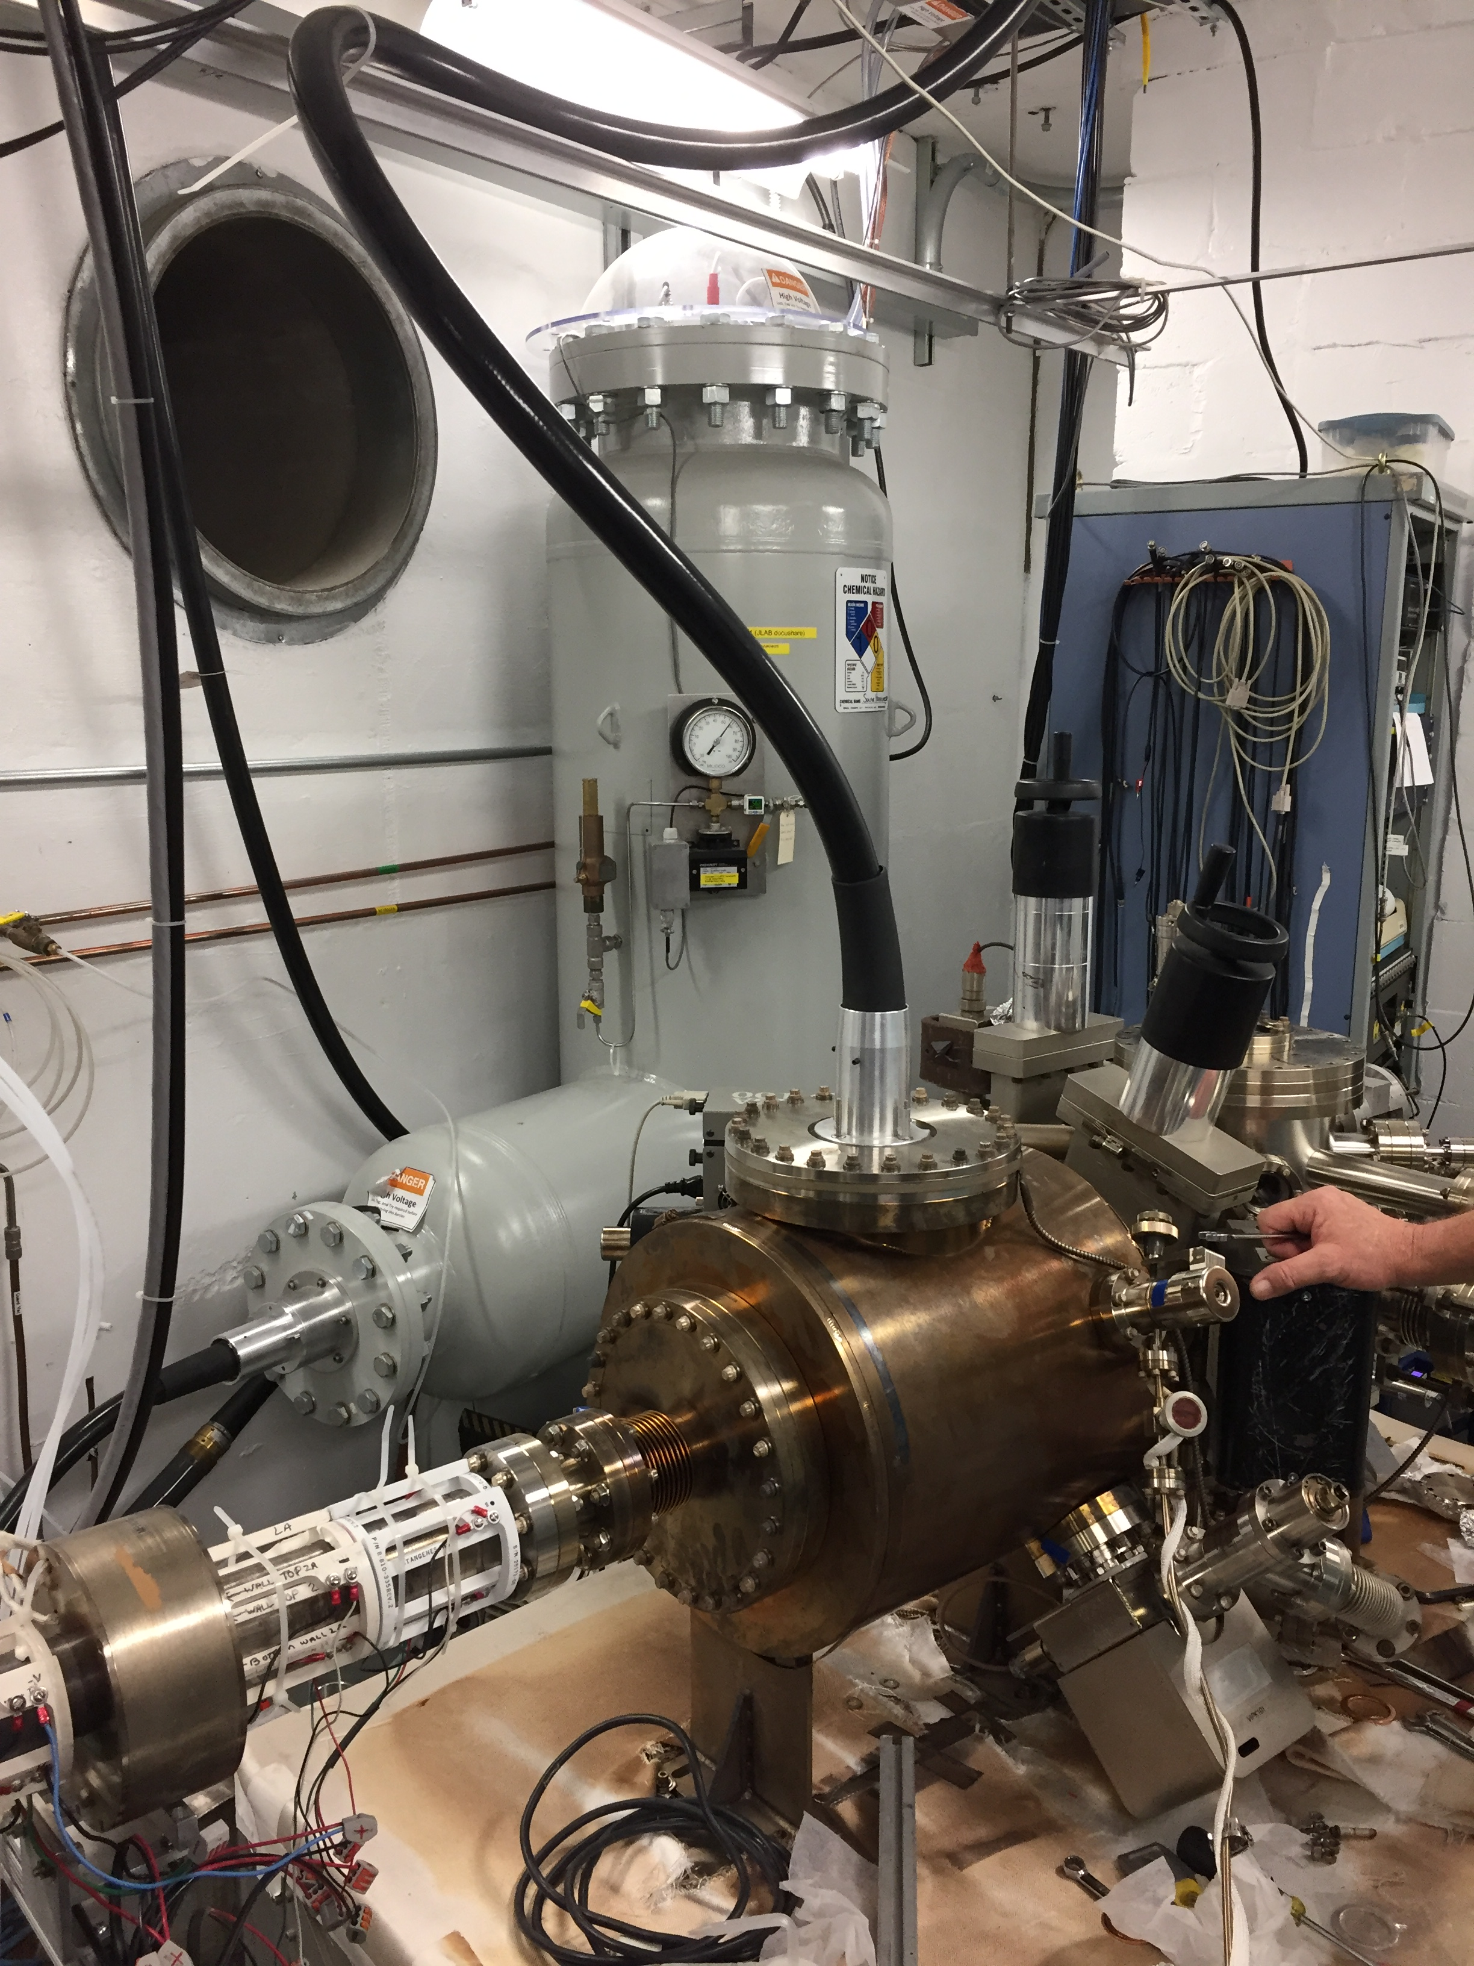
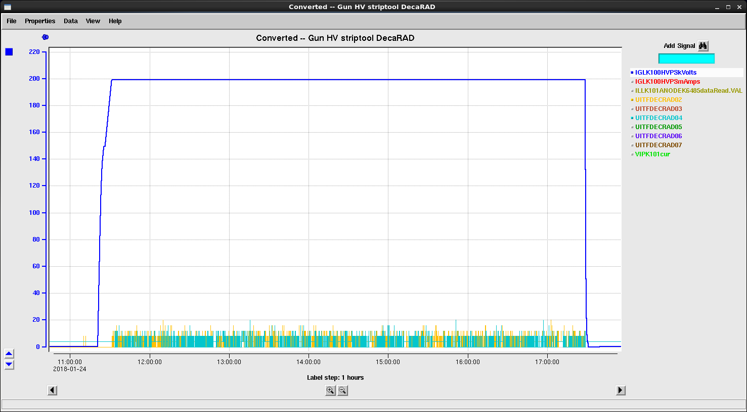
Conditioning w/ 350 kV HVPS (Nov-Dec 2017)
Moved HV chamber to gun table, baked and Kr gas conditioned to 227 kV (above the 225 kV Spellman!)
Reliable operation to 200 kV w/o signs of field emission.
Will move 200kV electrode to CEBAF HV chamber (better vacuum) in May 2018.

Slide 14
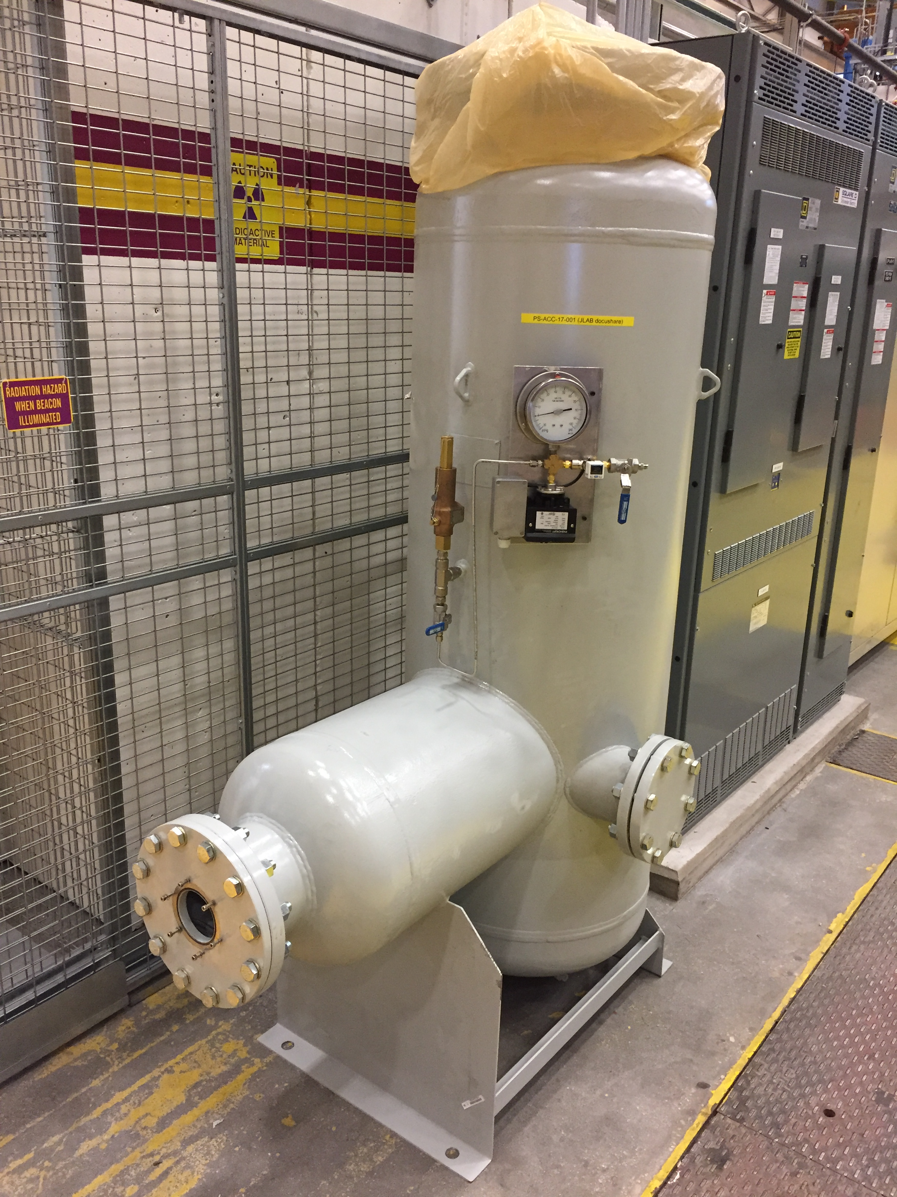
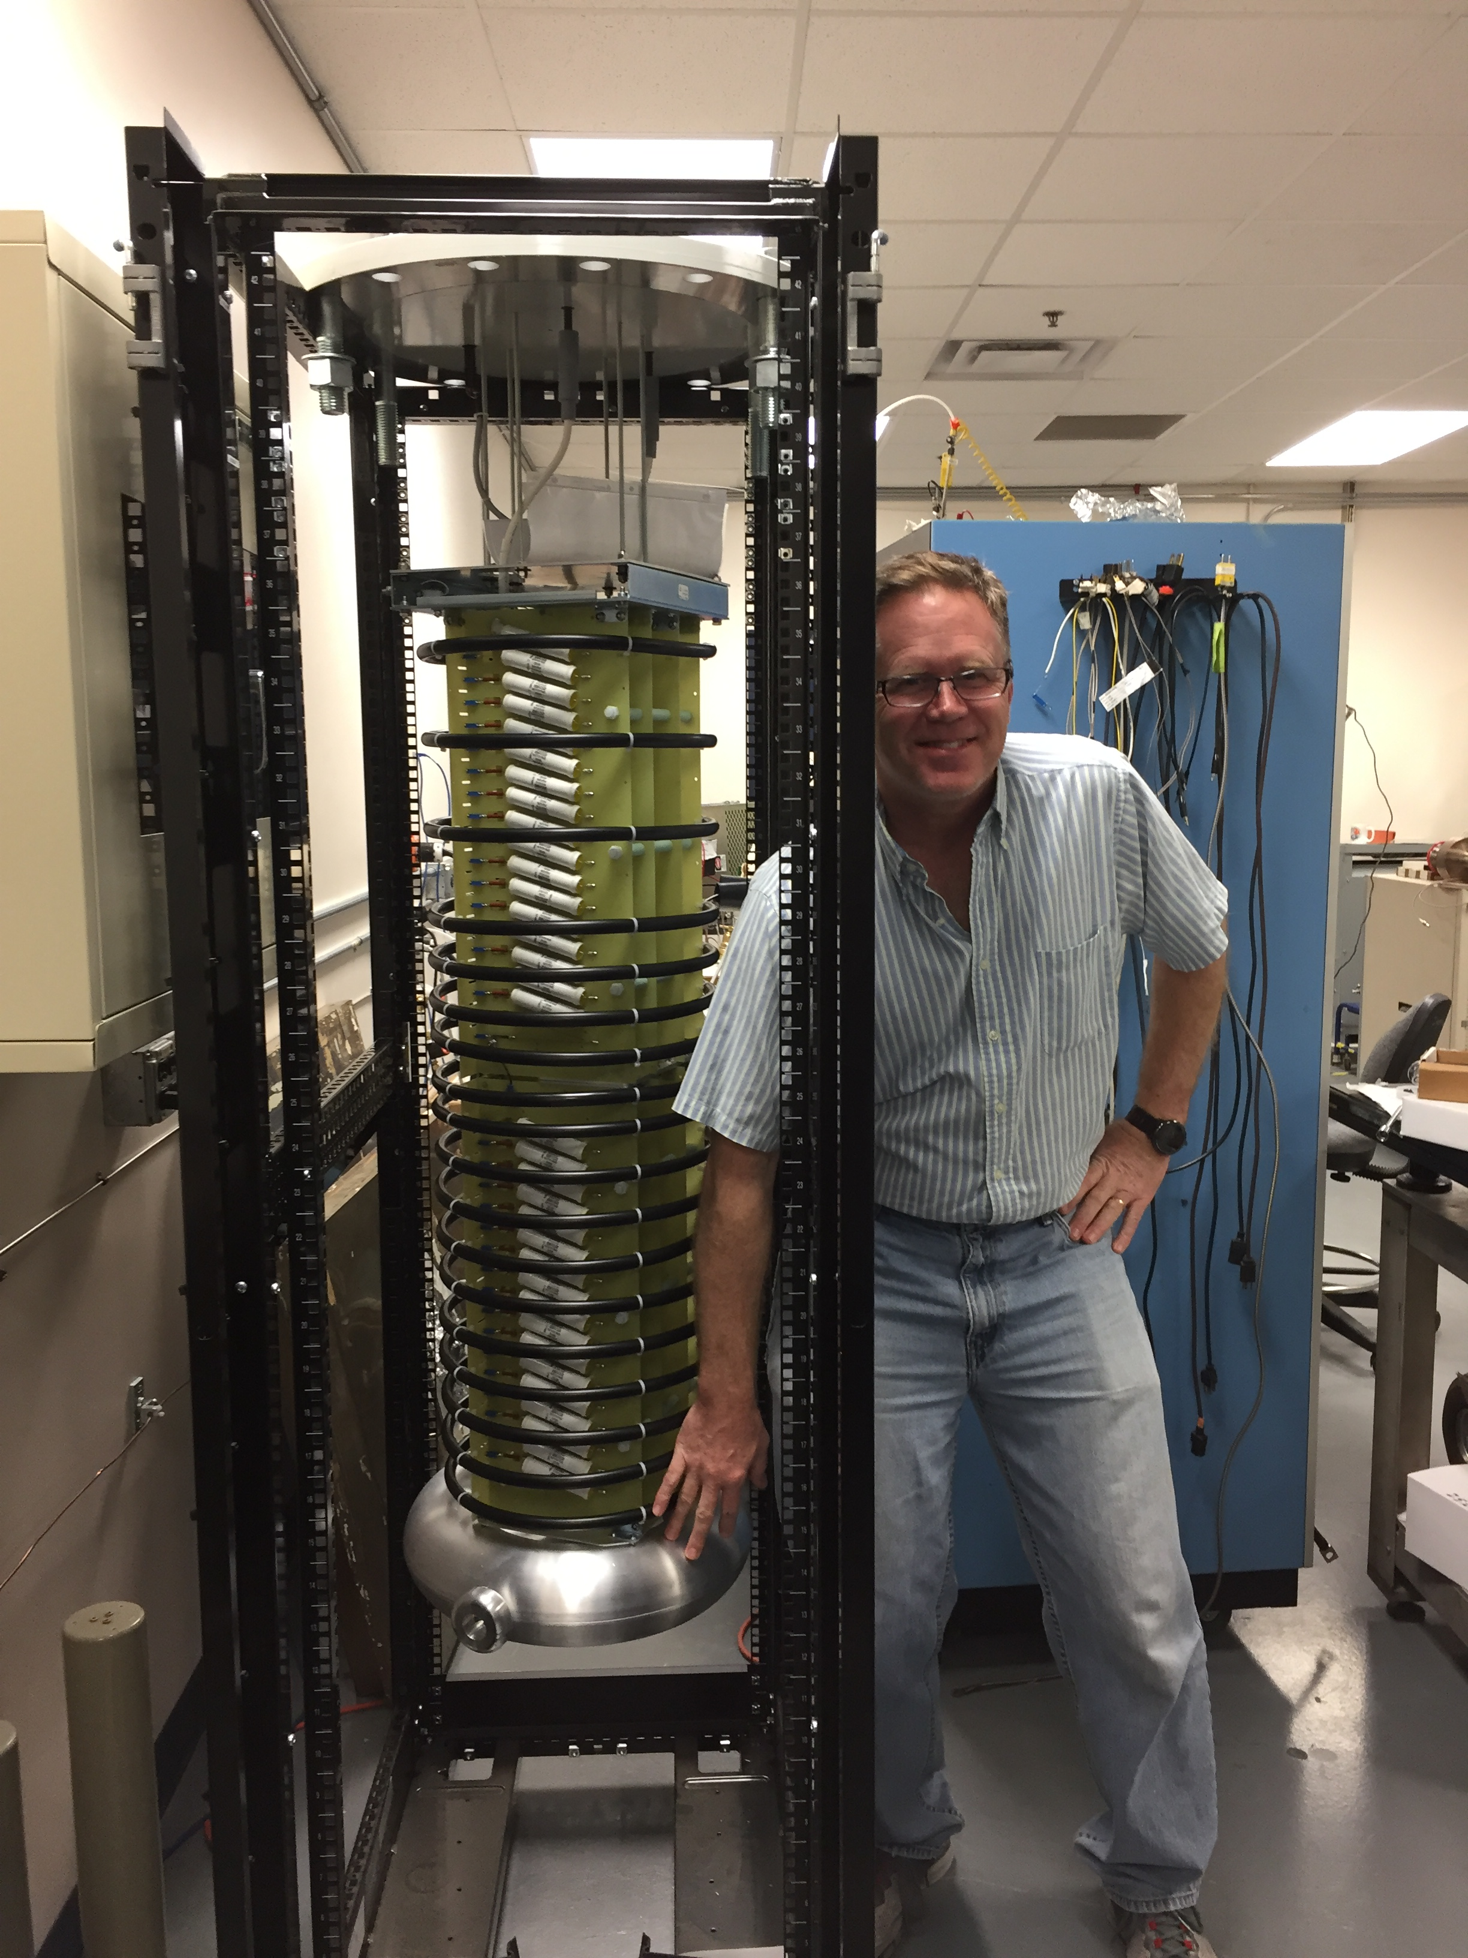
New Spellman 350 kV HVPS
Existing 150kV inadequate for upgraded gun
  SF6 pressure vessel delivered + plumbing/sensors ready
  Modifying stack for QE scans
  Major installation (safety systems, engineering, software)

Slide 15
New gun HV system simpler
NOW
HV Interlocks
PSS/MPS
Upgrade
HV Interlocks
PSS/MPS
ISB Rack
ISB Rack
Glassman (150kV)
Software
HV Enable
Knife Switch
Glassman (Control)
Software
HV Enable
Knife Switch
Bue Oil Tank
Ross Probe (1000:1)
Ross Probe DVM
Slow Lock (software)
HV Switch
Bias Switch
Battery Bias (cathode)
QE scan
Battery Bias (anode)
QE scan
Bus Bar
Gun Switches (x3)
Tunnel Penetration
Tunnel Penetration
Gun
350kV
HVPS
SF6 Tank
Gun
Little Oil Tank
Short
Resistor
Bus Bar
Resistor
SF6 Tank
Tunnel Floor
Tunnel Floor

Slide 16
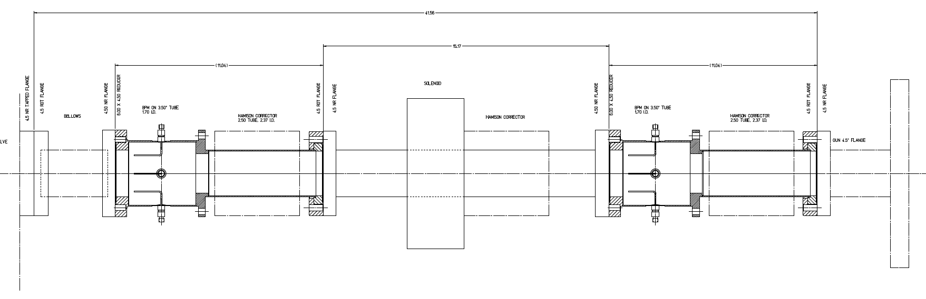
Upgrade NEG coated BPM beam pipe
Replace NEG coated pipe w/ one including BPM’s
  Improve spot move
  S/H for PQB tests
  Explore 2nd moment

Slide 17
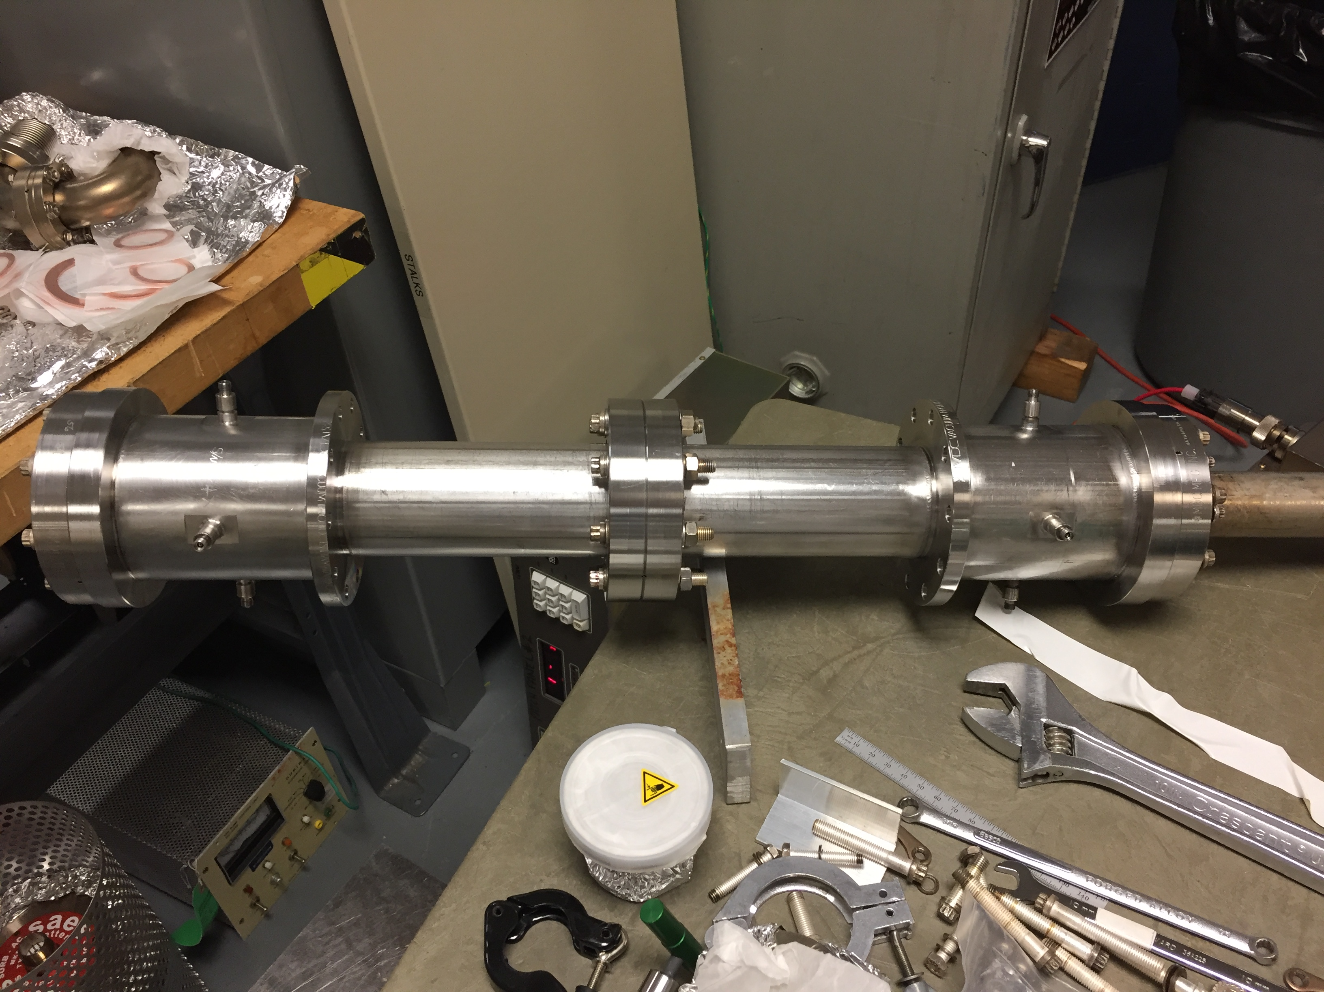
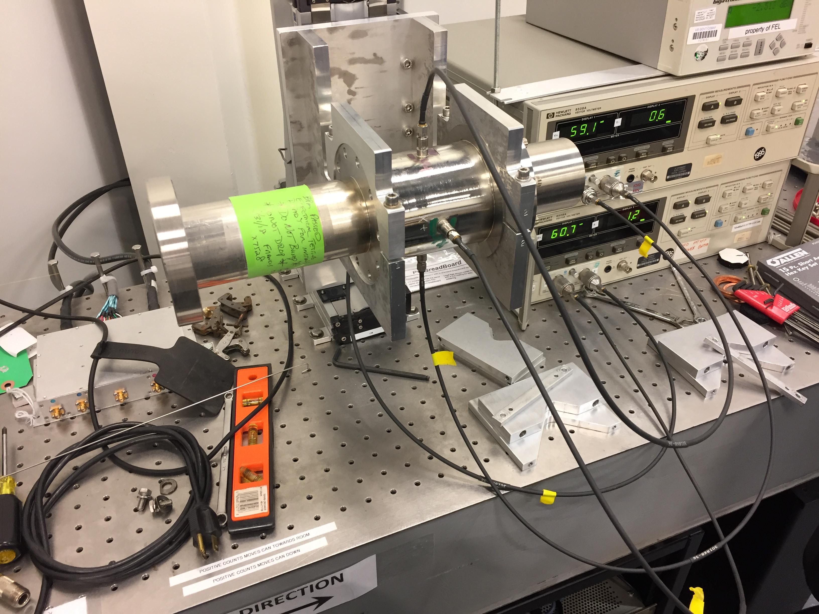
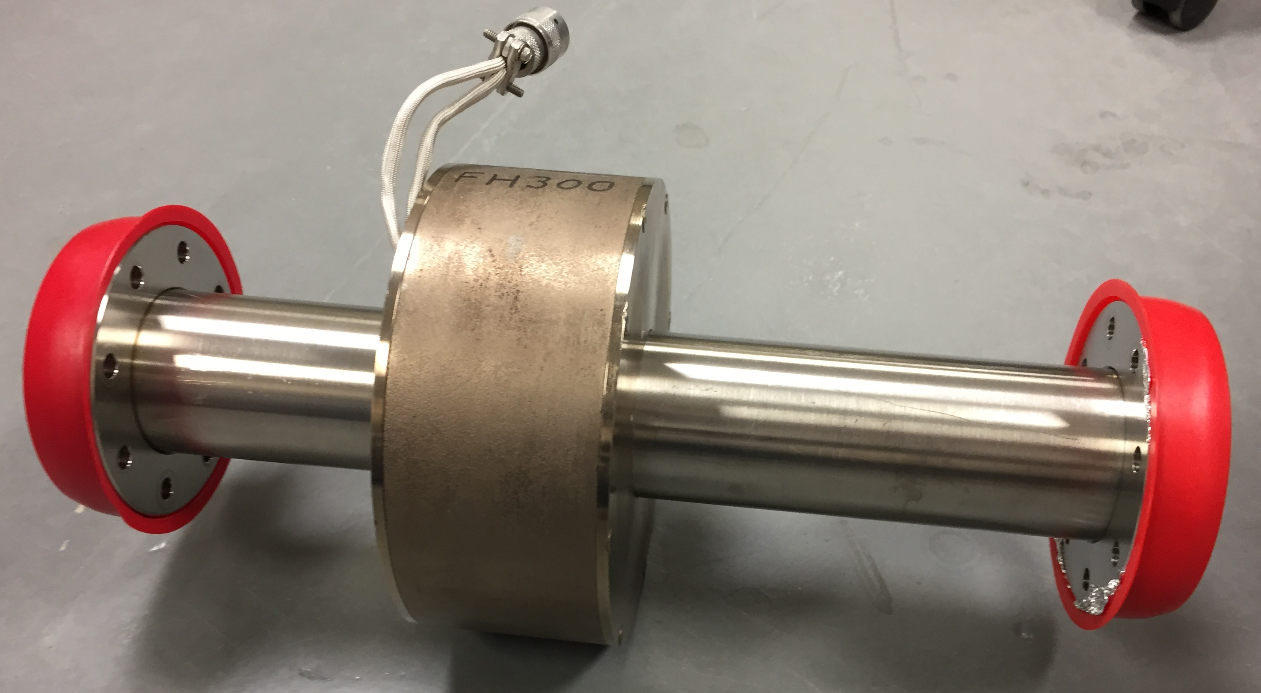
Plan A : Modify M20 spares on shelf (last year)
Plan A is happening, but repurposing existing M20’s w/ welded feedthroughs has proved cumbersome:
  Bake limited to 450C
  No fixture to repair leak
  Shield antennae from NEG coating
Status:
  Gabou mapping in progress
  Vacuum assembly test follows
Modified M20

Slide 18
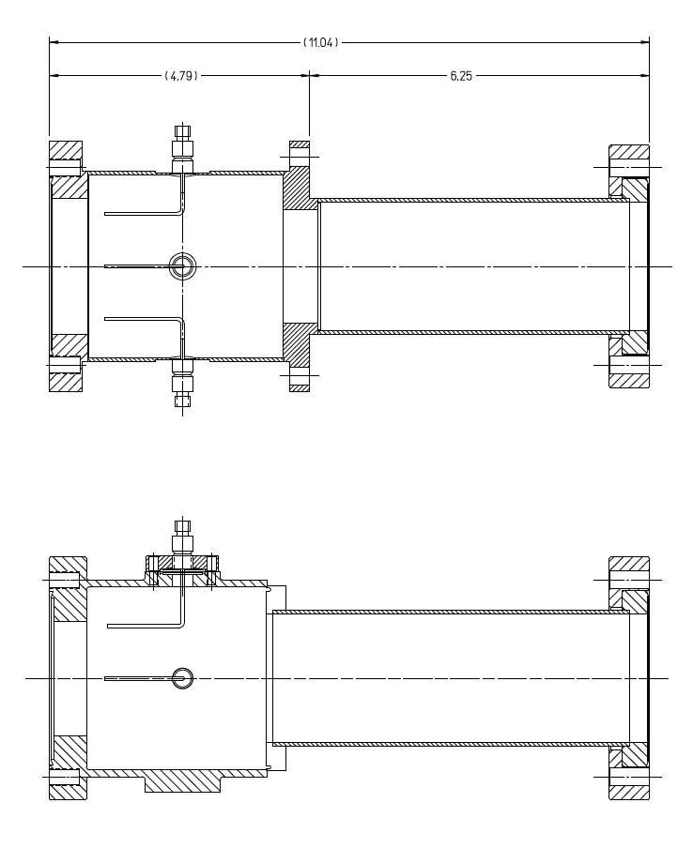
Plan B : New XHV M20
Plan B is a design aimed to achieve best vacuum:
  Antenna welded to mini CF
  Can may be 900C baked and coated in advance
  Machined tolerance to fixture antennae – yaw only gross degree of freedom
  Design robust to leaks
  Convenient to NEG coat
Status:
  Can design out for bid
  Electrical model in progress
Plan A
Plan B

Slide 19
Outline
CEBAF Polarized Source
  Simultaneous 4-Hall operation
  Source performance
Summer SAD 2018
  200 kV Gun
  350 kV HVPS
  NEG tube
Summer SAD 2019 and beyond…
  200 keV Wien filter
  Beamline Redesign
  Booster

Slide 20
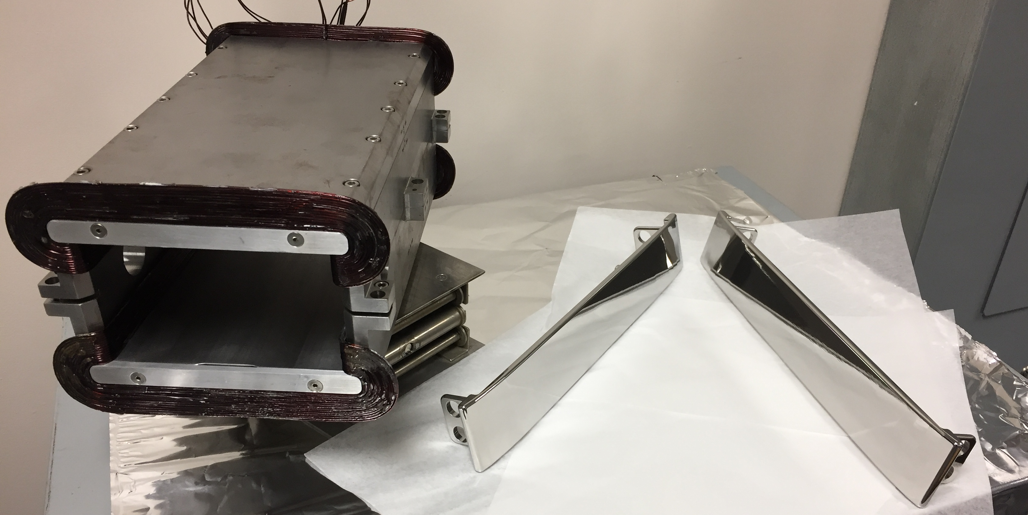
Upgrade 200 keV Wien filter
Upgrade the existing 130 keV Wien filters for 200 keV operation
Barrel polished electrodes and successfully tested to 20kV
Replace 14 kV supplies with 30 kV power supplies
Replace 10 A coils with 20 A coils (J. Benesch, JLAB-TN-15-032)
Wien Upgrade for 100 deg precession
Beam Voltage | keV | 200.00
Integrated BL | G-cm | 3993.86
Magnet Current | A | 15.36
Electric Field | MV/m | 2.67
Electrode High Voltage | kV | 20.05

Slide 21
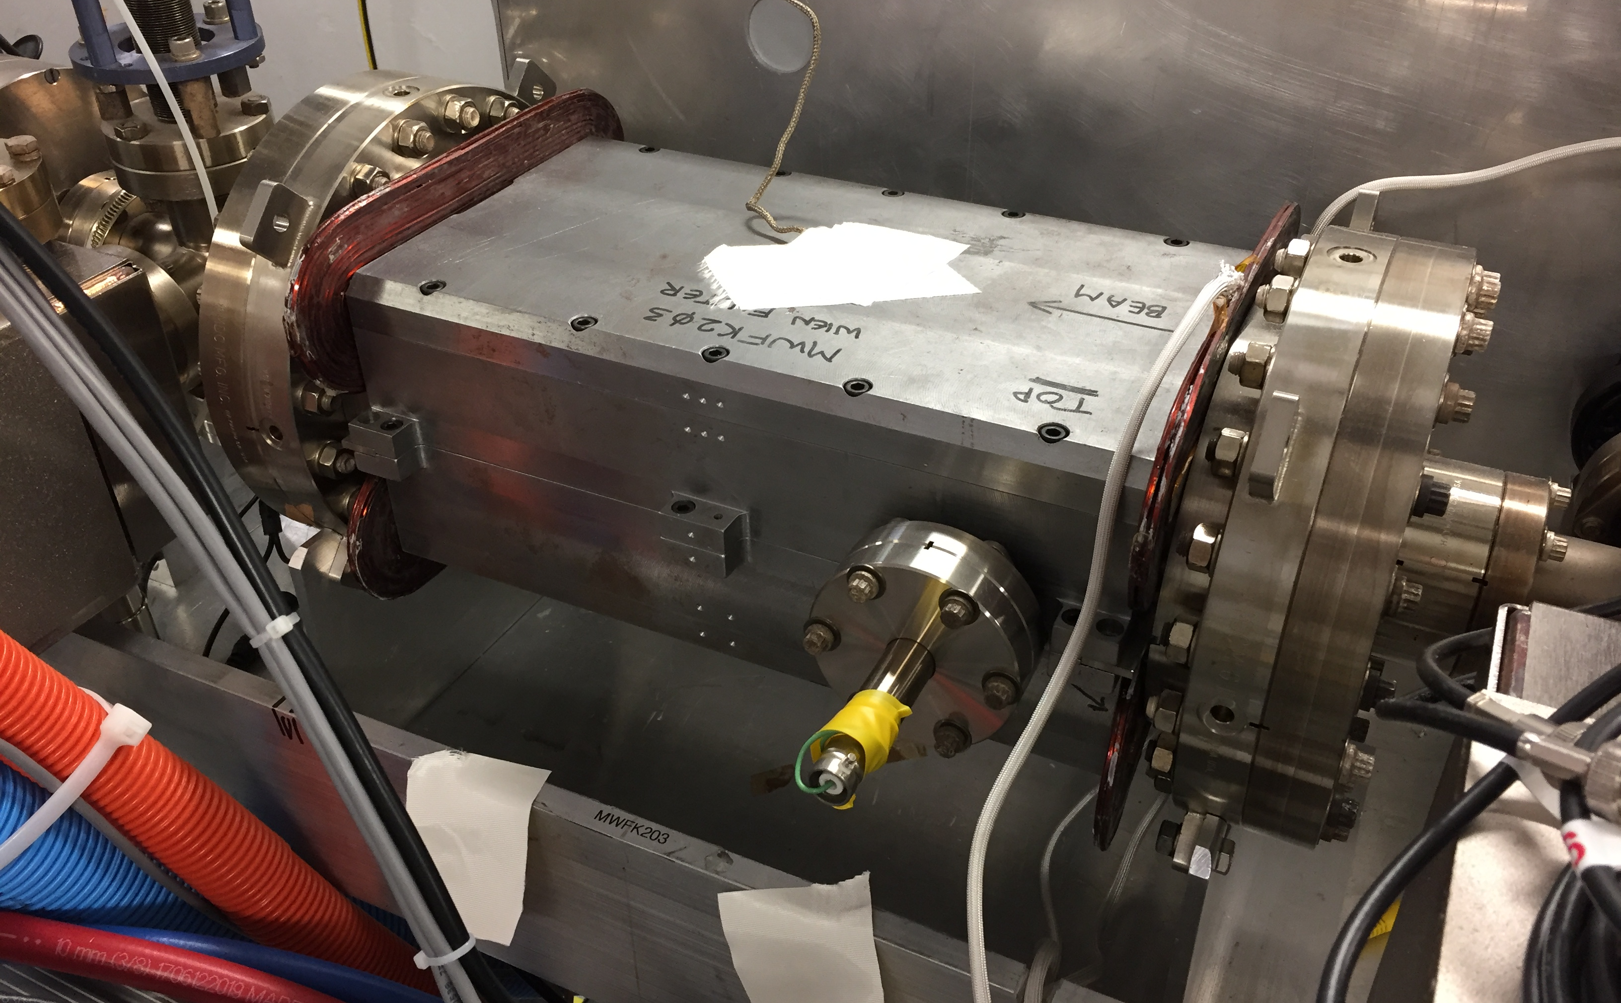
Under vacuum and magnet tested at UITF
Prototype Wien filter installed at UITF
Successfully powered to 15A (200kV requirement)
Machine shop working on 6 more coil pairs (improved design)
Software is working on communication to +/- 30kV Matsusada HVPS’s
Working with safety group to assess x-ray potential (60keV)

Slide 22
200 keV CEBAF : evaluating ME layout
New single gun Y-chamber
(delivered)
Retain Prebuncher
200 kV Gun
NEG w/ BPM’s
Repurpose INJTWF
(move bfore PB)
Simplify A1/A2 region

Slide 23
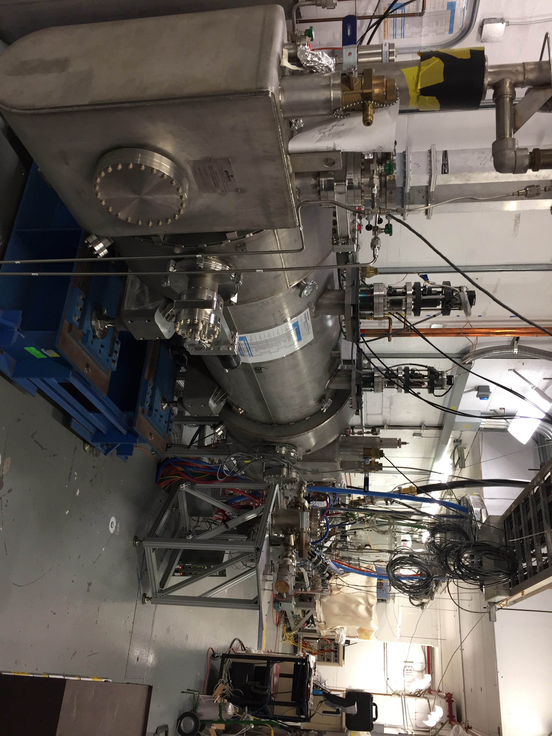
Testing new cryounit booster at UITF
Upgrade Cryounit Commissioning at Test Lab
  Nov 2017 – keV vacuum beam line connected
  Feb 2018 – 80K shield cooldown in progress
  March 2018 – application of klystron power

Slide 24
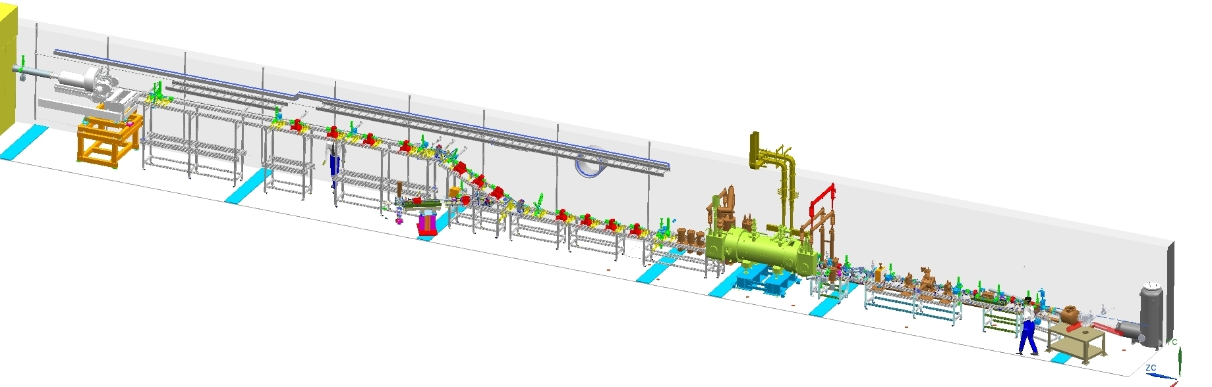
Testing new cryounit booster at UITF
Preparing for MeV beam commissioning
  Fabricating/installing immediate “straight” MeV section
  Completing design of horizontal spectrometer
  Planning to accelerate beam to MeV by ~August 2018
Now routinely running 200keV beam here
MeV spectrometer
Installing MeV vacuum beam line

Slide 25
Summary

