Slide 1
R30-4 gun
S&A during electrode assembly installation and laser retro-reflection evaluation
C. Hernandez-Garcia, G. Palacios-Serrano, M. Stutzman, B. Mares, C. Gould, S. Hardisty, R. Ammons
April 2024

Slide 2
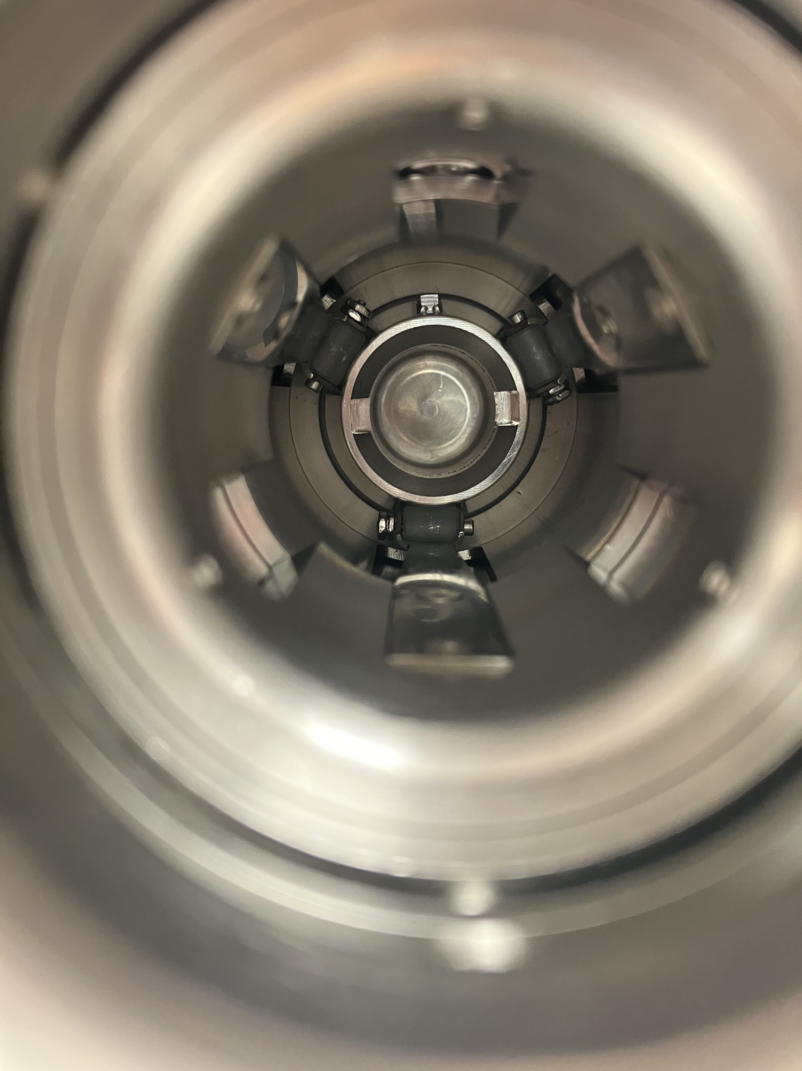
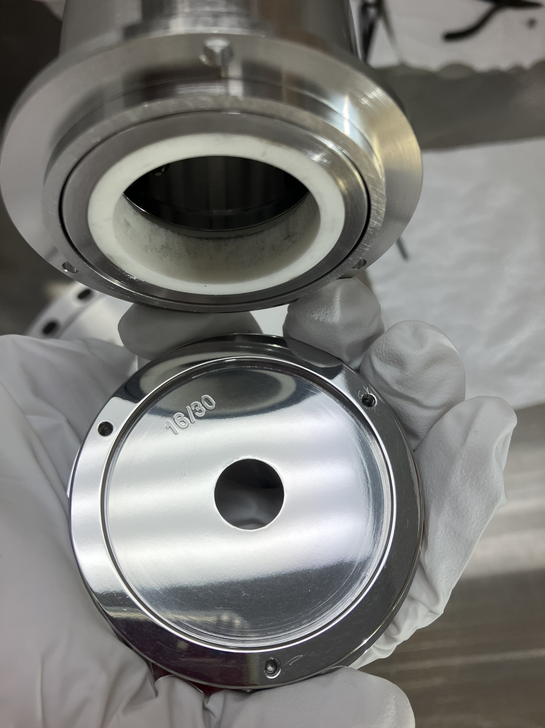
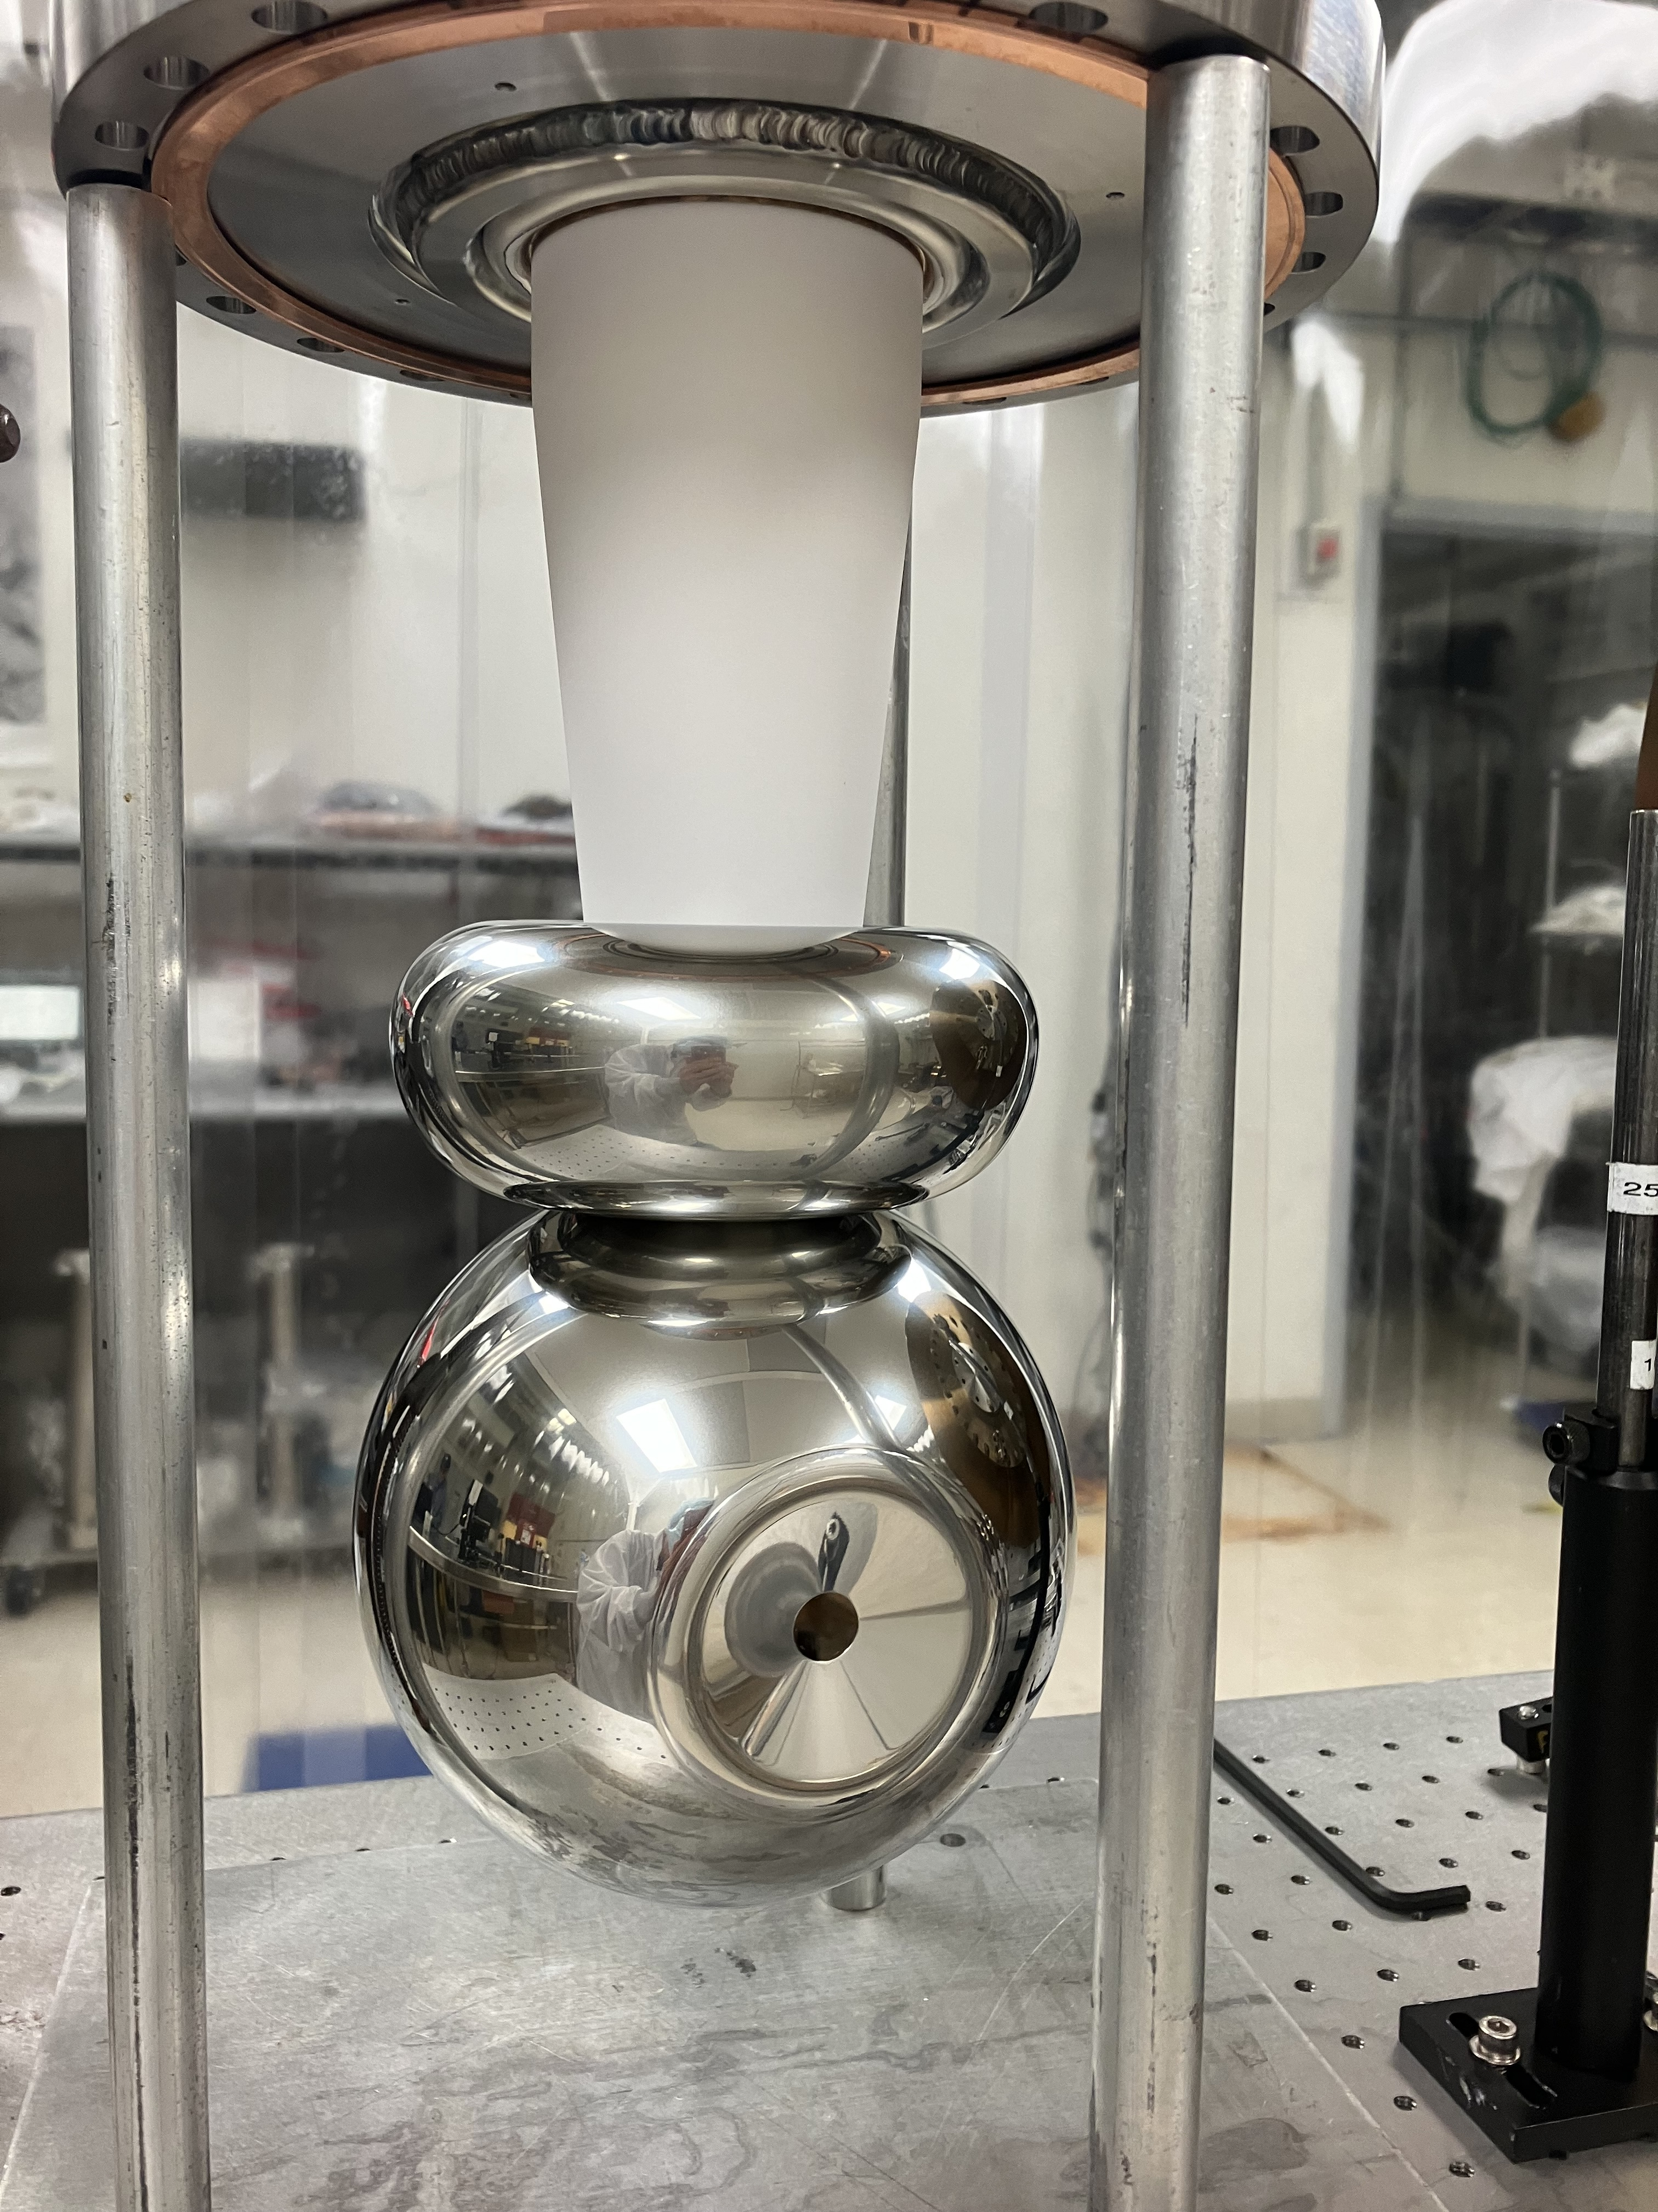
R30-4 gun electrode assembled on April 25, 2024 with 16/30 front end
R30-4 gun puck retainer assembly orientation
Up
Puck tab vertical at 12 o’clock orientation
Puck keys horizontal
Puck retainer spring at 6 o’clock orientation
R30-4 back end zoomed in showing orientation of puck retainer assembly to be used for installing puck with ear (tab) up

Slide 3
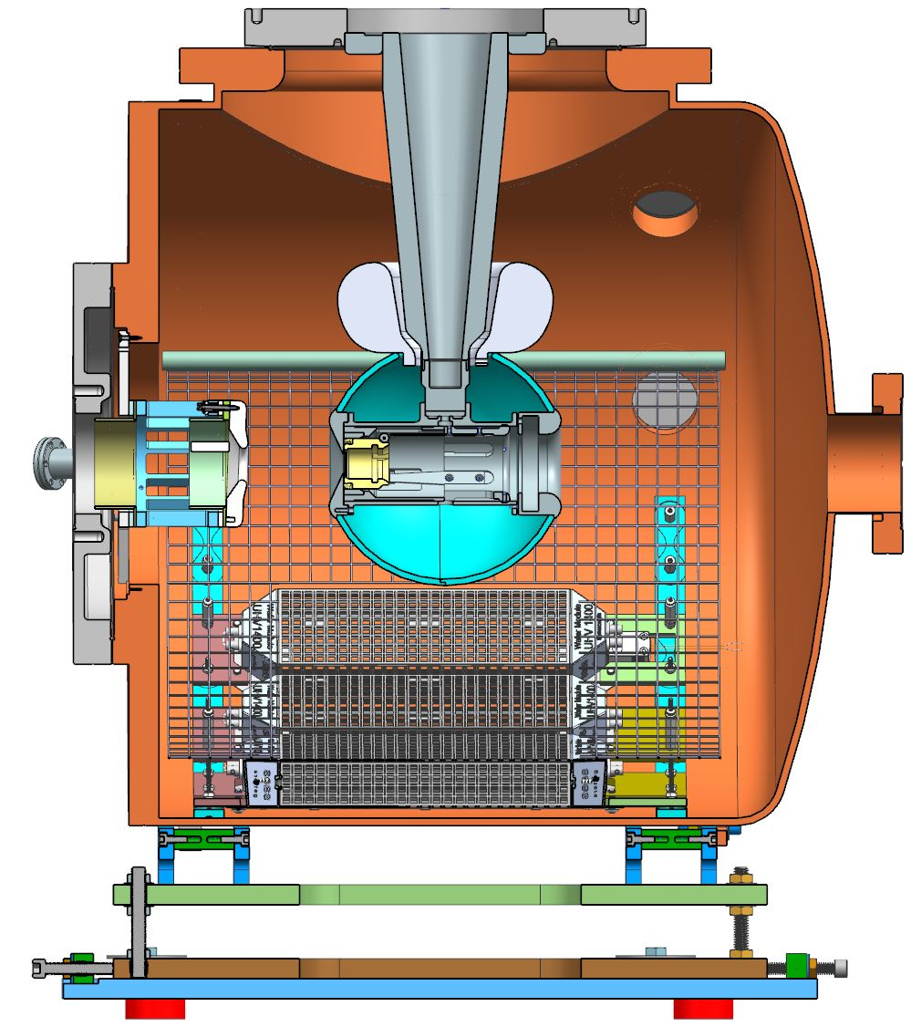
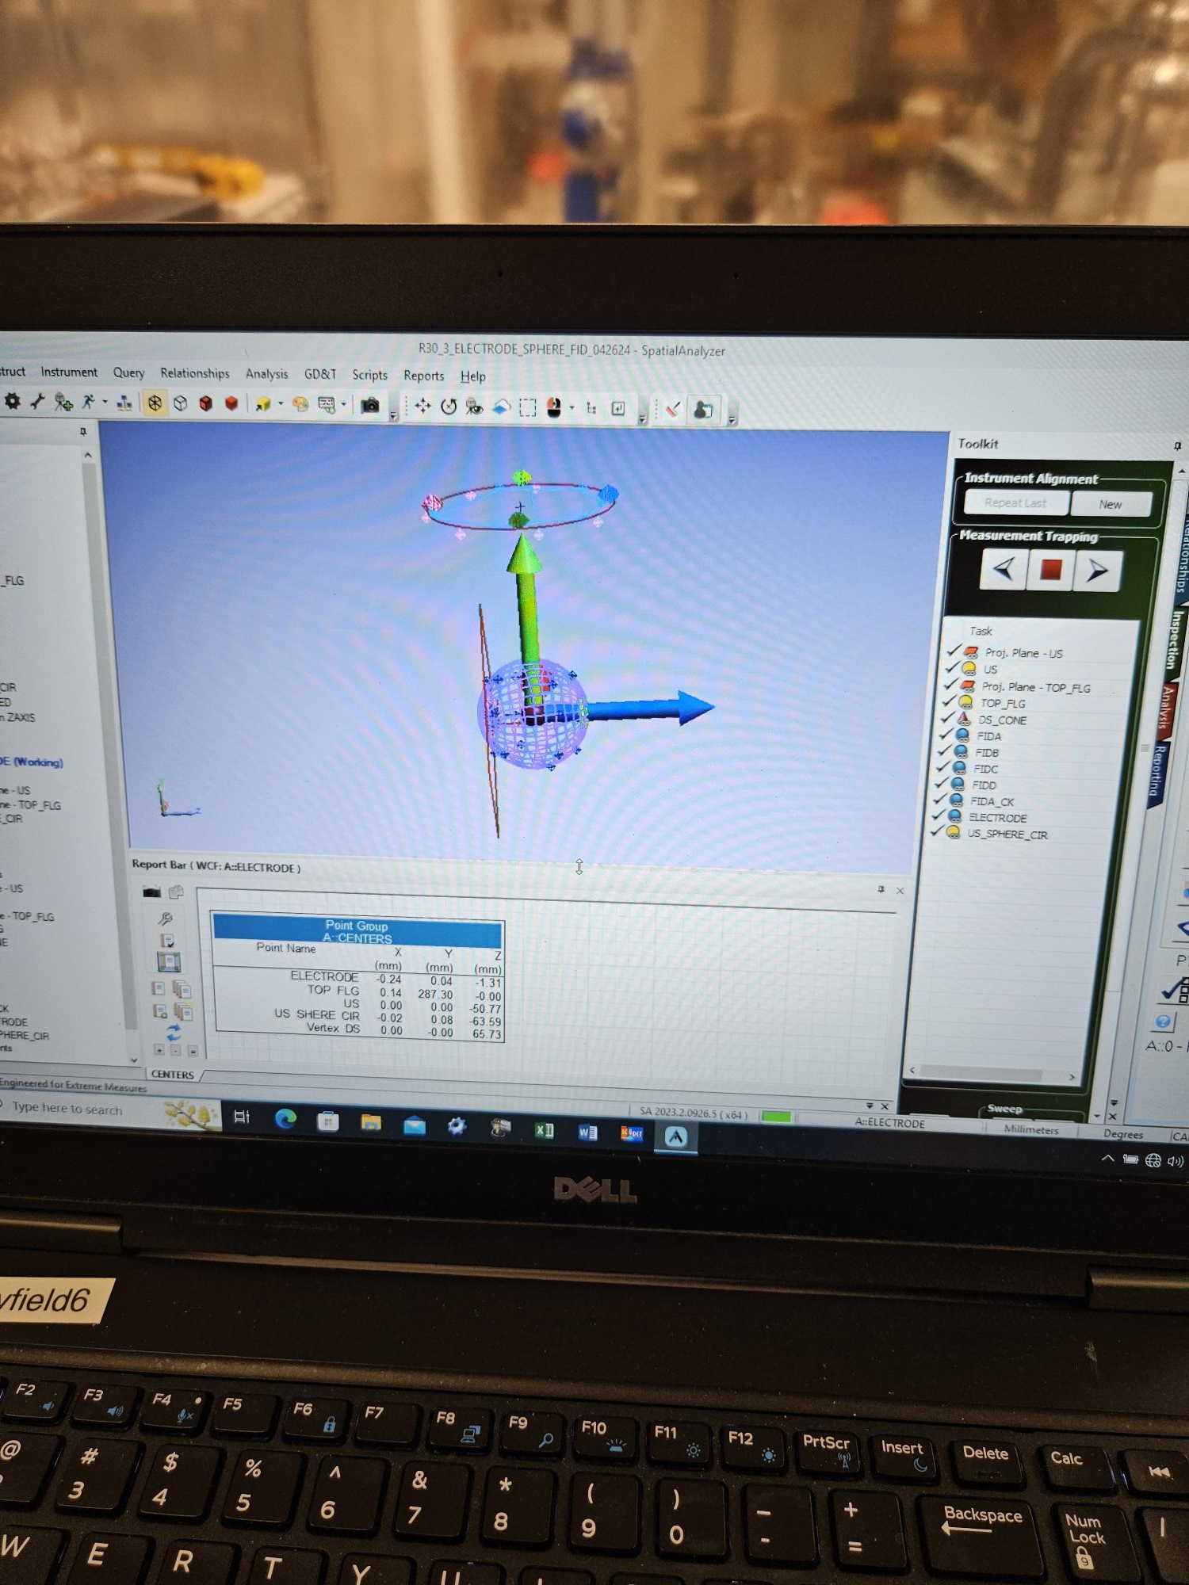
S&A setup to evaluate laser retro-reflection with R30-4 electrode installed to gun high voltage chamber
Puck plane
(mirror or GaAs)
Reflected laser spot measuring plane (card with pinhole)
The electrode z-axis is tilted down 0.124 deg with respect to chamber z-axis
532 nm laser beam path
Y reflected laser spot displacement (mm)
Reflected light angle is 2 X electrode angle
D = 1380 mm
S&A reports that the electrode z-axis is 0.124 deg pointing down wrt to the gun HVC z-axis

Slide 4
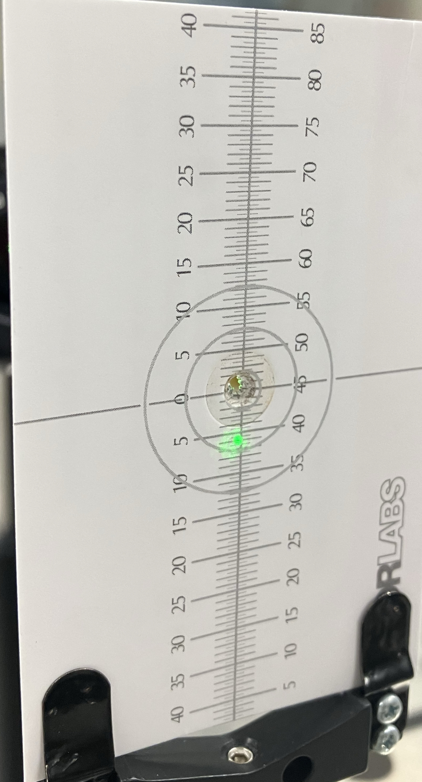
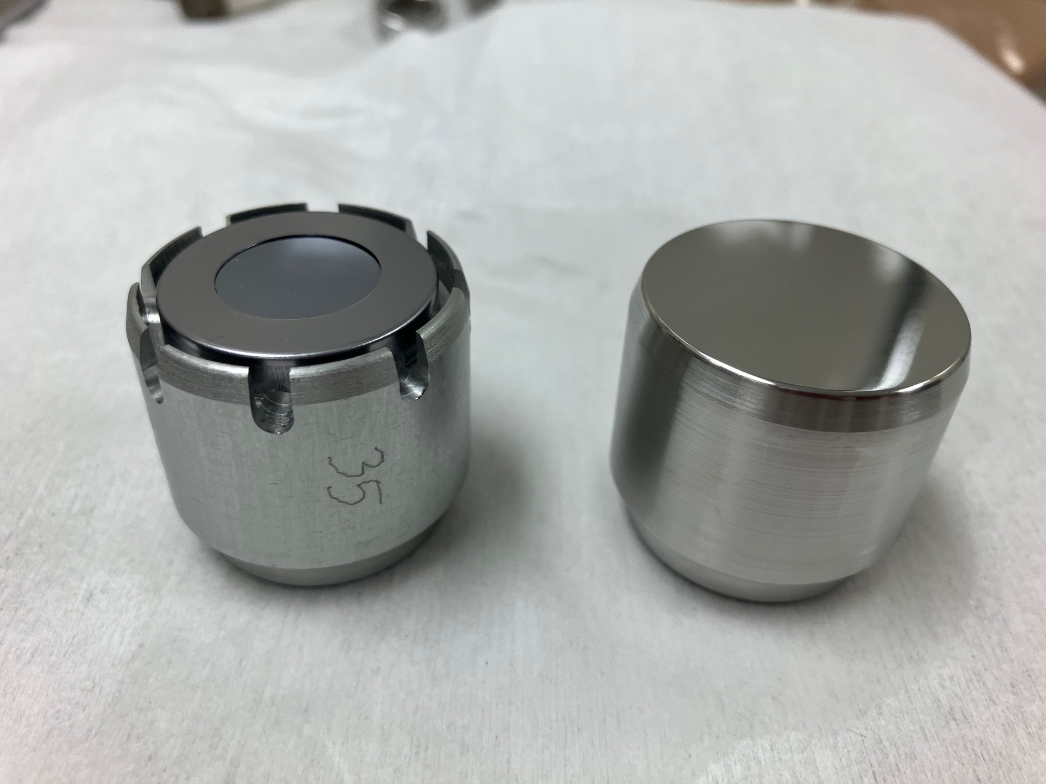
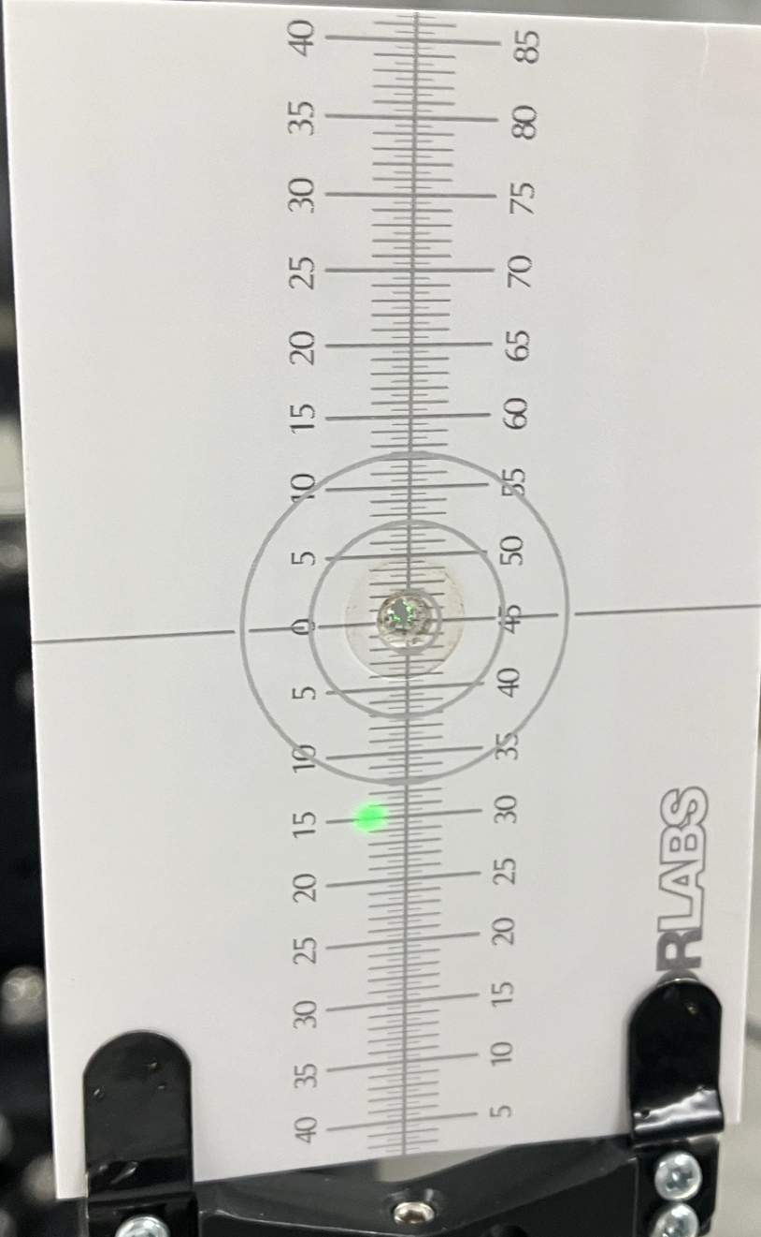
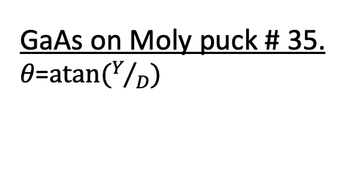
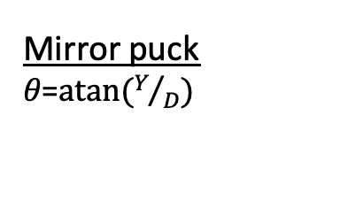
Laser colinear with R30-4 gun high voltage chamber z-axis
High voltage chamber
Mirror puck ear up
Mirror puck 𝜃=$atan⁡(Y/D)$
Y = 6 mm
D = 1380 mm
𝜃 = 0.249∘
Electrode z-axis angle = 𝜃/2 = 0.124∘
Agrees with S&A measurement
Electrode & mirror puck
𝜃 = 0.124 ∘
High voltage chamber
GaAs on Moly puck # 35. 𝜃=$atan⁡(Y/D)$
GaAs wafer on Moly puck # 35 ear up
Y = 15 mm
D = 1380 mm
𝜃 = 0.624∘
GaAs puck # 35 z-axis angle = 𝜃/2 = 0.312∘
Electrode & puck # 35
𝜃 = 0.312 ∘
Is the Moly puck z-axis tilted?
Or is the GaAs wafer plane tilted wrt to the moly puck z-axis?

Slide 5
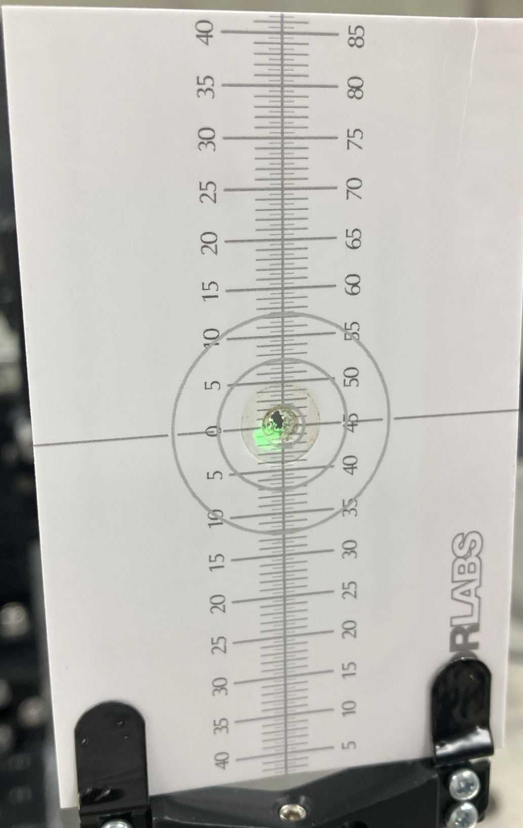
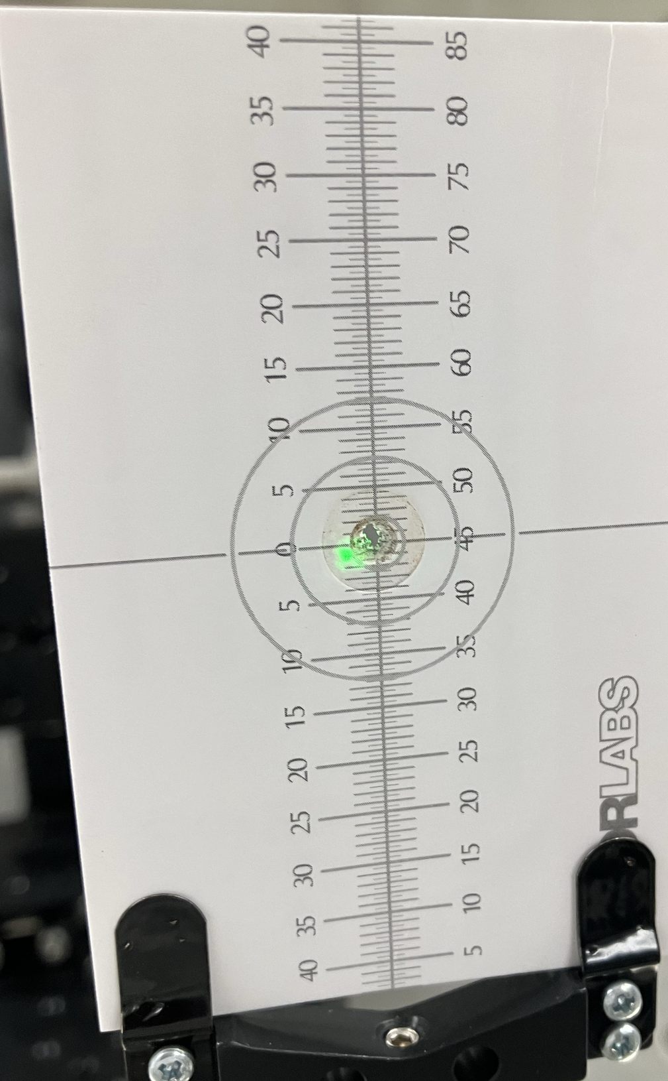
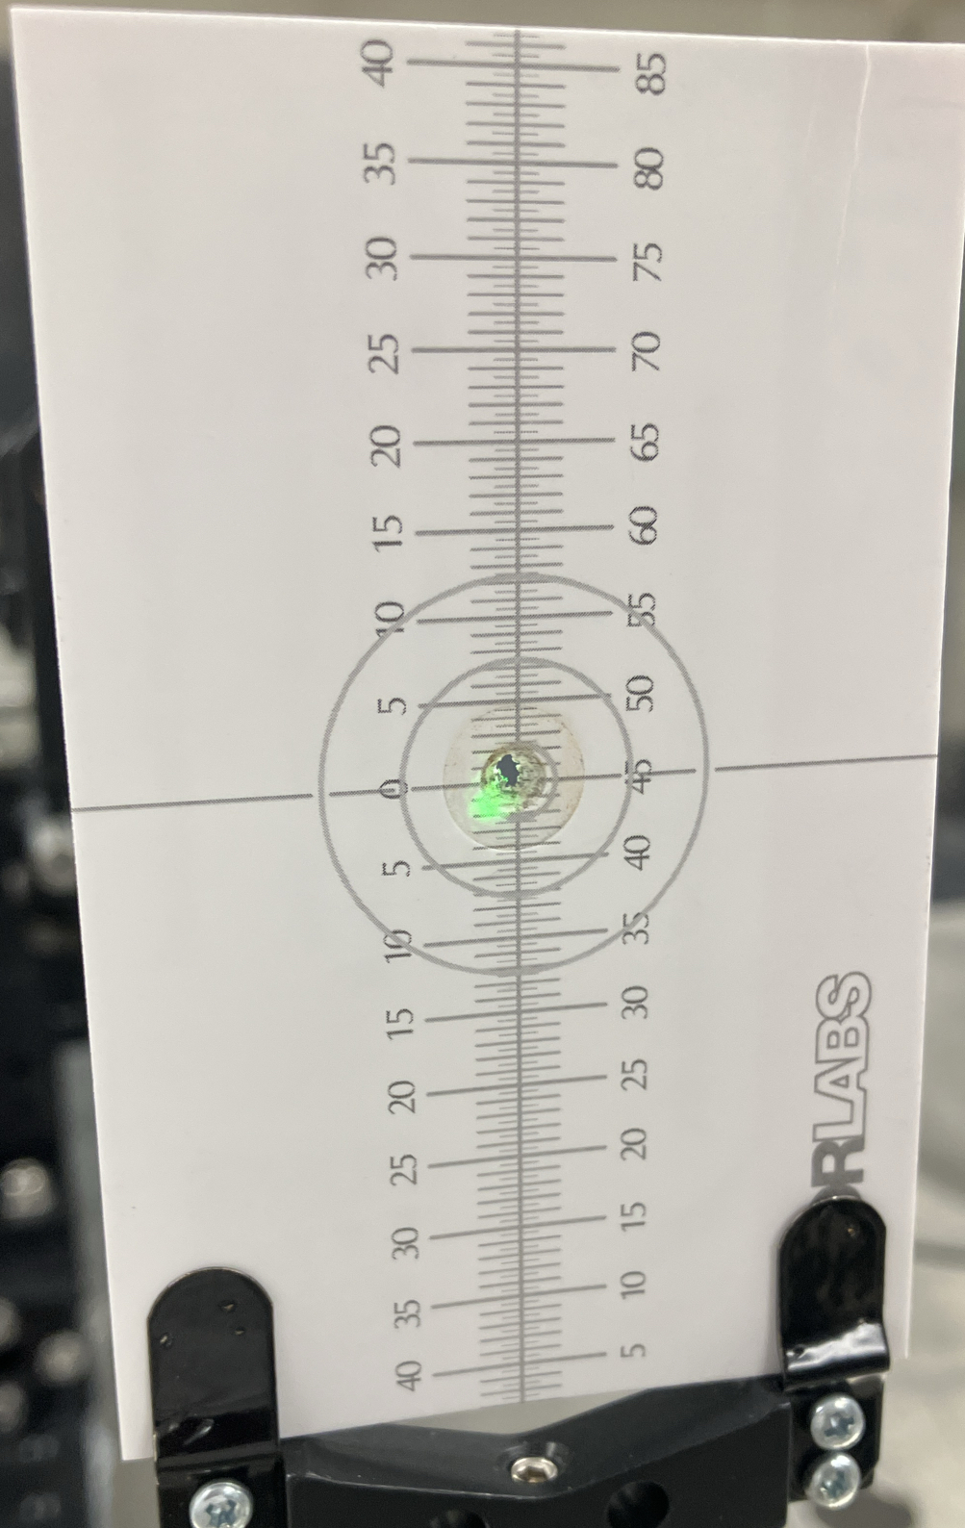
Laser colinear with R30-4 gun electrode z-axis
Mirror Puck
Ear to the left
Ear up
Ear to the right

Slide 6
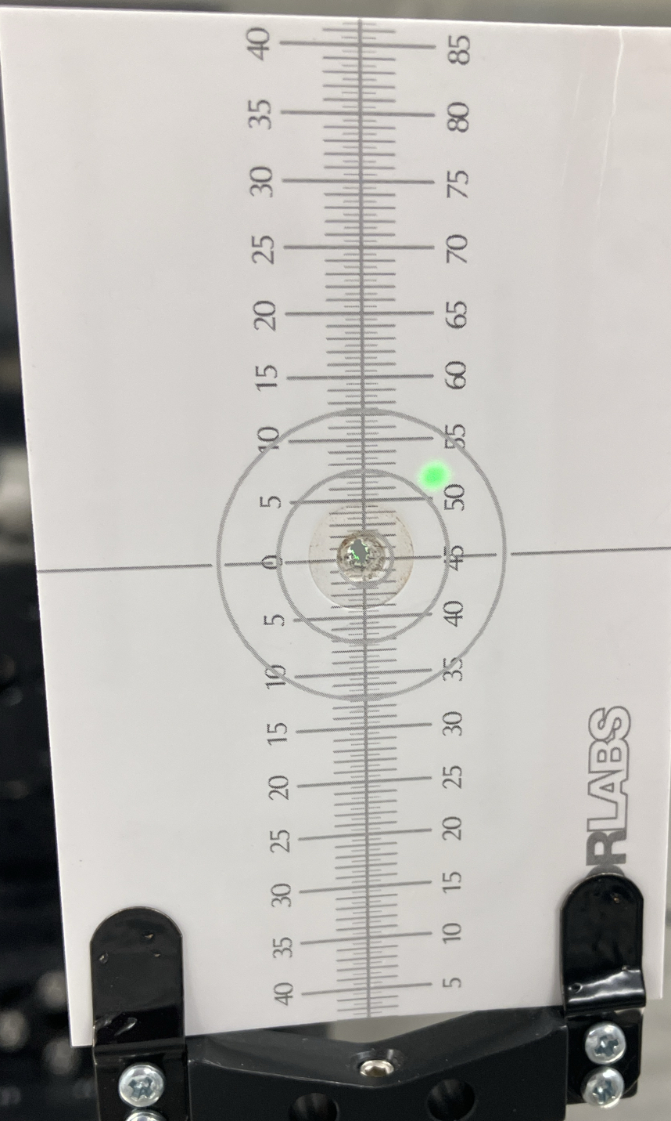
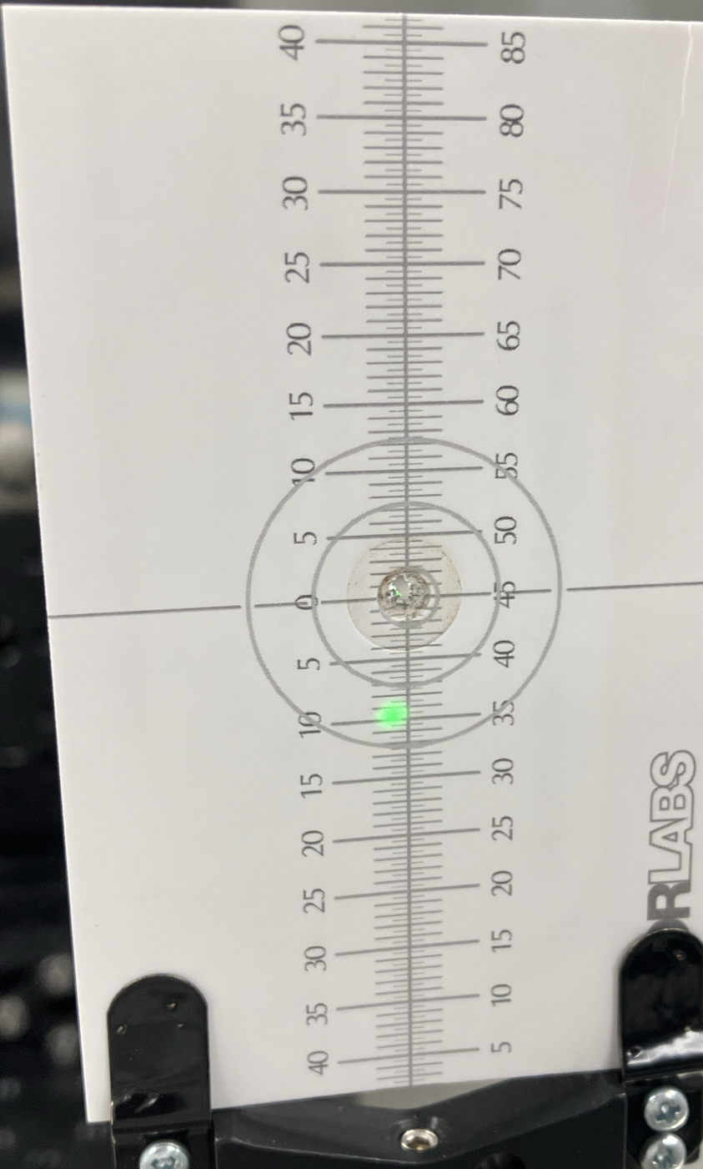
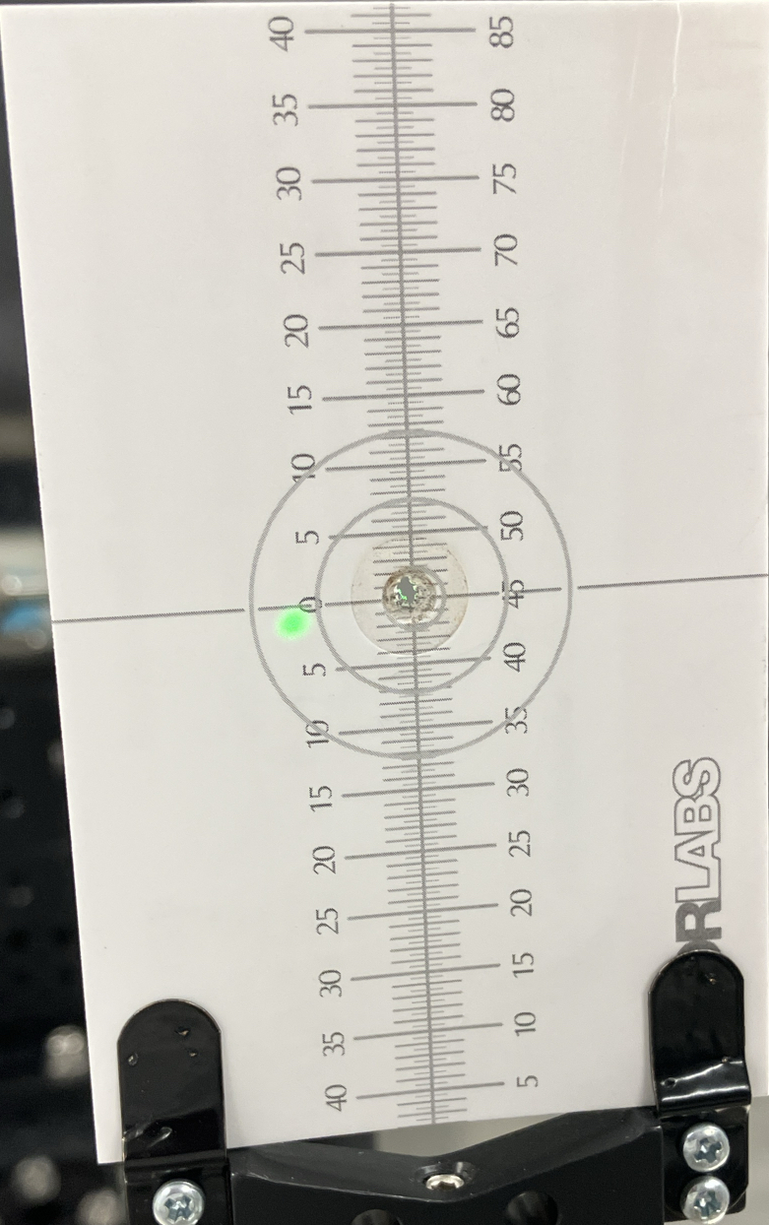
Laser colinear with R30-4 gun electrode z-axis
GaAs on Puck # 35
Ear to the left
Ear up
Ear to the right
The rotation (same r = 9 mm) of the reflected laser spot indicates the GaAs plane is not parallel to that of the puck

Slide 7
A 50 micron gap offset in the GaAs wafer wrt to the puck plane explains the observed laser retro-reflection spot displacement and rotation
𝛼 = 0.188 ∘
X = Y∙tan (0.188 ∘) = 0.048 mm or ~ 50 microns
Indium foil is 50 microns thick
Y= 15 mm
𝜃 = 0.124 ∘
𝛽 = 0.312 ∘
𝛼 = 0.312- 0.124 ∘
𝛼 = 0.188 ∘

