Slide 1
Injectors and Sources
Operations and R&D
M. Poelker
Jefferson Lab Accelerator Advisory Committee Mtg., September 13-15, 2017

Slide 2
Outline
Matt: Record level QE from High Polarization Photocathode with Distributed Bragg Reflector (DBR)
Carlos: Photogun with Inverted-Insulator geometry, 300 kV design
Mamun: Magnetized beam for JLEIC
Joe: Evaluating the performance of CEBAF polarized injector at milliampere beam current, for a possible polarized positron source
Notes:
Interior Page Design 2

Slide 3
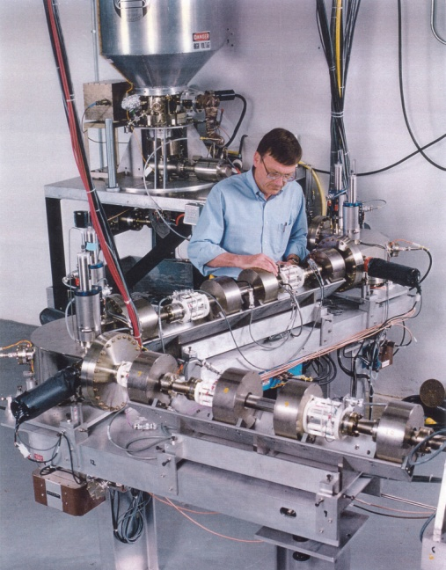
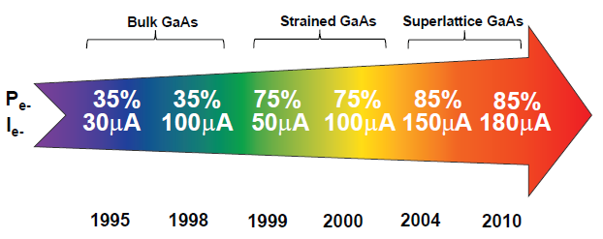
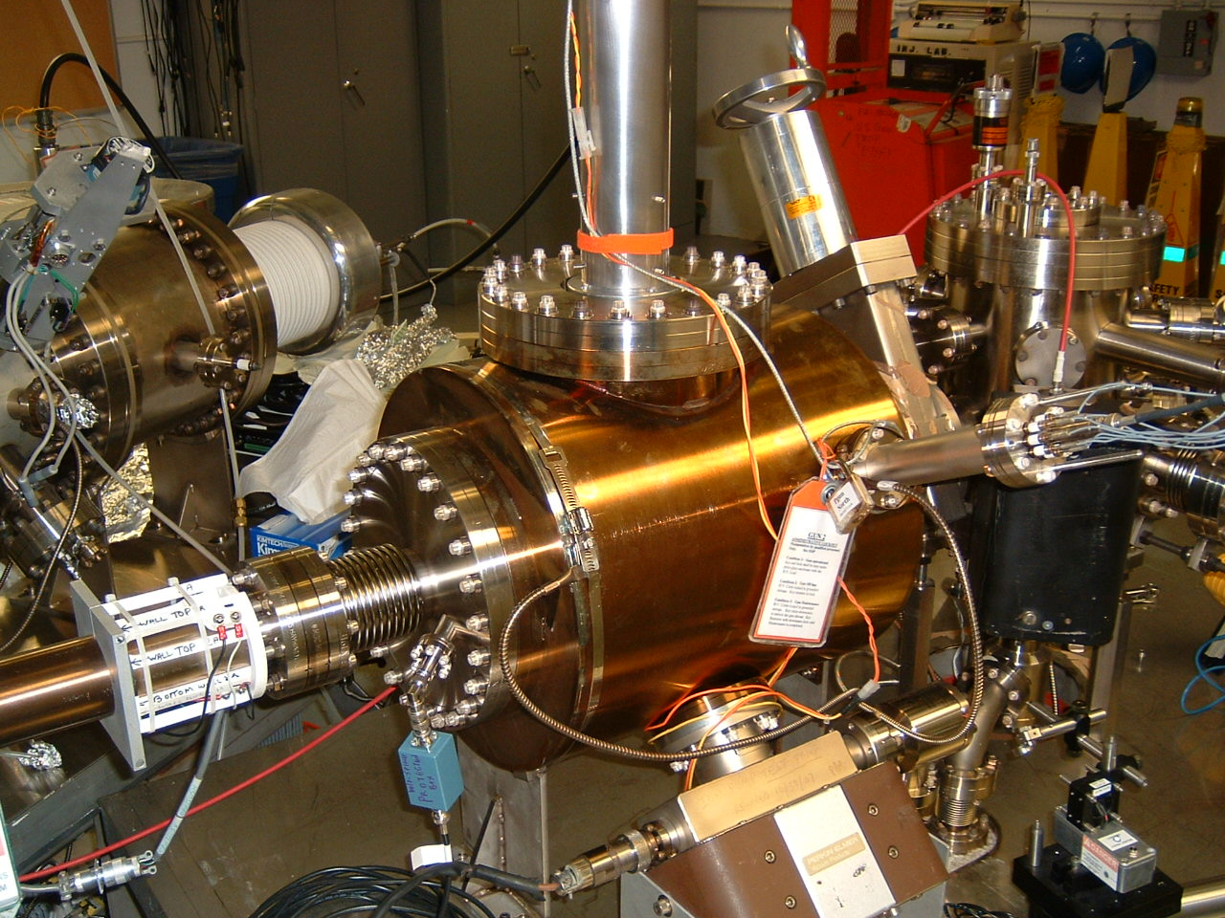
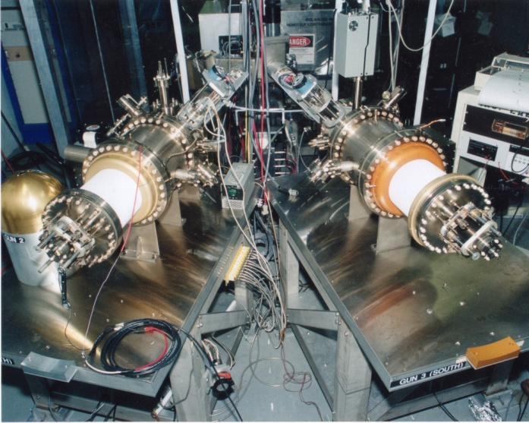
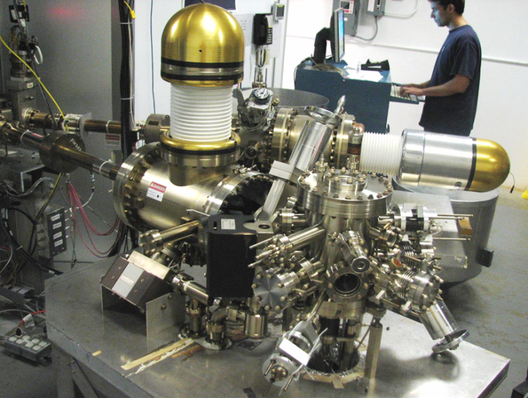
Always Tweaking the Design
1
4
Lifetime increased from 10s to 100s of Coulombs
The endless (?) quest for perfection
2
3
Notes:
Interior Page Design 1

Slide 4
Key Features of a Polarized Photogun
Photocathode
High Polarization
High QE (photoemission yield)
Long Lifetime
Vacuum
Static Vacuum
Dynamic Vacuum
High Voltage
Must eliminate field emission
Drive Laser
Reliable, phase locked to machine
Adequate Power
Wavelength Tunable
Notes:
Interior Page Design 2

Slide 5
Key Features of a Polarized Photogun
Photocathode
High Polarization
High QE (photoemission yield)
Long Lifetime (how to increase from 100s to 1000s Coulombs?)
Vacuum
Static Vacuum
Dynamic Vacuum
High Voltage
Must eliminate field emission
Drive Laser
Reliable, phase locked to machine
Adequate Power
Wavelength Tunable
Notes:
Interior Page Design 2

Slide 6
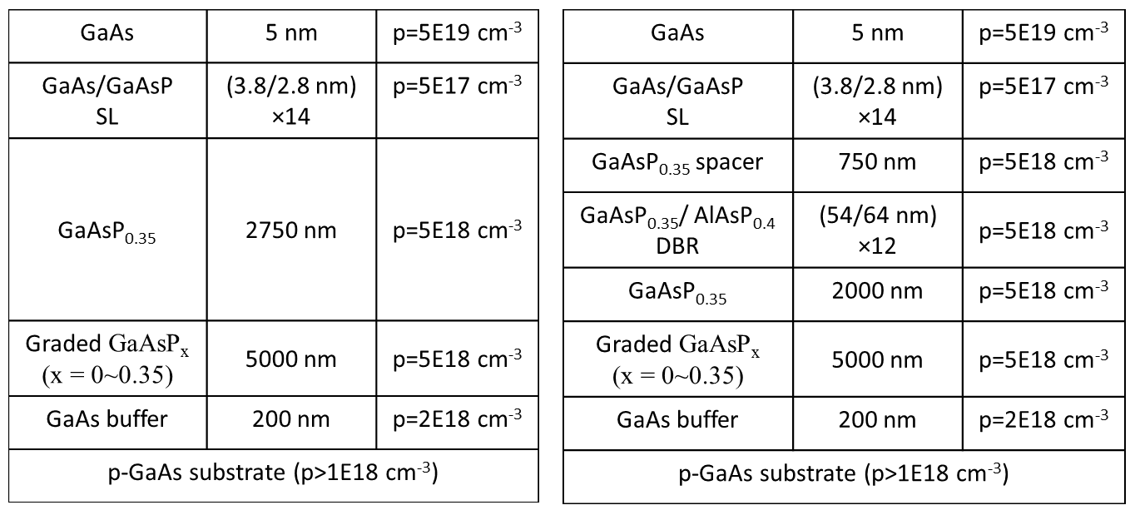
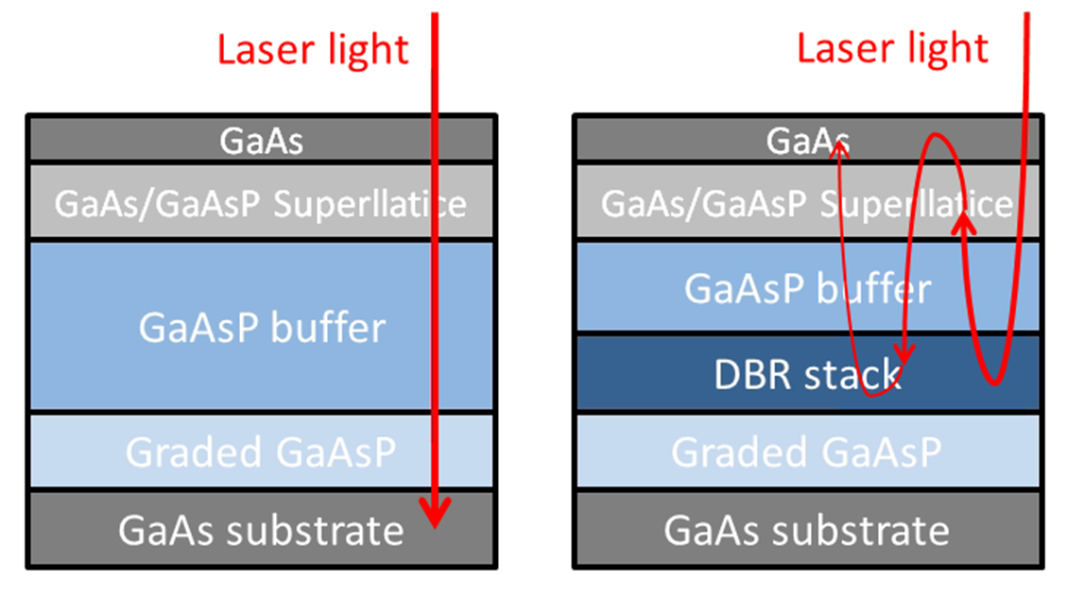
Benefits of Distributed Bragg Reflector
non-DBR Photocathode : absorption in the GaAs/GaAsP superlattice < 5%
Most light passes into the substrate leading to unwanted heating
DBR photocathode : absorption in the GaAs/GaAsP superlattice > 20%
Less light required to make required beam, less light means less heat
Great for high current initiatives like polarized positrons at CEBAF and EIC
Enhanced absorption occurs only at specific laser wavelengths
Photocathode without DBR
Photocathode with DBR
(57 layers!)
Non-DBR photocathode
DBR photocathode

Slide 7
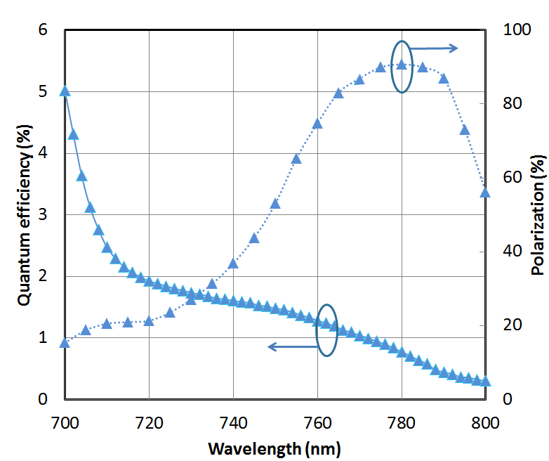
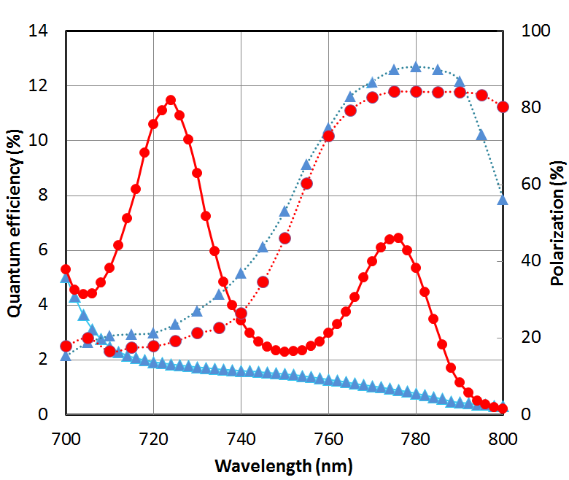
World Record QE from High Polarization Photocathode
Others have tried…but very difficult to obtain QE enhancement at the laser wavelength that also provides high polarization, CEBAF lasers operate at ~ 776 nm (doubled-telecom lasers)
Standard strained-superlattice
QE = 0.89%
Polarization = 92%
DBR
QE = 6.4%
Polarization = 84%
The highest reported QE of any high polarization photocathode
Excellent candidate for mA operations, will test at CEBAF this shutdown
SBIR partnership
W. Liu, S. Zhang, M. Stutzman, M. Poelker, Y. Chen, W. Lu, and A. Moy, Appl. Phys. Lett. 109, 252104 (2016)

Slide 8
New Photoguns for…
CEBAF Injector Full-Energy Upgrade
Replace 130 kV gun with 200 kV gun
Upgraded Injector Test Facility
Commission new hardware destined for CEBAF: 200kV gun, HDIce, new quarter cryomodule, etc.,
R&D: polarized positron source, Bubble Chamber astrophysics experiment, produce polarized targets for physics, etc.,
JLab Electron Ion Collider
Higher voltage polarized gun for higher bunch charge
Very high average current un-polarized beams for cooling ions – magnetized cooling
LERF/FEL
Replace vent/bake gun with load locked gun
Use alkali-antimonide photocathode instead of GaAs
Notes:
Interior Page Design 2

Slide 9
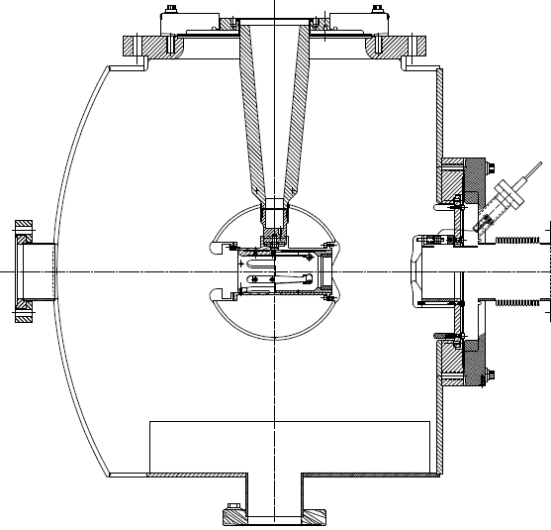
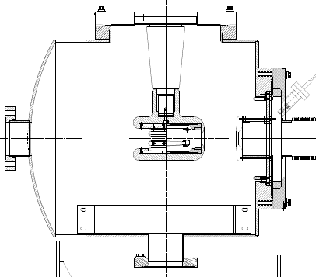
Inverted-Insulator Photoguns
CEBAF 130 kV, used since 2010
350 kV gun for GTS and UITF
Longer “R30” insulator
Spherical electrode
(At 350 kV, beam is sufficiently relativistic, don’t need a “capture” section )
Notes:
Interior Page Design 2

Slide 10
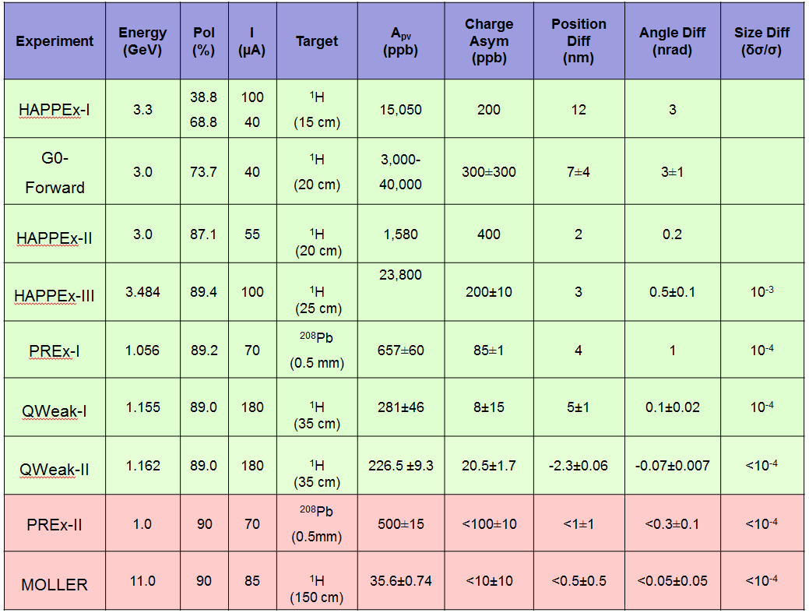
Parity Table
Upgrading the CEBAF Injector will help us conduct PREx, CREx and proposed parity violation experiments that are even more demanding
Notes:
Interior Page Design 2

Slide 11
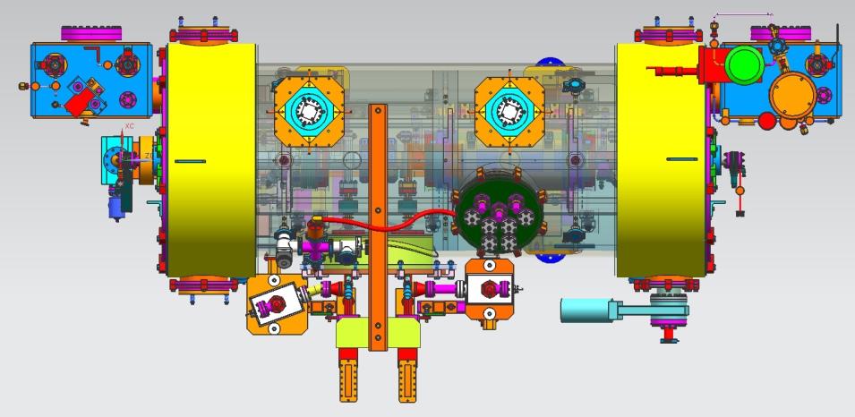
Injector Upgrade
200 kV
Increase gun voltage, modify Wien filters for 200kV operation
Improve baked beam line vacuum so gun does not pump on beam line
Locate H-Wien (energy filter) upstream of pre-buncher cavity
New SRF booster eliminates warm capture, RF deflection and x/y coupling
Our new “1/4 cryomodule”, or QCM:
2 cell capture section + 7 cell cavity,
should provide 10 MeV beam and introduce no x/y coupling, allow better matching, more adiabatic damping

Slide 12
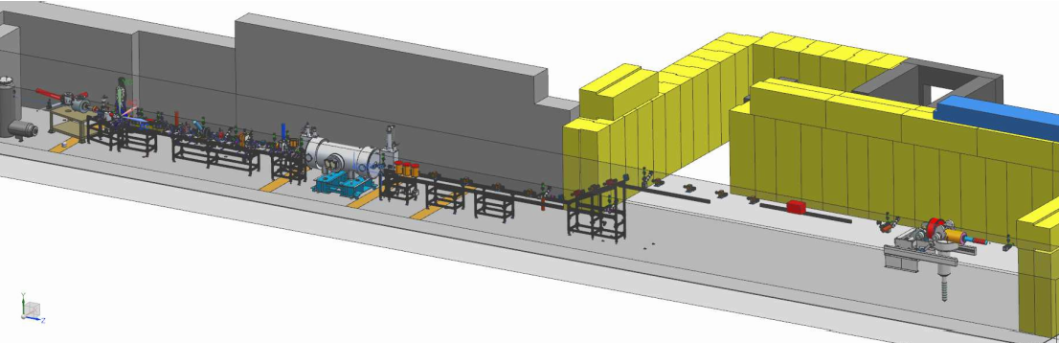
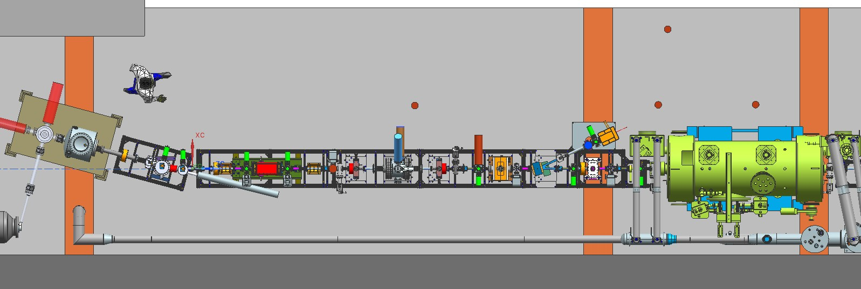
Upgraded Injector Test Facility - UITF
TEST HDIce
TEST NEW PHOTOGUNS
TEST 200 kV WIEN FILTER
COMMISSION NEW QUARTER CRYOMODULE
UITF beamline has BPMs, pockels cell tests can happen here…..
12

Slide 13
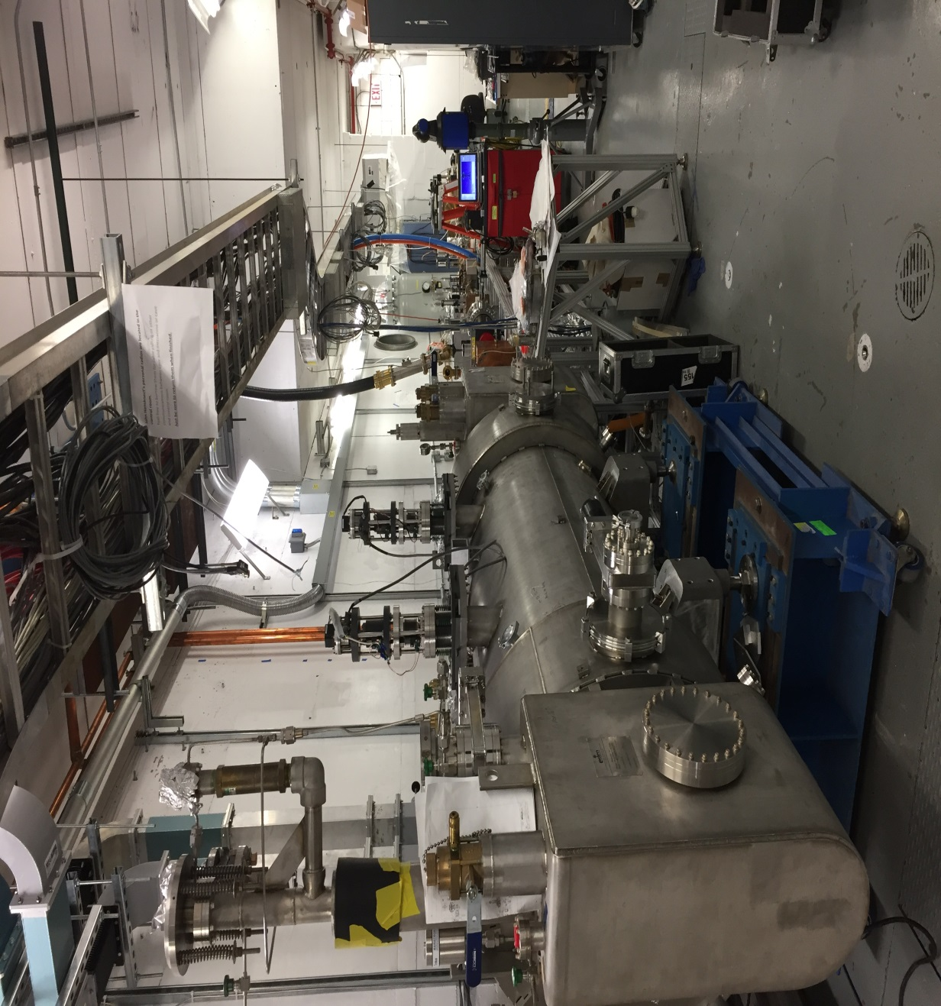
Upgraded Injector Test Facility
Expect keV beam operations soon
Apply RF to cold QCM this Fall
Build some portion of the MeV beamline
Work through some safety issues…
Make MeV beam during FY18

Slide 14
Summary
Actively engaged in CEBAF operations and in close contact with Users - we know their beam requirements
Making effective use of shutdown time, to improve the CEBAF injector and demonstrate new capabilities (e.g., 5 MeV Mott polarimeter, Bubble Chamber astrophysics experiment, beam delivery with SRF at 4K, etc.,)
Gun Test Stand is bearing fruit, and we expect fruitful endeavors at UITF: testing critical components before installation at CEBAF (e.g., 200 kV gun, QCM and HDIce) and opportunities for compelling R&D
Center for Injectors and Sources: P. Adderley, D. Bullard, J. Grames, J. Hansknecht, C. Hernandez-Garcia, Md. Abdullah A. Mamun, M. Stutzman, R. Suleiman, S. Zhang
PhD Students: Wei Liu, Gabriel Palacios, Sajini Wijethunga, Josh Yoskowitz, Yan Wang

Slide 15
Backup Slides

Slide 16
Publications
2017
C. Sinclair, T. Gay, J. Grames, M.J. McHugh, D. Moser, A.K. Opper, M. Poelker, X. Roca-Maza, R. Suleiman, and M. Stutzman, “The CEBAF 5 MeV Mott Polarimeter”, analysis complete, in press
Marcy L. Stutzman, Philip A. Adderley, M.A. Mamun, Matt Poelker, “NEG coated chambers to achieve 1x10⁻¹² Torr”, to be submitted J. Vac. Sci. Technol. A
M.A. Mamun, M. D. Hernandez-Flores, E. Morales, C. Hernandez-Garcia, and M. Poelker, “Temperature Dependence of Alkali-Antimonide Photocathodes: Evaluation at Cryogenic Temperatures”, submitted for publication Phys. Rev. Accel. and Beams
Wei Liu, Shukui Zhang, Marcy Stutzman, and Matt Poelker, “A Comprehensive Evaluation of Factors that Influence the Spin Polarization of Electrons Emitted from Bulk GaAs Photocathodes”, J. Appl. Phys., 122, 035703 (2017)
C. Hernandez-Garcia, D. Bullard, F. Hannon, Y. Wang and M. Poelker, “High voltage performance of a dc photoemission electron gun with centrifugal barrel-polished electrodes”, accepted for publication Rev. Sci. Instrum.
Yoshitaka Taira, Shukui Zhang, "Split in phase singularities of an optical vortex by off-axis diffraction through a simple circular aperture", Opt. Lett. 42, 1373 (2017)
2016
Wei Liu, Yiqiao Chen, Wentao Lu, Aaron Moy, Matt Poelker, Marcy Stutzman, and Shukui Zhang, "Record-level quantum efficiency from a high polarization strained GaAs/GaAsP superlattice photocathode with distributed Bragg reflector", Appl. Phys. Lett. 109, 252104 (2016)
Wei Liu, Shukui Zhang, Marcy Stutzman, and Matt Poelker, "Effects of ion bombardment on bulk GaAs photocathodes with different surface-cleave planes", Phys. Rev. Accel. Beams 19, 103402 (2016)
J. Grames et al., "Production of Highly Polarized Positrons Using Polarized Electrons at MeV Energies", Phys. Rev. Lett., 116, 214801 (2016)
B. Roberts, F. Hannon, M. M. Ali, E. Forman, J. Grames, R. Kazimi, W. Moore, M. Pablo, M. Poelker, A. Sanchez, and D. Speirs, "Harmonically resonant cavity as a bunch-length monitor", Phys. Rev. Accel. Beams 19, 052801 (2016)
C. Hernandez-Garcia, M. Poelker, and J. Hansknecht, "High Voltage Studies of Inverted-geometry Ceramic Insulators for a 350kV dc Polarized Electron Gun", IEEE Transactions on Dielectrics and Electrical Insulation, Vol. 23, No. 1; February 2016
Md Abdullah A. Mamun, Abdelmageed A. Elmustafa, Carlos Hernandez-Garcia, Russell Mammei, and Matthew Poelker, "Effect of Sb thickness on the performance of bialkali-antimonide photocathodes", J. Vac. Sci. Technol. A 34 021509 (2016)

Slide 17
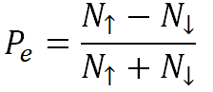
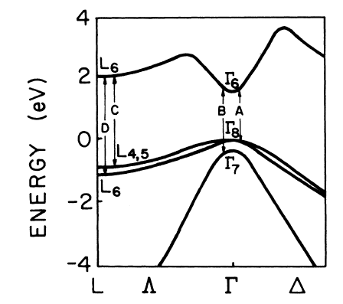
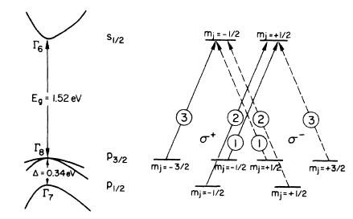
GaAs Energy Levels
$$=\frac{3−1}{3+1}=50\%$$
Use circularly polarized light to selectively populate the conduction band with electrons of a particular spin state
Notes:
Interior Page Design 2

Slide 18
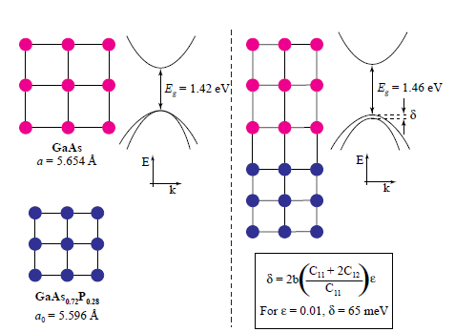
Breaking the 50% Barrier
Lattice mismatch provides stress
The band gap of the substrate layer must be larger than surface layer
Lattice constants must differ enough to introduce suitable strain
Adjust lattice constant of substrate by varying concentration of third element
Pablo Saez, PhD Thesis, SLAC Report 501, 1997
1% lattice mismatch provides equivalent force as hydraulic press!
Notes:
Interior Page Design 2

