Slide 1
High Current Electron Source for Cooling
Jefferson Lab Internal MEIC Accelerator Design Review
Riad Suleiman
January 17, 2014

Slide 2
Outline
MEIC Electron Beam Cooling Requirements
Thermionic Gun
Photogun
Magnetized Beam
Emittance Compensation for Magnetized Beam with Space Charge
Summary

Slide 3
Bunched Electron Beam for Cooling
Bunch Length | 100 ps (3 cm)
Repetition Rate | 25 MHz
Bunch Charge | 2 nC
Peak Current | 50 A
Average Current | 50 mA
Emitting Area | 6 mm ɸ
Transverse Normalized Emittance | 10s microns
Solenoid Field at Cathode | 2 kG

Slide 4
Performance & Dependencies
Thermal Emittance: Intrinsic property of a cathode. Depends on work function, surface roughness, laser wavelength, temperature.
Normalized Emittance: ε_{n} = βγε_{geom}
Thermal Emittance (normalized to emitting radius or the rms for a gaussian beam): ε_{th} = ε_{n} /R
Achievable Current: QE, laser wavelength, laser power, laser damage, heating, temperature.
Bunch Charge: laser peak power, repetition rate, active cathode area
Cathode Lifetime: ion back bombardment, dark current, contamination by residual gas, evaporation, beam loss, halo beam

Slide 5
Thermionic Gun
Example 1: TRIUMF e-Linac for photo-fission of actinide target materials to produce exotic isotopes:
BaO: 6 mm diameter, 775˚C
Grid at 650 MHz
Gun HV: 300 kV
Average beam current: 10 mA
Bunch charge: 16 pC
Normalized emittance: 30 microns. Emittance is dominated by the electric field distortion caused by the grid.
Production target sets no requirement on beam emittance

Slide 6
Example 2: MAX-LAB Thermionic – Photocathode RF Gun. Thorin et al., NIM A 606, 291 (2009):
Thermionic: for storage ring injection
BaO: 3 mm diameter, 1100˚C
3 GHz and 1.6 MeV
Normalized emittance: 35 microns
Large energy spread (2%)
To switch, reduce T=1100˚C to T=700˚C
Photocathode: for FEL
Bunch charge: 0.2 nC
Laser: 9 ps, 10 Hz, 263 nm
Average beam current: 2 nA
Normalized emittance: 5.5 microns
QE: 1.1 x 10⁻⁴

Slide 7
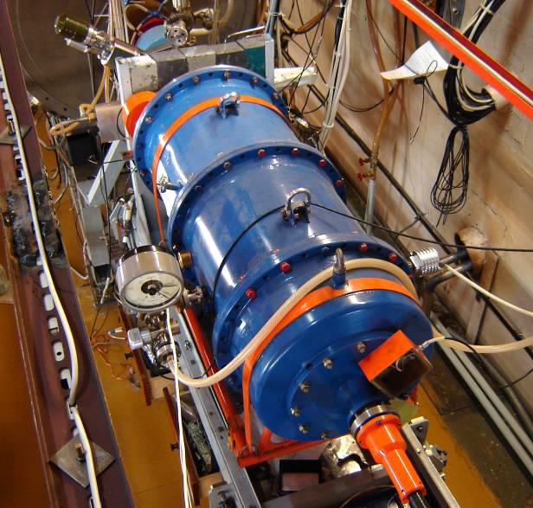
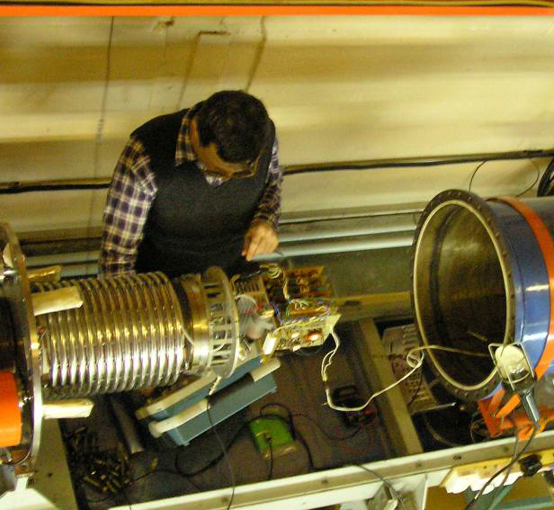
Example 3: Thermionic Gun and 1.5 MeV Injector of BINP’s NovoFEL. B.A. Knyazev et al., Meas. Sci. Tech. 21, 054017 (2010):
Gun HV | 300 kV
Maximum peak current | 1.8 A
Maximum average current | 30–45 mA
Maximum bunch repetition rate | 22.5 MHz
Bunch length | 1.3 ns
Bunch charge | 1.5-2 nC
Normalized emittance | 10 microns

Slide 8
RF system consisting of 3 identical 180.3 MHz cavities powered by different generators
Bunching/chirping cavity RFC1 with a voltage of up to 100 kV
Two accelerating cavities RFC2 and RFC3 with a voltage of up to 800 kV
Phase of RFC3 adjusted to also de-chirp removing correlated energy spread
1.5 ns bunch from the gun compressed to 100 ps at the exit from the injector
Final bunch energy is 1.5 MeV

Slide 9
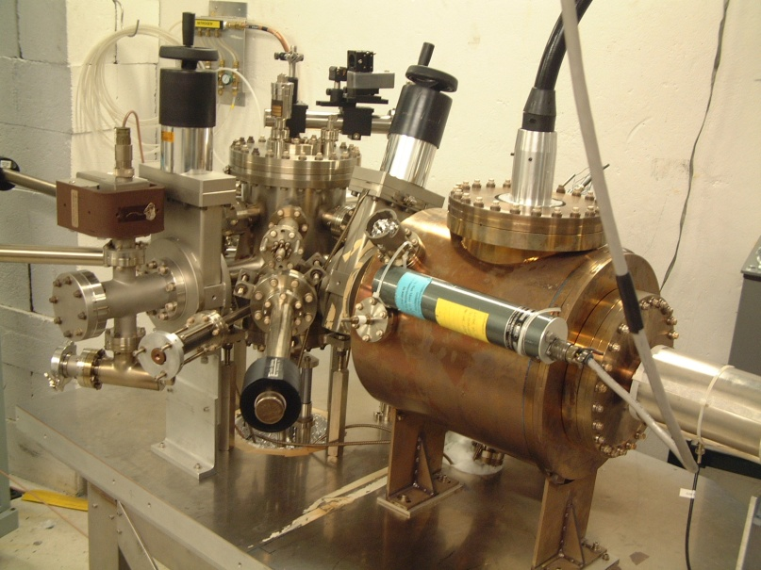
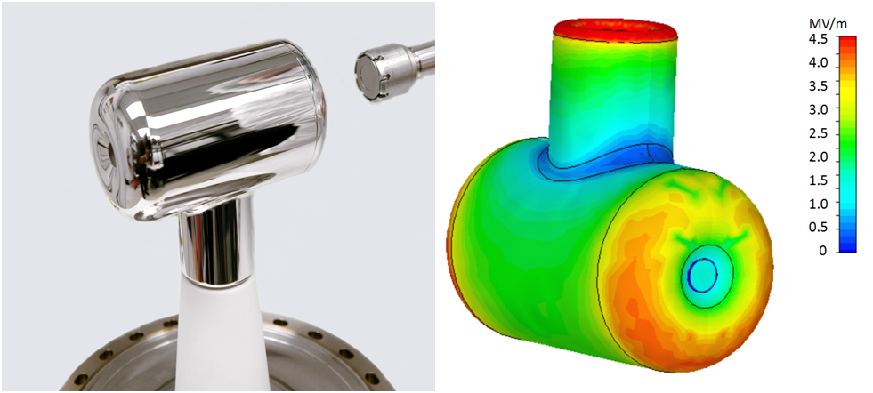
Photogun
Example 1: JLab 200 kV Inverted dc Gun with K₂CsSb photocathode:
Average beam current: 10 mA
Laser: 532 nm, dc
Lifetime: very long (weeks)
Thermal emittance: 0.7 microns/mm(rms)
Mammei et al., Phys. Rev. ST AB 16, 033401 (2013)

Slide 10
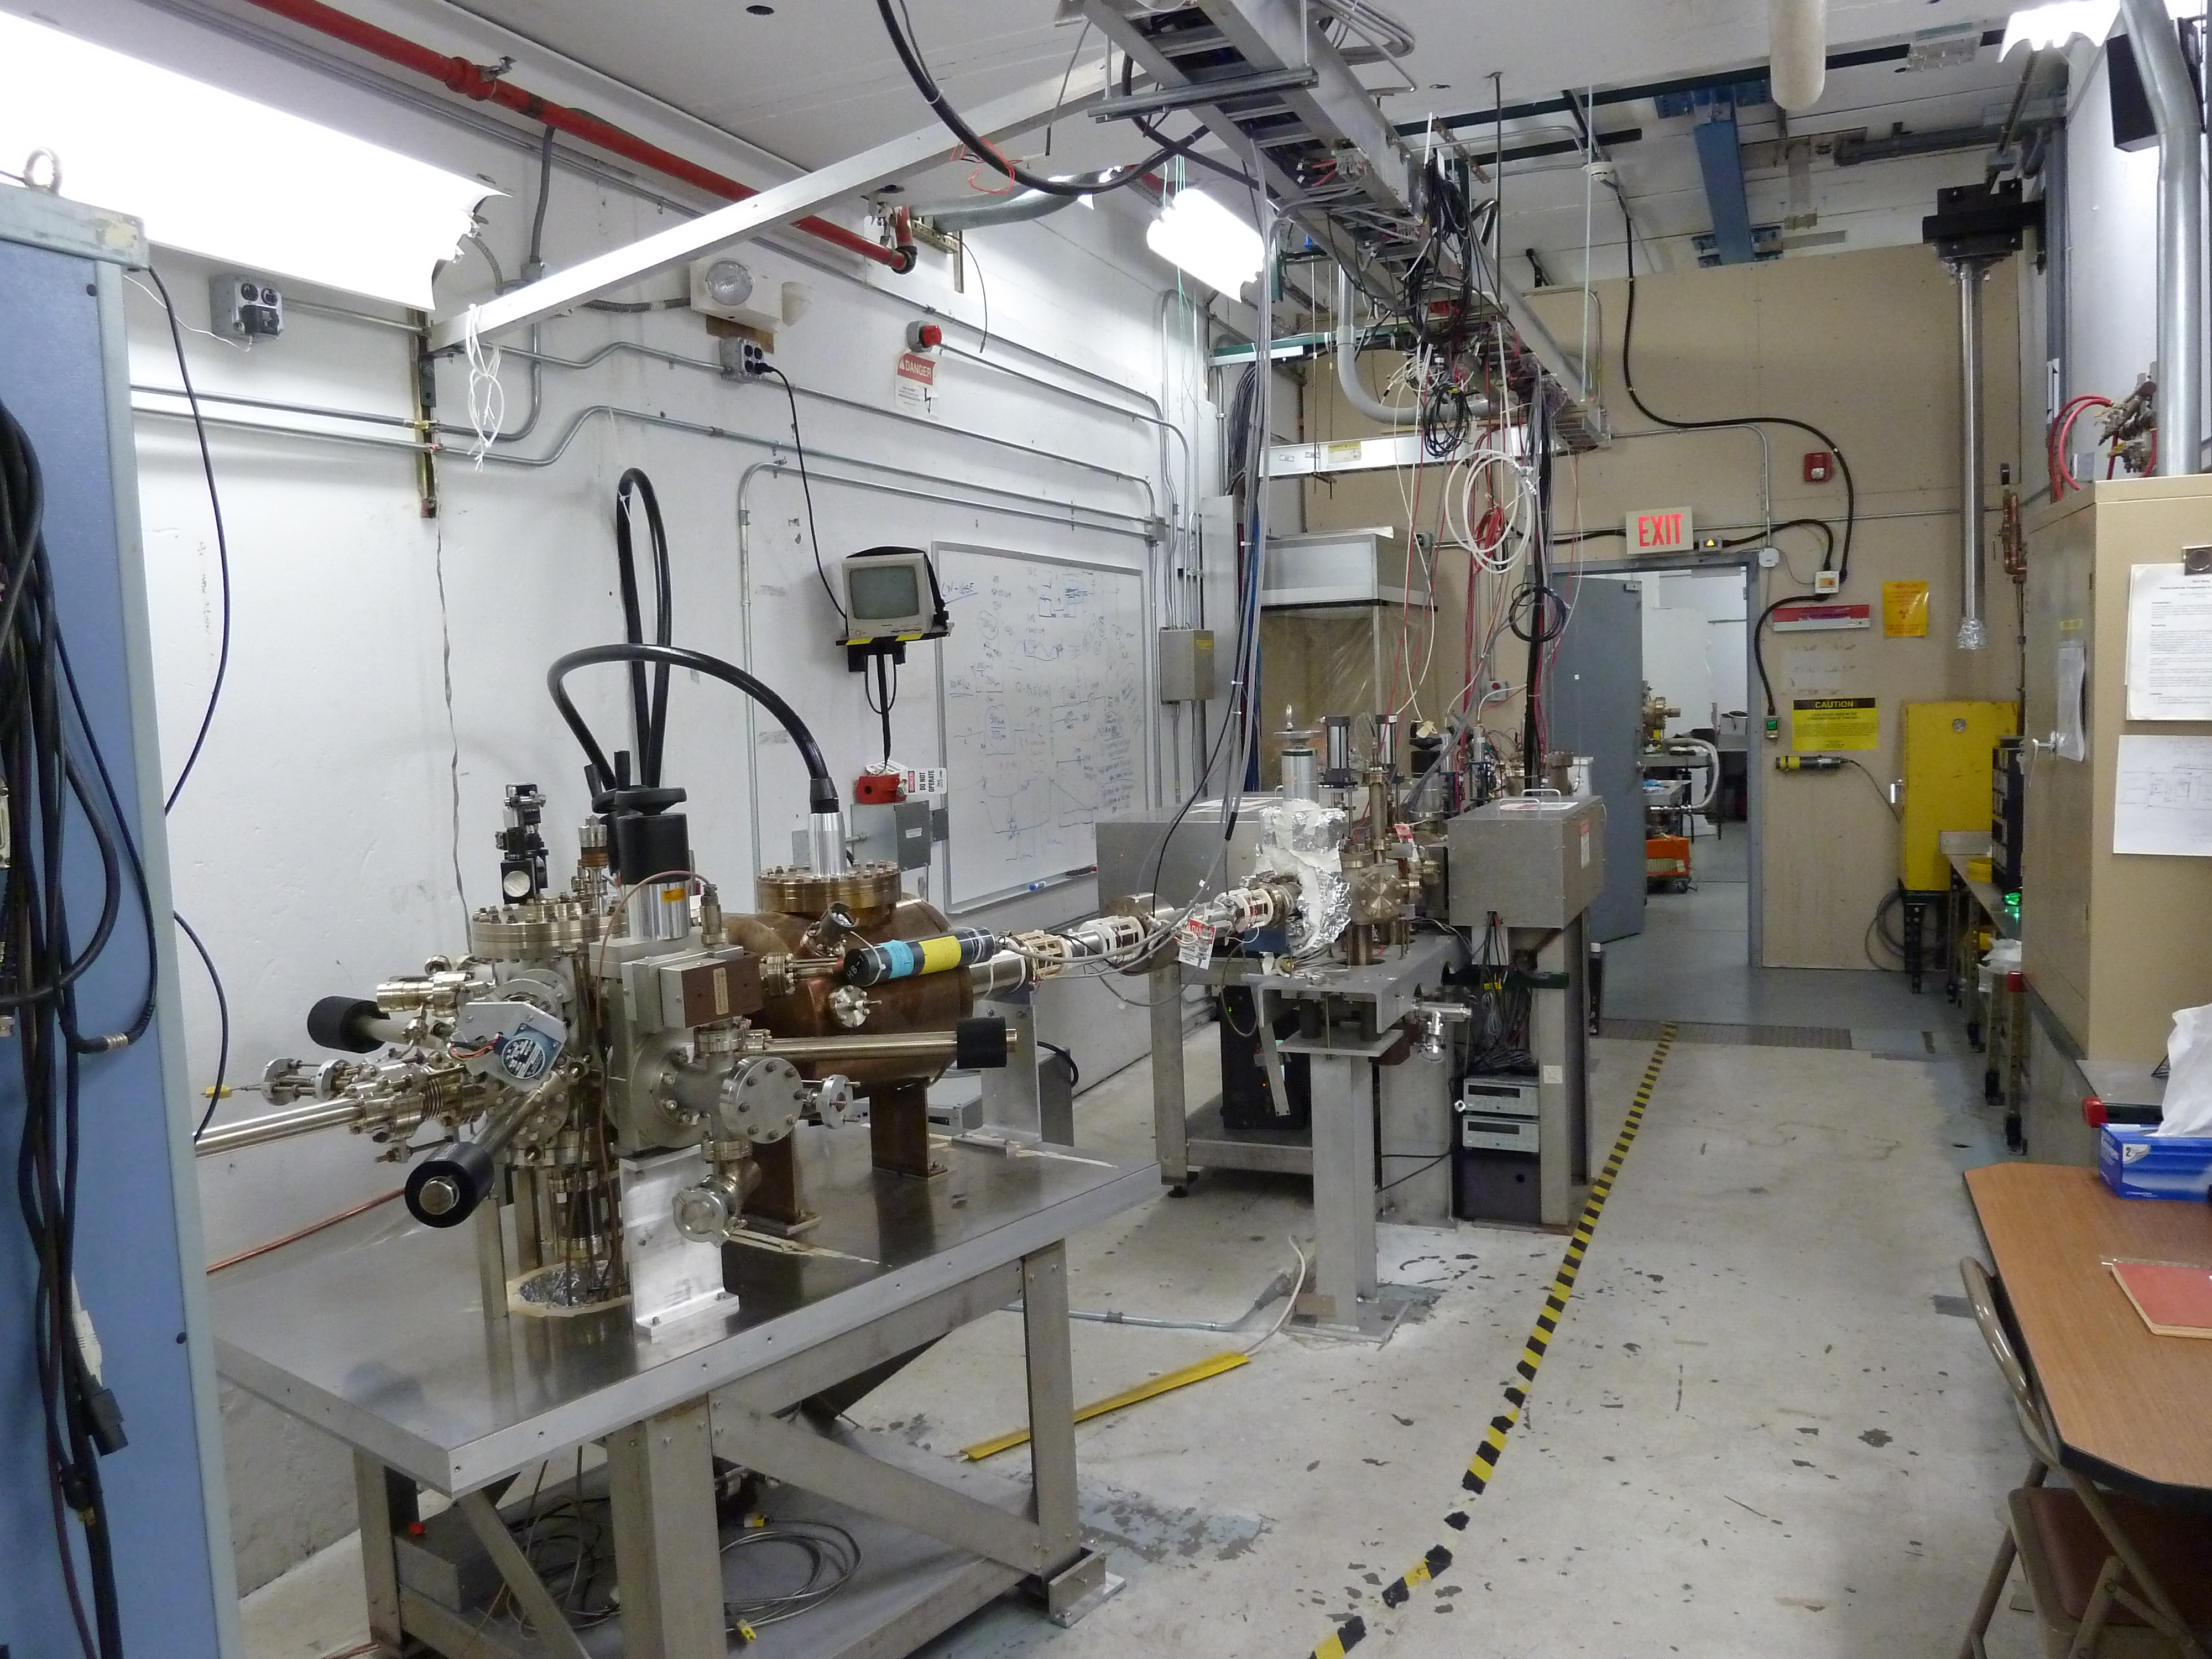

Slide 11
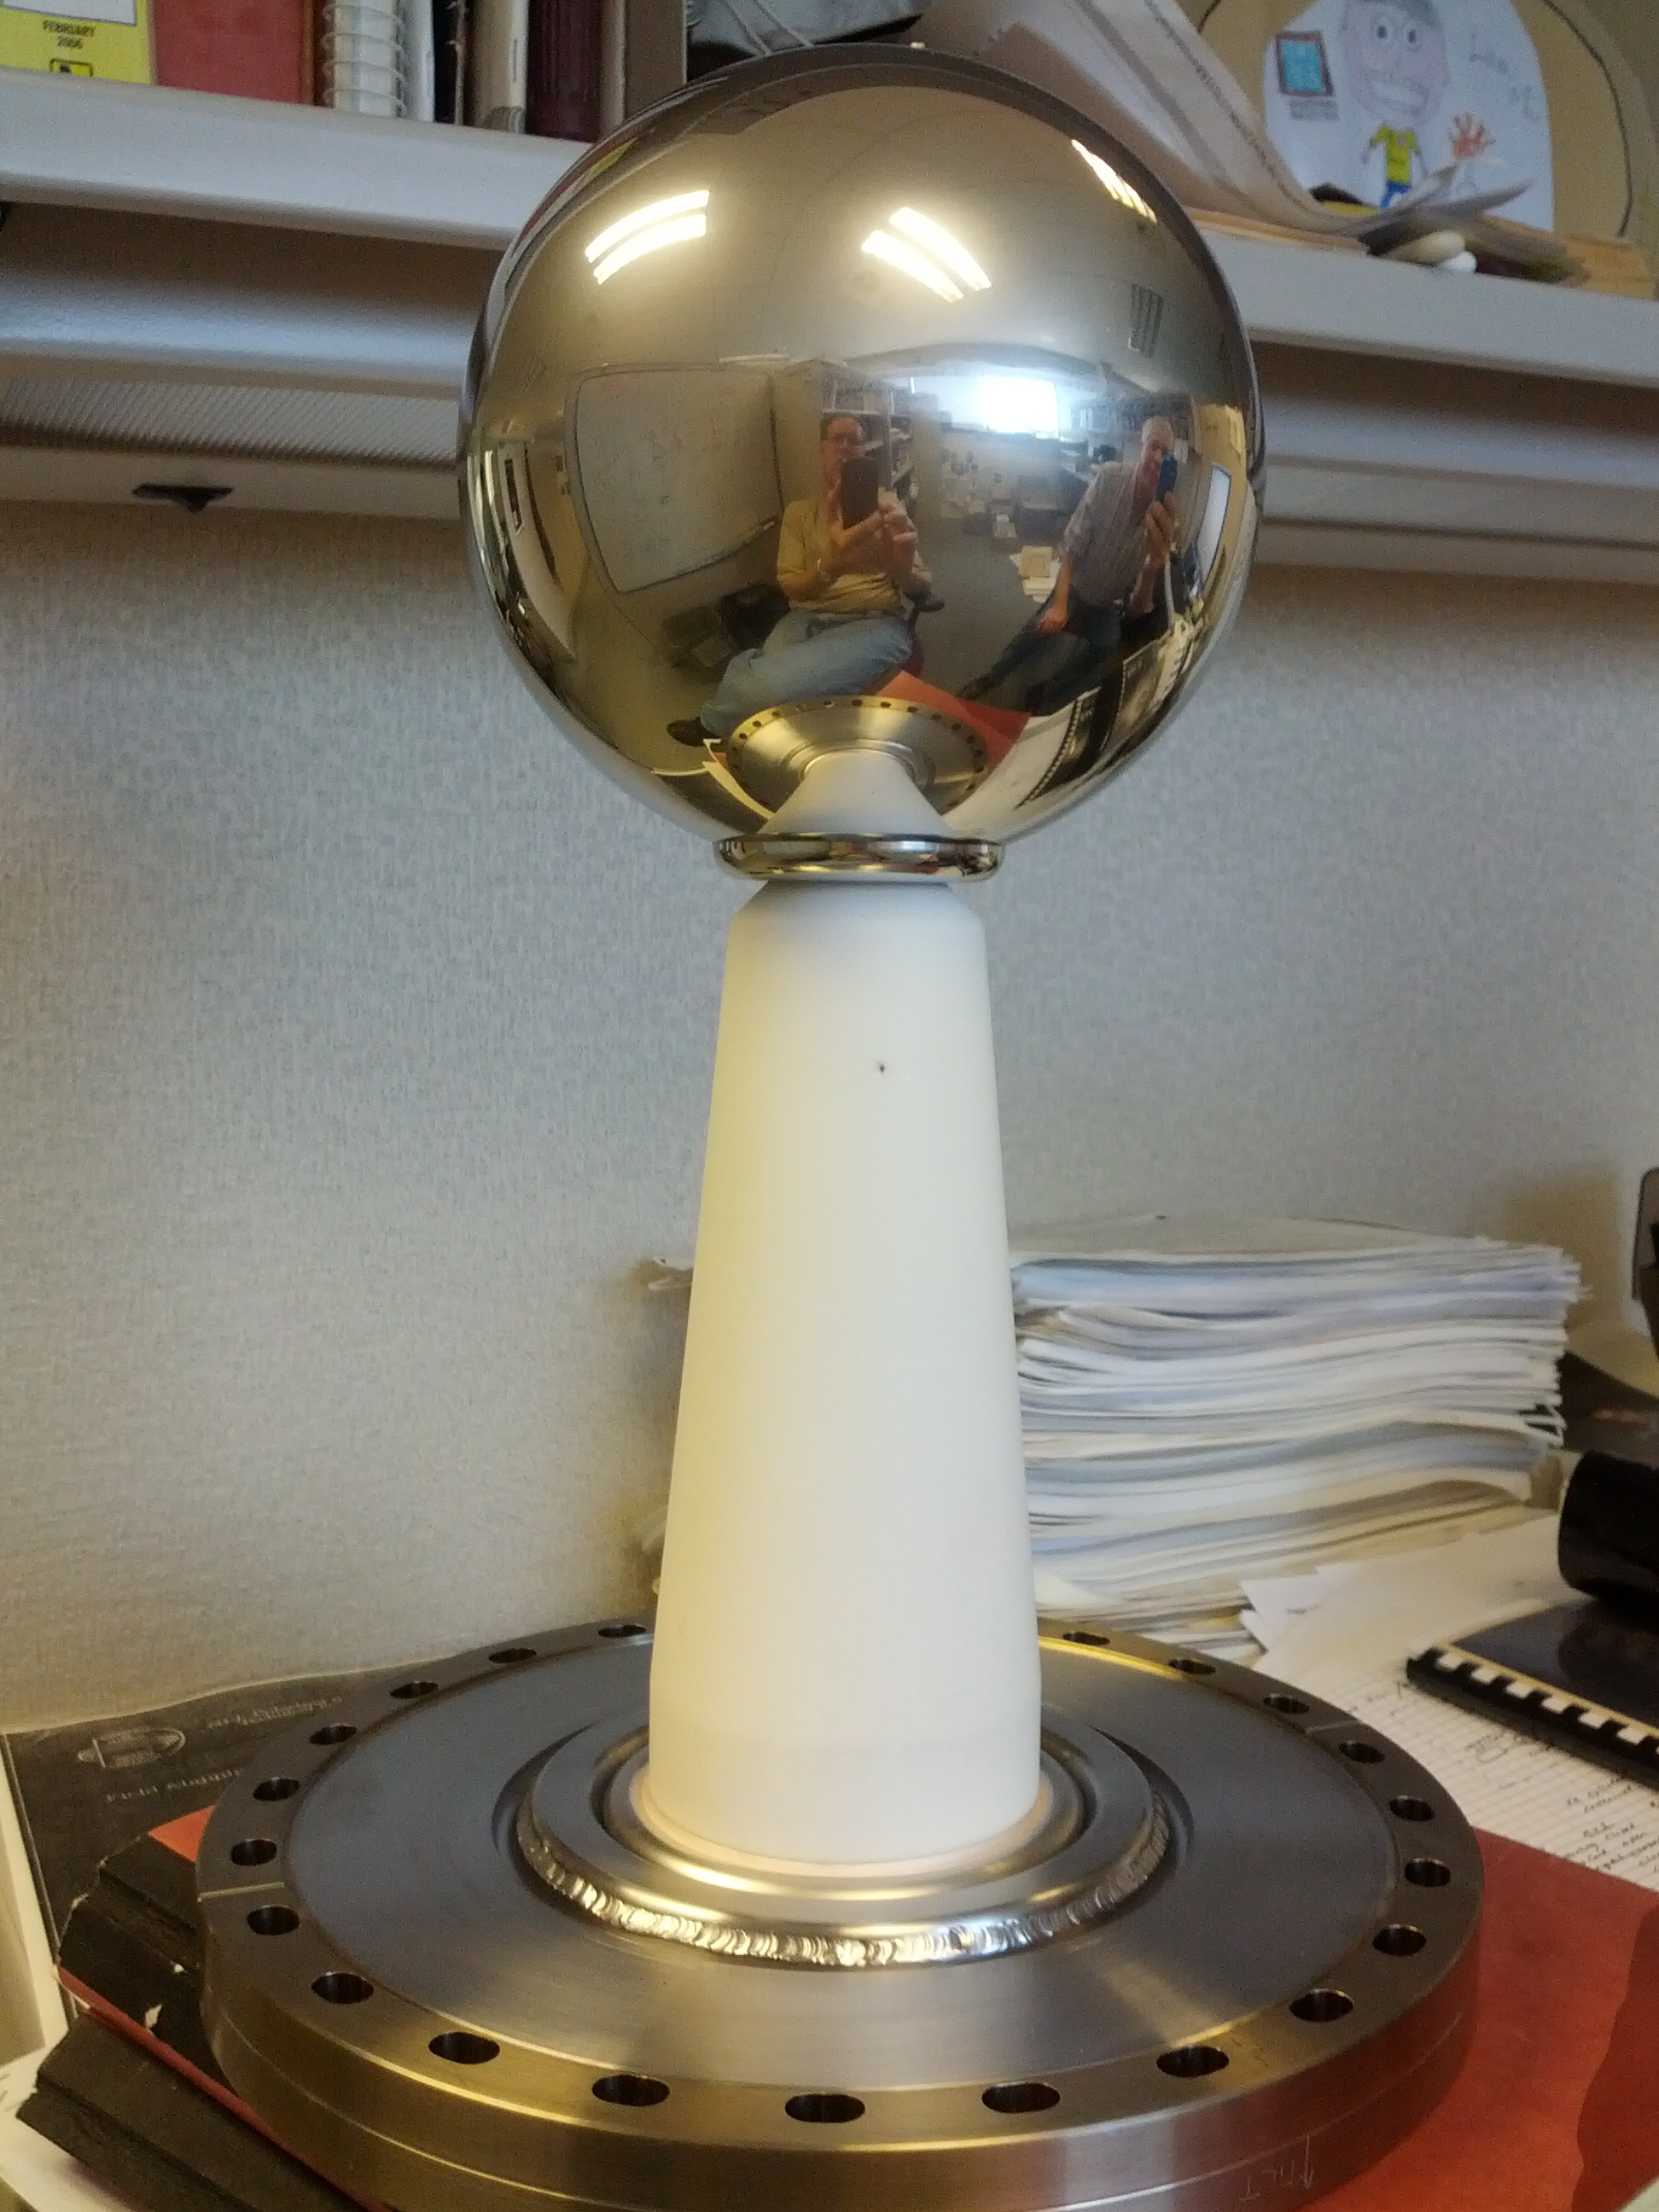
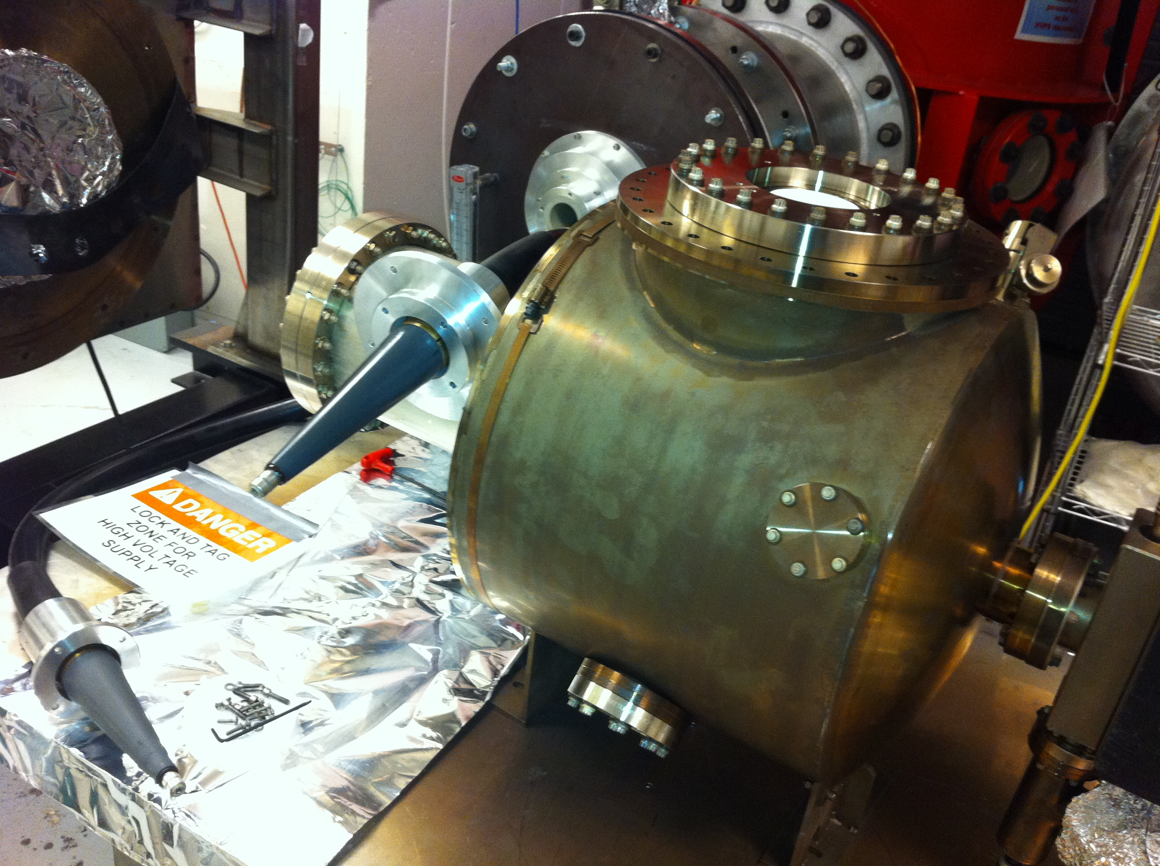
Example 2: JLab 350/500 kV Inverted Gun:
 | 200 kV Gun | 350/500 kV Gun
Chamber | 14” ɸ | 18’’ ɸ
Cathode | 2.5” T-shaped | 6” ɸ Ball
Cathode Gap | 6.3 cm | 6.3 cm
Inverted Ceramic | 4” long | 7” long
HV Cable | R28 | R30
HV Supply | Spellman 225 kV, 30 mA | Glassman 600 kV, 5 mA
Maximum Gradient | 4 MV/M | 7 (10) MV/m

Slide 12
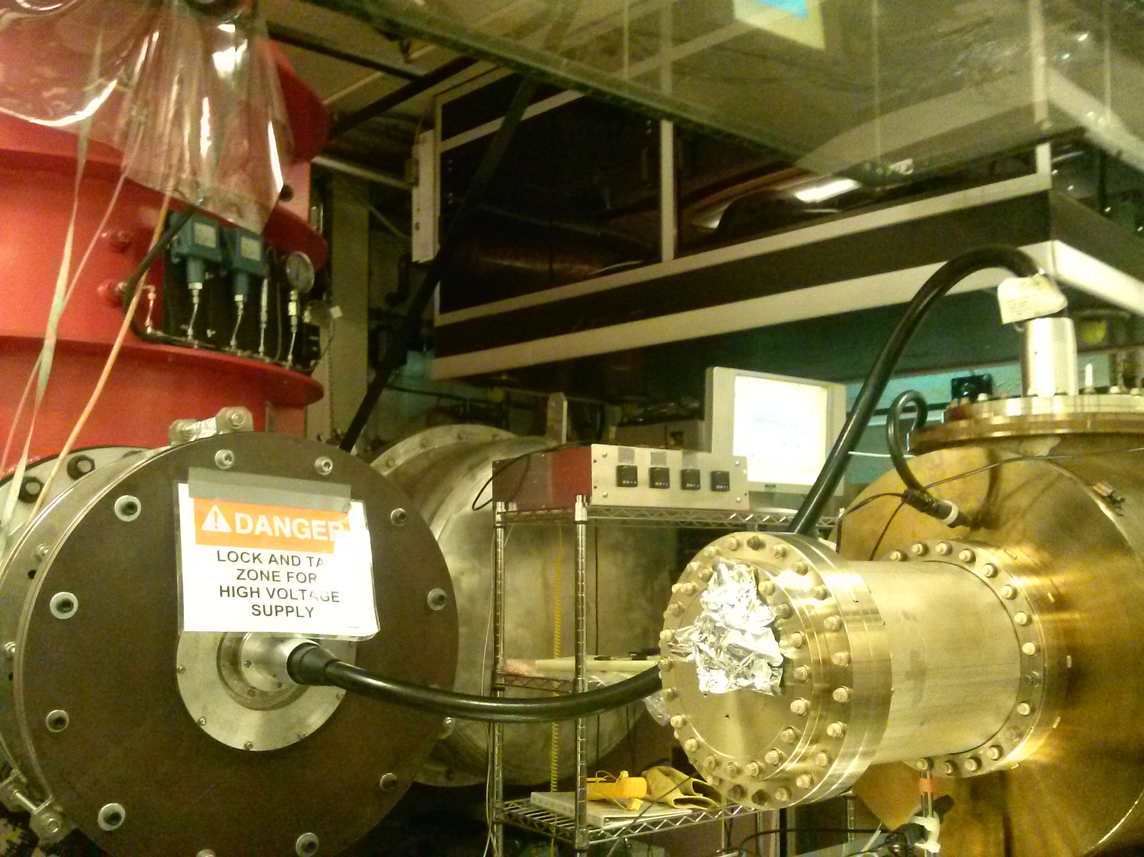
Achieved 350 kV with no FE (December 2013), next:
Keep pushing to reach 500 kV
Run beam with K₂CsSb photocathode

Slide 13
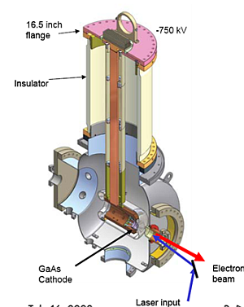
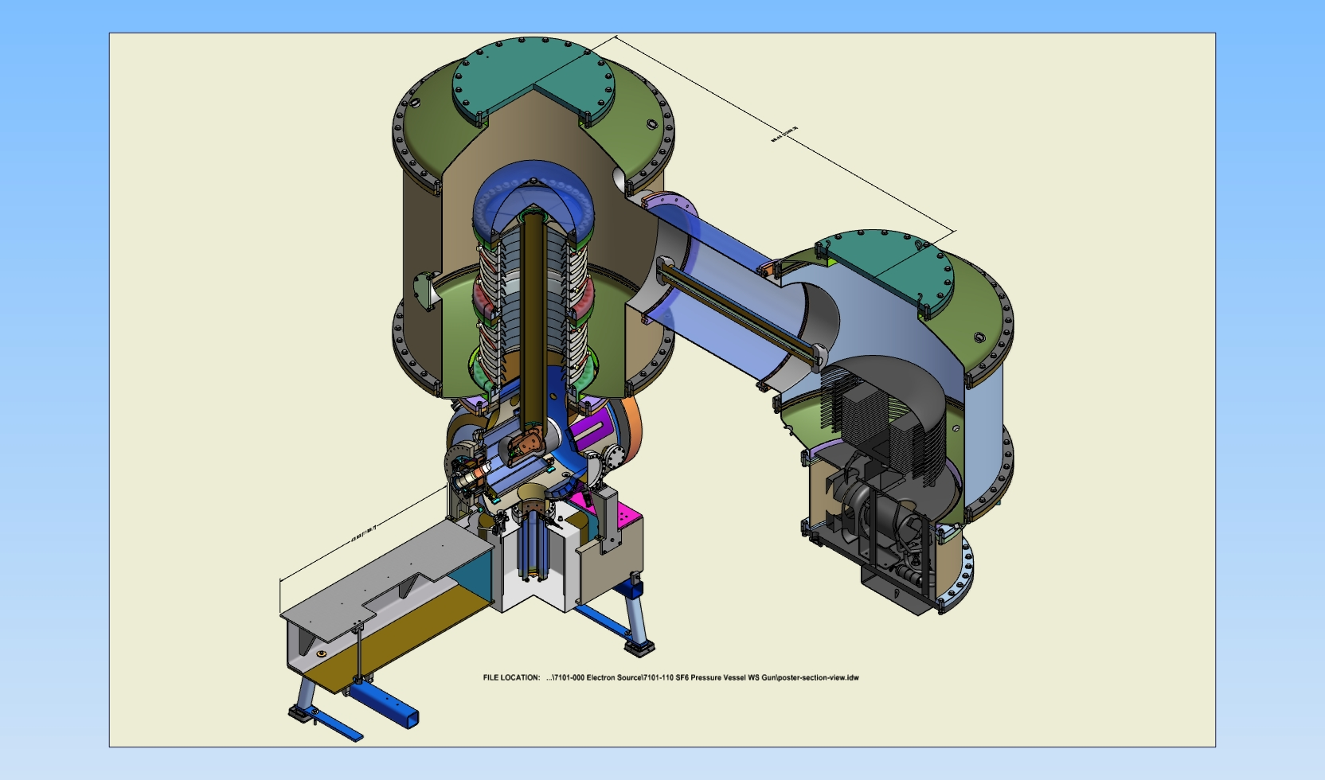
Example 3: Cornell dc Gun with K₂CsSb photocathode:
Gun HV: currently operating at 350 kV (designed 500-600 kV)
Average beam current: 100 mA
Bunch charge: 77 pC
Bunch length: 10 ps, 1.3 GHz
Normalized emittance: <0.5 microns

Slide 14
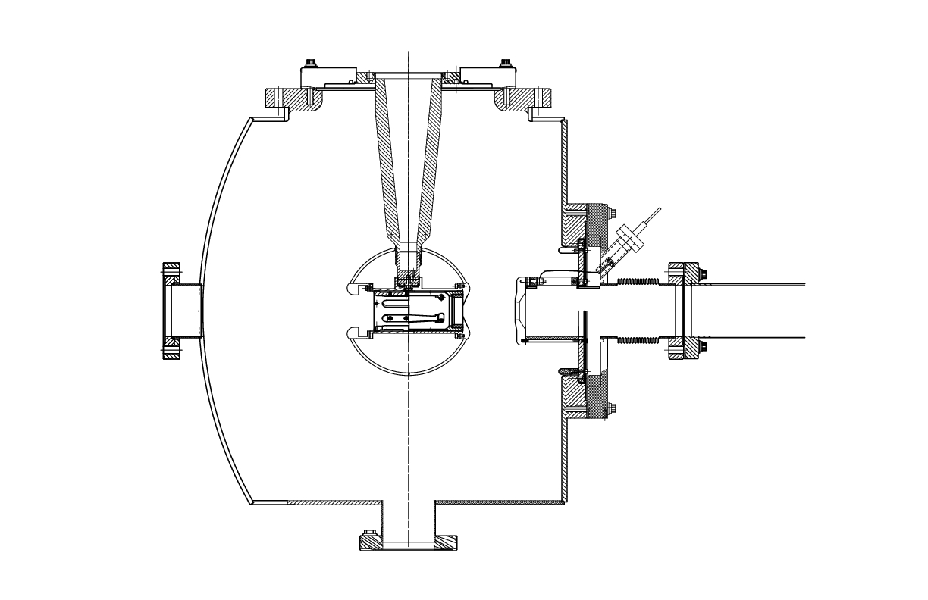
Magnetized Beam and Emittance Compensation
Solenoid (B_{z}~2kG)
(magnetized beam)
Magnetized Cathode:
To produce magnetized electron beam (to ensure zero angular momentum inside cooling-solenoid section)
Magnetized Injector:
To compensate space-charge emittance growth
Solenoid (B_{z}~2kG)
(space-charge emittance growth compensation)

Slide 15
Summary
Thermionic gun would be our first choice (less maintenance but may need complicated injector):
TRIUMF/BINP Gun with Inverted Ceramic
To allow for laser pulse shaping, a photogun could be an option:
JLab 350/500 kV Inverted Gun and JLab K₂CsSb

