Slide 1
Optics for UITF − ‘keV’ and ‘MeV’ beam-lines
Alex Bogacz

Slide 2
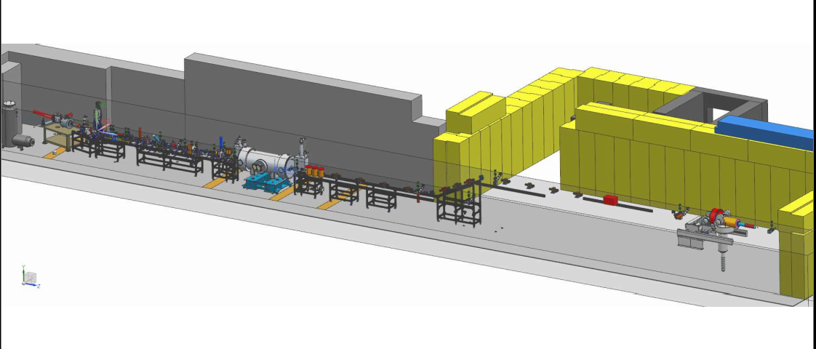
UITF Beamline Layout (‘keV’ + ‘MeV’ beamlines)
layout per J. Grames
40
1
350 keV
9.489 MeV
BETA_X&Y[m]
DISP_X&Y[m]
0
-1
0
BETA_X
BETA_Y
DISP_X
DISP_Y
28
cathode end
‘keV’ beamline
¼ Cryo
‘MeV’ beamline
target

Slide 3
Cathode-to-¼Cryo Layout (‘keV’ beamline)
1497 MHz choppers
15⁰ bend
Wien
Buncher
¼ CM
sol 2
quad 1
quad 2
sol 3
A1
A2
sol1
gun
10
1
BETA_X&Y[m]
DISP_X&Y[m]
0
-1
0
BETA_X
BETA_Y
DISP_X
DISP_Y
8.5
cathode end
15⁰ bend
Buncher
sol 1
sol 2
Wien Filter
Choppers
sol 3

Slide 4
Initial Beam Parameters at the Cathode
# Initial beam energy
#
$Tinj=0.350; => 0.35 (350 keV)
$Einj=$Tinj+$Me; => 0.8610034
$gamma=$Einj/$Me; => 1.68492695
$beta=sqrt(1-(1/($gamma*$gamma))); => 0.804835803
$Pinj=sqrt($Einj*$Einj-$Me*$Me); => 0.692966363
#
#Beam emittance and initial Twiss parameters
#
$RLaserSpot=0.02; => 0.02 (200 micron)
$Tc=0.04e-6; => 4e-08 (0.04 eV)
$Ptr=sqrt($Tc*$Me); =>0.000142969004
$Teta=$Ptr/$Pinj; =>0.000206314493
$Emit=$Teta*$RLaserSpot; =>4.12628985e-06 (ε_{geom} = 0.041 mm mrad)
#
$Beta=$RLaserSpot/$Teta; => 96.9393848 (β_{x,y} = 96.9 cm)
$LAccCol=7; => 7
$FAccCol=4*$LAccCol; => 28
$TetaF=$RLaserSpot/ $FAccCol; =>0.000714285714
$Alpha=-$TetaF/$Teta; => -3.46212089 (α_{x,y} = -3.46 cm)
$RLaserSpot
$Teta
$RLaserSpot
$Teta

Slide 5
Cathode-to-¼Cryo Optics (‘keV’ beamline)
350 keV
10
1
BETA_X&Y[m]
DISP_X&Y[m]
0
-1
0
BETA_X
BETA_Y
DISP_X
DISP_Y
8.5
cathode end
15⁰ bend
Buncher
sol 1
sol 2
Wien Filter
Choppers
sol 3
L = 7.62 cm
B = 294 Gauss
L = 7.62 cm
B = 297 Gauss
L = 6.35 cm
B = 334 Gauss
L = 6.35 cm
B = 281 Gauss
2×
L = 5 cm
B = 316 Gauss
L = 6.35 cm
B = 329 Gauss
Solenoid aperture radius: a = 1.25 cm

Slide 6
‘Soft-edge’ Solenoid Model (a ≲ L)
Non-zero aperture − correction due to the finite length of the edge:
It decreases the solenoid total focusing – via the effective length of:
It introduces axially symmetric edge focusing at each solenoid end:
‘Soft-edge’ solenoid transfer matrix:

Slide 7
Cathode-to-¼Cryo Optics (‘keV’ beamline)
10
1
BETA_X&Y[m]
DISP_X&Y[m]
0
-1
0
BETA_X
BETA_Y
DISP_X
DISP_Y
8.5
cathode end
15⁰ bend
Buncher
sol 1
sol 2
Wien Filter
Choppers
sol 3
Wien Filter - Combined magnetic and electric field
(balance between magnetic and electric forces preserves trajectory)
#
$fiwienn=30; => 30
$Lwienn=30.95; => 30.95
$FIwienn=$fiwienn*$PI/180; => 0.523598776
$Bwienn=$FIwienn*$Hr/$Lwienn; =>0.0391047416
$Ewienn=-$Bwienn*$beta*$c/1e8; => -9.43533688
#

Slide 8
Cathode-to-¼Cryo Optics (‘keV’ beamline)
10
1
BETA_X&Y[m]
DISP_X&Y[m]
0
-1
0
BETA_X
BETA_Y
DISP_X
DISP_Y
8.5
cathode end
15⁰ bend
Buncher
sol 1
sol 2
Wien Filter
Choppers
sol 3
Wien Filter - Combined magnetic and electric field
(balance between magnetic and electric forces preserves trajectory)
#
$fiwienn=30; => 30
$Lwienn=30.95; => 30.95
$FIwienn=$fiwienn*$PI/180; => 0.523598776
$Bwienn=$FIwienn*$Hr/$Lwienn; =>0.0391047416
$Ewienn=-$Bwienn*$beta*$c/1e8; => -9.43533688
#

Slide 9
Cathode-to-¼Cryo Optics (‘keV’ beamline)
10
1
BETA_X&Y[m]
DISP_X&Y[m]
0
-1
0
BETA_X
BETA_Y
DISP_X
DISP_Y
8.5
cathode end
15⁰ bend
Buncher
sol 1
sol 2
Wien Filter
Choppers
sol 3
skew quads

Slide 10
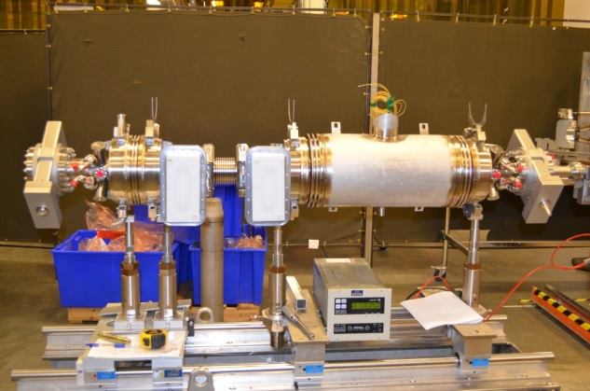
¼Cryo-to-Target Optics (‘MeV’ beamline)
350 keV
9.489 MeV
40
1
BETA_X&Y[m]
DISP_X&Y[m]
0
-1
8.5
BETA_X
BETA_Y
DISP_X
DISP_Y
28
¼ Cryo
Matching quads
Vertical step
Final telescope
raster
target
(2-cell + 7-cell cavities)

Slide 11
UITF Optics − Beam Envelopes at 6σ
40
1
350 keV
9.489 MeV
BETA_X&Y[m]
DISP_X&Y[m]
0
-1
0
BETA_X
BETA_Y
DISP_X
DISP_Y
28
cathode end
‘keV’ beamline
¼ Cryo
‘MeV’ beamline
target
0.4
0.4
Size_X[cm]
Size_Y[cm]
0
0
0
Ax_bet
Ay_bet
Ax_disp
Ay_disp
28

Slide 12
Summary
Linear Optics for UITF beamlines (transfer matrix modelling via OptiM)
Cathode-to-¼Cryo modelling (‘keV’ beamline):
FOFO lattice with ‘Soft edge’ solenoid lenses
Wien filter – Recommended to be centered between MFB2K02 and MFA3K01 lenses
Buncher – Recommended to be centered between MFA3K03 and MFA4K03 lenses
Recommended adding a pair of skew quads between MFA4K03 lens and ¼Cryo to decouple the lattice and rotate the dispersion into the vertical plane
¼Cryo-to-Target modelling (‘MeV’ beamline):
Quadrupole focusing lattice
¼Cryo (2-cell + 7-cell cavity)
Vertical step achromat
Final telescope
GPT tracking studies of ‘keV beamline’
….slides from Alicia……

Slide 13
Backup Slides

Slide 14
‘Soft-edge’ Solenoid – Nonlinear Effects
Nonlinear focusing term ΔF ~ O(r²) follows from the scalar potential:
Scalar potential in a solenoid
Solenoid B-fields

Slide 15
‘Soft-edge’ Solenoid – Nonlinear Effects
In tracking simulations the first nonlinear focusing term, ΔF ~ O(r²) is also included:
Nonlinear focusing correction at radius r:

