Slide 1
3D view of bubbles

Slide 2
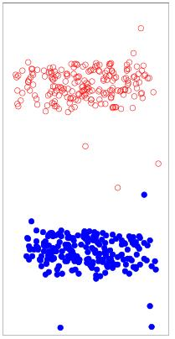
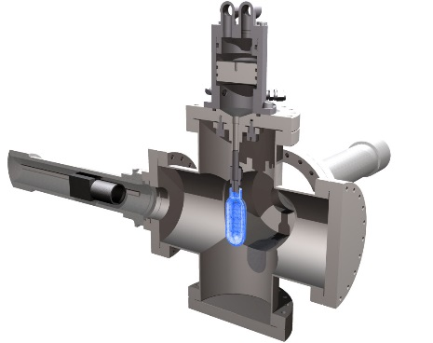
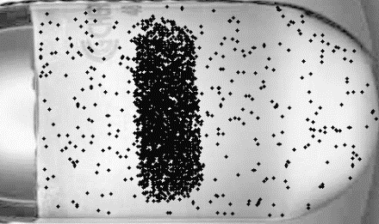
Position sensitivity in 3D at HIγS
2 fast cameras
Camera-1
Air
no hydraulic fluid
Camera-2
Not corrected for refraction

Slide 3
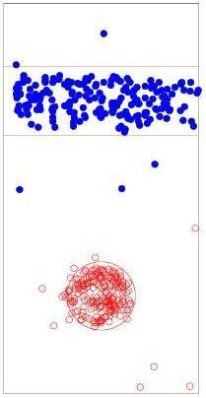
Position sensitivity in 3D at HIγS
Camera-2’
Camera-1’
Δx < 1 mm

Slide 4
View along and perpendicular to the beam

Slide 5
View at +- 12.5º

Slide 6
Reconstructed views +-45º
Reconstr. assum. 20% uncertainty theory

Slide 7
Reconstructed views +-12.5º
Reconstr. assum. 20% uncertainty theory

Slide 8
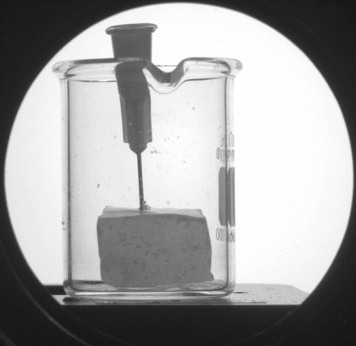
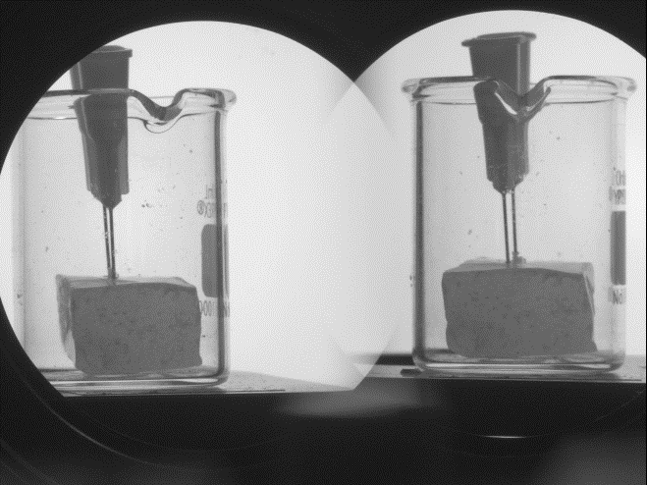
0º +-12.5º

