Slide 1
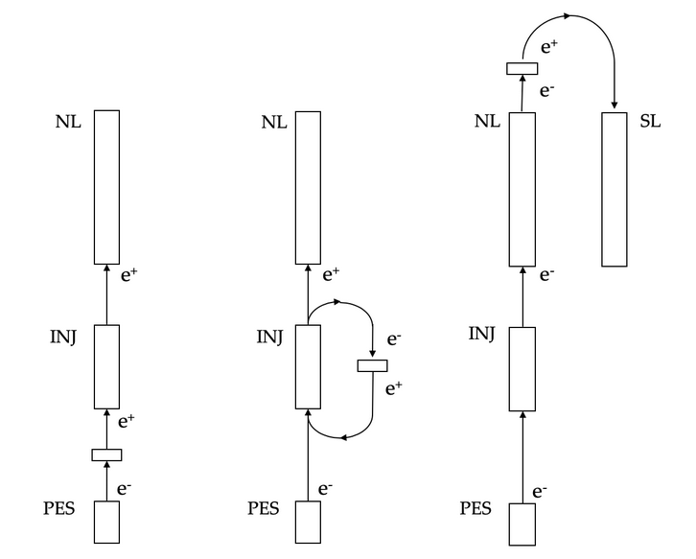
LDRD Proposal : A Positron Source for CEBAF
PEPPo : Polarized Electrons for Polarized Positrons
PRL 116 (2016) 214801
PEPPo demonstrated positrons >80% polarization using an 8 MeV electron beam at the CEBAF injector
10’s kW beam power should be sufficient to provide polarized and unpolarized positron beams to Users
2-year LDRD proposal submitted
  Evaluate integration to 12 GeV CEBAF, with either 10, 100 or 1000 MeV energy electron drive beam
  Study and optimize positron yield and polarization on critical source collection parameters
  Propose a follow-on prototype experiment
10 MeV
100 MeV
1 GeV

