Slide 1
Longitudinal manipulations of positrons

Slide 2
Input conditions for injector past ¼ cryomodule
Existing CEBAF injector parameters
At the exit of the ¼ cryomodule we have $E_{kin}=6.3 Mev$
Transverse emittances (normalized):
ex=0.4 to 0.8 mm.mrad , ey=0.1-1.2 mm.mrad from TN-15-052 (measured) ex=1mm.mrad, ey=1mm.mrad from historical 12 GeV deck values ex=ey=0.25mm.mrad (Alicia’s design)
Longitudinal parameters:
sigma_z <0.5ps (0.15mm) , sigmae/e from 1e-4 to 1e-3 (Alicia’s)
sigma_z=0.1mm. Sigmae/e=1e-4 from historical 12GeV decks
Sigma_z=0.24mm , sigmae/e=1.3e-4 from Kasimi/Chao’s 12GeV design study
Note that from Phys. Rev. Accel. Beams 19, 052801 (2016), size at gun goes from 45 to 102 ps (depending on current) and then is necked down at chopper slit as low as 18ps (publication in cis wiki)

Slide 3
Input conditions for positrons
Uncorrelated energy spread will dictate how well we can compress the bunch longitudinally in a single stage
We will need a G4 simulation which has longitudinal information. That is, taking into account the fact we produce the positrons via a bunched beam, meanwhile we can make a file using the existing simulations as a starting point and a guess on initial bunchlength.

Slide 4
Compressing with a magnetic chicane
Harmonic cavities not necessary if one only considers first order linearity
We can use regular cavities in linac 1 off crest instead.
If needed, we can de-chirp using the North linac. Actual need can be determined from simulations.

Slide 5
Energy spread and bunch length evolution
$$σ^{2}=βε+{η_{x}}^{2}{\left(σ_{δ,f}\right)}^{2}$$

Slide 6
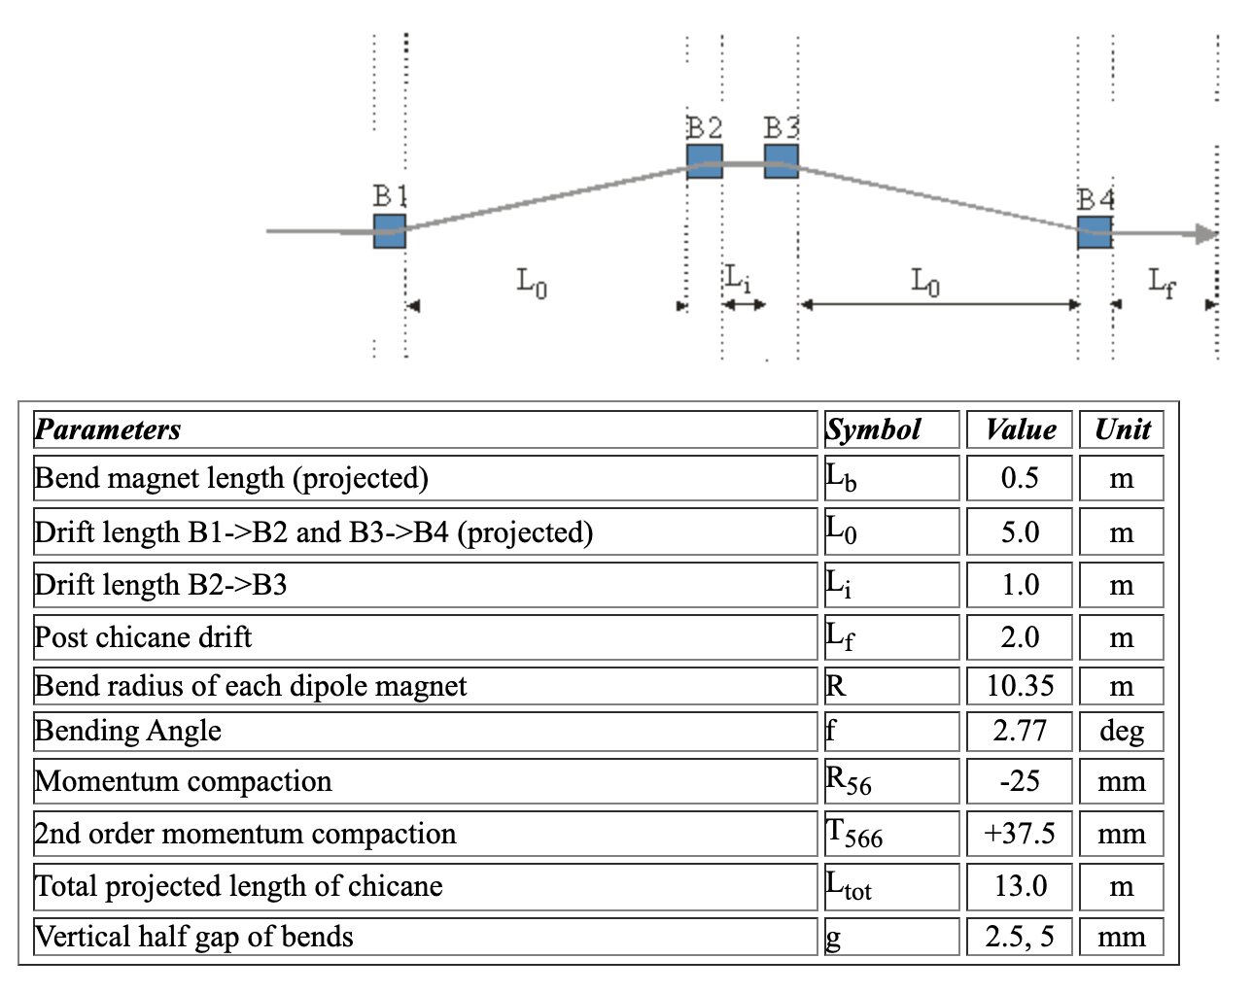
Example: Zeuten Chicane
Uses rectangular bends
See ELEGANT decks

Slide 7
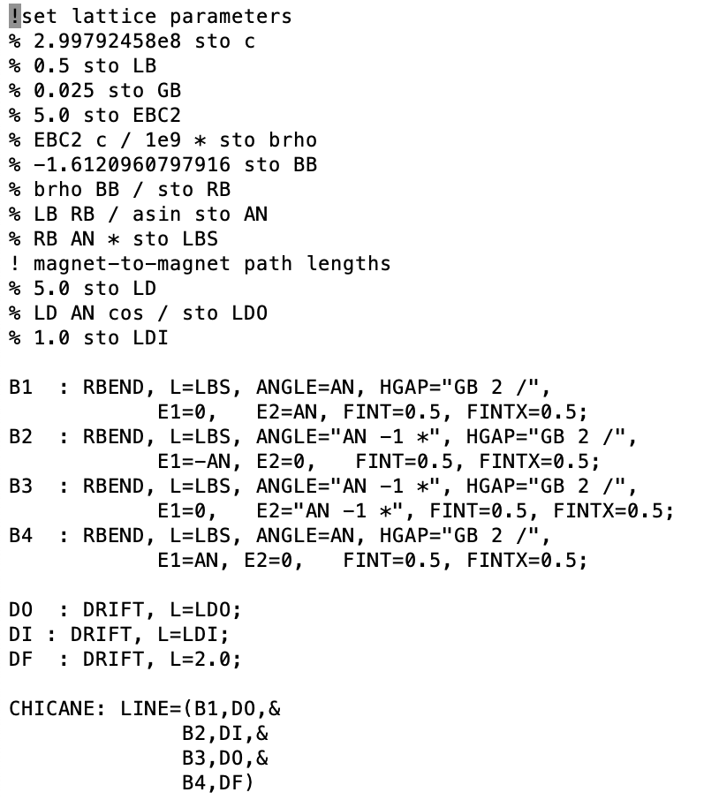
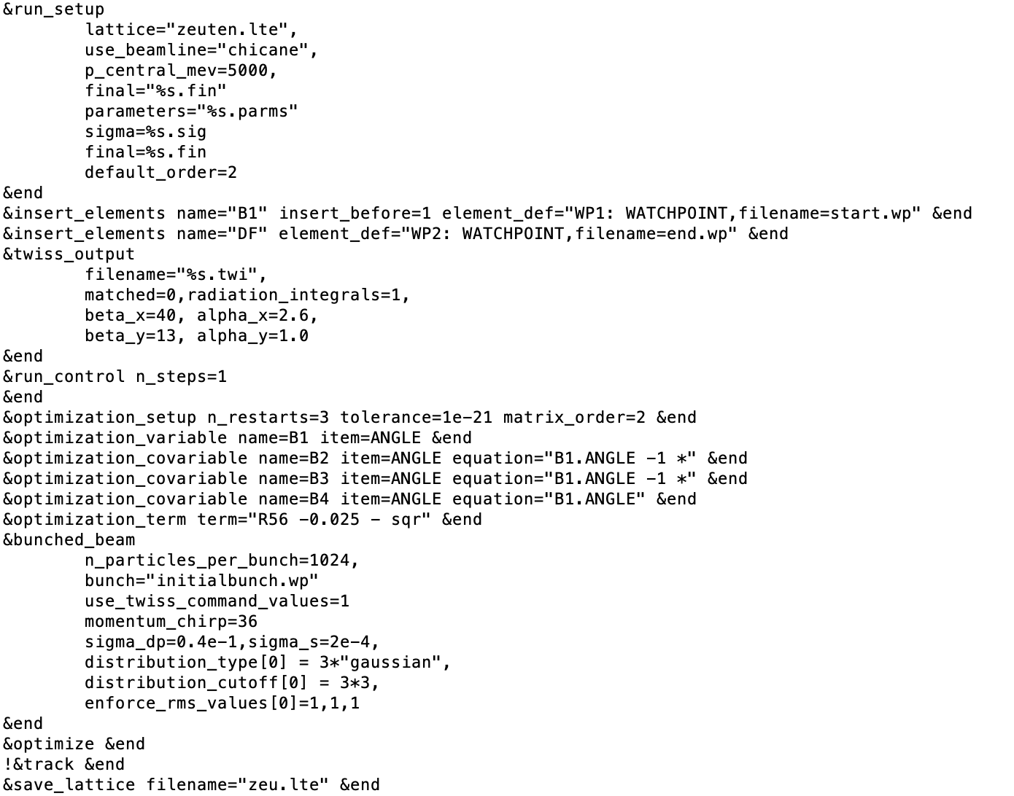
ELEGANT implementation

Slide 8
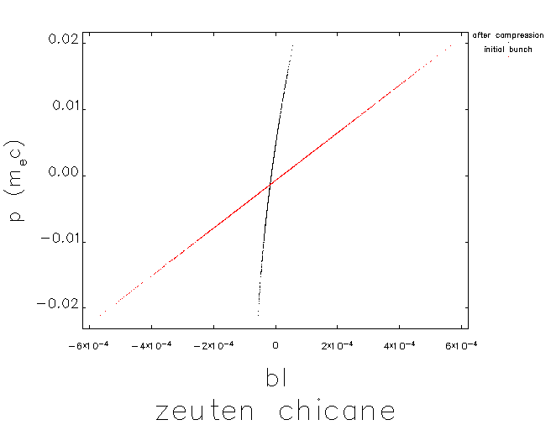
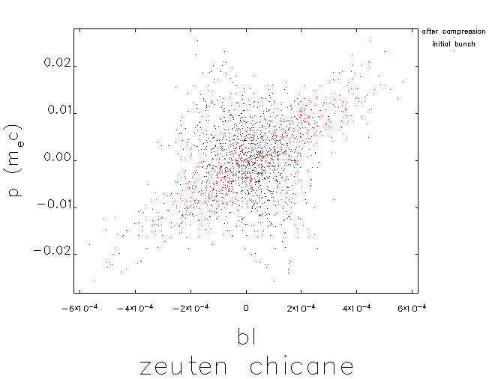
Example for various initial phase spaces
𝝈_{z} =2e-4 , 𝝈_{𝛿}=0.4e-5
𝝈_{z} =2e-4 , 𝝈_{𝛿}=0.4e-2
From 𝝈_{z} =2e-4 to 𝝈_{z} =2e-5
From 𝝈_{z} =2e-4 to 𝝈_{z} =1e-4

Slide 9
Various scenarios for longitudinal manipulations
Use a single magnetic chicane and do everything in it.
Use a chicane to rotate positron bunch upright, accelerate in NL to shrink uncorrelated energy spread, use ARC1 to compress bunch
Use two chicanes in injector. First one to make bunch upright at 60Mev, followed by acceleration with injector linac at 123 and a second chicane to compress bunch.
The first chicane can also have quadrupoles to shape dispersion and provide a region for putting collimators to do momentum selection. (1.6 meter dispersion in existing chicane means we select +/-1 1.6e-3 per 1mm radius aperture.

Slide 10
References, further reading
https://icfa-usa.jlab.org/archive/newsletter/icfa_bd_nl_38.pdf which describe chicane bunch compression physics.
https://uspas.fnal.gov/materials/10MIT/10_BunchCompressors.pdf class on bunch compressors.
https://wiki.jlab.org/ciswiki/images/3/36/CEBAF_harmonically_resonant_cavity_bunchlength_monitor.pdf paper on the brock cavity which has info on injector longitudinal optics relative to current out of Gun

