Slide 1
We are all on the same page !!!
  Positron upgrade is being considered as Stage I of an overall CEBAF upgrade that goes:
  positrons at 12 (11?) GeV using LERF as injector
  LERF upgrade in energy to prepare for 22 GeV CEBAF
  FFA arcs to upgrade CEBAF to 22 GeV
Yet, … positrons by itself is challenging.

Slide 2
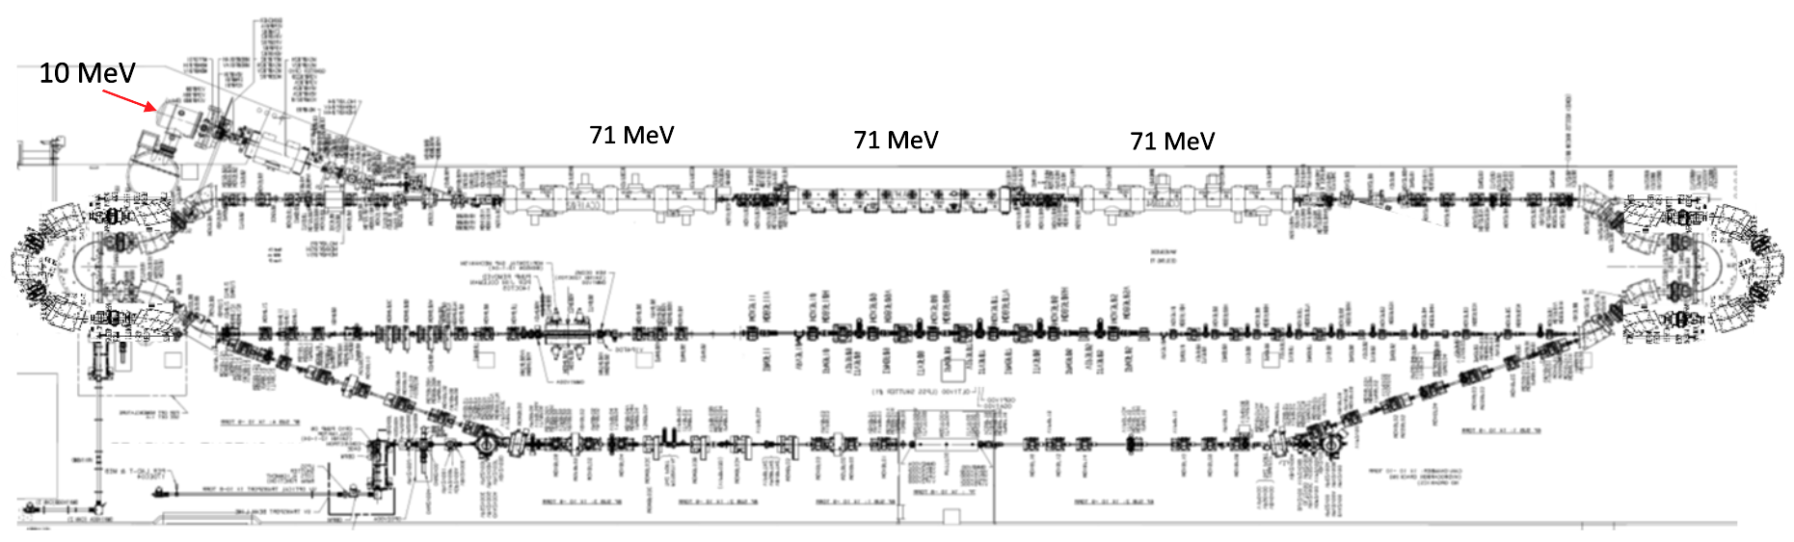
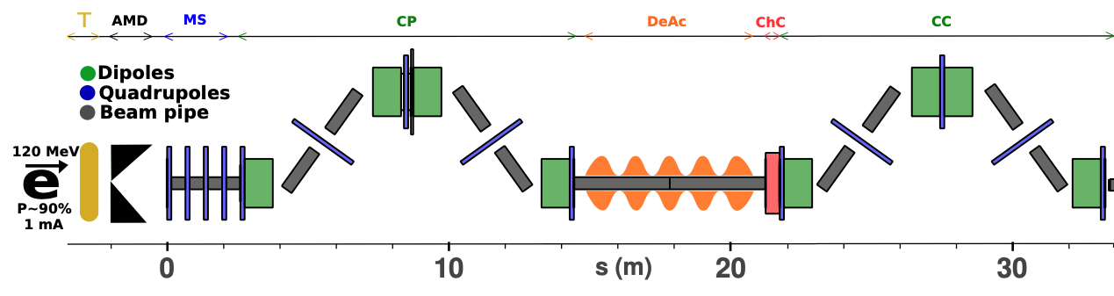
PEPPo II : Polarized e⁺ Prototype Experiment
Next, we want to build a scalable polarized positron injector at LERF to demonstrate beam
  300 kV polarized gun + Wien filter, demonstrate > 1kC lifetime at milliamp current
  Build up the SRF e- injector 50 – 100 MeV
  Ramp up efforts for high power target 50 – 100 kW, e+ collection and compression
  Complete start-to-end concept in FY23
#1 – Compact P-Gun, Wien filter, 10 MeV e- injector
#6 – SRF accelerate e+ to 123 MeV
#2 - SRF accelerate 60-120 MeV
#5 – Injector e+ to linac
#3 – Extract e- to target
#4 - Produce e+ accelerate to 50-70 MeV
#7 – Transport e+ at 123 MeV to exit LERF
2

Slide 3
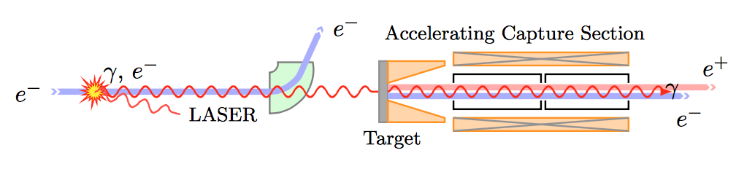
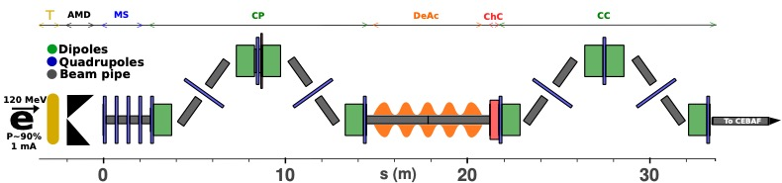
Collection concept is critical for FY23.
Fall 2021
Spring 2022
Shape of magnetic field determines whether a broad (intensity) or narrow (polarization) slice of momentum is selected.
Collection efficiency (0.01%) means 100 kW needed for 100 nA of polarized e+ or 1 uA of unpolarized e+
Target dE/dx can be 20-30 kW + eddy current loses if target spins in a magnetic field

Slide 4


Why a prototype experiment is so important…
Inside LERF (<123 MeV)
  5 mA polarized gun
  300 kV Wien filter
  100 MeV SRF e- linac
  20-30 kW cooled target
  0.5-1.5 Tesla solenoid
  warm e+ linac w/ solenoid
  100 MeV SRF e+ linac
  radiation/shielding
  transport optics
  100 MeV e+ spin rotator
  diagnostics
  Controls
  safety
Outside LERF (123 MeV – 12 GeV)
  tunnel
  new transport line
  re-injection into CEBAF
  bi-polar power supplies
  bi-polar magnets
  Hall D permanent magnet
  low-current diagnostics
  Large beam damps with energy
  Large dp/p beam damps with energy
  HE e+ spin rotators
  controls
  safety
Proposing Physics takes a lead role

Slide 5
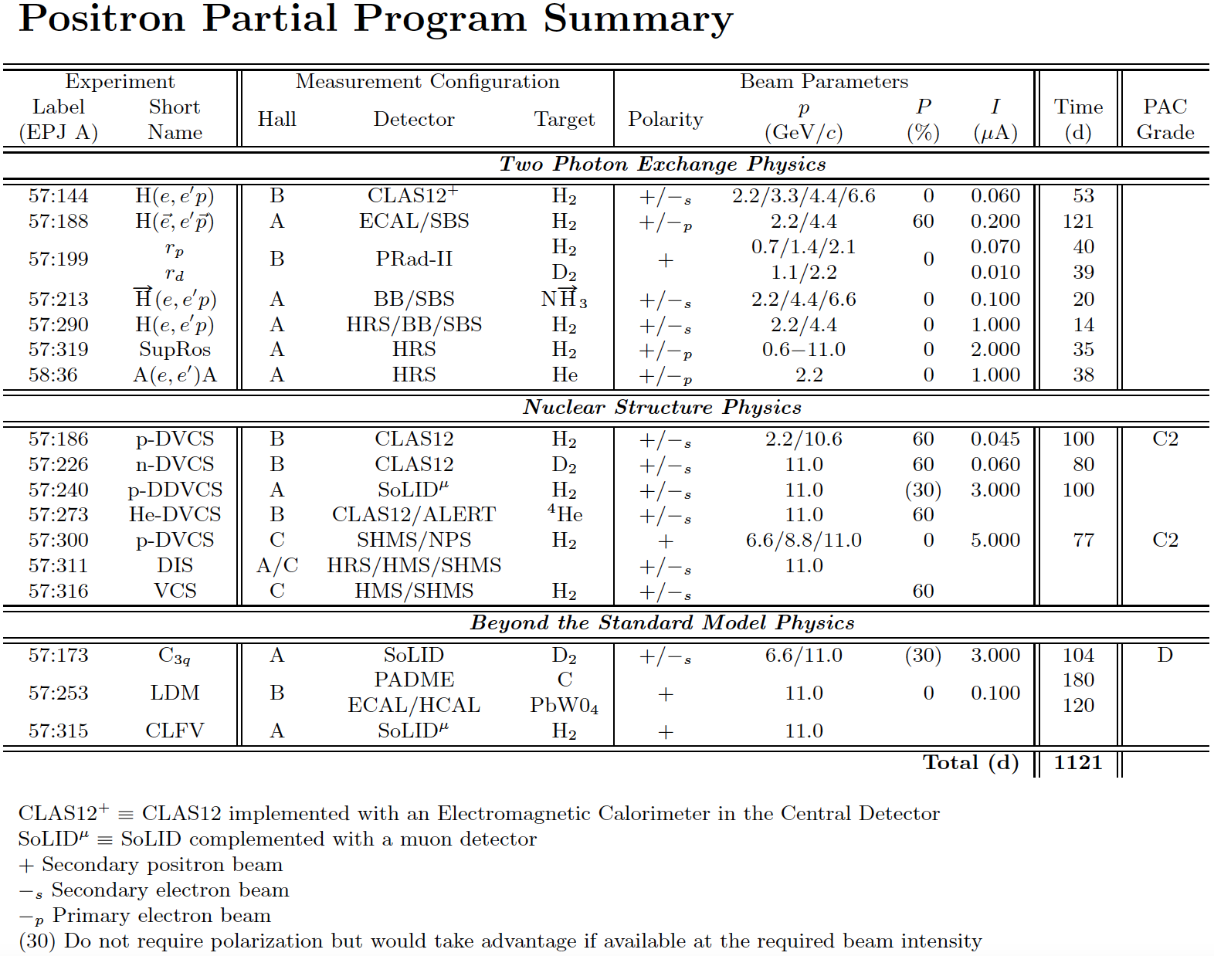

Slide 6
Some questions…
(and why I ask)
Would run periods be grouped as polarized and unpolarized?
(so far we imagine settings that collect one or the other; (maybe we can merge beams from two targets, doubling some of the resources, or being clever to extract two e+ beams from same target)
How many halls should be able to receive beam at once?
(w/ 0.01% collection efficiency each 100 kW of beam power provides a 100 nA or 1 uA beams; so variation like 0.01-0.04% is so important to test, tells us how many halls can be operated per kW)
Do we plan Hall D always needs 100 nA for a photon program?
(seems efficient, but need to imagine required rep rates needed for 5.5 pass, dealing with giant permanent magnet, and quality for coherent radiation if that’s required)
Do we retain capability to operate from CEBAF?
(meaning, might we run say for X months of e+ from LERF and then switch over to Y months of e- from CEBAF; could be an effective way to allows e+ experiments and e- experiments to be staggered, limiting # of halls for e+ at once?)
Do you envision positrons coming after Moller, but before SoLID?
(trying to understand the time frame for the prototype study, for setting priorities)

