Slide 1
The Wien filter spin rotator energy upgrade at Jefferson Lab
Gabriel G. Palacios Serrano
gpala001@odu.edu

Slide 2
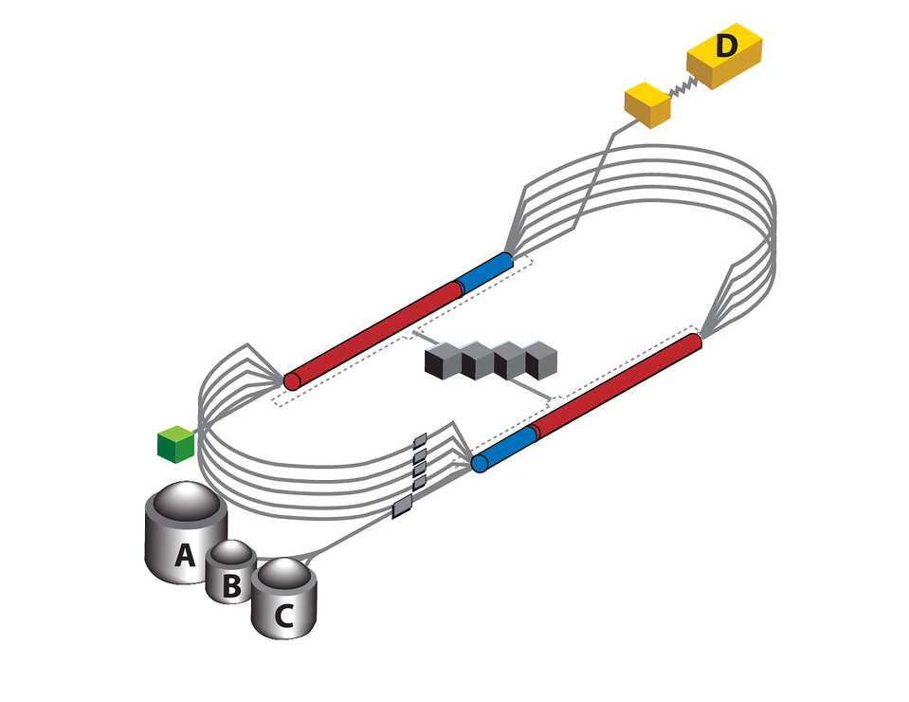
Introduction
Thomas Jefferson Nation Accelerator Facility (2019)
Jefferson Lab’s CEBAF* is the main linear electron accelerator
The initial section is the injector, which produces a beam of electrons
The beam interacts with the (many!) magnets throughout the 5 cycle acceleration, therefore, resulting in spin precession.
Nuclear physics experiments require beam polarized in a specific direction.
The spin angle is corrected in the injector using the Wien filter so that it reaches the four experimental rooms at the appropriate angle.
RF acceleration
Injector
+
Wien filter
Refrigeration
Bending magnets
Aligned Spin!
Experimental halls
* Continuous Electron Beam Accelerator Facility

Slide 3
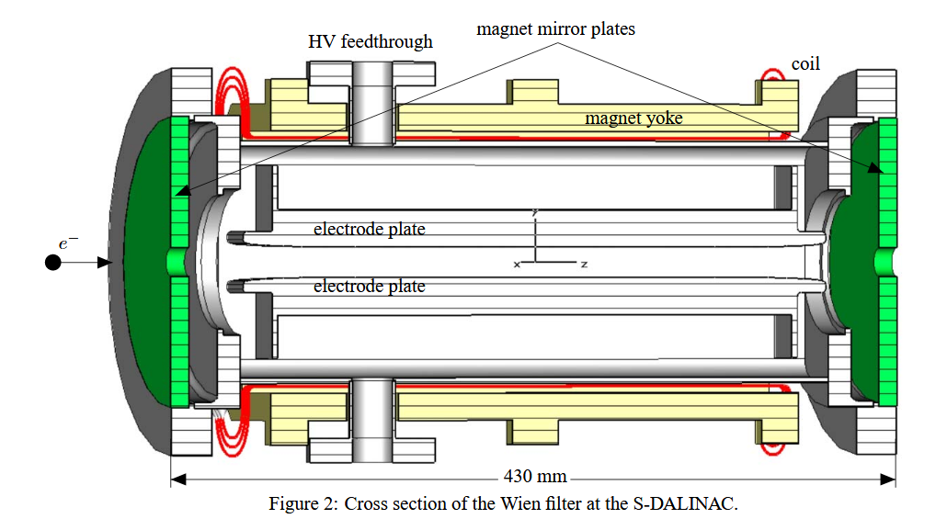
B. Steiner, W. Ackermann. (2007)
A little history
W. Wien (1898) Invented and used it to measure the charge-mass electron ratio
R. Herzog. W. Henneberg (1934) developed theory for charged particles inside the homogeneous E and B
W . Legler (1963) used it as an electron monochromator
H. Boersch et al (1964) used it as an energy analyzer
R. L. Seliger (1972) used it as a mass filter
The design used at CEBAF is originally from SLAC, and has been replicated at MAMI, MIT-Bates, and S-DALINAC.
*K. Tsuno & D. Ioanoviciu (2013)

Slide 4
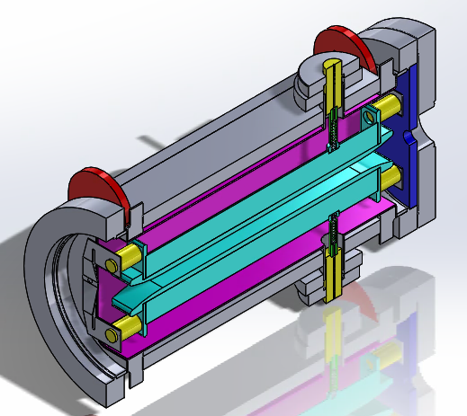
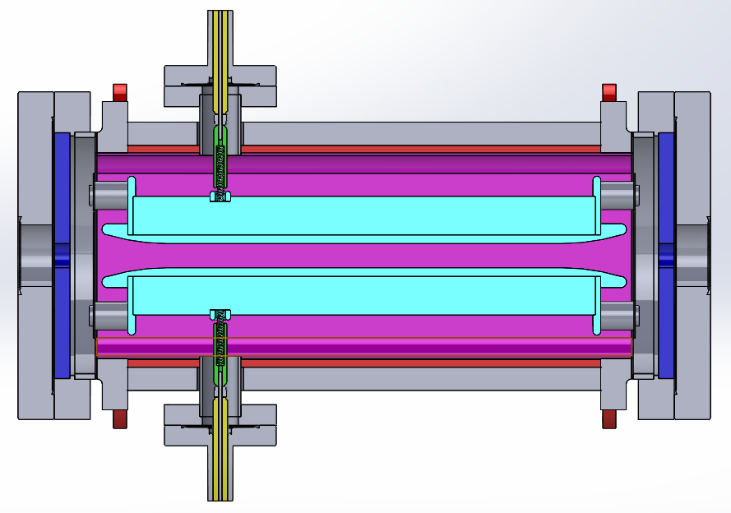
But, what is a Wien filter?
CEBAF’s 100 keV Wien filter
High voltage feedthrough
42 cm
Magnetic mirrors
Mounting insulators
Vacuum chamber
High voltage plates
Magnet coil
E
Steel shield
v
B

Slide 5
Two objectives
Provide Spin angle control
Do not deviate the beam trajectory
Beam trajectory
100 keV -> 200 keV

Slide 6
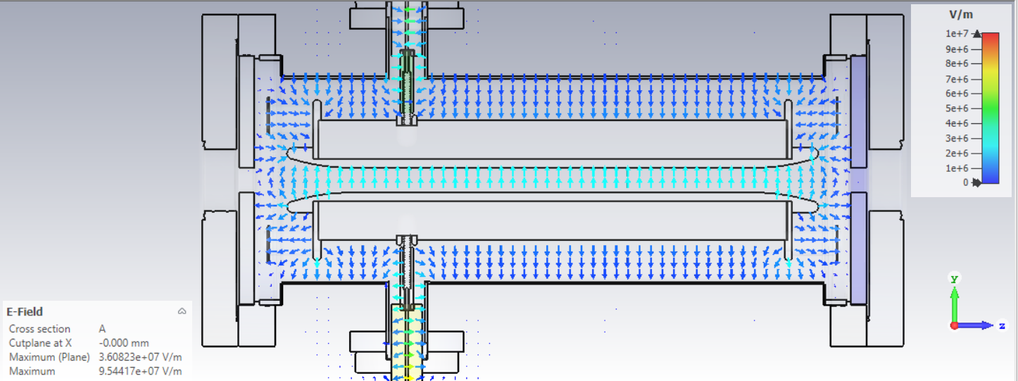
Beam trajectory
Don’t deviate the beam
Equilibrium condition: $q \left(E+v×B\right)=0$
Preserve this relation: $E_{y}=− v_{z} B_{x}$
Beam trajectory
Magnetic field

Slide 7
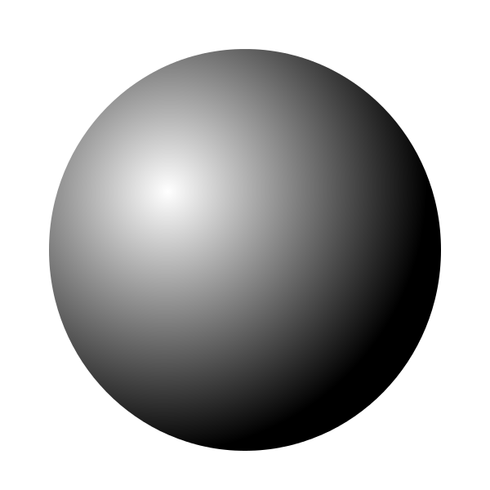
*Gamma here is not relativistic
Pause: What is spin?
Electrons behave as point magnetic dipoles
Analogous to macroscopic intrinsic spin
Electrons are point particles, so those can’t rotate
Then electron spin is a quantum property and we use more sophisticated math to model its behavior
Time evolution
Spin state with direction given by θ₀ and φ₀
Final state has rotated!
B. Zwiebach (2013)

Slide 8
Provide Spin angle control
Relativity requires Thomas-BMT to describe the change of spin with respect to time:
$\frac{ds}{dt}=s×$ $\text{Ω}$
For our case:
$$B=\frac{mcγ^{2}β\text{Ω}}{eL}$$
So the spin rotation angle:
Magnetic moment anomaly
Wait, what?
* J. D. Jackson. Wiley, (1975)
Notes:
Bargmann–Michel–Telegdi

Slide 9
Example at JLab:
For 100° spin rotation angle and we know the energy:
$$E_{k}=\left(γ−1\right)m_{0}c^{2}$$
$γ=\frac{E_{k}}{m_{0}c^{2}}+1=\frac{200 [keV]}{(0.510 [MeV/c^{2}])c^{2}}+1$ = 1.3914
The normalized velocity:
$$γ=\frac{1}{\sqrt{1−β^{2}}}→β=\sqrt{1−\frac{1}{γ^{2}}}=0.6953$$
And we obtain the magnetic field magnitude (at homogeneous region):
$$B_{x}= \frac{m_{0}cγ^{2}β\text{Ω}}{eL}$$
$$B_{x}=\frac{ (9.1093×{10}^{−31} [kg])(3×{10}^{8} [m/s]){(1.3914)}^{2}(0.6953)\left(\text{1.74533} rad\right)}{(307×{10}^{−3} [m])(1.602×{10}^{−19} [C])}$$
$$B_{x}=13 [mT]$$
Kinetic energy
Relativistic factor
Will use this to get Ey

Slide 10
Then the electric field
We use the magnetic field in the equilibrium condition:
$$E_{y}=v_{z}∙B_{x}$$
$$E_{y}=\left(0.6953\right)\left(3×{10}^{8}\left[\frac{m}{s}\right]\right)\left(13×{10}^{−3} \left[T\right]\right)=2.7\left[\frac{MV}{m}\right]$$
So the potential per plate for a 0.015 [m] gap:
$$V=20.3 [kV]$$
To keep the beam trajectory
Which defines the power supply set point
All great but in practice…

Slide 11
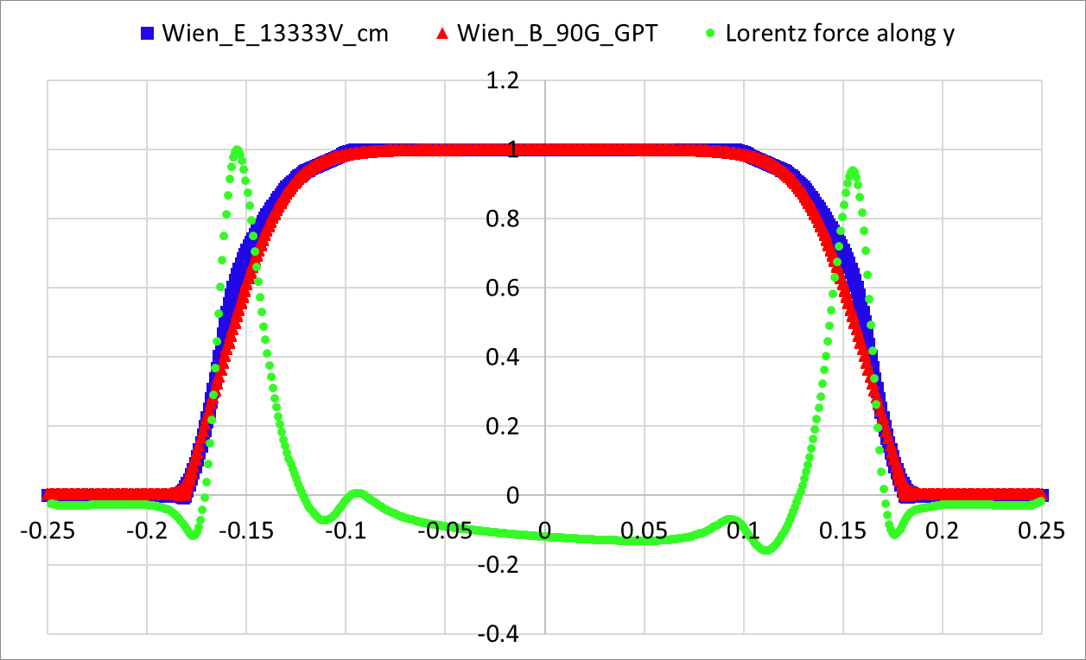
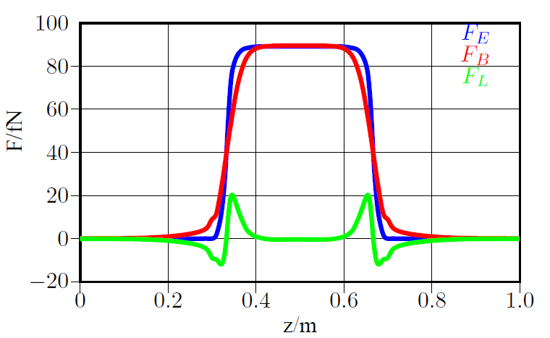
GPT simulation results for CEBAF
But in practice
What!?
Ideally, to fulfill the equilibrium condition, E and B should be step functions that result in a zero net force F_{L}
Experimentally this is not possible, producing vertical deviations, due to fringe field region asymmetry. We call this “the kick”.
B. Steiner, W. Ackermann. (2007)
Let’s see the device then!

Slide 12
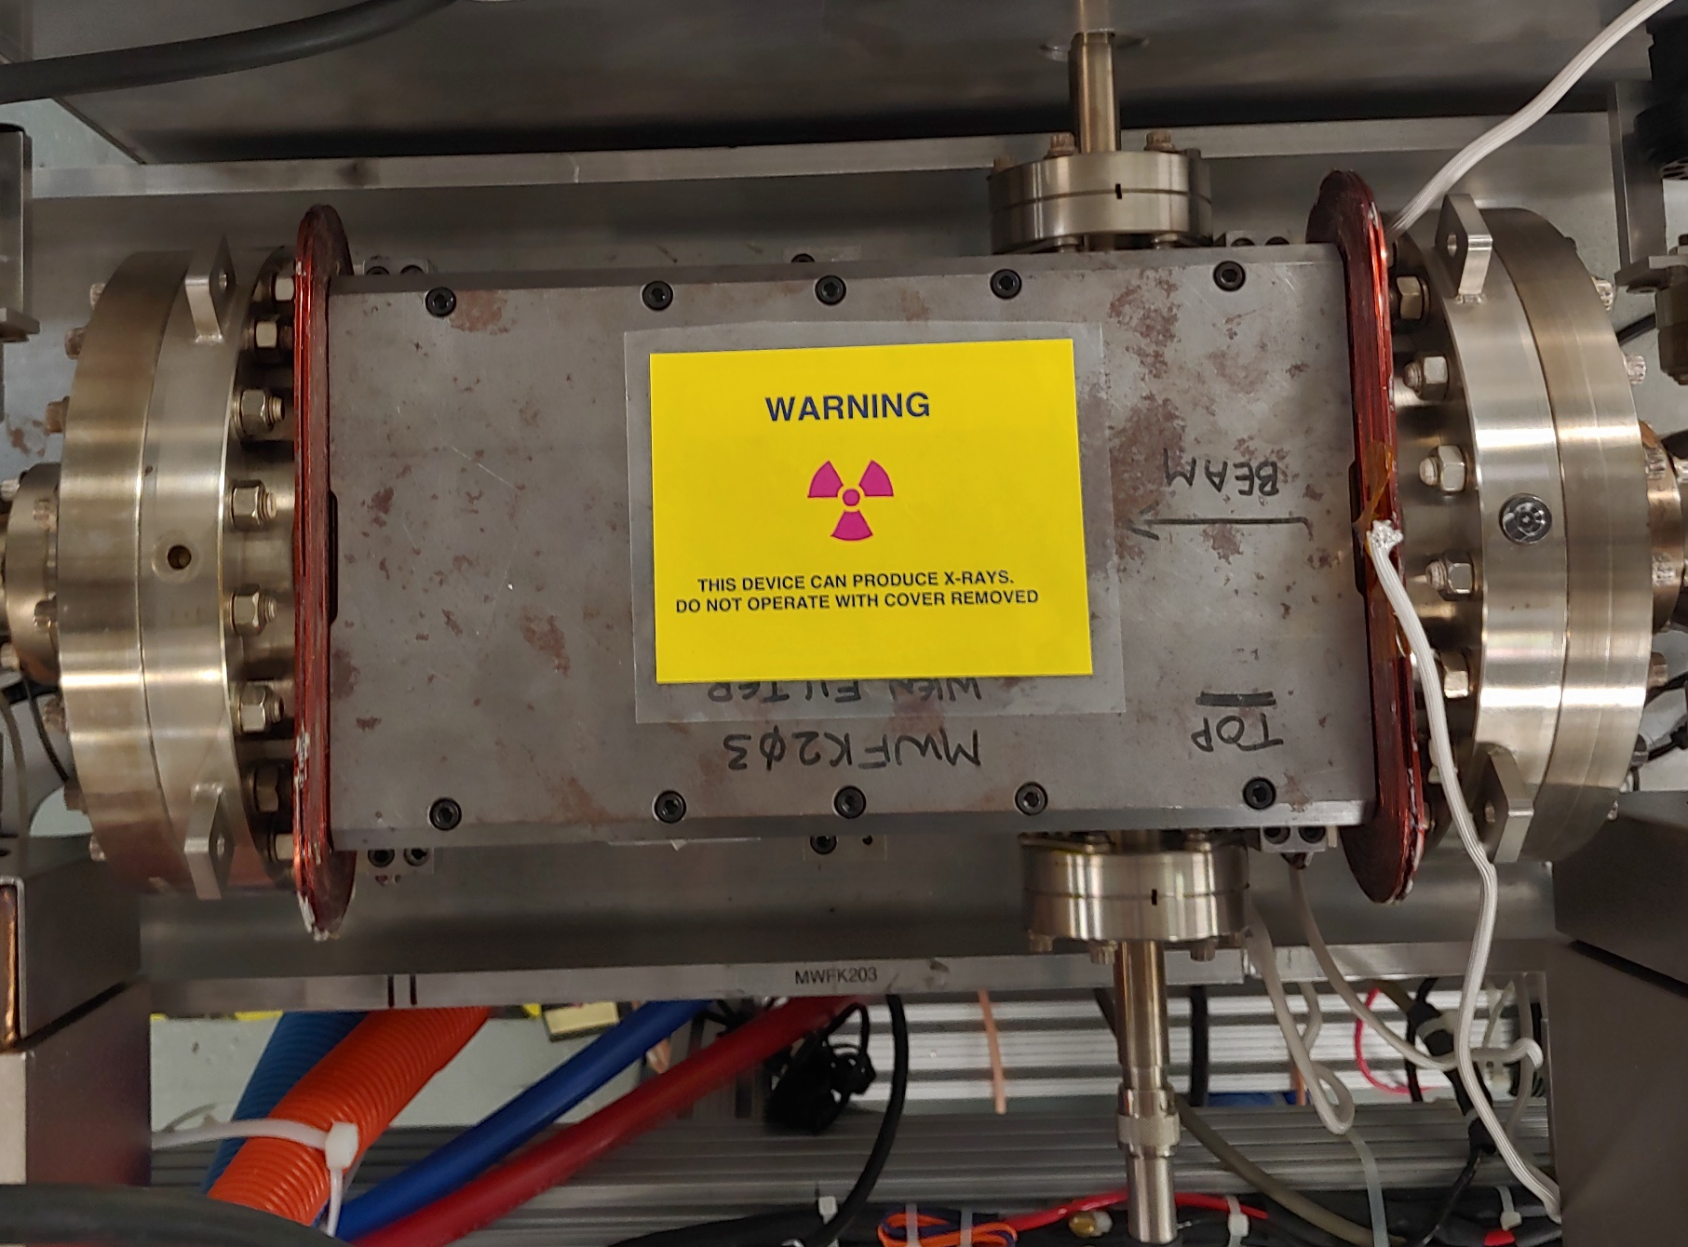
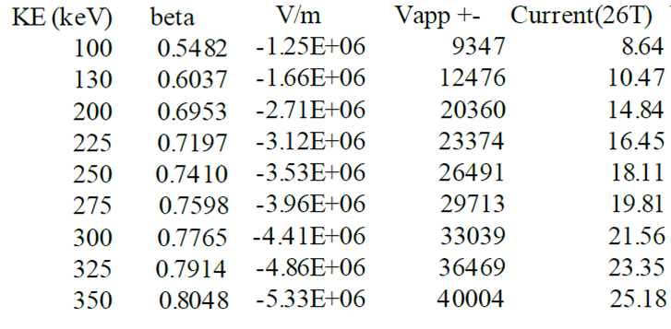
Experiments
Jefferson Lab (2019)
Existing in CEBAF 130 keV
We want to go to 200 keV!
For 100° spin rotation
J. Benesch. (2009)
Thesis!

Slide 13
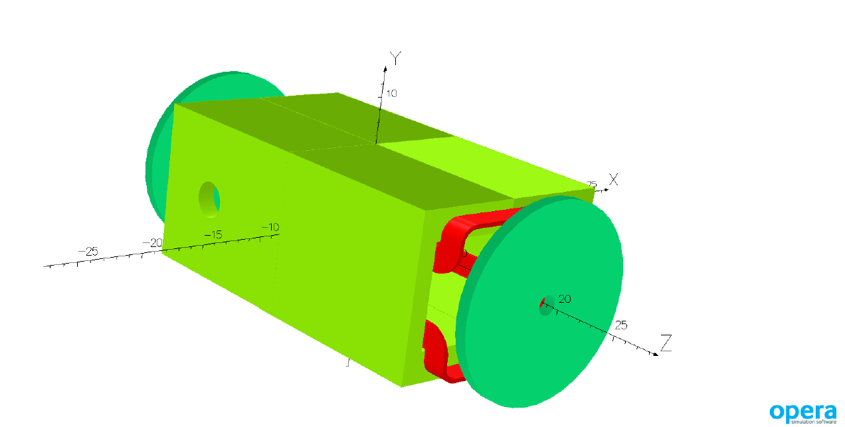
What do we need?
CEBAF requires higher energy beam
we updated the electron source
we update the Wien filter
Higher energy beam requires:
Higher electric field
Higher magnetic field
High voltage challenges:
New HV feedthroughs compatible with our geometry
New power supplies
No field emission
Higher current in coils, increased cross section
J. Benesch. (2009)
But we must not change too many things because:
Time
Money
Test it in the virtual world

Slide 14
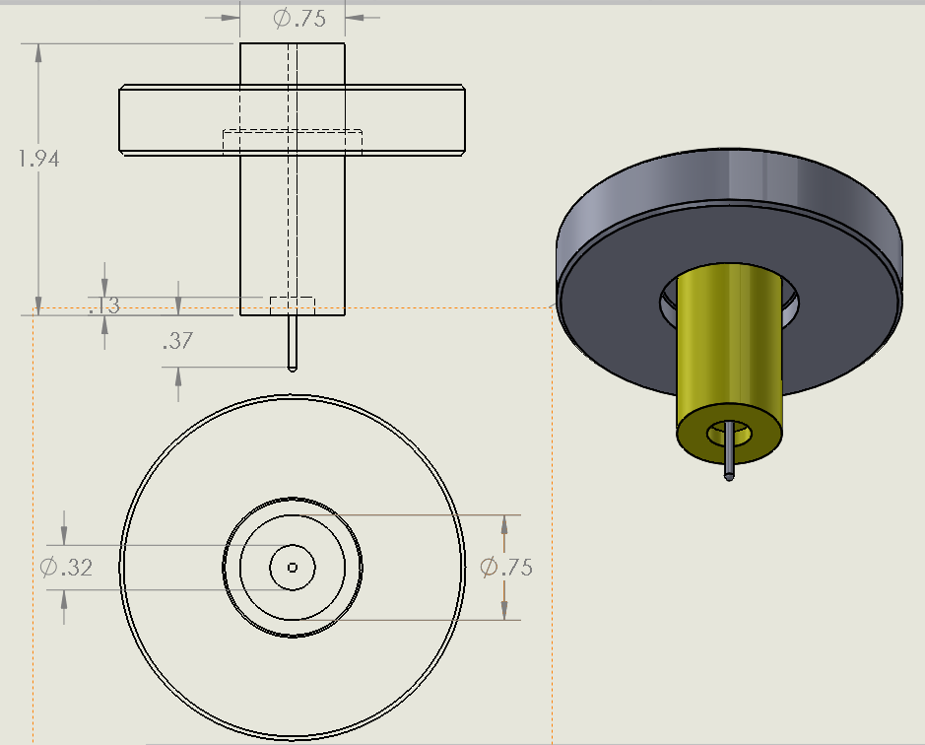
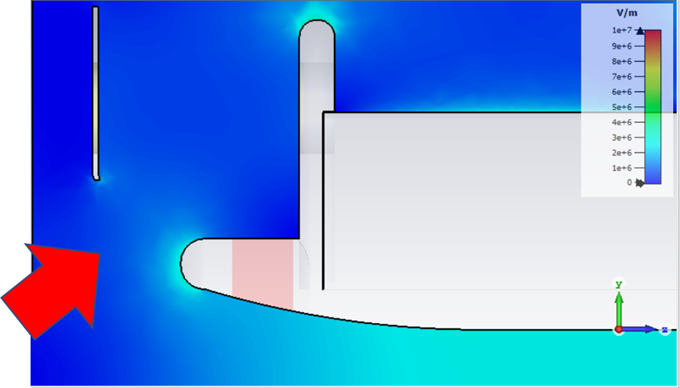
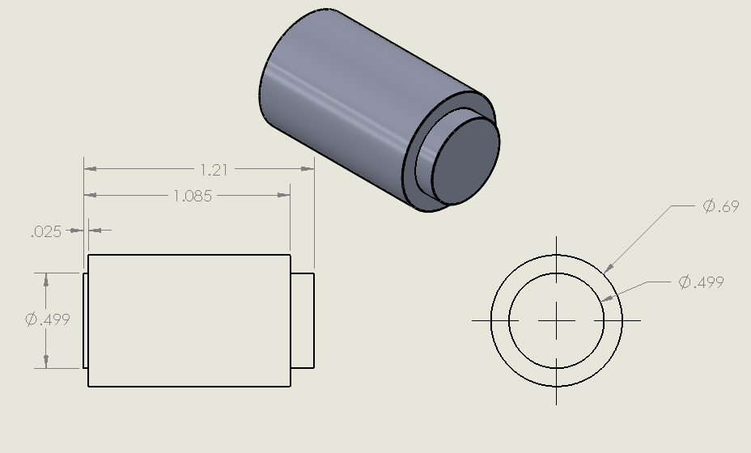
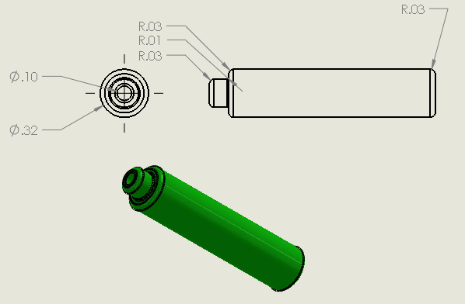
Simulations
CST EM studio
Thesis!
Solidworks models

Slide 15
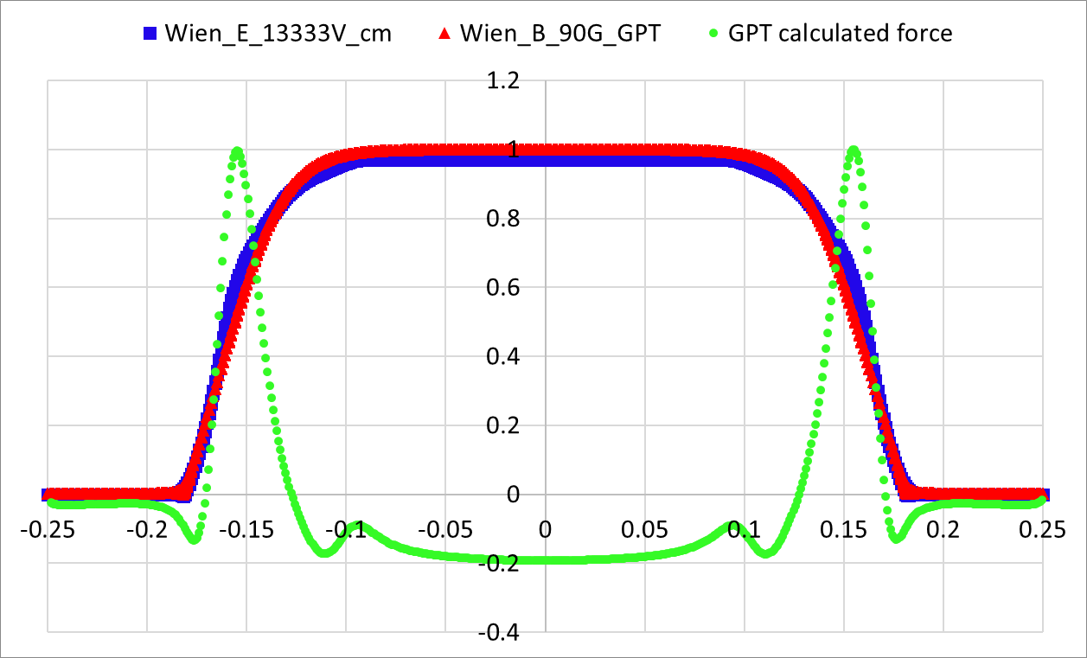
Remember me?
Simulations
Kick due to fringe fields!
F_{y}
F_{z}
“No transmission”
vs transmission (97% Ey)
$$F_{y}=q\left(E_{y}+v_{z}B_{x}\right)=\frac{d }{dt}({{γ m}_{e} v}_{y})$$
$$F_{z}=q\left(E_{z}+v_{y}B_{x}\right)=\frac{d }{dt}({γ{ m}_{e} v}_{z})$$
Done with Pulsar physics GPT

Slide 16
Now to the real world
Simulations
Based on the beam dynamics digest by the Darmstadt team
Done with Pulsar physics GPT

Slide 17
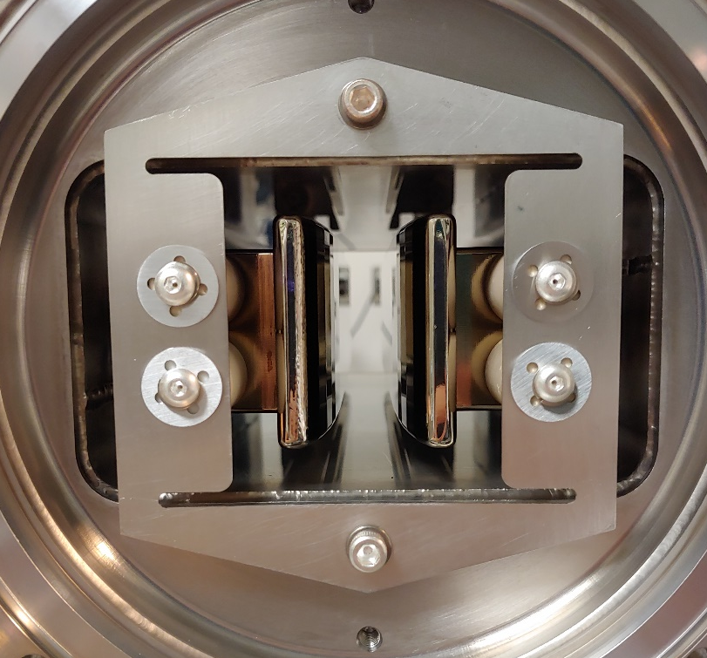
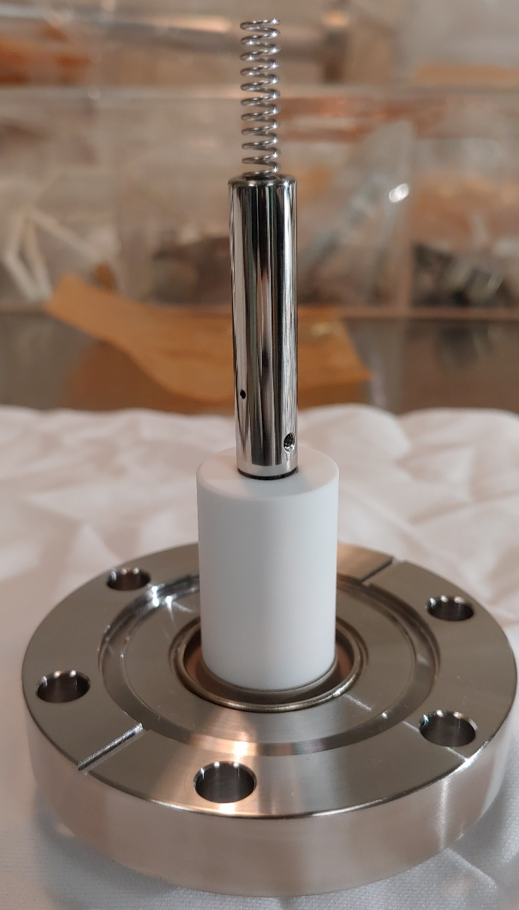
Hands-on work
Bake, vacuum check, troubleshoot
Test, repair
Assembly/S&A
Final product!
Buy/manufacture

Slide 18
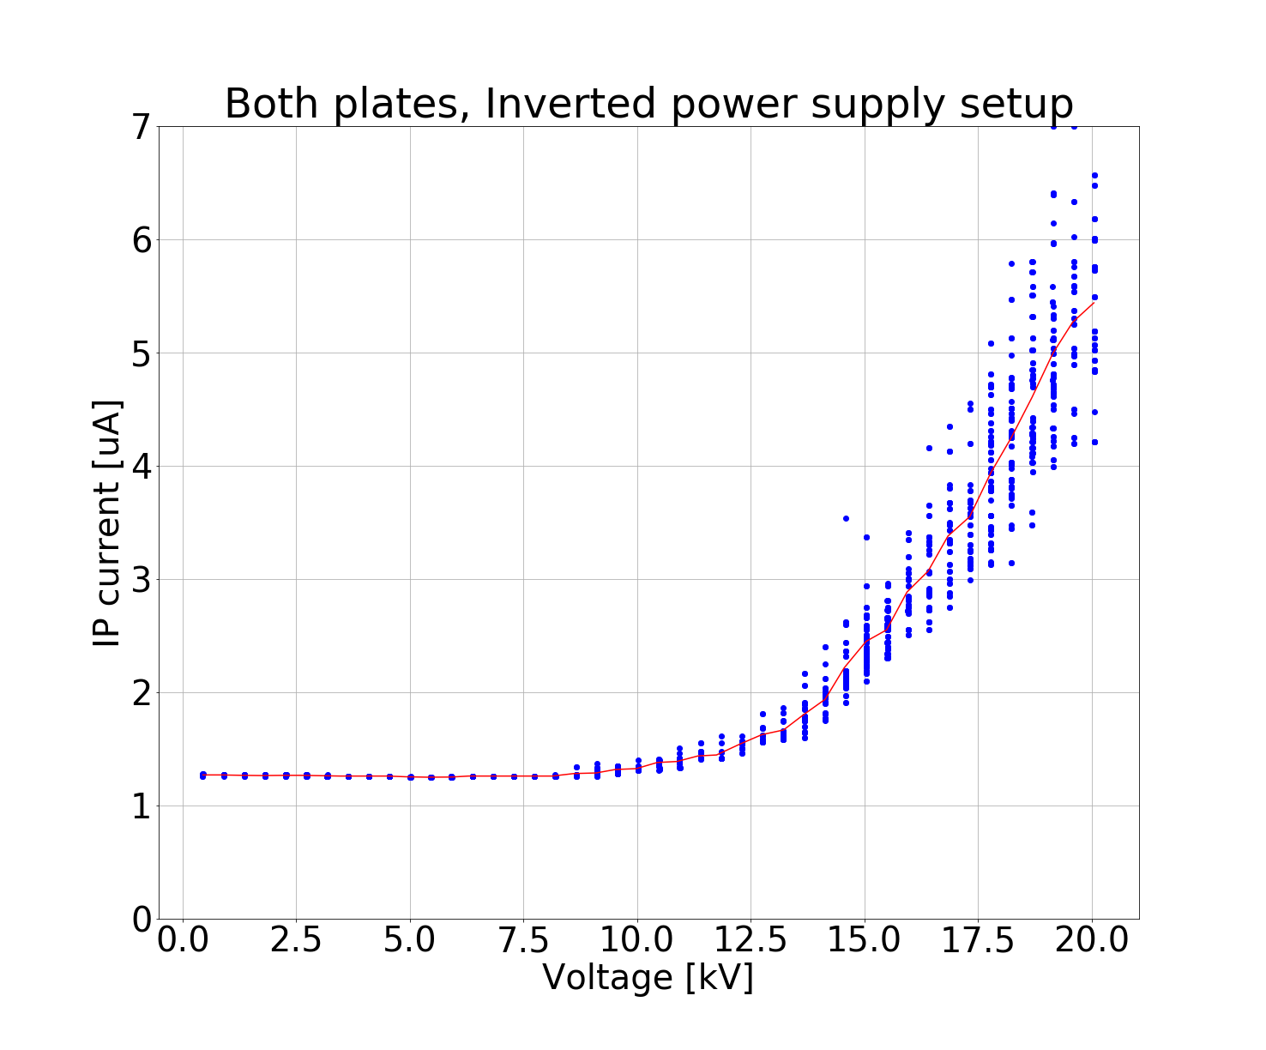
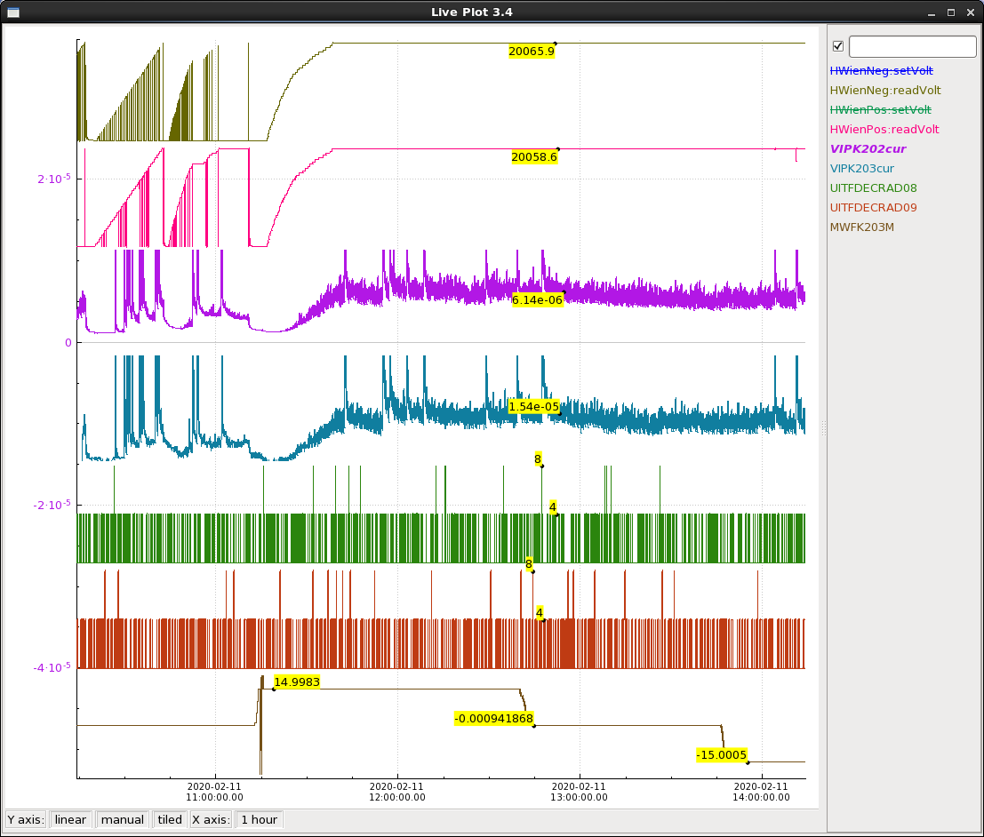
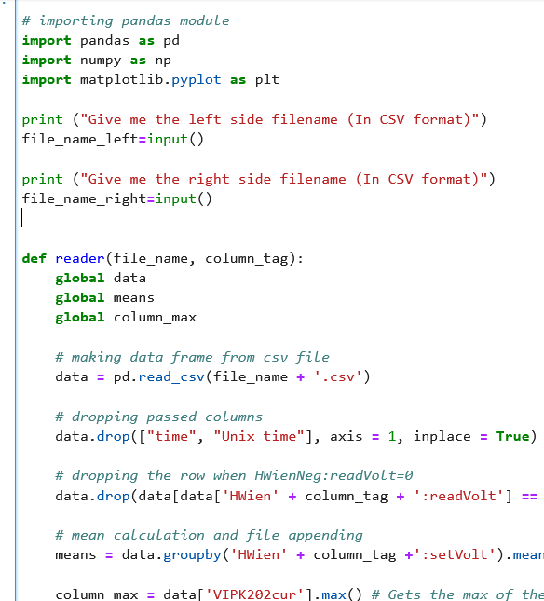
HV testing
Data processing with
Python
Visualization and analysis
Done!
Monitor on EPICS

Slide 19
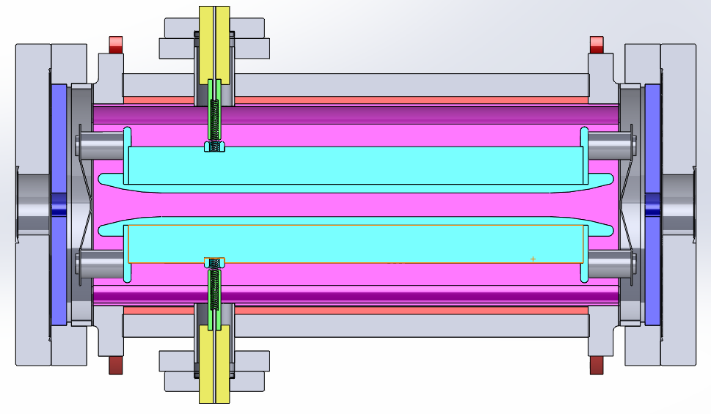
What’s next?
Variable Gap
High gradient optimization
Rogowski profile
Asymmetric bias
Magnetic mirror optimization
And of course: Beam! ☹

Slide 20
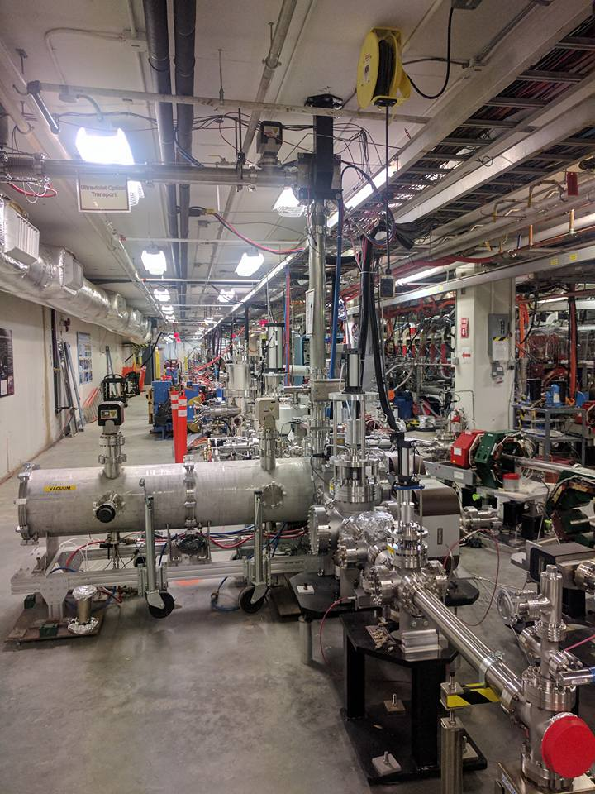
Finally
There are many other things related to the Wien filter!
Polarimetry, Monte Carlo simulations, machine learning …
The accelerator community is going to keep using this device and at higher energies, so we need to keep working on it!
The field is an excellent place for new science students to thrive and develop a career!
The accelerator community needs you!

Slide 21
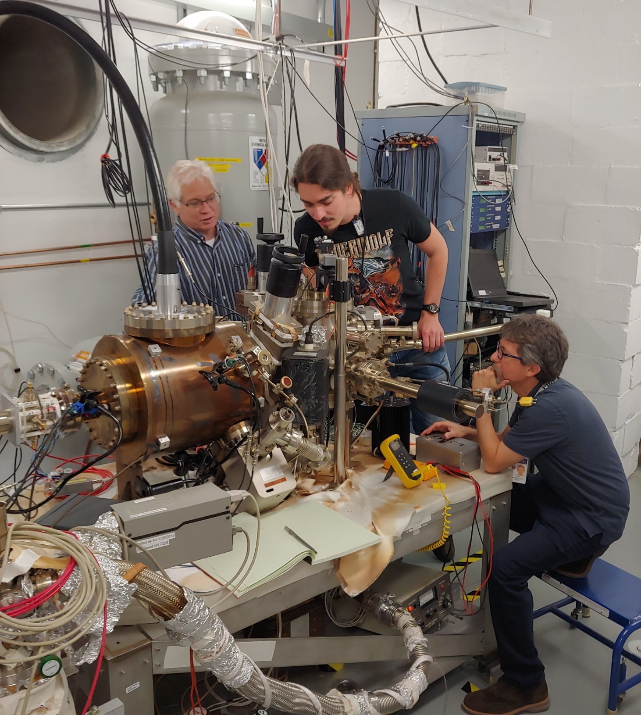
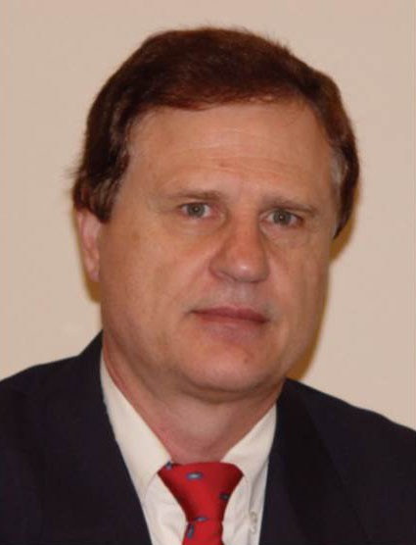
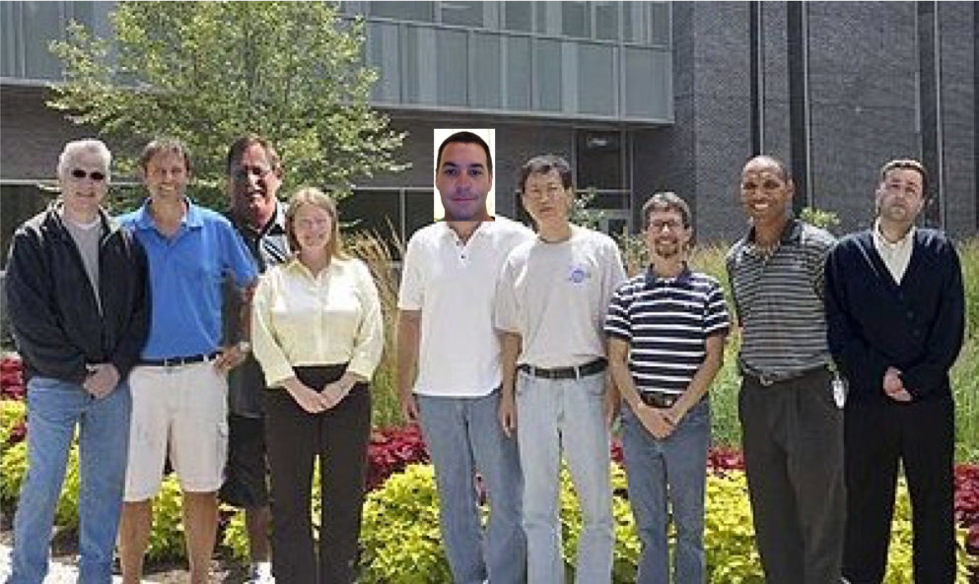
Acknowledgements
I thank my advisers Dr. Helmut Baumgart, Dr. Matt Poelker, and Dr. Carlos Hernández García for the support and patience!
To Jefferson Lab’s injector group for the guidance and for being so cool!
To ODU and you, the audience for your attention!

Slide 22
References
The MOLLER Collaboration. arXiv:1411.4088v2 [nucl-ex] (2014).
E. Plies et al. Nuclear Instruments and Methods in Physics Research A645 (2011).
M. Salomaa & H. A. Enge. Nuclear Instruments and Methods 145 (1977).
E. Leal-Quiros & M. A. Prelas. Rev. Sci. Instrum. 60 (3), (1989).
B. Steiner, W. Ackermann. Proceedings of PAC07, Albuquerque, New Mexico, USA. (2007).
V. Tioukine, K. Aulenbacher. Nuclear Instruments and Methods in Physics Research A 568 (2006).
J. Grames et al. Proceedings of 2011 Particle Accelerator Conference, New York, NY, USA. (2011).
J. Grames et al. Physical Review Special Topics - Accelerators and beams, Vol. 7, 042802 (2004).
J. D. Jackson. Wiley, (1975)
P. Pereyra. Fundamentals of quantum physics. Springer (2012).
J.L. McCarter et al. Nuclear Instruments and Methods in Physics Research A 738 (2014).
T. Zolkin. Notes on QMII. University of Chicago department of Physics.
Jay Benesch. Modeling the SLAC/JLab Wien filter. Jlab internal technical note. 2009.
J.L. McCarter et al. Nuclear Instruments and Methods in Physics Research A618 (2010).
B. Zwiebach . Two state systems, MIT Open Courseware, (2013).
K. Tsuno & D. Ioanoviciu. Advances in Imaging and Electron Physics 176. Academic Press (2013)
CST Studio Suite, “CST Microwave Studio,” 2019. http://www.cst.com
Solidworks https://www.solidworks.com
Pulsar Physics General Particle Tracer http://www.pulsar.nl/gpt

Slide 23
FIN

Slide 24
Extras
Using the calculated value of E field = 1.65 MV/m
kicks beam out of z-axis
Using 97 % E (1.61 MV/m) restores the trajectory

Slide 25
Extras

Slide 26
Extras

