Slide 1


Generation and Dynamics of Magnetized Beams for High-Energy Electron Cooling*
Northern Illinois Center for Accelerator
and Detector Development
Philippe Piot,
Department of Physics and Northern Illinois Center for Accelerator & Detector Development, Northern Illinois University, DeKalb IL 60115
Accelerator Physics Center, Fermi National Accelerator Laboratory, Batavia IL 60510
Yin-e Sun,
Advanced Photon Source, Argonne National Laboratory, Argonne IL 60439
International Workshop on Accelerator Science & Technologies
for future electron-ion colliders (EIC’14), Jefferson Lab, March 17-21, 2014
*sponsored by the DOE awards DE-FG02-08ER41532 to Northern Illinois University and
DE-AC02-07CH11359 to the Fermi Research Alliance LLC.

Slide 2
Outline
Introduction
Features and parameterization of magnetized beams
Formation of magnetized bunches:
  methods and limitations,
  experiments in rf gun.
Transport and Manipulation:
  transverse matching,
  longitudinal manipulations,
  decoupling into flat beams.
Outlook

Slide 3

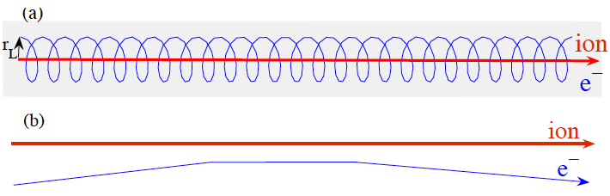


Required Electron-Beam Parameters
Cooling interaction
time
magnetized cooling
less dependent on
e- beam transverse emittance (to what
extent?)
(magnetized)
(not magnetized)
(not magnetized)
(magnetized)
electron-cooling accelerator provides beam eventually matched to cooling-solenoid section

Slide 4
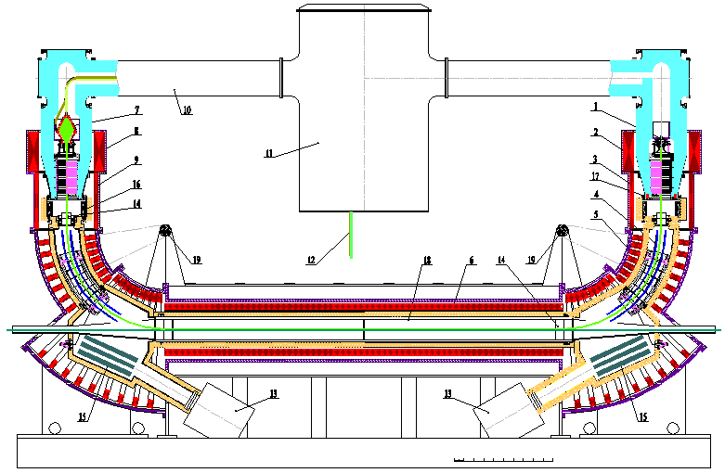
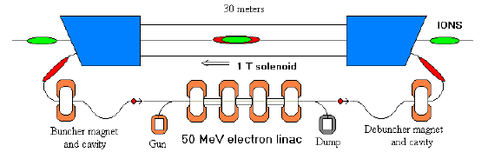
Cooler configurations
low-energy coolers:
  lattice (bends) embed-ded in magnetic fields,
  based on DC electron sources,
  no further acceleration or bunching, needed.
high-energy coolers:
  medium energies required (50-100 MeV),
  acceleration in SCRF linac bunching
  lumped solenoidal fields matching
e.g. see S. Nagaitsev, et al, PRL96, 044801 (2006)
e.g. see I. Ben-Zvi, et al., Proc. PAC2001, p. 48 (2001)
300 keV, 3 A cooler produced
by Budker INP for IMP,
Lanzhou (China)
early concept for RHIC e-cooling

Slide 5
High-energy coolers
matching
mode/converter
magnetized-
beam injector
acceleration
bunching
debuncher
injector: produces bunched beam for RF acceleration
debuncher: matched electron bunch length to ion-beam’s,
matching + mode/converter sections: repartition “physical” emittances, match in cooling-solenoid section.
matching
cooling
section
dump or
energy recovery

Slide 6

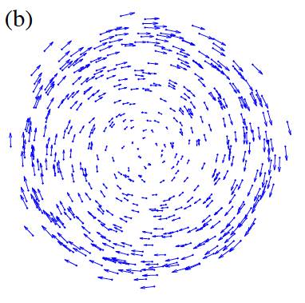
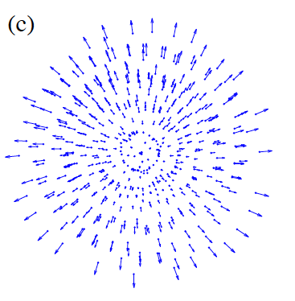
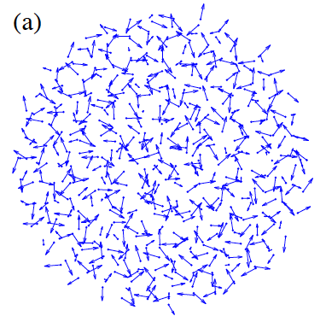
Beam dynamics regimes (round beams)
Radial envelope (σ ) equation in a drift (Lawson):
adapted from Y.-E Sun, Dissertation U. Chicago (2005)
angular momentum
contribution
space charge
emittance “pressure”
: generalized perveance
: uncorrelated geometric emittance
: magnetization

Slide 7
Features & Parameterization
possible parameterization of coupled motion between 2 degrees of freedom has been extensively discussed; see:
  D.A. Edwards and L.C. Teng, IEEE Trans. Nucl. Sci. 20, 3, pp. 885-889 (1973).
  I. Borchardt, E. Karantzoulis, H. Mais, G. Ripken, DESY 87-161 (1987).
  V. Lebedev, S. A. Bogacz, ArXiV:1207.5526 (2007).
  A. Burov, S. Nagaitsev, A. Shemyakin, Ya. Derbenev, PRSTAB 3, 094002 (2000).
  A. Burov, S. Nagaitsev, Ya. Derbenev, PRE 66, 016503 (2002).
Simpler description that provides the necessary insights..

Slide 8
A simple description of coupled motion
Consider the 4x4 beam matrix
Introduce the “correlation” matrix:
Beam matrix takes the form:
The correlation subjects to transforms as
C provides information on the coupling only.
where

Slide 9
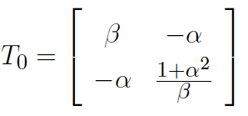
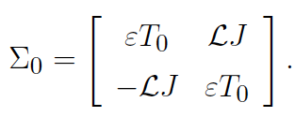


Beam matrix for a round magnetized beam
At a waist, the matrix of a magnetized (round) beam is
The eigen-emittances of this beam matrix are:
the eigen-emittances can be mapped into “physical” emittances using a skewed
beamline
where
and the magnetization is
K.-J. Kim, PRSTAB 6, 104002 (2003)
D. A. Edwards, unpublished (2001)
where
decoupling
when

Slide 10
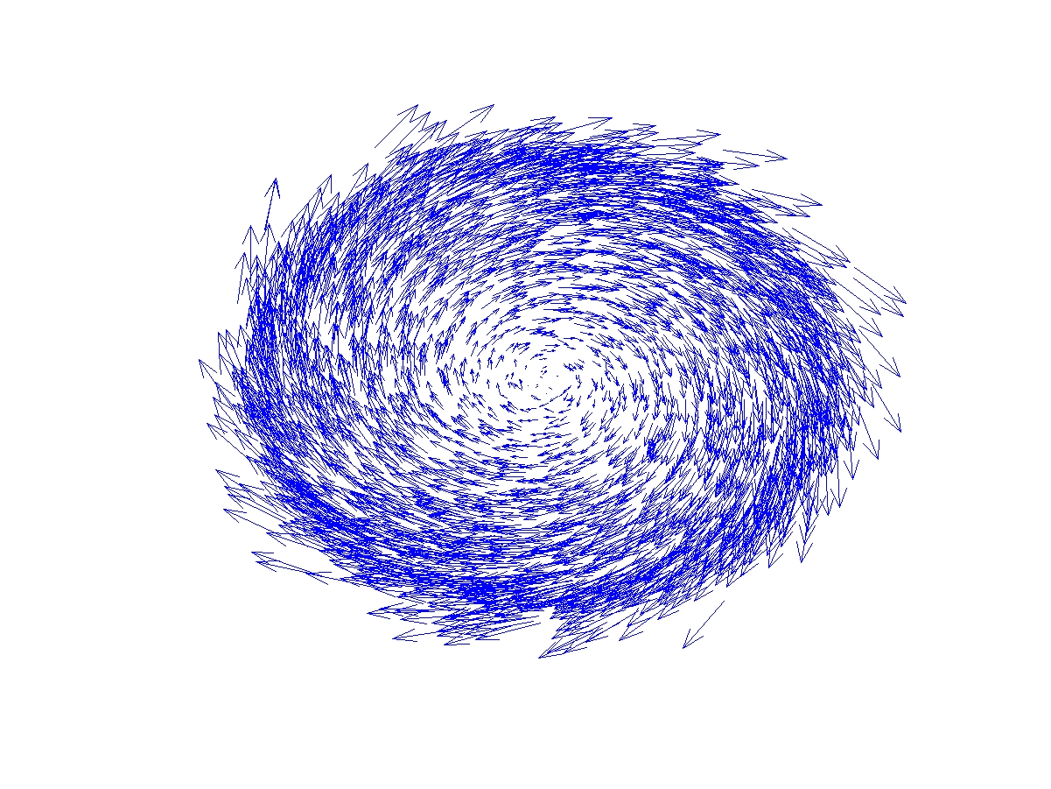

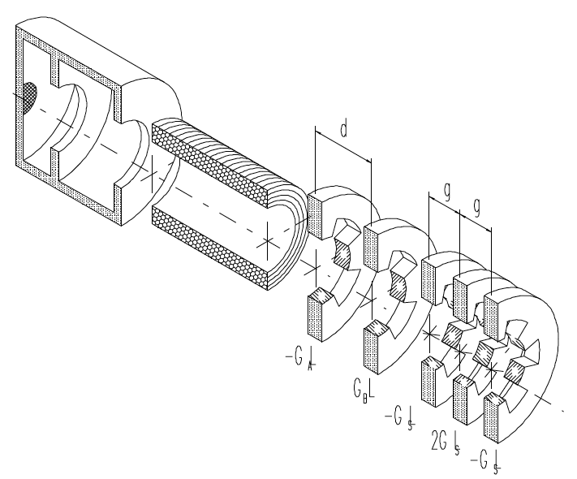
Formation of magnetized bunches
Cathode immersed
in an axial B field
Sheet beams at birth (with
subsequent flat-to-round
beam converter)
  shaped cathode,
  line-laser focus
  Nonlinear optics
  (speculative)
mode
converter
Y. Derbenev, University of Michigan
report UM-HE-98-04 (1998)
G. Florentini, et al.,
Proc. PAC95, p. 973 (1996)

Slide 11
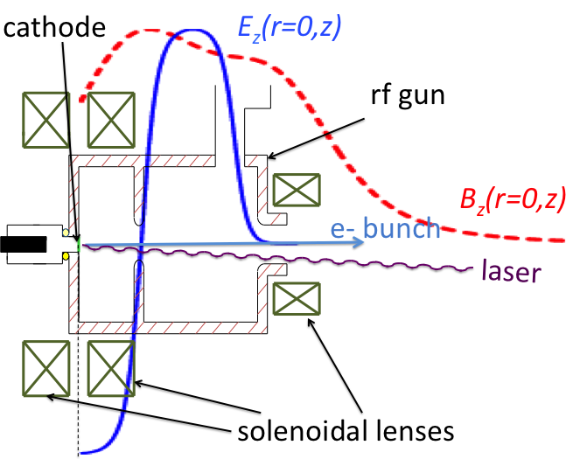
Cathode in a magnetic field
electrons born in an axial B field CAM
upon exit of solenoid field ( ): CAM becomes purely kinetic.

Slide 12
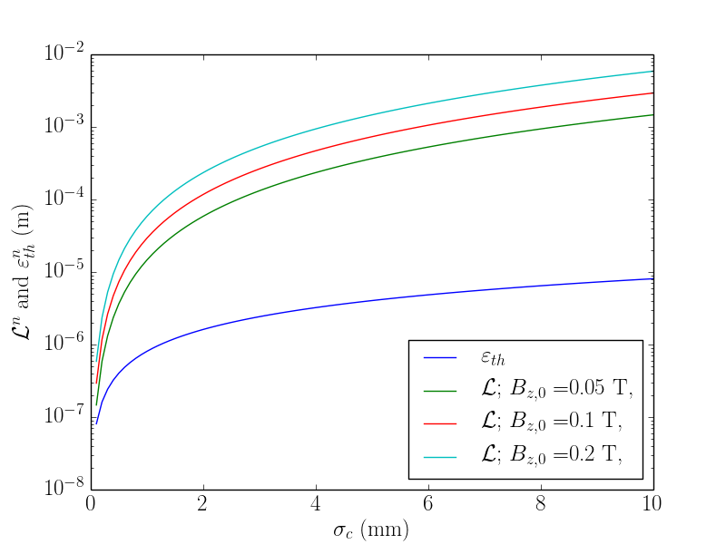
Emittance vs magnetization
“effective emittance”
magnetization
The emittance has a
lower-bound value :
Practically, includes other
contributions.
where is the excess in kinetic
energy during emission

Slide 13
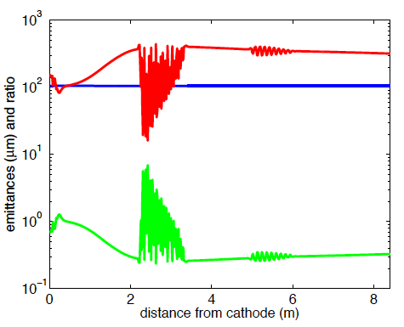
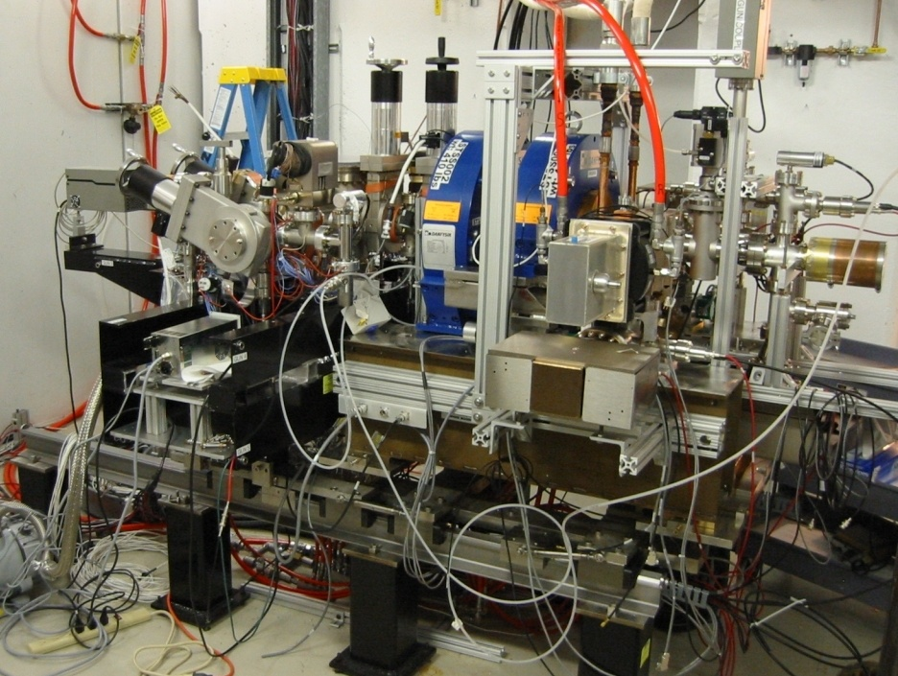
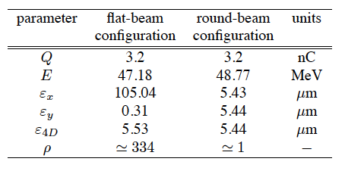
Example of 3.2-nC magnetized bunch
high-charge bunch
subject to emittance
degradation
proper optimization
(emittance compensation)
4-D emittance com-
parable to round beams.
eigenemittances evolution
in ASTA photoinjector
P. Piot et al. IPAC13; C-X. Wang, FEL06, 721 (2006)
X. Chang, I. Ben-Zvi, J. Kewisch AAC04 (2004)

Slide 14
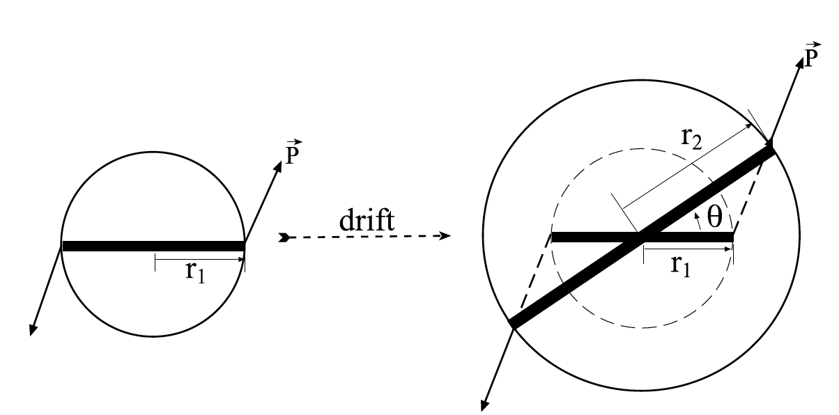
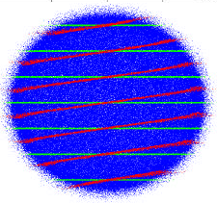
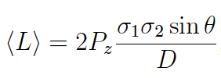

Measuring (kinetic) angular momentum
Kinetic angular momentum can be measured
using a slit technique (similar to emittance)
The beam’s average angular
momentum is given by
Y.-E Sun et al, PRSTAB 7, 123501 (2004)
beam at slits
beam at observation point
: rms beam size at slit (1) and
observation screen (2),
: axial momentum
: drift length between locations
(1) and (2).

Slide 15
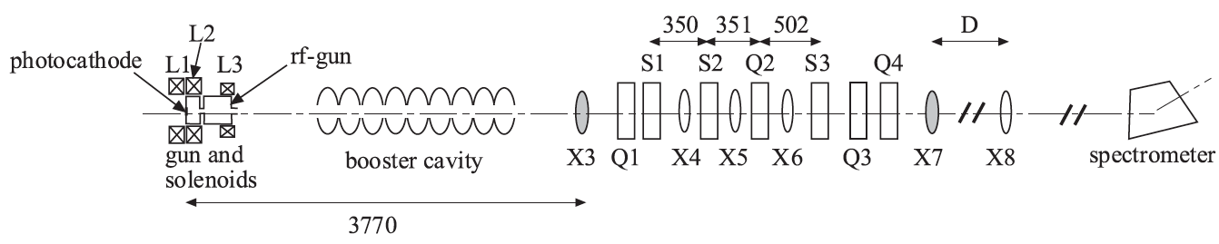
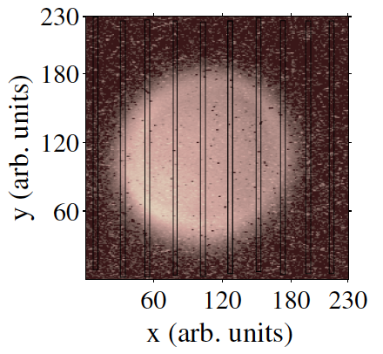
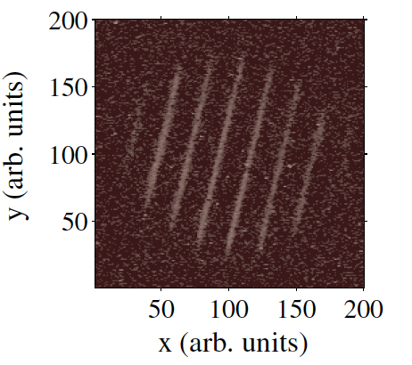
Experimental generation in a photoinjector
Fermilab A0 normal-conducting photoinjector (decommissioned),
15 MeV, charge up to 2 nC,~3-10 ps bunch
main focus was conversion to flat beams
Y.-E Sun et al, PRSTAB 7, 123501 (2004)

Slide 16
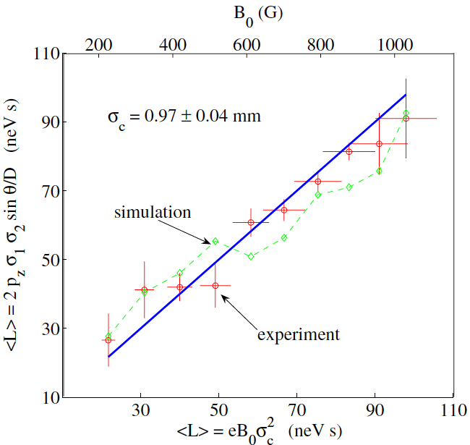
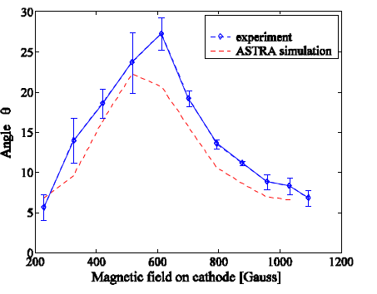
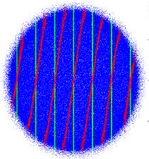
Experimental generation in a photoinjector
linear scaling with B field on photocathode
Y.-E Sun et al, PRSTAB 7, 123501 (2004)
rotation angle (deg)
magnetic field B₀ on cathode (G)

Slide 17
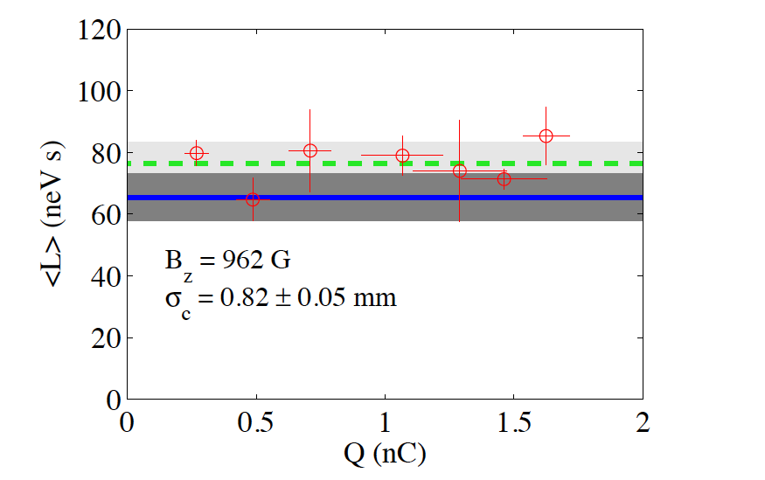
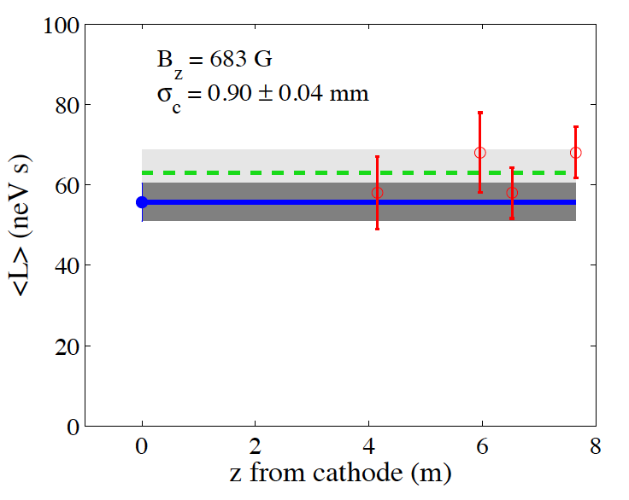
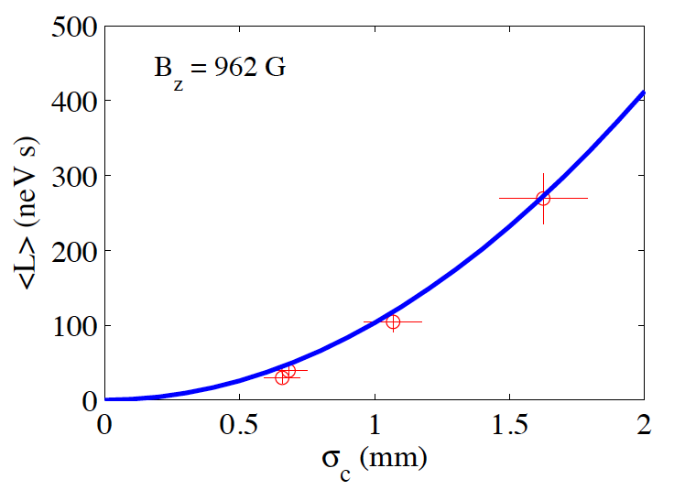

Experimental generation in a photoinjector
weak dependence,
quadratic scaling
with laser spot size
on photocathode.
Y.-E Sun et al, PRSTAB 7, 123501 (2004)
measured kinetic
angular momentum
CAM from applied B field

Slide 18
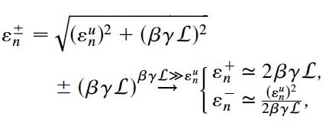
Decoupling into flat (ε_{x}/ε_{y}≠1) beam
Transport of magnetized bunches while preserving is challenging,
Use of round-to-flat beam transformer to
convert into uncoupled (flat) beam
eigen-emittances maps into “physical” transverse emittances:
R. Brinkmann et al., PRSTAB 4, 053501 (2001)
Y. Derbenev, University of Michigan report UM-HE-98-04 (1998)

Slide 19
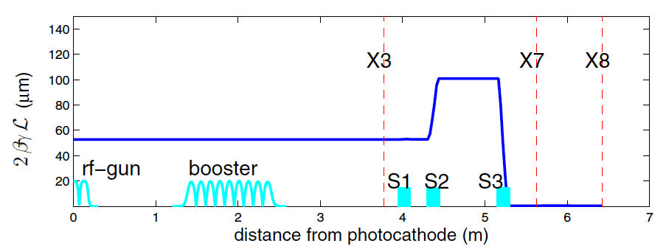
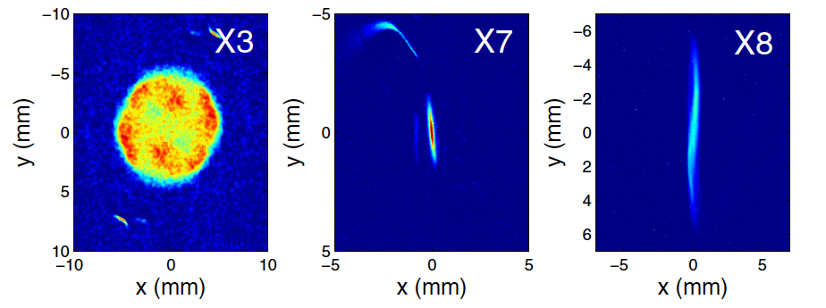
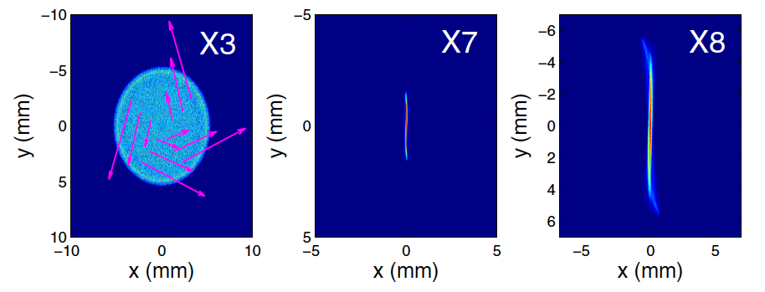
Decoupling into flat beam: experiments (1)
Same experimental setup as used for generation
of CAM-dominated beams
simulations
P. Piot, et al, PRSTAB 9
, 031001 (2006)
0.5 nC
experiments
simulations

Slide 20
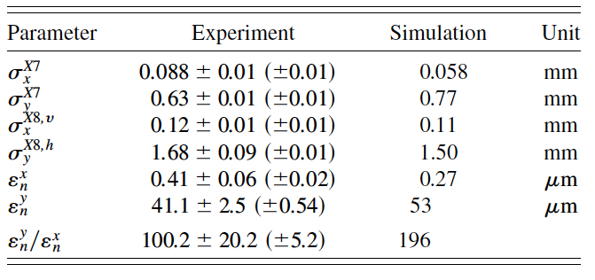
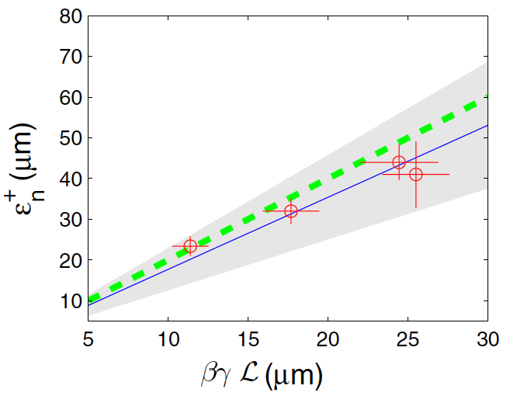
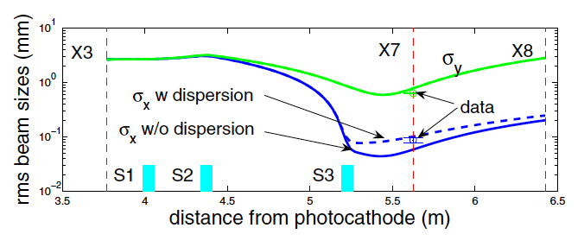
Decoupling into flat beam: experiments (2)
normal emittances
map into the flat-
beam emittance
large experimental
uncertainties for
smallest emittance meas.

Slide 21
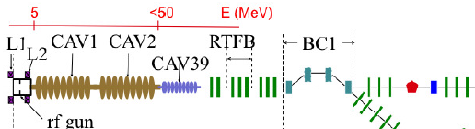
Outlook + open questions
magnetized beam from a SCRF gun:
  flux concentrator around cathode?
  flat beam at cathode
  [J. Rosenzweig, PAC93 showed ( , )=(95,4.5) μm]
needed and ? and limit on 4-D emittance?
planned future experiment at ASTA

