Slide 1
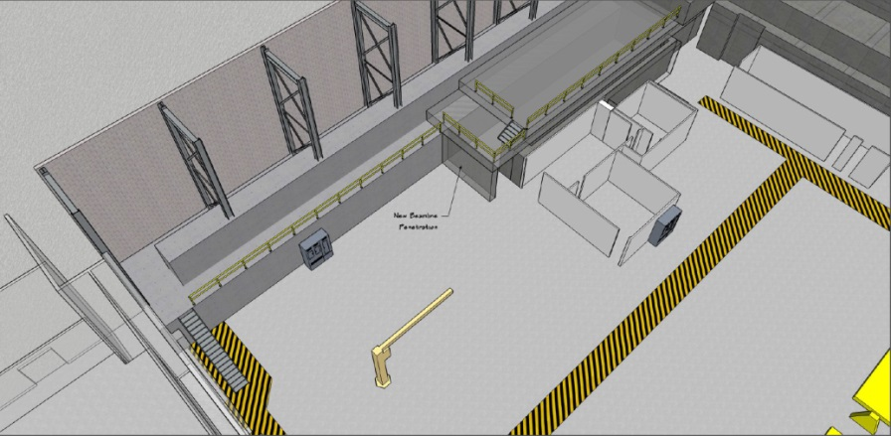
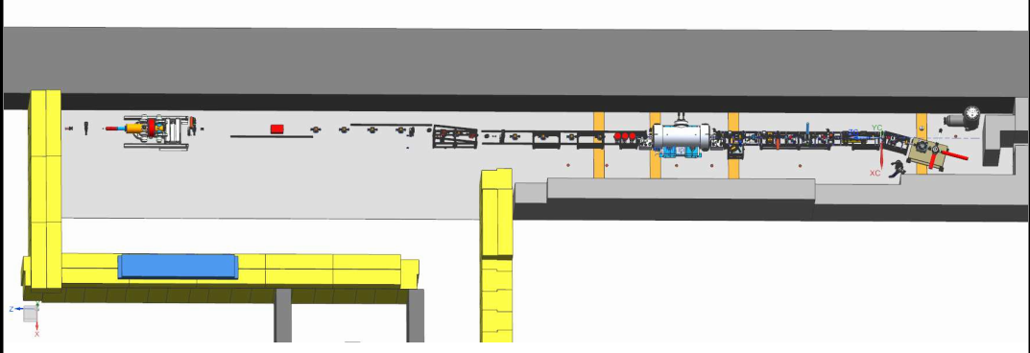
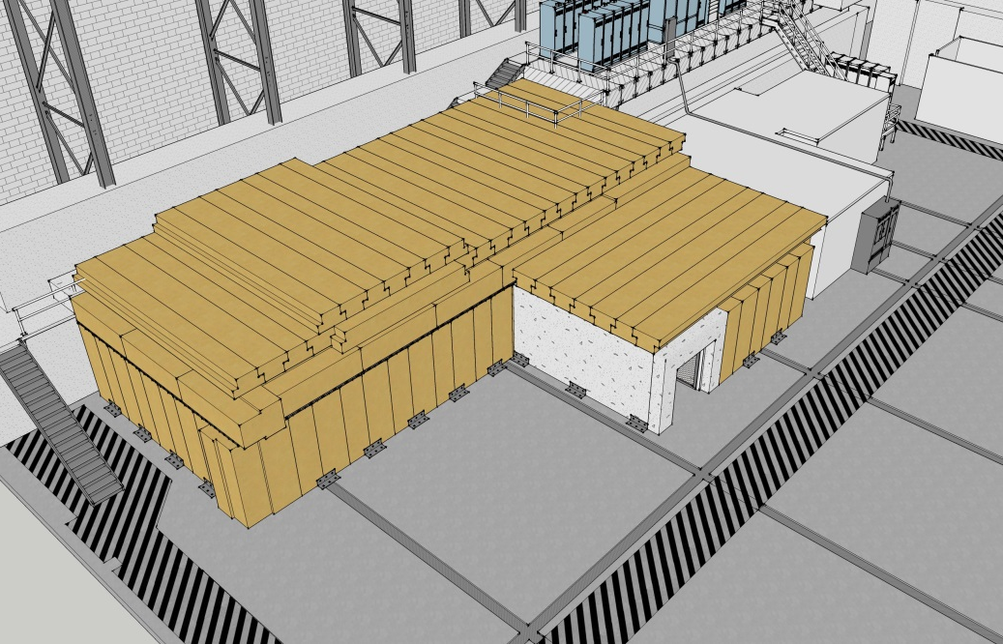
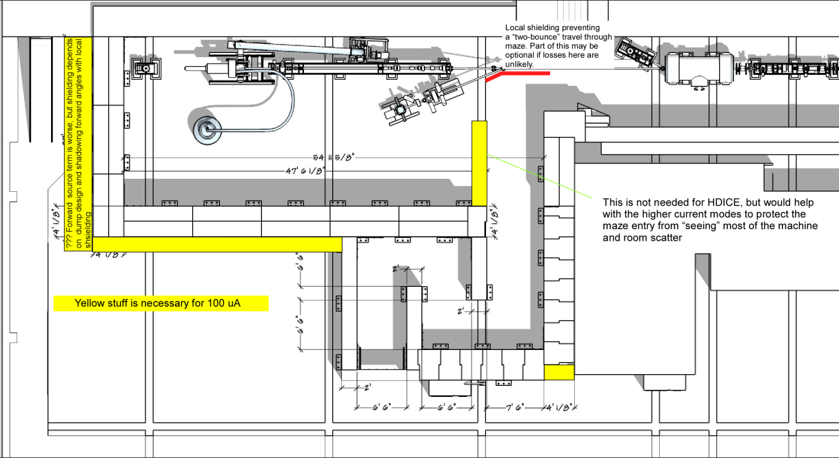
Upgraded Injector Test Facility - UITF
What we started with…
UITF as imagined

Slide 2
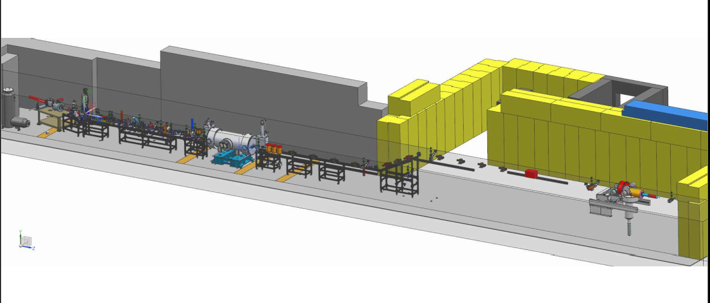

Slide 3
Charge Codes!
ITFCRY
ITFPTB
UITFBL
Facilities
Cryo Infrastructure including some RF
Polarized Target Beamline
UITF
Facilities

Slide 4
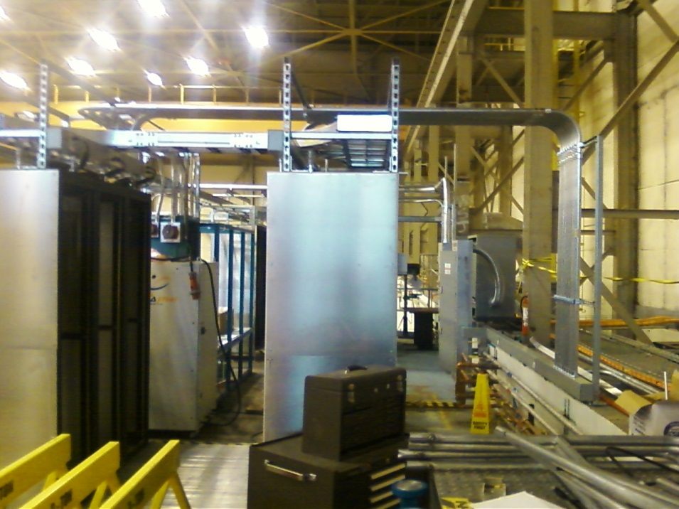
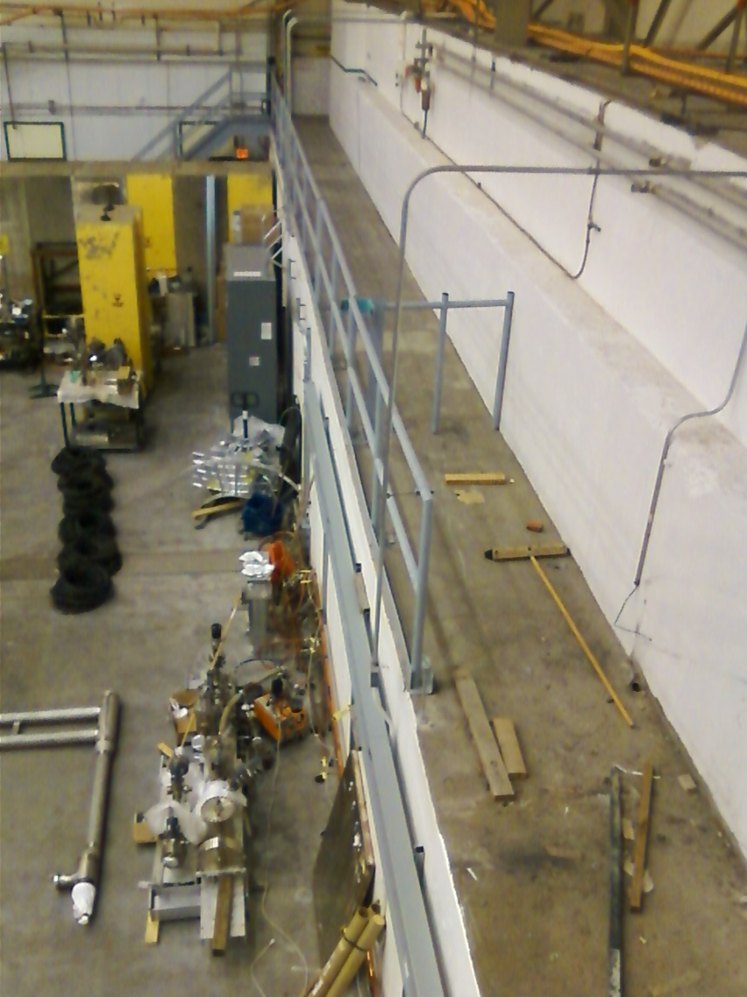
Status Facilities
Cave 1 electric and network complete
NEXT: Clean off ledge and move IPC

Slide 5
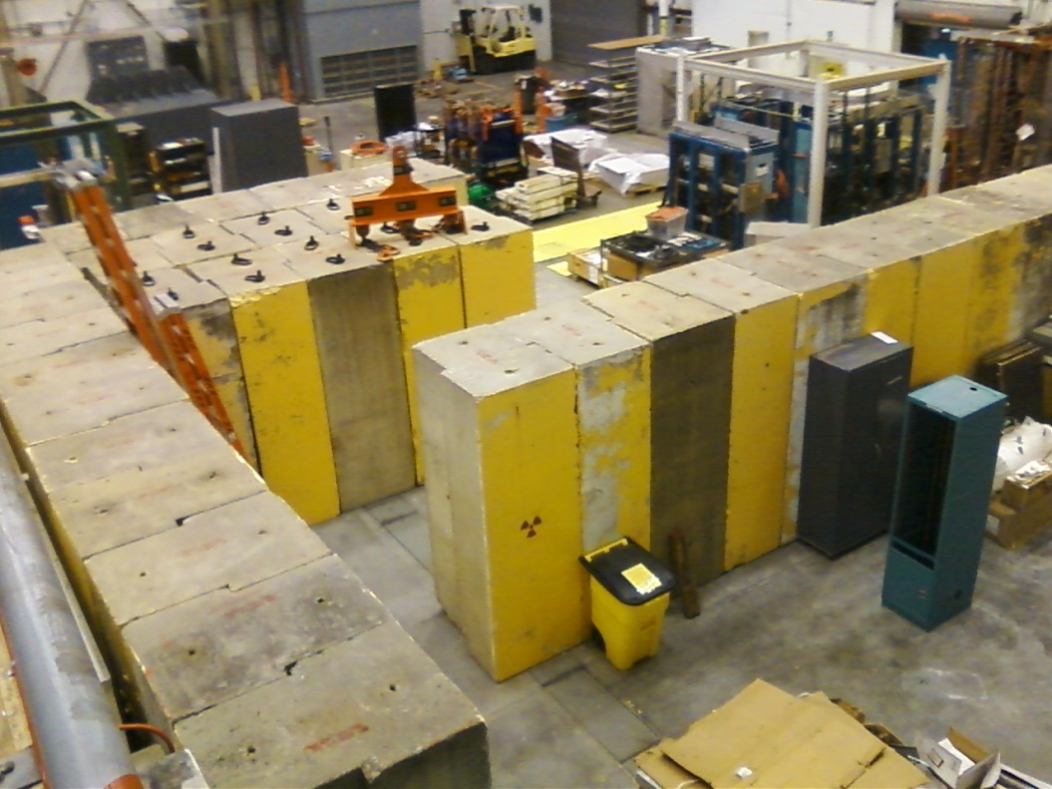
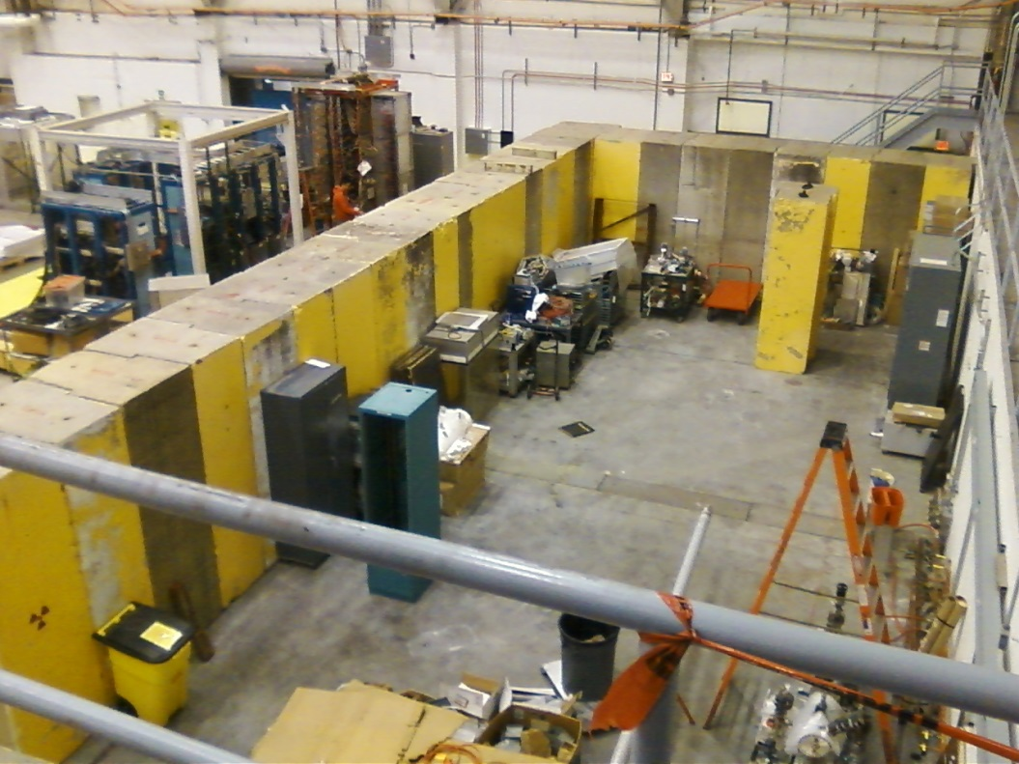
Status Facilities
Precast concrete bids to arrive soon – this package includes bracing and means to secure 2nd layer

Slide 6
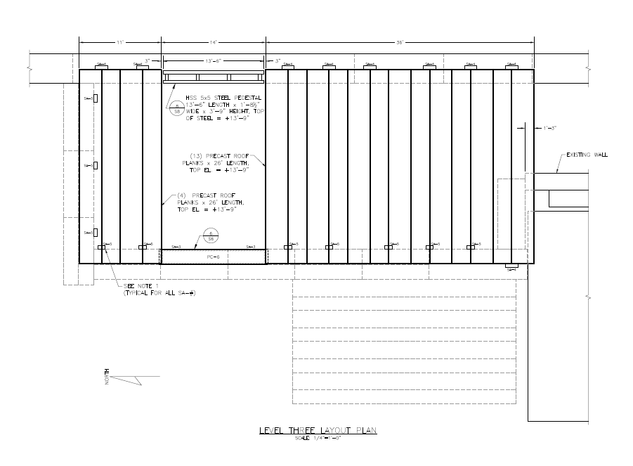
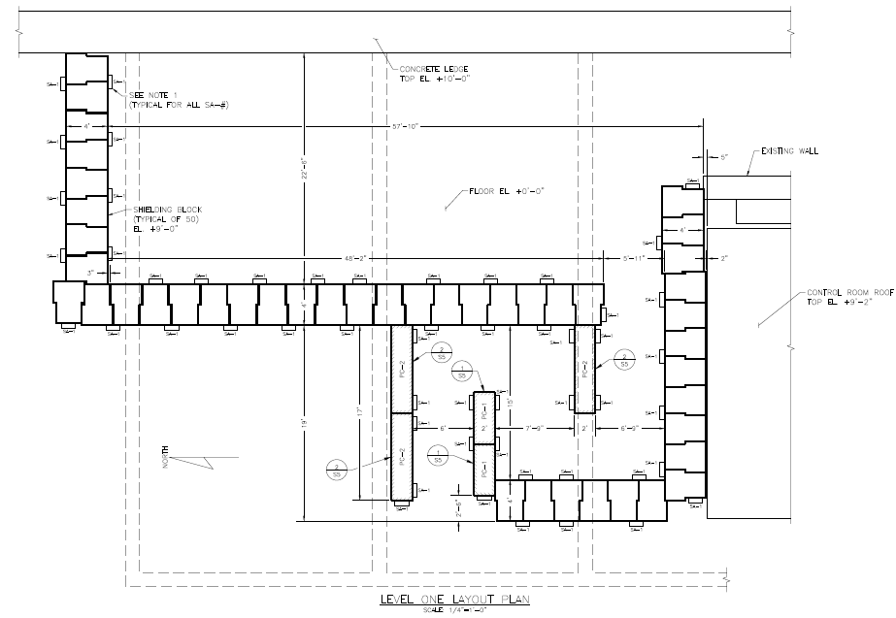
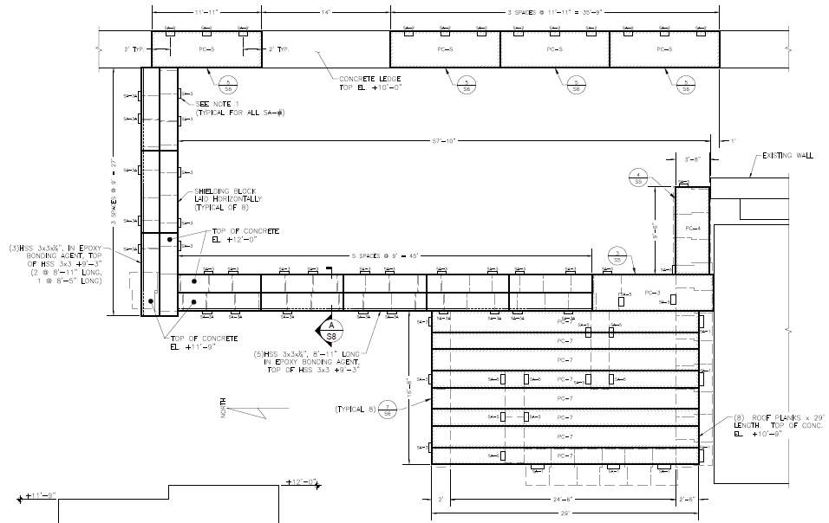
Facilities (T. Renzo)

Slide 7
Facilities Tasks and Timeline
February 2016
Cave1 electrical work complete
Facilities has issued PR for Cave2 concrete and bracing, out for bids
March
Installation Group willing to secure Cave2 structure, install other utilities
April
Facilities moves IPC outside Cave2
Concrete for Cave2 arriving on site, installing it
Physics installs 2nd layer of concrete, adds bracing
May
Cave2 including labyrinth complete, roof not yet installed
June
Facilities focus shifts to utilities inside Cave2: electricity, lights, fire suppression, gate
July
Facilities continues to work on utilities inside Cave2: electricity, lights, fire suppression, gate
August
Facilities completes utilities inside Cave2: electricity, lights, fire suppression, gate, entire Cave2 roof installed. All bracing complete
Facilities provides power to big Bertha from diesel generator (this could happen later, since no Beam to HDIce until Jan 2017)

Slide 8
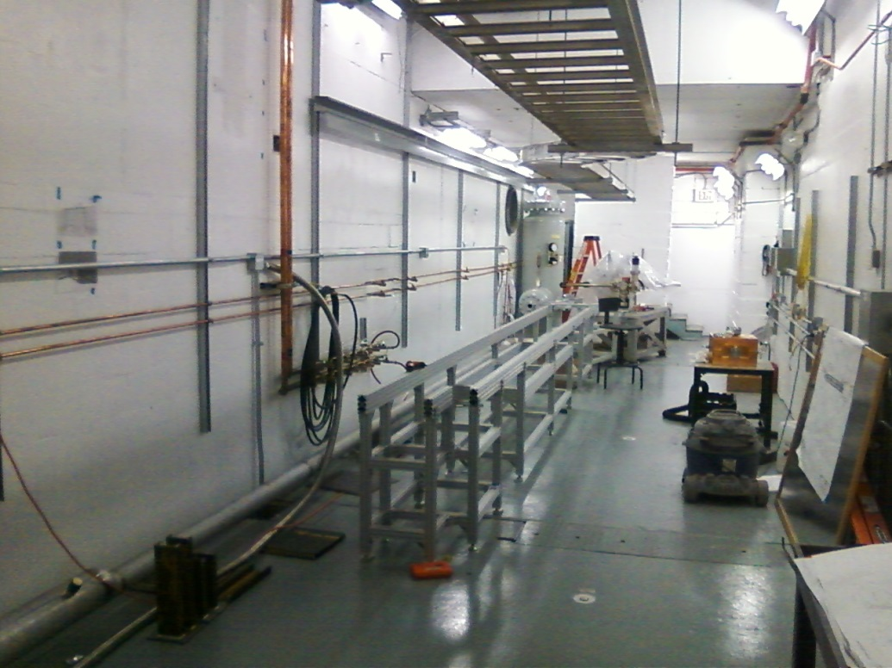
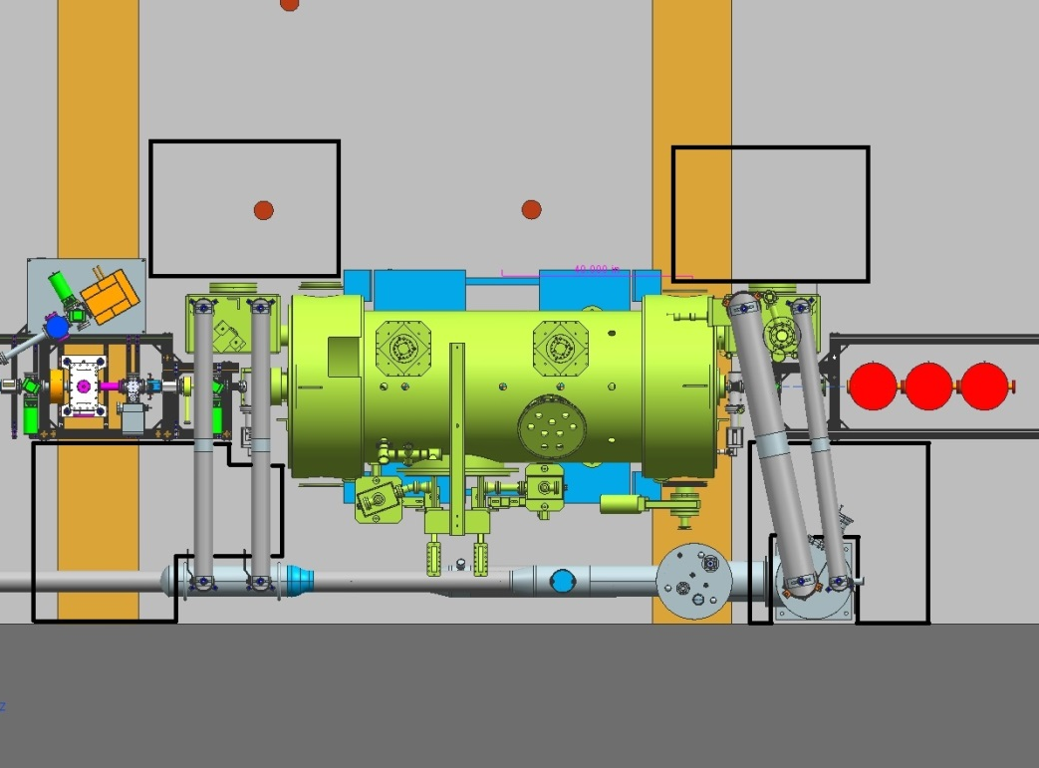
Status Cryo Group
Installed transfer line, leak checked OK
Purchased a turbo pump for leaky shield line
Building the heat exchanger
Controls getting worked

Slide 9
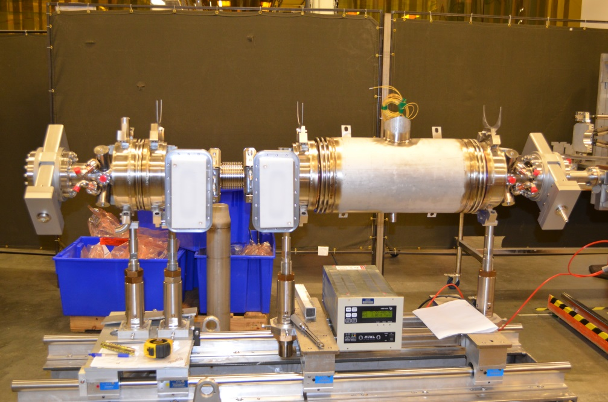
Status New ¼ CM
Test at CMTF June
Install at UITF July
Met with Cryo, SRF, RF, and Kazimi of Ops
Discussing relief valves from ODH point of view
Who does what? e.g. Cryo makes u-tubes and SRF stabs them, Cryo pulls cables, SRF provides connectors
Expect 8 MeV beam with available klystrons

Slide 10
Cryo, SRF, RF and new 1/4 CM
Recall, we agreed on means to “park” the ¼ CM when not accelerating beam: circulate 80K LN2 through 35K shield line. UITF should not be a burden on CTF 34 wks per year
LN2 temp could fluctuate 80 to 100 K, no problem for parking but….
How to cool HDIce? I think we are leaning toward CTF connection…
Nagging ODH assessment is “nagging” because some issues were ill-defined: parking strategy and relief valves
New ¼ CM requires waveguide tuners
Chad Seaton building the high power rf control board
Next biggest issue: designing the waveguide layout

Slide 11
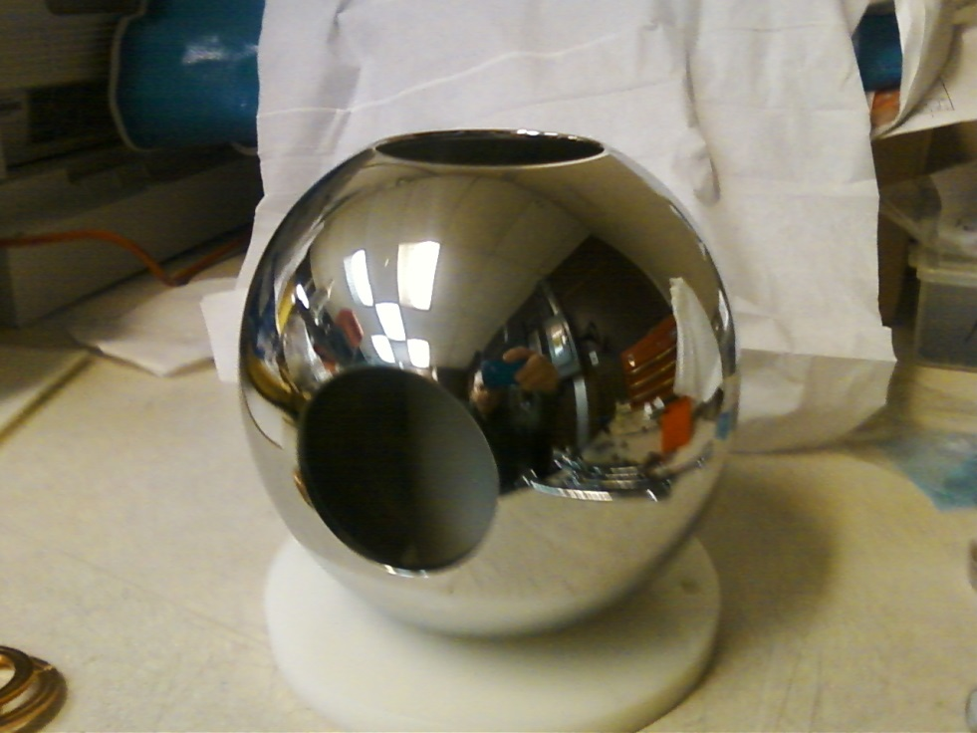
Status Gun Group
Barrel polished in 2 days
HV power supply
buncher
Gun HV power supply installed inside SF6 tank, very little corona at 60 psi
Gun table and 80/20 keV beamline structure moved into place
NEXT: add gun HV chamber, install big beamline elements, buy stuff….

Slide 12
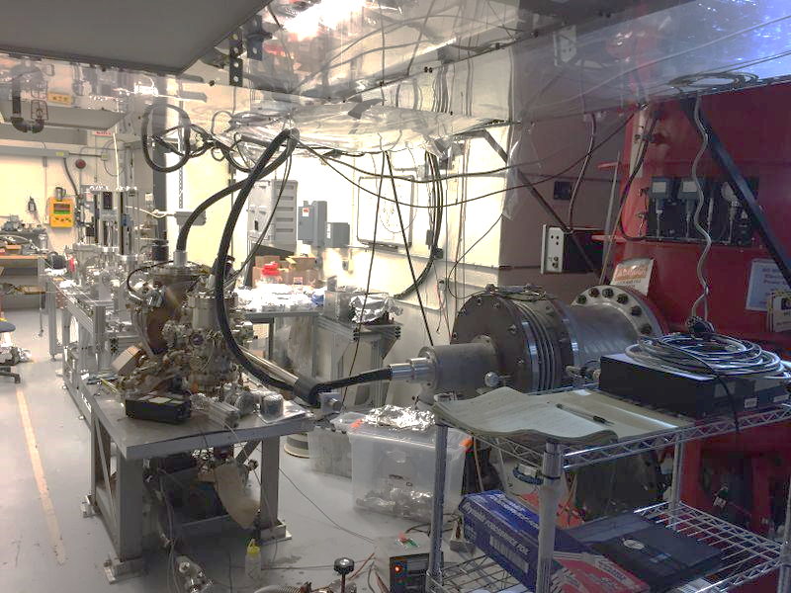
Gun and Beamline at GTS

Slide 13
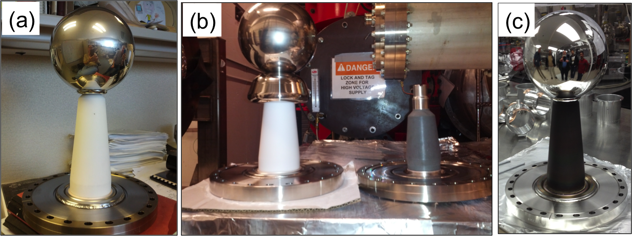
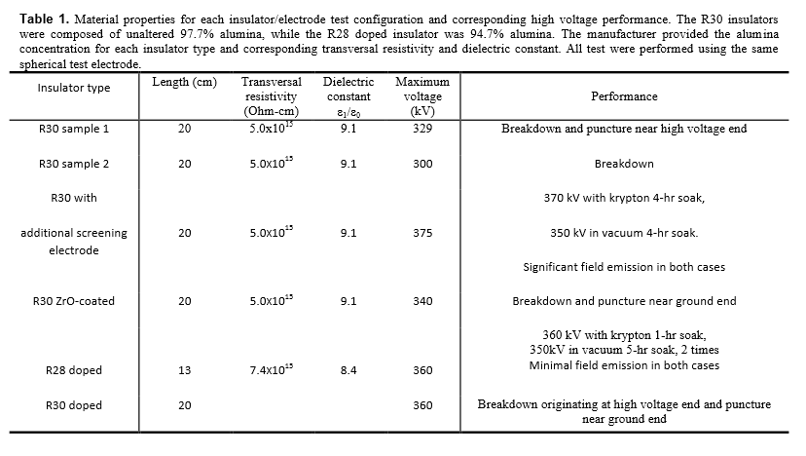
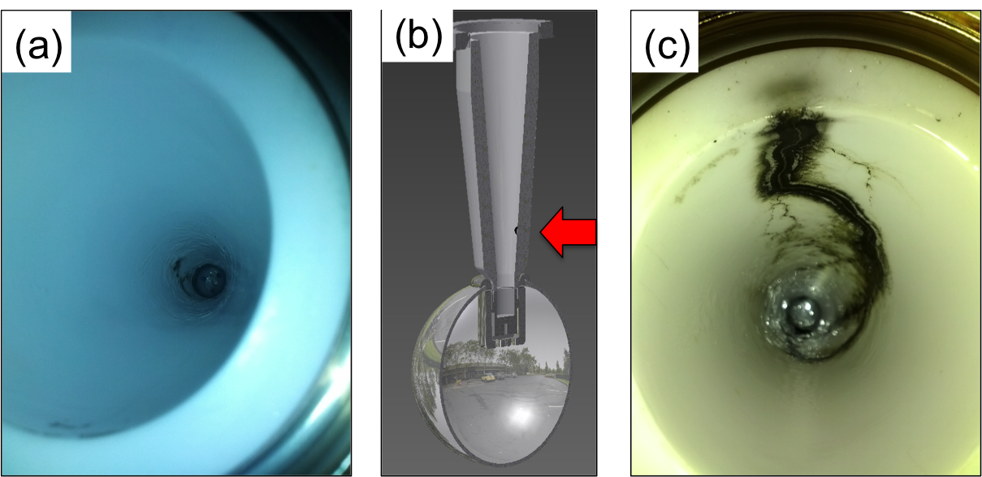
Notes:
Interior Page Design 2

Slide 14
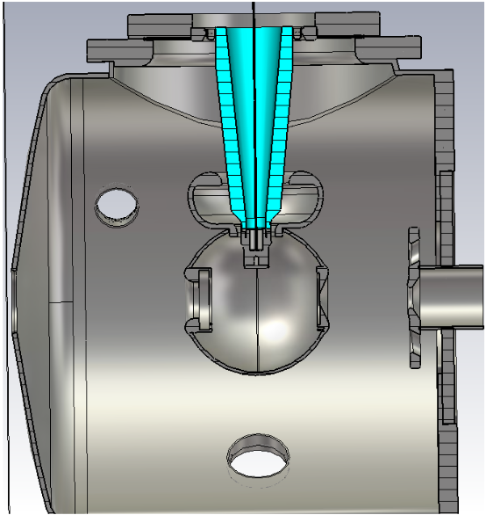
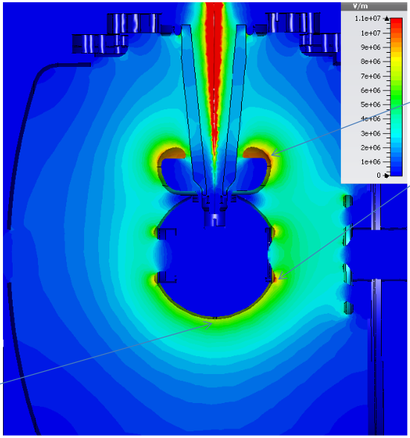
Status Gun Group
11 MV/m
8 MV/m
Yan Wang’s POISSON simulations validated by Fay Hannon using CST 3D field mapper

Slide 15
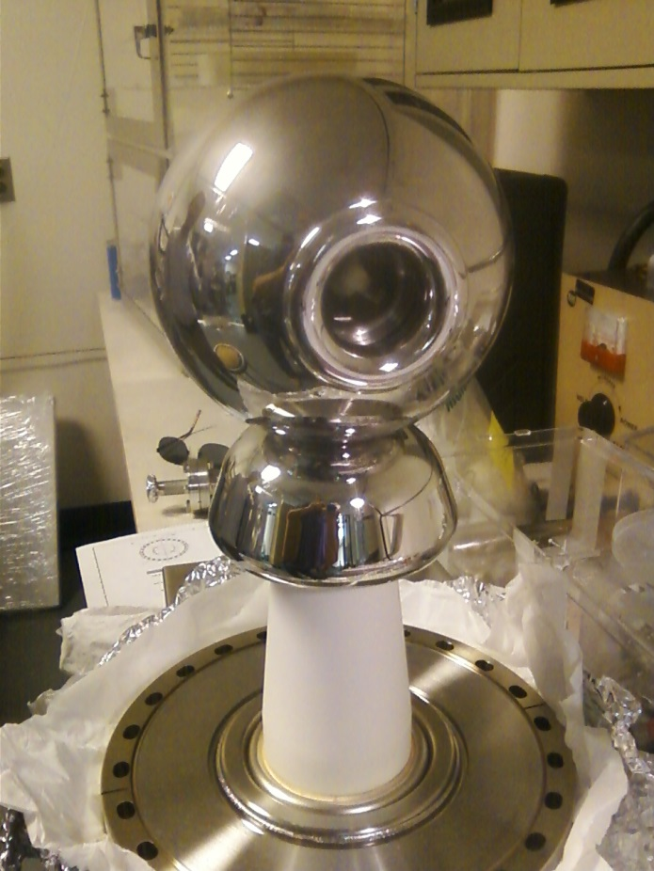
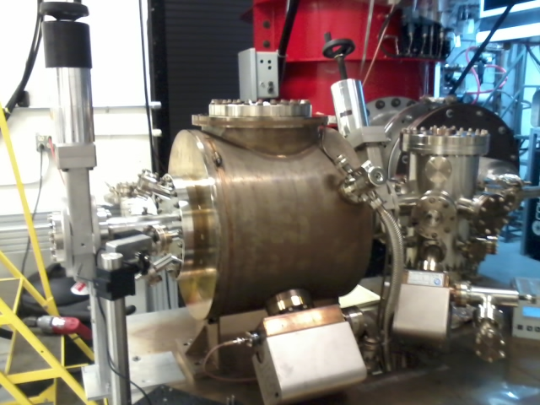
Building the electron gun at LERF GTS
The new gun happy at 325 kV, stopping at this voltage for now. Shifting focus to building the beamline and photocathode deposition chamber (LDRD magnetized beam tests)

Slide 16
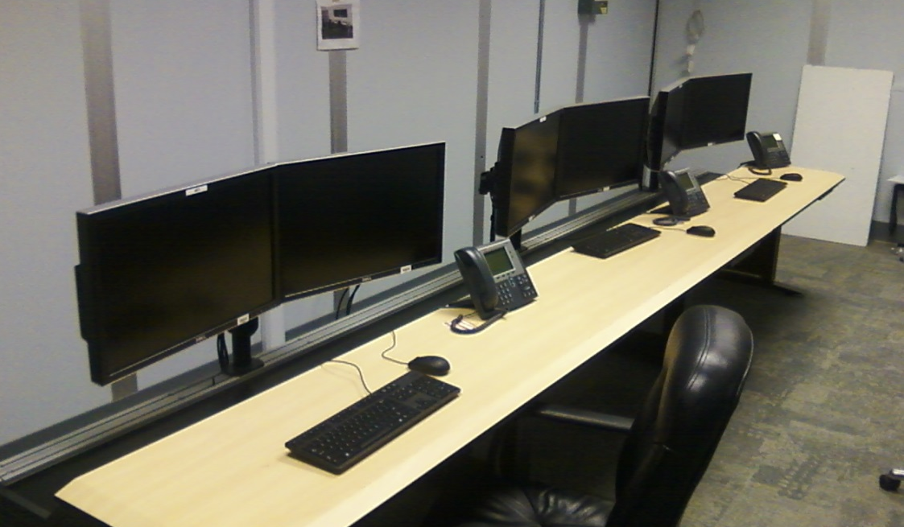
Status Operations
Network switcher hardware installed
Computer terminals installed in control room
6100 IOCs ordered, but we can use older IOCs if needed sooner
Groups are installing hardware in racks, and conversations have started with Software (Scott Higgins our POC)

Slide 17
Status Engineering
I&C building stripline bpm electronics
DC power prep-ing magnet racks, pulling cables
RF control boards in fab
RF group building second water skid
RF group building the klystron control panel
Safety System Group on track, ODH and PSS
Installation Group done with Cave1, can help with Cave2 when it makes sense

Slide 18
Status Reviews
UITF Accelerator Review: where beamline design is reviewed by Ops/CASA/SRF, March 18, 2016
Geoff Krafft, Mike Spata, Reza Kazimi, Arne Freyberger, Todd Satogata, Bob Rimmer
Need to send out pre-review material soon: beamline design, optics envelope, machine protection
Safety Systems Review, May 2016
Machine and Personnel, including radiation protection
SCMB?
UITF Readiness Review, August 2016
Commissioning and Operations plans
Experimental Readiness Review, December 2016
Focused on HDIce
Documents: FSAD, mini-AOD, ESAD

Slide 19
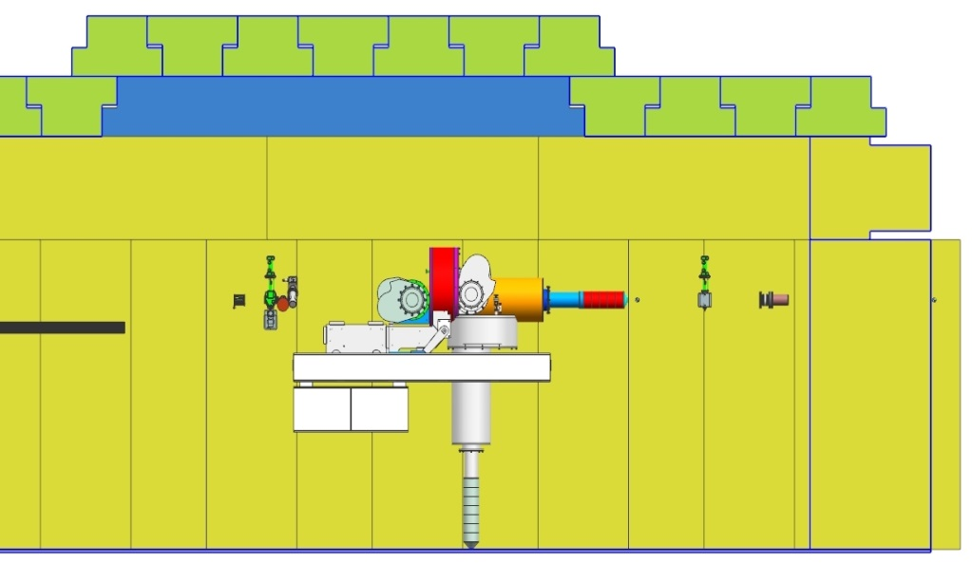
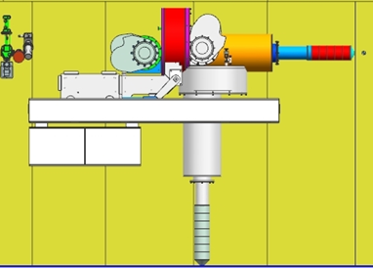
Status HDIce
Lots of scattering at MeV energy. Beam size very large at target. Decided to flip the orientation of the target
Cave2 design seems fine either way, need a Physics designer to be responsible for installation at UITF
Target here
Target here, better
e-beam
e-beam
Upstream radiation baffle blows up beam
In this configuration, we can achieve desired small beam size at target

Slide 20
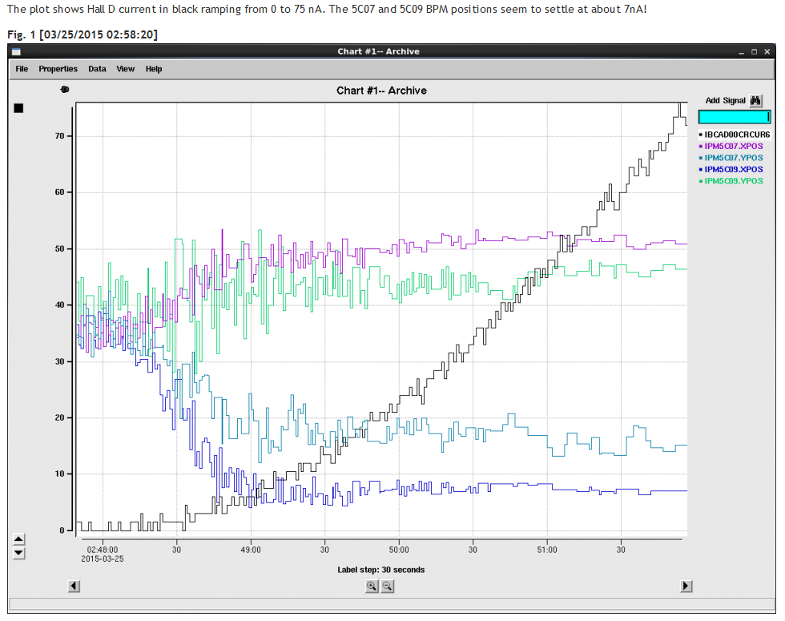
Status HDIce
Stripline BPMs see 7nA beam with 1 Hz integration time. But we want to see 1nA beam, or even less at UITF. Don’t want to fly blind

Slide 21
Status HDIce
$$1nA=DutyFactor Ipeak+Ibaseline$$
$\frac{0.1msec}{16.7msec}$ x 10 nA = 0.06 nA ; I_{baseline} = 0.94nA
I_{peak}
Acceptable duration of high peak current: long enough to see but not long enough to depolarize
I_{baseline}
Need to work out details with HDIce and T. Allison, J. Musson

Slide 22
Monthly Meeting with Mont
Purpose: to inform Lab Leadership of the UITF status
Action Items (from previous meetings)
Project Update
Progress Update
Milestones Update
Budget Update
Highlights & Concerns
Next meeting agenda
Notes:
RW=Roy Whitney

Slide 23
Progress Update
Major components
Facilities
Engineering
Mech Design
Installation
Cryo
Safety Systems
I&C
DC Power
Low Level RF systems
High Power RF
Survey & Alignment
SRF
Build new ¼ CM
Commission with RF
Operations
Network and communications
Green means we can see progress

Slide 24
Progress Update
Major components
Source Group
Reliable 350kV ops
Beam to cup in front of ¼ CM
Beam to cup in front of HDIce
EHSQ
Shielding approval, ODH assessment
Global hazard review
FSAD
Accel Readiness Review
Commissioning Plan
HDIce
Installation at Cave
Beam on HDIce
Green means we can see progress

