Slide 1
Injector Test facility Upgrade Phase I: 5-10 Mev Injector
Feb. 7, 2014

Slide 2
People
Accelerator Division
Andrew Hutton, Evelyn Akers, Arne Freyberger, James Henry, Reza Kazimi, Geoff Krafft, Fulvia Pilat, Matt Poelker, Joe Preble, Robert Rimmer
Physics Division
Rolf Ent, Patrizia Rossi, Javier Gomez, Walt Akers, Chris Keith, David Meekins, Andy Sandorfi, Xiangdong Wei
Engineering Division
Trent Allison, Greg Arnold, Omar Garza, Curt Hovater, Andrew Kimber, John Musson

Slide 3
Previous Configuration
The next three slides show the ITFU configuration shown in October, 2013

Slide 4
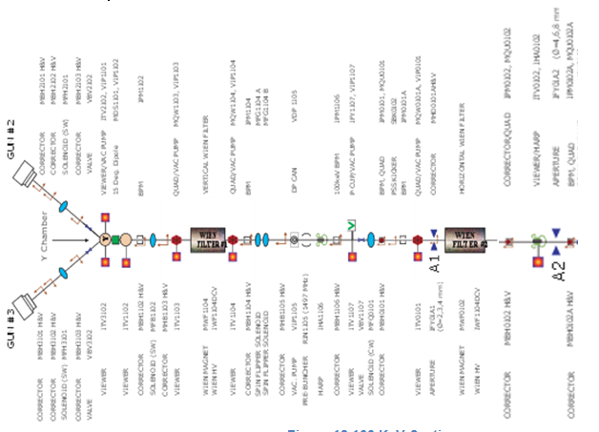
160 KeV Section- CEBAF Tunnel

Slide 5
500 Kev Section and SRF Acceleration

Slide 6
Experimental Area

Slide 7
What is New? (Since October, 2013)
After careful evaluation, we concluded that a 350 KV gun is a better choice than replicating the present CEBAF injector
Fewer Components
Shorter beamline
Easier radiation controls
Eliminates the capture section
Tests for precision parity experiments can be made within the present enclose cave

Slide 8
Scope
350 KV Gun
High current beam confined to the well shielded cave
5-10 MeV Injector
Limited to 100 nA average beam during tune
1 nA CW in experimental area for HdIce
Completion by end of FY 2015

Slide 9
BPM
Faraday Cup/
Beam Dump
Corrector
Dipole
Solenoid
Present Cave wall
350 KV
Gun
Buncher
Slits
Chopper
¼ cryo
Wien
Filter
Polarimeter/
Spectrometer
Harp

Slide 10
Solenoid
BPM
Faraday Cup/
Beam Dump
Corrector
Dipole
Quads
Harp
Present Cave wall
Raster
BCM
HDice

Slide 11
Test Cave – Opening in WALL (October 2013)

Slide 12
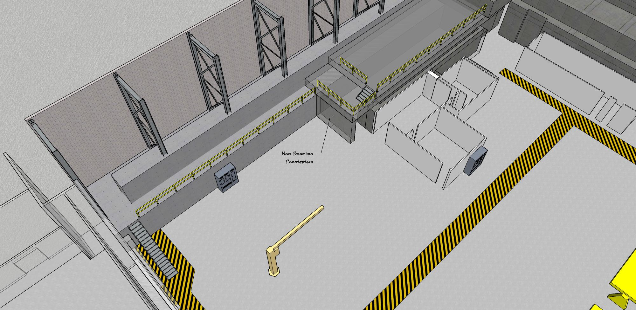
Test Cave – Closed WALL (new)

Slide 13
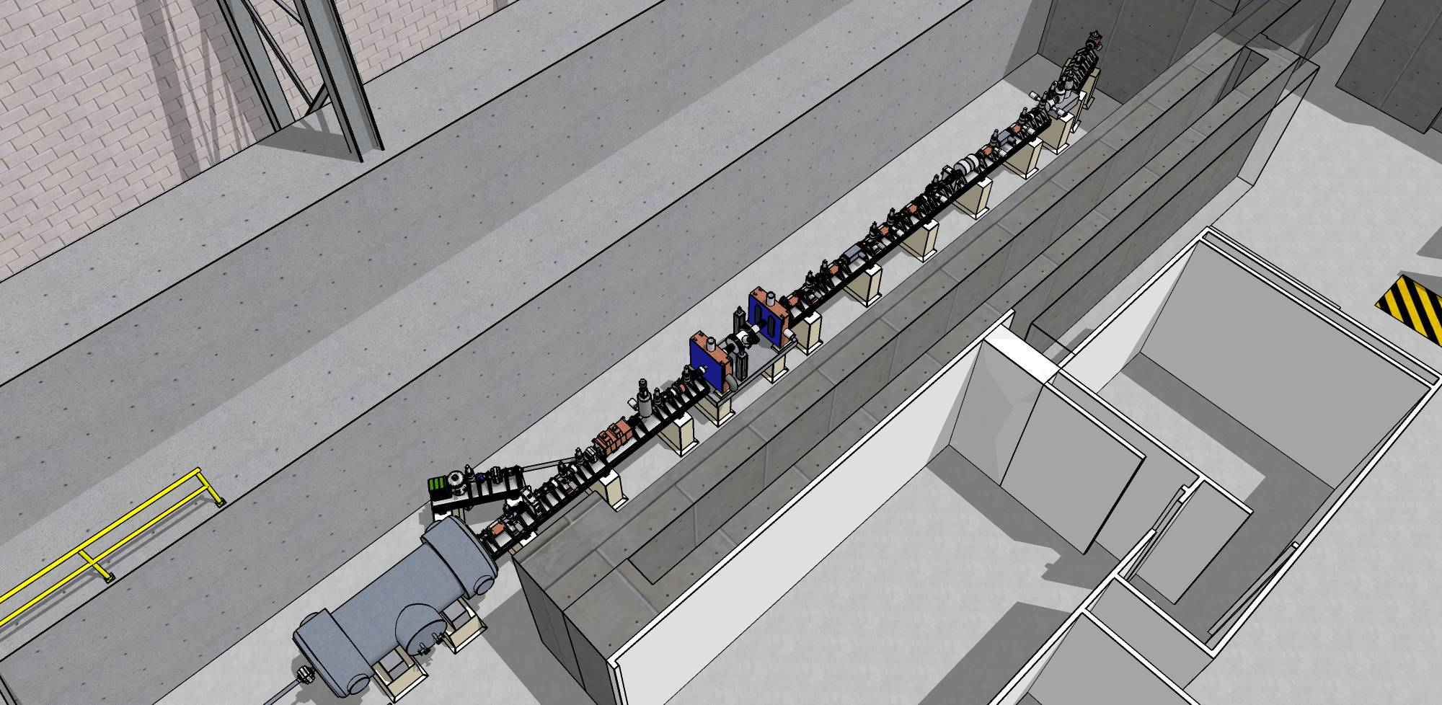
Layout Inside the Cave (October, 2013)
Note the length of the beam line and the position of ¼ cryomodule

Slide 14
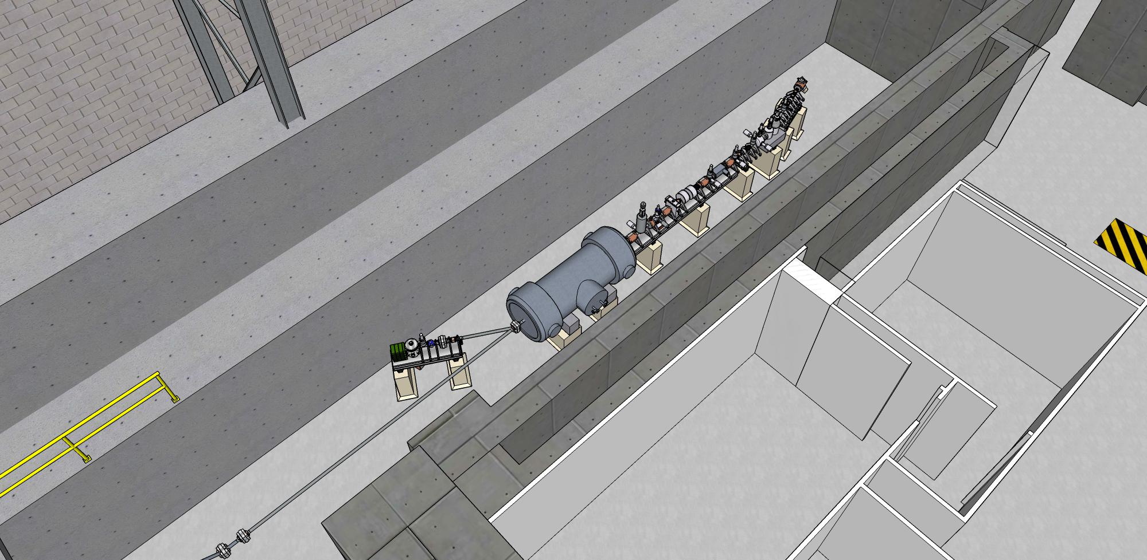
New Layout Inside the Cave

Slide 15
Experimental Area (October, 2013)

Slide 16
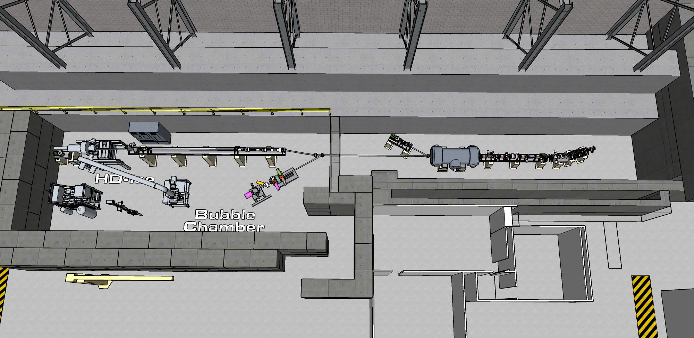
New Layout of ITFU

Slide 17
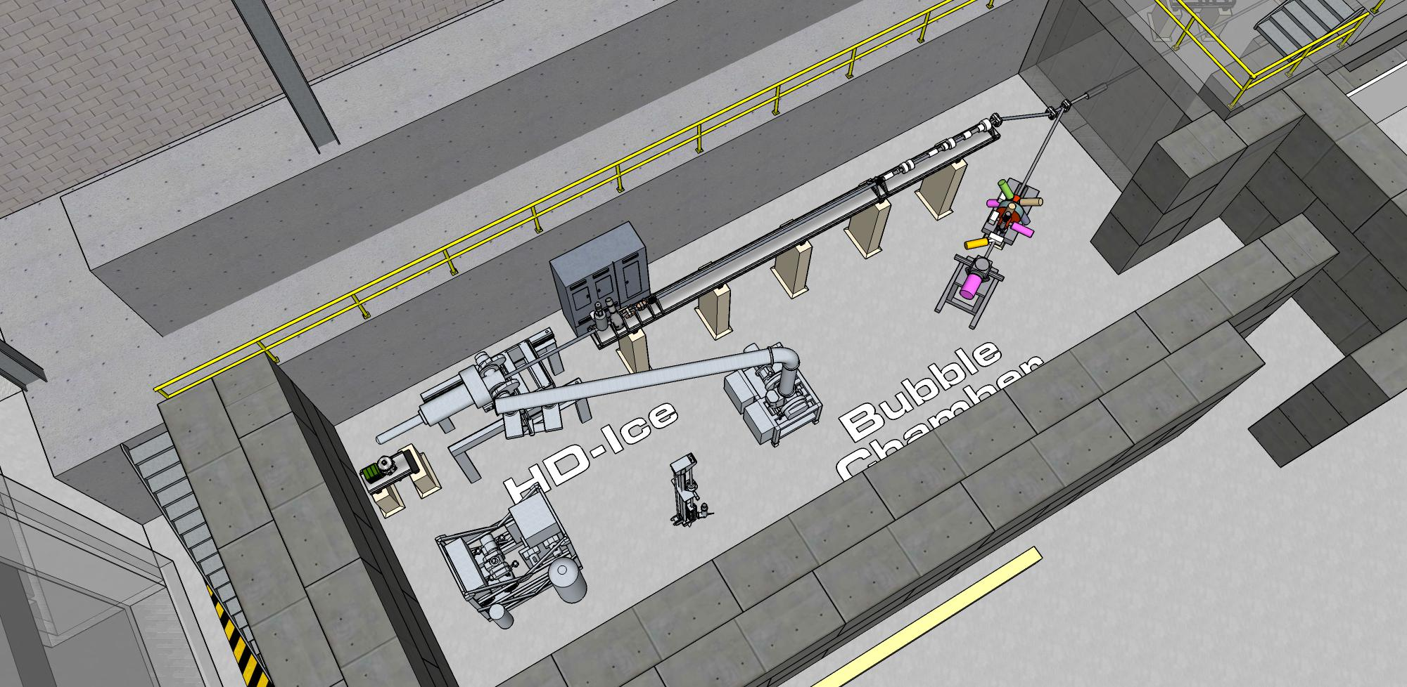
New Layout of ITFU

Slide 18
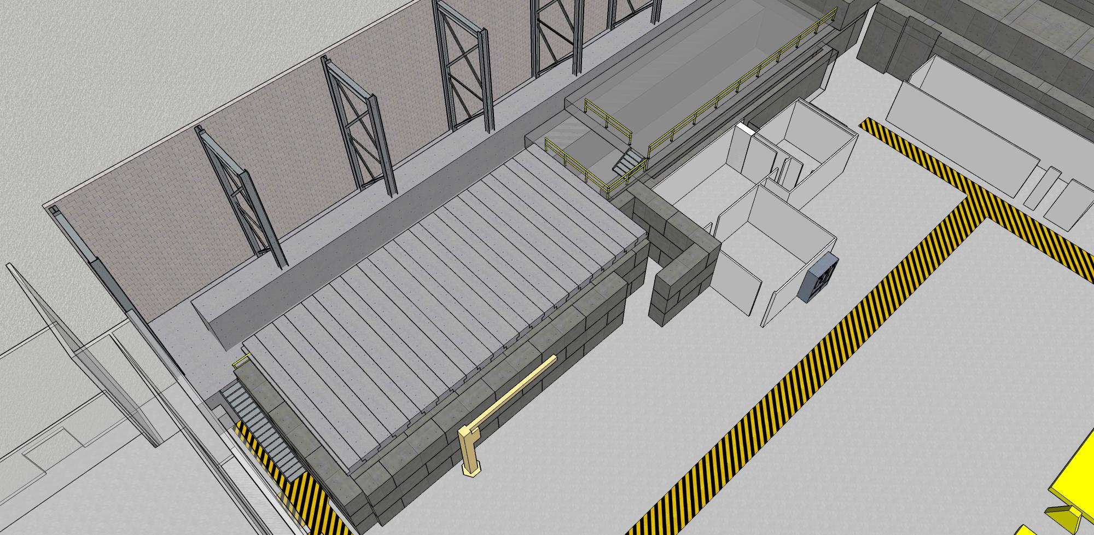
ITFU with Shielding

Slide 19
Total Project Cost
Cost of the entire project: $2650
Includes the cost of facilities which is: $477
FTEs: 6.1
Includes facilities: 0.4

Slide 20
Cost - Summary
Total procurement-direct(loaded): $766K ($1100K)
Total Labor – direct (loaded): $723K ($1071K)
2014 Procurement-direct(loaded): $357K ($491K)
2014 Labor – direct(loaded): $445K ($657K)
2015 Procurement-direct(loaded): $409K ($609K)
2015 Labor – direct(loaded): $278K ($414k)

Slide 21
Facilities Cost - Summary
Total Procurement-direct (loaded): $270K ($401)
Total Labor-direct(loaded): $51K ($76K)
2014 Procurement-direct(loaded): $122K ($180K)
2014 Labor – direct(loaded): $17K ($25K)
2015 Procurement-direct(loaded): $148K ($221K)
2015 Labor – direct(loaded): $34K ($51K)

Slide 22
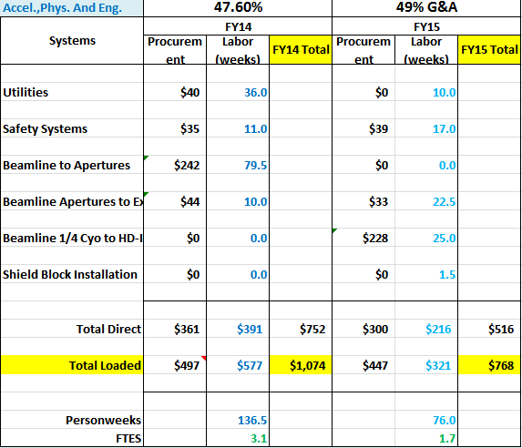

Slide 23
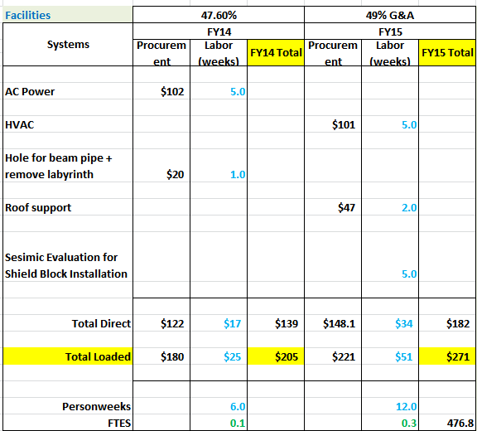

Slide 24
Scope - 2014
Installation of
350 KeV Gun
Laser systems
AC Power
Beamline an vacuum components
Racks for Electronics
Acquisition
Beamline elements
Removal of Labyrinth and hole in the wall
Completion of the straight 350 KV section
No Beam

Slide 25
2014 Major Tasks List
Begin procurements
Civil work, removal of labyrinth, hole in the wall
AC Power
Laser System
Component Layout
LCW and Instrument Air
Install Instrumentation Racks
Commence PSS and MPS Design
Radiation Assessment
Fire Safety Assessment
Control System Design
¼ cryo stand design
Begin instrumentation wiring
Install beam line to ¼ cryo
Survey and alignment to ¼ cryo
Cryoline installation
No Beam

Slide 26
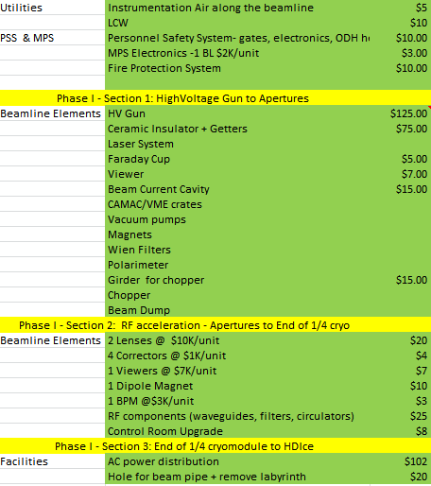
2
0
1
4
P
R
O
C
U
R
E
M
E
N
T
S

Slide 27
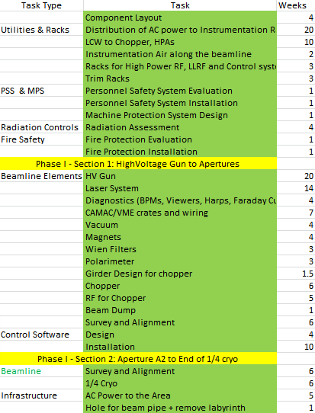
2
0
1
4
L
A
B
O
R

Slide 28
Scope-2015
Installation
Cryolines
¼ Cryomodules
RF Systems
Shield Wall
HdIce beamline
Acquisition
Beamline elements

Slide 29
Scope-2015
Commissioning
Control System
Safety Systems
Cryomodule
350 KeV Beamline
5 MeV Beamline
Tune mode and CW beam operations

Slide 30
2015 Major Task List
Remaining procurement
Cryostand and 1/4cryomodule installation
Cryoline and RF hook up
Beam line from ¼ Hdice
Beam line Instrumentation
HdIce installation begins
PSS and MPS installed
Radiation controls installed
Fire protection installed
Control Software installed
Shielding in the Experimental area
Commissioning of individual systems and the entire ITFU
Tune mode and 1 nA CW Beam

Slide 31
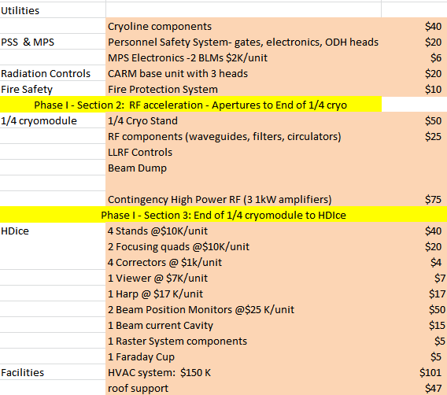
2
0
1
5
P
R
O
C
U
R
E
M
E
N
T
s

Slide 32
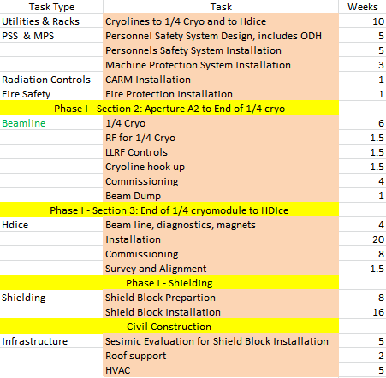
2
0
1
5
L
A
B
O
R

Slide 33
2014 Task List
Begin procurements
Civil work, removal of labyrinth, hole in the wall
AC Power
Laser System
Component Layout
LCW and Instrument Air
Install Instrumentation Racks
Commence PSS and MPS Design
Radiation Assessment
Fire Safety Assessment
Control System Design
¼ cryo stand design
Begin instrumentation wiring
Install beam line to ¼ cryo
Survey and alignment to ¼ cryo
Cryoline installation
No Beam

Slide 34
2015 Task List
Remaining procurement
Cryostand and 1/4cryomodule installation
Cryoline and RF hook up
Beam line from ¼ Hdice
Beam line Instrumentation
HdIce installation begins
PSS and MPS installed
Radiation controls installed
Fire protection installed
Control Software installed
Shielding in the Experimental area
Commissioning of individual systems and the entire ITFU
Tune mode and 1 nA CW Beam

Slide 35
We expect the project to be completed by the end of FY15

