Slide 1
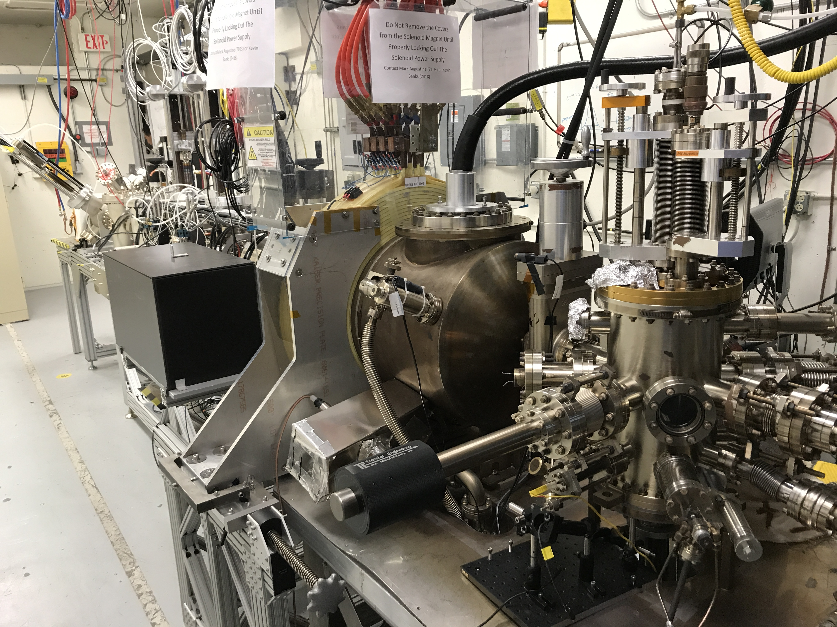
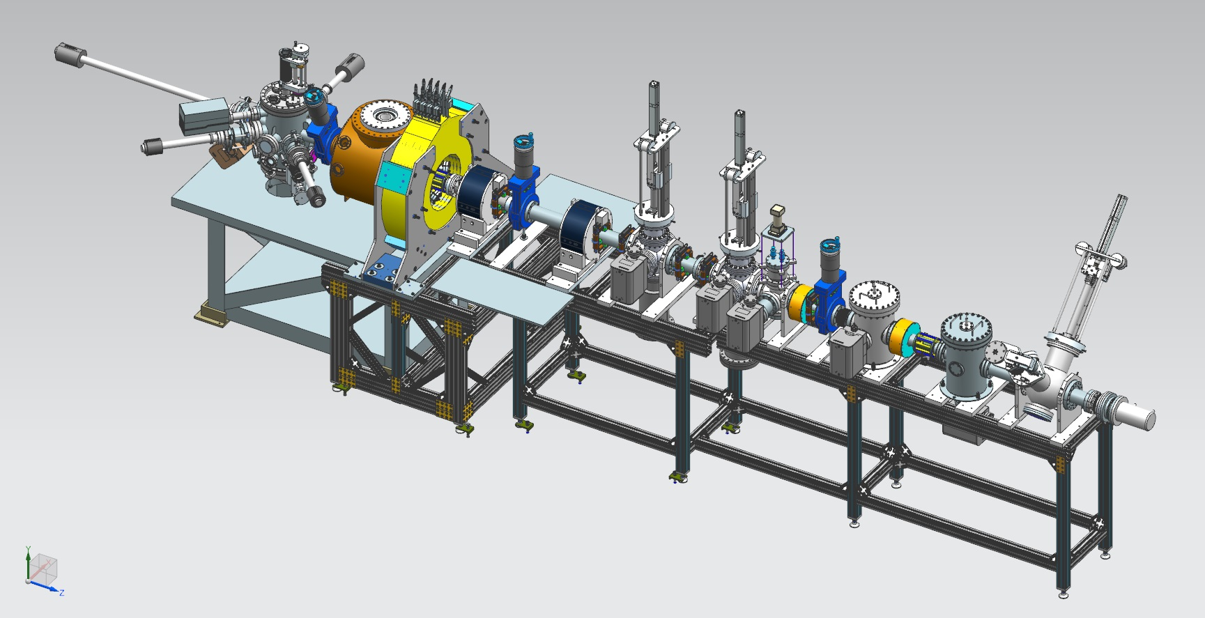
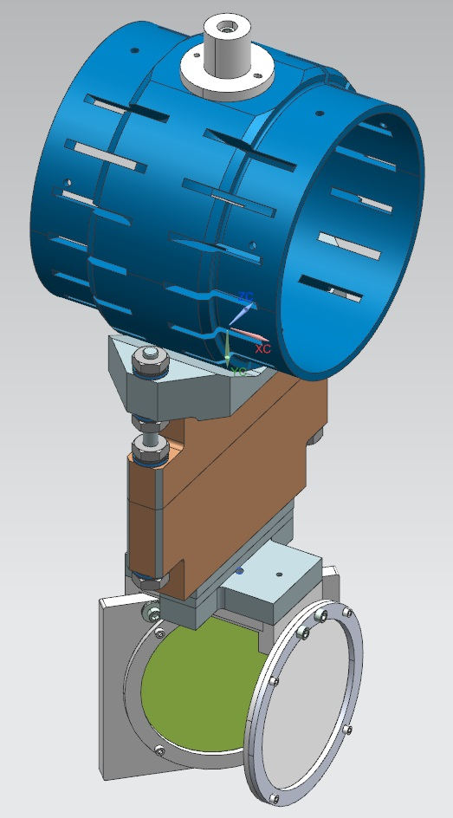
Magnetized Beam
Gun HV Chamber
Gun Solenoid
Beamline
Photocathode
Preparation
Chamber
0 G
Measuring electron beam mechanical angular momentum (aka beam magnetization) using slit and viewer screen method with 1450 G at photocathode
Shield Tube
1450 G
Slit
Viewer Screen

