Slide 1
American Vacuum Society History Committee
Marcy Stutzman
History Committee Chair

Slide 2
AVS Policy (Est. 1986/ Rev. 2004)
Acquire & store AVS documents and records
Maintain historical records & publish history summaries
Encourage historical reviews & artifact displays
Liaise with similar committees (e.g. AIP)
Acquire & distribute relevant memoirs

Slide 3
History Committee Activities
Annual additions to Archives at AIP
Current Documents: Promotional, minutes, programs, ballots, contracts, leases
Gathered by Yvonne Towse, sent to Archivist Bill Westwood, indexed, shipped to AIP
Historical interviews-now at Annual Symposium via Voice recognition (earlier transcribed by AIP)
Digitized documents (Newsletters, etc.)
Relevant books
Plan for Special Events (e.g. 60th anniversary in 2013, Division Anniversaries) - equipment displays, talks, Trivia contest, etc.
Notes:
Annual additions to Archives:
This annual archive project happens each Spring. All year, Yvonne collects everything that is distributed Society-wide, all promotional materials, minutes, programs, ballots, contracts, leases, etc… Basically it is everything that sums up what AVS is all about and would also help us to reinvent the business in the face of total disaster. She organizes all of these documents into categories and ships everything to Bill Westwood; he then indexes everything, updates the archive list, ships materials to AIP to be catalogued and stored in the Archive Storage Facility in MD and returns the master list to Yvonne.

Slide 4
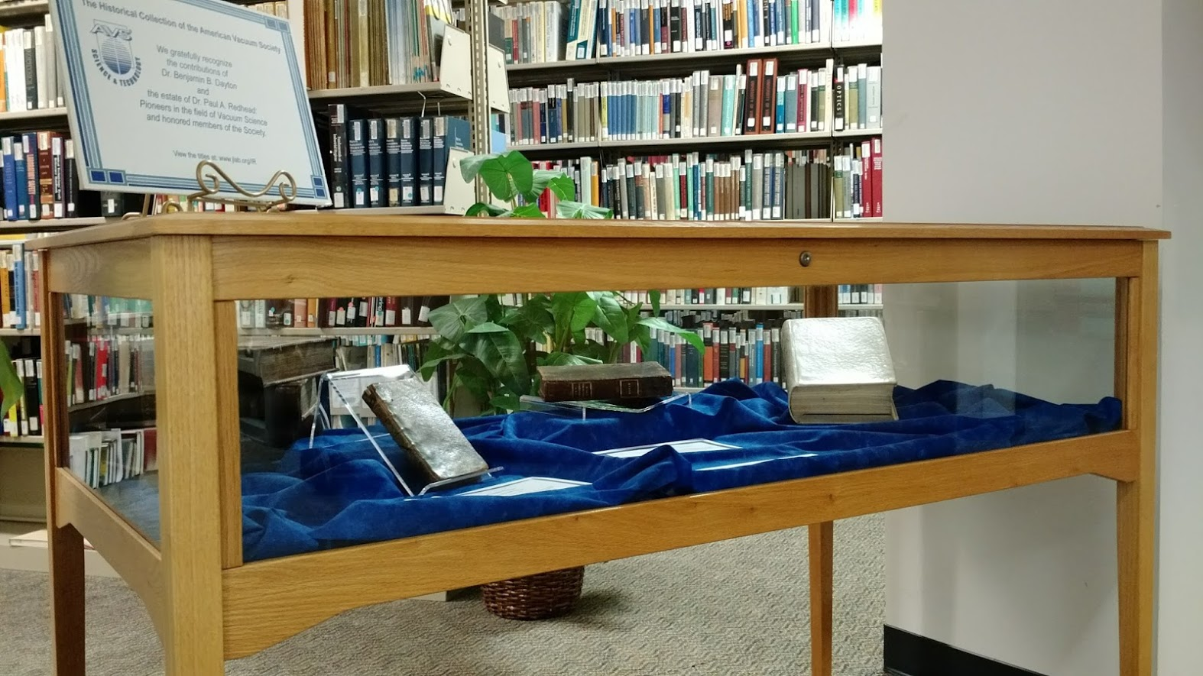
AVS Historical Books Collection
In the queue for cataloging in AIP Neils Bohr database as an externally held collection.
Collection began with donations from Paul Redhead and Benjamin Dayton
222 titles held in circulating collection, available for ILL
https://www.jlab.org/div_dept/cio/IR/AVS.html
Notes:
Rare and historical book collection began with donations from Paul Redhead and Benjamin Dayton

Slide 5
http://www.avs.org/About/History
Organizational Structure
Vacuum Time Line – updated to 2013
AVS Presidents & significant vacuum events
E-history: till 2013 (60th anniversary)
AVS history: admin, publications, awards, conferences, education, short courses, chapters
Oral interviews: recorded & transcribed
Award winners (1992-2015)
Historical figures (1986-2010)

