Slide 1
Using CEBAF as a positron machine
Yves Roblin
JPOS17
Newport News
Sept 12-15, 2017

Slide 2
OUTLINE
Machine layout
Various options
Limiting parameters of the lattice
Electron injection and transport
Linac optics
Spreader modifications
Positron generation, collection and dump system
Conclusion

Slide 3
Transverse Emittance* and Energy Spread†
Area | δp/p [x10⁻³] | ε_{x} [nm] | ε_{y} [nm]
Chicane | 0.5 | 4.00 | 4.00
Arc 1 | 0.05 | 0.41 | 0.41
Arc 2 | 0.03 | 0.26 | 0.23
Arc 3 | 0.035 | 0.22 | 0.21
Arc 4 | 0.044 | 0.21 | 0.24
Arc 5 | 0.060 | 0.33 | 0.25
Arc 6 | 0.090 | 0.58 | 0.31
Arc 7 | 0.104 | 0.79 | 0.44
Arc 8 | 0.133 | 1.21 | 0.57
Arc 9 | 0.167 | 2.09 | 0.64
Arc 10 | 0.194 | 2.97 | 0.95
Hall D | 0.18 | 2.70 | 1.03
12GeV config
Damping
e- beam is dominated
by synch. rad at 12GeV
Sync. Rad.
* Emittances are geometric
† Quantities are rms
Notes:
Values are calculated at the end of each arc.
Normalized emittance is beta.gamma*egeometric
These calculations were checked with 3 different codes and also agree with a simpler analytical estimate (sand’s formula) which
Does not take into account synch rad. Loss in quadrupoles.

Slide 4
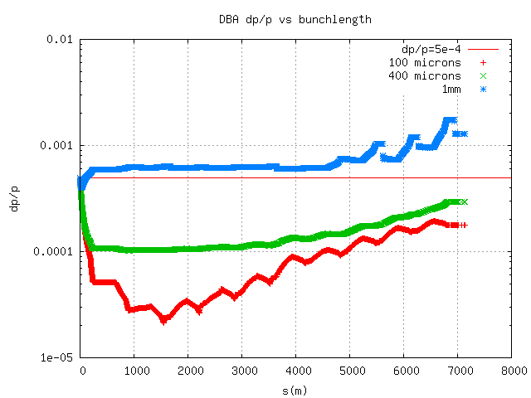
Bunchlength and energy spread
Notes:
Longitudinal requirements on the positron beam include the fact that longer bunches will yield higher energy spread because of the effects in the linac. Depending on the e+ generation option, other longitudinal limitations may have to be considered (in the injector proper)

Slide 5
Various options
Several ideas have been proposed.
Generate 6.3 MeV e+ in injector area, use existing injector to accelerate
Generate 63 MeV e+ in injector, accelerate with last C100 cavity to 123 MeV/c
Generate 100 MeV e+, use a separate injector cave and beamline
Use an accumulator ring to increase e+ current
Generate 123 MeV e+, using 1GeV/c e- beam
Notes:
All of these options have to adhere to certain limitations in the lattice. I will be discussing the last one but most of the discussion on lattice limitations is applicable to the other options.

Slide 6
Machine Layout for 1GeV option
e- injector 123 MeV/c
Notes:
e- generated in a separate injector, accelerated to 1.2GeV/c thru south linac, transported by arc10 to generate a 123 MeV/c positron beam which is then injected into the north linac. This allows e+ to use the entire machine with the exception of Hall D.

Slide 7
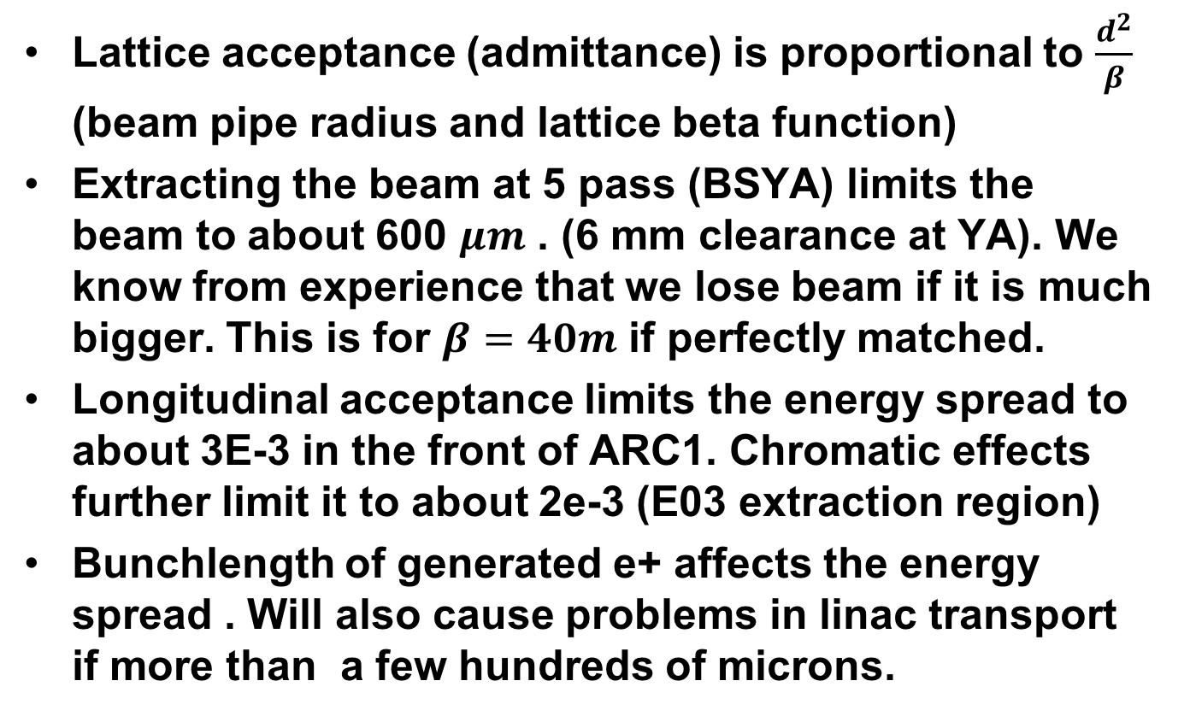
Limiting parameters for the e+ transport
Lattice acceptance (admittance) is proportional to $\frac{d^{2}}{β}$ (beam pipe radius and lattice beta function)
Extracting the beam at 5 pass (BSYA) limits the beam to about 600 $μm$ . (6 mm clearance at YA). We know from experience that we lose beam if it is much bigger. This is for $β=40m$ if perfectly matched.
Longitudinal acceptance limits the energy spread to about 3E-3 in the front of ARC1. Chromatic effects further limit it to about 2e-3 (E03 extraction region)
Bunchlength of generated e+ affects the energy spread . Will also cause problems in linac transport if more than a few hundreds of microns.

Slide 8
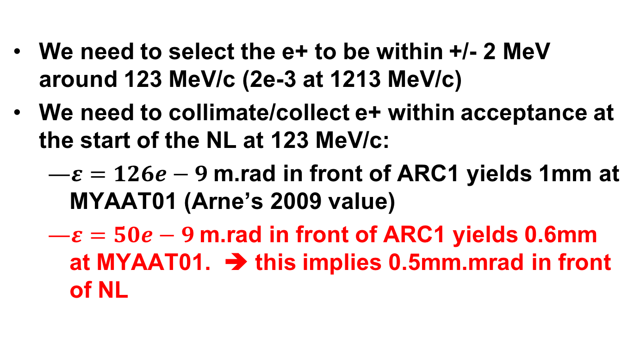
Limiting parameters for e+ (cont)
We need to select the e+ to be within +/- 2 MeV around 123 MeV/c (2e-3 at 1213 MeV/c)
We need to collimate/collect e+ within acceptance at the start of the NL at 123 MeV/c:
  $ε=126e−9$m.rad in front of ARC1 yields 1mm at MYAAT01 (Arne’s 2009 value)
  $ε=50e−9$m.rad in front of ARC1 yields 0.6mm at MYAAT01. ➔ this implies 0.5mm.mrad in front of NL
Notes:
In JPOS 2009, Arne considered 126 nmrad at the front of ARC1. I ended up with roughly half that after taking in consideration limits that we know exist for the new 12GeV machine.

Slide 9
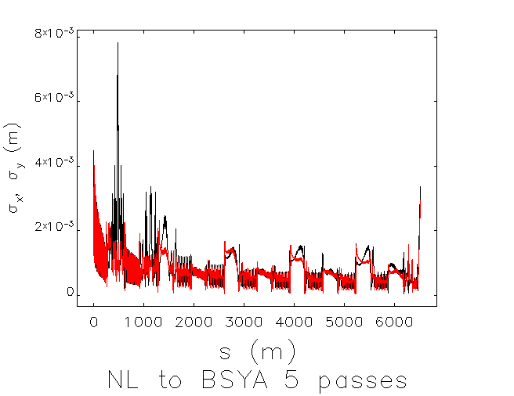
Beam sizes from NL to BSYA
Notes:
We can replace the ARC1 optics by a low dispersion optics. Its 4mm sigma at the first cavity in NL.

Slide 10
Transverse Emittance* and Energy Spread†
Area | δp/p [x10⁻³] | ε_{x} [nm] | ε_{y} [nm]
Chicane | 10 | 500 | 500
Arc 1 | 1 | 50 | 50
Arc 2 | 0.53 | 26.8 | 26.6
Arc 3 | 0.36 | 19 | 18.6
Arc 4 | 0.27 | 14.5 | 13.8
Arc 5 | 0.22 | 12 | 11.2
Arc 6 | 0.19 | 10 | 9.5
Arc 7 | 0.17 | 8.9 | 8.35
Arc 8 | 0.16 | 8.36 | 7.38
Arc 9 | 0.16 | 8.4 | 6.8
MYAAT01 | 0.18 | 9.13 | 6.19
Positrons
Damping
Sync. Rad.
* Emittances are geometric
† Quantities are rms
Notes:
Values are calculated at the end of each arc.
Normalized emittance is beta.gamma*egeometric
These calculations were checked with 3 different codes and also agree with a simpler analytical estimate (sand’s formula) which
Does not take into account synch rad. Loss in quadrupoles.

Slide 11
Electron injection
Need a new injector located at the front of the SL. (there is an alcove there where it could be installed)
Has to produce 123 MeV/c e- with 1 mA
Has to inject into the SL. Straight ahead or chicane?

Slide 12
South Linac Optics
Linac lattice usually set to be a 120 Degrees FODO. The e- beam would be severely off-momentum.
Need for an alternate south linac optics which allows for both the e- (from 123→ 1213 MeV) and e+ (from 1213 to 2303 MeV) to be transported.
This is a limiting factor regarding the emittance that the incoming e+ beam can have and still transport, as well as the ability to keep the e- beam focused enough to get to the SW spreader modified magnet (more on this later)

Slide 13
SW BCOM modifications
Concept:
Reverse polarity of the SW spreader in order for e+ to be transported correctly.
Consequence:
Incoming 1.2GeV/c e- beam will be
bend downwards in the BCOM.
Remedies:
  Dig into the concrete floor and create a transport line to capture the e- and feed it into ARC 10.
  OR
  Modify the BCOM and raise it by an inch (M.Tiefenback, J. Benesch suggestions). This might avoid having to do civil engineering.
Notes:
The SW corner spreader has to be reversed in polarity since it will transport the e+ . Hence, the incoming e- will be deflected downward.

Slide 14
BCOM modifications
e+
e+ goes to 2S (+18.6 degs)
Modifying the pole shape for the BCOM
Would allow for controlling the downward
bend of the e- beam
e-
e-
e- (1.2GeV/c) bends down
Another dipole pair needed to
complete the spreader and inject into MXAAS05
Dispersion correction probably not needed

Slide 15
Shunt and power requirements for ARC10
ARC10 will be configured to transport 1.213 GeV/c e- beam instead of 11023 GeV/c e- beam.
Consequently, the power supplies will have to be modified to allow for regulating in this regime or an alternate one used.
MXXAS05 connected to MARC8, MZAAS04 to RSEP8A. We need to consider that when designing the e- transport (since RSEP8A and MARC8 have to be set for e+ energy).

Slide 16
Magnet polarity reversal
With the exception of ARC10, every magnet needs to have its leads reversed in order to transport the e+.
Machine setup:
  Configure the machine for 5 pass running, including the special south linac optics using e-
  Stop beam delivery, reverse magnet polarities
  Quadrupole leads also need to be reversed (instead of reversing setpoints in order to cancel systematic offsets).
  Using SLM’s and viewers adjust steering with e+
Notes:
Mike T. will discuss this in detail in his talk. Note that configuring for e+ by reversing the polarity of a machine tuned for e- is not perfect. Earth magnetic field kicks are opposite for e+ and thus ,we will have to do some steering with e+. Likely the viewers will be sufficient for that.

Slide 17
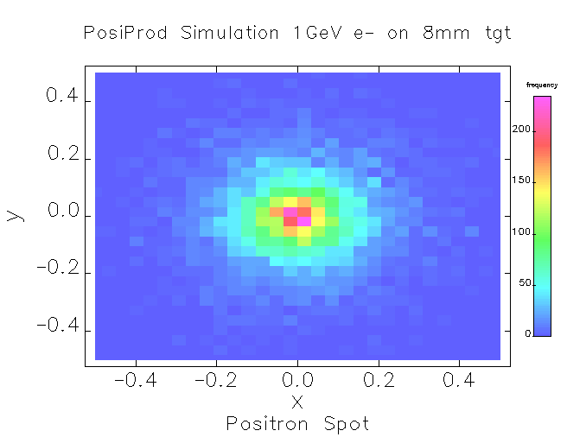
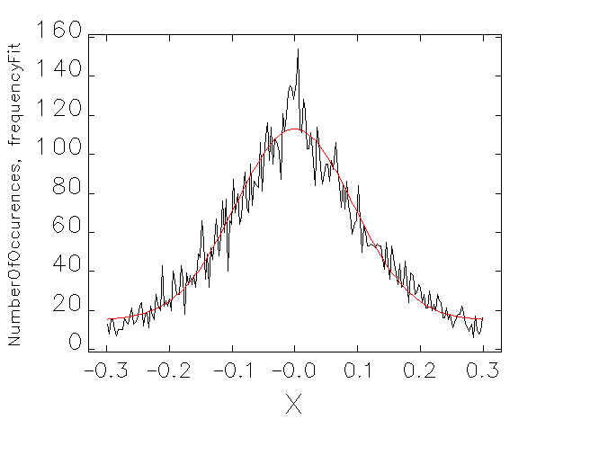
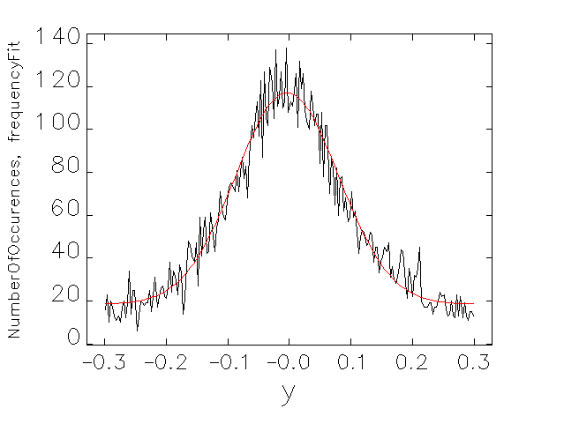



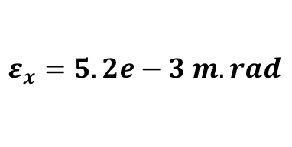

Positron production with 1GeV e- beam
$$σ_{x}=9.29e−2$$
$$σ_{x′}=5.56e−2$$
$$σ_{y}=8.35e−2$$
$$σ_{y′}=5.34e−2$$
$$ε_{x}=5.2e−3 m.rad$$
Total Yield is 0.016
121<P<125 MeV/c
Notes:
Quite a huge emittance for the generated positron beam. Of course, it has to be concentrated via a collection system. This plot already has a momentum selection applied to it. Yield is large because target is thick. Its possible to change target thickness to increase polarization. This will reduce yield.

Slide 18
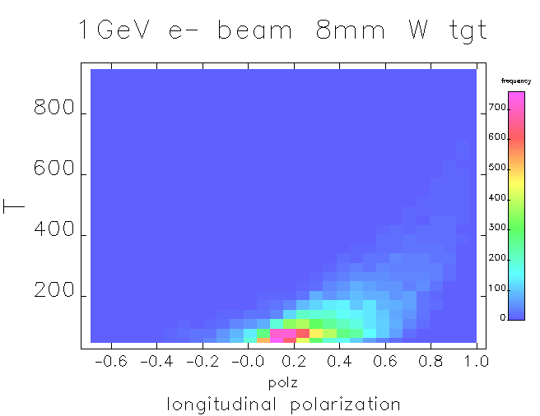
Longitudinal polarization versus e+ Energy
Depends on target thickness. Optimization not done
Notes:
For 123MeV/c positrons, we have roughly 20 % longitudinal polarization for a 8mm W target.

Slide 19
Positron collection system
Various options that can be studied (i.e see S. Golge Thesis )
Quad Triplet
Quad Triplet + dipole pair
Solenoid ? (maybe not at 123 MeV/c)
Need to assess whether we can have it after the recombiner of ARCA, in the reinjection chicane.
Other option is to have it at end of ARCA (2nd step of recombiner) and build a bypass line for the e+, this may make it easier to locate the dump.
Notes:
Quad triplets make use of chromatic effects (dbeta/d(dp/p) ) to “purify” the beam. Cascading triplets can allow for an arbitrarly tight selection of momentum. When coupled with collimators, we also end up with emittance selection to fall within the acceptance of the machine.
Still, we have to design the system to deflect/separate the e+ and e-. The former have to be injected in NL whereas the latter have to be send to a dump to die.

Slide 20
dump requirements
If one uses a 1 mA e- beam (readily available with existing polarized gun), then a MW dump is needed.
A 100 kW dump is relatively small (BSY dump is 100 kW) and could be installed after the production target. This would limit the beam to 0.1 mA.
If one wishes to use 1 mA, then one may need to relocate the e+ production to the 2nd step of the recombiner (end of ARCA) and make a bypass line to reinject the e+ into the NL.
Notes:
Not sure if putting a MW dump in the middle of the arc is even possible. Likely would be buried and we would design a deflection system to send the electrons to it ? 100 kW is small enough that we can do that (like in BSY dump)

Slide 21
Conclusions
Several options are being considered to use CEBAF as a positron machine
R&D is needed to flesh out a complete option
No fundamental show stopper, most issues can be resolved by modifying existing machine
Choice will be driven by the physics needs (polarized, unpolarized, intensity, etc..)
Notes:
In short, I don’t have the time and resources to spend on this project unless its lab funded …

