Slide 1

How to Use UITF
Irradiation of wastewater samples
Gianluigi Ciovati
December 12, 2018

Slide 2
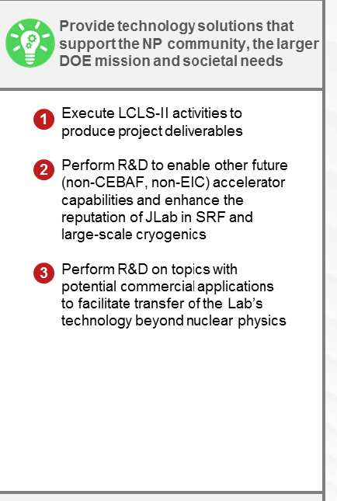
JLab’s agenda
We produced conceptual designs of compact, efficient e-beam accelerators for environmental remediation

Slide 3
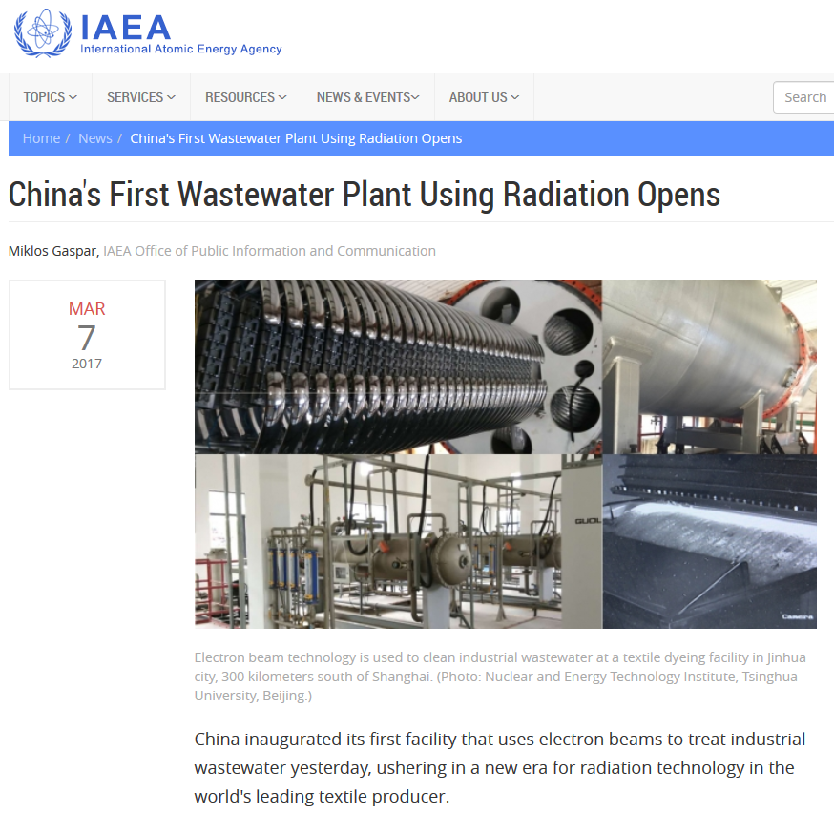
E-beam irradiation of wastewater
Electron beam irradiation is been used for wastewater treatment
A dose of ~1 kGy is sufficient to remove color, odor, disinfection and removal of some organic pollutants.
New challenges in wastewater treatment:
  removal of perfluoroalkyl substances (https://www.epa.gov/pfas/basic-information-pfas)
  removal of pharmaceutical and personal care products

Slide 4

Funding opportunity
We are forming a collaboration with ODU (Civil and Environmental Engineer Dept. and Chemistry Dept.) to submit a proposal for the reduction of PFAS. E-beam irradiation would be one of the treatment steps.
Funding to complete a beamline for the irradiation of wastewater samples and some UITF operator time could be requested as part of the budget
Deadlines: Jan 8, 2019 (Pre-proposal), March 5, 2019 (Full proposal), March-April 2020 (Awards)

Slide 5
Beam energy, Beam Current
Beam energy: 2 – 10 MeV
Beam current: 100 μA
Duration: unclear at this point, proposal would be for 3 years
5

Slide 6
Benefits
This project (if funded) would support JLab’s agenda on expanding the reach of accelerators to meet societal needs and towards tech transfer/commercialization
  Places JLab “on the map” as a facility where e-beam irradiation studies are possible
  Helps creating a “local team” of experts in wastewater treatment using e-beam irradiation
  Increases the likelihood of future potential investors in compact accelerators that JLab is designing

