Slide 1
CEBAF Source and Injector Upgrade Status Moller Collaboration Meeting November 11-12, 2016
Joe Grames
Center for Injectors and Sources

Slide 2
Topics
CEBAF
4-Hall Laser Upgrade
Gun2 Operation
Delivering Spin in 12 GeV era
UITF – CEBAF Injector Upgrade
Gun Status
200 keV Wien
Upgrade Cryounit
Photocathode R&D

Slide 3
CEBAF Polarized Electron Injector
Experiment | Beam Energy (GeV) | Pol (%) | I (µA) | Target (Length) | A_{pv} (ppb) | Charg Asym (ppb) | Position Diff (nm) | Angle Diff (nrad) | Size Diff (δσ/σ)
HAPPEx-I (Achieved) | 3.3 | 38.8 68.8 | 100 40 | ¹H (15 cm) | 15,050 | 200 | 12 | 3
G0-Forward (Achieved) | 3.0 | 73.7 | 40 | ¹H (20 cm) | 3,000-40,000 | 300±300 | 7±4 | 3±1
HAPPEx-II (Achieved) | 3.0 | 87.1 | 55 | ¹H (20 cm) | 1,580 | 400 | 2 | 0.2
HAPPEx-III (Achieved) | 3.484 | 89.4 | 100 | ¹H (25 cm) | 23,800 | 200±10 | 3 | 0.5±0.1 | <10⁻³
PREx-I (Achieved) | 1.056 | 89.2 | 70 | ²⁰⁸Pb (0.5 mm) | 657±60 | 85±1 | 4 | 1 | <10⁻⁴
QWeak-I (Achieved) | 1.155 | 89.0 | 180 | ¹H (35 cm) | 281±46 | 8±15 | 5±1 | 0.1±0.02 | <10⁻⁴
QWeak | 1.162 | 90 | 180 | ¹H (35 cm) | 234±5 | <100±10 | <2±1 | <30±3 | <10⁻⁴
PREx-II | 1.0 | 90 | 70 | ²⁰⁸Pb (0.5mm) | 500±15 | <100±10 | <1±1 | <0.3±0.1 | <10⁻⁴
MOLLER | 11.0 | 90 | 85 | ¹H (150 cm) | 35.6±0.74 | <10±10 | <0.5±0.5 | <0.05±0.05 | <10⁻⁴

Slide 4
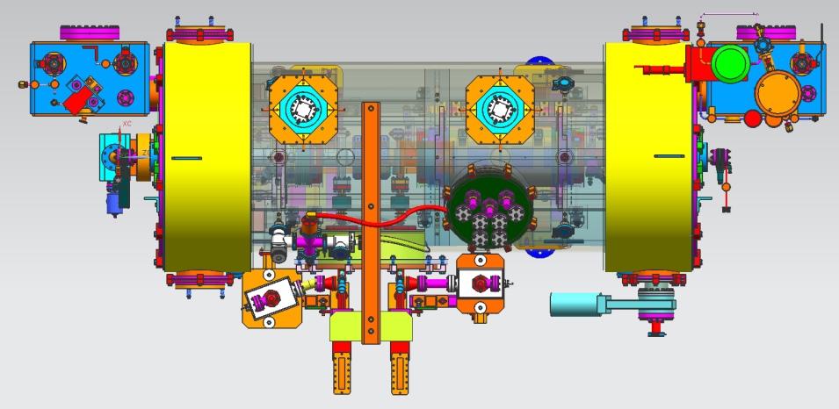
MOLLER Injector
Replace 130kV gun with 200kV gun
Replace ¼ CM with an improved ¼ CM having an SRF capture section
No prebuncher (?)
Upgrade Wien to 200 keV and improve spin flipper layout
More attention paid to beamline vacuum
Our new “1/4 cryomodule”:
2 cell capture section + 7 cell cavity,
should provide 10 MeV beam and introduce no x/y coupling, allow better matching, more adiabatic damping

Slide 5
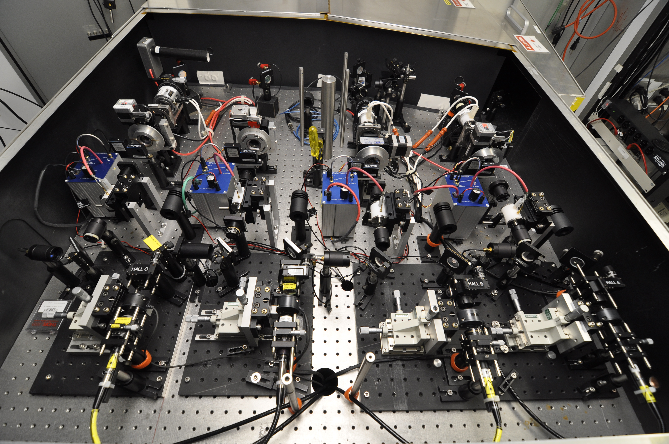
4-Hall Laser Upgrade
Summer 2016

Slide 6
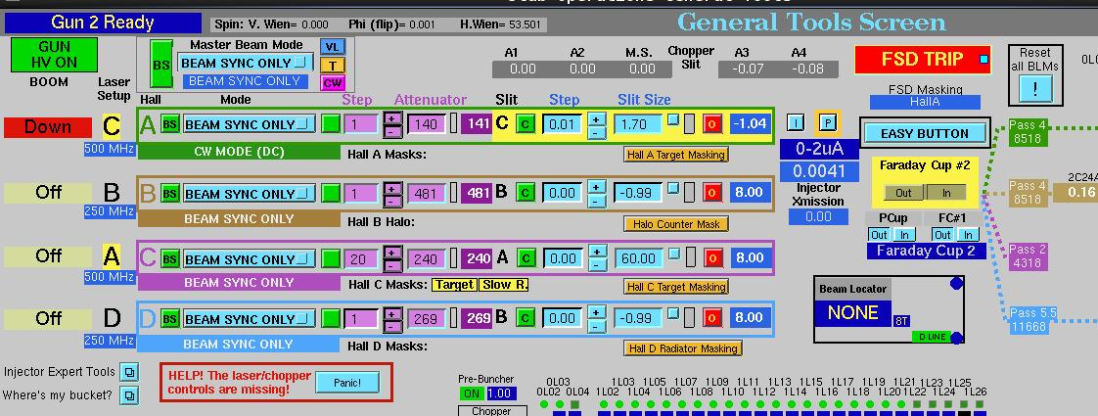
4-Hall Laser Upgrade
Fall 2016
Each laser is manually configurable to a 249.5 or 499 MHz RF spigot
Ops can ‘assign’ any laser to any hall e.g. now : Laser C => Hall A
Only 3 RF spigots presently available

Slide 7
4-Hall Laser Upgrade
January 2017
New LLRF system with 4-spigots, one per laser
Remote control to change laser rep rate (laser + RF)
Provide phase control at each frequency (now all done at 499 MHz)
Spring 2017
Planned simultaneous 4-Hall beam test (if all Halls ready)
We anticipate 3-beam chopper will be limiting factor
Injector group (Kazimi) is working on scheme for new 4-Hall chopper

Slide 8
Gun2 Operation
Spring/Fall 2016
SSL GaAs/GaAsP SVT #5756-4 (Polarization ~ 87%)
No heat/activation over Summer SAD
Jun 2016
Sep 2016
8

Slide 9
Gun2 Operation
Fall 2016
Gun2 operating at -130 kV without any problems
Charge lifetime >100C with average current 70-80 μA

Slide 10
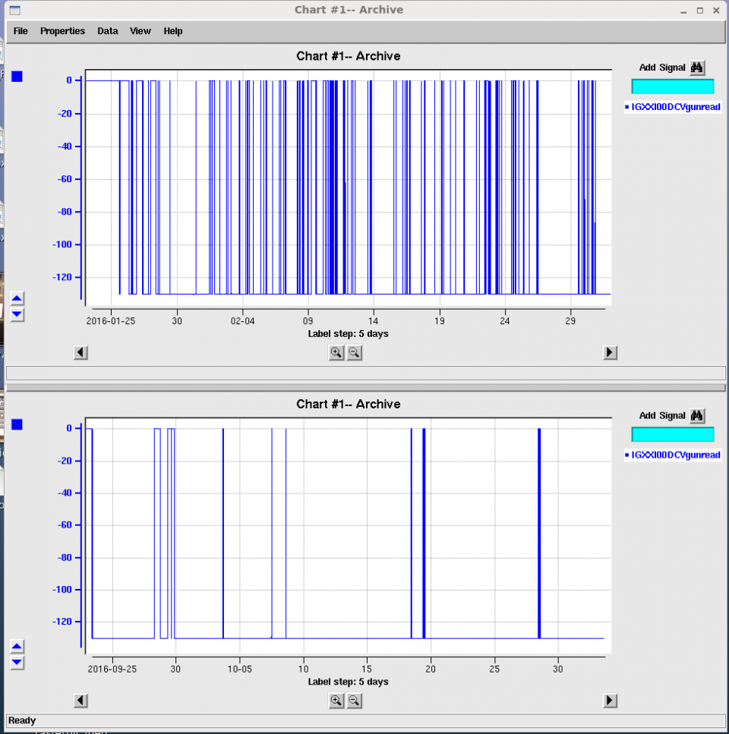
Gun2 Operation
Fall 2016
Gun HV power supply may now remain ON in Power Permit
May anticipate improved reliability, monitoring and charge lifetime
First 5 weeks of
Spring 2016 Run
First 5 weeks of
Fall 2016 Run

Slide 11
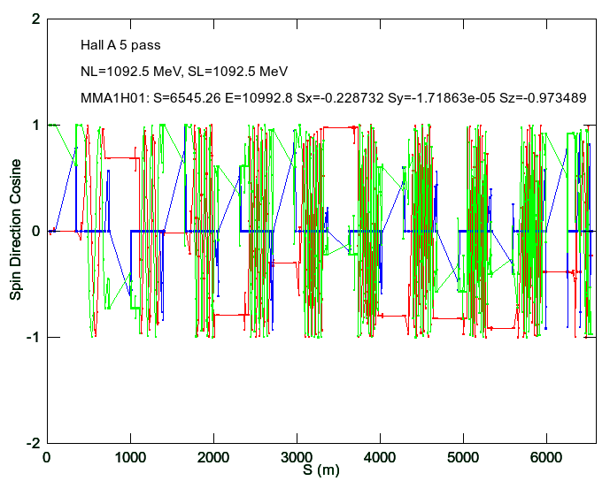
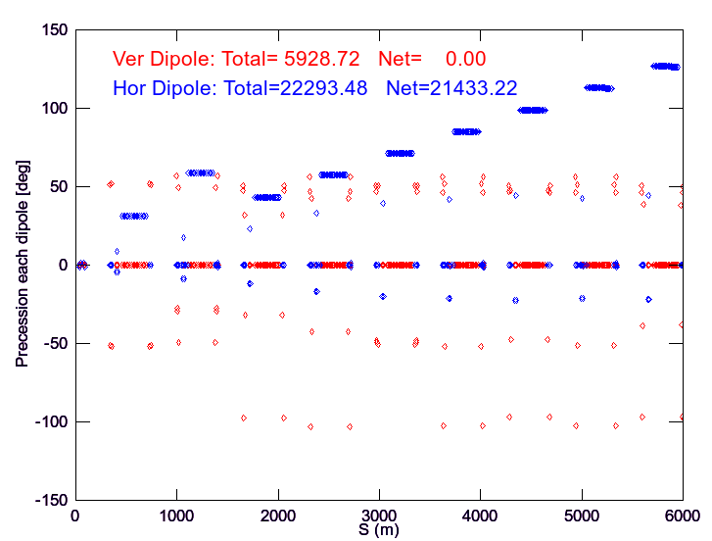
Delivering Spin in 12 GeV era
Spring 2016
Elegant model w/ synchrotron radiation to predict energy @ dipoles
Hall A arc energy measurement (+0.23% above machine value)
Integrated spin precession from injector to Hall A

Slide 12
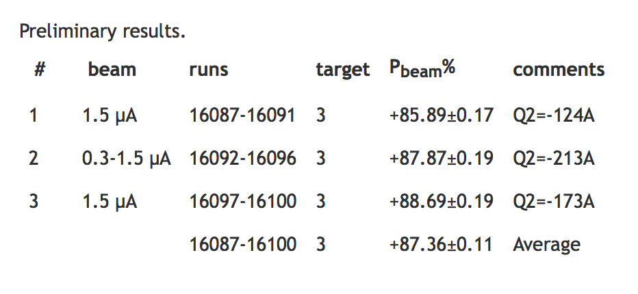
Delivering Spin in 12 GeV era
Fall 2016
LINACS reduced 4% to 1050 MeV for gradient headroom
Hall A arc energy measurement (+0.19% above machine value)
Elegant model and spin precession for Hall A @ 4th pass
Without spin dance Moller measurement indicate high polarization
Investigation about discrepancy in LINAC/ARC energy calibration
Hall A Moller @ 4th pass 8516 MeV
(11/1/16)

Slide 13
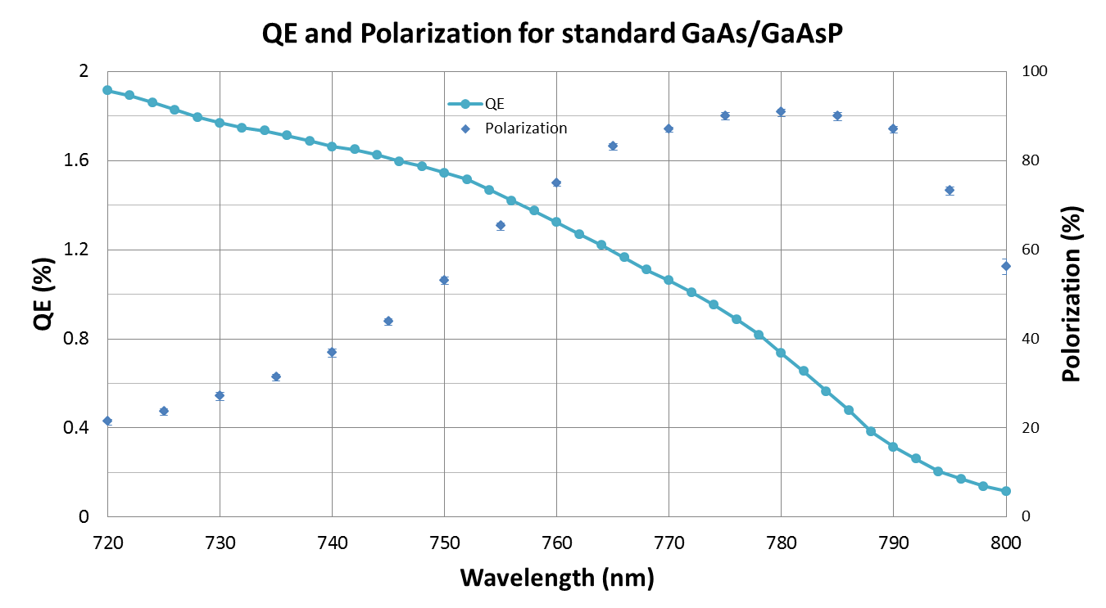
Our highest polarization result
Polarization varies sample to sample, high 80s typical
Not a “knob” we can turn Up or Down
Expect some depolarization at 11 GeV due to synchrotron radiation
Assuming 90% is not realistic, but we should be close
QE not so important, but can’t let QE get too low….

Slide 14
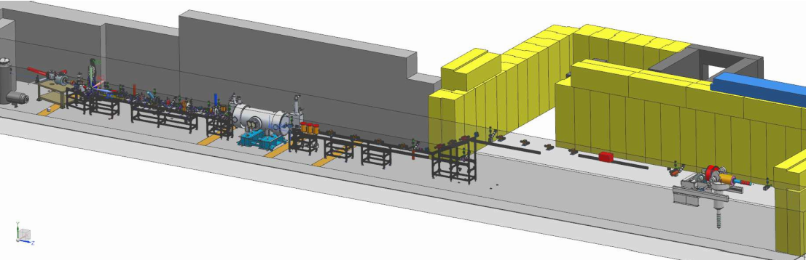
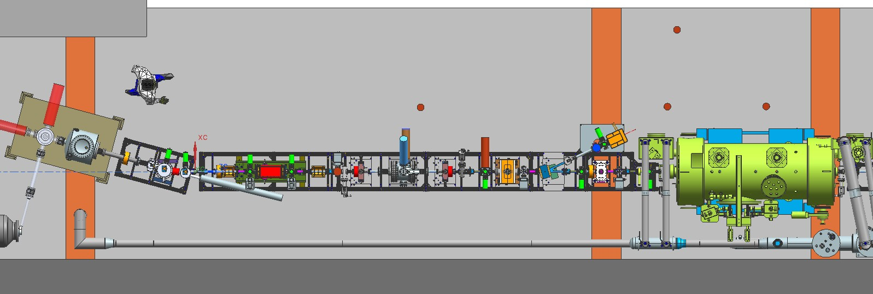
UITF – CEBAF Upgrade Testing
TESTING MORE ROBUST (>300kV) INVERTED GUN
TEST 200 kV WIEN FILTER
COMMISSIONING NEW 2/7 CELL CRYOUNIT

Slide 15
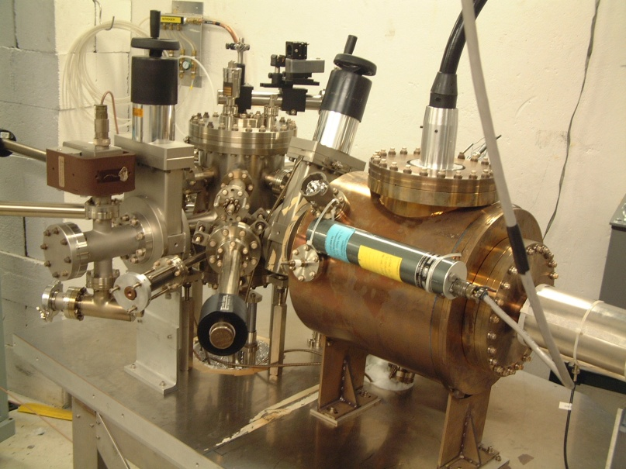
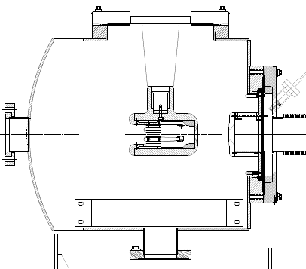
UITF - CEBAF/ILC 200 kV Inverted Gun
Developed and ready for installation
Commissioned at Test Cave to 225 kV w/o field emission
Large grain Niobium electrode
-200kV
light in
e- out
photocathode

Slide 16
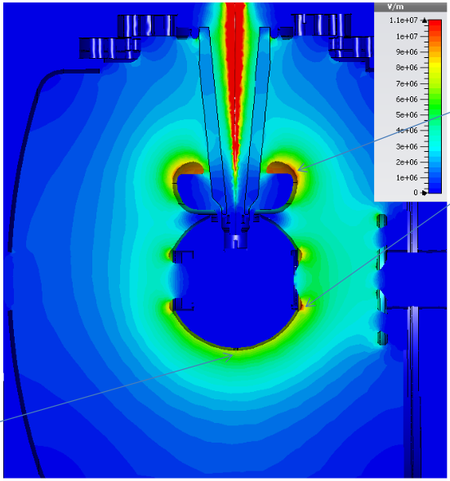
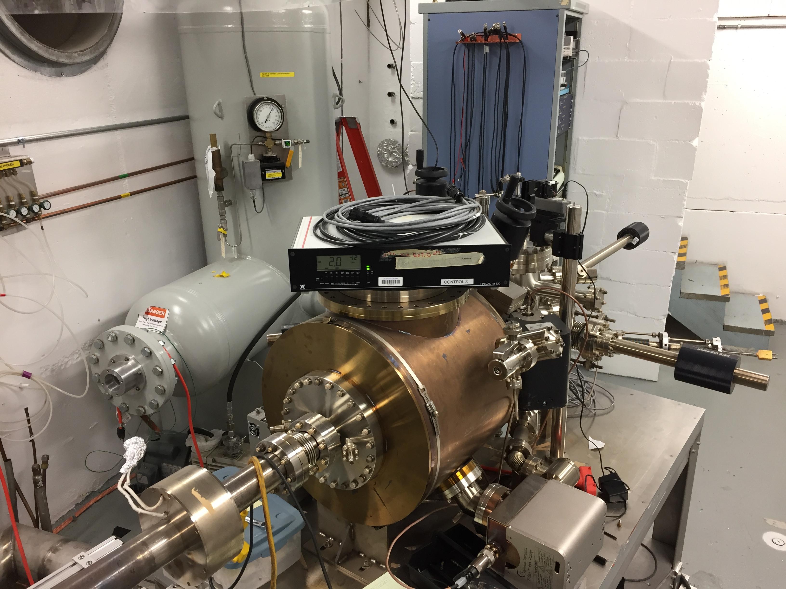
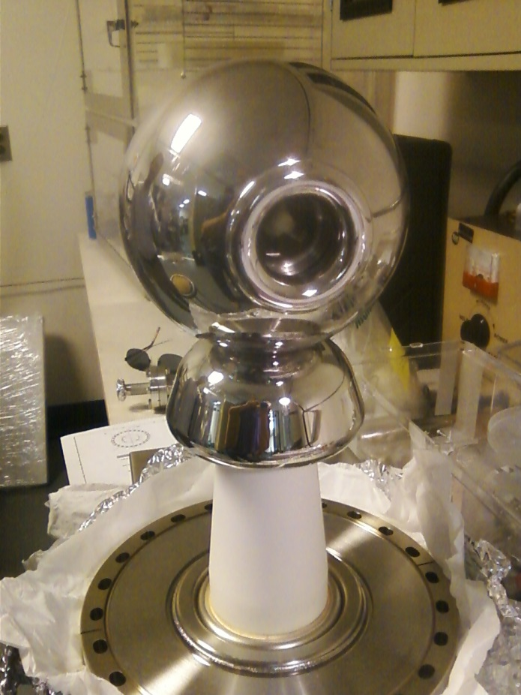
UITF - Higher Voltage Polarized Source
Benefits of higher gun voltage will be tested
Stiffer beam leads to less loss
Higher voltage reduces improves QE
Rapid energy gain reduces ionization
11 MV/m
450kV HVPS
Tested
Prep Chamber ready for activation
8 MV/m
HV Chamber
Baked ~2E-12 T

Slide 17
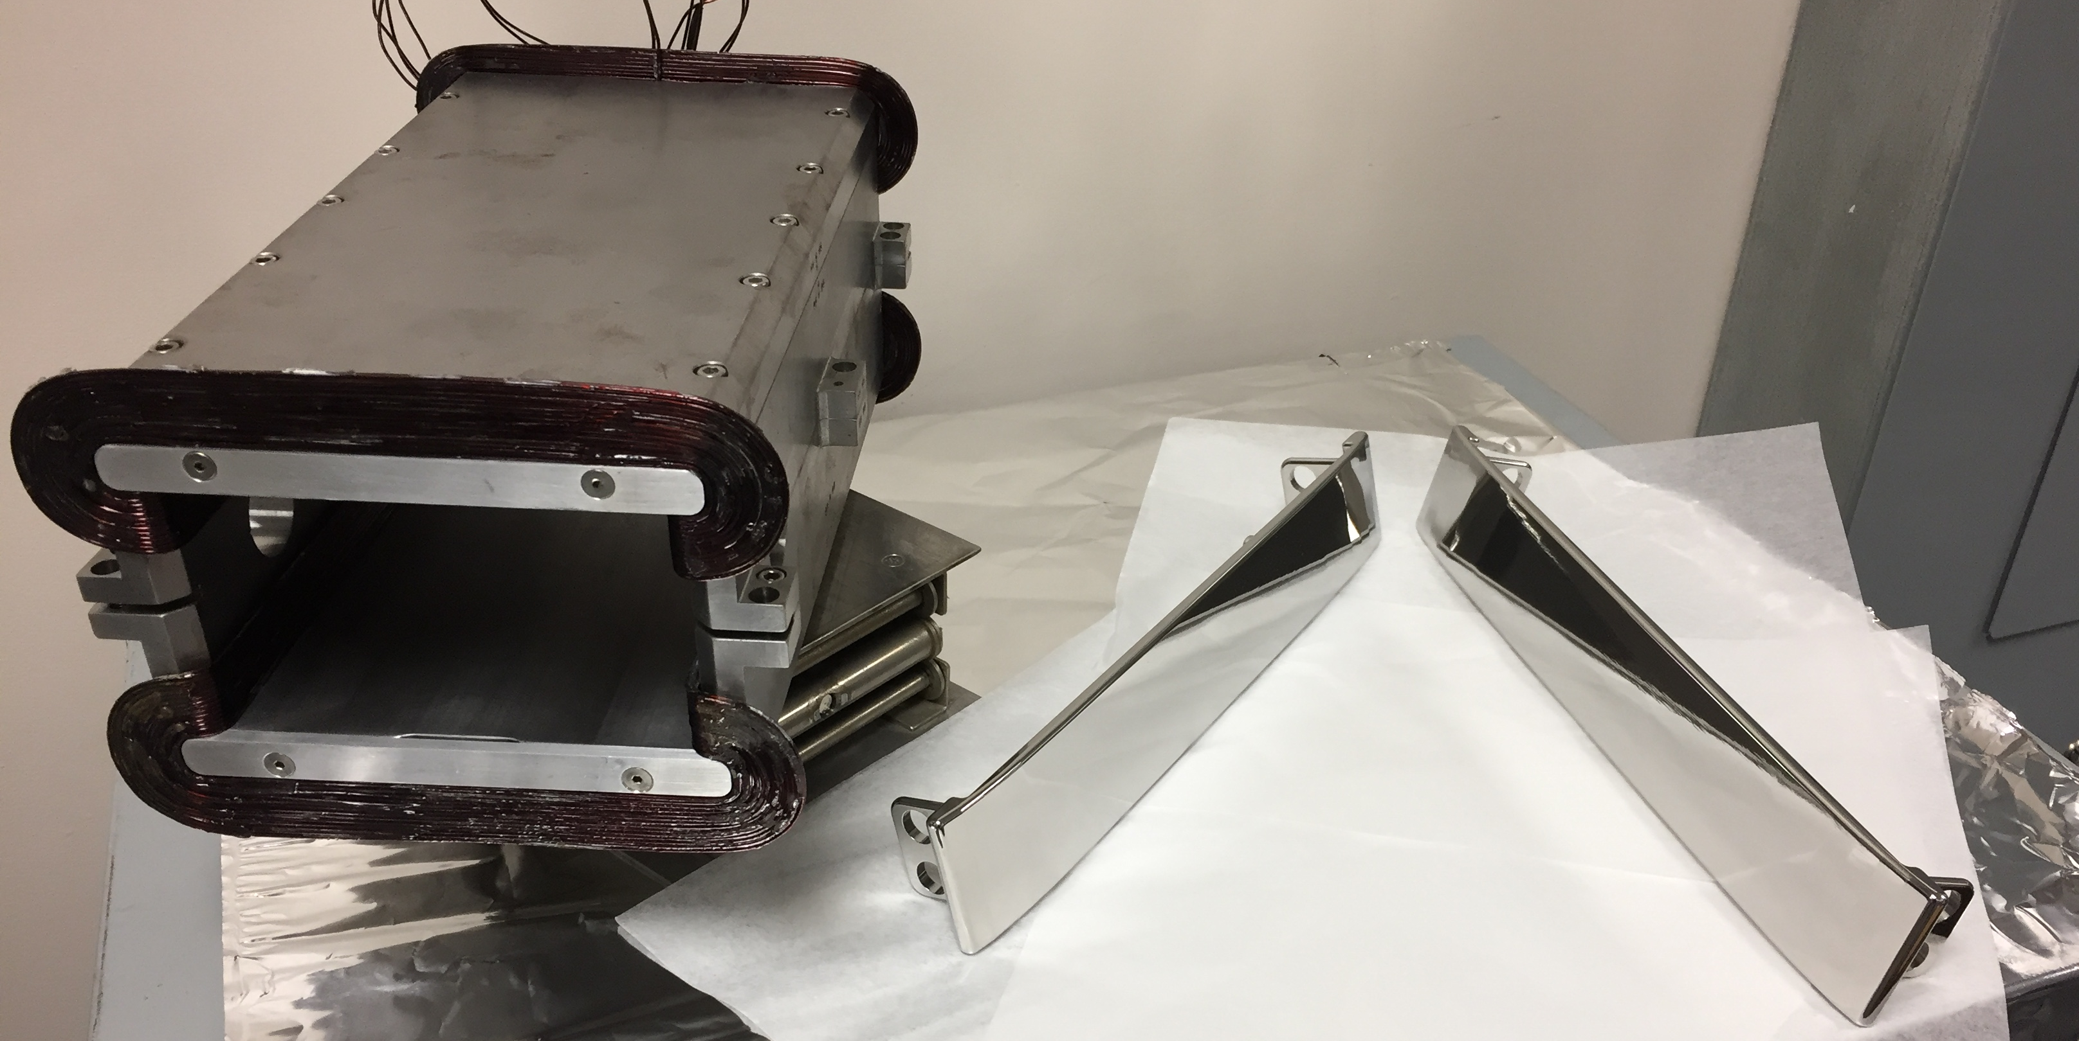
UITF – 200 keV Wien upgrade
UITF will provide opportunity for 200 keV Wien characterization
10A magnet limits 200 keV spin precession to ~65 deg
Jay proposed (JLAB-TN-15-032) to retrofit new 20A magnet coils to extend capability to higher beam energy
Successfully tested HV feed thru to 20kV and polished the electrodes
Wien Upgrade for 100 deg precession
Beam Voltage | keV | 200.00 | 350.00
Integrated BL | G-cm | 3993.86 | 6788.51
Magnet Current | A | 15.36 | 26.11
Electric Field | MV/m | 2.67 | 5.27
Electrode High Voltage | kV | 20.05 | 39.56

Slide 18
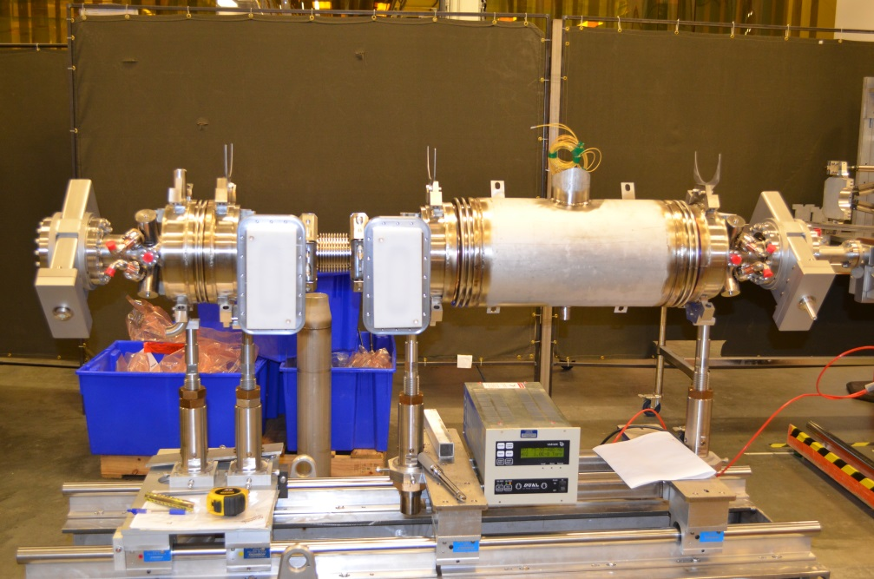
UITF - New CEBAF Injector Cryounit
2016 Commissioning at Test Lab
Summer – Cryostat assembled + cryo @ UITF
Fall – SRF commissioned to 20 MV/m @ CMTF
Winter – Install @ UITF, planned up to ~8 MeV (klystrons)
Installation timeline at CEBAF in advance of Moller TBD

Slide 19
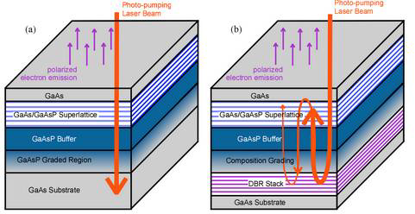
UITF – Photocathode R&D
Testing benefits of Standard vs. DBR GaAs/GaAsP SSL
Standard photocathode: absorption in the GaAs/GaAsP superlattice < 5%
DBR photocathode : absorption in the GaAs/GaAsP superlattice >20%
Non-DBR photocathode
DBR photocathode

Slide 20
UITF – Photocathode R&D
High polarization photocathodes
Standard high QE photocathode w/ polarization > 90%
Test DBR photocathode for reliability and lifetime before CEBAF option
At 776 nm:
Standard
QE = 0.89%
Polarization = 92%
DBR
QE = 6.4%
Polarization = 84%

Slide 21
Summary
CEBAF
Source is operating reliably w/ high polarization and QE
Charge lifetime is good at typical Moller current, possible gain from HVPS
4-Laser upgrade went well, will complete LLRF this Winter, then test delivery
Summer 2017: would be good to install 200kV gun and 200kV Wien filters, and move prebuncher downstream of 2-Wien flipper but plate is full. That would be the right time to replace vacuum window (less birefringence)
UITF Injector Upgrade Activities
Higher voltage polarized gun w/ spherical electrode tested soon
200kV Wien filter modification in progress
New cryounit assembled and SRF commissioning completed, install soon
Not to forget…
Wrapping up Mott analysis, publication early 2017
Stewart platform development can proceed if test “owner” identified
Maybe some interest to test a helicity quad for spot size sensitivity?

Slide 22
Summary
Not to forget…
Please continue to characterize 11 GeV beam
Quantify depolarization due to synchrotron radiation
Look for SR-induced helicity correlated beam asymmetry? We can send you beam with vertical polarization.
Is DC beam (aka, bleedthrough) the cause of halo and tails, frustration for Qweak? Replace gain-switched diode laser with mode-locked fiber laser
Spin Dance in 12 GeV era, start building support for this big job
Jay is convinced we would benefit from solenoids that provide a uniform field over a larger region of the beampipe. keV region and MeV region of the injector. And I think it would be easier to set up the injector using solenoids versus quads

