Slide 1
Cosmic ray background (beam intensity independent)
N = (Fiducial + Background)/2
Fiducial
T = run time
Background
Trig = triggers
Rate = N/(T-10*Trig)
Used runs 56, 70, 78, 79, 92, 109, 110, 111

Slide 2
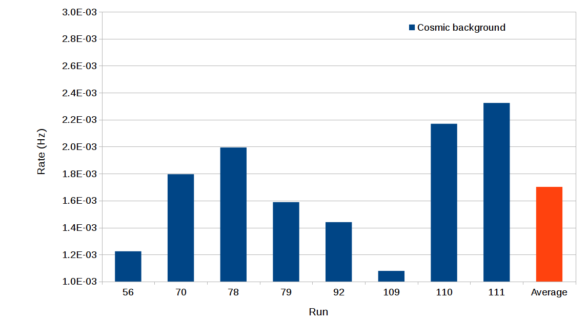
Cosmic ray background average = 1.7E-3 Hz

Slide 3
Beam induced background (calculated at I = 50 μA, E = 4 MeV)
N = (Fiducial – Background)
Fiducial
T = run time
Background
Trig = triggers
Rate = N/(T-10*Trig)
Used run 91
Beam induced background = 8.3e-3 Hz, 1.7e-4 Hz/μA

Slide 4
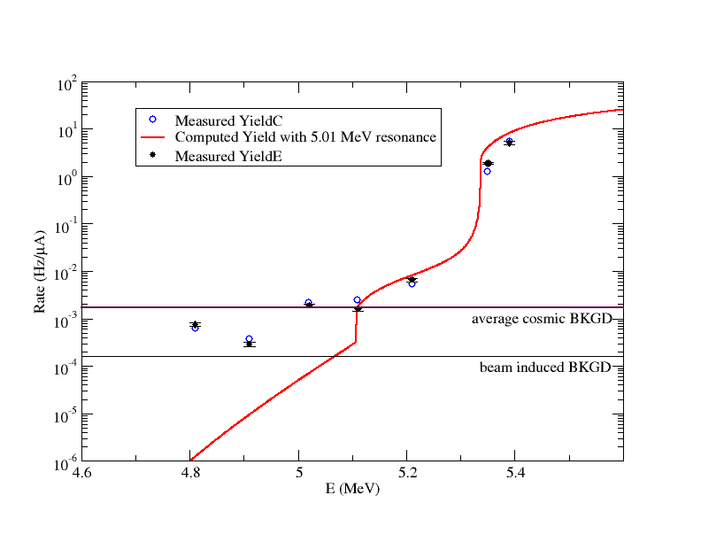

Slide 5
σ(α,γ)= 4.1 x10⁻¹⁰ b
σ(γ,α)= 5.0 x10⁻⁸ b

Slide 6
 | Rate (Hz) @ 50uA | Rate (Hz/uA)
Average rate fiducial @ 4.81 MeV | 3.12E-2 | 6.25E-4
Average rate fiducial @ 4.91 MeV | 1.83E-2 | 3.66E-4
Beam induced BKGD | 8.30E-3 | 1.66E-4
Average Cosmic BKGD | 1.70E-3 | 1.70E-3

