Slide 1
GPT Routine to Simulate Secondary Electron Yield (SEY)
Josh Yoskowitz

Slide 2
Theory: Basics
Incident Electron
Secondary Electrons
e-
e-
A particle (in this case, an electron) is incident on a piece of material at an angle θ with kinetic energy T. It will either back scatter from the material or penetrate it. We’ll focus on the latter case.
As the electron penetrates the material, it scatters off the material’s atoms/molecules loses energy.
Some of this lost energy is transferred to electrons (referred to here as secondary electrons) within the material.
Depending on the kinetic energy W and depth x of the secondary electrons, they may be able to reach the surface before they lose too much kinetic energy to collisions.
If the secondary electrons have sufficient kinetic energy, they will overcome the surface potential (i.e. work function φ) of the material and leave the surface.
θ
e-
x

Slide 3
Theory: Derivation Sketch Pt. 1
Following the derivation by Dionne (1973/1975), presented by Sims (1992).
The general formula for the secondary electron yield (SEY) $δ$ due to an electron with energy $T$ that is normally incident on a material is given by:
$$δ=\int_{0}^{∞}{n\left(x,T\right)}f\left(x\right)dx$$
where $n(x,T)$ is the average number of secondary electrons produced at a depth $x$ and $f(x)$ is the escape probability at this depth.
$n\left(x,T\right)$ is related to the stopping power (i.e. energy loss per unit depth) by
$n\left(x,T\right)=−\frac{1}{ξ_{0}}\left(\frac{dE(x,T)}{dx}\right)$
where $ξ_{0}$ is the excitation energy of an electron in the material.

Slide 4
Theory: Derivation Sketch pt. 2
In order to calculate $δ$, Dionne makes three main assumptions:
The stopping power can be expressed as a power law: $\frac{dE}{dx}=−AE^{1−n}$for $n>1 and A$ is a constant.
The energy loss rate is constant as the primary electron penetrates the material (Young’s modification 1956).
The migration and escape probability function $f(x)$ decreases exponentially with depth: $f\left(x\right)=Be^{−αx}$ where B is the escape probability and $α$ is the inverse mean free path of the secondary electron.
Using these assumptions, we can write $δ$ as:
$δ=\frac{B}{ξ_{0}}{\left(\frac{An}{α}\right)}^{\frac{1}{n}}{\left(αd\right)}^{\frac{1}{n}−1}\left(1−e^{−αd}\right)$
where $d=\frac{T^{n}}{An}$ is the maximum penetration depth.
The above equation can be written in terms of the theoretical maximum yield $δ_{m}$ and corresponding energy at maximum yield $E_{m}$. To do this, the above equation is differentiated with respect to $αd$ and is set equal to zero, arriving at:
$$αd_{m}=\left(1−\frac{1}{n}\right)\left(e^{αd_{m}−1}\right)$$

Slide 5
Theory: Derivation Sketch pt. 3
$n$ is set according to the primary kinetic energy range (see Dionne, 1973). For energies between 0.3-7.25 keV, $n=1.35$. For energies between 7.25-40 keV, $n=1.66$. Using $n=1.35,$ we can extend our equation for $δ$ to encompass all incident angles by replacing $α$ with $α\cos\left(θ\right)$, resulting in our final equation for $δ$:
$$δ\left(θ,T\right)={\frac{1.114δ_{m}}{\cos\left(θ\right)}\left(\frac{T_{m}}{T}\right)}^{0.35}\left(1−exp⁡(−2.28\cos\left(θ\right) {\left(\frac{T}{T_{m}}\right)}^{1.35}\right)$$
Ono and Kanaya (1978) give equations for $δ_{m}$ and $T_{m}$:
$$δ_{m}=0.12Z^{\frac{1}{15}}I^{\frac{4}{5}}\left(1+1.26r\right)$$
$T_{m}=57.9Z^{\frac{1}{15}}I^{\frac{4}{5}}\left(1+5r^{2}\right)$ (eV)
where $Z$, $I$, and $r$ are the atomic number, ionization energy, and backscatter coefficient for a monoatomic target material. For semiconductor materials of the form ${\left(Z_{1}\right)}_{p}{\left(Z_{2}\right)}_{q} (like GaAs)$ one can use:
$$δ_{m}=\frac{1}{p+q}\left(pδ_{1m}+qδ_{2m}\right)$$
$T_{m}=\frac{1}{p+q}\left(pT_{1m}+qT_{2m}\right)$ (eV)

Slide 6
Sample SEY calculations for various materials using values from Ono and Kanaya (1978)
Material | Z (Z₁, Z₂) | I (I₁, I₂) (eV) | r (r₁, r₂) | E_{m} (eV) | $$δ_{m}$$
Fe | 26 | 7.8 | 0.33 | 400 | 1.10
| | | | | | | | | | |
| | | | | | | | | | |
| | | | | | | | | | |
V | V | V | V | V | V
GaAs | 31, 33 | 6.0,9.8 | 0.35,0.36 | 562 | 1.14
Al
T (keV) | $θ$ (⁰) | $$δ(T,θ)$$
1 | 60 | 1.81
1 | 30 | 1.11
0.1 | 0 | 0.46
1 | 0 | 0.968
10 | 0 | 0.434
1 | 0 | 1.03

Slide 7
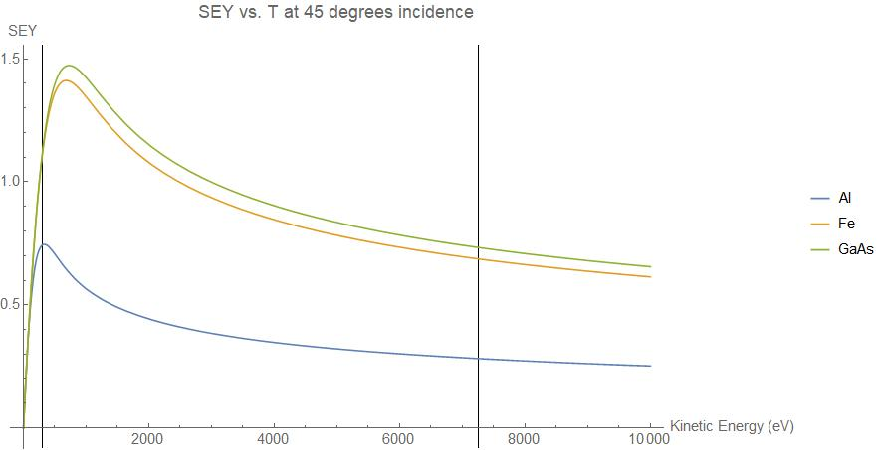
SEY Graphs: Normal Incidence and 45⁰ Incidence
0.3 keV
7.25 keV
0.3 keV
7.25 keV

Slide 8
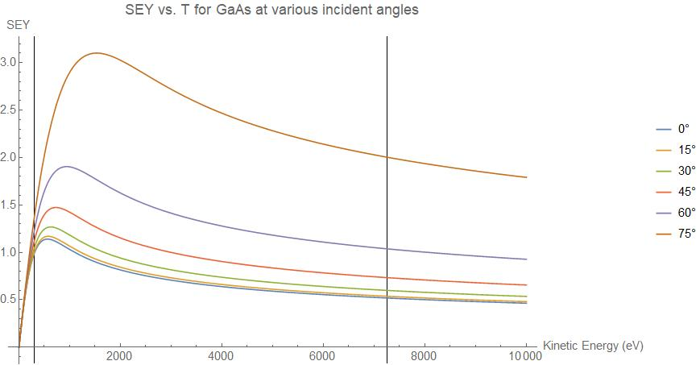
SEY Graphs: Fe and GaAs, Various Incident Angles
0.3 keV
7.25 keV
0.3 keV
7.25 keV

Slide 9
GPT SEY Routine Algorithm
Surfaces (i.e. beampipe, photocathode, etc.) with corresponding SEY scattering model are set in the input file.
(Primary) electrons with at least 300 eV that intersect the material boundary within a given timestep are eligible to create secondary electrons.
Using the primary electron’s parameters (i.e. energy, angle of incidence, etc.) and the type of boundary specified, the SEY is calculated.
A Monte Carlo routine takes the decimal part of the SEY value and determines whether or not an additional secondary electron is created (i.e. if SEY = 1.34, one electron is created and there is a 34% chance of an additional electron being created in this time step.)
Since the SEY can be quite large for primary electron macro-particles, a single secondary electron macro-particle is created representing all secondary electrons emitted from the surface.
The secondary electron is given kinetic energy based on a Maxwellian distribution with the most probable energy of 2 eV.
The secondary electron macro-particle is added to the simulation and the incident particle is removed.

Slide 10
Example GPT Simulation: Electron bunch incident on a GaAs plate
Parameter | Value
# of electron macro-particles | 10000
Total charge | 1 nC
Initial KE | (1 ± 0.511) keV
Initial radius | 0.1 m
Square Plate position | Z = 0.5 m (centered)
Square Plate length | 0.5 m

Slide 11
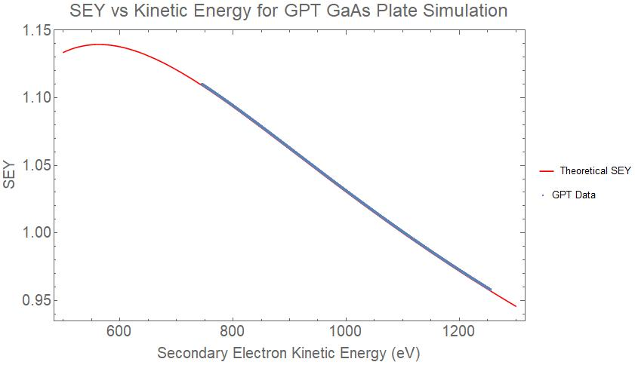
Analysis of electron bunch on GaAs plate GPT simulation
Numerical Results
Description | Numerical Value
Total # primary electrons | 6.241×10⁹
Total # secondary electrons | 6.444×10⁹
Net Electron Gain | 2.023×10⁸ (+3.2%)
(Avg ± σ) SEY per single electron | 1.032 ± 0.045

Slide 12
Example GPT Simulation: Electron bunch through an Aluminum pipe with Ionization
Parameter | Value
# of electron macro-particles | 10000
Total charge | 1 nC
Initial KE | 1 keV
Initial radius | 0.1 m
Pipe start/end | 0.1 m<=Z<=0.8 m (centered)
Pipe radius | 0.5 m
H₂ density within pipe | 10¹⁴ m⁻³ (≈3×10⁻⁹ torr)

Slide 13
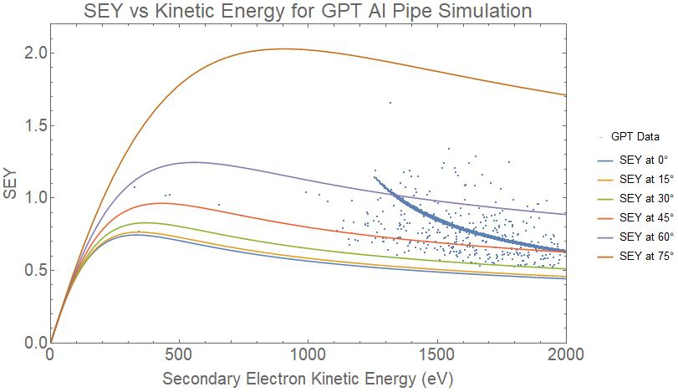
Analysis of electron bunch through an Aluminum pipe with Ionization
Numerical Results
Description | Numerical Value
Total # primary electrons | 6.241×10⁹
Total # secondary electrons | 6.444×10⁹
Net Electron Gain | -3.369×10⁹ (-54%)
(Avg ± σ) SEY per single electron | 0.756 ± 0.107

