Slide 1
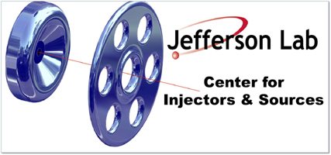
Injector Status & Commissioning
P. Adderley, J. Clark, S. Covert, J. Grames, J. Hansknecht,
M. Poelker, M. Stutzman, R. Suleiman, K. Surles-Law
QWeak Collaboration Meeting
May 24, 2010

Slide 2
Inverted Gun at CEBAF
First Inverted Gun (with Stainless Steel Cathode) installed at CEBAF, operational since July 2009
Running at 100 kV. Conditioned to 110 kV
Lifetime about 100 C at 50 µA average current
2 weeks between spot moves, 2-3 months between heat/activations
Maximum possible Gun Voltage is 150 kV (limited by Safety System and HV Power Supply)

Slide 3
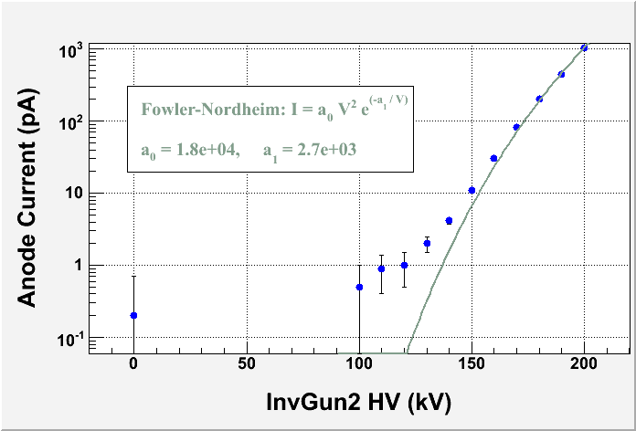
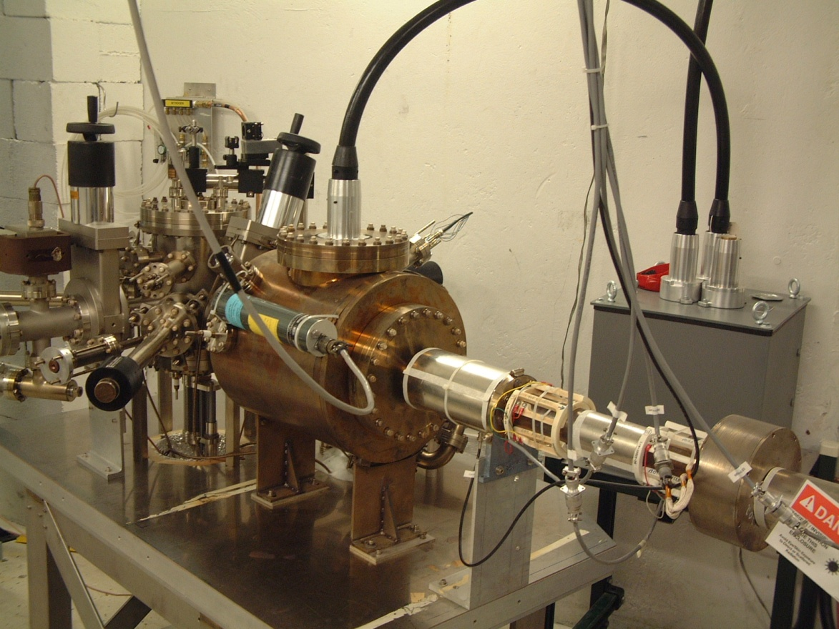
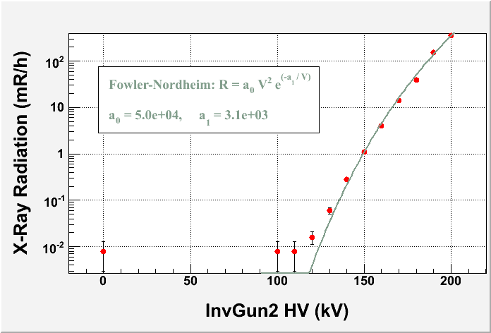
Inverted Gun at Test Cave
Second Inverted Gun (with large grain Niobium Cathode) installed at Test Cave in November 2009
Conditioned to 200 kV

Slide 4
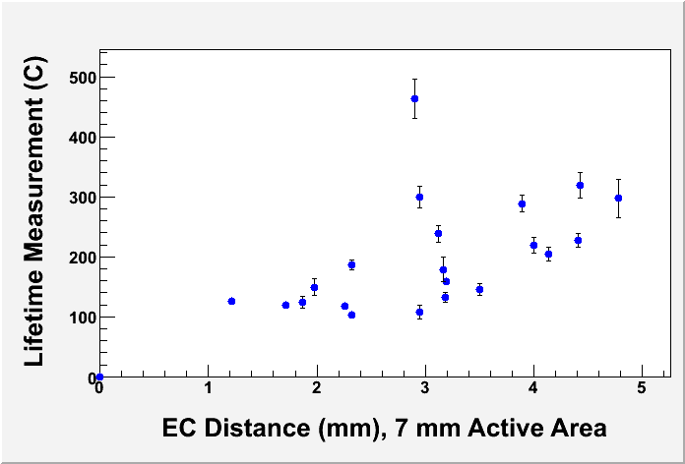
Measured lifetime at 100 kV
(Bulk GaAs, 2 mA, 532 nm, 0.35 mm laser spot)

Slide 5
Test Cave Plan (June – July):
Measure lifetime at 140 kV
Measure lifetime at 200 kV
Re-condition to 225 kV to reduce Field Emission (FE) at 200 kV
Re-measure lifetime at 200 kV with smaller FE

Slide 6
Helicity Reversal
Fast Pockels Cell (PC) Reversal:
New Helicity Board commissioned during PREx
Slow Wien Reversal commissioned during PREx
Experiment | Rate | Clock | Pattern
HAPPEx III & PVDIS | 30 Hz | Free | Quartet
PREx | 120 Hz 240 Hz | Free Free | Quartet Octet
QWeak (Preliminary) | 1 kHz | Free | Quartet

Slide 7
Injector Team
Coordinator: Suleiman
Members: Poelker, Grames, Hansknecht, King, Carlini, Paschke, Ramsay
A student and a postdoc

Slide 8
Commissioning Plan
Benchmark Hall C beam with PREx Injector setup. Beam quality should be pretty good since C laser lies on top of A laser (8 hours during Beam Studies before June 22)
Heat & re-activate photocathode (2 shifts)
Install hand-wound A1 corrector to improve steering through A1 and A2
Study PC ringing (opto-coupler and HV Switch) and swap PC (if needed), then perform Pockels Cell re-alignment (2 shifts)

Slide 9
Devise a means to quantify ringing on once a week basis. An access to laser table can be made, but remote measurement preferable.
Rotate photocathode to reduce effect of vacuum window birefringence (1 shift)
Wien Filter calibration, part II (2 shifts during beam studies before June 22)

Slide 10
Study beam phase-space when using Wien Flip. Quantify the difference between Vertical Wien and Solenoid method with beam to Hall and large position differences (2 shifts)
After PREx ends, and before summer shutdown, run 180 µA using 100 kV gun to assess beam quality and for beamline and hydrogen target commissioning
Zero vertical polarization using 5 MeV Mott Polarimeter in Injector – requirement: P_{y} < 4% (1 shift)

Slide 11
Spin dance to zero transverse polarization using Hall C Polarimeter – requirement: P_{x} < 4%
Optimize Helicity Board settings: T_Settle, T_Stable, and Pattern. Need hydrogen target and Lumi (3 shifts)
Try 32 MHz beam for background studies and Moller Polarimeter in Hall C

Slide 12
Deferred To Summer Shutdown (August)
4-peak charge asymmetry feedback IA electronics: installation and commissioning
CEBAF Inverted Gun HV Conditioning to 150 kV
Injector setup with 125 kV gun (or higher) and commissioning
Modification to Beamline: New A1 Aperture assembly installation and beamline bake out

