Slide 1
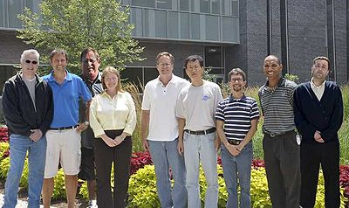
CEBAF Polarized Electron Source
Joe Grames
Center for Injectors and Sources
wiki.jlab.org/ciswiki
JLab Summer Lecture Series, July 5, 2018

Slide 2
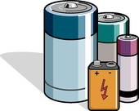
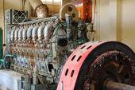

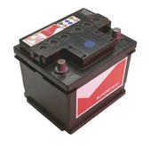
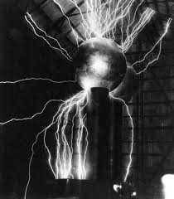
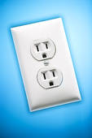
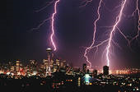
Where do we find energetic electrons ?
Storage batteries, power generators, wall-plug power, Nature, movies and… in particle accelerators!!!

Slide 3
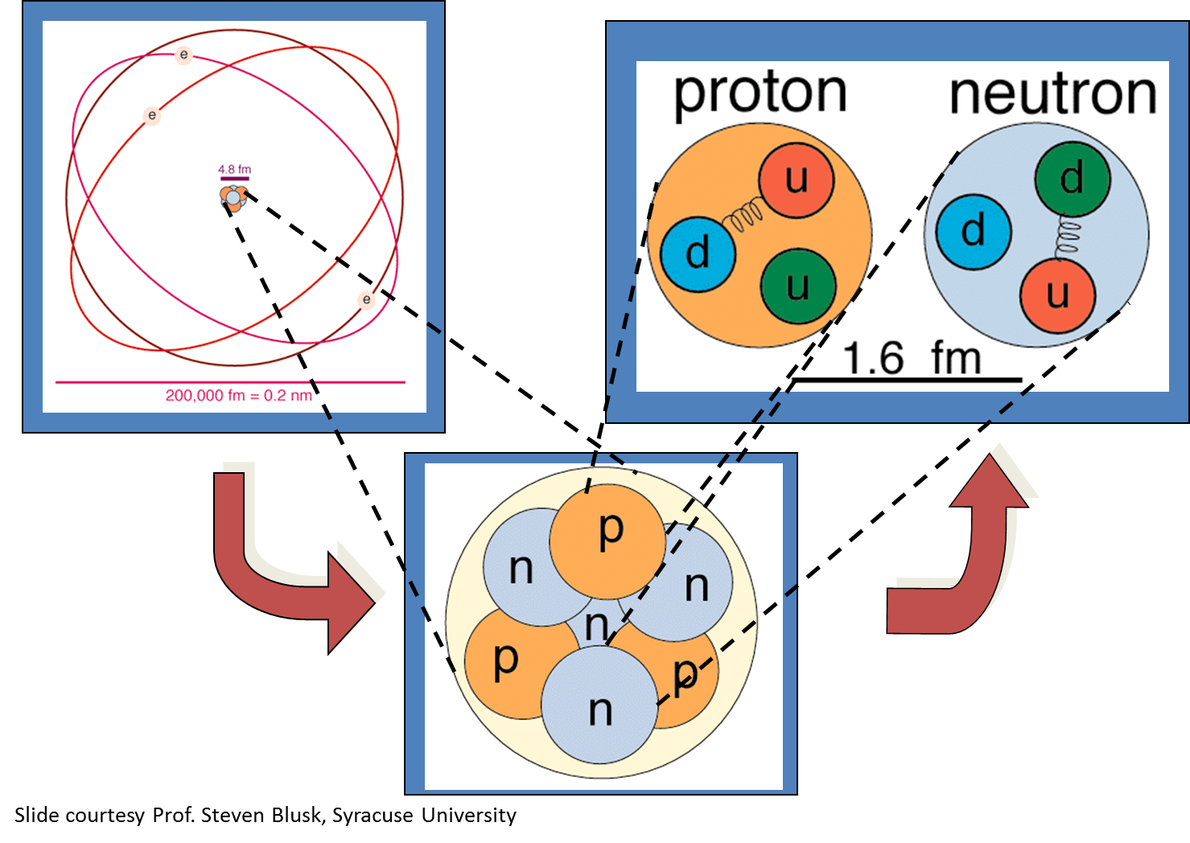
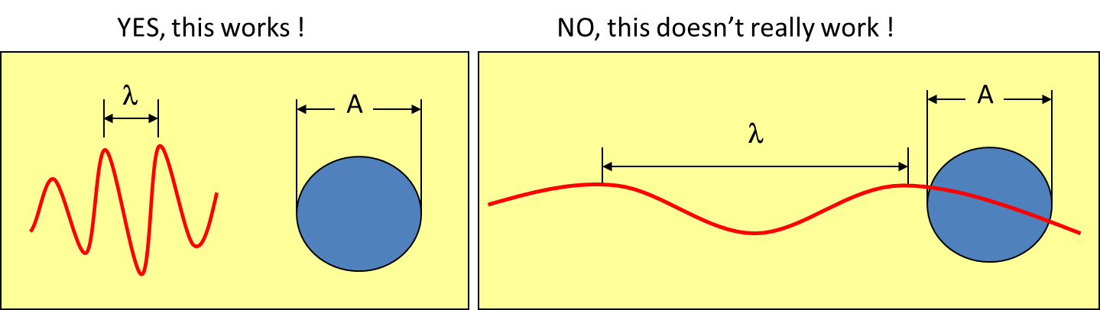
⁷Li

Slide 4
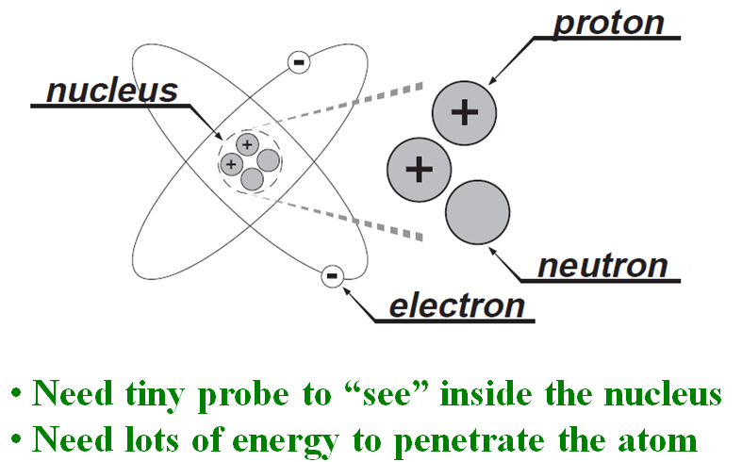
Energy scale to probe massive particles…
M ~ 938 MeV/c²
m ~ 0.511 MeV/c²
energy ~ 1/λ ~ mass
E = mc²

Slide 5
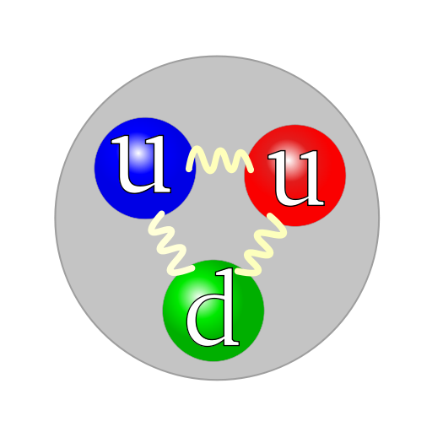
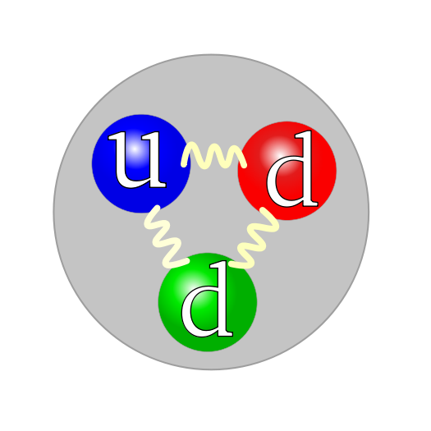
What to do?
Build a 5 mile long electron microscope!
Electron
Proton
Neutron
Make electrons energetic enough (E_{beam}) to peek inside proton or neutron (M_{nucleon}).

Slide 6
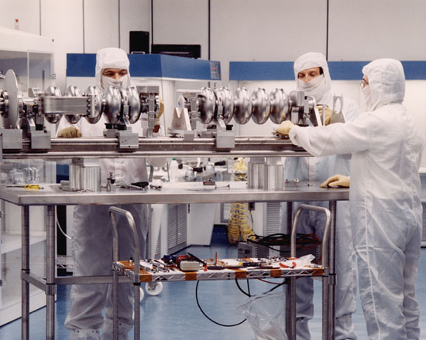
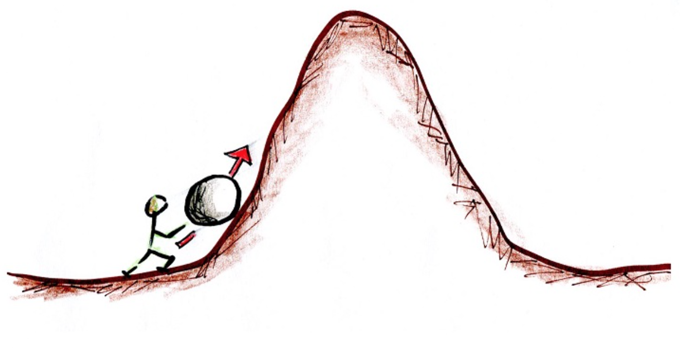
How to make the electrons “energetic” ?
Use oscillating voltage !!!
Accelerating voltage
How about static voltage?
Air ~ 6 MV/m
Sulfur hexafluoride ~15 MV/m
Ceramic ~ 30 MV/m
?
?
Decelerating voltage
Electrons gain energy on each crest!

Slide 7
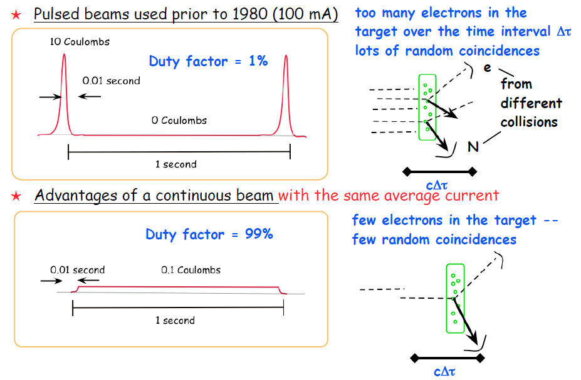
The “C” in CEBAF
1 Coulomb
1 Coulomb

Slide 8
Accelerators need “freed” electrons !
How might get them?
Field Emission (electronic energy)
Thermionic Emission (thermal energy)
Photo Emission (optical energy)
All are manifestations of electromagnetism

Slide 9
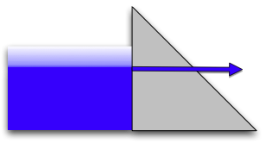

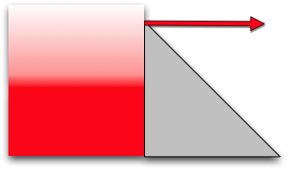

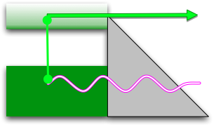

The Canonical Emission Equations
(slide courtesy of Dr. K. Jensen, Naval Research Laboratory)
Field Emission
Fowler Nordheim
E.L. Murphy, and R.H. Good,
Physical Review 102, 1464 (1956).
Thermal Emission
Richardson-Laue-Dushman
C. Herring, and M. Nichols,
Reviews of Modern Physics 21, 185 (1949).
Photoemission
Fowler-Dubridge
L.A. DuBridge
Physical Review 43, 0727 (1933).
Listed chronologically

Slide 10
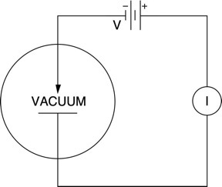
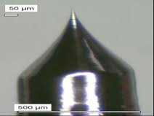
Field Emitter Sources
Explained by Fowler and Nordheim (1928): a quantum mechanical tunneling effect
Small emission area makes for a very “bright” beam, good for surface science
I = BV² exp(-C/V)
Vacuum diode
60°
human hair

Slide 11

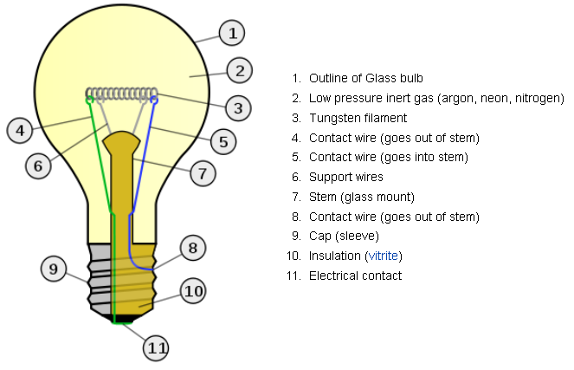
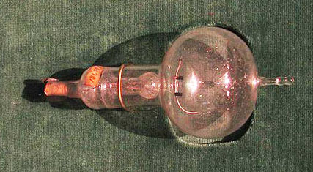
Thermionic Emission
Studied since early 1800’s and perfected over 100 years
Thermionic emission from Tungsten filaments and metalloids like LaB6 operating at >1000K are common
>90% of consumed power simply generates heat
Edison’s patent,
Long-lasting filament
Melts 3695K

Slide 12
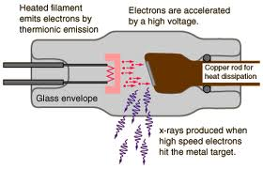
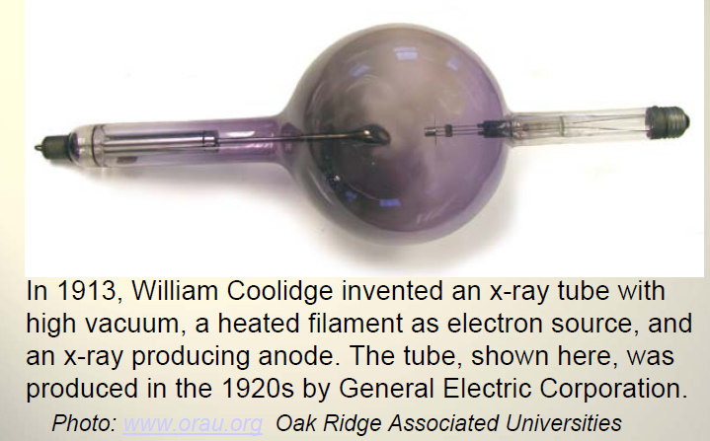

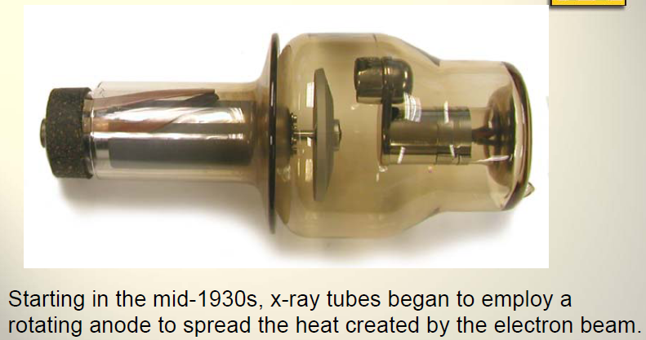
Thermionic Emission
Used to make x-ray light….
bias at high voltage
1880s
Rotating anode to distribute heat
X-rays are generated when a DC electron beam, typically a few mA, strikes a tungsten target at 60-200 keV. e-Beam quality is not a big concern
1930’s

Slide 13
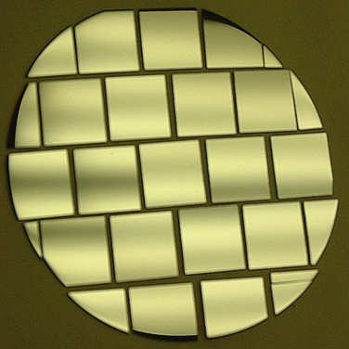
Photo-Emission from bulk GaAs
Dipole layers of
Cesium + NF₃
Reduces Work Function
Negative Electron Affinity (NEA)
Bare GaAs surface
Large Work Function
Positive Electron Affinity (PEA)
NEA Surface Activation
PEA=4.07 eV
-
Conduction
Band
-
χ^{NEA} ~ 0.2 eV
E_{gap}
Valence
Band
+
Light
GaAs
Vacuum
GaAs
Vacuum
Quantum Efficiency ~ 10% (1e-/10 photons)

Slide 14

What about the probing with spin ?
Target
You measure
an experimental
asymmetry

Slide 15
Parity Violation Experiments at CEBAF
Experiment | Energy (GeV) | I (µA) | Target | A_{pv} (ppb) | Maximum Charge Asym (ppb) | Maximum Position Diff (nm) | Maximum Angle Diff (nrad) | Maximum Size Diff (δσ/σ)
HAPPEx-II (Achieved) | 3.0 | 55 | ¹H (20 cm) | 1400 | 400 | 1 | 0.2 | Was not specified
HAPPEx-III (Achieved) | 3.484 | 100 | ¹H (25 cm) | 16900 | 200±100 | 3±3 | 0.5±0.1 | 10⁻³
PREx | 1.063 | 70 | ²⁰⁸Pb (0.5 mm) | 500 | 100±10 | 2±1 | 0.3±0.1 | 10⁻⁴
QWeak | 1.162 | 180 | ¹H (35 cm) | 234 | 100±10 | 2±1 | 30±3 | 10⁻⁴
Møller | 11.0 | 75 | ¹H (150 cm) | 35.6 | 10±10 | 0.5±0.5 | 0.05±0.05 | 10⁻⁴
PV experiments motivate polarized e-source R&D

Slide 16
What does “234 ppb” even mean?
A - B
A
1,000,000,000
Target
1,000,000,000
A = 500,000,117
B = 499,999,883
B

Slide 17
Electron Bunch Spin & Polarization
0% Polarization
☹
v
50% Polarization
☺
v

Slide 18
Spin Polarized Photoemission from Bulk GaAs
E
E
J
S_{1/2}
-1/2
+1/2
S_{1/2}
σ+
σ-
E_{gap}=1.42 eV
3
1
1
3
P_{3/2}
E_{F}
P_{3/2}
Δ=0.34 eV
-3/2
-1/2
+1/2
+3/2
P_{1/2}
-1/2
+1/2
P_{1/2}
k
σ+: Right circularly polarized light
σ- : Left circularly polarized light
m_{j}
Laser excitation from P_{3/2} to S_{1/2} : E_{gap} < E_{γ} < E_{gap}+Δ
Electron Polarization:
Reverse electron polarization by reversing light polarization

Slide 19
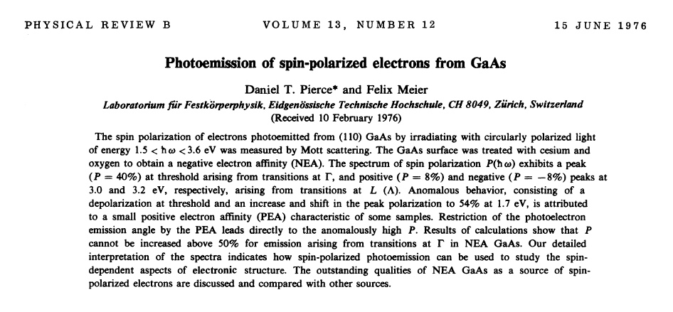
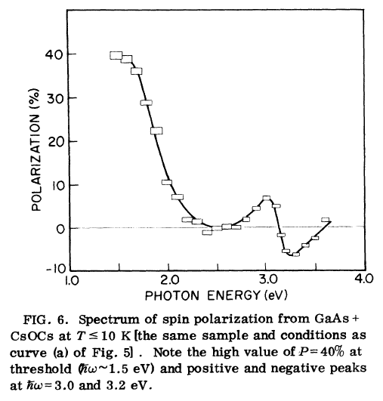
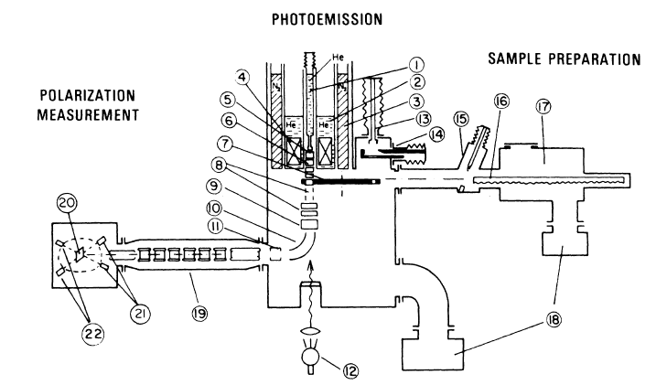
First Observation of Polarization from GaAs

Slide 20
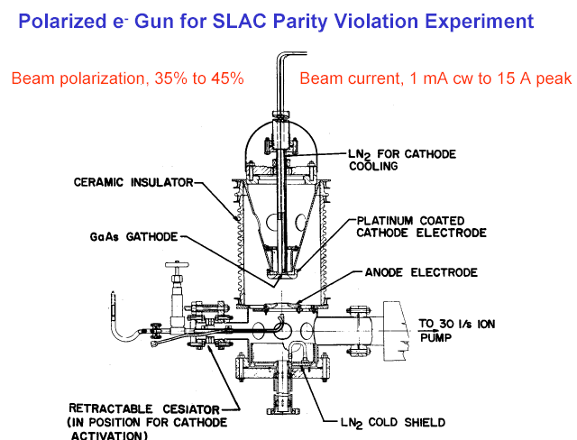
First HV GaAs photogun used on an accelerator
Built for SLAC parity-violation experiment E122
December 1977 - Polarized electrons accelerated at SLAC
June 1978 - E122 announces parity violation (Standard Model)
μΑ

Slide 21
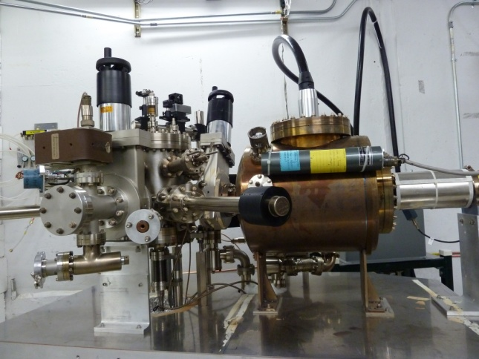
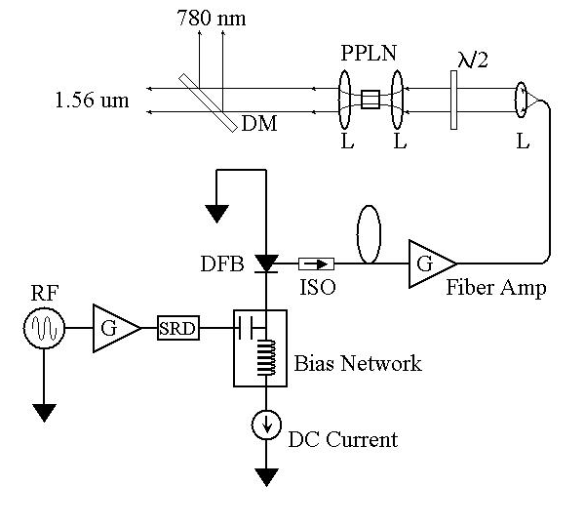
The CEBAF polarized source “Big Three”
Gun
Laser
Photocathode
Very high voltage
Ultra high vacuum
No field emission
High frequency
High power
Polarization
Many electrons/photon
High polarization
Fast response time

Slide 22
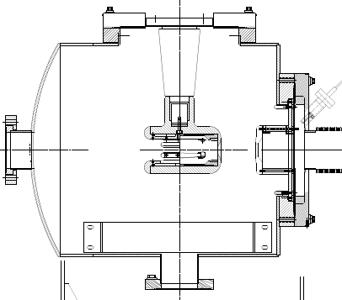
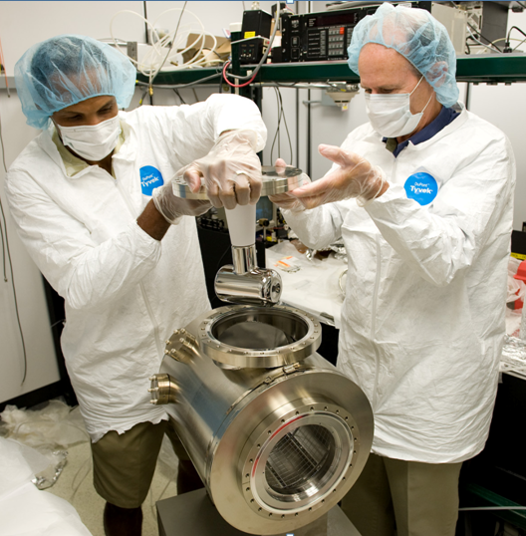
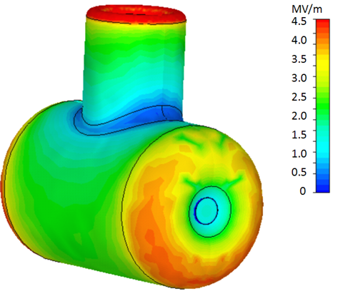
DC High Voltage Electron Gun
-130kV
light in
electrons out
photocathode

Slide 23
Vacuum conditions at CEBAF
Application | Pressure Range | Location | Vacuum Regime
Beamline to dumps | 10⁻⁵ Torr | Target to dump line | Medium
Insulating vacuum for cryogens | 10⁻⁴ Torr to 10⁻⁷ Torr | Cryomodules, transfer lines | Medium to high
Targets, Scattering Chambers | 10⁻⁶ to 10⁻⁷ Torr | Experimental Halls | High to very high
RF waveguide warm to cold windows | 10⁻⁷ to 10⁻⁹ Torr | Between warm and cold RF windows | High to very high
Warm beamline | 10⁻⁷ to 10⁻⁸ Torr | Arcs, Hall beamline, BSY, some injector | High to very high
Warm region girders | 10⁻⁹ Torr or better | Girders adjacent to cryomodules | Very high to ultrahigh
Differential pumps | Below 10⁻¹⁰ Torr | Ends of linacs, isolate cryomodules | Ultrahigh vacuum
Baked beamline | 10⁻¹⁰ to 10⁻¹¹Torr | Y chamber, Wien filter, Pcup | Ultra high vacuum
Polarized guns | 10⁻¹¹ to 10⁻¹² Torr | Photoguns | Ultra to Extreme high vacuum
SRF cavity vacuum | < 10⁻¹² Torr | Inside SRF cavities with walls at 2K | Extreme high vacuum
1 Atmosphere ~ 760 Torr

Slide 24
Vacuum regimes
Air ~ 10¹⁶ / Torr-cm³
Low, Medium Vacuum (>10⁻³ Torr)
  Viscous flow
    interactions between particles are significant
  Mean free path less than 1 mm
High, Very High Vacuum (10⁻³ to 10⁻⁹ Torr)
  Transition region
Ultra High Vacuum (10⁻⁹ - 10⁻¹² Torr)
  Molecular flow
    interactions between particles are negligible
    interactions primarily with chamber walls
  Mean free path 100-10,000 km
Extreme High (<10⁻¹² Torr)
  Molecular flow
  Mean free path 100,000 km or greater

Slide 25
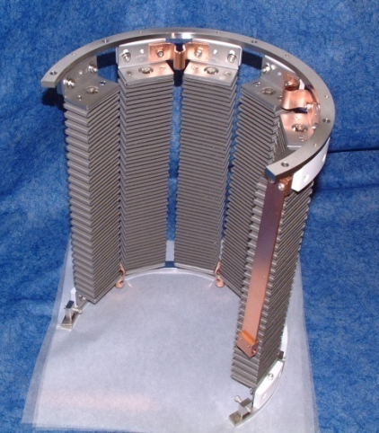
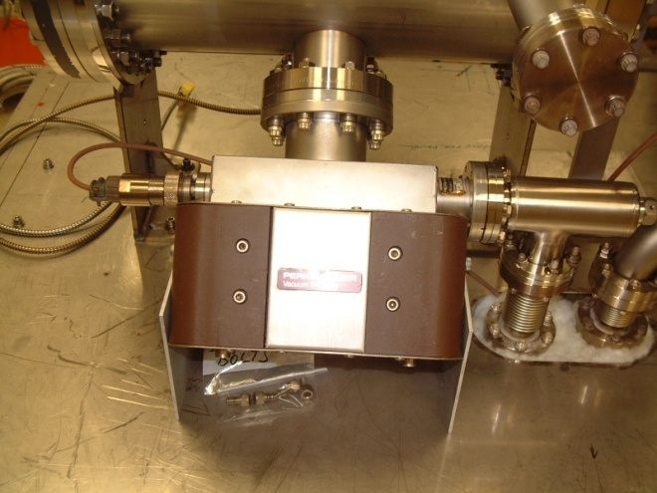
Ultra High Vacuum
Avoid contamination by oils due to roughing pumps, fingerprints, machining.
Baking used to get pressures below 10⁻¹⁰ Torr
  250°C for 30 hours removes water vapor bonded to surface that otherwise limits pressure
Getter Pumps
  Chemically active surface
    Titanium sublimed from hot filament
    Non-Evaporative Getters
  Molecules stick when they hit
    Does not work well for inert gasses such as Argon, Helium or for methane
Ion Pumps
  Electric field to ionize gasses
  Magnetic field to direct gasses into cathodes where they are trapped
    Has some pumping capability for noble gasses
NEG pump array
Ion Pump

Slide 26
The CEBAF polarized source “Big Three”
Gun
Laser
Photocathode
Very high voltage
Ultra high vacuum
No field emission
High frequency
High power
Define Polarization
Many electrons/photon
High polarization
Fast response time

Slide 27
Continuous Electron Beam Accelerator Facility
A B C A B C
D
2 Linacs
1497 MHz
100 ps
RF Synchronous
Lasers
499 MHz,
ΔФ = 120°
A
B
C
D
B
A
RF Separators
499 MHz
B
Pockels Cell
A
C
C
Gun

Slide 28
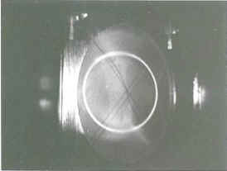
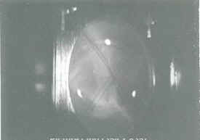
Photo Finish at 2 billionths of a second !!!
“DC” Electron Current
Short Pulse Electron Bunches
500 MHz = 2 ns/revolution
Bunch~50 ps
B
A
C
A B C
DC beam
Short electron bunch

Slide 29
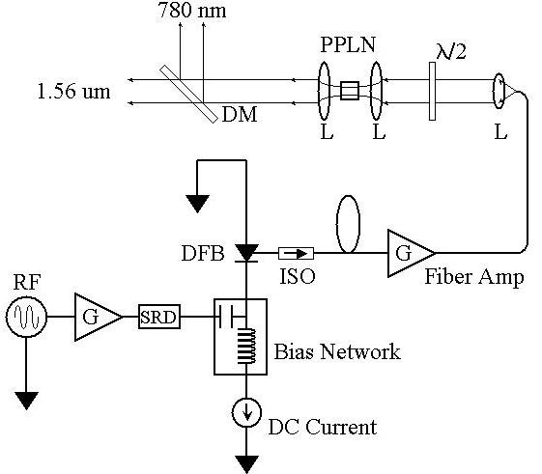
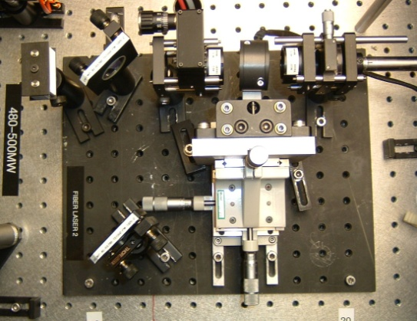
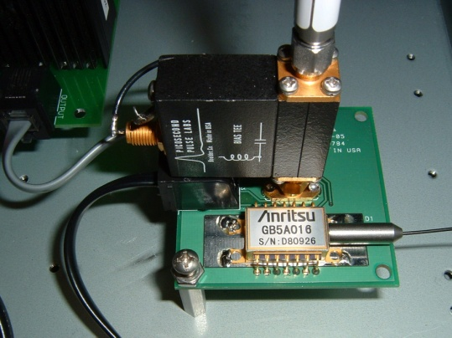
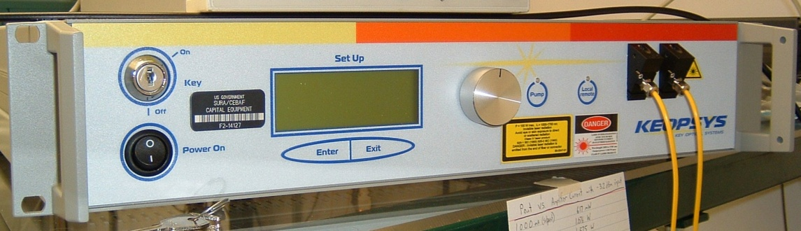
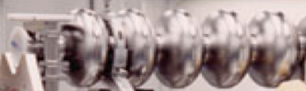
RF High Power Fiber Laser
200 mW @ 780 nm
50 ps @ 499/249.5 MHz
=> 6 uA/mW/%
780 nm
Frequency-doubler
1560 nm to 780 nm
30% Efficiency (2 W)
Low-Power (1 mW)
1560 nm Fiber Diode
Follows RF sine wave
1560 nm
Master Oscillator
499 MHz
High Power (6 W) 1560 nm Fiber Amplifier

Slide 30
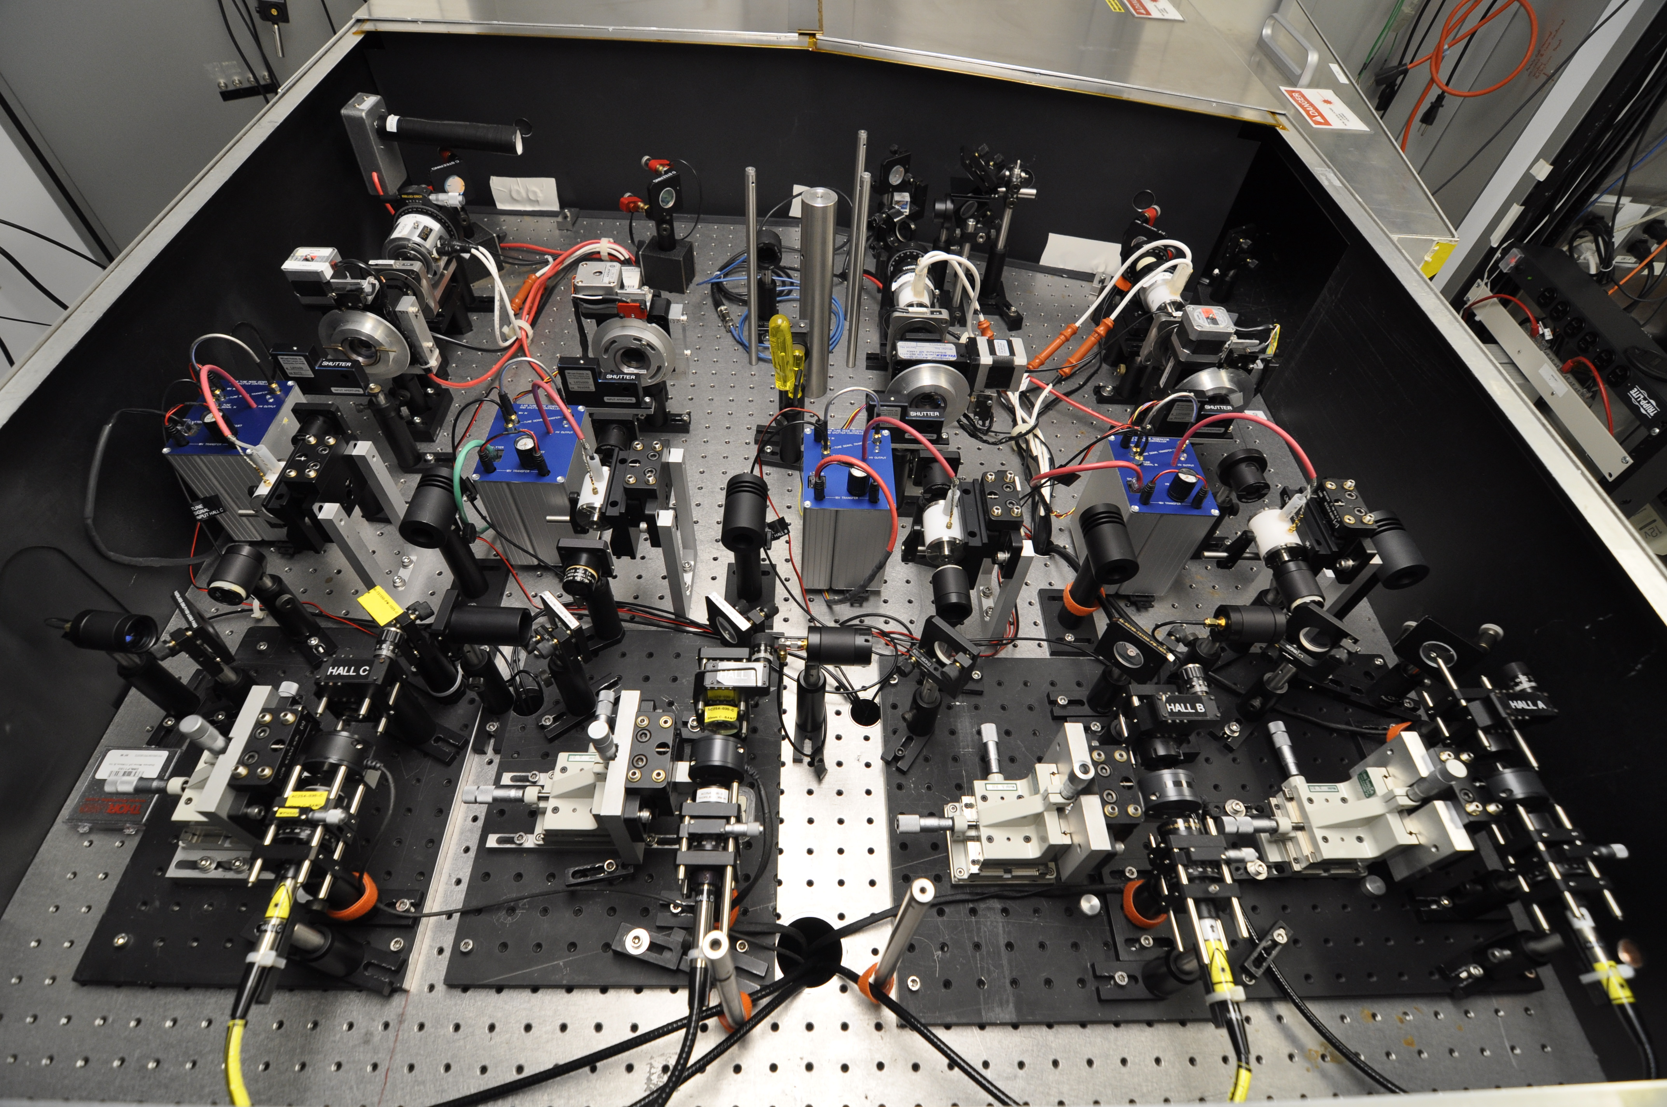
Combine 4 lasers onto a single path !!!

Slide 31
The CEBAF polarized source “Big Three”
Gun
Laser
Photocathode
Very high voltage
Ultra high vacuum
No field emission
High frequency
High power
Synchronous RF
Many electrons/photon
High polarization
Fast response time

Slide 32
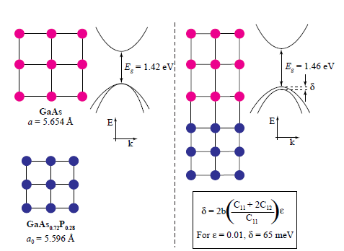
Breaking the 50% Barrier
Lattice mismatch provides stress
The band gap of the substrate layer must be larger than surface layer
Lattice constants must differ enough to introduce suitable strain
Adjust lattice constant of substrate by varying concentration of third element
Pablo Saez, PhD Thesis, SLAC Report 501, 1997
1% lattice mismatch provides equivalent force as hydraulic press!
Notes:
Interior Page Design 2

Slide 33
Strained layer GaAs
S_{1/2}
m_{j} = -1/2
+1/2
0.1 μm
Strained GaAs
σ+
σ-
250 μm
GaAs_{1-x}P_{x} (x=0.29)
P_{3/2}
m_{j} = -3/2
+3/2
250 μm
GaAs_{1-x}P_{x} (0<x<0.29)
-1/2
+1/2
p-type GaAs
substrate
Strain relaxes in 0.1 μm layer
Not all electrons reach surface
Polarization 75% >> 50% ☺
QE 0.1% << 6% ☹
600 μm
MOCVD-grown epitaxial spin-polarizer wafer

Slide 34

Strained-Superlattice GaAs/GaAsP
QE 1% and Polarization 85%
GaAsP
30 A
Strained GaAs
30 A
1000 A
Active Region
GaAs_{0.64}P_{0.36}
Buffer
GaAsP
2.5μm
Strained GaAs
GaAs_{(1-x)}P_{x} Graded Layer
2.5μm
GaAsP
Strained GaAs
GaAs Substrate
D. Luh et al, SLAC, PESP2002
From Aaron Moy, SVT Assoc and SLAC, PESP2002

Slide 35
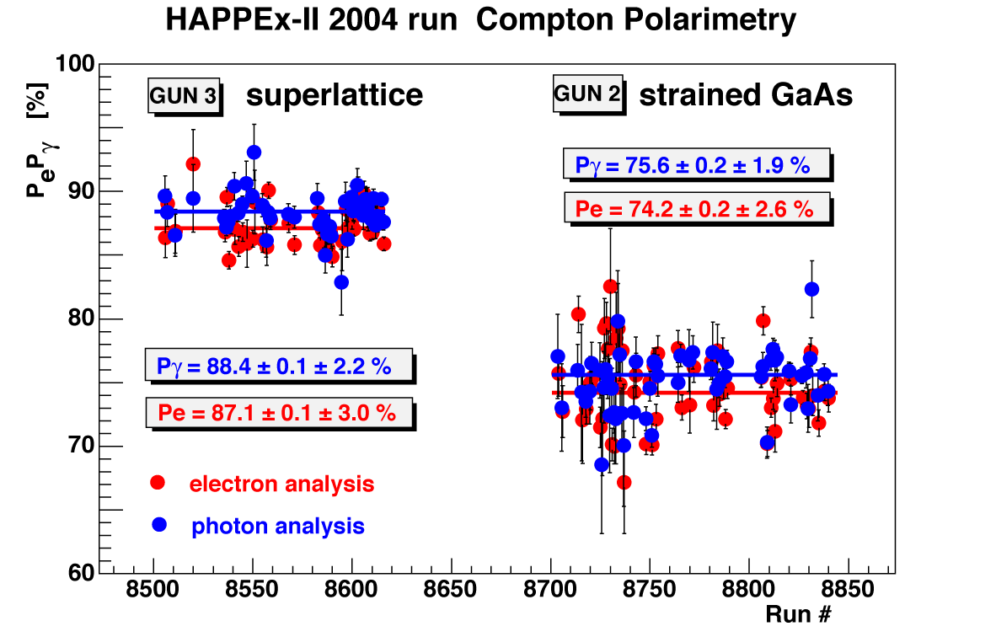
And, it really works!
Experiment Figure of Merit
2
P I
sup.
= 1.38
2
P I
str.
QE ~ 1.0%
QE ~ 0.2%

Slide 36
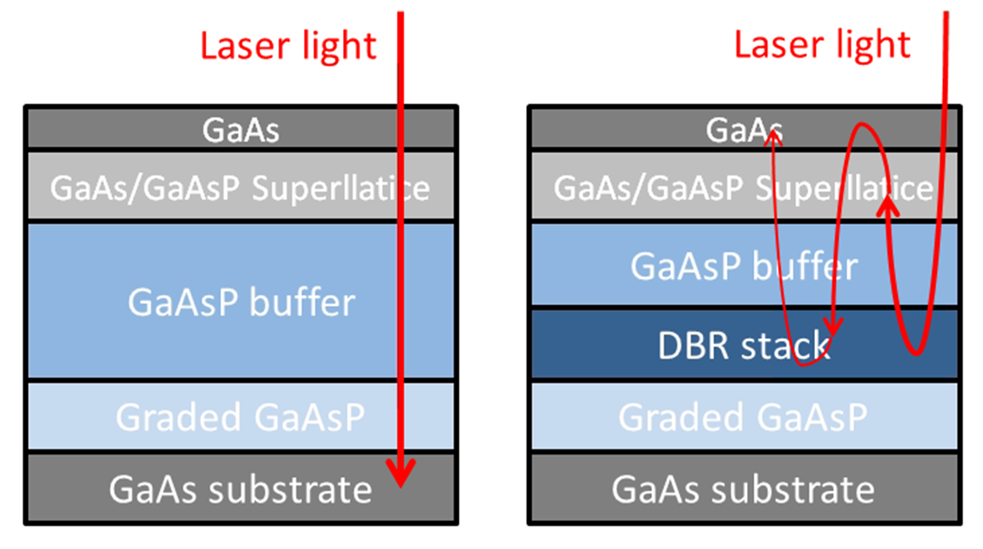
Benefits of Distributed Bragg Reflector
non-DBR Photocathode : absorption in the GaAs/GaAsP superlattice < 5%
  Most light passes into the substrate leading to unwanted heating
DBR photocathode : absorption in the GaAs/GaAsP superlattice >20%
  Less light required to make required beam, less light means less heat
Great for high current initiatives like polarized positrons at CEBAF and eRHIC
Non-DBR photocathode
DBR photocathode

Slide 37
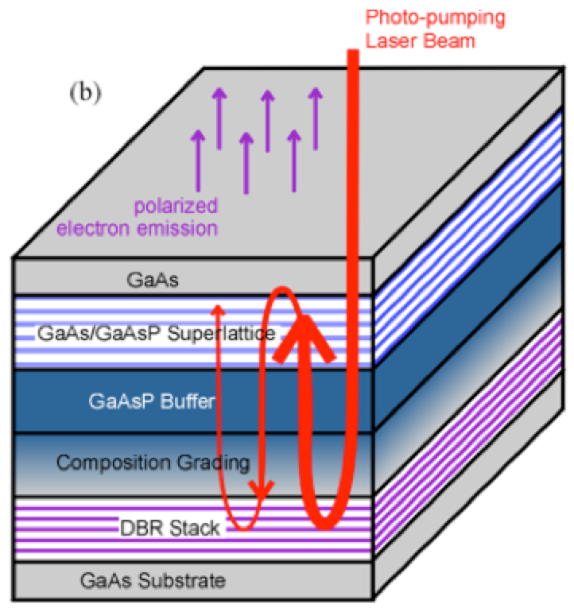
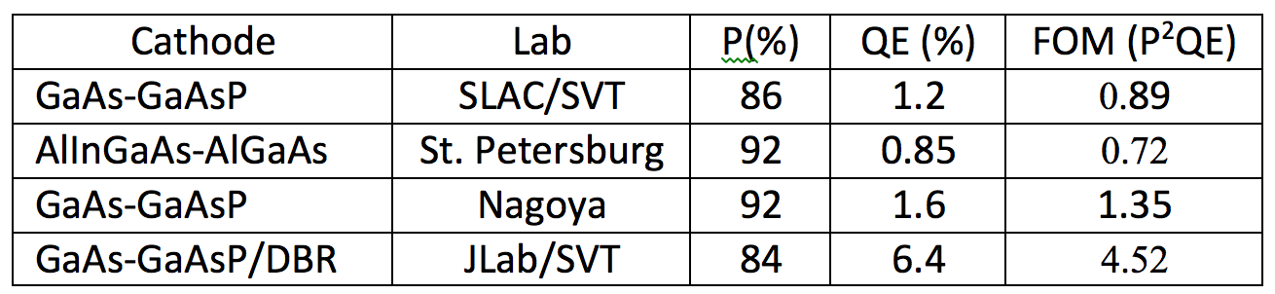
World Record QE from High Polarization Photocathode
6.4% QE & 84% polarization at 776 nm from strained GaAs/GaAsP superlattice photocathode with GaAsP/AlAsP Distributed Bragg Reflector (DBR)
The highest QE & FOM of any reported high polarization photocathode
Candidate photocathode for mA ops
SBIR partnership
Photo-cathode
DBR
Substrate
W. Liu, S. Zhang, M. Stutzman, M. Poelker, Y. Chen, W. Lu, and A. Moy, Appl. Phys. Lett. 109, 252104 (2016)

Slide 38

We understand Alice’s worry…
“The woods were dark and foreboding, and Alice sensed that sinister eyes were watching her every step. Worst of all, she knew that Nature abhorred a vacuum” – Gary Larson
Air ~ 10¹⁶ / Torr-cm³
Gun ~ 10⁻¹² Torr

Slide 39

Ion Bombardment

Slide 40


Ion back bombardment
Ion bombardment – with characteristic QE “trench” from laser spot to electrostatic center of photocathode – damages NEA of GaAs
High energy ions are focused to electrostatic center: create QE “hole”
  Don’t run beam from electrostatic center.
QE can be restored, but takes about 8 hours to heat and reactivate
Photocathode “QE scan”
  Active area = 5 mm
  Laser size = 0.35 mm

Slide 41





Always Tweaking the Design
1
4
The endless (?) quest for perfection
2
3

Slide 42


High Polarization from GaAs:
Trending toward higher current…
EIC
?
Ave. Beam Current (mA)
Year
First polarized beam from GaAs photogun
First low polarization, then high polarization at CEBAF
(Insert your name) breaks world record !!!

