Slide 1
Looking at the 500 nm data point
Marcy Stutzman
17Dec2015

Slide 2
First task: FESEM 500 nm thickness
FESEM Center:
carbon contamination, one clear area
FESEM edge piece:
several very nice images
 | Thickness (nm) | Stat uncertainty | Total uncertainty
Center only | 470.2 | 5.7 | 28.89
Edge only | 493.83 | 3.41 | 28.54
All data | 488.94 | 2.92 | 28.48

Slide 3
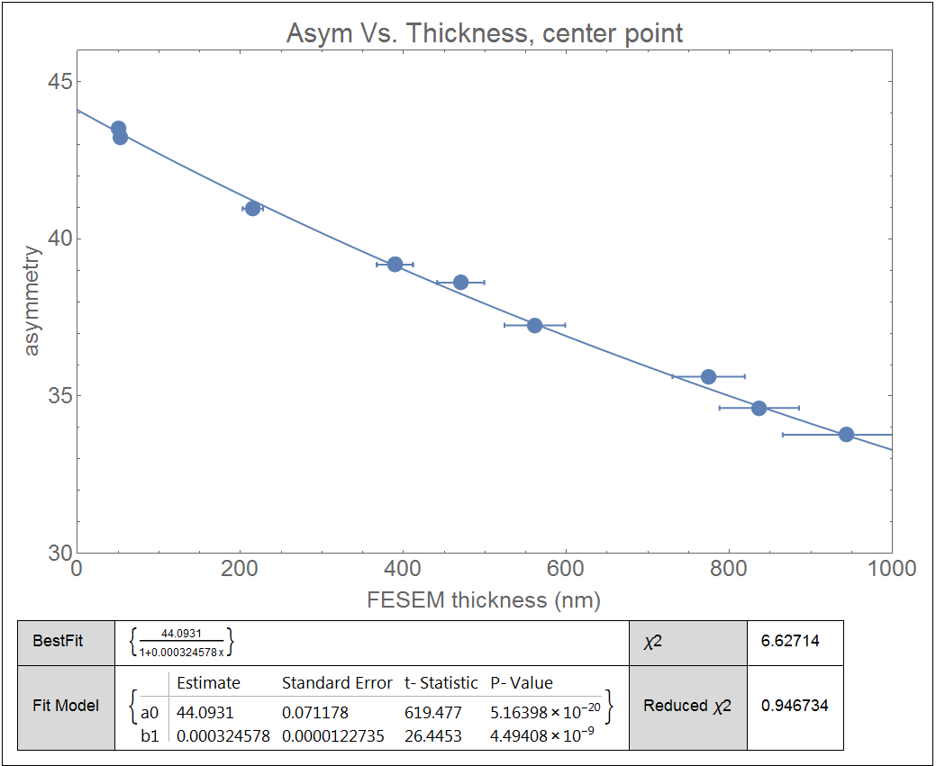
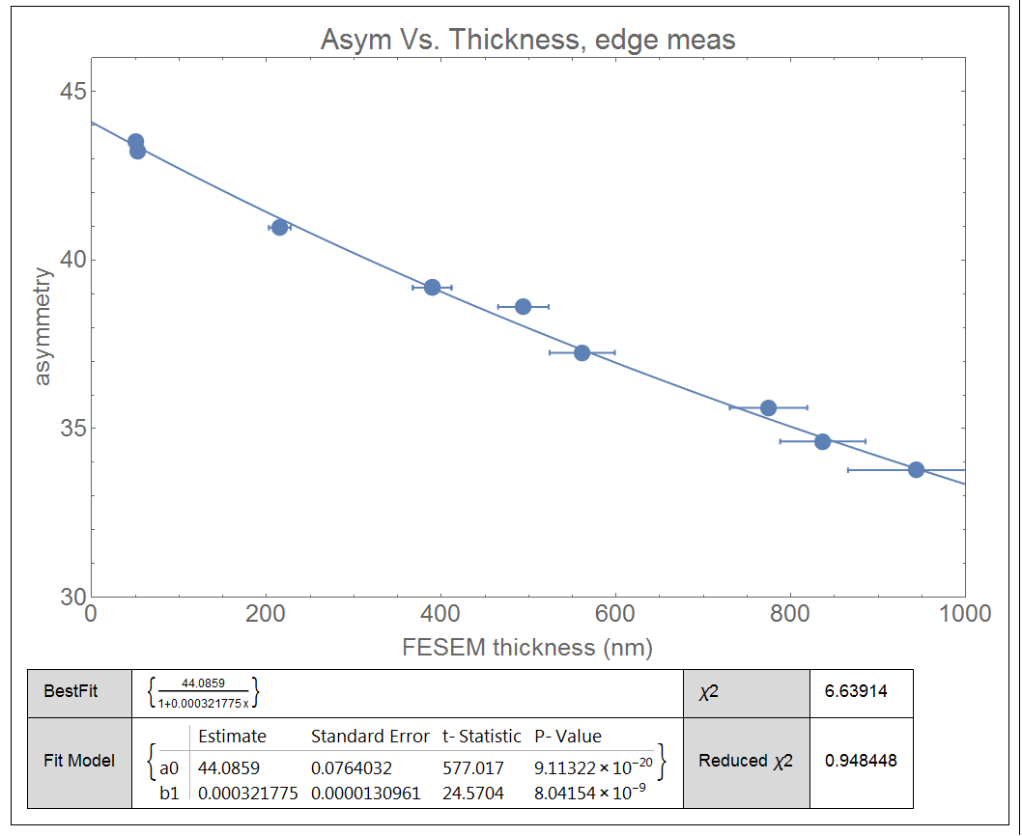
Effect of fit on varying ~500nm FESEM data selection

Slide 4
Effect of 500 nm data selection on extrapolation
 | ao | Std error | b1 | Std error | Reduced χ2
All data | 44.0878 | 0.0749 | 3.222e-4 | 1.29e-5 | 0.948
Center only | 44.0931 | 0.0712 | 3.246e-4 | 1.23e-5 | 0.947
Edge only | 44.0859 | 0.0764 | 3.218e-4 | 1.31e-5 | 0.948
0.016% difference in extrapolated value
All data weighted for fit using only the x-error bars
as a weighting factor (no difference using combination)
Using only the measurement on the
Central part of the foil looks slightly better…
Now compare to rate data

Slide 5
Comparing fits of Rate vs. Thickness, varying selection of 500 nm point (experimental error bars smaller than points)
 | χ2
All data | 0.078624
Center only | 0.058915
Edge only | 0.083782
Edge only
Slightly smaller χ2 when using measurement
from the central foil only
Data closer to the line

Slide 6
Final values for thickness measurement
Thickness | uncertainty
943.71 | 78.19
836.76 | 48.76
774.57 | 44.33
561.18 | 37.24
470.22 | 28.89
389.44 | 22.21
389.44 | 22.21
215.17 | 12.57
52.03 | 5.99
50.00 | 5
Comparing fits with FESEM of center, edge or both
Slight reduction in error of the extrapolated asymmetry with center only
Visually better fit to the rate data with center only
Total magnitude of effect tiny (0.16%) in asym. extrapolation
Use data point of 470.22 nm for FESEM thickness

