Slide 1
Generation and Characterization of Magnetized Bunched Electron Beam from DC Photogun for MEIC Cooler
PIs: Riad Suleiman and Matt Poelker
MEIC bunched magnetized electron cooler is part of Collider Ring and aims to maintain ion beam emittance and extend luminosity lifetime
LDRD Scientific Goals:
Generate magnetized electron beam and measure its properties
Explore impact of cathode magnet on photogun operation
LDRD Benefits:
Simulations and measurements will provide insights on ways to optimize MEIC electron cooler and help design appropriate electron source
JLab will have direct experience magnetizing high current electron beam

Slide 2
Milestones and Costs
Year 1: Design, procure and install cathode magnet, skew quads and slits
Year 2: Generate magnetized beam, measure mechanical angular momentum and benchmark simulation
Year 3: Measure photocathode lifetime vs magnetization up to 32 mA , generate flat beam with three skew quads – RTFB Transformer – and measure horizontal and vertical emittances using slit method
Materials and Supplies:
Cathode magnet
Three skew quadrupoles
Components for three diagnostics crosses
Labor:
Gun magnet design and installation
Mechanical designer for skew quad magnets and slits
ASTRA and GPT modeling
Postdoc
FY16 | $339,211
FY17 | $265,850
FY18 | $212,025
Total | $817,086

Slide 3
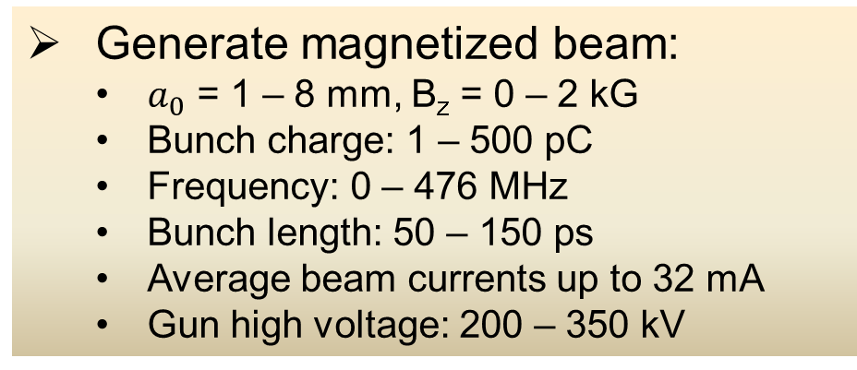
Experimental Overview: GTS
Cathode Solenoid or Helmholtz pair
(B_{z}=2 kG)
Diagnostic Cross 3
(YAG Screen)
Cathode
Three Skew Quads
(Round-to-Flat Beam Transformer)
Green
Laser
Anode
K₂CsSb
Photocathode
Injector Focusing Solenoids
Diagnostic Cross 1
(Multislit + YAG Screen)
Diagnostic Cross 2
(H,V slit + YAG Screen)
Generate magnetized beam:
$a_{0}$ = 1 – 8 mm, B_{z} = 0 – 2 kG
Bunch charge: 1 – 500 pC
Frequency: 0 – 476 MHz
Bunch length: 50 – 150 ps
Average beam currents up to 32 mA
Gun high voltage: 200 – 350 kV

