Slide 1
Parity Experiments and JLab Injector
Riad Suleiman
February 5, 2016

Slide 2
Experiment | Energy (GeV) | Pol (%) | I (µA) | Target | A_{pv} (ppb) | Charge Asym (ppb) | Position Diff (nm) | Angle Diff (nrad) | Size Diff (δσ/σ)
HAPPEx-I (Achieved) | 3.3 | 38.8 68.8 | 100 40 | ¹H (15 cm) | 15,050 | 200 | 12 | 3
G0-Forward (Achieved) | 3.0 | 73.7 | 40 | ¹H (20 cm) | 3,000-40,000 | 300±300 | 7±4 | 3±1
HAPPEx-II (Achieved) | 3.0 | 87.1 | 55 | ¹H (20 cm) | 1,580 | 400 | 2 | 0.2
HAPPEx-III (Achieved) | 3.484 | 89.4 | 100 | ¹H (25 cm) | 23,800 | 200±10 | 3 | 0.5±0.1 | 10⁻³
PREx-I (Achieved) | 1.056 | 89.2 | 70 | ²⁰⁸Pb (0.5 mm) | 657±60 | 85±1 | 4 | 1 | 10⁻⁴
QWeak-I (Achieved) | 1.155 | 89.0 | 180 | ¹H (35 cm) | 281±46 | 8±15 | 5±1 | 0.1±0.02 | 10⁻⁴
QWeak | 1.162 | 90 | 180 | ¹H (35 cm) | 234±5 | <100±10 | <2±1 | <30±3 | <10⁻⁴
PREx-II | 1.0 | 90 | 70 | ²⁰⁸Pb (0.5mm) | 500±15 | <100±10 | <1±1 | <0.3±0.1 | <10⁻⁴
MOLLER | 11.0 | 90 | 85 | ¹H (150 cm) | 35.6±0.74 | <10±10 | <0.5±0.5 | <0.05±0.05 | <10⁻⁴

Slide 3
Attenuator
IA
Rotatable GaAs
Photocathode
Gain-switched Diode Laser and Fiber Amplifier
LP HWP LP
PC WP LP
Shutter
Helicity Control Board
Helicity Flip Fiber
HV Supply
(0 – 90 V)
15° Dipole
nHelicity
Flip Fiber
Vacuum
Window
Delayed
Helicity Fiber
T-Settle
Fiber
Hall
RHWP
Charge Feedback (IA)
V-Wien Filter
Target
DAQ
Spin Solenoids
BCM
Charge Feedback (PITA)
H-Wien Filter
BPMs
Position
Feedback
Pockels
Cell
HV Supply
(0 – ±4000 V)
CEBAF
5 MeV
Helicity Magnets
PZT
Mirror
IHWP
Electron
Beam

Slide 4
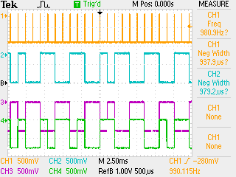
T_Settle
Helicity Flip
8– flips delay
nHelicity Flip
Delayed Helicity

Slide 5
How to carry out a parity violation experiment:
Scatter longitudinally polarized electrons off un-polarized target (i.e., Hydrogen, Deuterium, Helium, Lead)
Reverse the beam helicity (±) with Pockels Cell, measure detected signals (S±) and currents (I±), calculate physics asymmetry (A _{physics}):
Repeat the whole experiment: Millions of measurements
Statistical distribution of these measurements is Gaussian: Mean is average asymmetry and error is width of Gaussian divided by square root of number of asymmetry measurements
Average asymmetry is very small (1-50 ppm)
1/15th of a second

Slide 6
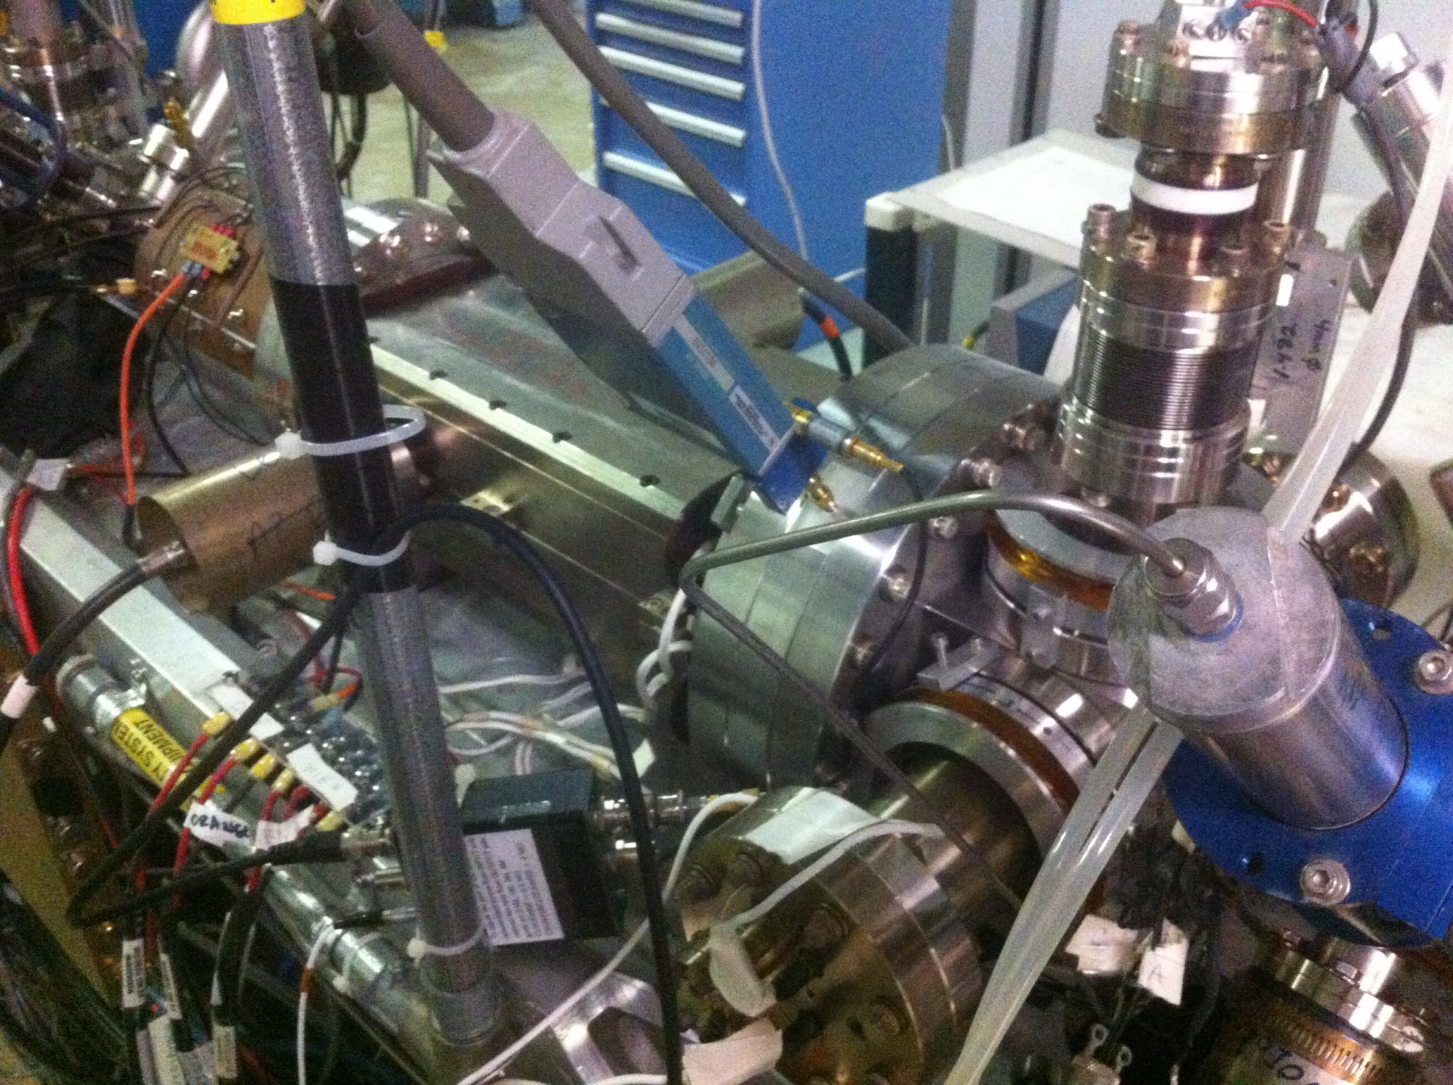
Brock Cavity

Slide 7
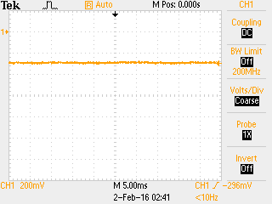

Slide 8
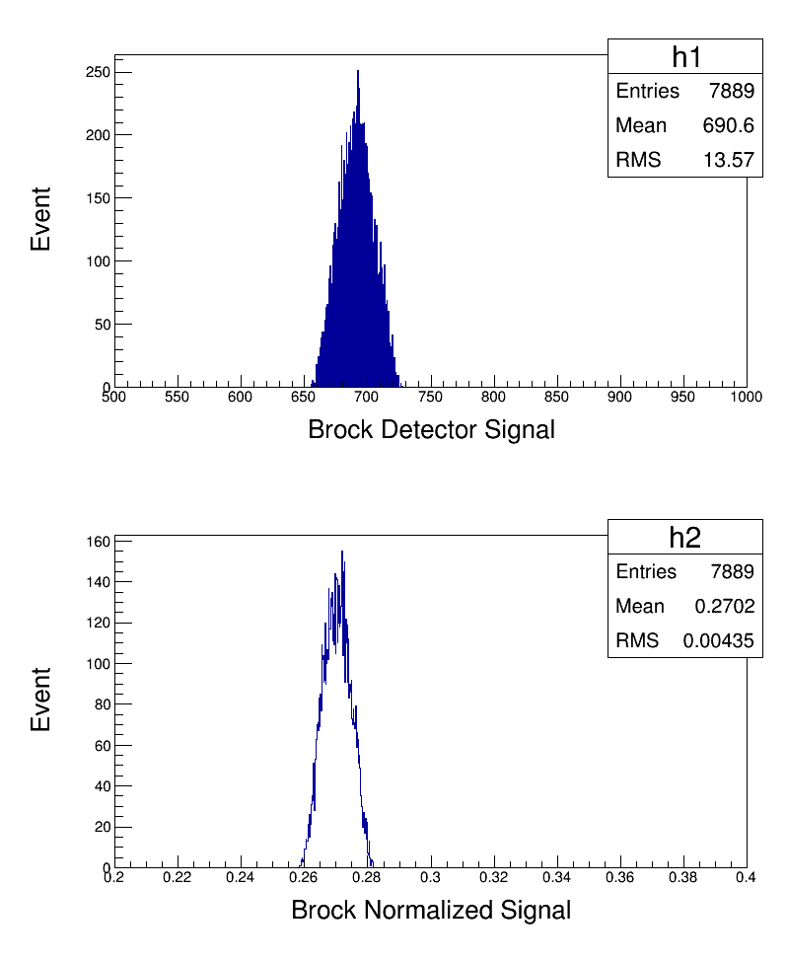

Slide 9
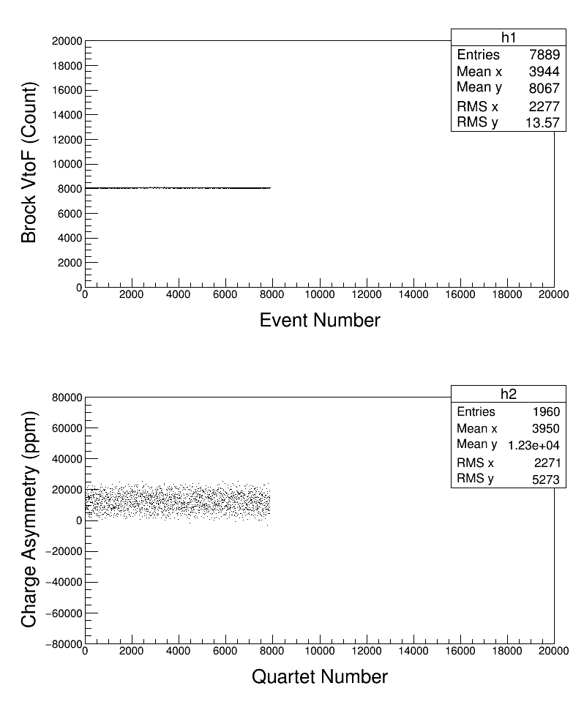

Slide 10
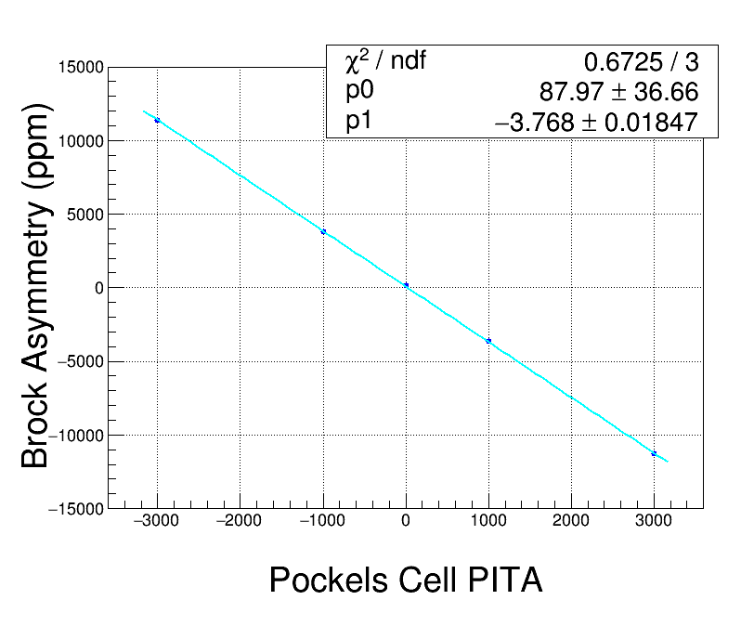

Slide 11
For any polarimeter:
Signal = Constant (1 + Ay . P)
Polarization
Proportional to beam current
Analyzing Power
Question: What is Ay for RF polarimeter?

