Slide 1

200 uA

Slide 2
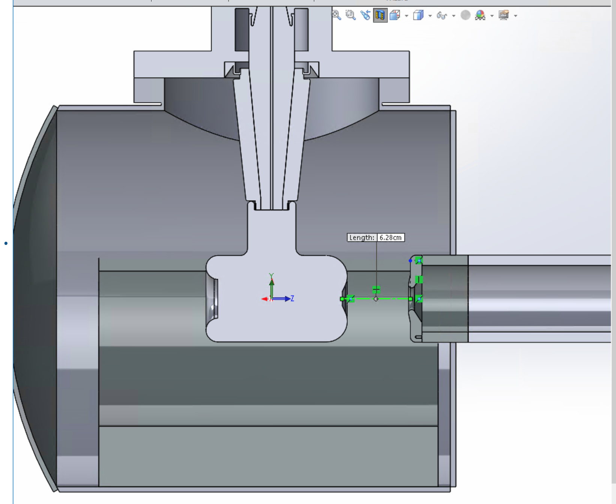
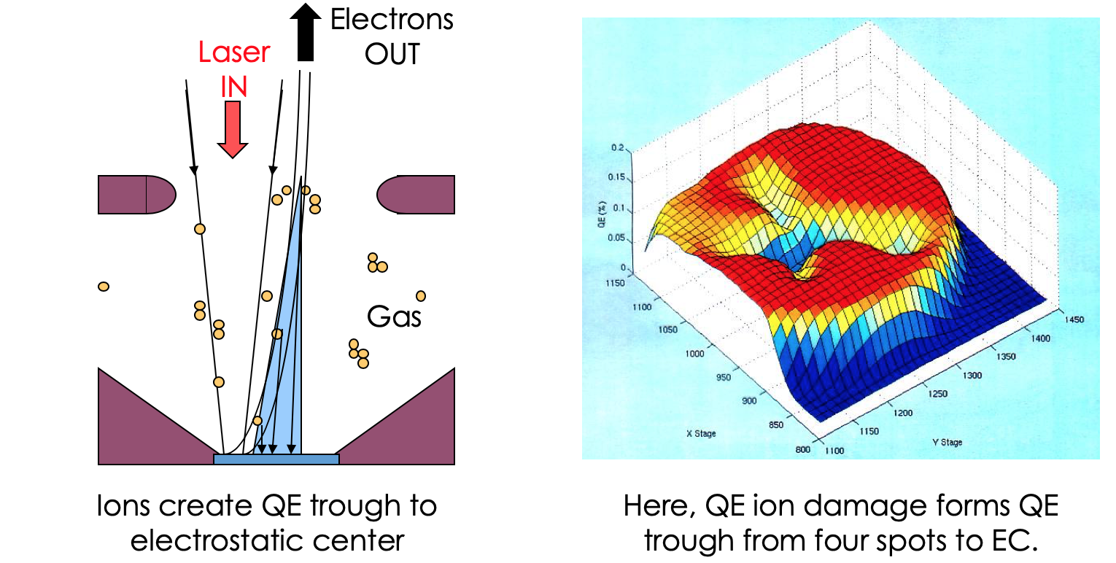
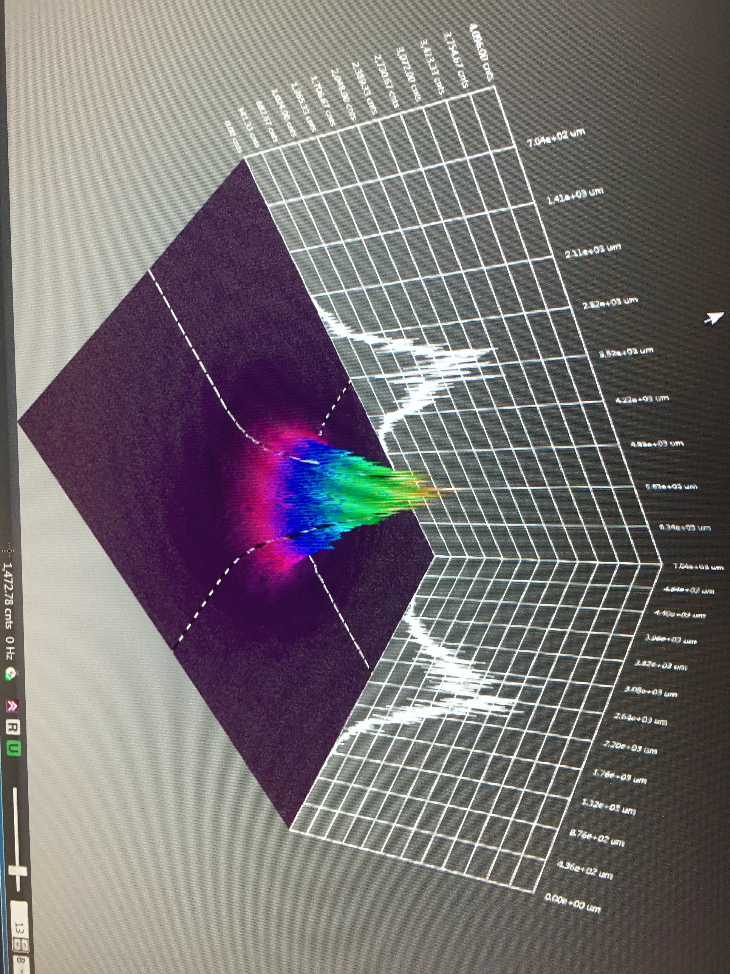

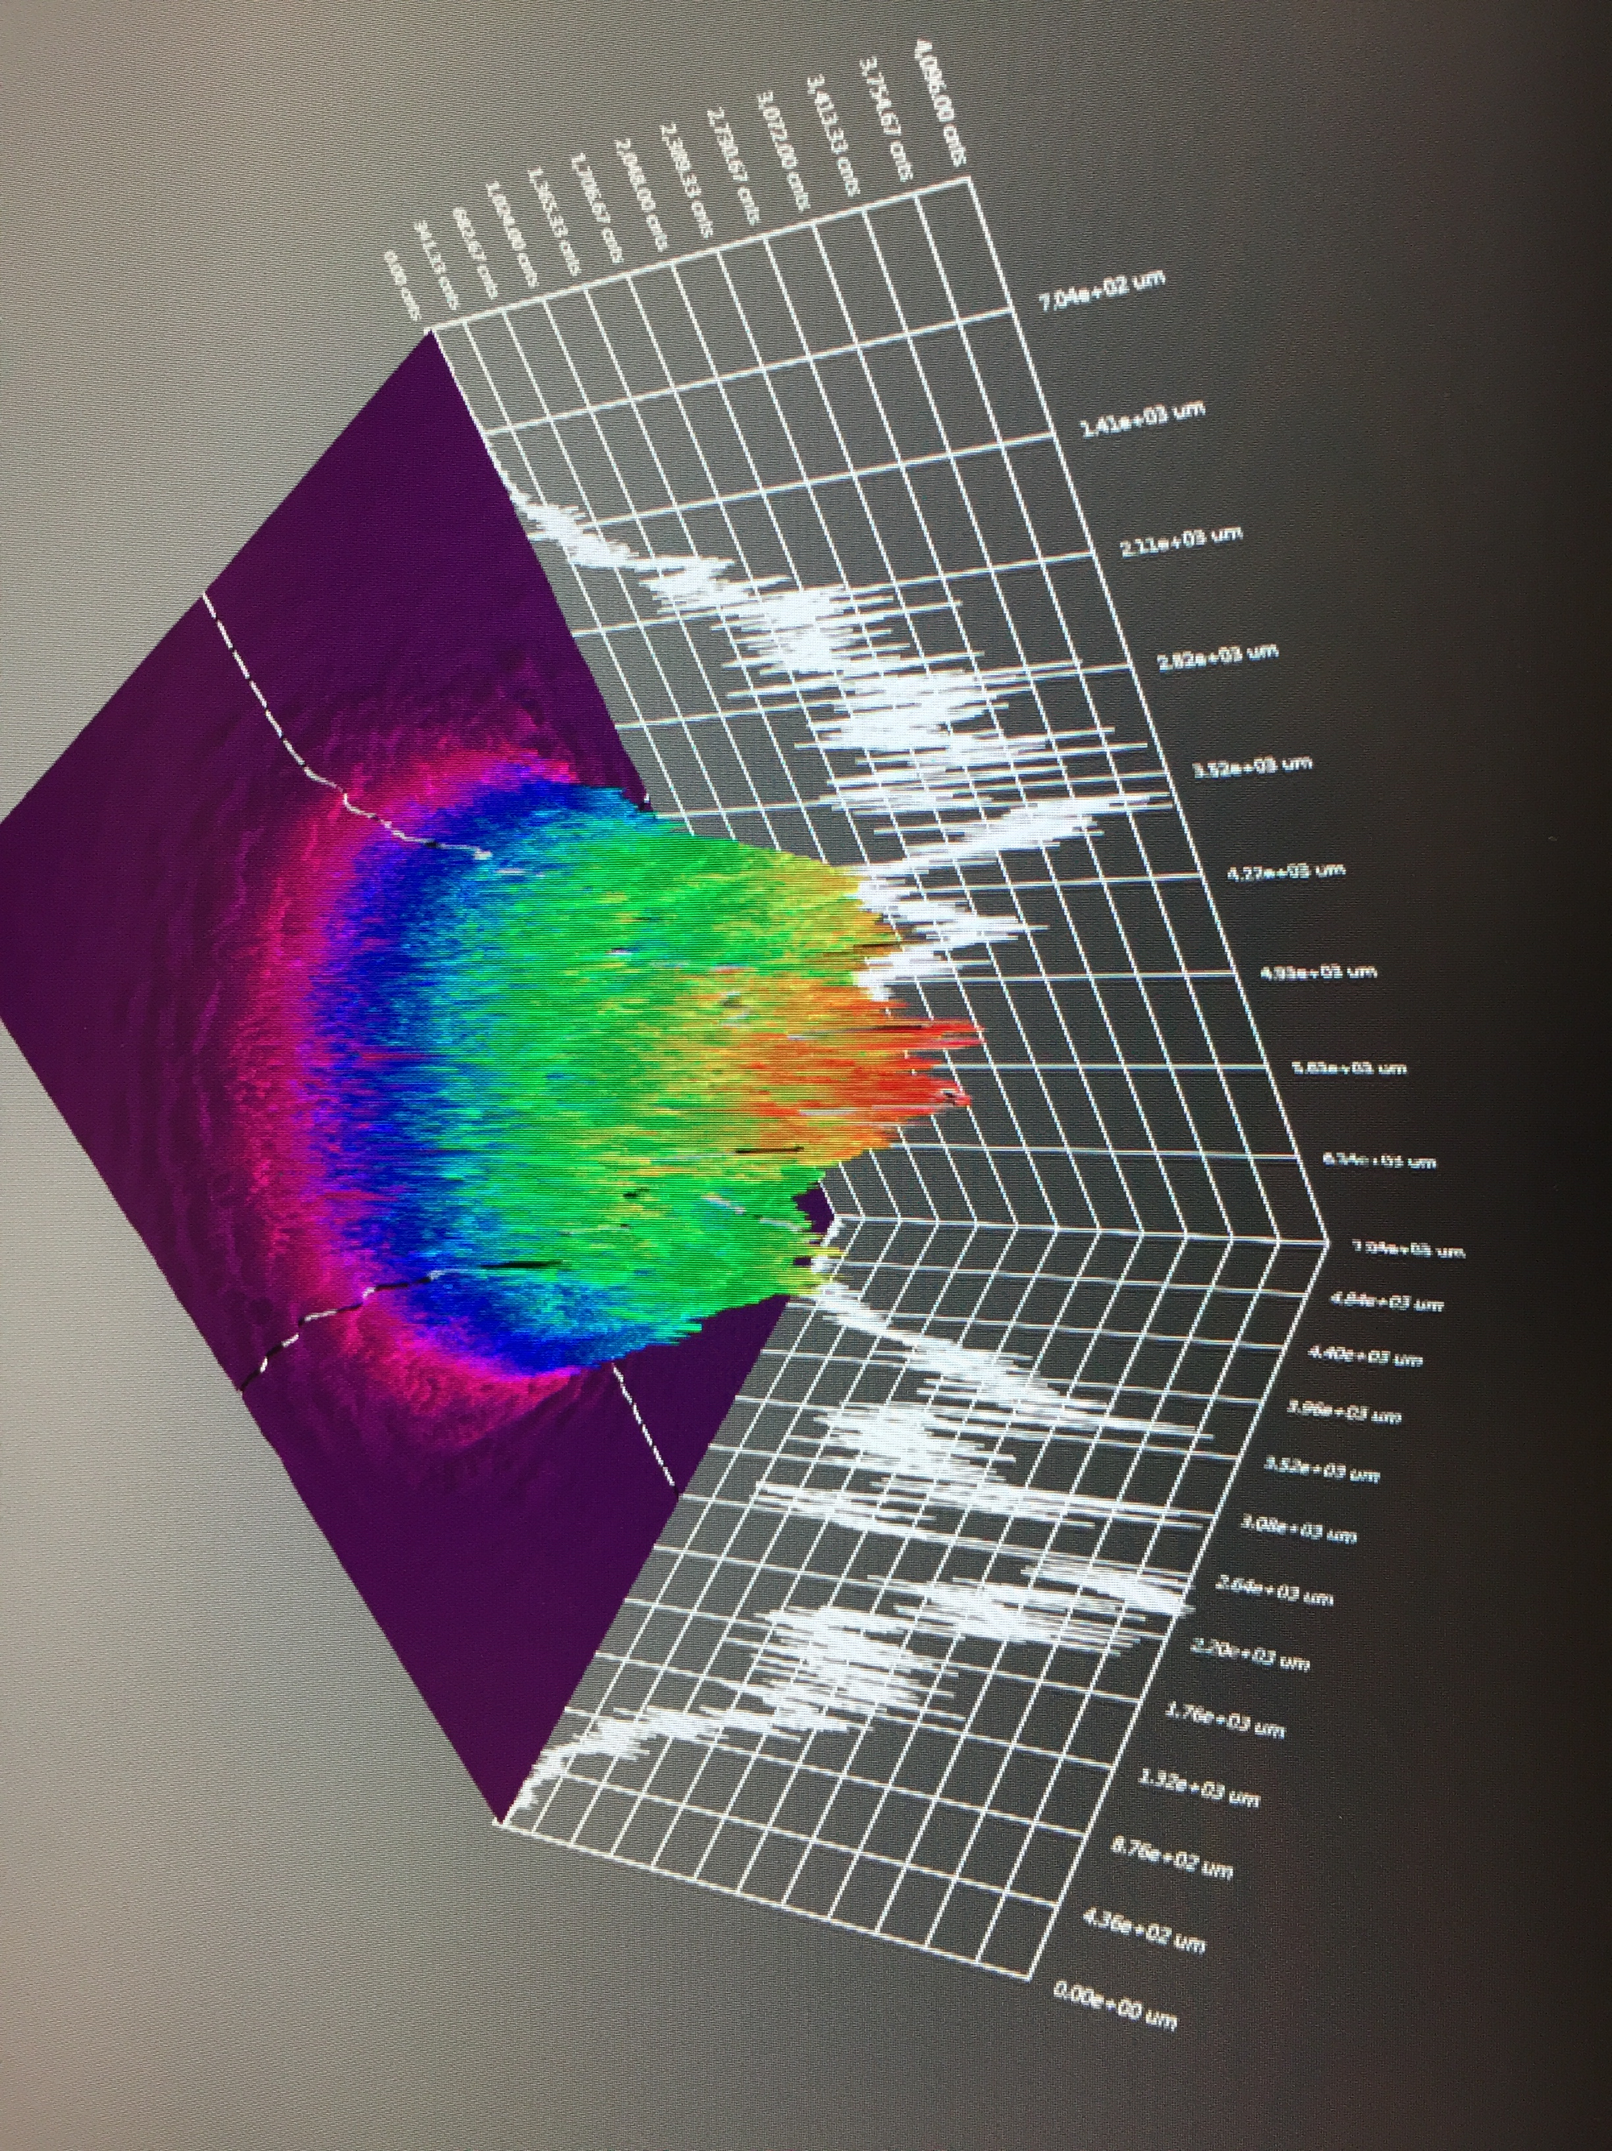
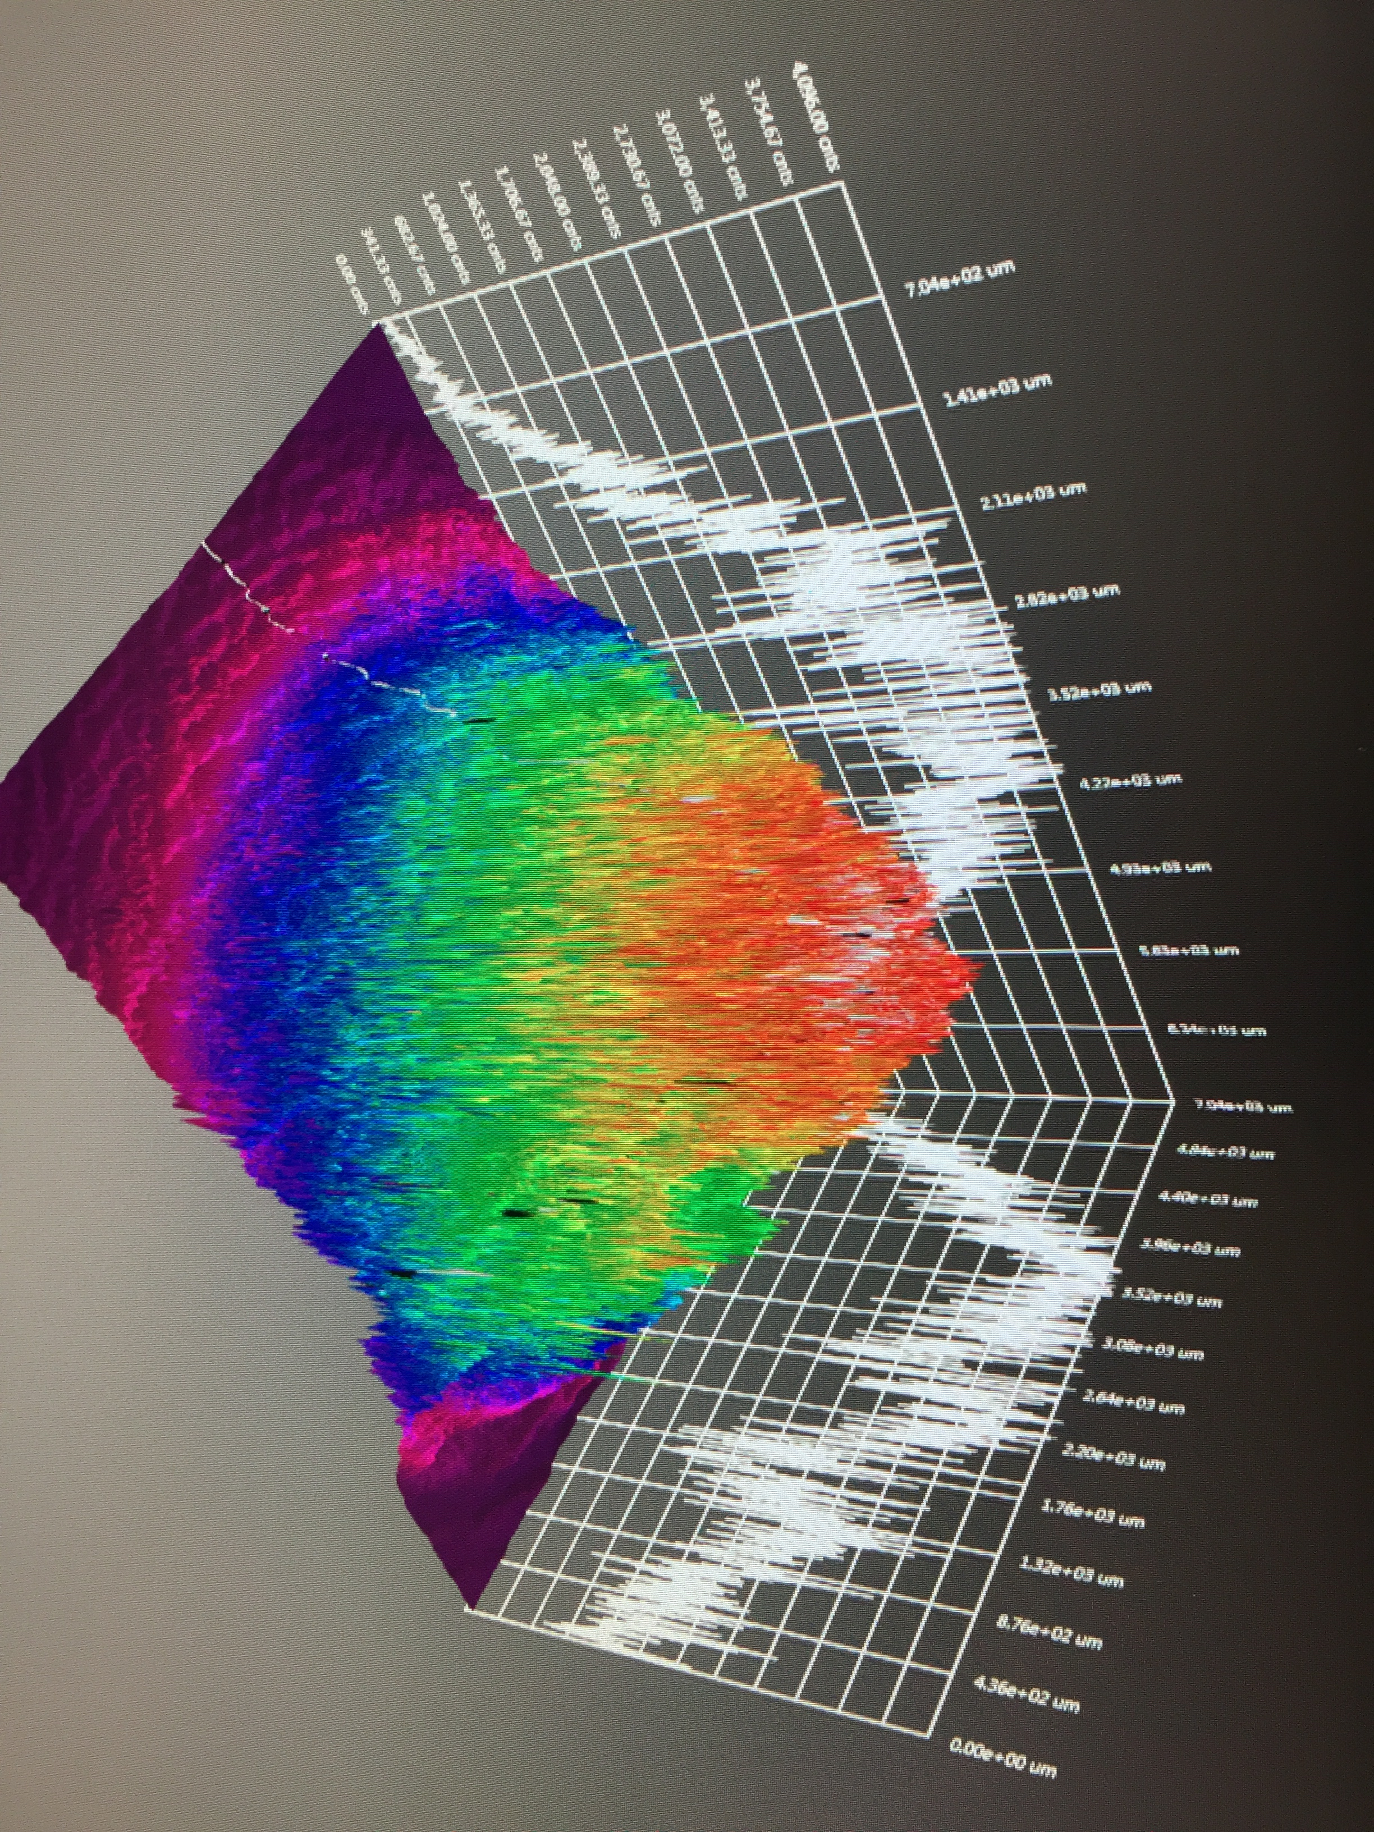
Question #1 : As the laser size is varied (increased) how does the ion impact distribution (#, energy) change?
A cylindrically symmetric case can demonstrate the concept, but in reality
  electo-static field NOT symmetric
  laser position NOT symmetric
  laser profile NOT symmetric

Slide 3
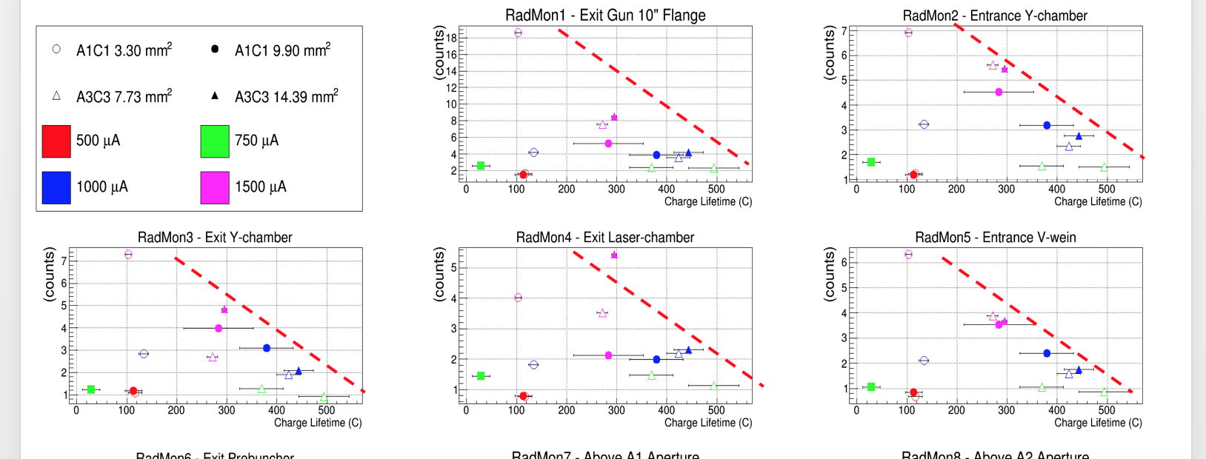
Question #2 : What is the limiting factor in this data set (and in general)?
X-rays monitor are correlated with photocathode lifetime.
Is beam too large to manage?

Slide 4
How to begin?
Working on #1:
Electrode geometry => we have field map
Laser position => we have QE maps of photocathode, I need to post these
Laser profiles => maybe start w/ ideal, and later can implement actual values (saved as GIF image)
Working on #2:
Beamline => we have layout and fields…but, how far to go and w/ what degree of detail
Real beam => find a way to impart real qualities that can be lost (e.g. laser halo, reflection halo)
X-ray production => start by quantifying beam loss intensity?
Vacuum => define which secondaries to consider (ion production, gas desorption, ejected e-)

