Slide 1
UITF keV- and MeV- Baseline
Joe Grames
UITF Operational Review
March 18, 2016
With special thanks to A. Bogacz, D. Douglas, F. Hannon A. Hofler,
C. Hovater, M. Poelker, T. Powers and C. Tennant for advice and/or inspiration.

Slide 2
keV region overview
Polarized Source
Inverted Gun
with 450 kV HVPS
Yao or Brock cavity to optimize bunching
(9) Viewer
(1) Harp
(5) BPM
I
(5) Current
750 MHz buncher to compress bunch for QCM
CEBAF style Wien filter upgraded for 200 keV operation
FC
MS
FC
A3
A4
Spectrometer to calibrate buncher gradient and measure energy spread
Y-chamber to introduce laser normal to the photocathode
1497 MHz chopper to set low current (pA) and measure longitudinal profile
New QCM to achieve 5-10 MeV beam
(depends on klystrons)

Slide 3
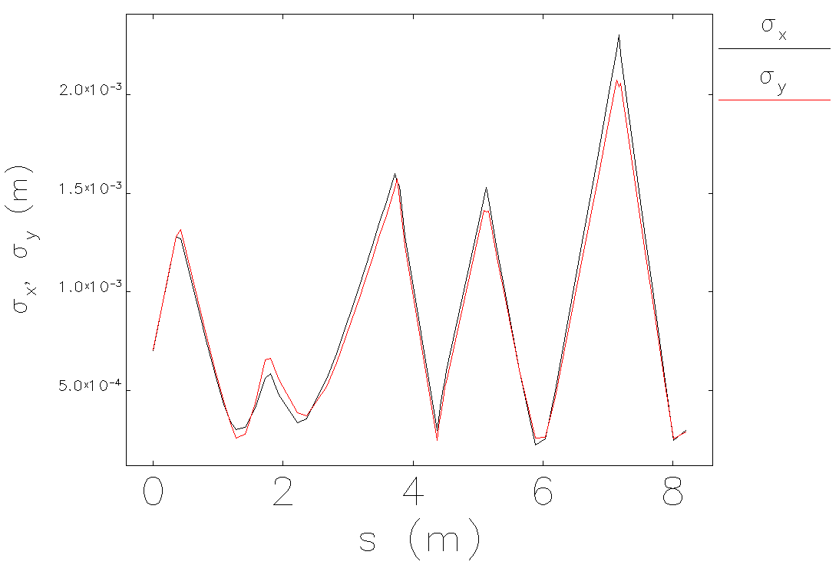
keV region beam envelope management
ε_{t,RMS} 0.5 mm-mrad/mm
ε_{g} = 3.69 x 10⁻⁷ μm @ 350 kV
β_{x} ~ β_{y} ~ 1.5 m (s=20cm, PARMELA 130keV)
α_{x} ~ α_{y} ~ 3.0 rad (s=20cm, PARMELA 130 keV)
QCM
Y-Chamber
Wien
Buncher
Chopper

Slide 4
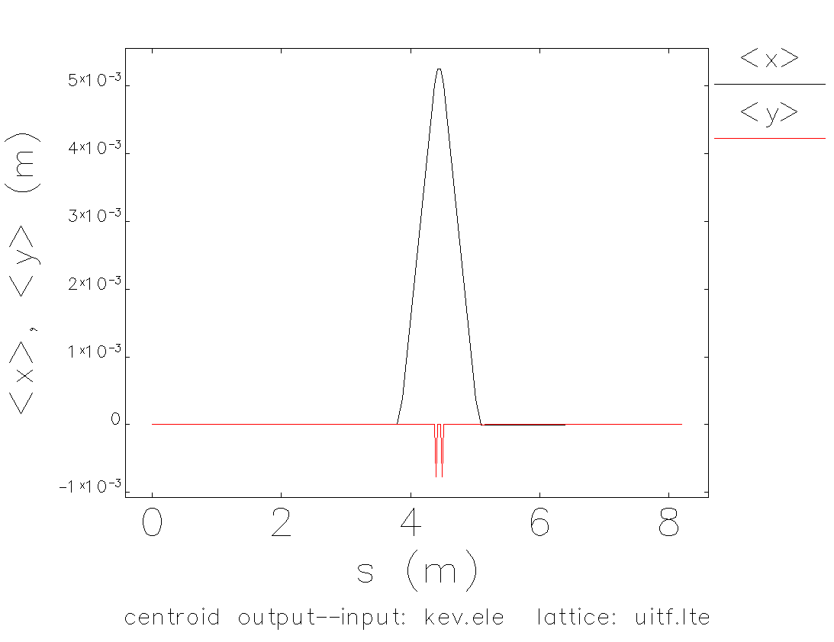
keV region chopping/dechopping
C1
C2
S1
S2
S3
S4
S1 defines beam size on chopping plane
C1-S2-S3-C2 transform inverts kick
θ_{x} = 10 mrad @ 350 keV
0
M₁₁
M₁₂
0
M₁₂ = 0
M₂₂ = -1
=
-x’
M₂₁
M₂₂
x’
S2 focal length is C1-S2 distance (f=0.566m)
Choose C1 kick θ for chopping plane.
Make S2-S3 distance as small as feasible

Slide 5
keV operation : solenoids, dipoles, quads @ 200 keV
E0 (MeV) | 0.5110
T (MeV) | 0.2000
E (MeV) | 0.7110
P (MeV/c) | 0.4944
γ | 1.3914
β | 0.6953
β γ | 0.9675
B ρ (G-cm) | 1649.0135
Solenoid | Element Name | Elegant Lattice |  | Elegant Model |  | Focal Length |  | Solenoid
 |  | Strength KS | Length L | Strength KS | Length L | F | B2L | "HMAX" | Current | IMAX
 |  | [rad/m] | m | [rad/m] | m | m | G2-cm | G2-cm/A2 | Amp | Amp
Y Waist | MFH1K01 | 11.00 | 0.07620 | 11.00 | 0.07620 | 0.434 | 250719.8751 | 8.60E+04 | 1.71 | 3.5
Wien Waist | MFB2K02 | 13.40 | 0.07620 | 13.40 | 0.07620 | 0.292 | 372060.0064 | 9.98E+04 | 1.93 | 3.5
Chopping Waist | MFA3K02A | 12.70 | 0.03175 | 12.70 | 0.06350 | 0.391 | 278502.8144 | 1.11E+05 | 1.58 | 2.5
 | MFA3K02B | -12.70 | 0.03175
Before Slit | MFD3K02AA | 11.98 | 0.02500 | 11.98 | 0.05000 | 0.557 | 195133.6021 | 1.43E+05 | 1.17 | 1
 | MFD3K02AB | -11.98 | 0.02500
After Slit | MFD3K02BA | 11.98 | 0.02500 | 11.98 | 0.05000 | 0.557 | 195133.6021 | 1.43E+05 | 1.17 | 1
 | MFD3K02BB | -11.98 | 0.02500
Buncher Waist | MFA3K03B | -12.00 | 0.03175 | 12.00 | 0.06350 | 0.437 | 248647.81 | 1.11E+05 | 1.50 | 2.5
 | MFA3K03B | 12.00 | 0.03175
Cryounit Waist | MFA4K03A | -11.00 | 0.03175 | 11.00 | 0.06350 | 0.521 | 208933.2292 | 1.11E+05 | 1.37 | 2.5
 | MFA4K03B | 11.00 | 0.03175
Dipole | Element Name | Bend Angle θ |  | Int. Field BL | FMAP BL v. I | Current I | IMAX
 |  | deg | rad | G-cm | G-cm/A | Amp | Amp
15 deg bend | MDS2K01 | -15.0 | -0.262 | -430.479 | 136.300 | -3.158 | 3.5A (41.5C)
45 deg bend | MDI4K02 | -45.0 | -0.785 | -1262.100 | 653.800 | -1.930 | 3.5
Steering Coil | MHB*H | 5.8 | 0.100 | 165.420 | 178.4 | 0.927 | 1.0
Steering Coil | MHB*V | 5.8 | 0.100 | 165.420 | 142.4 | 1.162 | 1.0
Steering Coil | MBH*H | 5.8 | 0.100 | 165.420 | 172.5 | 0.959 | 1.0
Steering Coil | MBH*V | 5.8 | 0.100 | 165.420 | 147.2 | 1.124 | 1.0
Quadrupole | Element Name | Length L | Strength K1 | Int. Gradient B'L | FMAP B v. I | Current I | IMAX
 |  | m | 1/m2 | Gauss | G/A | Amp | Amp
Wien Quad | MQU2K02 | 0.050 | 3.000 | 247.352 | 76.800 | 3.221 | 10.000
 | MQU2K03 | 0.050 | 3.000 | 247.352 | 76.800 | 3.221 | 10.000
Test chopping solenoids for > 1.2A
Steering coils at 100 mrad OK, but marginal

Slide 6
keV region operation : dipoles, solenoids, quads @ 350 keV
E0 (MeV) | 0.5110
T (MeV) | 0.3500
E (MeV) | 0.8610
P (MeV/c) | 0.6930
γ | 1.6849
β | 0.8048
β γ | 1.3561
B ρ (G-cm) | 2311.4512
Solenoid | Element Name | Elegant Lattice |  | Elegant Model |  | Focal Length |  | Solenoid
 |  | Strength KS | Length L | Strength KS | Length L | F | B2L | "HMAX" | Current | IMAX
 |  | [rad/m] | m | [rad/m] | m | m | G2-cm | G2-cm/A2 | Amp | Amp
Y Waist | MFH1K01 | 11.00 | 0.07620 | 11.00 | 0.07620 | 0.434 | 492617.4532 | 8.60E+04 | 2.39 | 3.5
Wien Waist | MFB2K02 | 13.40 | 0.07620 | 13.40 | 0.07620 | 0.292 | 731028.0157 | 9.98E+04 | 2.71 | 3.5
Chopping Waist | MFA3K02A | 12.70 | 0.03175 | 12.70 | 0.06350 | 0.391 | 547205.7096 | 1.11E+05 | 2.22 | 2.5
 | MFA3K02B | -12.70 | 0.03175
Before Slit | MFD3K02AA | 11.98 | 0.02500 | 11.98 | 0.05000 | 0.557 | 383400.8695 | 1.43E+05 | 1.64 | 1
 | MFD3K02AB | -11.98 | 0.02500
After Slit | MFD3K02BA | 11.98 | 0.02500 | 11.98 | 0.05000 | 0.557 | 383400.8695 | 1.43E+05 | 1.64 | 1
 | MFD3K02BB | -11.98 | 0.02500
Buncher Waist | MFA3K03B | -12.00 | 0.03175 | 12.00 | 0.06350 | 0.437 | 488546.2346 | 1.11E+05 | 2.10 | 2.5
 | MFA3K03B | 12.00 | 0.03175
Cryounit Waist | MFA4K03A | -11.00 | 0.03175 | 11.00 | 0.06350 | 0.521 | 410514.5443 | 1.11E+05 | 1.92 | 2.5
 | MFA4K03B | 11.00 | 0.03175
Dipole | Element Name | Bend Angle θ |  | Int. Field BL | FMAP BL v. I | Current I | IMAX
 |  | deg | rad | G-cm | G-cm/A | Amp | Amp
15 deg bend | MDS2K01 | -15.0 | -0.262 | -603.410 | 136.300 | -4.427 | 3.5A (41.5C)
45 deg bend | MDI4K02 | -45.0 | -0.785 | -1769.108 | 653.800 | -2.706 | 3.5
Steering Coil | MHB*H | 5.8 | 0.100 | 231.872 | 178.4 | 1.300 | 1.0
Steering Coil | MHB*V | 5.8 | 0.100 | 231.872 | 142.4 | 1.628 | 1.0
Steering Coil | MBH*H | 5.8 | 0.100 | 231.872 | 172.5 | 1.344 | 1.0
Steering Coil | MBH*V | 5.8 | 0.100 | 231.872 | 147.2 | 1.575 | 1.0
Quadrupole | Element Name | Length L | Strength K1 | Int. Gradient B'L | FMAP B v. I | Current I | IMAX
 |  | m | 1/m2 | Gauss | G/A | Amp | Amp
Wien Quad | MQU2K02 | 0.050 | 3.000 | 346.718 | 76.800 | 4.515 | 10.000
 | MQU2K03 | 0.050 | 3.000 | 346.718 | 76.800 | 4.515 | 10.000
Upgrade 15° dipole and evaluate solenoids
Steering coils limited ~60 mrad, or replace w/ e.g. RadiaBeam (STM-01-341-110) BL_{max} = 500 G-cm

Slide 7
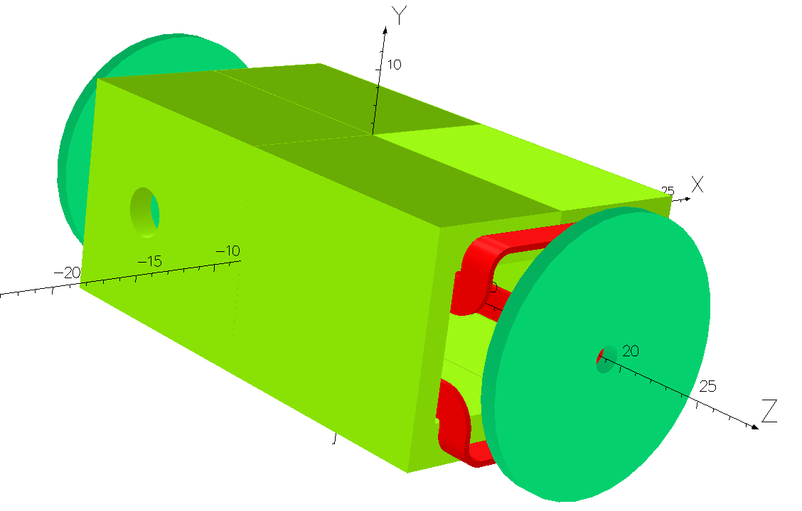
keV region Wien Filter @ 200 to 350 keV
The SLAC Wien filter used at CEBAF has limited capacity for UITF beam energies.
Beam Voltage | keV | 200.00 | 350.00
Integrated BL | G-cm | 2600.00 | 2600.00
Current | A | 10.00 | 10.00
Precession | deg | 65.10 | 38.30
Effective Length | cm | 31.00 | 31.00
Electric Field | MV/m | 1.74 | 2.02
Differential Voltage | kV | 26.10 | 30.30
Power Supply Voltage | kV | 13.05 | 15.15
Jay proposes (JLab-TN-15-032) to retrofit SLAC Wien filter for operation to 250-275 kV operation:
increase coil cross section for 20A operation
increase HVPS and HV feed-through for 30kV
We are looking at modifications of spare Wien now.
Beam Voltage | keV | 200.00 | 250.00 | 300.00 | 350.00
Integrated BL | G-cm | 3993.86 | 4878.05 | 5816.55 | 6788.51
Current | A | 15.36 | 18.76 | 22.37 | 26.11
Precession | deg | 100.00 | 100.00 | 100.00 | 100.00
Effective Length | cm | 31.00 | 31.00 | 31.00 | 31.00
Electric Field | MV/m | 2.67 | 3.49 | 4.36 | 5.27
Differential Voltage | kV | 40.09 | 52.35 | 65.44 | 79.11
Power Supply Voltage | kV | 20.05 | 26.17 | 32.72 | 39.56

Slide 8
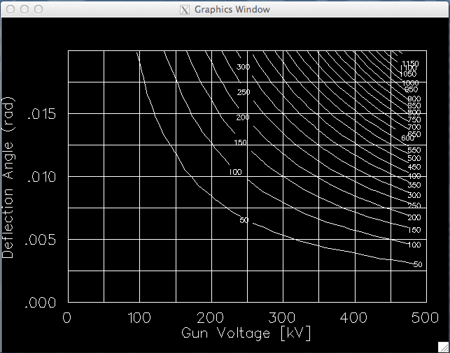
keV region 1497 MHz Choppers @ 200 to 350 keV
Re-purpose original 1497 MHz X/Y chopper cavities:
TN-90-214, C. Yao – Comparison of measurement and MAFIA (agrees 50%)
TN-90-234, G. Krafft – Includes relativistic correction, deflection equation, cavity parameters
Power ~ (E_{b} * β * θ)² / [ (R/Q) * Q₀ ]
R/Q ~ 12 ohms
Q₀ ~ 14000
= 10 mrad
Chopper tests 2014.
75W
200W
C1
C2
Pair of chopping cavities are capable to provide planar or circular 10 mrad chopping to 350 keV

Slide 9
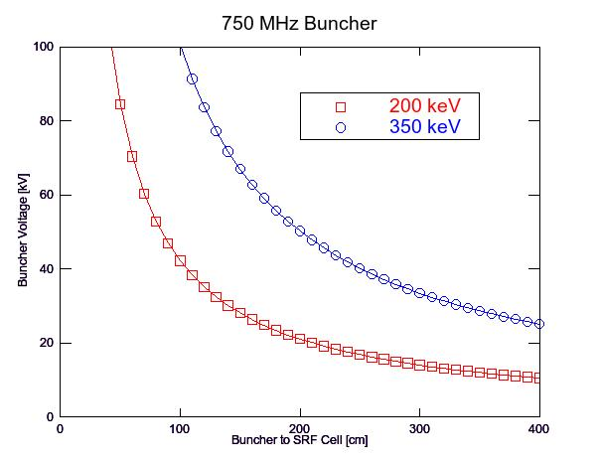
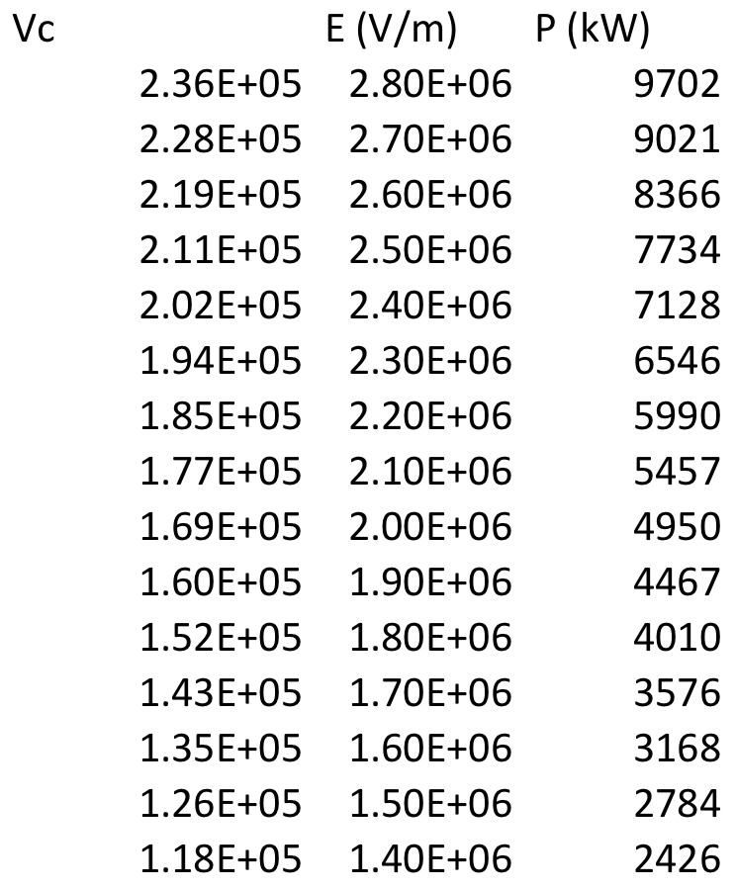
keV region 750 MHz Buncher @ 200 and 350 keV
The LERF 750 MHz buncher will initially be used at UITF.
The voltage V_{b} required to form a longitudinal waist a distance L downstream of the buncher is used (Handbook of Accelerator Physics & Eng. P. 554) to estimate required RF power < 1 kW.
V_{b} = (λ_{RF}/2πL) m_{e}c² γ (γ²-1) where λ_{RF} = c / 750 MHz
Courtesy T. Powers
~36 kV
~15 kV

Slide 10
MeV region overview
(optical layout inspired by D. Douglas)
QCM Exit Valve
Chicane to increase beam height (90”), manage η and measure energy
Telescope #2:
set beam at IBC
IBC with beam dump and diagnostics
FC
DL
DL
Raster and drift for beam control (x,x’) and diagnostics (x,I,σ)
“Straight ahead” stub for diagnostics or UITF expansion floor level
(9) Viewer
(3) Harp
Telescope #1: matching from QCM
(13) BPM
I
(3) Current

Slide 11
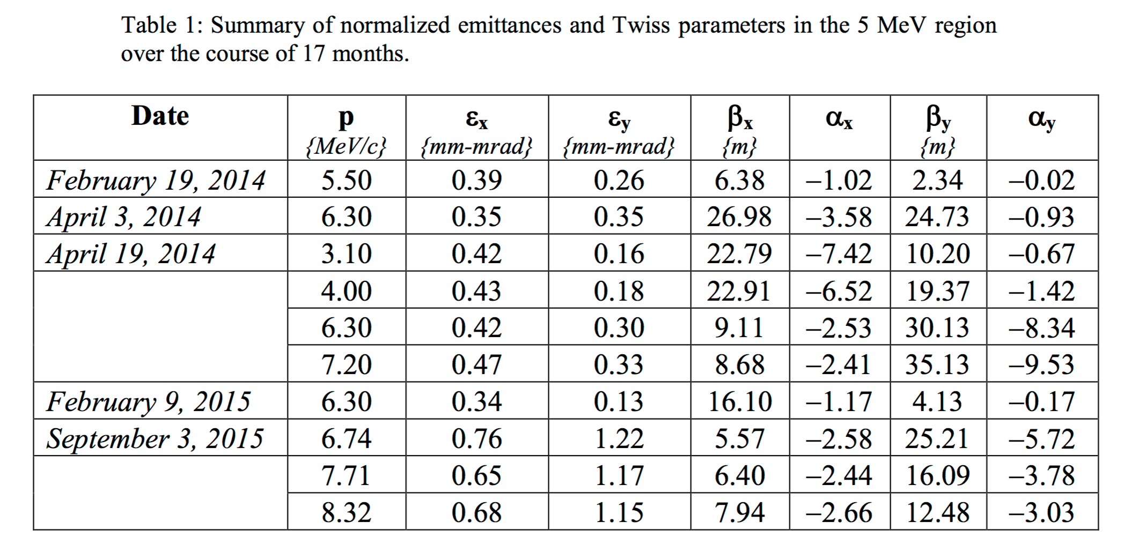
MeV region beam input
In support of PEPPo, Mott and Bubble experiments Chris Tennant extensively characterized beam emittance after the CEBAF QCM over a broad momentum range.
ε_{norm,RMS} 0.7 mm-mrad, ε_{norm,RMS} 1.2 mm-mrad
β_{x} = 6.6 m, β_{y} = 17.9 m
α_{x} = -2.6 rad α_{y} = -4.2 rad
I Assume
σ_{p}/p = 0.5%

Slide 12
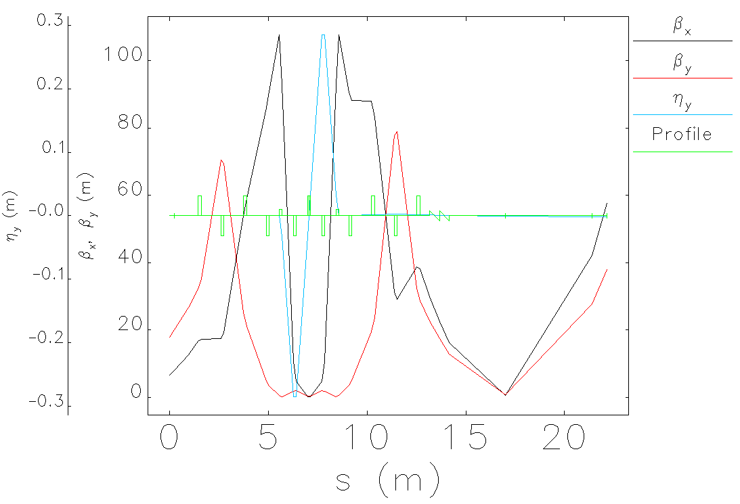
MeV region optics
Set waist w/ σ_{x} = σ_{y}
Zero η_{y}
Set α_{x} = α_{y} = 0

Slide 13
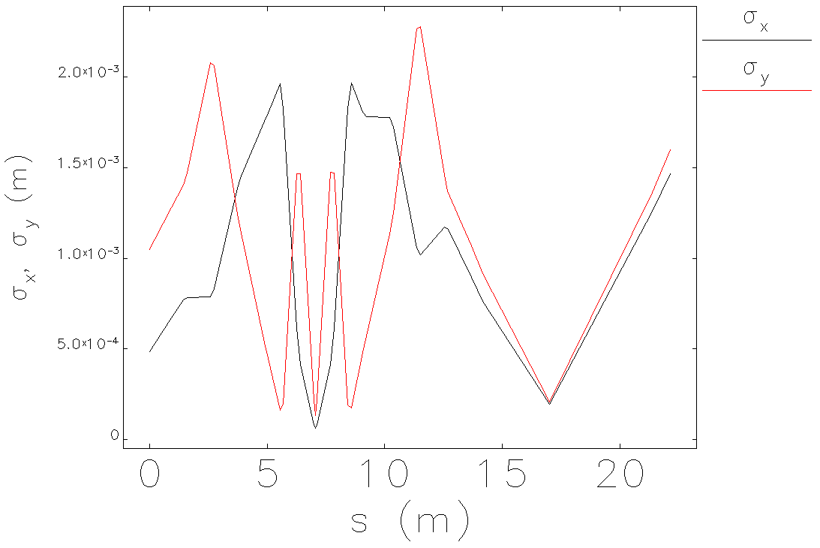
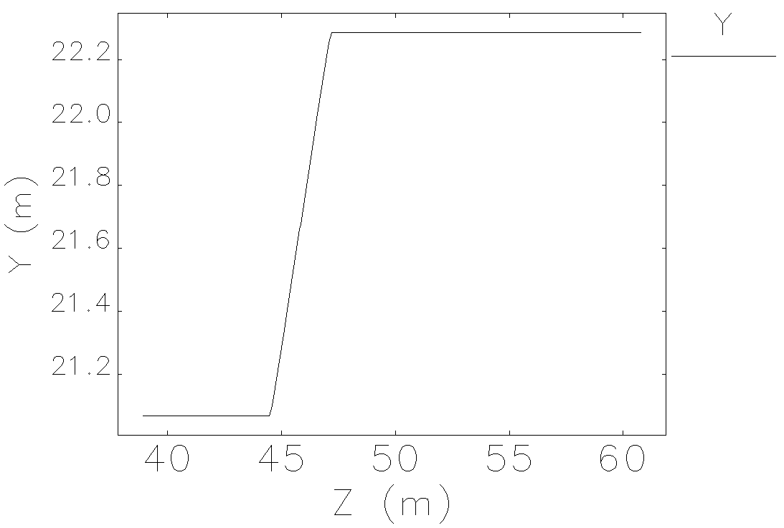
MeV region beam envelope
Set waist w/ σ_{x} = σ_{y} ≈ 200 μm

Slide 14
MeV region operation : dipoles and quads @ 10 MeV
Evaluate steering coil needs for final layout, e.g. combination of RadiaBeam (STM-01-340-138: 1250 G-cm) and Haimson sufficent, modest deflection, etc.
Momentum (MeV/c) | 10.00
γ | 19.5695
β | 0.9987
β γ | 19.5439
B ρ (G-m) | 333.56
Function | Quantity | Name | Length L | Strength K1 | Integrated Field B'L | QJ HMAX 59.4 G/A | QD HMAX 321.4 G/A
 | # |  | m | 1/m2 | Gauss | Amp | Amp
Matching from QCM | 1 | Q1 | 0.150 | 1.682 | 84.157 | 1.417 | 0.262
 | 1 | Q2 | 0.150 | -4.566 | -228.455 | -3.846 | -0.711
 | 1 | Q3 | 0.150 | 1.202 | 60.141 | 1.012 | 0.187
 | 1 | Q4 | 0.150 | -0.083 | -4.133 | -0.070 | -0.013
Manage Chicance Dispersion | 2 | QA | 0.150 | -19.919 | -996.622 | -16.778 | -3.101
 | 1 | QB | 0.075 | 4.980 | 124.577 | 2.097 | 0.388
Sets HDIce Beam on Target | 1 | QW | 0.150 | -1.198 | -59.941 | -1.009 | -0.186
 | 1 | QX | 0.150 | 2.520 | 126.086 | 2.123 | 0.392
 | 1 | QY | 0.150 | -5.330 | -266.681 | -4.490 | -0.830
 | 1 | QZ | 0.150 | 2.430 | 121.583 | 2.047 | 0.378
Dipole Function | Element Name | Angle |  | BL | MDL "HMAX" | Current | IMAX
 |  | deg | rad | G-cm | G-cm/A | Amp | Amp
Chicane Dipole | B1 | 25.000 | 0.436 | 14439.120 | 2400.0 | 6.016 | 10
Chicane Dipole | B2 | -25.000 | -0.436 | -14439.120 | 2400.0 | -6.016 | 10
Steering Coil | MHB*H | 5.8 | 0.100 | 3346.085 | 178.4 | 18.756 | 1
Steering Coil | MHB*V | 5.8 | 0.100 | 3346.085 | 142.4 | 23.498 | 1
Steering Coil | MBH*H | 5.8 | 0.100 | 3346.085 | 172.5 | 19.398 | 1
Steering Coil | MBH*V | 5.8 | 0.100 | 3346.085 | 147.2 | 22.732 | 1
Radiabeam (med) | H/V | 5.8 | 0.100 | 3346.085 | 169.3 | 19.764 | 7.5

Slide 15
Summary
High Level Summary
The UITF keV- and MeV- baseline layout looks feasible.
Layout fits within cave footprint; not much wiggle room upstream of QCM.
keV Region Concerns
Magnets fine for 200 keV; higher voltage (➔350keV) requires upgrades, primarily addressing coils sufficient for lower energy; chopping solenoids are critical path.
200W chopping amplifiers don’t exist; maybe 75W (200keV) more promising?
Buncher is far (3m) from QCM, good for power (<500W), but is it OK for beam?
MeV Region Concerns
Quads (QJ/QD) fine for 10 MeV; need to identify (25°?) chicane dipoles and must find suitable steering coils.
Are we using best estimate for QCM exit emittance?
Outlook
Refine or improve the optics model; optimize toward HDIce requirements.
Integrate handshake with IBC/Dump.
Develop “final” base line for HDIce and Injector Upgrade conditions

