Slide 1
Tune Mode Generator (TMG)
TIMING
Steve Covert (scovert@jlab.org) x6878

Slide 2
MACROPULSE CHASSIS
Converts fiber to TTL logic
Compares TTL logic to FSD
If OK, sends TTL out to TMG
Only has two very robust AND and INVERTER gates

Slide 3
NOTICE!
Re-Triggerable circuits start a “timer” that changes the state of the flipflop (Q to !Q), unless it receives another pulse beforehand to restart it’s timer. Example: The supervisor has a timer of 100mS and a pulse is received:
Q (VL mode) goes to !Q (CW Mode)
If another falling edge received, goes back to Q (VL)
If NO falling edge received after 100ms, !Q stays active (CW Mode)
Designed delay times using Capacitors and Resistors and the resulting 5RC time constants do not match measured timings on the scope, but fall well within parameters. Example: The Shutter delay on schematic says “100mS” but is actually ~350mS on scope.
You will need the LOGIC DIAGRAM to follow the data, I suggest you use an 11” x 17” printout from this PDF to save time flipping pages ☺

Slide 4
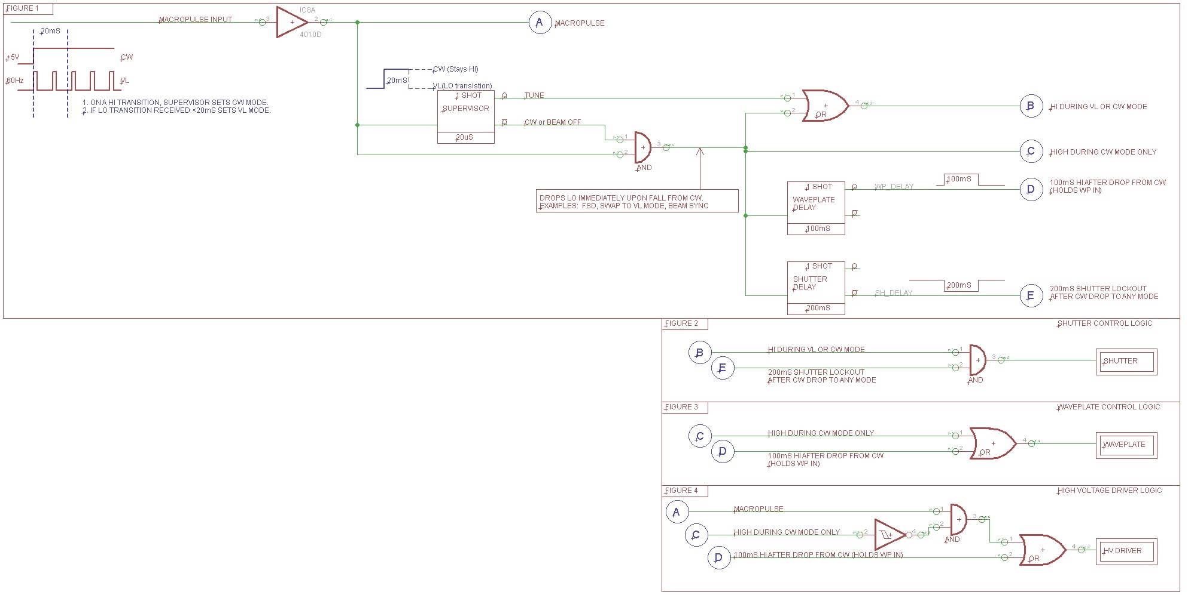

Slide 5
WHAT EXACTLY DOES THE TMG SEE?
It is important to know that the TMG input from the Macro Pulse Chassis is a 5V TTL signal. It only sees:
Steady State 0V or 5V
Transition from LO to HI
Transition from HI to LO
That’s all. It knows nothing of what is going on in the outside world. It employs a timer in a supervisor circuit to select an output based on a rising or falling edge. The board is made up of logic gates to interpret the output of the supervisor circuit such that it matches what the outside world needs.
We will discussing design parameters (timers) and looking at actual scope shots. The timing in the scope shots is close but not exact, as the flip flops are controlled by a simple 5RC timer. It does get confusing looking at a “200mS” timer (on paper) and seeing a 350mS timer on the scope!

Slide 6
TMG SUPERVISOR GATE LO to HI Transition
Examine TTL input and determine if TTL is pulsing or constant.
Activates CONSTANT or PULSING output configuration
Measured 22mS with scope.
If no LO transition detected, selects CONSTANT Mode.
Sets up CONSTANT component configuration.
If LO transition detected within 25mS, selects PULSING Mode.
Sets up PULSING component configuration.
NOTE: Minimum SCAM frequency is 40Hz, or 25mS
This Photo by Unknown Author is licensed under CC BY-NC

Slide 7
Configurations for Rising Edge Detected Note: Must be in Beam Sync, applying 0V to TMG for >=100mS
PULSING
SHUTTER Closed to Open
WAVEPLATE Retracted to Retracted
POCKELS CELL OFF to OFF
CONSTANT
SHUTTER Closed to Open
WAVEPLATE Retracted to Inserted
POCKELS CELL OFF to ON

Slide 8
TMG SUPERVISOR GATE HI to LO Transition >=22ms
If LO is present for 22mS
Measured 22mS with scope.
If LO transition detected within 25ms of previous LO:
Do nothing, we are in PULSING mode.
If LO transition present for >25mS (VL to BS or FSD):
NOTE: Minimum SCAM frequency is 40Hz, or 25mS

Slide 9
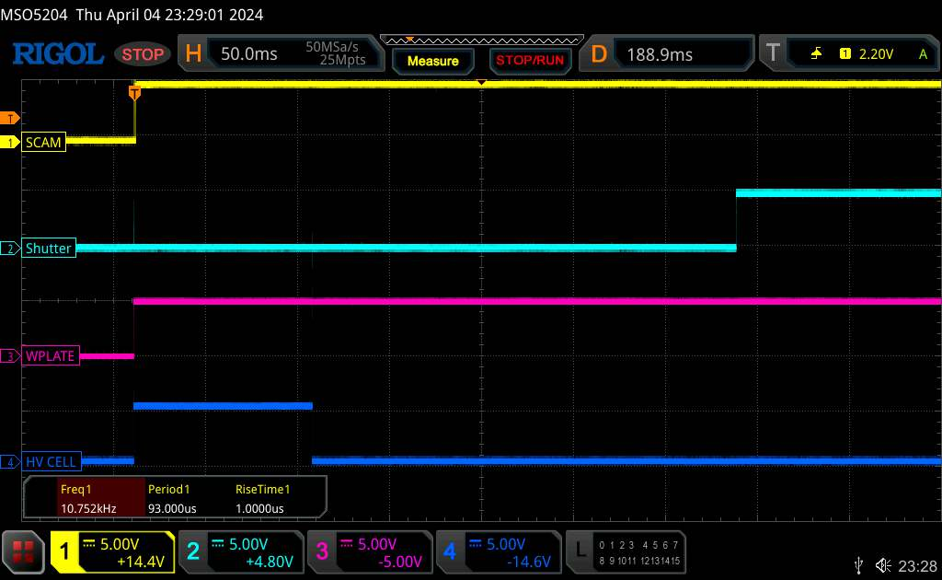
EXAMINE THE MODES: Beam Sync to CW
FIGURE | NOTES
1 SUPERVISOR LOGIC | A: Stays HI B: Goes HI C: Goes HI D: Stays LO E: Stays HI
2 SHUTTER | B: HI *AND* E: HI Shutter delay starts (200mS) Shutter goes HI
3 WAVEPLATE | C: HI *OR* D: LO WP delay starts (100mS) Waveplate goes HI, retracts
4 HIGH VOLTAGE | A: HI C: HI D: LO WP delay active (100mS). After WP timeout cell LO, passing beam in CW Mode

Slide 10
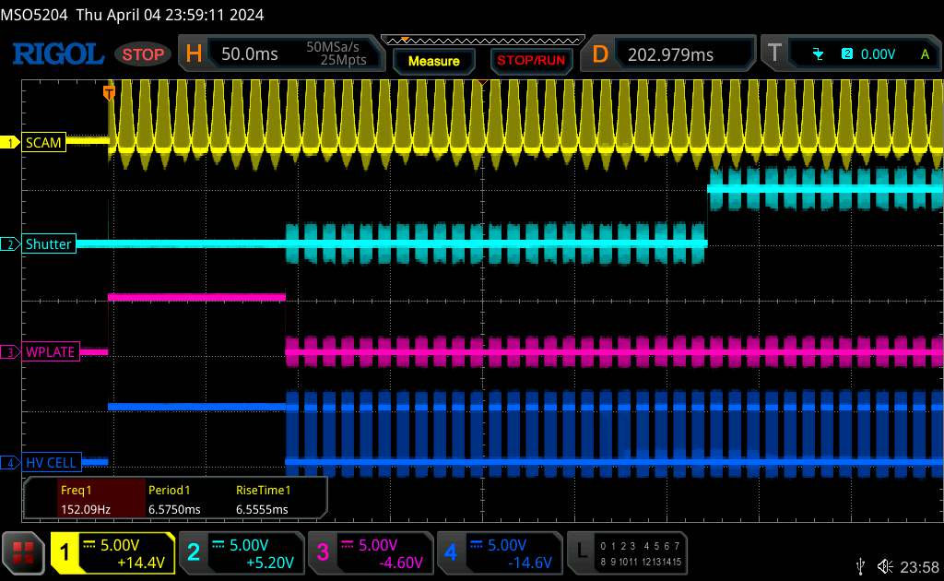
EXAMINE THE MODES: Beam Sync to VL
FIGURE | NOTES
1 SUPERVISOR LOGIC | A: Pulsing 60Hz (33.3ms) Supervisor 100mS delay triggers on LO D: Stays LO E: Stays HI
2 SHUTTER | B: HI *AND* E: HI Shutter delay starts (200mS) Shutter goes HI
3 WAVEPLATE | C: LO *OR* D: LO WP delay starts (100mS) Waveplate goes HI, retracts
4 HIGH VOLTAGE | A: Pulsing 60Hz C: LO D: LO WP delay active (100mS). After WP timeout cell LO, passing Macro pulses in VL Mode

Slide 11
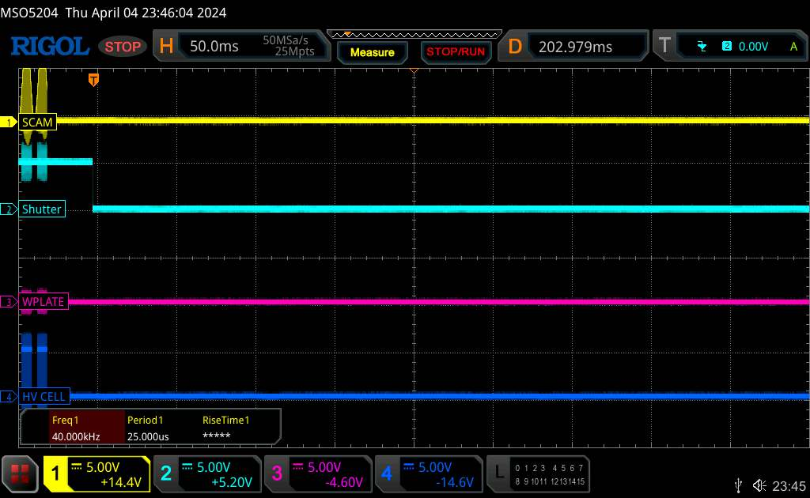
EXAMINE THE MODES: VL to Beam Sync (or FSD)
FIGURE | NOTES
1 SUPERVISOR LOGIC | A: Goes static LO delay starts (20mS) B: Goes LO after delay D: Stays LO E: Stays HI
2 SHUTTER | B: LO *AND* E: LO Shutter goes LO immediately
3 WAVEPLATE | C: LO *OR* D: LO WP stays LO
4 HIGH VOLTAGE | A: LO C: LO D: Goes static LO High voltage stops passing Macro pulses and Stays LO
Since the HV is following the pulsing, if an OFF or an FSD occurs, the HV simply stays OFF and Waveplate stays IN. Shutter activated when Supervisor’s 22mS times out.

Slide 12
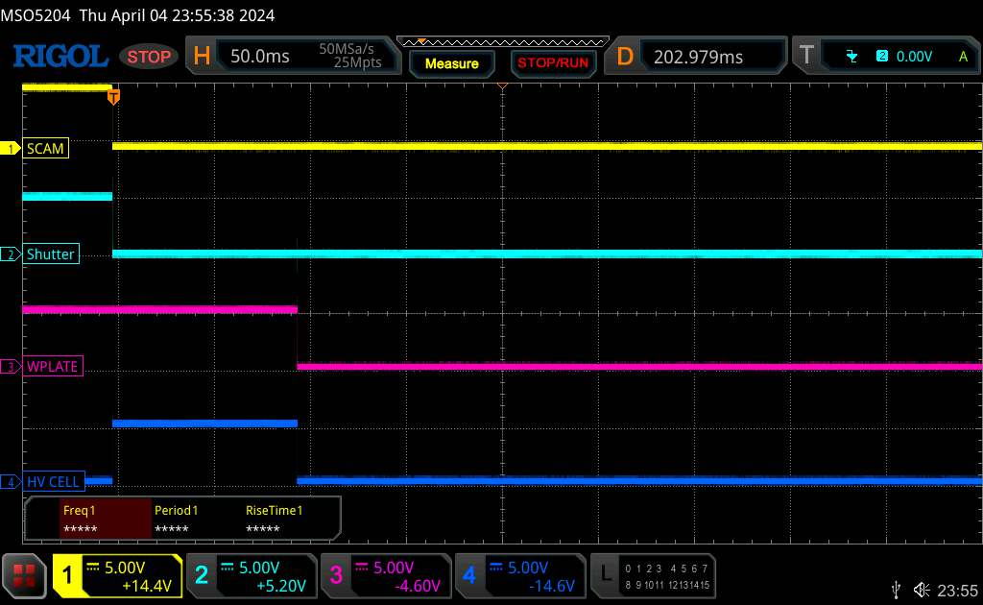
EXAMINE THE MODES: CW to Beam Sync (or FSD)
FIGURE | NOTES
1 SUPERVISOR LOGIC | A: Goes LO delay starts (20mS) B: Goes LO after delay C: Goes LO WP delay starts (100ms) D: Goes HI (100mS) E: Stays HI
2 SHUTTER | B: LO *AND* E: LO Shutter goes LO immediately
3 WAVEPLATE | C: LO *OR* D: LO WP delay starts (100ms) WP stays HI 100mS
4 HIGH VOLTAGE | A: LO C: LO D: Goes HI for 100mS High voltage extinction for 100mS while WP inserts
WP stays retracted and High Voltage applied (fast extinction) to “stop” beam while shutter is closing (mS to move).

Slide 13
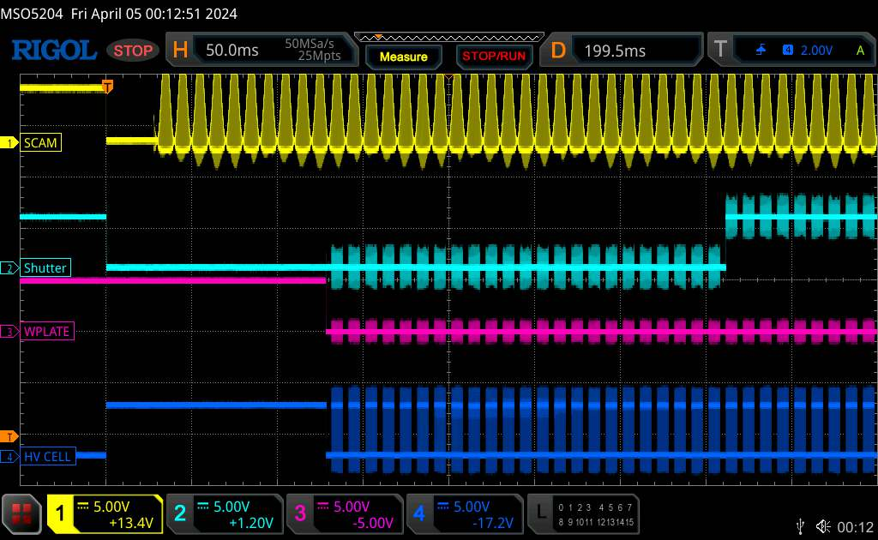
EXAMINE THE MODES: CW to VL
FIGURE | NOTES
1 SUPERVISOR LOGIC | A: Goes from HI to Pulsing Q goes HI (VL), !Q goes LO (CW) delay starts (20mS) B: Stays HI C: Goes LO WP delay starts (100ms) Shutter delay starts (200ms) D: Goes HI (100mS) E: Goes HI (200mS)
2 SHUTTER | B: HI *AND* E: HI (200mS delay) then LO Shutter goes LO immediately for 200mS
3 WAVEPLATE | C: LO *OR* D: Goes LO after delay (100mS) Inserts WP after 100mS
4 HIGH VOLTAGE | A: LO C: LO D: Goes HI for 100mS When timer expires, follows (A) pulsing

Slide 14
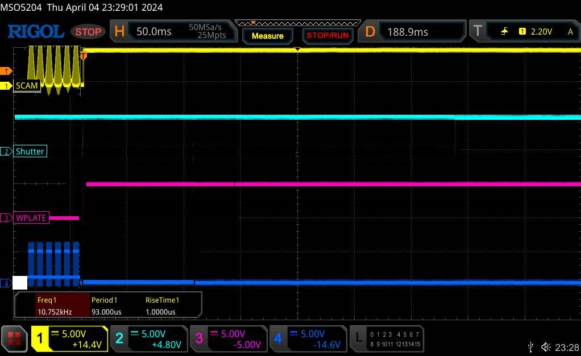
EXAMINE THE MODES: VL to CW
FIGURE | NOTES
1 SUPERVISOR LOGIC | A: Goes from Pulsing to static HI delay starts (20mS) B: Stays HI C: Goes HI D: Stays LO E: Stays HI
2 SHUTTER | B: HI *AND* E: HI **SHUTTER STAYS OPEN**
3 WAVEPLATE | C: HI *OR* D: LO WP retracts immediately
4 HIGH VOLTAGE | A: HI C: HI D: LO High voltage turns OFF
This is the only transition where the **SHUTTER STAYS OPEN**
(I apparently did not save this image – recreated it)

Slide 15
What happens if we get an FSD during the transition from Beam Sync to Viewer Limited Mode? An in depth look.

Slide 16
Standard Beam Sync to VL Mode
On rising edge of SCAM:
Waveplate and HV are activated as this could be CW Mode if SCAM stays HI.
At 22mS Supervisor now knows this is VL Mode and closes the Waveplate. High voltage then pulses to follow SCAM input.
At 350mS Shutter is ordered OPEN.

Slide 17
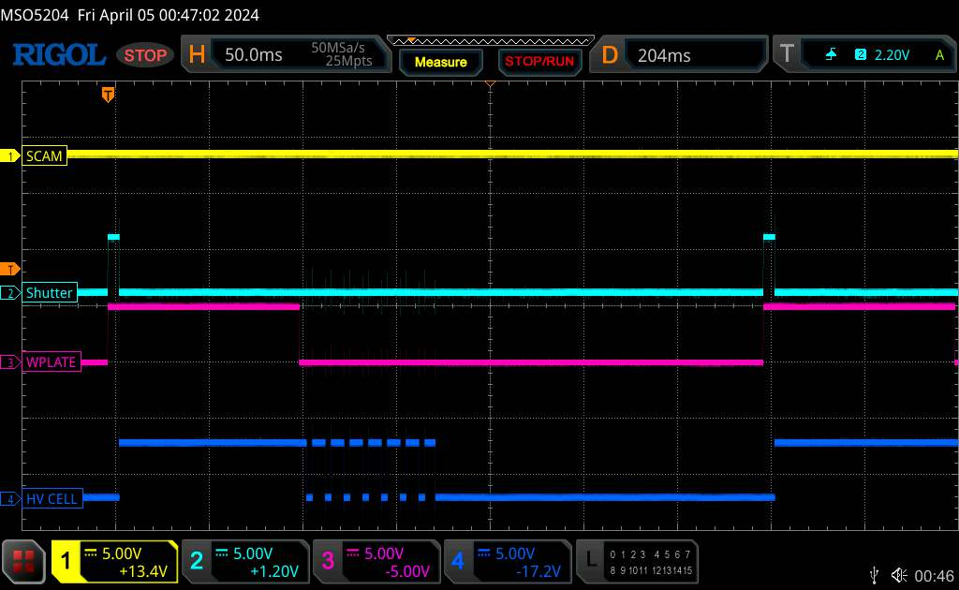
What happens if an FSD come in during before the 350mS timer to turn on the shutter?
If the VL input goes LO and stays LO for ~22uS, the supervisor circuit detects this and sets the 100mS timer..
At 100mS Supervisor now knows and OFF is ordered and Shutter is ordered closed. As it already is, there is no action.
To prove this, we saw earlier that the Shutter is ordered OPEN after 350mS on the initial rise. Riad had the great suggestion of sending 300mS / 350mS pulses to show the Shutter stayed CLOSED, which it did. We then went to ~360mS and you can see above that indeed the Shutter circuit goes high as expected, as the shutter timeout has expired.
This shows that an FSD is seen within the 350mS setup time, the Shutter remains closed.

Slide 18
FUTURE POSSIBILITIES
Use existing shutter’s readback to implement a fast failsafe.
Any design changes would take some time to implement and could be installed during the SAD.

