Slide 1
200 kV gun CST microwave studio simulations
Shield modifications
Gabriel Palacios
gabrielp@jlab.org
07/09/18

Slide 2
Summary
Solidworks
  Geometry modifications: 4 new shield proposals.
    Shields 1 and 2 have decreasing height
    Shields 3 and 4 have decreasing radius
CST
  Details of simulation
  Electric field and potential plots and false color images
Additional slides

Slide 3
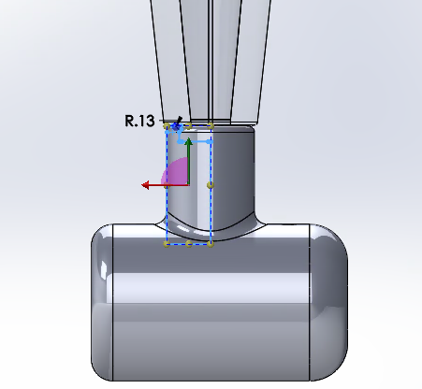
Solidworks geometry modifications: No shield

Slide 4
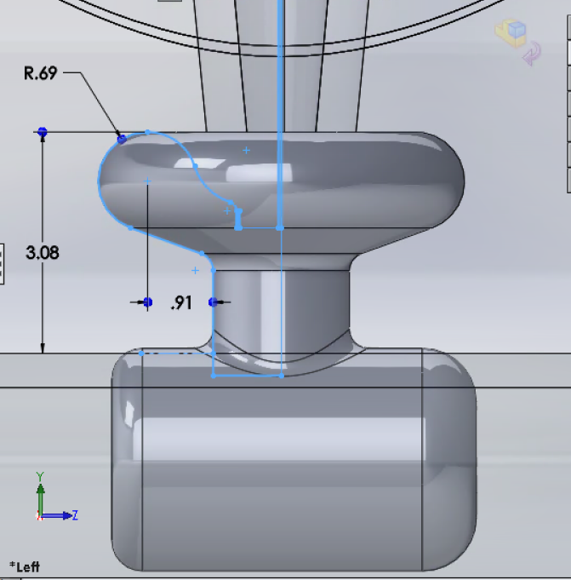
Solidworks geometry modifications: Original

Slide 5
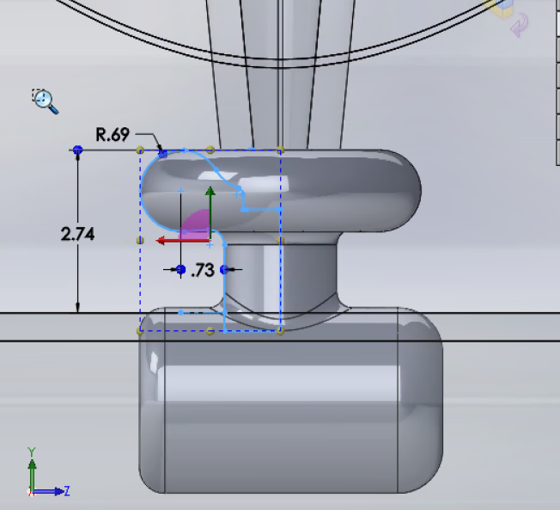
Solidworks geometry modifications: Shield 1

Slide 6
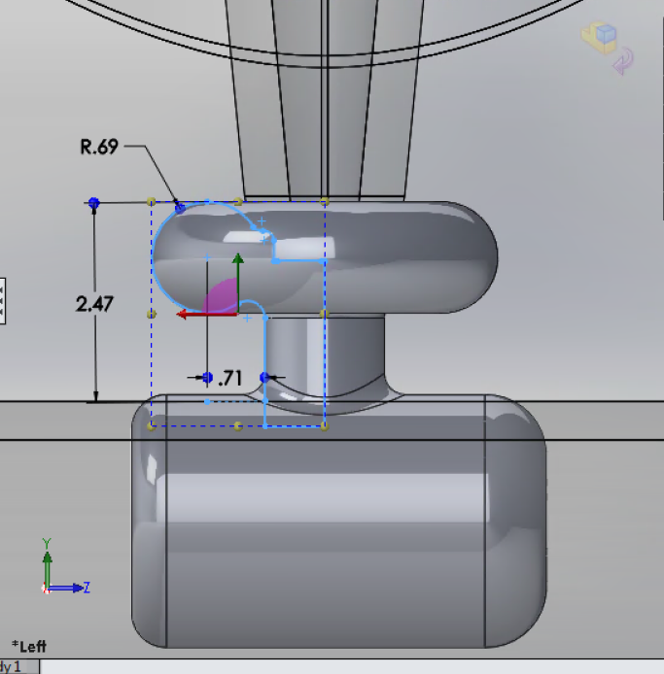
Solidworks geometry modifications: Shield 2

Slide 7
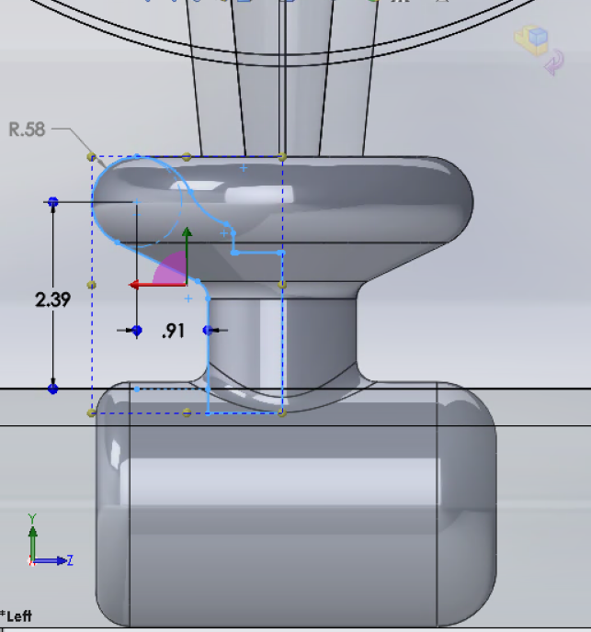
Solidworks geometry modifications: Shield 3

Slide 8
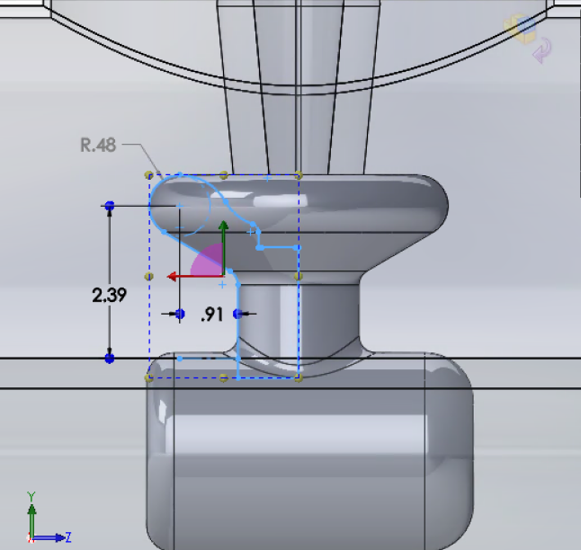
Solidworks geometry modifications: Shield 4

Slide 9

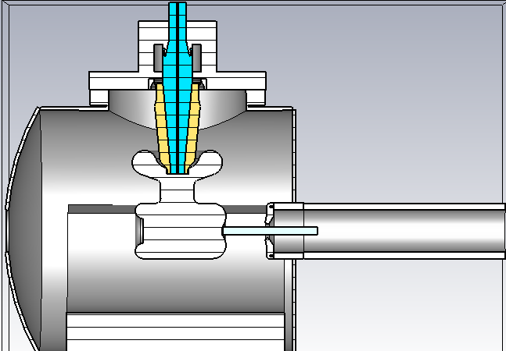
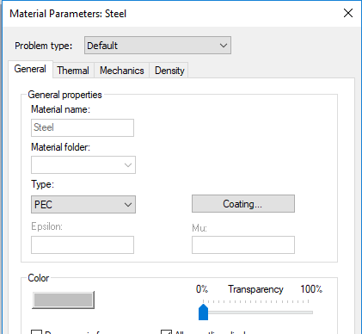
CST materials: PEC
Steel for all metal components with Perfect electric conductor (PEC). Since this is a preset we don’t need to define anything. Also, Thermal, Mechanical and Density properties are not included in the calculation.

Slide 10
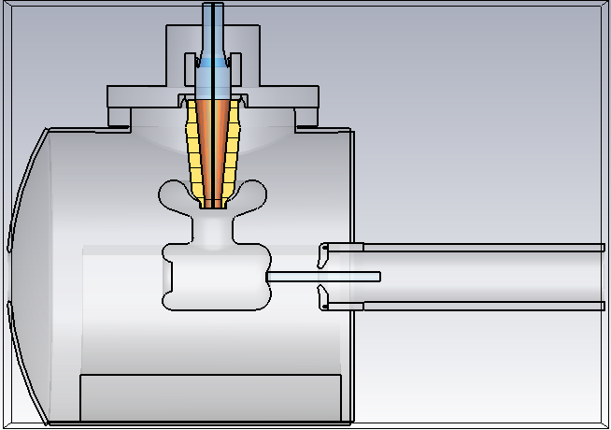
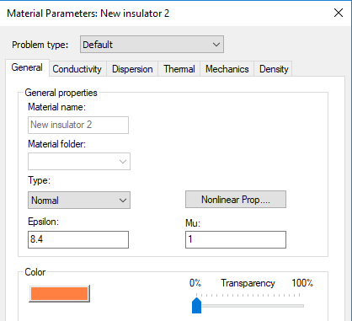
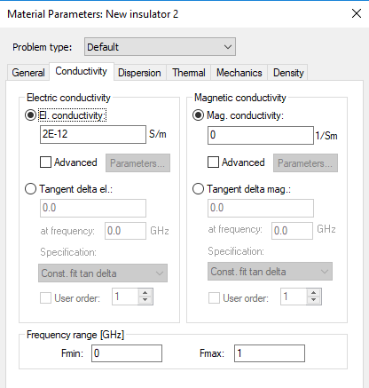
CST materials: Insulator
For black alumina I used the same parameters as in COMSOL.
ε=8.4
σ=2E-12 [S/m]

Slide 11
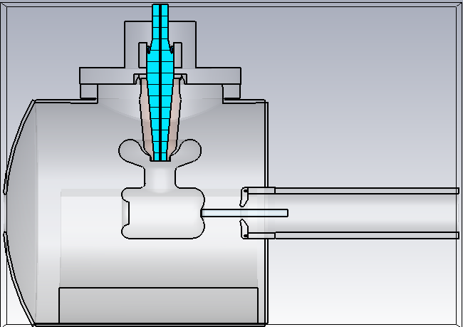
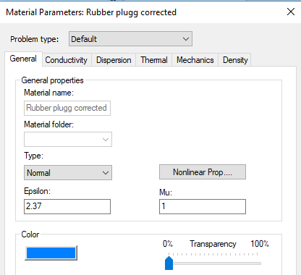
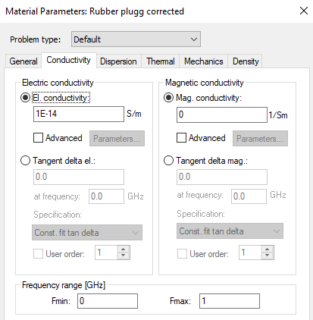
CST materials: Insulator
For rubber I used the same parameters as in COMSOL.
ε=2.37
σ=1E-14 [S/m]

Slide 12
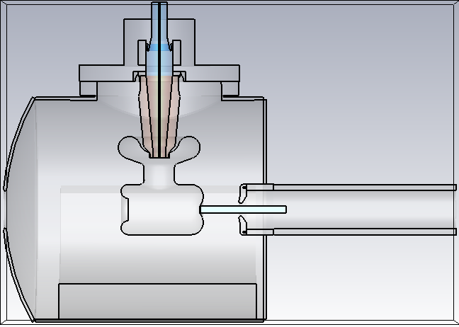
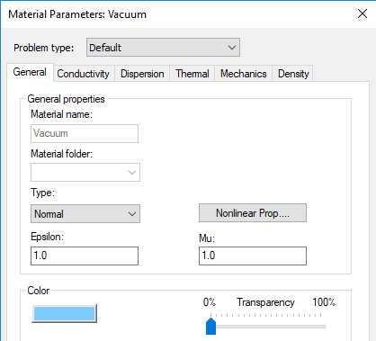
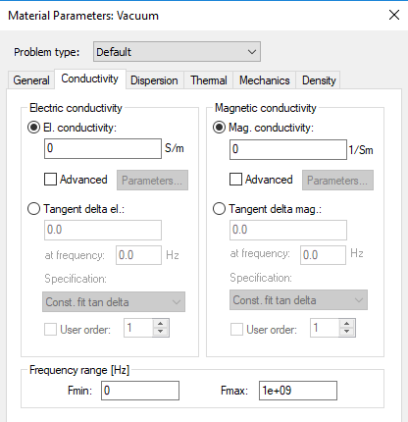
CST materials: vacuum
For vacuum cylinder and surroundings.
ε=1.0
σ=0 [S/m]

Slide 13
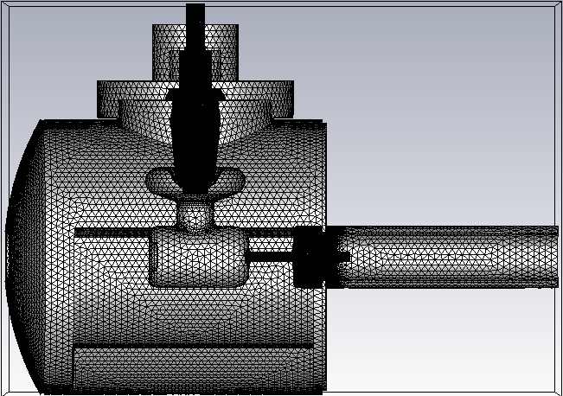
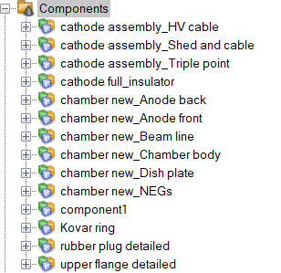
CST mesh:
The mesh was separated into (maybe too many) pieces. :P
The important part is, I only set some individual parts that require fine detail and left the rest to be auto-meshed.

Slide 14

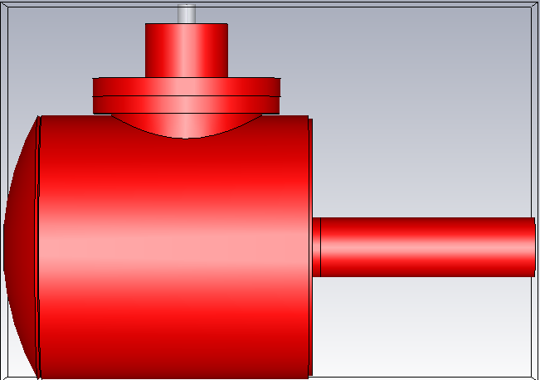
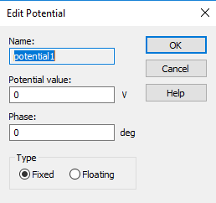
CST simulation: Potential
  Chamber, upper flange, Kovar ring, anode and beam-pipe at 0 V.

Slide 15
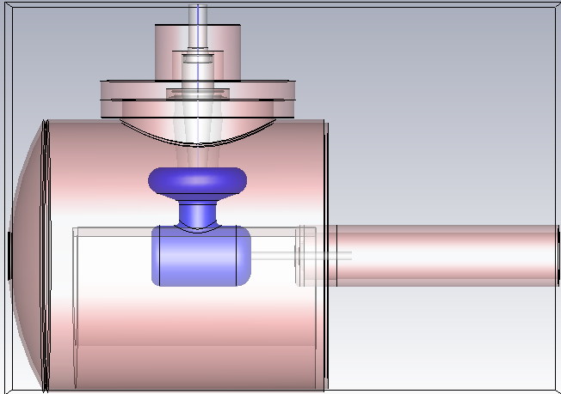
CST simulation: Potential
  Cathode electrode (including Pierce geometry), shield and high voltage cable at -200 kV.

Slide 16

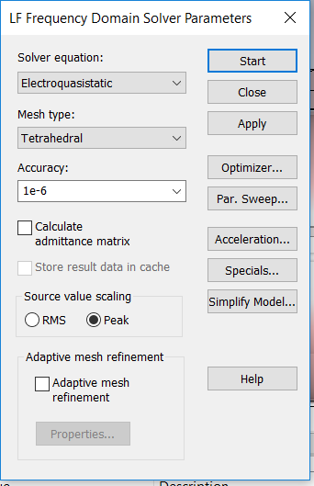
CST simulation: Solver
Used the Low frequency as suggested by Fay.
Did not use the adaptive mesh refinement this time.

Slide 17
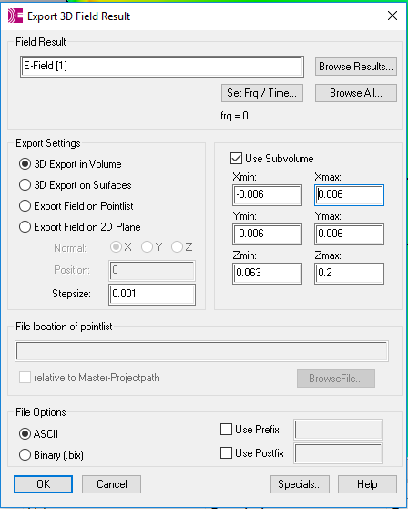
CST results:
The results for electric field magnitude and potential plotted and also presented as false color. Also produced 2D and 3D field maps for the cathode-anode gap.

Slide 18
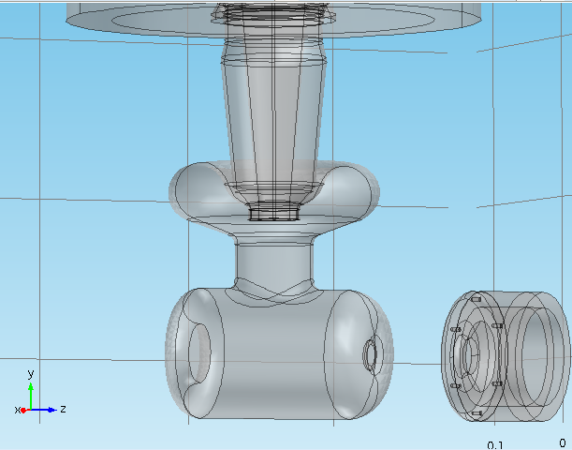
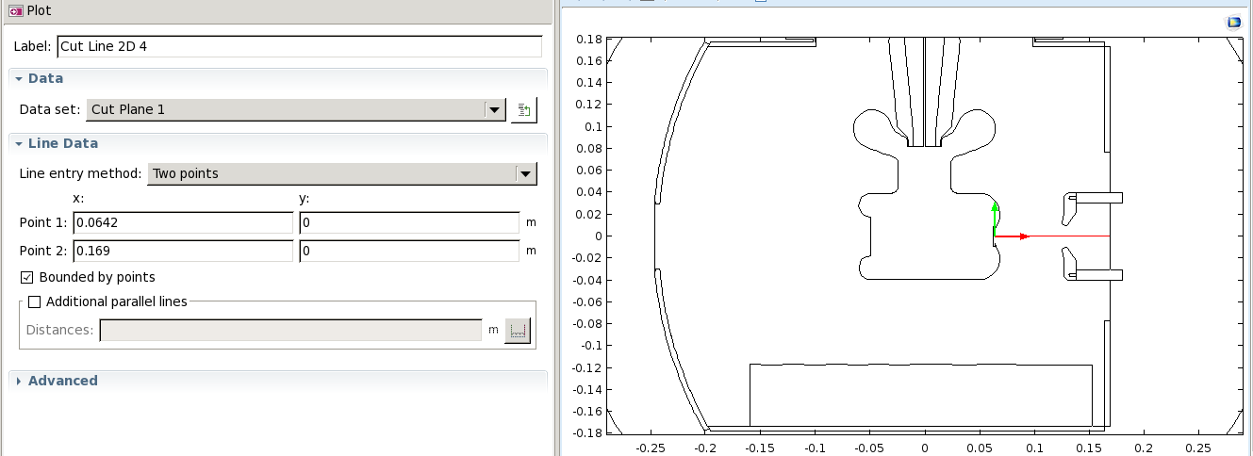
Cathode-anode gap:
The data for the following plots was taken along the cathode anode gap as a function of the height (on the photocathode surface) varying from -6mm to 6mm.

Slide 19
No shield vs Original vs Shield 1 vs Shield 2: Transversal electric field
As the Shield height is reduced, the max value in the middle region of the cathode-anode gap is reduced by 7% from 0.27 MV/m to 0.25 MV/m. The min value decreases in 50% from 0.08 MV/m to 0.04 MV/m. This min value is achieved by going upwards on the photocathode surface.

Slide 20
CST results: Transverse electric field – No shield
The gray data set is the whole field map. The different colors show how the transverse electric field changes as a function of height on the photocathode in the interval -6mm<y<6mm
119% difference between 0.21 and -0.04

Slide 21
CST results: Transverse electric field – original shield
The gray data set is the whole field map. The different colors show how the transverse electric field changes as a function of height on the photocathode in the interval -6mm<y<6mm
70% difference between 0.27 and 0.08

Slide 22
CST results: Transverse electric field – Shield 1
The gray data set is the whole field map. The different colors show how the transverse electric field changes as a function of height on the photocathode in the interval -6mm<y<6mm
74% difference between 0.27 and 0.07

Slide 23
CST results: Transverse electric field – Shield 2
The gray data set is the whole field map. The different colors show how the transverse electric field changes as a function of height on the photocathode in the interval -6mm<y<6mm
84% difference between 0.25 and 0.04

Slide 24
No shield vs Original vs Shield 3 vs Shield 4 : Transversal electric field
As the Shield radius is reduced, the max value in the middle region of the cathode-anode gap is also reduced around 4% from 0.27 MV/m to 0.26 MV/m. The min value decreases in 37.5% from 0.08 MV/m to 0.05 MV/m. This min value is again achieved by going upwards on the photocathode surface.

Slide 25
CST results: Transverse electric field – No shield
The gray data set is the whole field map. The different colors show how the transverse electric field changes as a function of height on the photocathode in the interval -6mm<y<6mm
119% difference between 0.21 and -0.04

Slide 26
CST results: Transverse electric field – original shield
The gray data set is the whole field map. The different colors show how the transverse electric field changes as a function of height on the photocathode in the interval -6mm<y<6mm
70% difference between 0.27 and 0.08

Slide 27
CST results: Transverse electric field – Shield 3
The gray data set is the whole field map. The different colors show how the transverse electric field changes as a function of height on the photocathode in the interval -6mm<y<6mm
77% difference between 0.26 and 0.06

Slide 28
CST results: Transverse electric field – Shield 4
The gray data set is the whole field map. The different colors show how the transverse electric field changes as a function of height on the photocathode in the interval -6mm<y<6mm
78% difference between 0.26 and 0.05

Slide 29
CST results: Transverse electric field – No shield vs Original vs all shields (1,2,3 & 4) at C-a gap center line
All the data sets correspond to the center line in the cathode-anode gap. Different colors represent different shields.
~12% difference between 0.17 and 0.15
~53% difference between 0.17 and 0.08

Slide 30
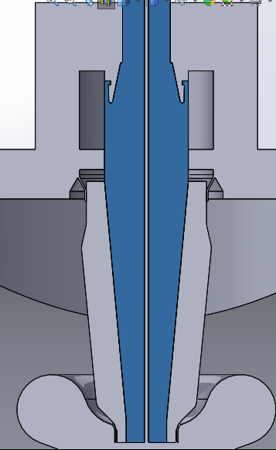
CST results: Transverse electric field – No shield vs Original vs all shields (1,2,3 & 4) at insulator interface
The potential and electric fields along the rubber plug – ceramic insulator interface was obtained (as shown in the image as a red dotted line), plotted as a function of the height (y-coordinate).

Slide 31
CST results: Transverse electric field – No shield vs Original vs all shields (1,2,3 & 4) at insulator interface
Different colors represent different shields.
38% difference between 0.8 and 1.3
65% difference between 0.8 and 2.3

Slide 32
CST results: Transverse electric field – No shield vs Original vs shields 1&2 at insulator interface
Different colors represent different shields.
38% difference between 0.8 and 1.3
38% difference between 0.8 and 1.3

Slide 33
CST results: Transverse electric field – No shield vs Original vs shields 3&4 at insulator interface
Different colors represent different shields.
11% difference between 0.8 and 0.9
65% difference between 0.8 and 2.3

Slide 34
CST results: Longitudinal electric field – No shield vs Original vs all shields (1,2,3 & 4) at insulator interface
Different colors represent different shields.
WT?

Slide 35
CST results: Longitudinal electric field – No shield vs Original vs shields 1&2 at insulator interface
Different colors represent different shields.
WT?

Slide 36
CST results: Longitudinal electric field – No shield vs Original vs shields 3&4 at insulator interface
Different colors represent different shields.
WT?

Slide 37
CST results: Potential – No shield vs Original vs all shields (1,2,3 & 4) at insulator interface
Different colors represent different shields.
20% difference between 123 and 153

Slide 38
CST results: Potential – No shield vs Original vs shields 1&2 at insulator interface
Different colors represent different shields.
9% difference between 139 and 153

Slide 39
CST results: Potential – No shield vs Original vs shields 3&4 at insulator interface
Different colors represent different shields.
2% difference between 149 and 153

Slide 40
No shield vs Original vs all Shields (1,2,3 & 4): Longitudinal electric field at c-a gap
You can notice the variation on the longitudinal electric field in the cathode-anode gap is minimal, due to a change of radius or a change in the shield height. The largest difference is around the z= 0.075 m, and its of ~3%. Similarly around z=0.12 m.

Slide 41
CST results: Longitudinal electric field – No shield
The gray data set is the whole field map. The different colors show how the longitudinal electric field changes as a function of height on the photocathode in the interval -6mm<y<6mm

Slide 42
CST results: Longitudinal electric field – original shield
The gray data set is the whole field map. The different colors show how the longitudinal electric field changes as a function of height on the photocathode in the interval -6mm<y<6mm

Slide 43
CST results: Longitudinal electric field – Shield 1
The gray data set is the whole field map. The different colors show how the longitudinal electric field changes as a function of height on the photocathode in the interval -6mm<y<6mm

Slide 44
CST results: Longitudinal electric field – Shield 2
The gray data set is the whole field map. The different colors show how the longitudinal electric field changes as a function of height on the photocathode in the interval -6mm<y<6mm

Slide 45
CST results: Longitudinal electric field – Shield 3
The gray data set is the whole field map. The different colors show how the longitudinal electric field changes as a function of height on the photocathode in the interval -6mm<y<6mm

Slide 46
CST results: Longitudinal electric field – Shield 4
The gray data set is the whole field map. The different colors show how the longitudinal electric field changes as a function of height on the photocathode in the interval -6mm<y<6mm

Slide 47
False color

Slide 48
Electric field norm: No shield vs Original vs shields 1&2

Slide 49
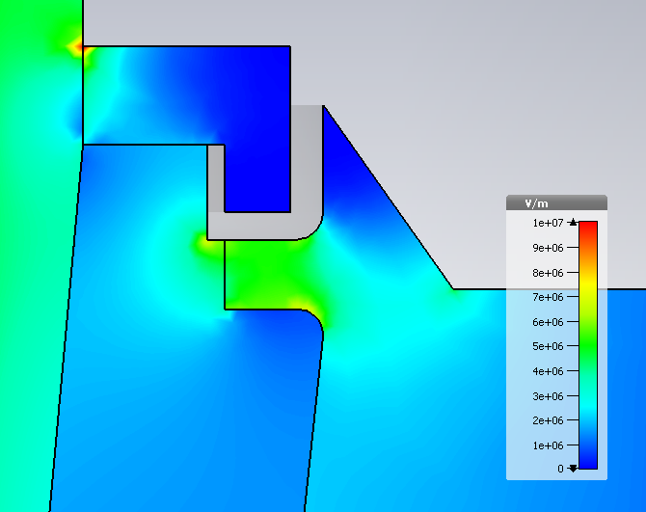
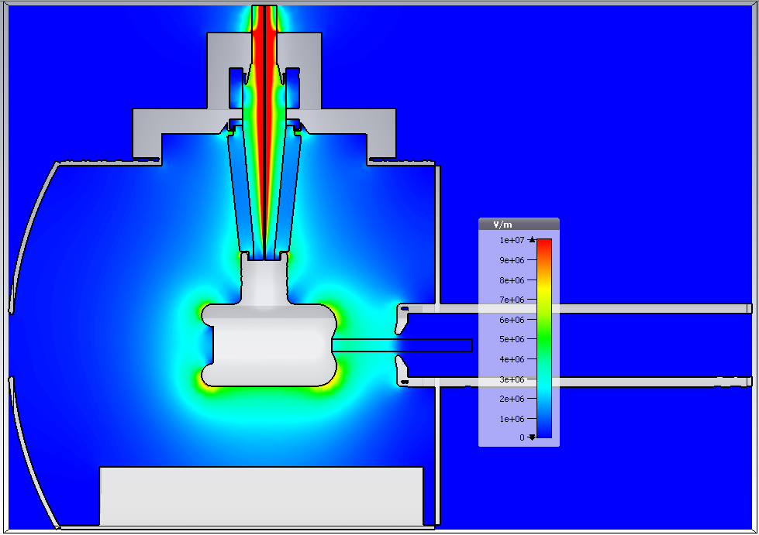
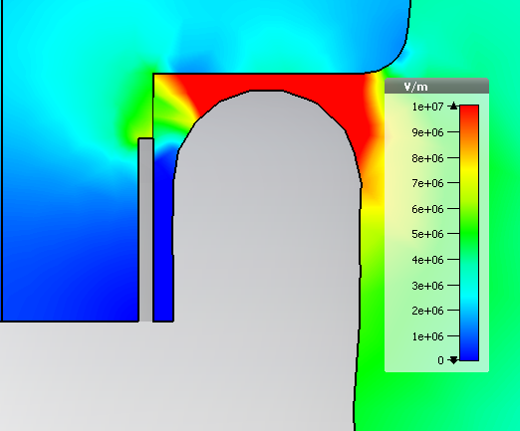
CST results: Electric field norm– No shield
Triple points:
Upper flange:5MV/m
29MV/m at cusp
Triple points:
Cathode: 3.6MV/m
6.5MV/m
7.9MV/m
4.87 MV/m

Slide 50
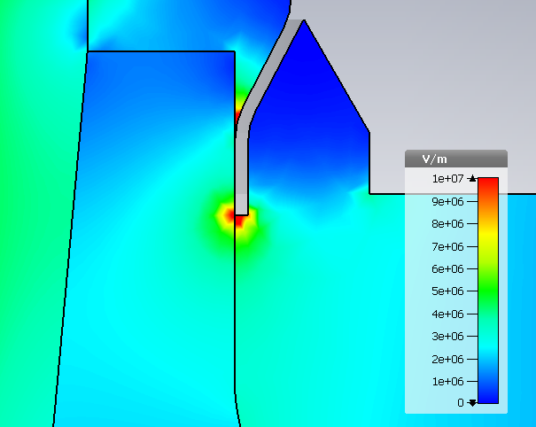
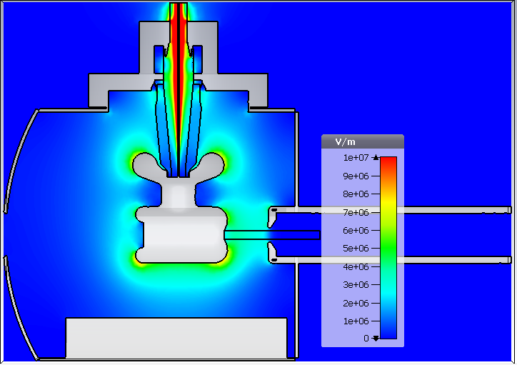
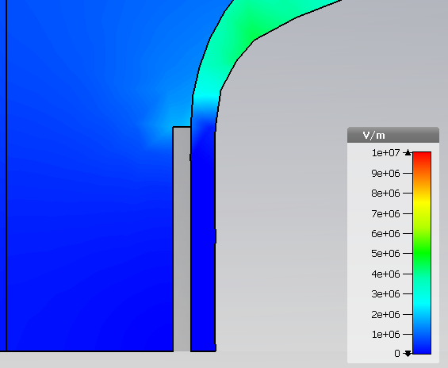
CST results: Electric field norm– original shield
Triple points:
Upper flange:10MV/m
7.2MV/m
5.6MV/m
Triple points:
Cathode: 0.6MV/m
7.9MV/m
4.85 MV/m

Slide 51
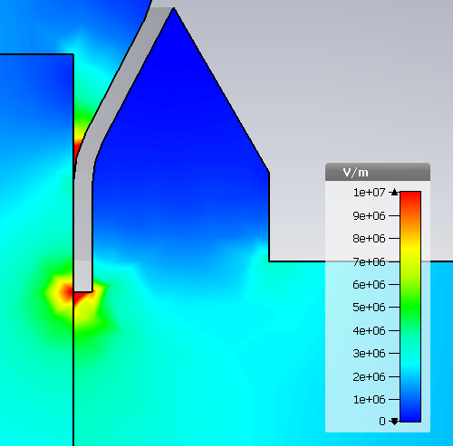
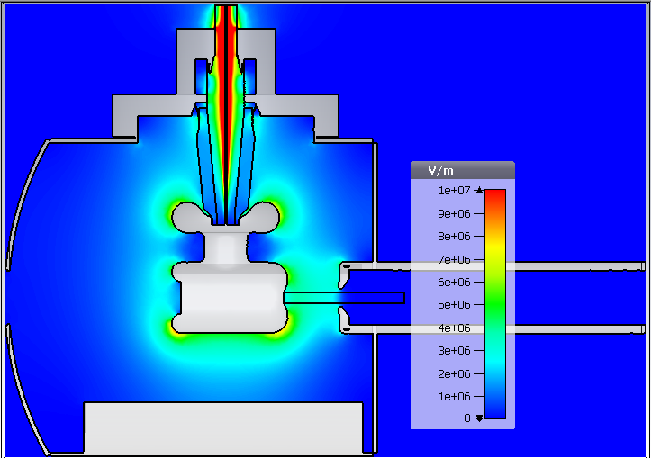
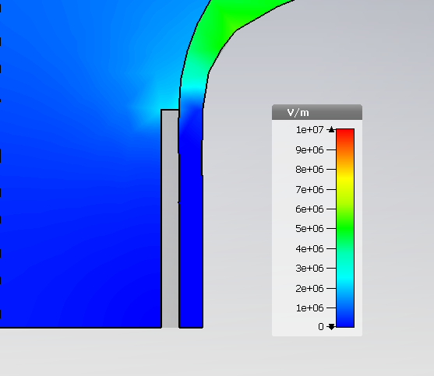
CST results: Electric field norm– Shield 1
Triple points:
Upper flange:10MV/m
7.1MV/m
5.7MV/m
Triple points:
Cathode: 0.7MV/m
7.9MV/m
4.83 MV/m

Slide 52
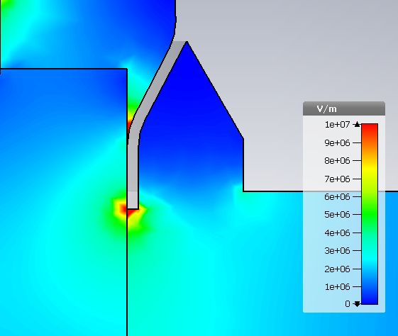
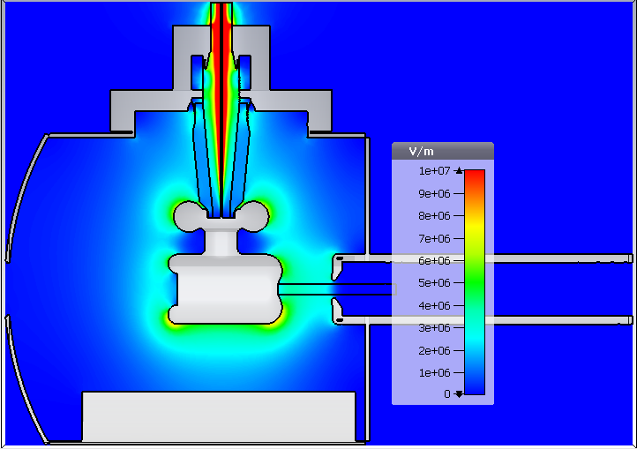
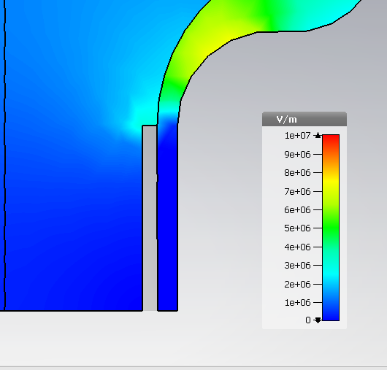
CST results: Electric field norm– Shield 2
Triple points:
Upper flange:13MV/m
6.9MV/m
6.1MV/m
Triple points:
Cathode: 0.9MV/m
8.0MV/m
4.85 MV/m

Slide 53
Electric field norm: No shield vs Original vs shields 3&4

Slide 54
CST results: Electric field norm– No shield
Triple points:
Upper flange:5MV/m
29MV/m at cusp
Triple points:
Cathode: 3.6MV/m
6.5MV/m
7.9MV/m
4.87 MV/m

Slide 55
CST results: Electric field norm– original shield
Triple points:
Upper flange:10MV/m
7.2MV/m
5.6MV/m
Triple points:
Cathode: 0.6MV/m
7.9MV/m
4.85 MV/m

Slide 56
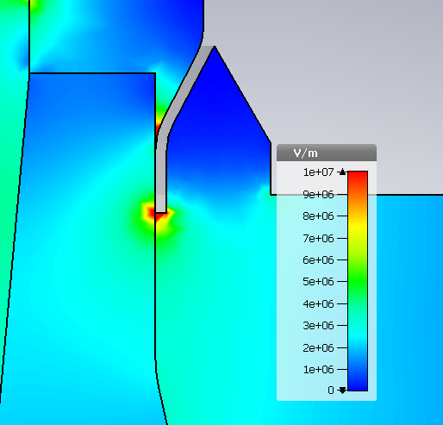
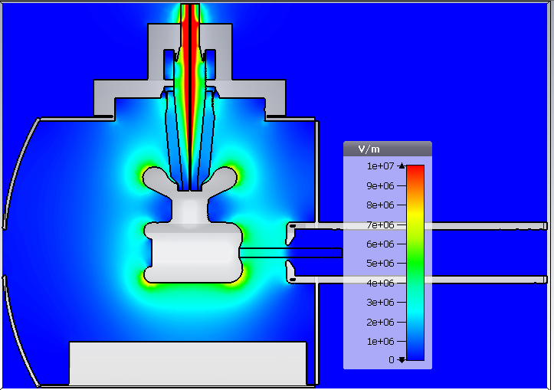
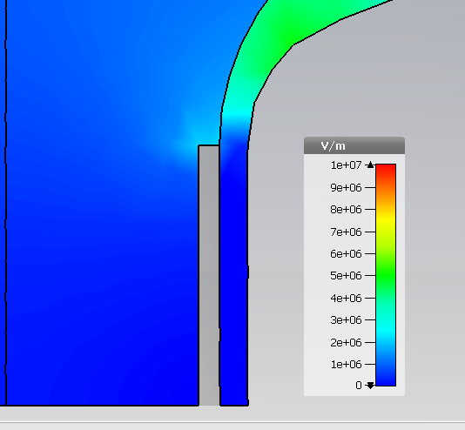
CST results: Electric field norm– Shield 3
Triple points:
Upper flange:12MV/m
7.5MV/m
5.7MV/m
Triple points:
Cathode: 0.6MV/m
7.8MV/m
4.86 MV/m

Slide 57
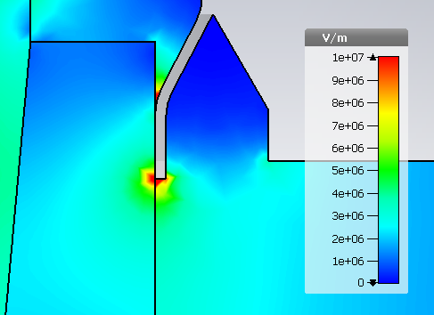

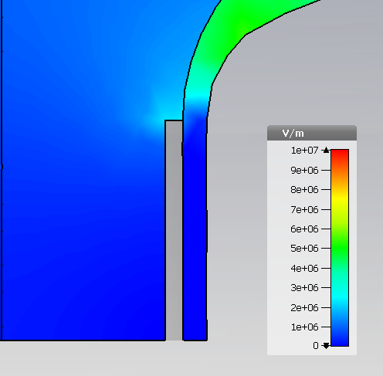
CST results: Electric field norm– Shield 4
Triple points:
Upper flange:12MV/m
8.3MV/m
5.8MV/m
Triple points:
Cathode: 0.7MV/m
7.9MV/m
4.85 MV/m

Slide 58
Electric field norm: No shield vs Original vs shields 1 vs shields 2
On the metallic surface
Pics are sadly not to scale, in all of them the cathode size is the same.

Slide 59
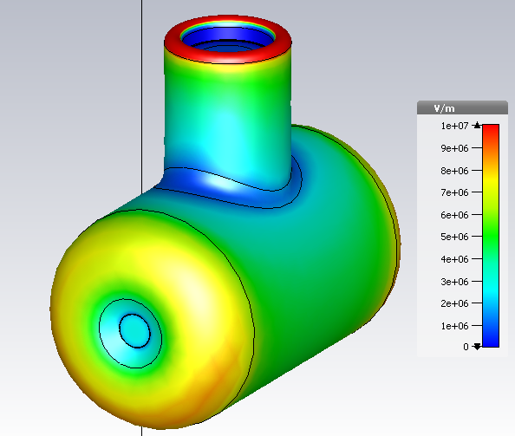
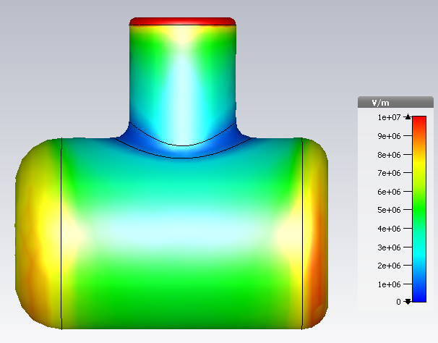
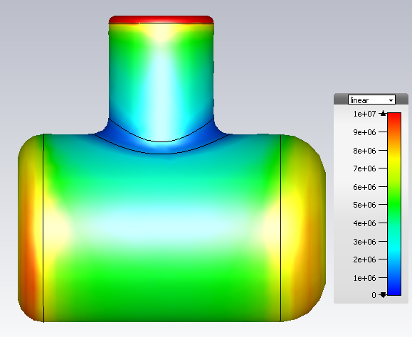
CST results: Electric field norm– No shield

Slide 60
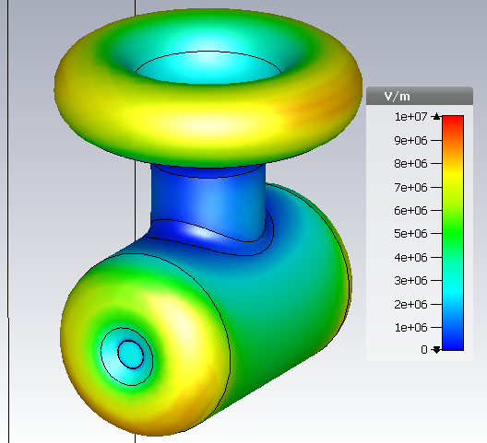
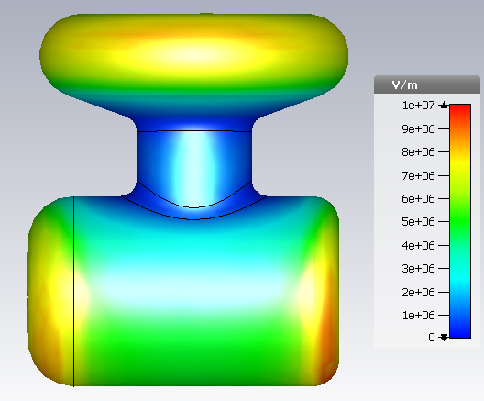
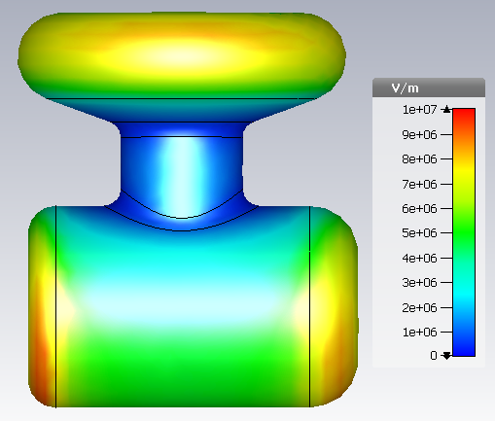
CST results: Electric field norm– Original

Slide 61



CST results: Electric field norm– Shield 1

Slide 62



CST results: Electric field norm– Shield 2

Slide 63
Electric field norm: No shield vs Original vs shields 1 vs shields 2
On the metallic surface
Pics are sadly not to scale, in all of them the cathode size is the same.

Slide 64
CST results: Electric field norm– No shield

Slide 65
CST results: Electric field norm– Original

Slide 66



CST results: Electric field norm– Shield 3

Slide 67



CST results: Electric field norm– Shield 4

Slide 68
Preliminary conclusions
Cathode anode gap
  Transverse electric field
    Original vs shield 1 & 2
      Benefit if height is reduced and we produce beam from the top of the photocathode.
    Original vs shield 3 & 4
      Benefit if radius is reduced and we produce beam from the top of the photocathode.
    Original vs shield 1,2, 3 & 4
      If beam is produced at the center of the photocathode, I would pick Shields 2 or 4.
  Longitudinal electric field
    The changing of the shields has a small impact only.
Insulator-rubber plug interface
    The transverse electric field gets worst for shield 2. The rest remain close.
    Longitudinal electric field has a discontinuity that must be revised.

Slide 69
Preliminary conclusions
Cathode contour
  Electric field norm
    Original vs shield 1 & 2
      The cusp field reduces, at cost of the fields on the Pierce geometry contour and the triple point which reaches ~ 1MV/m .
    Original vs shield 3 & 4
      The radius change increases the field at its cusp to ~8 MV/m with some impact on the Pierce geometry.
    All
      Upper flange triple point appears and remains at ~12 MV/m

Slide 70
Preliminary conclusions
In short:
  Height reduction =
    Smaller vertical “kick” at cathode-anode gap
    Worst transversal field at the insulator-rubber plug interface
    Smaller field at the cusp
    Worst field at triple point
  Cusp radius reduction =
    Smaller vertical “kick” at cathode-anode gap
    Slightly worst transversal field at the insulator-rubber plug interface
    Worst field at the cusp
    Slightly Worst field at triple point

Slide 71
Future steps
Mix between smaller radius and smaller height prototype.
Maybe correct Shield 2 since it’s a bit slimmer.

Slide 72
Fin.

Slide 73
Additional slides
Potentials false color
Transverse field false color
Longitudinal field false color

Slide 74
Potential: Original vs Shield 1 vs Shield 2

Slide 75

CST results: Potential – No shield

Slide 76

CST results: Potential – original shield

Slide 77

CST results: Potential – Shield 1

Slide 78

CST results: Potential – Shield 2

Slide 79
Potential: Original vs Shield 3 vs Shield 4

Slide 80
CST results: Potential – No shield

Slide 81
CST results: Potential – original shield

Slide 82

CST results: Potential – Shield 3

Slide 83

CST results: Potential – Shield 4

Slide 84

Transverse electric field: No shield

Slide 85

CST results: Transverse electric field – original shield

Slide 86

CST results: Transverse electric field – Shield 1

Slide 87

CST results: Transverse electric field – Shield 2

Slide 88
Transverse electric field: Original vs Shield 3 vs Shield 4

Slide 89
Transverse electric field: No shield

Slide 90
CST results: Transverse electric field – original shield

Slide 91

CST results: Transverse electric field – Shield 3

Slide 92

CST results: Transverse electric field – Shield 4

Slide 93
Longitudinal electric field: Original vs Shield 1 vs Shield 2

Slide 94

CST results: Longitudinal electric field – No shield

Slide 95

CST results: Longitudinal electric field – original shield

Slide 96

CST results: Longitudinal electric field – Shield 1

Slide 97

CST results: Longitudinal electric field – Shield 2

Slide 98
Longitudinal electric field: Original vs Shield 3 vs Shield 4

Slide 99
CST results: Longitudinal electric field – No shield

Slide 100
CST results: Longitudinal electric field – original shield

Slide 101

CST results: Longitudinal electric field – Shield 3

Slide 102

CST results: Longitudinal electric field – Shield 4

Slide 103


CST frame of reference:
y
x
z
X goes into the page.

