Slide 1
Parity Violation Experiments & Beam Requirements
Riad Suleiman
Center for Injectors and Sources
MCC Ops Training
August 05, 2009

Slide 2
Outline
Fundamental Interactions and Conservation Rules
Parity Reversal and Parity Violation
Experimental Techniques
Beam Requirements and Physics Motivation
Ops’ and Users’ Responsibilities
Summary

Slide 3
Fundamental Interaction
Interaction | Source | Field Quantum | Range (m) | Coupling | Example
Gravity | Mass | Graviton | ∞ | 0.53x10⁻³⁸ | Solar System, Black Holes
Electromagnetic (EM) | Electric Charge | Photon | ∞ | 1/137 | Friction, Lighting
Weak | Weak Charge | Bosons (W±, Z°) | 10⁻¹⁸ | 1.02x10⁻⁵ | Neutron Decay, Neutrino Interaction
Strong | Color Charge | Gluon | 10⁻¹⁵ | 1 | Proton, Nuclei
Gravity is irrelevant in elementary
particle interactions
r
Proton
Proton

Slide 4
Conservation Rules
Interaction | Energy | Momentum | Electric Charge | Time Reversal | Parity Reversal* (Spatial Inversion)
Gravity | Yes | Yes | Yes | Yes | Yes
Electromagnetic (EM) | Yes | Yes | Yes | Yes | Yes
Weak | Yes | Yes | Yes | Yes | No
Strong | Yes | Yes | Yes | Yes | Yes
* Do the laws of nature remain the same under Parity Reversal? Are an object and its mirror image the same?

Slide 5
Parity Reversal
Under Parity Reversal, the Right-handed electron becomes Left-handed electron (Helicity Reversal)
Changing the electron’s spin direction (Helicity Reversal) is equivalent to Parity Reversal
Spin
Electron
Momentum
Mirror
Right-handed Electron
(+Helicity)
Left-handed Electron
(–Helicity)

Slide 6
Parity Violation
EM interaction is the same for Right-handed and Left- handed electrons (Parity is conserved)
Weak interaction is not the same for Right-handed and Left-handed electrons: Left-handed electrons interact weakly but Right-handed do not (Parity is violated)
Electrons do not interact strongly
Particle | Electric Charge | Weak Charge
 | Right/Left | Right-handed | Left-handed
e | -1 | 0 | -½
proton | +1 | 0 | 1-4sin²θ_{W} (=0.08)
Neutron | 0 | 0 | 1

Slide 7
Experimental Techniques
How to carry out a parity violation experiment:
Scatter longitudinally polarized electrons off un-polarized target (i.e., Hydrogen, Deuterium, Helium, Lead)
Reverse the beam helicity (±) with Pockels Cell, measure detected signals (D±) and currents (I±), calculate physics asymmetry (A _{physics}):
Repeat the whole experiment: Millions of measurements
Statistical distribution of these measurements is Gaussian: Mean is average asymmetry and error is width of Gaussian divided by square root of number of asymmetry measurements
Average asymmetry is very small (1-50 ppm)
(1 drop of ink in 50 liters of water would produce an "ink concentration" of 1 ppm)
1/15th of a second

Slide 8
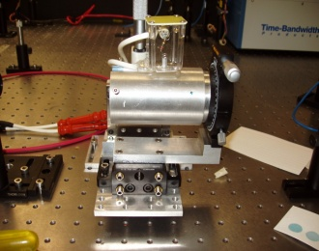
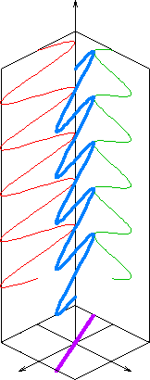
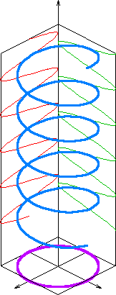
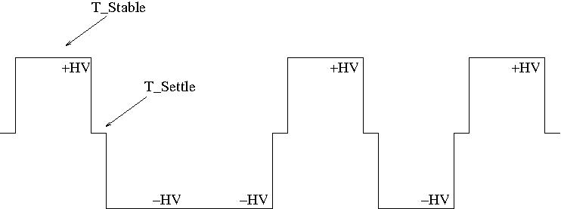
Pockels Cell
Pockels Cell is voltage controlled quarter wave plate
Changes polarization of laser from linearly-polarized light to circularly polarized light
E Field
Linearly
Polarized Light
Circularly
Polarized Light
+HV: Right-handed circularly polarized light → +Helicity electron
-HV: Left-handed circularly polarized light → -Helicity electron
Pockels Cell
HV

Slide 9
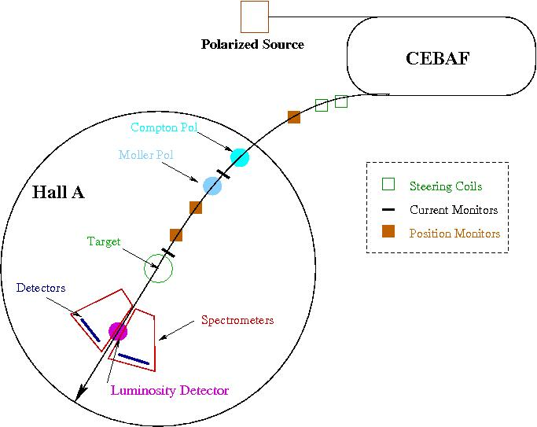
Experiment Layout

Slide 10
Charge Asymmetry and Position Difference
Charge Asymmetry: When the average current of the electron beam corresponding to one helicity state is different from the other state,
We measure charge asymmetry of order 1-50 ppm
Position Difference: When the average position of the electron beam corresponding to one helicity state is different from the other state,
We measure position differences of order 1-40 nm
(1 nm is one-billionth of a meter. The width of human hair is 50,000 nm)

Slide 11
Parity-Quality Beam (PQB)
Goal: Use the Pockels Cell at Fast Helicity Reversal to reverse only the spin direction, nothing else: All other properties of the electron beam (i.e., position, current, energy, size) must stay the same
Techniques to achieve “PQB”:
(users) Careful alignment of the Pockels Cell to minimize un-wanted changes
(ops) Slow Helicity Reversal using Insertable Half Wave Plate (IHWP) and the Two Wien to cancel un-wanted changes on the electron beam
(Reza, Yves) Injector and Accelerator Matching to achieve Adiabatic Damping of beam orbits
(users) Charge Feedback to reduce beam’s current changes using either Pockels Cell or Intensity Attenuator (IA) without or with the option to correct for Pockels Cell hysteresis
(users) Position Feedback can also be done using the helicity magnets

Slide 12
Pockels Cell Fast Helicity Reversal
We have been using 30 Hz helicity reversal:
Power line 60 Hz frequency is major source of noise in parity experiments
For 30 Hz reversal, T_Stable (= 33.333 ms) contains exactly two cycles of 60 Hz line noise → this reversal cancels line noise
However:
There are other sources of noise at low frequencies, i.e., target density fluctuations, beam current fluctuations
→ Cause larger widths of helicity correlated distributions, double-horned distributions
Solution: Use faster helicity reversal (faster than 30 Hz)

Slide 13
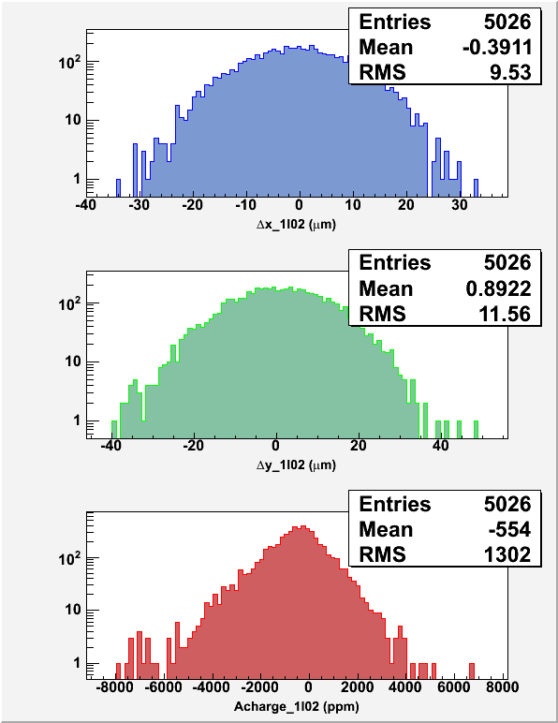
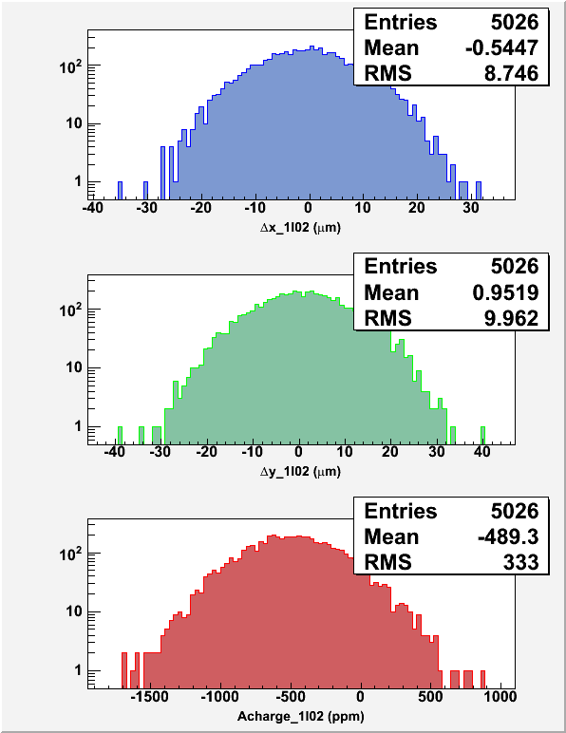
30 Hz, T_Stable = 33.333 ms, T_Settle = 500 µs
1 kHz, T_Stable = 0.980 ms, T_Settle = 60 µs

Slide 14
Summary of Fast Helicity Reversal Studies (Spring 09)
Faster Helicity Reversal is needed:
Reasonable reduction in beam position noise
Reduces noise on beam current by factor of 4
Huge reduction of noise from target density fluctuations
Achieved Pockels Cell T_Settle of 60 µs
Future Parity Experiment:
New Helicity Board to be installed in August 2009
Experiment | Frequency | Clock | Pattern
HAPPEx III & PVDIS | 30 Hz | Line-Locked | Quartet
PREx | 240 Hz | Line-Locked | Octet
QWeak | 1 kHz | Free | Quartet

Slide 15
Slow Helicity Reversal
Slow Helicity Reversal (once a day) reverses the sign of the physics asymmetry. Some false asymmetries do not change sign, thus cancel when combining the data
Insertable Half Wave Plate (IHWP) provides slow helicity reversal of laser polarization:
Cancels electronic cross talk and Pockels Cell steering
Residual linear polarization effects do not cancel
Spot size asymmetry, which we cannot measure, does not cancel
New: Slow helicity reversal of electron polarization using two Wien Filters and Solenoid:
Cancels all helicity-correlated beam asymmetries from Injector including spot size
Will be installed in Winter SAD, modify beamline from Gun to Chopper

Slide 16
IHWP Slow Helicity Reversal
E Field

Slide 17
E Field

Slide 18
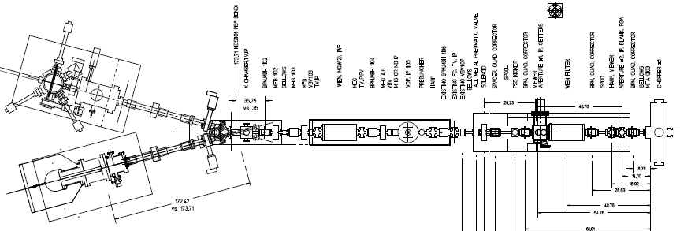
Two Wien Slow Helicity Reversal
Wien settings constant
Solenoid rotates spin by ±90° with ±B but focuses beam as B²
Maintain constant Injector and Accelerator configuration
+ Solenoid current
- Solenoid current
“Spin Flipper”
Vertical Wien = 90°
Azimuthal Solenoid = ± 90°
“Long. Pol. for Halls”
Horizontal Wien = -90° → +90°

Slide 19
Parity Beam Requirements
Experiment | Hall | Start | Energy (GeV) | Current (µA) | Target | A _{physics} (ppm) | Maximum Charge Asym (ppm) | Maximum Position Diff (nm)
HAPPEx-III | A | Aug 09 | 3.484 | 85 | ¹H (25 cm) | 16.9±0.4 | 1±1 | 10
PVDIS | A | Oct 09 | 6.068 | 85 | ²H (25 cm) | 63±3 | 1±1 | 10
PREx | A | March 10 | 1.056 | 50 | ²⁰⁸Pb (0.5 mm) | 0.500±0.015 | 0.100±0.010 | 2
QWeak | C | May 10 | 1.162 | 180 | ¹H (35 cm) | 0.234±0.005 | 0.100±0.010 | 2
Achieved |  |  |  |  |  |  | 0.4 | 1

Slide 20
Physics Motivation
HAPPEx-III: Measure weak charge distribution of strange-quark sea in proton
PVDIS: Measure weak charges of quarks
PREx: Measure weak charge distribution of neutrons in Lead (82 protons, 126 neutrons)
QWeak: Measure weak charge of proton (1-4sin²θ_{W})

Slide 21
Ops’ Responsibilities
Good transmission in Injector through A1, A2, and MS. Watch the widths of charge asymmetries (will be displayed on Wall)
Low beam halo in Compton Polarimeter
Alarm Handler:
Pockels Cell ON
Helicity Board settings
IHWP IN/OUT

Slide 22
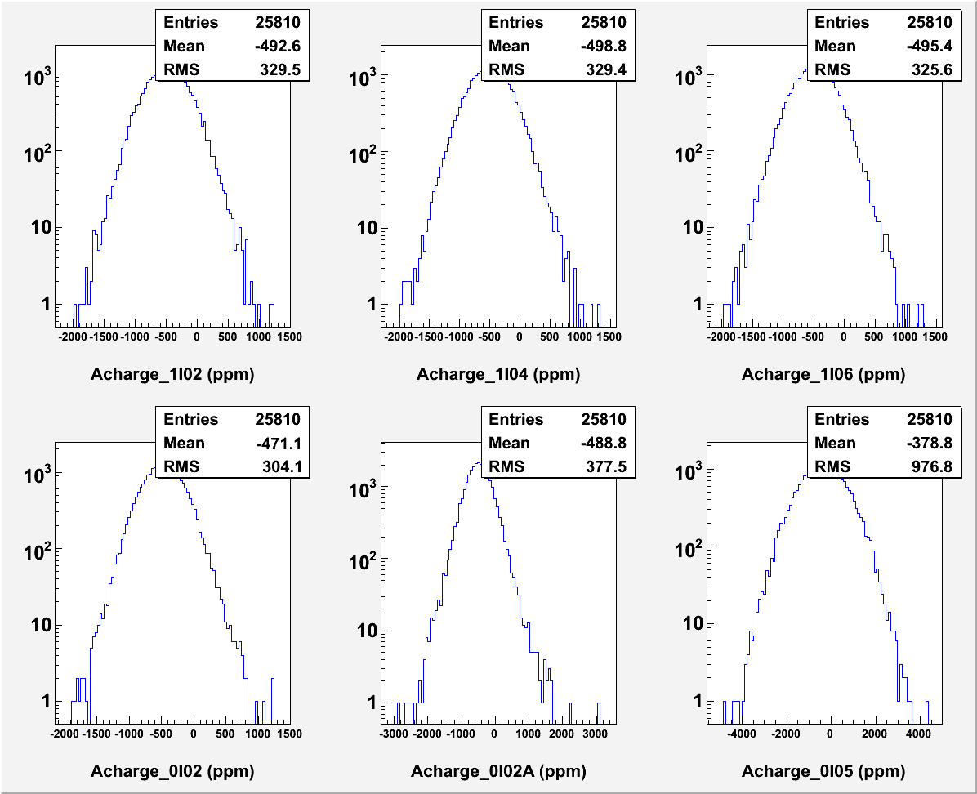
Example of bad transmission through Master Slit

Slide 23
Users’ Responsibilities
Pockels Cell alignment
Charge Feedback: Channel Access to IA or Pockels Cell Voltages. Note: Each Hall has its own IA but the Pockels Cell is common to three Halls. Hall A will also do charge feedback on Hall’s C charge asymmetry and vise versa.
Position Feedback (if needed)
Will turn off Fast Feedback (FFB) when doing Coil Modulation

Slide 24
Summary
The success of parity violation experiments depends mainly on achieving “PQB”
Jefferson Lab is an ideal place for parity violation experiments
We are getting better with many improvements in “PQB”
Looking forward for even more demanding parity violation experiments at 12 GeV

Slide 25
Backup Slides

Slide 26
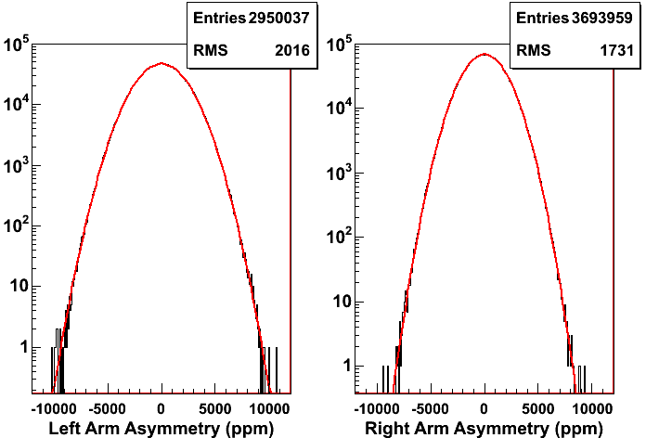
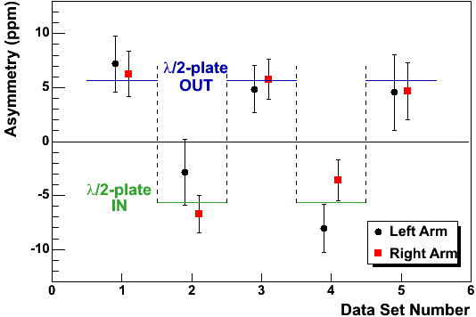
⁴He Results
Helicity Window Pair Asymmetry

