Slide 1
Conditioning resistor tank design (longer) with R30 connectors for 350kV based on John Hansknecht’s original design with R28 connectors (250kV)
Electrostatic POISSON and CST models by C.Hernandez-Garcia July-Aug 2020
SF6 breakdown curves from Malik and Qureshi IEEE Trans. Electr. Insul, Vol E1-13 No 3, June 1978

Slide 2
Model includes HV cable plugs. All fields in MV/m for 400 kV
Tank radius | Resistor (V,E) | Connector (V/E) | R30 (V,E)
6 cm | 400kV, 18 MV/m | 400kV, 22 MV/m | 58kV, 5 MV/m
16 cm design | 400kV, 10 MV/m | 400kV, 10 MV/m | 165kV, 3MV/m
26 cm | 400kV, 8.7 MV/m | 400kV, 9.3 MV/m | 185kV, 2.7 MV/m
The tank radius was designed by John to be 3 times the receptacle radius, this is the ideal ratio to minimize electric field at receptacle surface
Resistor
Connector
R30 receptacle
Tank radius

Slide 3
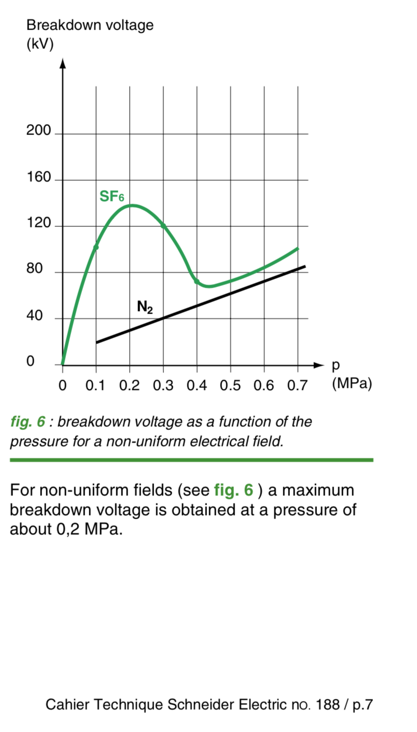
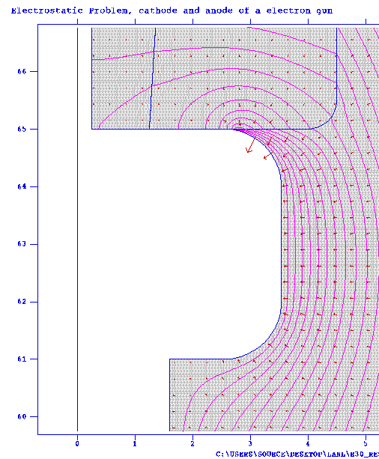
All fields in MV/m at 400 kV
Tanks are filled to 15 psig = 30 psi abs = 0.2 MPa
20
5
~135 kV
10
8
For uniform fields
184 kV/cm 18.4 MV/m @ 15 psig
153 kV/cm 15.3 MV/m @ 10 psig
8

Slide 4
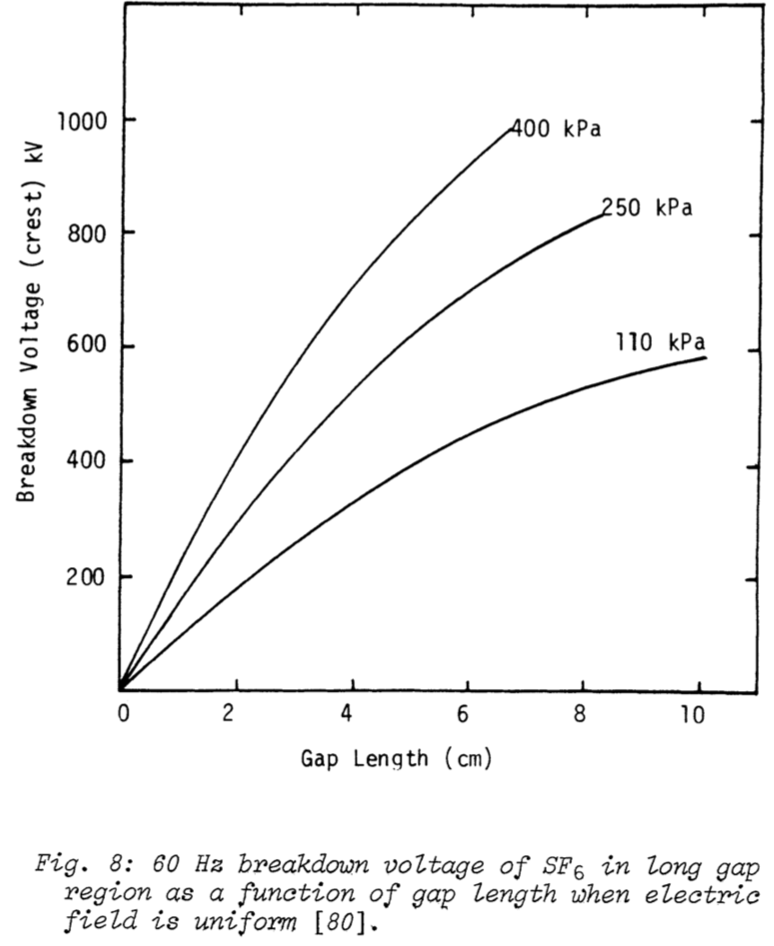
Breakdown in SF6
Malik and Qureshi in IEEE Trans. Electr. Insul. Vol E1-13, No. 3, June 1978
P = 15 psig (30 psi abs) = 206,843 Pa ~ 200 kPA
D = 16 cm – 4.5 cm = 11.5 cm
PxD = 2300 kPa cm
Breakdown = > 600 kV
P = 10 psig (25 psi abs)= 172,369 Pa ~ 172 kPA
D = 16 cm – 4.5 cm = 11.5 cm
PxD = 1978 kPa cm
Breakdown = > 600 kV

Slide 5
The resistor tank was also modeled in CST, including details with rubber plug and its central conductor, and epoxy receptacle

Slide 6
The potential was set to 400kV

Slide 7
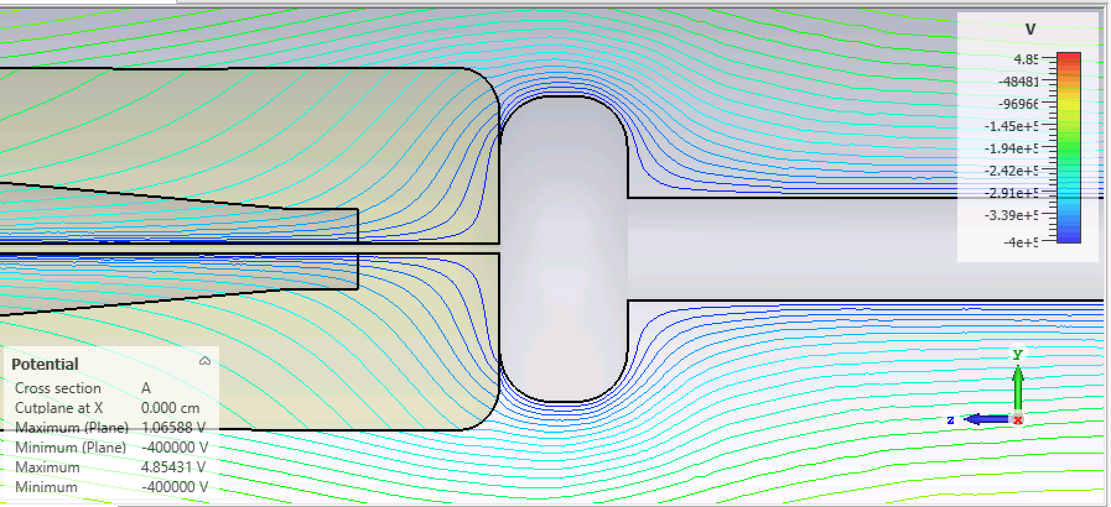
Potential from CST at 400 kV

Slide 8
The electric field absolute is shown below

Slide 9
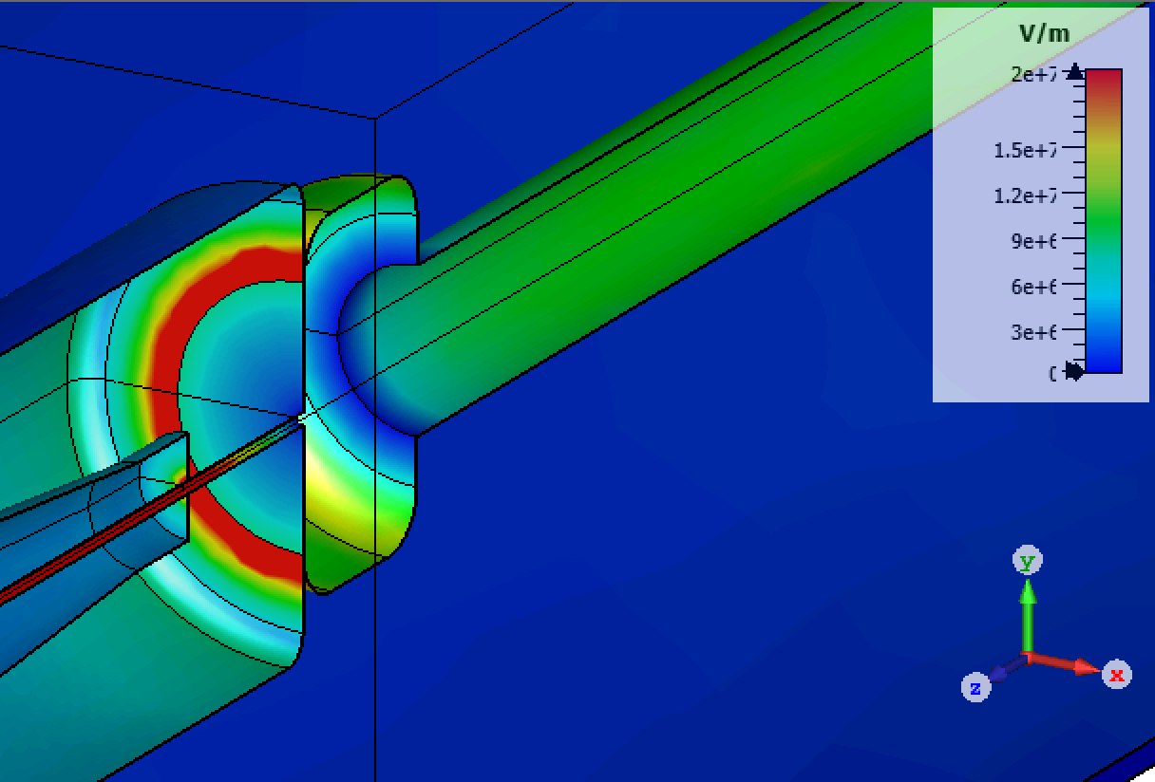
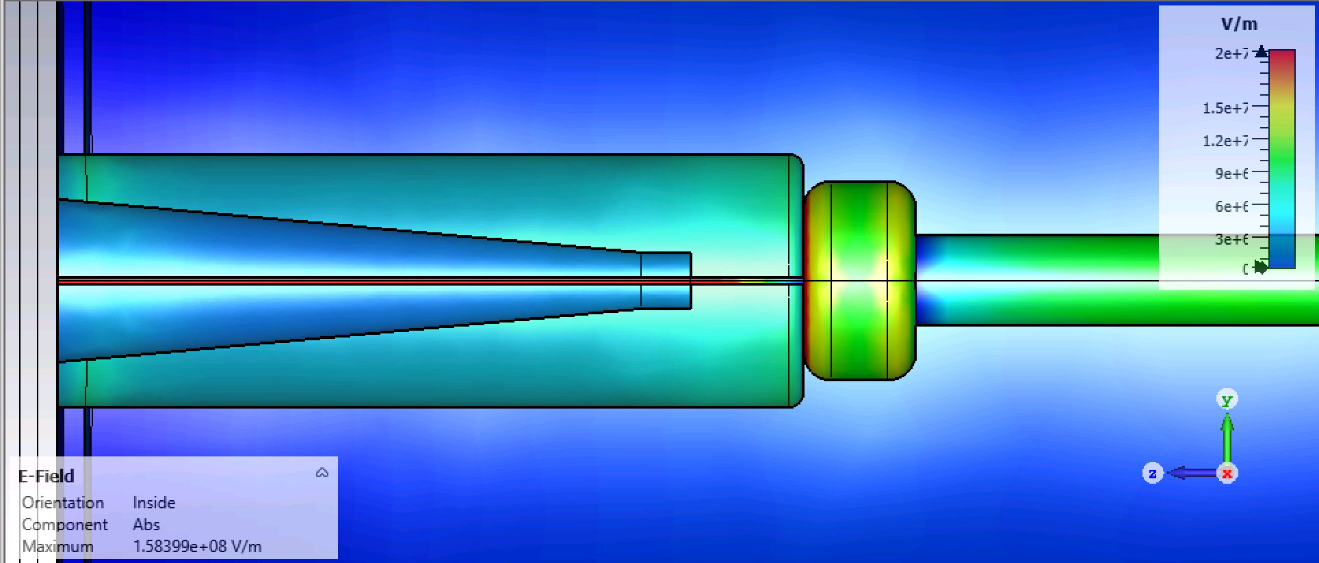
The highest gradient (not surprisingly) is at the triple point junction

Slide 10
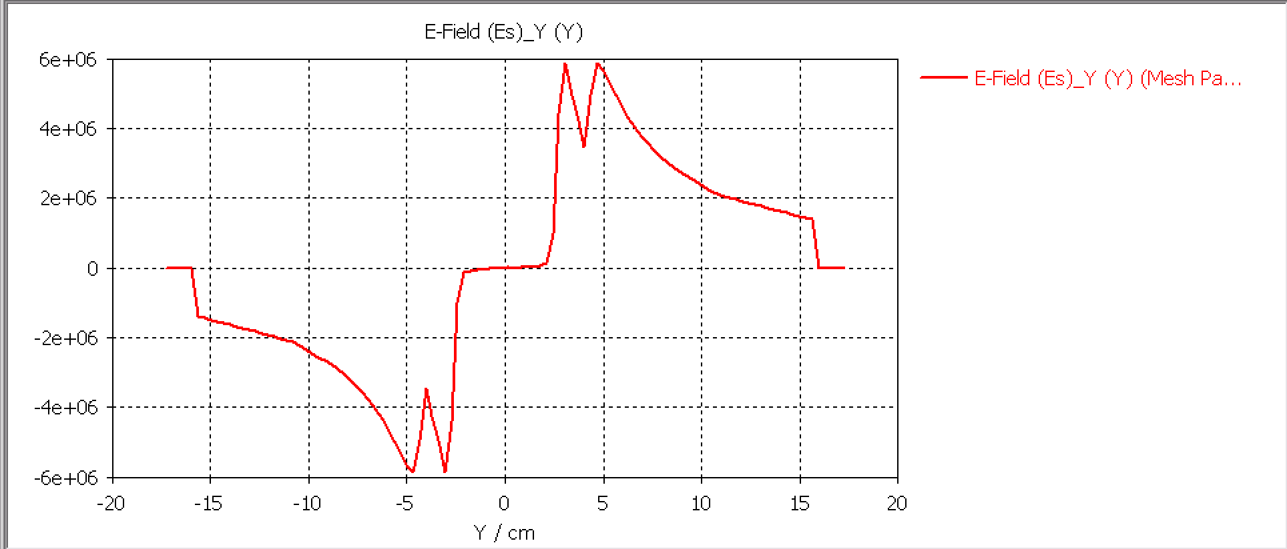
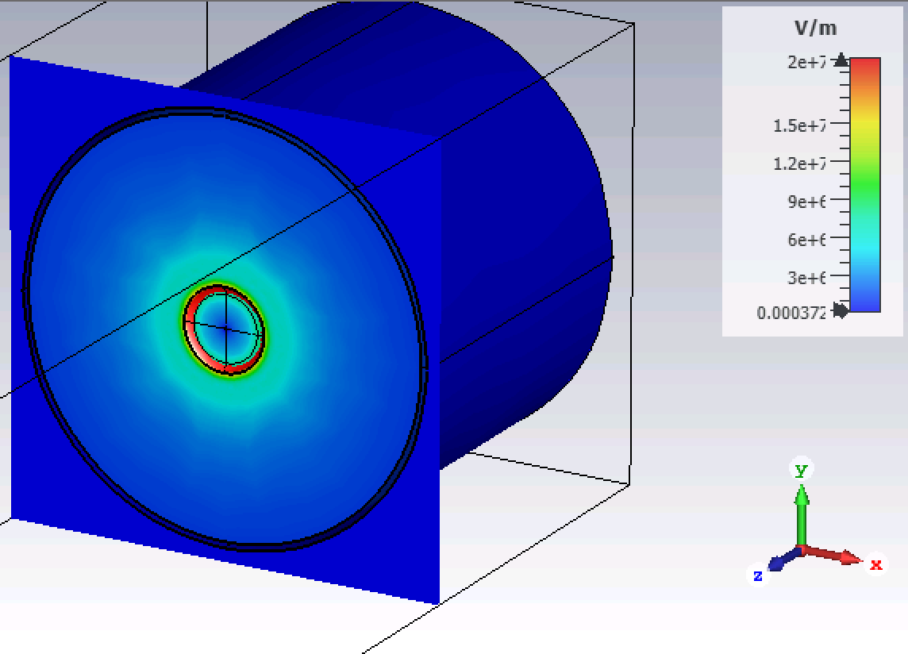
Gradient at the triple point junction in the radial direction is about 6 MV/m,
and in the longitudinal direction is 35 MV/m

Slide 11
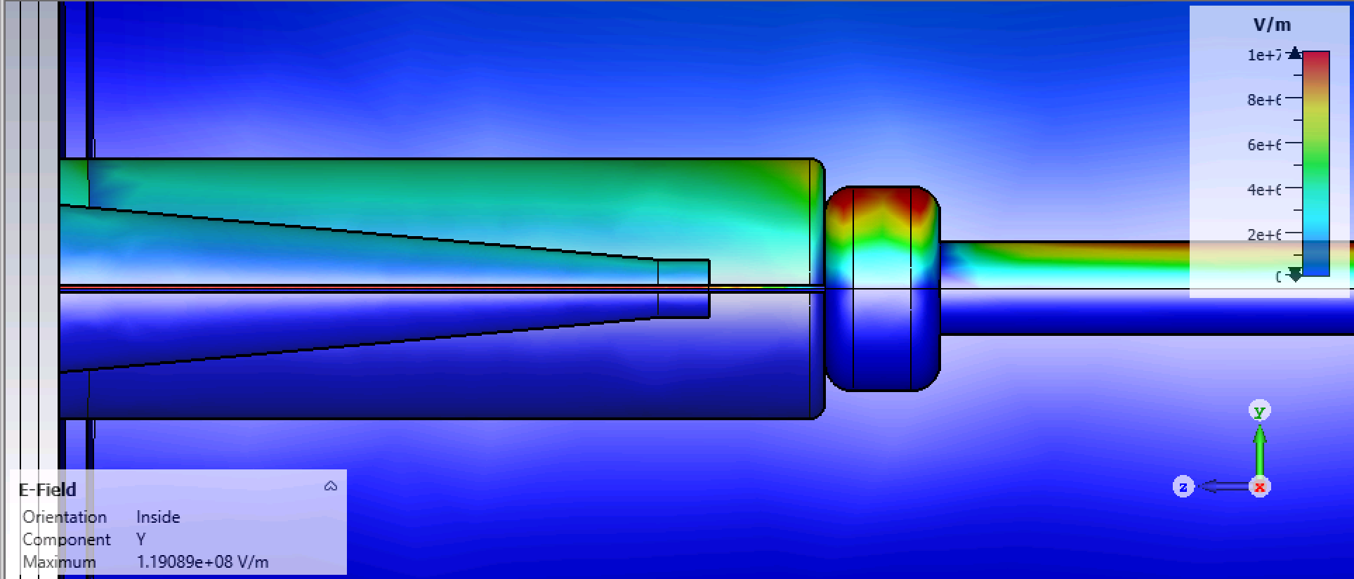
The highest field in the radial direction is on the surface of the resistor connector, 10 MV/m

Slide 12
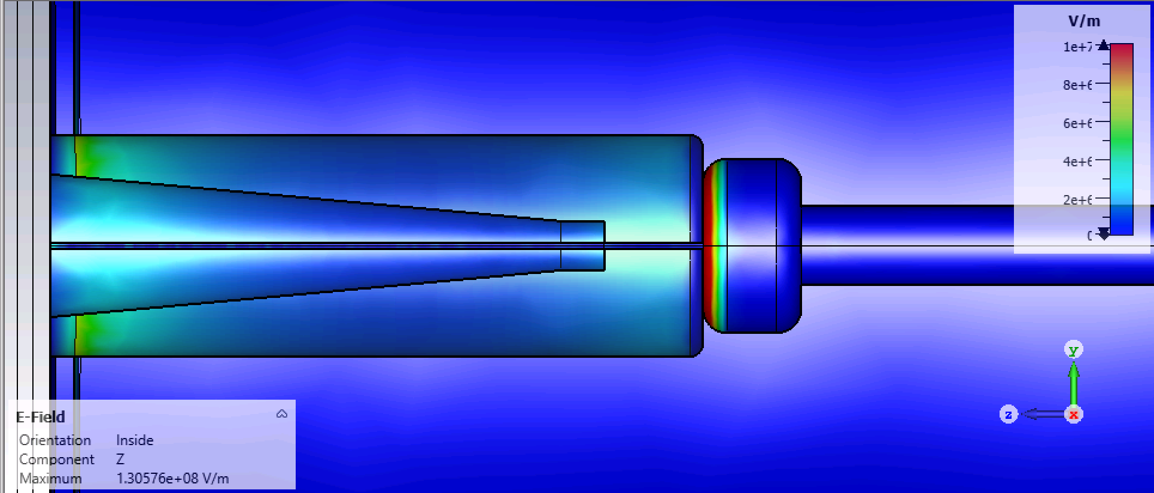
The longitudinal component of the gradient at the triple point is what triggers arcing along the epoxy receptacle,.

Slide 13
John has demonstrated this is not an issue at 400kV and 10 psig
Plugs are wet with NovaGard G661 silicone grease
Essex X-Ray R-30 Receptacles, Quantity 2 Part # S61006/C Essex X-Ray R-30 Cable, 6 feet.
https://wiki.jlab.org/ciswiki/index.php/Insulators,_Receptacle_connectors_and_cables:_drawings_and_inventories - HIGH_VOLTAGE_TESTS
Test start date 5-9-2012 Log entries in FGTS log (entries 1783796 and later) This test is presently ongoing.
“We have reached 400kV and it has been holding for many days. “ J. Hansknecth
07/14/20 Carlos got feedback from Jerry Goldlust (Dielectric Sciencies):
“The R30 receptacle and cable, at 10 psig are fine at 300 KVDC , with proper shielding of the triple point. Cutting ridges in the insulator should enhance the rating but not by much because of the non-linearity of the charge on the surface. As regards the cable plug itself, we have had the plug to 450 KVDC for ½ hour (with the receptacle in 20 psig of SF6).”

Slide 14
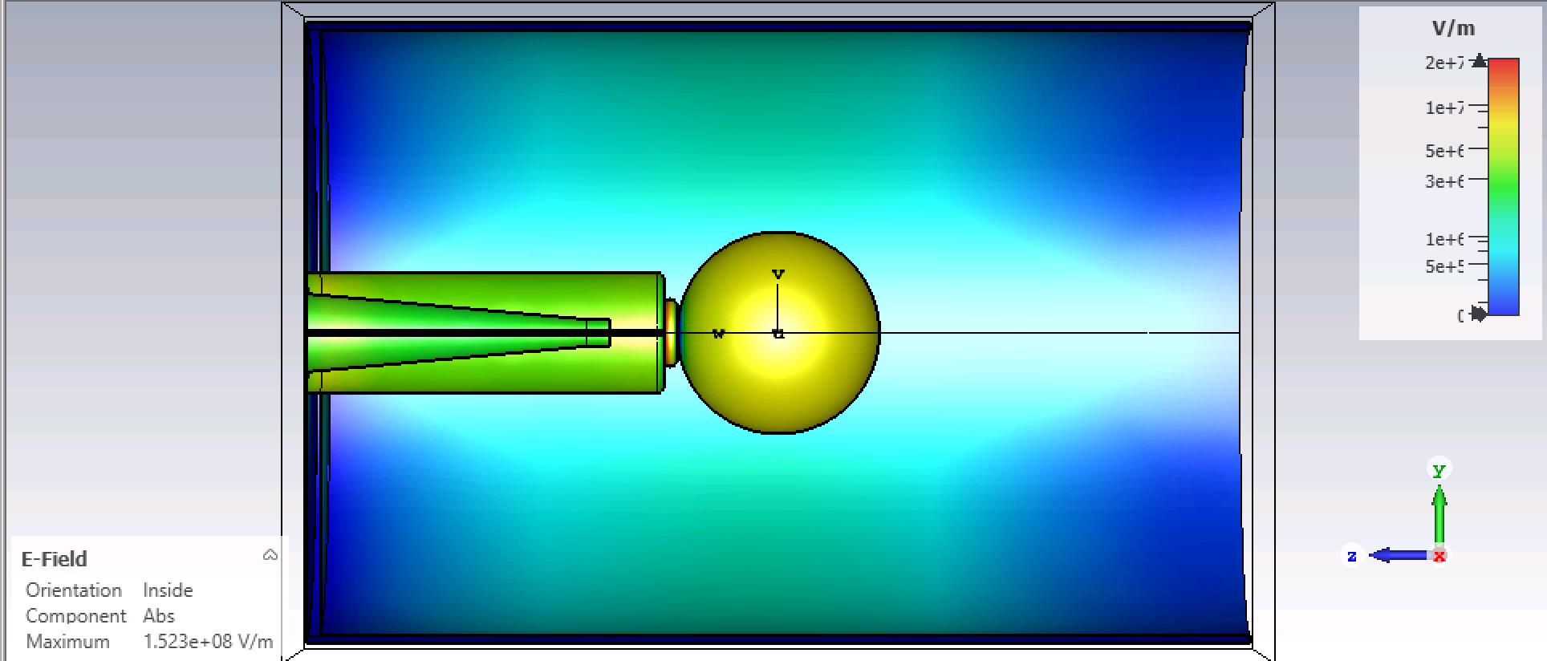
We modeled John’s test setup in CST

Slide 15
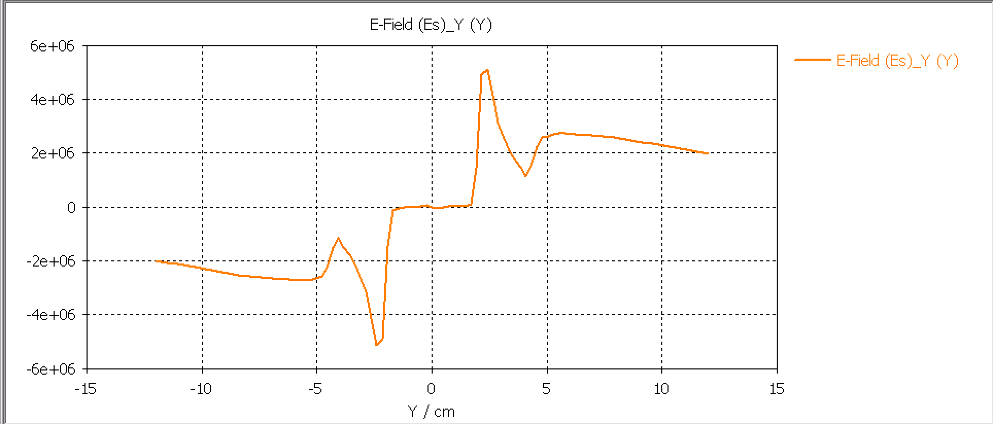
The models shows the gradient at the triple junction is lower than in the resistor tank, likely because the ball serves as a shield

Slide 16
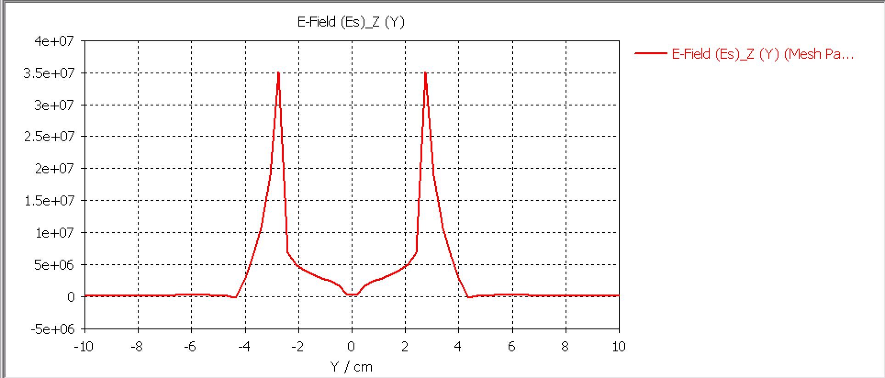
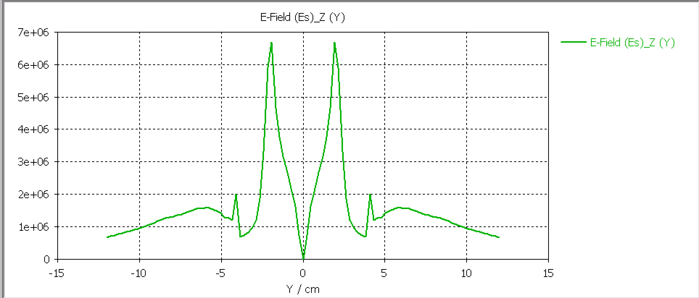
This is the longitudinal field comparison between the resistor tank and the ball test triple junction both at 400kV

