Slide 1
200 kV gun CST microwave studio simulations
Shield modifications
Gabriel Palacios
gabrielp@jlab.org
07/23/18

Slide 2
Summary
Solidworks
  Geometry modifications: 4 new shield proposals.
    Shields 1 and 2 have decreasing height
    Shields 3 and 4 have decreasing radius
CST
  Details of simulation
  Electric field and potential plots and false color images
Additional slides

Slide 3
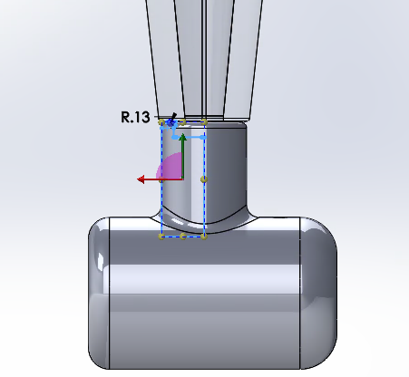
Solidworks geometry modifications: No shield

Slide 4
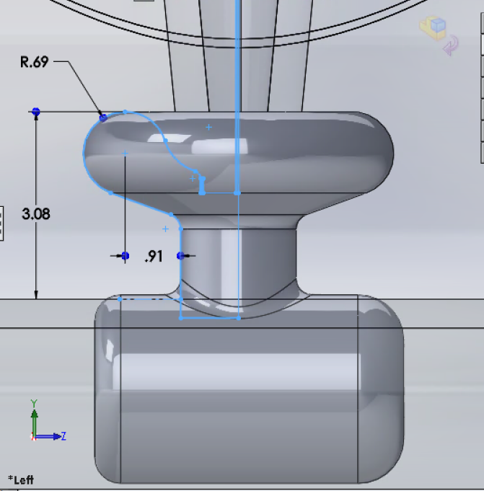
Solidworks geometry modifications: Original

Slide 5
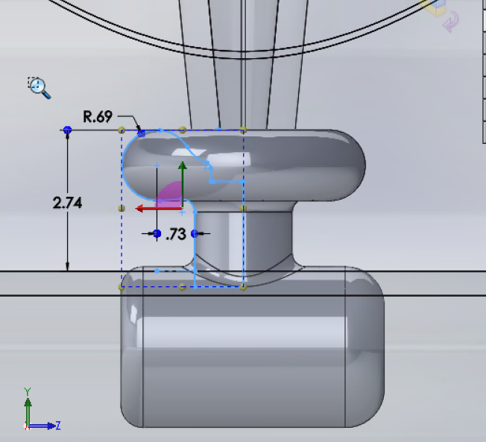
Solidworks geometry modifications: Shield 1

Slide 6
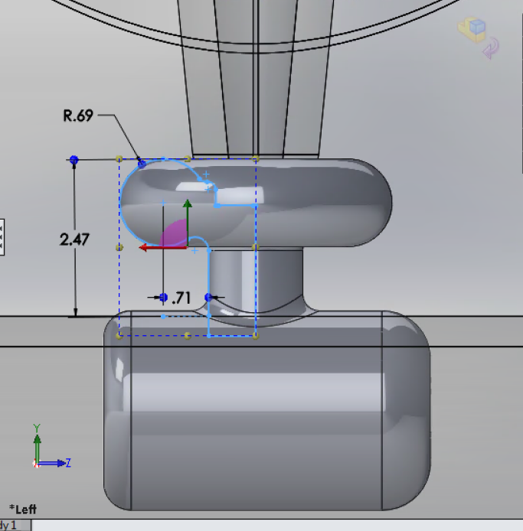
Solidworks geometry modifications: Shield 2

Slide 7
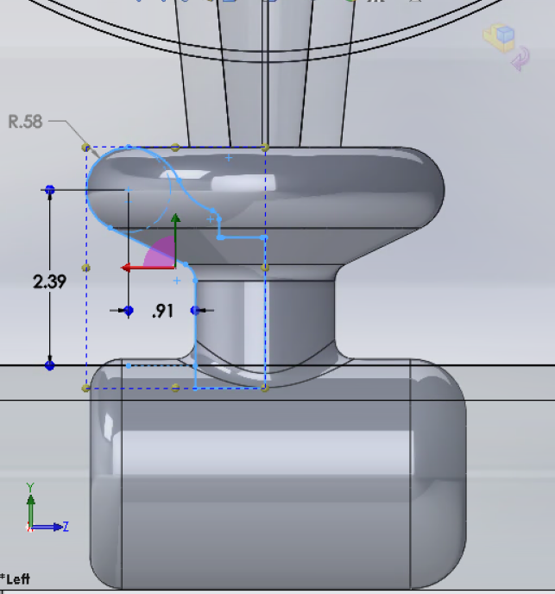
Solidworks geometry modifications: Shield 3

Slide 8
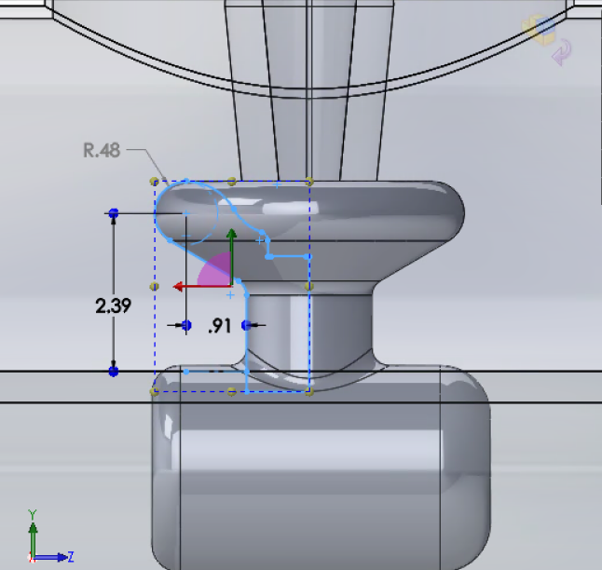
Solidworks geometry modifications: Shield 4

Slide 9
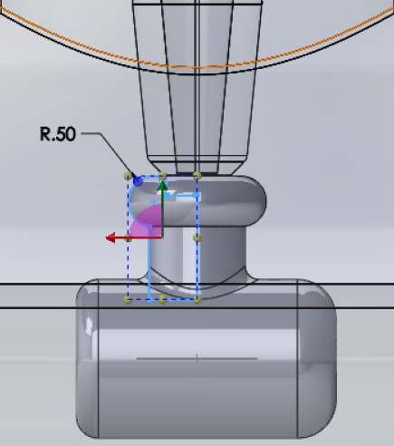
Solidworks geometry modifications: Shield 5

Slide 10
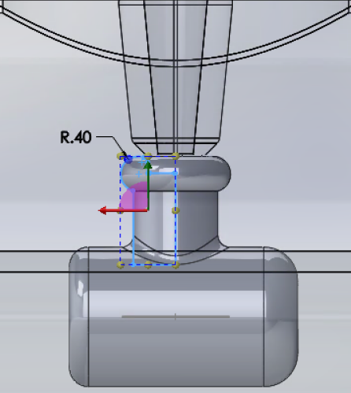
Solidworks geometry modifications: Shield 6

Slide 11
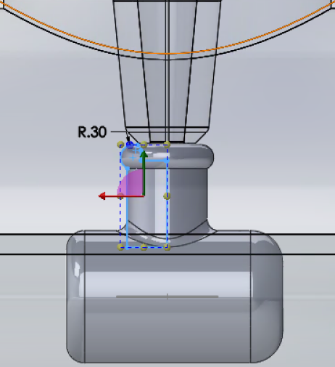
Solidworks geometry modifications: Shield 7

Slide 12
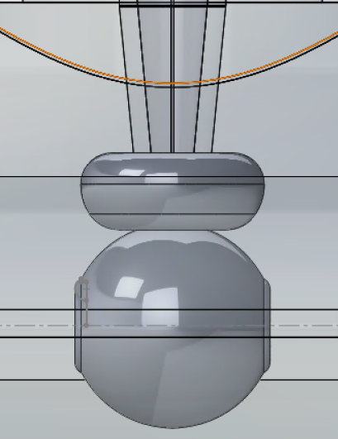
Solidworks geometry modifications: GTS with small anode
EXTRA!

Slide 13

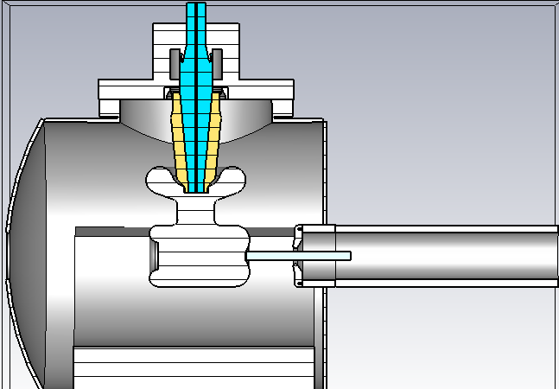
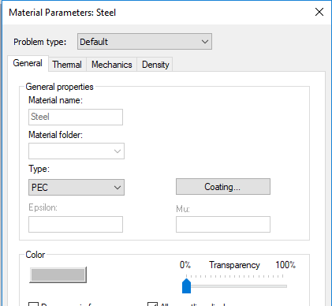
CST materials: PEC
Steel for all metal components with Perfect electric conductor (PEC). Since this is a preset we don’t need to define anything. Also, Thermal, Mechanical and Density properties are not included in the calculation.

Slide 14
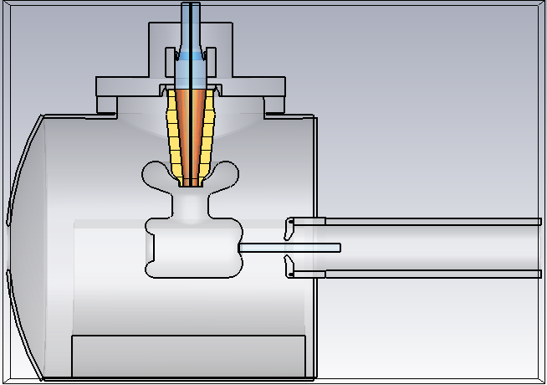
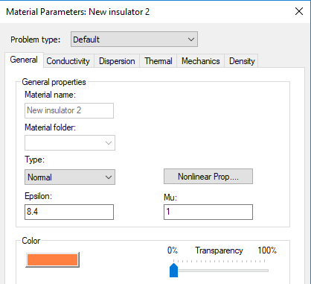
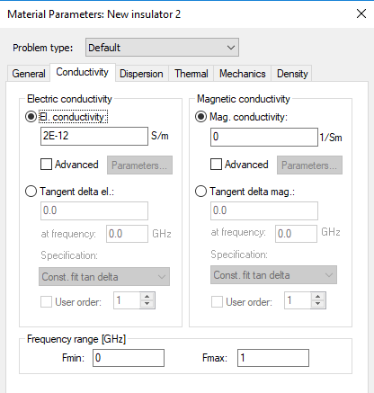
CST materials: Insulator
For black alumina I used the same parameters as in COMSOL.
ε=8.4
σ=2E-12 [S/m]

Slide 15
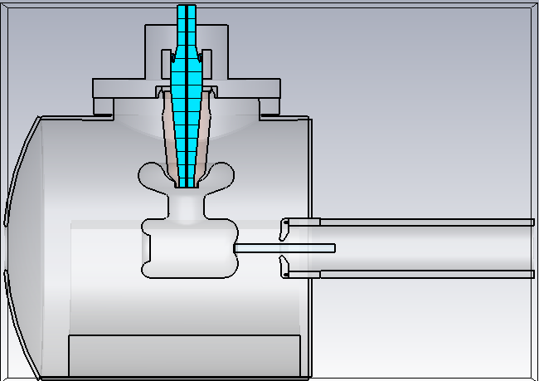
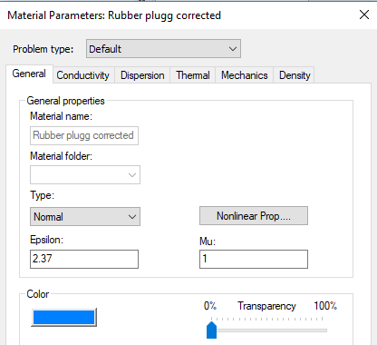
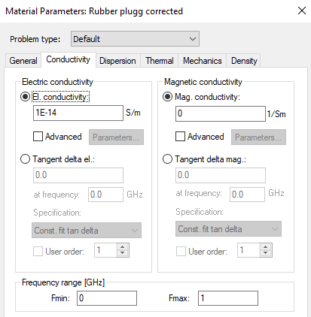
CST materials: Insulator
For rubber I used the same parameters as in COMSOL.
ε=2.37
σ=1E-14 [S/m]

Slide 16
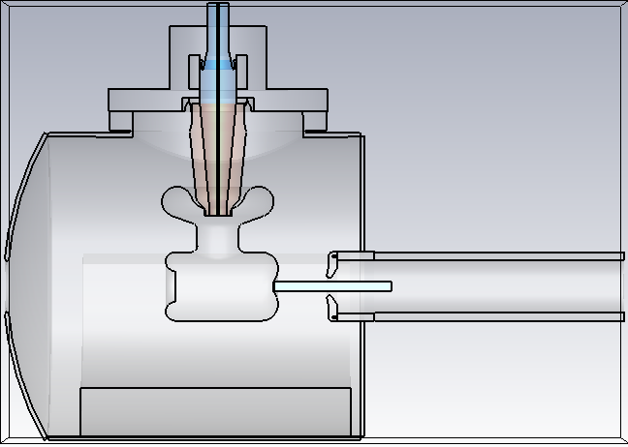
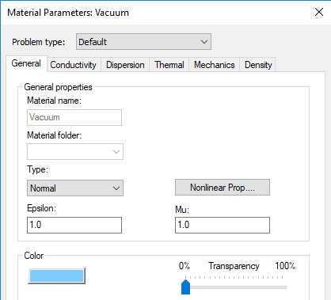
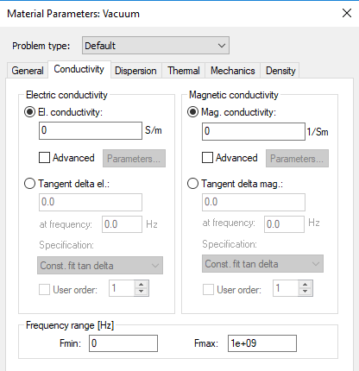
CST materials: vacuum
For vacuum cylinder and surroundings.
ε=1.0
σ=0 [S/m]

Slide 17
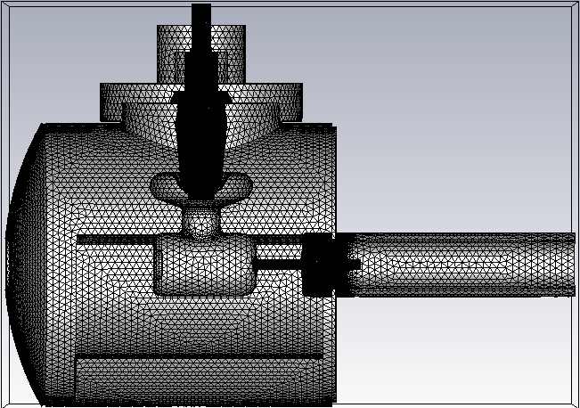
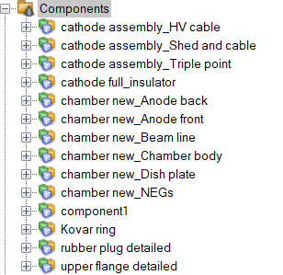
CST mesh:
The mesh was separated into (maybe too many) pieces. :P
The important part is, I only set some individual parts that require fine detail and left the rest to be auto-meshed.

Slide 18

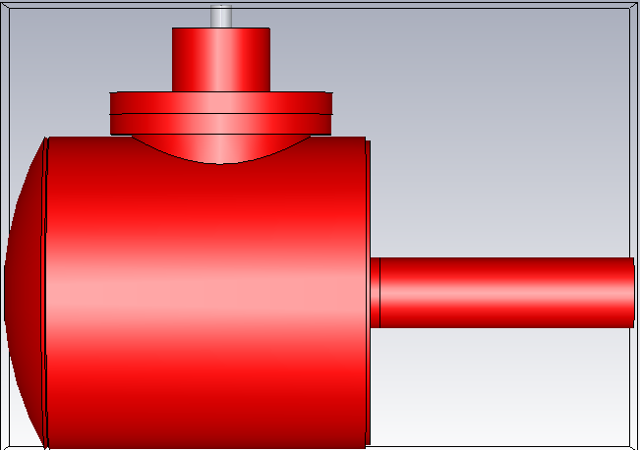
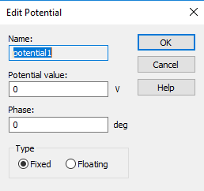
CST simulation: Potential
  Chamber, upper flange, Kovar ring, anode and beam-pipe at 0 V.

Slide 19
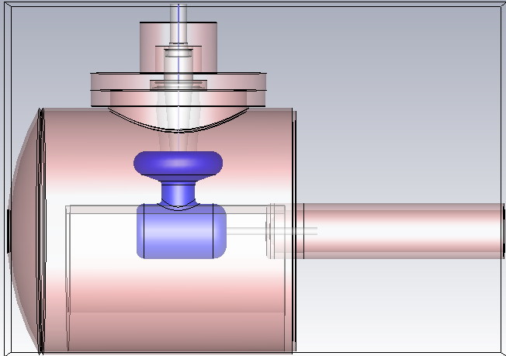
CST simulation: Potential
  Cathode electrode (including Pierce geometry), shield and high voltage cable at -200 kV.

Slide 20

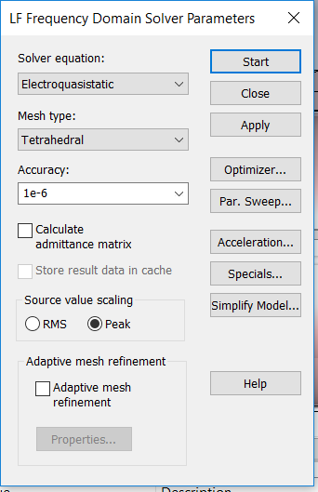
CST simulation: Solver
Used the Low frequency as suggested by Fay.
Did not use the adaptive mesh refinement this time.

Slide 21
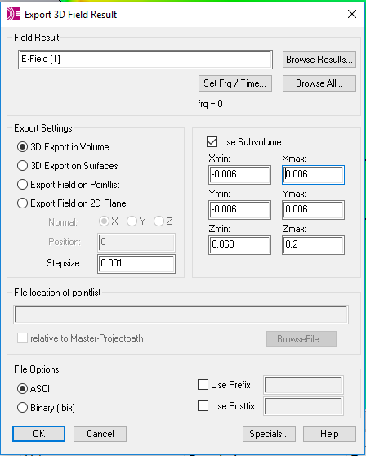
CST results:
The results for electric field magnitude and potential plotted and also presented as false color. Also produced 2D and 3D field maps for the cathode-anode gap.

Slide 22
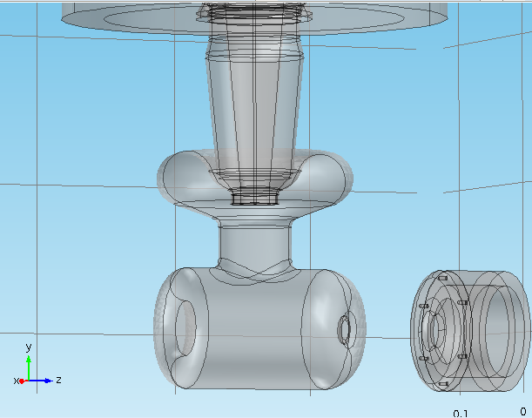
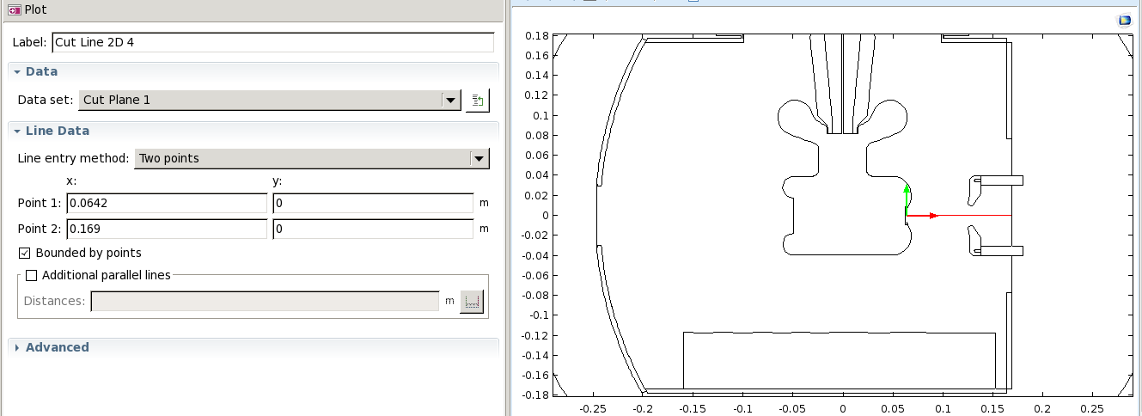
Cathode-anode gap:
The data for the following plots was taken along the cathode anode gap as a function of the height (on the photocathode surface) varying from -6mm to 6mm.

Slide 23
No shield vs Original vs Shield 1 vs Shield 2: Transversal electric field
As the Shield height is reduced, the max value in the middle region of the cathode-anode gap is reduced by 7% from 0.27 MV/m to 0.25 MV/m. The min value decreases in 50% from 0.08 MV/m to 0.04 MV/m. This min value is achieved by going upwards on the photocathode surface.

Slide 24
CST results: Transverse electric field – No shield
The gray data set is the whole field map. The different colors show how the transverse electric field changes as a function of height on the photocathode in the interval -6mm<y<6mm
119% difference between 0.21 and -0.04

Slide 25
CST results: Transverse electric field – original shield
The gray data set is the whole field map. The different colors show how the transverse electric field changes as a function of height on the photocathode in the interval -6mm<y<6mm
70% difference between 0.27 and 0.08

Slide 26
CST results: Transverse electric field – Shield 1
The gray data set is the whole field map. The different colors show how the transverse electric field changes as a function of height on the photocathode in the interval -6mm<y<6mm
74% difference between 0.27 and 0.07

Slide 27
CST results: Transverse electric field – Shield 2
The gray data set is the whole field map. The different colors show how the transverse electric field changes as a function of height on the photocathode in the interval -6mm<y<6mm
84% difference between 0.25 and 0.04

Slide 28
No shield vs Original vs Shield 3 vs Shield 4 : Transversal electric field
As the Shield radius is reduced, the max value in the middle region of the cathode-anode gap is also reduced around 4% from 0.27 MV/m to 0.26 MV/m. The min value decreases in 37.5% from 0.08 MV/m to 0.05 MV/m. This min value is again achieved by going upwards on the photocathode surface.

Slide 29
CST results: Transverse electric field – No shield
The gray data set is the whole field map. The different colors show how the transverse electric field changes as a function of height on the photocathode in the interval -6mm<y<6mm
119% difference between 0.21 and -0.04

Slide 30
CST results: Transverse electric field – original shield
The gray data set is the whole field map. The different colors show how the transverse electric field changes as a function of height on the photocathode in the interval -6mm<y<6mm
70% difference between 0.27 and 0.08

Slide 31
CST results: Transverse electric field – Shield 3
The gray data set is the whole field map. The different colors show how the transverse electric field changes as a function of height on the photocathode in the interval -6mm<y<6mm
77% difference between 0.26 and 0.06

Slide 32
CST results: Transverse electric field – Shield 4
The gray data set is the whole field map. The different colors show how the transverse electric field changes as a function of height on the photocathode in the interval -6mm<y<6mm
78% difference between 0.26 and 0.05

Slide 33
No shield vs Original vs Shield 5,6&7 : Transversal electric field
The Shield radius is reduced further

Slide 34
CST results: Transverse electric field – No shield
The gray data set is the whole field map. The different colors show how the transverse electric field changes as a function of height on the photocathode in the interval -6mm<y<6mm
119% difference between 0.21 and -0.04

Slide 35
CST results: Transverse electric field – original shield
The gray data set is the whole field map. The different colors show how the transverse electric field changes as a function of height on the photocathode in the interval -6mm<y<6mm
70% difference between 0.27 and 0.08

Slide 36
CST results: Transverse electric field – Shield 5
The gray data set is the whole field map. The different colors show how the transverse electric field changes as a function of height on the photocathode in the interval -6mm<y<6mm
109% difference between 0.22 and -0.02

Slide 37
CST results: Transverse electric field – Shield 6
The gray data set is the whole field map. The different colors show how the transverse electric field changes as a function of height on the photocathode in the interval -6mm<y<6mm
113% difference between 0.22 and -0.03

Slide 38
CST results: Transverse electric field – Shield 7
The gray data set is the whole field map. The different colors show how the transverse electric field changes as a function of height on the photocathode in the interval -6mm<y<6mm
114% difference between 0.21 and -0.03

Slide 39
No shield vs Original vs GTS gun at 200 kV w/small anode : Transversal electric field
EXTRA!

Slide 40
CST results: Transverse electric field – No shield
The gray data set is the whole field map. The different colors show how the transverse electric field changes as a function of height on the photocathode in the interval -6mm<y<6mm
119% difference between 0.21 and -0.04

Slide 41
CST results: Transverse electric field – original shield
The gray data set is the whole field map. The different colors show how the transverse electric field changes as a function of height on the photocathode in the interval -6mm<y<6mm
70% difference between 0.27 and 0.08

Slide 42
CST results: Transverse electric field – GTS gun at 200 kV w/small anode
The gray data set is the whole field map. The different colors show how the transverse electric field changes as a function of height on the photocathode in the interval -6mm<y<6mm
20% difference between 0.1 and 0.08

Slide 43
Comparing all shields at the c-a gap only for the y=0 electric field line

Slide 44
Comparing all shields at the c-a gap only for the y=0 electric field line

Slide 45
CST results: Transverse electric field – No shield vs Original vs all shields (1&2) at C-a gap center line
All the data sets correspond to the center line in the cathode-anode gap. Different colors represent different shields.
~12% difference between 0.17 and 0.15
~53% difference between 0.17 and 0.08

Slide 46
CST results: Transverse electric field – No shield vs Original vs all shields (3&4) at C-a gap center line
All the data sets correspond to the center line in the cathode-anode gap. Different colors represent different shields.
~12% difference between 0.17 and 0.15
~53% difference between 0.17 and 0.08

Slide 47
CST results: Transverse electric field – No shield vs Original vs all shields (5,6&7) at C-a gap center line
All the data sets correspond to the center line in the cathode-anode gap. Different colors represent different shields.
~53% difference between 0.17 and 0.08
~11% difference between 0.09 and 0.08

Slide 48
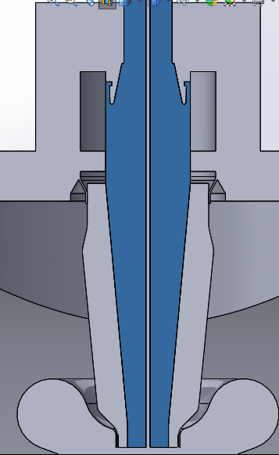
CST results: Transverse electric field – No shield vs Original vs all shields at insulator interface
The potential and electric fields along the rubber plug – ceramic insulator interface was obtained (as shown in the image as a red dotted line), plotted as a function of the height (y-coordinate).

Slide 49
CST results: Transverse electric field – No shield vs Original vs all shields at insulator interface
Different colors represent different shields.

Slide 50
CST results: Transverse electric field – No shield vs Original vs shields 1&2 at insulator interface
Different colors represent different shields.
38% difference between 0.8 and 1.3
63% difference between 0.8 and 2.2

Slide 51
CST results: Transverse electric field – No shield vs Original vs shields 3&4 at insulator interface
Different colors represent different shields.
11% difference between 0.8 and 0.9
65% difference between 0.8 and 2.3

Slide 52
CST results: Transverse electric field – No shield vs Original vs shields 5,6&7 at insulator interface
Different colors represent different shields.
65% difference between 0.8 and 2.3

Slide 53
CST results: Longitudinal electric field – No shield vs Original vs all shields at insulator interface
Different colors represent different shields.
WT?

Slide 54
CST results: Longitudinal electric field – No shield vs Original vs shields 1&2 at insulator interface
Different colors represent different shields.
WT?

Slide 55
CST results: Longitudinal electric field – No shield vs Original vs shields 3&4 at insulator interface
Different colors represent different shields.
WT?

Slide 56
CST results: Longitudinal electric field – No shield vs Original vs shields 5,6&7 at insulator interface
Different colors represent different shields.
WT?

Slide 57
CST results: Potential – No shield vs Original vs all shields at insulator interface
Different colors represent different shields.
20% difference between 123 and 153

Slide 58
CST results: Potential – No shield vs Original vs shields 1&2 at insulator interface
Different colors represent different shields.
9% difference between 139 and 153

Slide 59
CST results: Potential – No shield vs Original vs shields 3&4 at insulator interface
Different colors represent different shields.
2% difference between 149 and 153

Slide 60
CST results: Potential – No shield vs Original vs shields 5,6&7 at insulator interface
Different colors represent different shields.

Slide 61
No shield vs Original vs all Shields: Longitudinal electric field at c-a gap
You can notice the variation on the longitudinal electric field in the cathode-anode gap is minimal, due to a change of radius or a change in the shield height.

Slide 62
CST results: Longitudinal electric field – No shield
The gray data set is the whole field map. The different colors show how the longitudinal electric field changes as a function of height on the photocathode in the interval -6mm<y<6mm

Slide 63
CST results: Longitudinal electric field – original shield
The gray data set is the whole field map. The different colors show how the longitudinal electric field changes as a function of height on the photocathode in the interval -6mm<y<6mm

Slide 64
CST results: Longitudinal electric field – Shield 1
The gray data set is the whole field map. The different colors show how the longitudinal electric field changes as a function of height on the photocathode in the interval -6mm<y<6mm

Slide 65
CST results: Longitudinal electric field – Shield 2
The gray data set is the whole field map. The different colors show how the longitudinal electric field changes as a function of height on the photocathode in the interval -6mm<y<6mm

Slide 66
CST results: Longitudinal electric field – Shield 3
The gray data set is the whole field map. The different colors show how the longitudinal electric field changes as a function of height on the photocathode in the interval -6mm<y<6mm

Slide 67
CST results: Longitudinal electric field – Shield 4
The gray data set is the whole field map. The different colors show how the longitudinal electric field changes as a function of height on the photocathode in the interval -6mm<y<6mm

Slide 68
CST results: Longitudinal electric field – Shield 5
The gray data set is the whole field map. The different colors show how the longitudinal electric field changes as a function of height on the photocathode in the interval -6mm<y<6mm

Slide 69
CST results: Longitudinal electric field – Shield 6
The gray data set is the whole field map. The different colors show how the longitudinal electric field changes as a function of height on the photocathode in the interval -6mm<y<6mm

Slide 70
CST results: Longitudinal electric field – Shield 7
The gray data set is the whole field map. The different colors show how the longitudinal electric field changes as a function of height on the photocathode in the interval -6mm<y<6mm

Slide 71
False color

Slide 72
Electric field norm: No shield vs Original vs shields 1&2

Slide 73
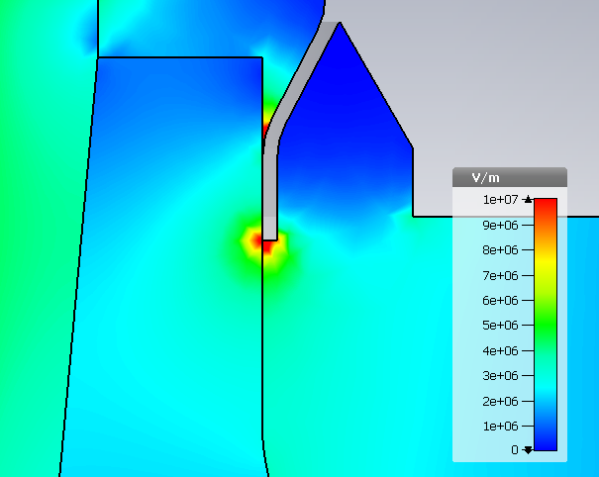
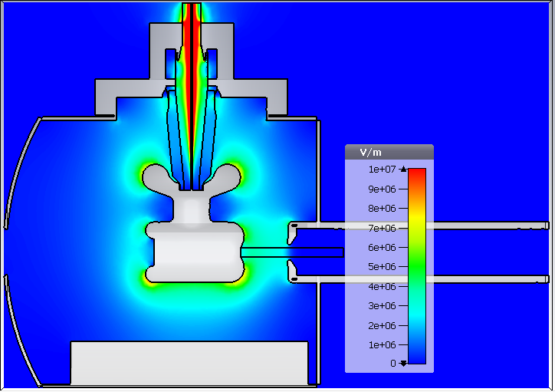
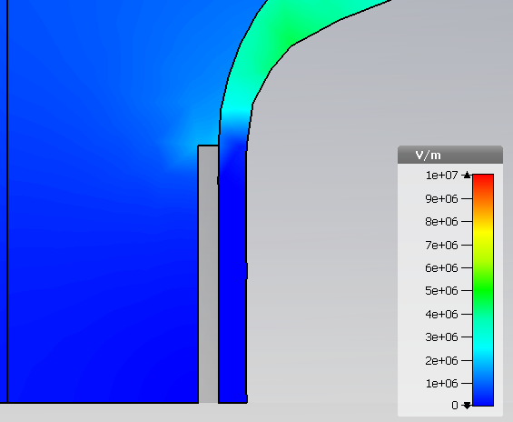
CST results: Electric field norm– original shield
Triple points:
Upper flange:10MV/m
7.2MV/m
5.6MV/m
Triple points:
Cathode: 0.6MV/m
7.9MV/m
4.85 MV/m

Slide 74
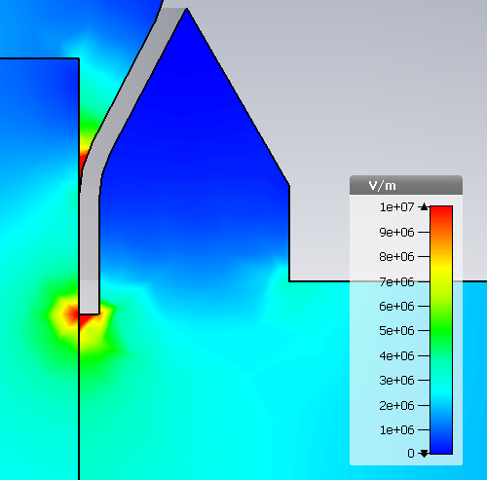
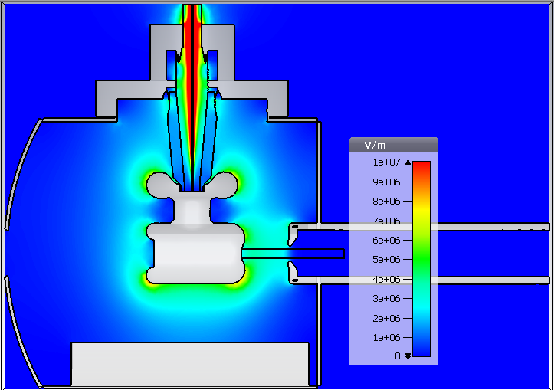
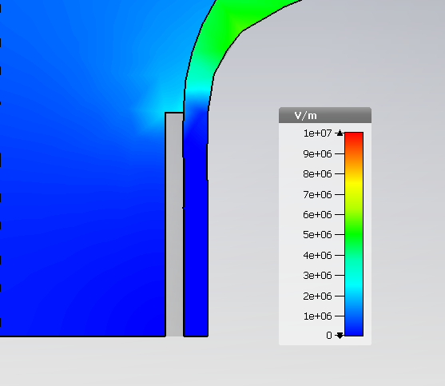
CST results: Electric field norm– Shield 1
Triple points:
Upper flange:10MV/m
7.1MV/m
5.7MV/m
Triple points:
Cathode: 0.7MV/m
7.9MV/m
4.83 MV/m

Slide 75
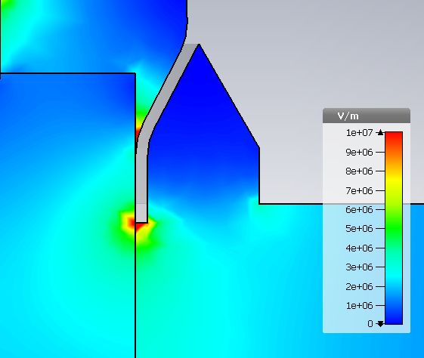
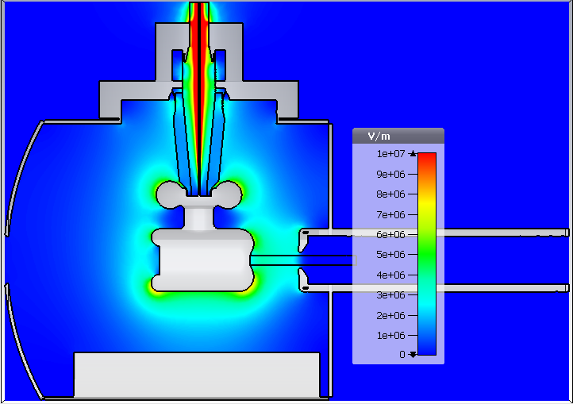
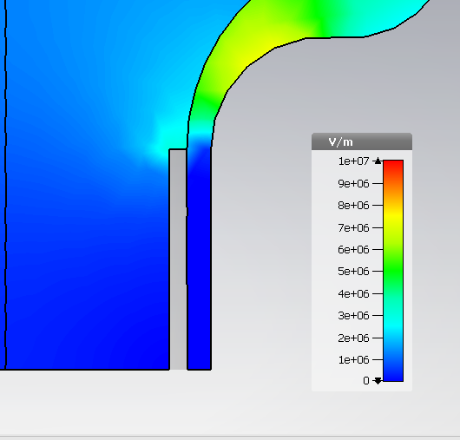
CST results: Electric field norm– Shield 2
Triple points:
Upper flange:13MV/m
6.9MV/m
6.1MV/m
Triple points:
Cathode: 0.9MV/m
8.0MV/m
4.85 MV/m

Slide 76
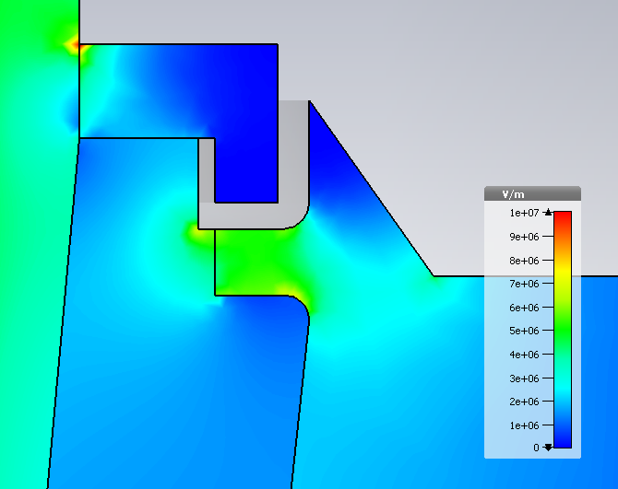
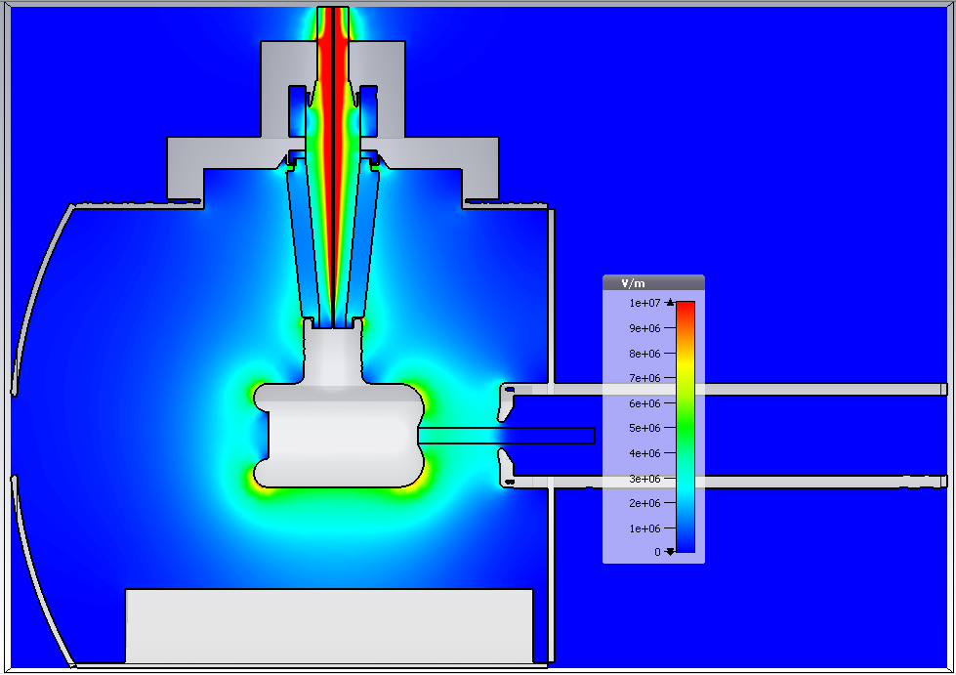
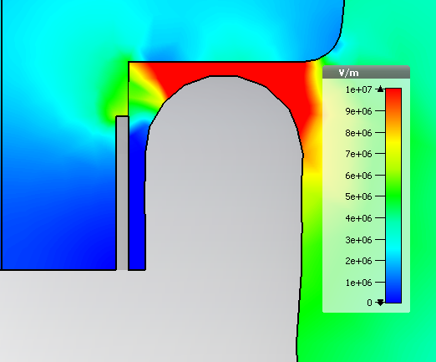
CST results: Electric field norm– No shield
Triple points:
Upper flange:5MV/m
29MV/m at cusp
Triple points:
Cathode: 3.6MV/m
6.5MV/m
7.9MV/m
4.87 MV/m

Slide 77
Electric field norm: No shield vs Original vs shields 3&4

Slide 78
CST results: Electric field norm– original shield
Triple points:
Upper flange:10MV/m
7.2MV/m
5.6MV/m
Triple points:
Cathode: 0.6MV/m
7.9MV/m
4.85 MV/m

Slide 79
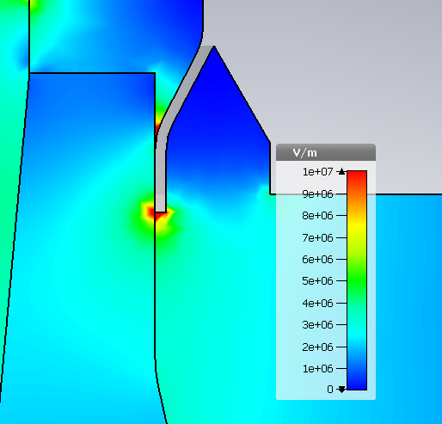
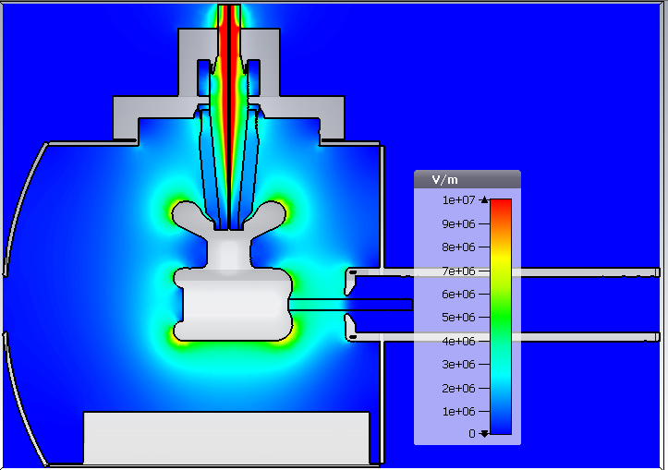
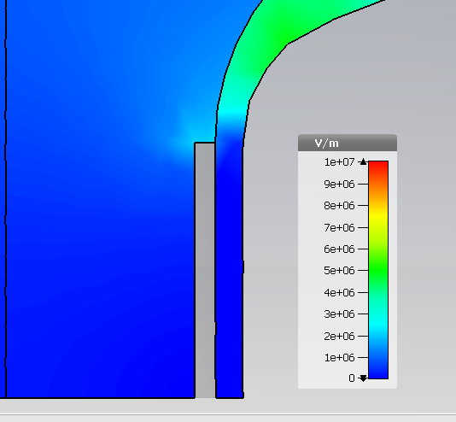
CST results: Electric field norm– Shield 3
Triple points:
Upper flange:12MV/m
7.5MV/m
5.7MV/m
Triple points:
Cathode: 0.6MV/m
7.8MV/m
4.86 MV/m

Slide 80
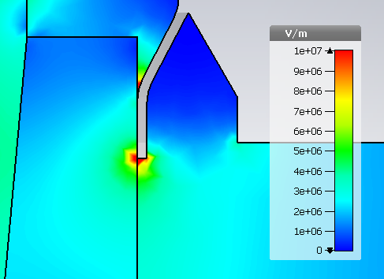

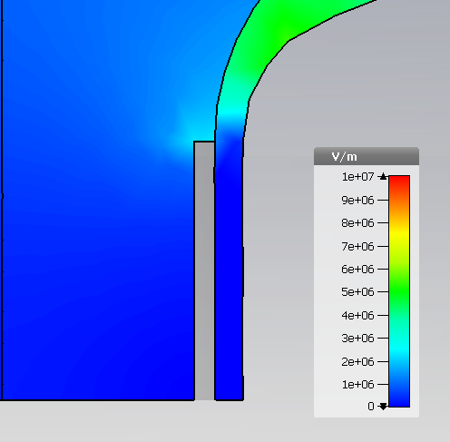
CST results: Electric field norm– Shield 4
Triple points:
Upper flange:12MV/m
8.3MV/m
5.8MV/m
Triple points:
Cathode: 0.7MV/m
7.9MV/m
4.85 MV/m

Slide 81
CST results: Electric field norm– No shield
Triple points:
Upper flange:5MV/m
29MV/m at cusp
Triple points:
Cathode: 3.6MV/m
6.5MV/m
7.9MV/m
4.87 MV/m

Slide 82
Electric field norm: No shield vs Original vs shields 5,6&7

Slide 83
CST results: Electric field norm– original shield
Triple points:
Upper flange:10MV/m
7.2MV/m
5.6MV/m
Triple points:
Cathode: 0.6MV/m
7.9MV/m
4.85 MV/m

Slide 84
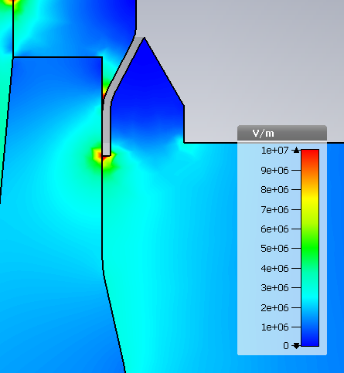
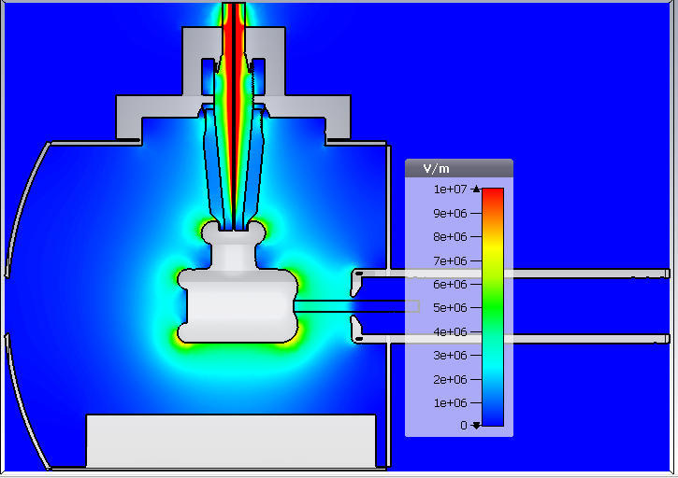

CST results: Electric field norm– Shield 5
Triple points:
Upper flange:12MV/m
6.8MV/m
6.4MV/m
Triple points:
Cathode: 1.6MV/m
7.9MV/m
4.86 MV/m

Slide 85



CST results: Electric field norm– Shield 6
Triple points:
Upper flange:12MV/m
7.8MV/m
6.4MV/m
7.9MV/m
Triple points:
Cathode: 1.7MV/m
4.86 MV/m

Slide 86



CST results: Electric field norm– Shield 7
Triple points:
Upper flange:12MV/m
8.5MV/m
6.5MV/m
Triple points:
Cathode: 1.8MV/m
7.9MV/m
4.85 MV/m

Slide 87
CST results: Electric field norm– No shield
Triple points:
Upper flange:5MV/m
29MV/m at cusp
Triple points:
Cathode: 3.6MV/m
6.5MV/m
7.9MV/m
4.87 MV/m

Slide 88
Electric field norm: No shield vs Original vs shields 1 vs shields 2
On the metallic surface
Pics are sadly not to scale, in all of them the cathode size is the same.

Slide 89



CST results: Electric field norm– Original

Slide 90



CST results: Electric field norm– Shield 1

Slide 91



CST results: Electric field norm– Shield 2

Slide 92



CST results: Electric field norm– No shield

Slide 93
Electric field norm: No shield vs Original vs shields 3 vs shields 4
On the metallic surface
Pics are sadly not to scale, in all of them the cathode size is the same.

Slide 94
CST results: Electric field norm– Original

Slide 95



CST results: Electric field norm– Shield 3

Slide 96



CST results: Electric field norm– Shield 4

Slide 97
CST results: Electric field norm– No shield

Slide 98
Electric field norm: No shield vs Original vs shields 5,6&7
On the metallic surface
Pics are sadly not to scale, in all of them the cathode size is the same.

Slide 99
CST results: Electric field norm– Original

Slide 100



CST results: Electric field norm– Shield 5

Slide 101



CST results: Electric field norm– Shield 6

Slide 102



CST results: Electric field norm– Shield 7

Slide 103
CST results: Electric field norm– No shield

Slide 104
Preliminary conclusions
Cathode anode gap
  Transverse electric field
    Original vs shield 1 & 2
      Benefit if height is reduced and we produce beam from the top of the photocathode.
    Original vs shield 3 & 4
      Benefit if radius is reduced and we produce beam from the top of the photocathode.
    Original vs shield 5,6& 7
      Benefit if radius is reduced further and we produce beam from the top of the photocathode, closely resembling the results from the no-shield gun.
  Longitudinal electric field
    The changing of the shields has a relatively small impact.
Insulator-rubber plug interface
    The transverse electric field gets worst for shield 2,5,6&7.
    Longitudinal electric field has a discontinuity that must be revised.

Slide 105
Preliminary conclusions
Cathode contour
  Electric field norm
    Original vs shield 1 & 2
      The cusp field reduces, at cost of the fields on the Pierce geometry contour and the triple point which reaches ~ 1MV/m .
    Original vs shield 3 & 4
      The radius change increases the field at its cusp to ~8 MV/m with some impact on the Pierce geometry.
    Original vs shield 5,6 & 7
      Further decreasing the radius change increases the field at its cusp to ~8.5 MV/m with some impact on the Pierce geometry.
    All
      Upper flange triple point appears and remains at ~12 MV/m

Slide 106
Preliminary conclusions
In short:
  Height reduction =
    Smaller vertical “kick” at cathode-anode gap
    Worst transversal field at the insulator-rubber plug interface
    Smaller field at the cusp
    Worst field at triple point
  Cusp radius reduction =
    Smaller vertical “kick” at cathode-anode gap
    Slightly worst transversal field at the insulator-rubber plug interface
    Worst field at the cusp
    Slightly Worst field at triple point

Slide 107
Future steps
Mix between smaller radius and smaller height prototype.
Add GTS at 200 kV w/small anode comparing with other guns?

Slide 108
Fin.

Slide 109


CST frame of reference:
y
x
z
X goes into the page.

