Slide 1
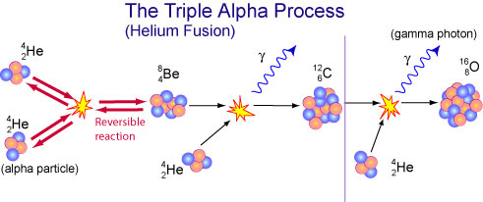
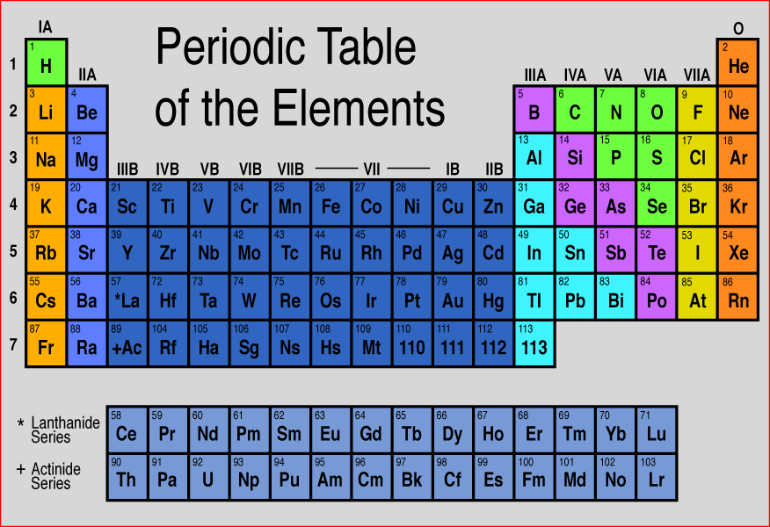
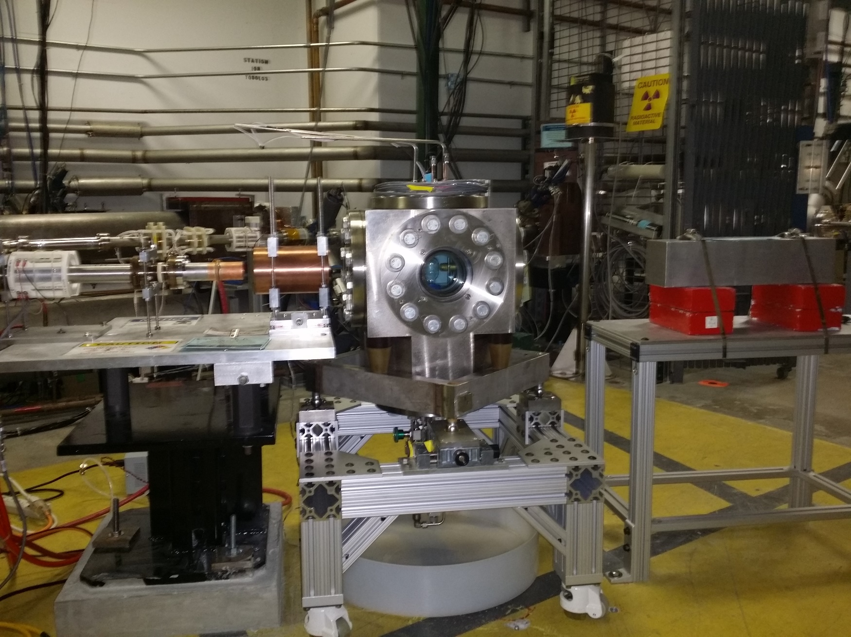
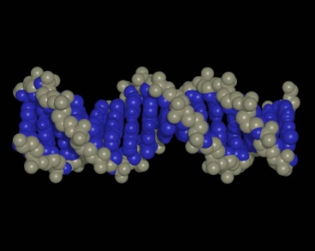
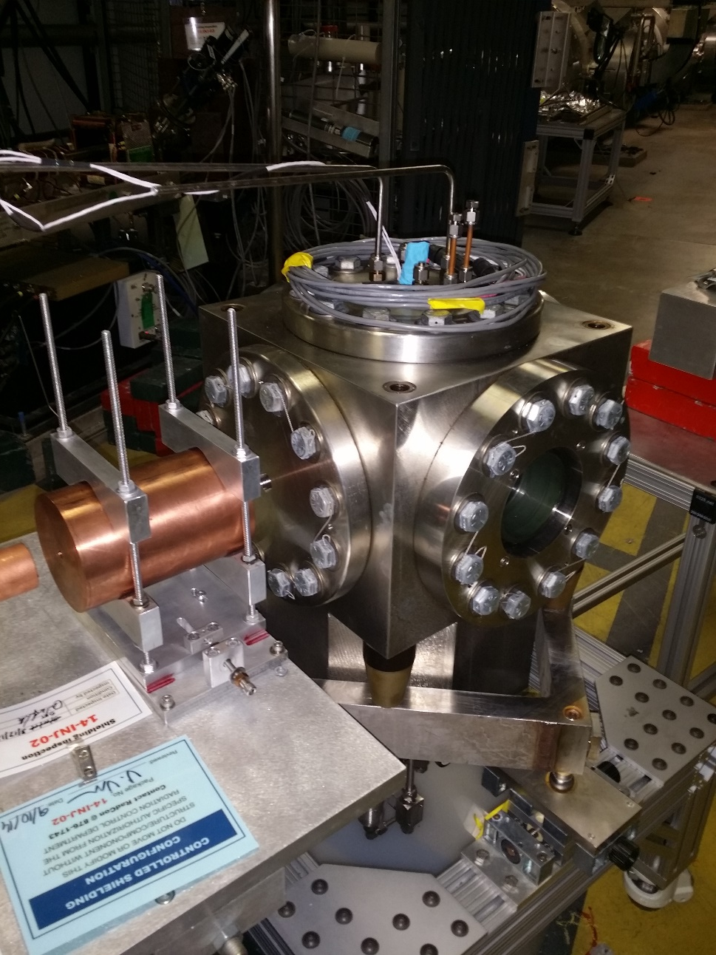
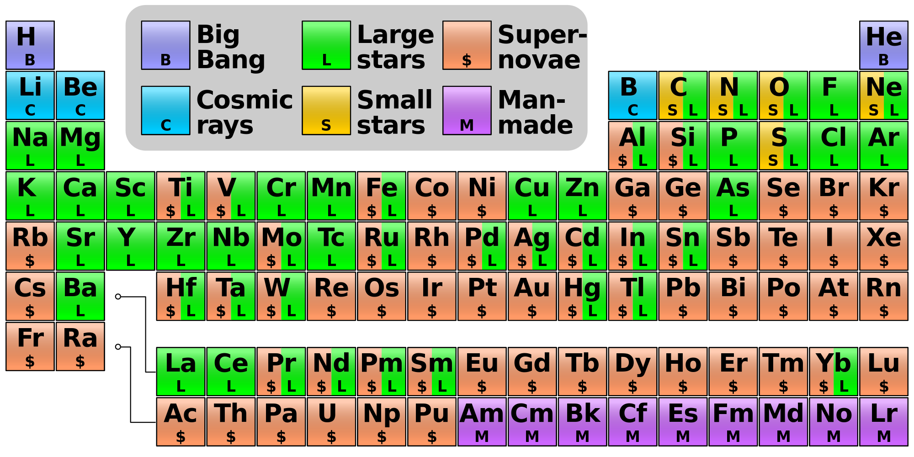
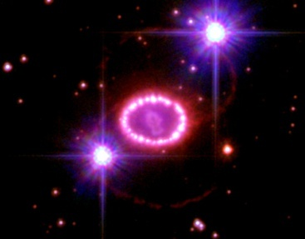
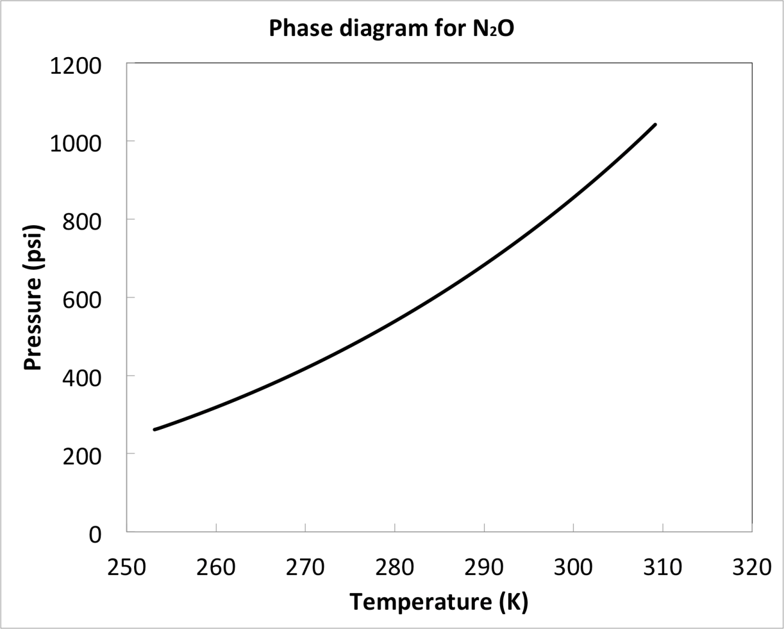
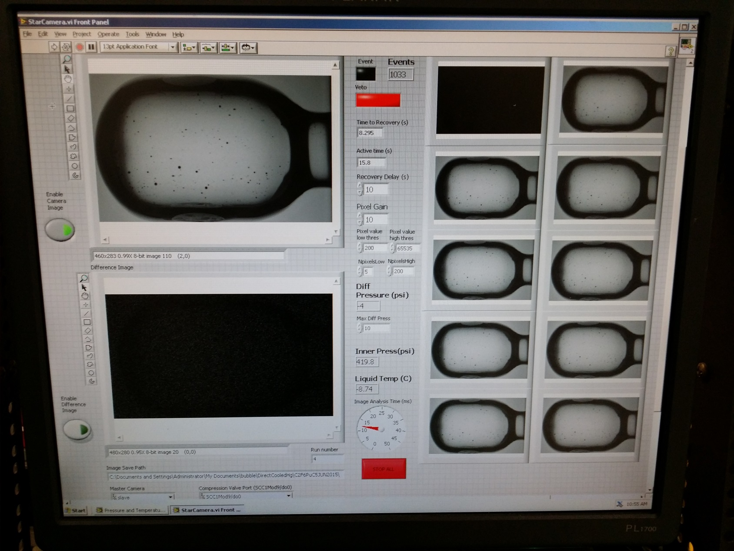
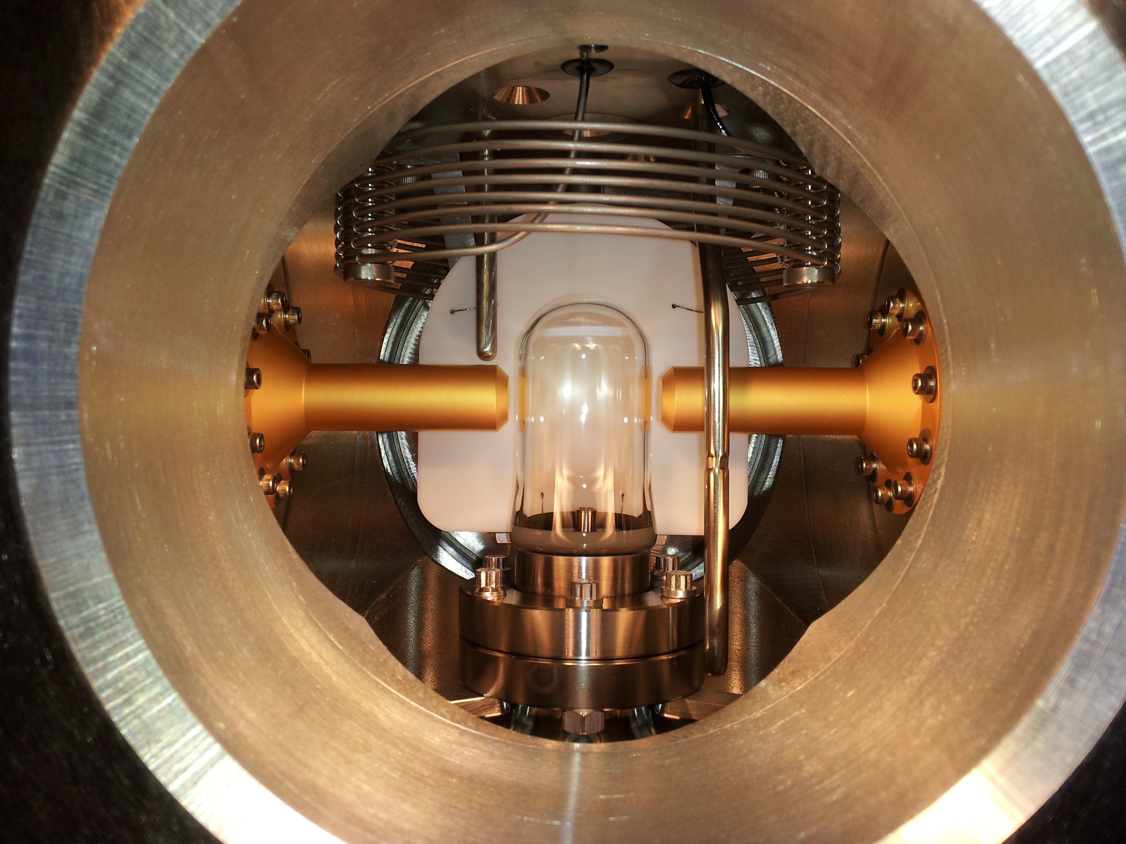
Measurement of ¹⁶O(γ,α)¹²C with Bubble Chamber and Bremsstrahlung Beam at Jefferson Lab Injector
Jefferson Laboratory, Argonne National Laboratory, Fermi National Laboratory, University of Illinois
Motivation
Stellar Helium Burning
Time Reversal Reaction
Relative Abundance of Elements by Weight
¹²C
¹⁶O
beam
target
signal
α
γ
γ + ¹⁶O → ¹²C + α
Extra gain (factor of 100) by measuring time reversal reaction
Target density up to 10⁴ higher than conventional targets. Number of ¹⁶O nuclei = $3.5×{10}^{22}$/cm² (3.0 cm cell)
Solid Angle and Detector Efficiency = 100%
Electromagnetic debris (electrons and gammas, or positrons) do NOT trigger nucleation (detector is insensitive to γ-rays by at least 1 part in 10¹¹).
Big Bang Nucleosynthesis: quark ̶ gluon plasma → p, n, He
Stellar Nucleosynthesis: H burning, He burning, CNO cycle
Supernovae Nucleosynthesis: Si burning
Cosmic Ray Spallation
Affects the synthesis of most of the elements of the periodic table
Gammas are generated by an electron beam hitting a copper radiator
Sets the N(¹²C)/N(¹⁶O) (≈0.4) ratio in the universe
Determines the minimum mass a star requires to become a supernova
Bubbles
Helium – carbon fusion to form oxygen is very important reaction
It is easier to measure the disintegration of oxygen to helium and carbon when bombarded with gammas
At Jefferson Lab, we use electron beam to generate gammas
These gammas hit oxygen nuclei in laughing gas
The laughing gas is very unstable liquid and the helium and carbon will heat the small part of it and vaporize it
The bubble generated is monitored by a camera
Bubble Chamber
Summary
Use Nitrus Oxide (N₂O, laughing gas) as target
T = -10˚C, P = 20 atm
LabVIEW processes images from 100 Hz digital camera
2
Liquid
1 Cell is cooled then filled with room temperature gas
2 Gas is cooled and condenses into liquid
3 Once cell is completely filled with liquid, pressure is reduced creating a superheated liquid
3 Nuclear reactions induce bubble nucleation
2 High speed camera detects bubble and repressurizes
3 System depressurizes and ready for another cycle
1
3
Vapor
Acknowledgement: This work has been supported by US DOE (DE-AC02-06CH11357)
and Jefferson Science Associations, LLC (DE-AC05-06OR23177)

