Slide 1
Look into x-y error bars
The way that you can fit nonlinear equations with x and y uncertainties is not straightforward
Can’t do directly in mathematica without coding
Should be possible in root
Can we linearize the equations for the asym vs. thickness and get a better handle on error propogation?

Slide 2
Assume this functional form
First: obtain a linear relationship between thickness and (1/asym)
Assuming that the equation for the Asym vs. Thickness follows the form
$$Asym=\frac{A_{0}}{1+λ∗Thickness}$$
we can invert both sides of the equation getting
$$\frac{1}{Asym}=a+b∗Thickness$$
where the uncertainty for the inverted asymmetry becomes
$$∂\left(\frac{1}{Asym}\right)=\frac{dAsym}{{Asym}^{2}}$$

Slide 3
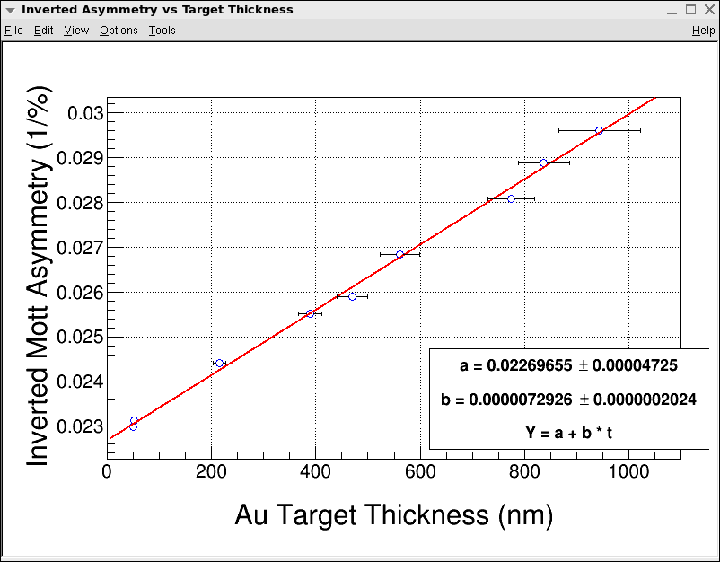
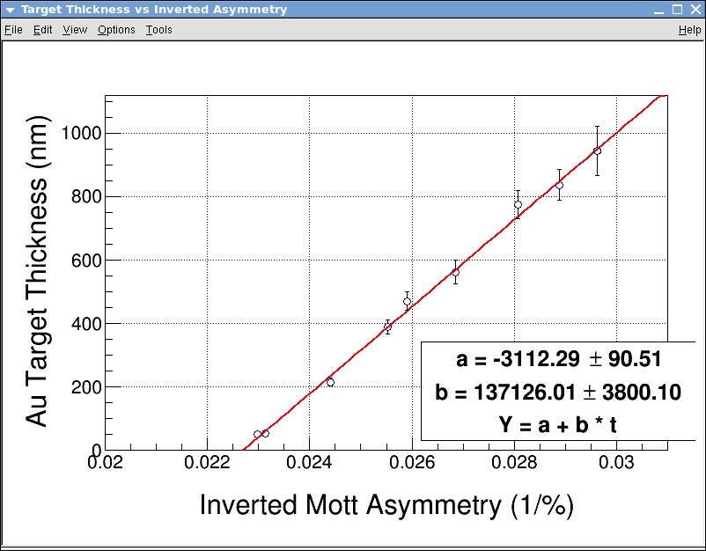
Ideally, we should get the same answer for (x vs. y) or (y vs. x)
$$\frac{1}{Asym}=a+b∗Thickness$$
$$Thickness=a+b(\frac{1}{Asym})$$

Slide 4
Mathematica vs. root fits
Root: intended to have both x and y uncertainties handled as in regular asym vs. thickness data
Mathematica:
Only used uncertainty in y-axis for the fit
 | Mathematica |  | Root
 | asym | uncertainty | asym | uncertainty
Fitting with thickness in y axis | 44.09 | 0.47050 | 44.06 | 0.51070
Fitting with (1/asym) in y axis | 44.08 | 0.07463 | 44.06 | 0.09170
Uncertainties not the same:
Mathematica, since I am ignoring dThickness or dAsym. Root: Same problem in uncertainty handling?
Is this a valid point? Should the total uncertainties be the same?
From Tim: There is a problem with the t vs. 1/A fits to a straight line; the slope and intercept are correlated, which is not true of the 1/A vs. t fits.

Slide 5
Why don’t we use rate rather than thickness to extrapolate?
The Lebow uncertainties are 10%
The FESEM uncertainties are 5-9%
The rate uncertainties are all ~1%
Can we fit asymmetry vs. rate and get a better extrapolation?

Slide 6
Relate rate equation to 1/asym
If we have a graph of rate vs. thickness that is of the form
$$Rate=e+f∗T+g∗T^{2}$$
And we have can relate thickness to asymmetry using
$$\frac{1}{Asym}=a+b∗Thickness$$
We can substitute and get the relation between rate and asymmetry to be (using arbitrary constants)
$$Rate=α+β∗\frac{1}{Asym}+γ∗{\left(\frac{1}{Asym}\right)}^{2}$$
Where again
$$∂\left(\frac{1}{Asym}\right)=\frac{dAsym}{{Asym}^{2}}$$

Slide 7
Rate vs. 1/asym
The error bars are smaller than the points
Investigate 1/asym vs. rate instead?
Error propogation in progress (lots of algebra – ran out of time to finish)

Slide 8
Questions
Is it reasonable to expect the same uncertainty plotting (1/asym)vs.T or Tvs.(1/asym)?
If so, root seems to be mishandling the x axis uncertainty since it is getting the same results as mathematica with y uncertainty taken into account
There is a potential to use rate instead of thickness for extrapolation – are there any physical reasons this would/would not work well?

