Slide 1
Solenoid Field in FLUKA
Magnetic Fields in FLUKA
Solenoid Field
Implementation of Solenoid Field in FLUKA
A. Ushakov

Slide 2
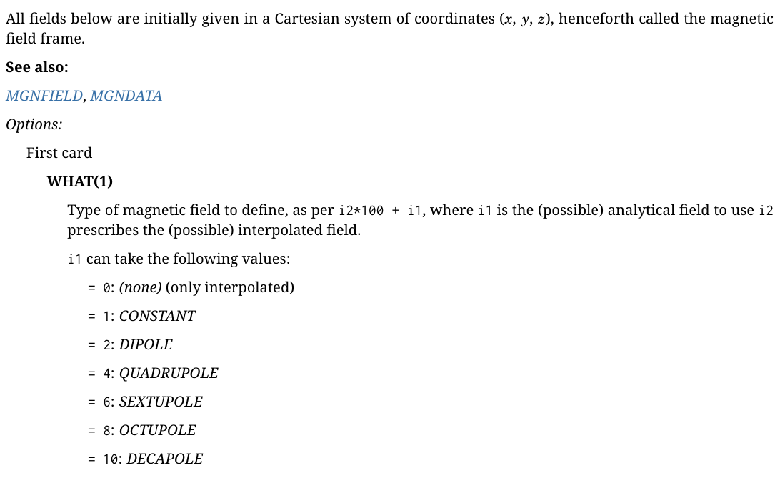
Magnetic Fields in FLUKA: MGNCREAte Card (FLUKA Manual)
No SOLENOID

Slide 3
User-Defined Fields in FLUKA: Magnetic Field Subroutine
*===magfld=============================================================*
*
SUBROUTINE MAGFLD ( X, Y, Z, BTX, BTY, BTZ, B, NREG, IDISC )
* Input variables: *
* x,y,z = current position *
* nreg = current region *
* Output variables: *
* btx,bty,btz = cosines of the magnetic field vector *
* B = magnetic field intensity (Tesla) *
* idisc = set to 1 if the particle has to be discarded *

Slide 4
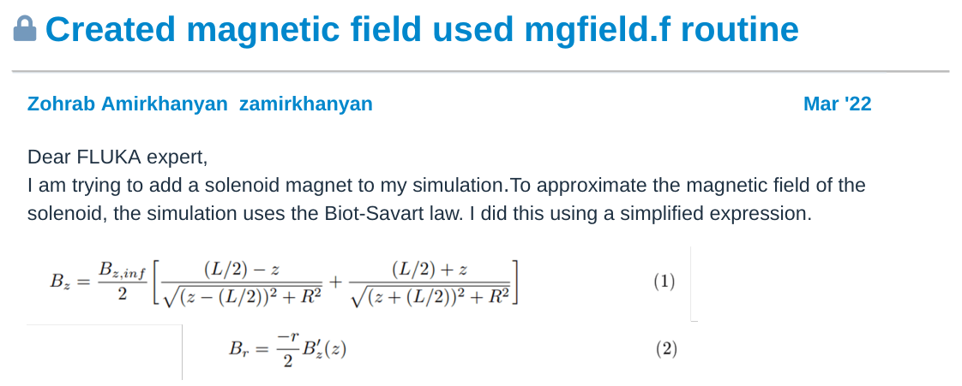
Example of Adding Solenoid Field - FLUKA Forum

Slide 5
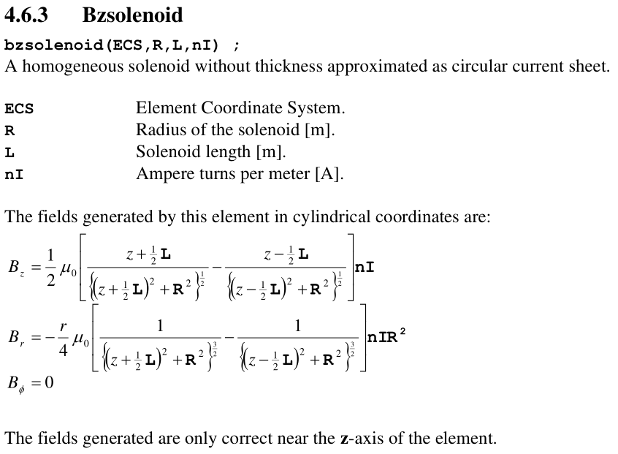
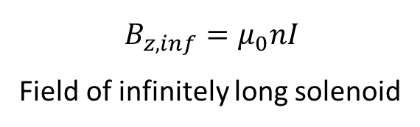

Solenoid Field in GPT
$$B_{z,inf}=μ_{0}nI$$
Field of infinitely long solenoid
$B_{z}=f(z,r)$

Slide 6
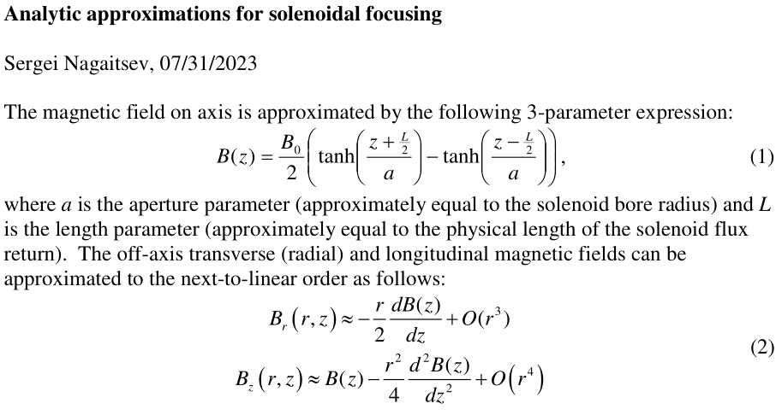
More Precise Field Approximation

Slide 7
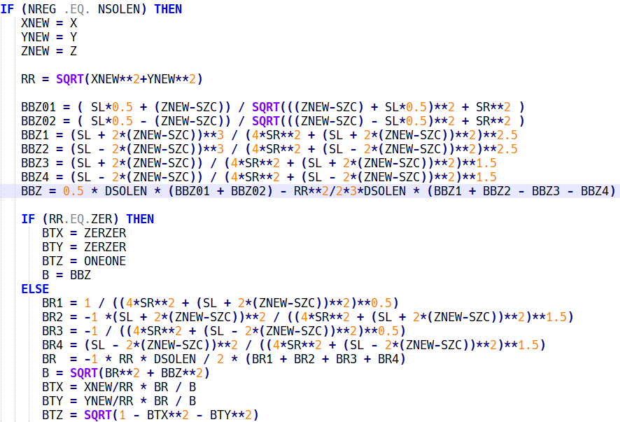
My Source Code of Field Subroutine

Slide 8
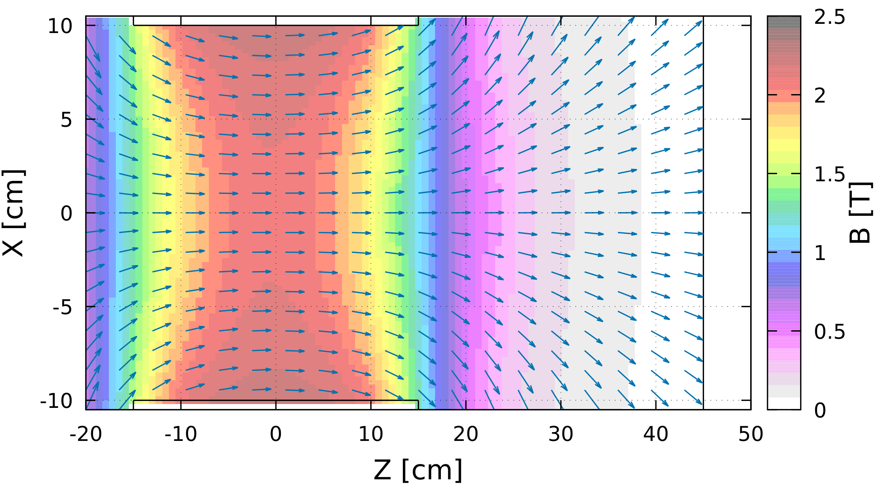
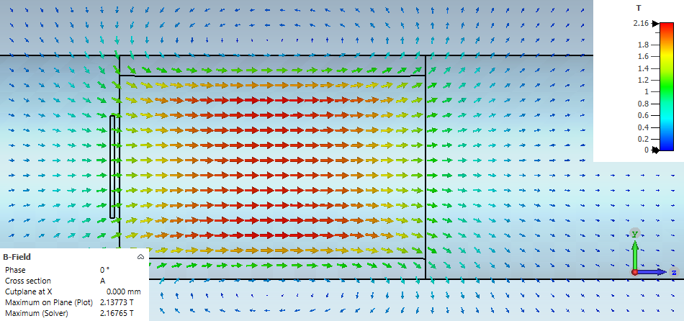
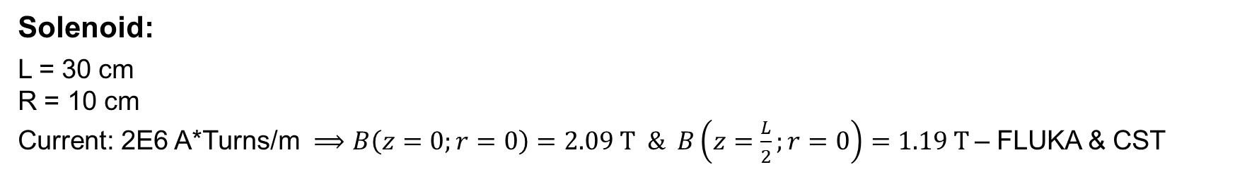
Field Distribution in FLUKA and CST
FLUKA
CST
Solenoid:
L = 30 cm
R = 10 cm
Current: 2E6 A*Turns/m $⟹B\left(z=0;r=0\right)=2.09 T \& B\left(z=\frac{L}{2};r=0\right)=1.19 T$– FLUKA & CST

Slide 9
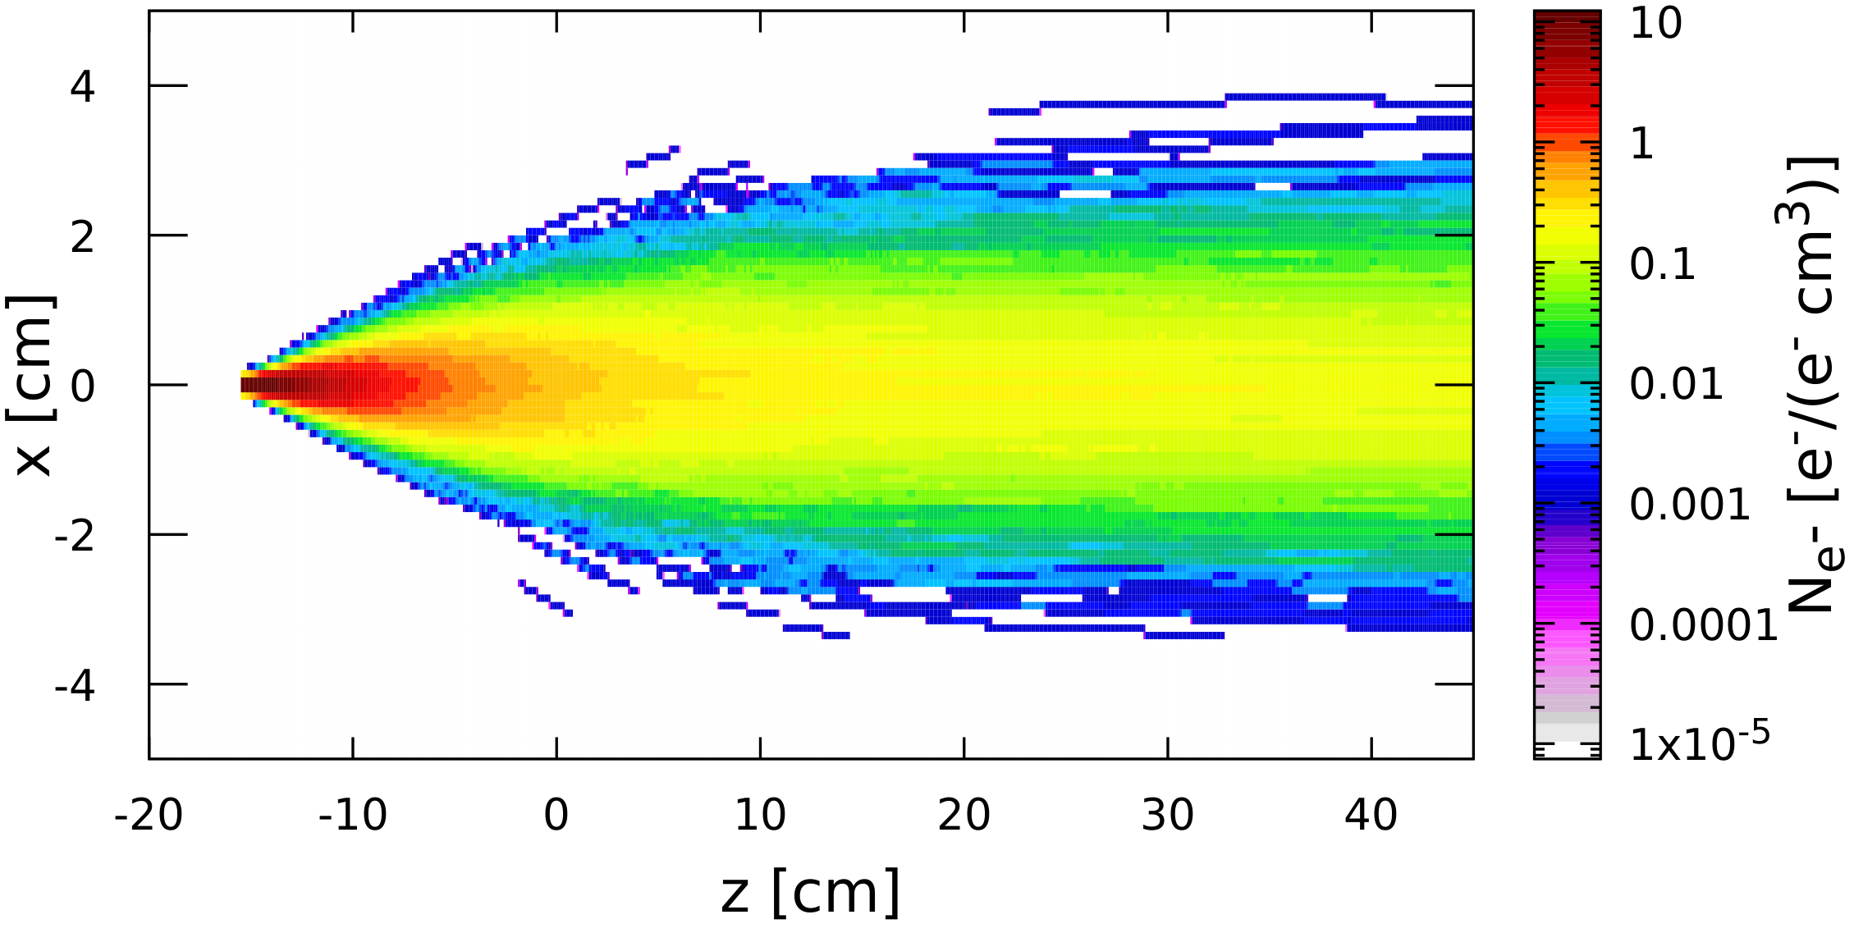
Tracking of Particles in FLUKA and GPT
FLUKA
GPT
E_{e-} = 120 MeV
σ_{xe-},σ_{ye-} = 1 mm
Thickness of W target = 4 mm
E_{e+} = 60 MeV
ΔE_{e+}/E_{e+} = 5%
E = 60 MeV
ΔE/E = 0
σ_{Δϕ} = 100 mrad
σ_{x},σ_{y} = 1 mm

Slide 10
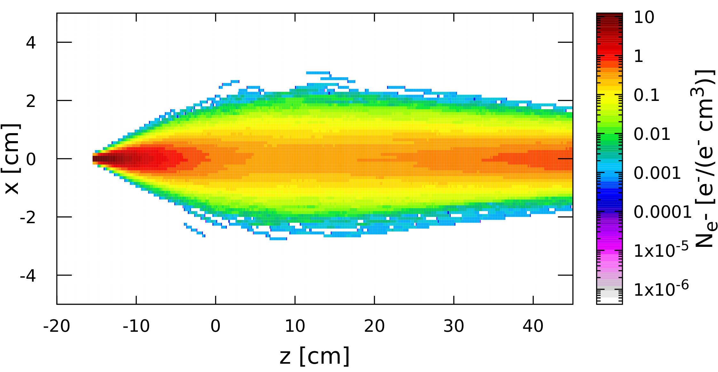
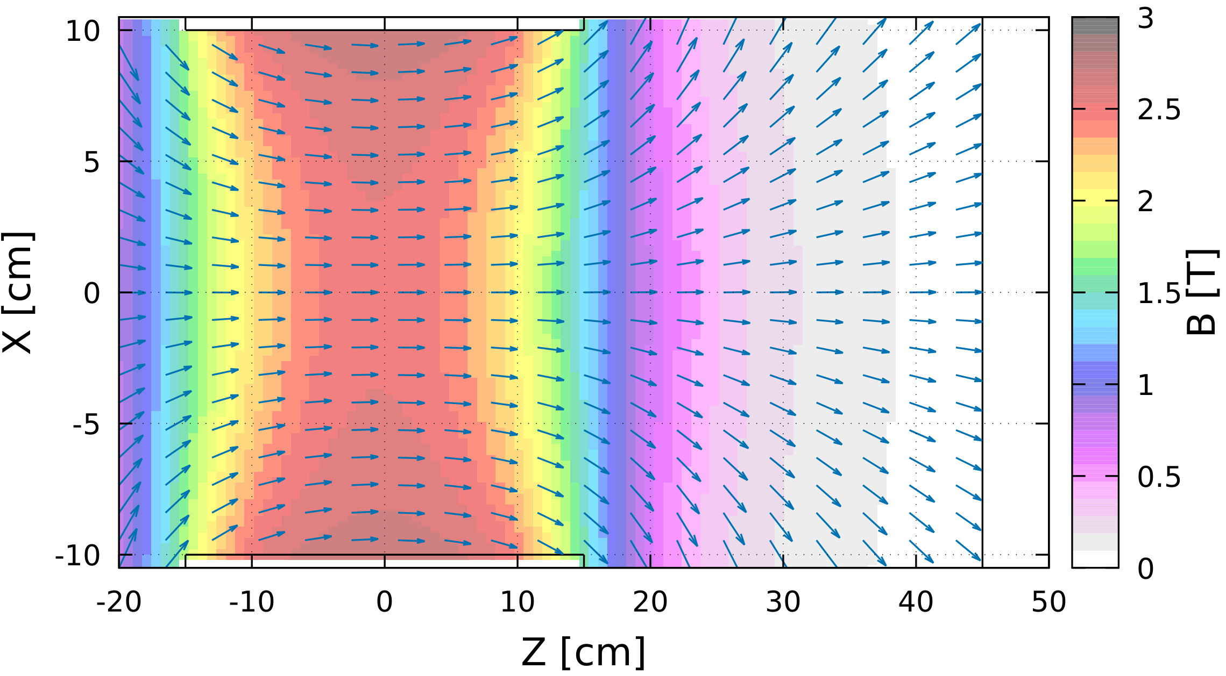
Beam Focusing by 2.5 T Solenoid
Beam Tracking
B-Field

Slide 11
Summary and Outlook
Solenoid field was added to FLUKA
Next steps
Simulations of beams downstream the target
Work on beam absorber protecting SC solenoid

