Slide 1
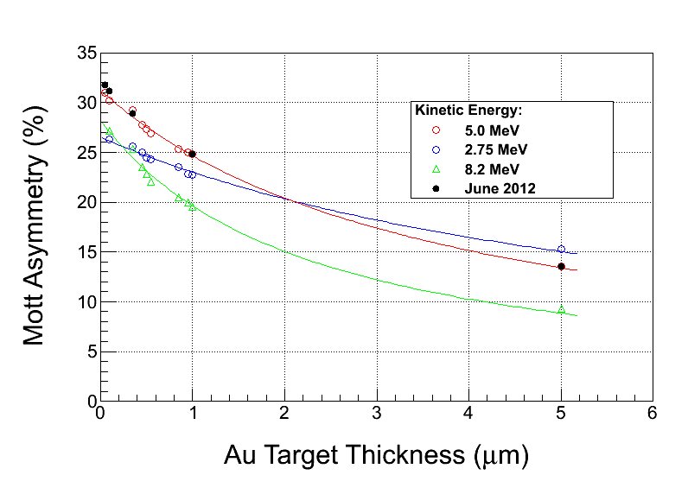
Steigerwald results reported in SPIN 2000
JLab measurements in June 2012
after 12 years good agreement
Results depend on (energy=same, targets=same, TOF cut=same)
Do we agree at a precision level?
similar at few percent, but what about <1% ??? => motivates experiment

Slide 2
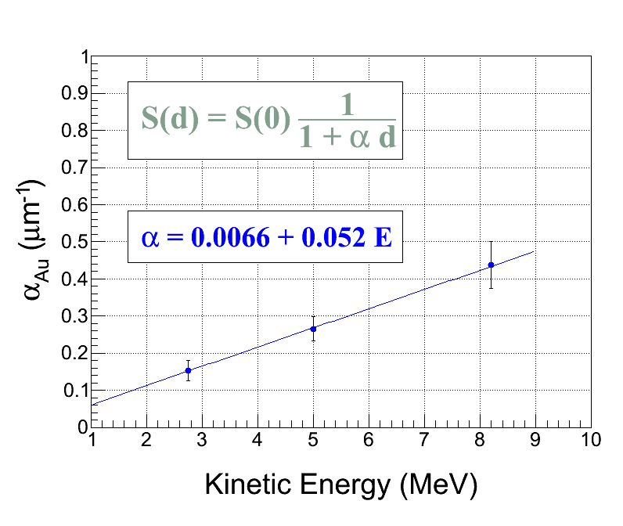
Significance of target thickness
Our vendor Lebow claims 10% absolute and 2% relative to foil
dS(d)/S(d) = (-β * αd) / ( 1+ αd), where β = δd/d

Slide 3
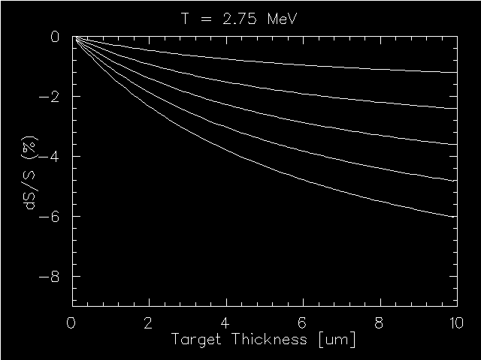
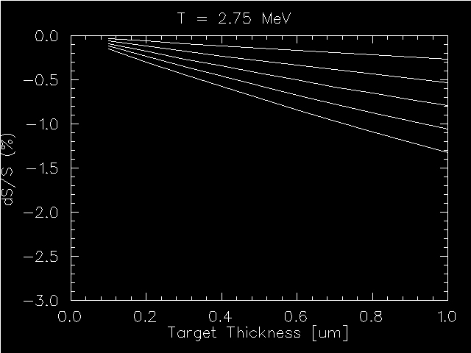
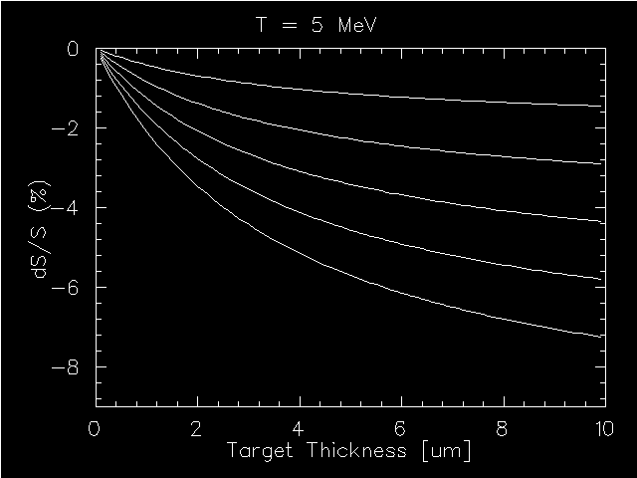
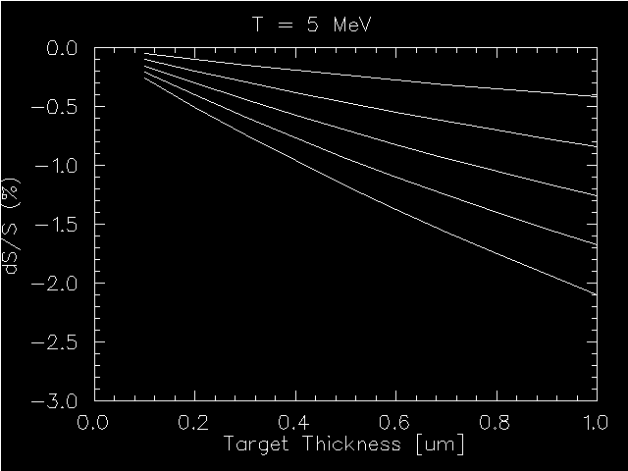
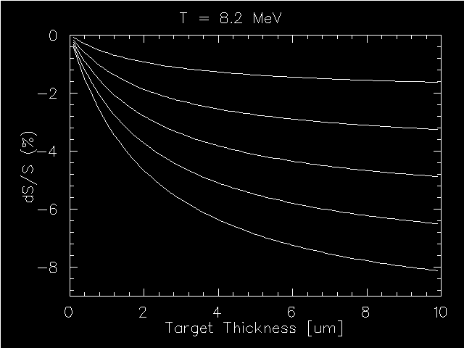
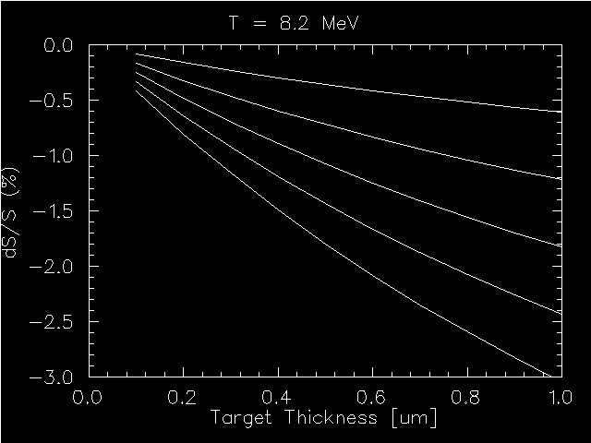
dS(d)/S(d) = (-β * αd) / ( 1+ αd), where β = δd/d
0 – 10 μm
0 – 1 μm
β
2%
4%
6%
8%
10%

Slide 4
Thermionic SEM images :
encouraging, consistent with vendor claim
in future will co-deposit onto Si wafer
employ field emission SEM (1 nm = 0.001 μm resolution)

Slide 5
Initial electron beam condition before and after the target

Slide 6
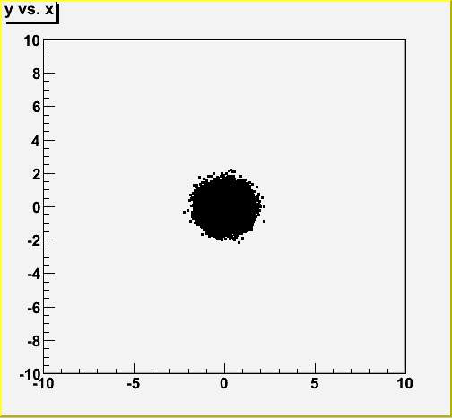
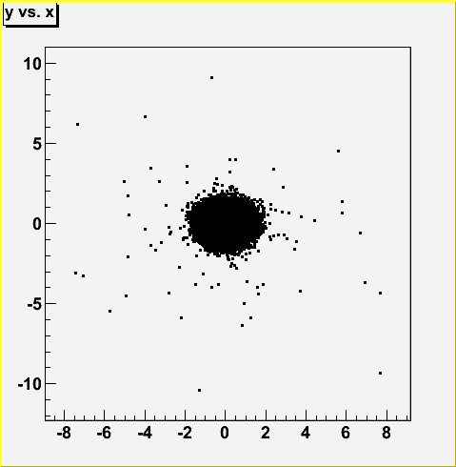
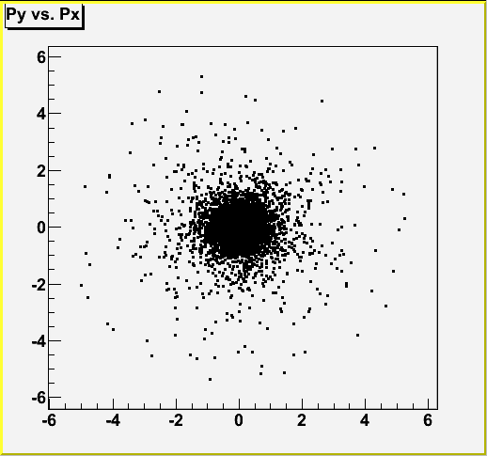
10⁵ e- pass 1um Au target & illuminate 1” thick dump : Cu, Al, C, Be
Units are millimeters and MeV/c unless stated
Electrons are RED and Photons are GREEN unless stated
Particles entering target (z = -1)
Pencil Beam
P_{z} = 5.5
P_{x} = P_{y} = 0
σ_{x} = σ_{y} = 0.5
σ_{px} = σ_{py} = 0
 | Cu 29 | Al 13 | C 6 | Be 4
e- | 10⁵ | 10⁵ | 10⁵ | 10⁵
γ | 0 | 0 | 0 | 0
Particles exiting target (z = 1, R=12.7)
 | Cu 29 | Al 13 | C 6 | Be 4
e- | 10⁵+65 | 10⁵ +66 | 10⁵+63 | 10⁵+62
γ | 226 | 228 | 227 | 231

Slide 7
Electron and photon spatial distributions in front of dump (going to or coming from)

Slide 8
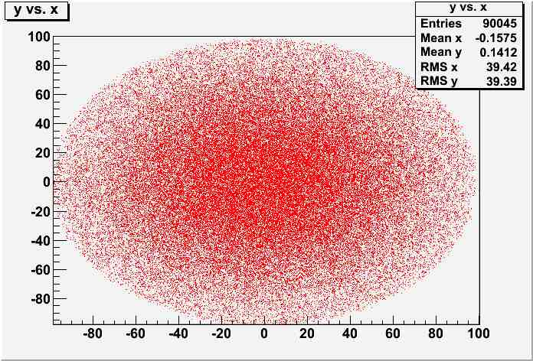
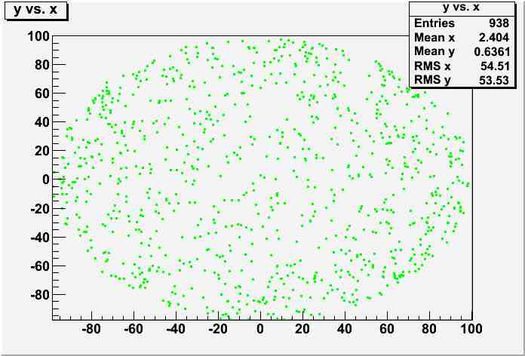
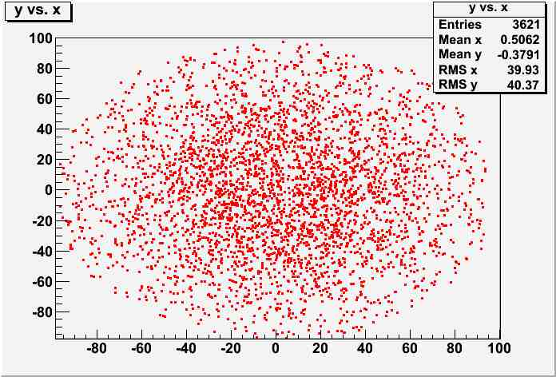
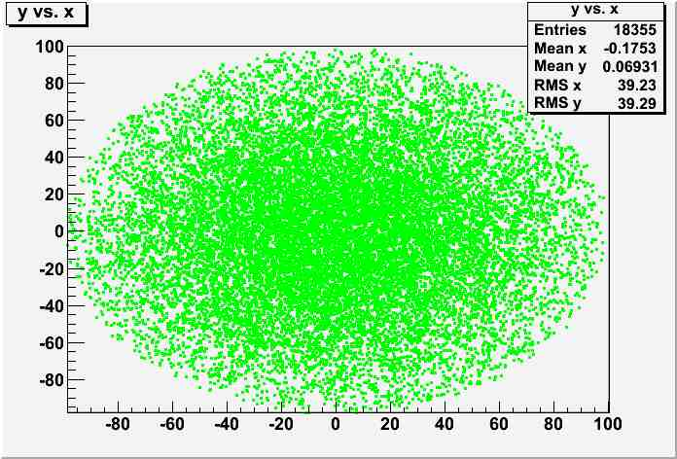
1 mm upstream of Dump
Copper (Z=29)
Pz>0
Pz<0

Slide 9
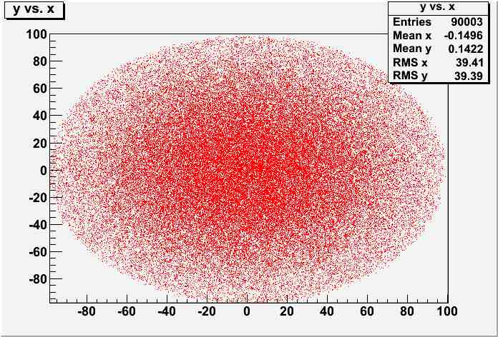
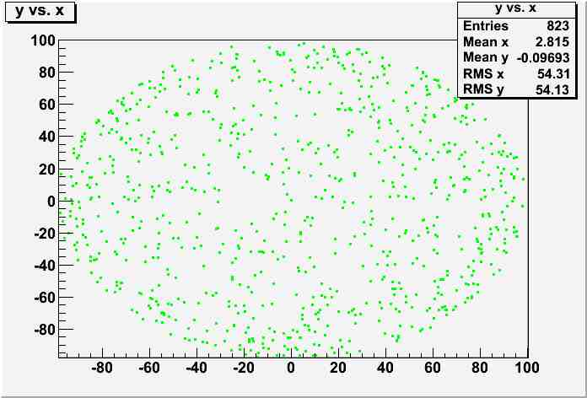
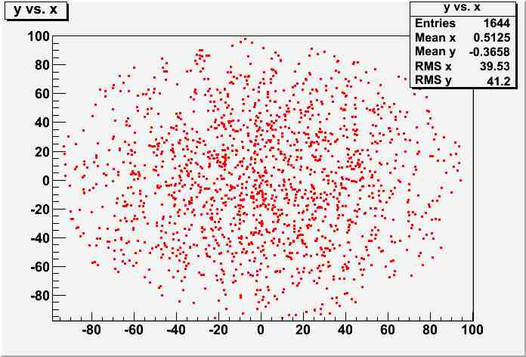
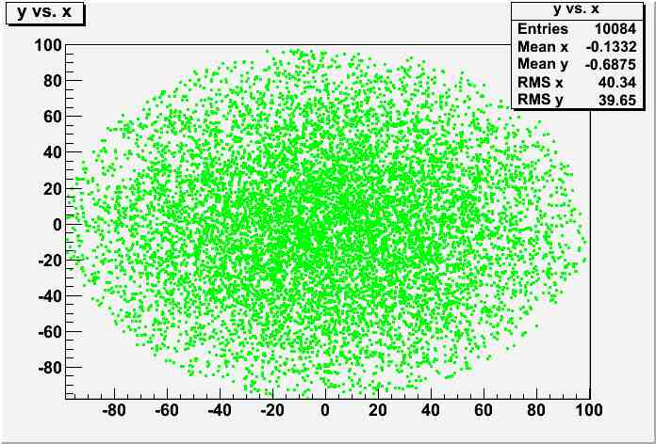
1 mm upstream of Dump
Aluminum (Z=13)
Pz>0
Pz<0

Slide 10
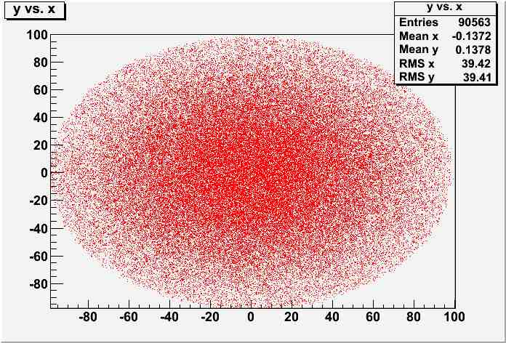
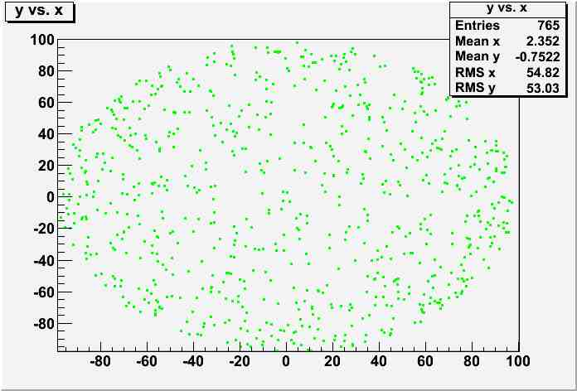
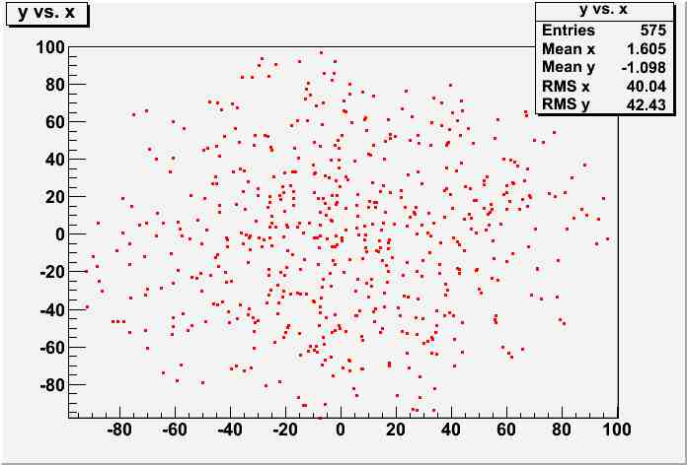
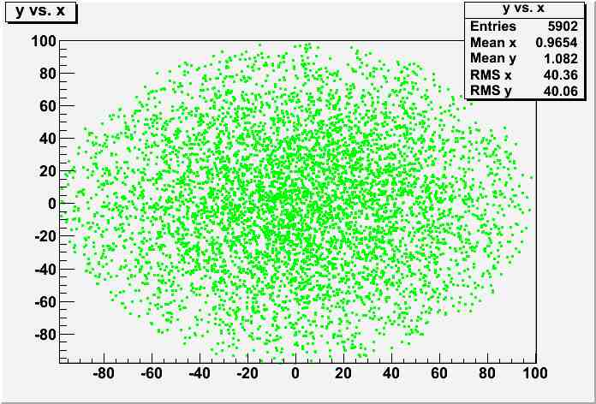
1 mm upstream of Dump
Carbon (Z=6)
Pz>0
Pz<0

Slide 11
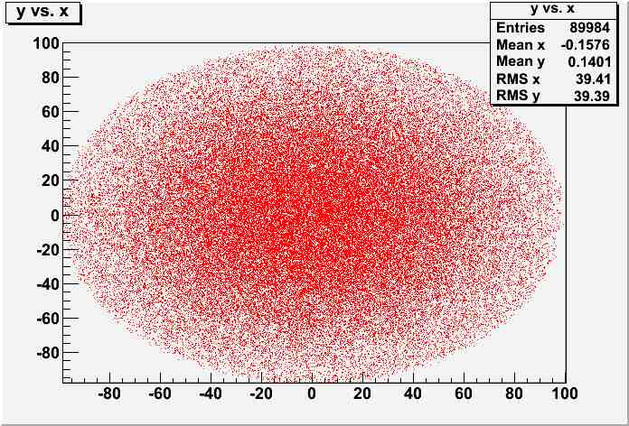
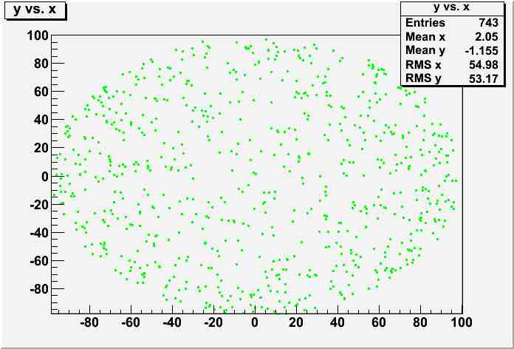
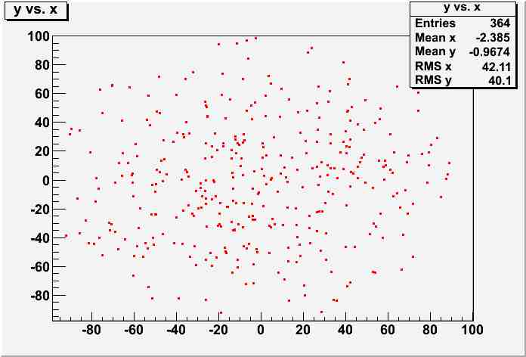
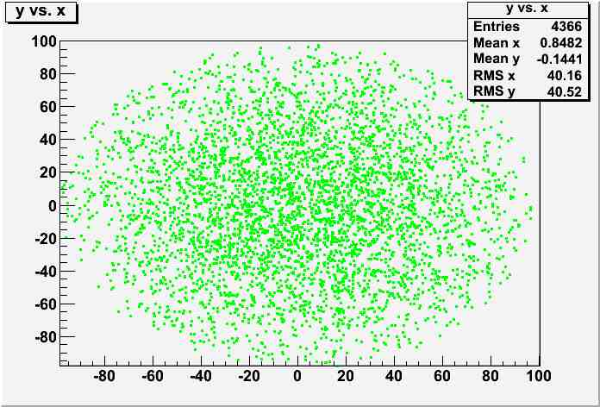
1 mm upstream of Dump
Beryllium (Z=4)
Pz>0
Pz<0

Slide 12
Electron and photon momentum distributions in front of dump returning toward target

Slide 13
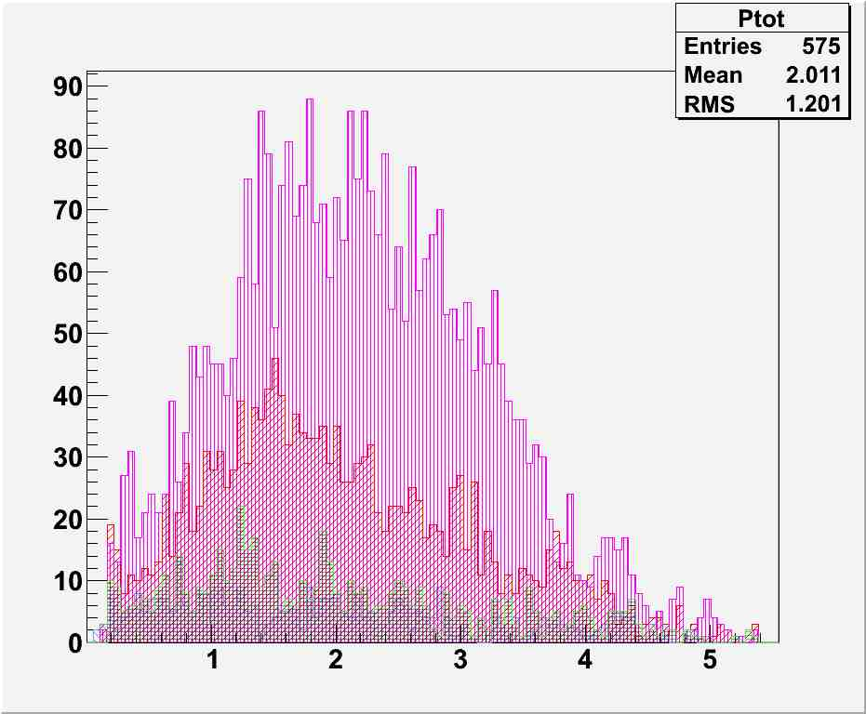
1 mm upstream of Dump
Electrons with Pz < 0
Cut: Pz < 0
Cu
Al
Number of Electrons
C
Be
Total Momentum [MeV/c]

Slide 14
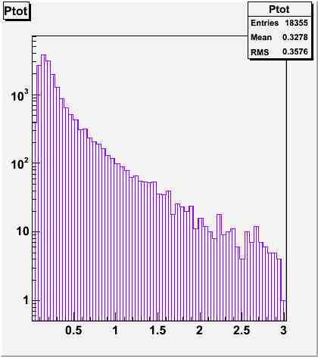
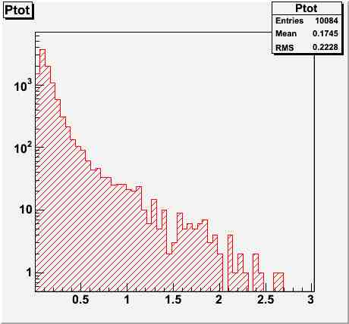
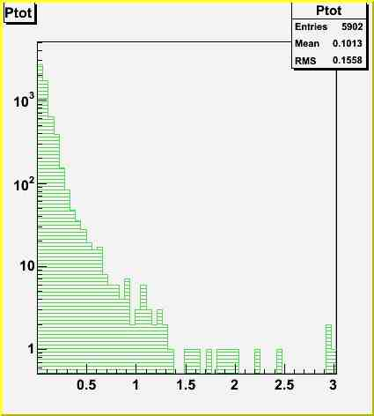
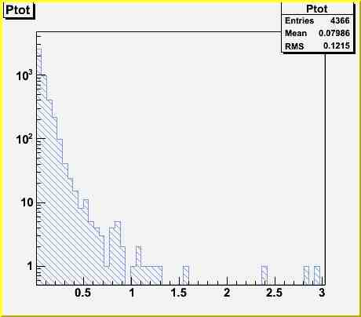
1 mm upstream of Dump
Photons with Pz < 0
Cu Z=29
Al Z=13
Number of photons
Number of photons
Total Momentum [MeV/c]
Total Momentum [MeV/c]
C Z=6
Be Z=4
Number of photons
Number of photons
Total Momentum [MeV/c]
Total Momentum [MeV/c]

Slide 15
Electron and photon spatial distributions exiting downstream of dump

Slide 16
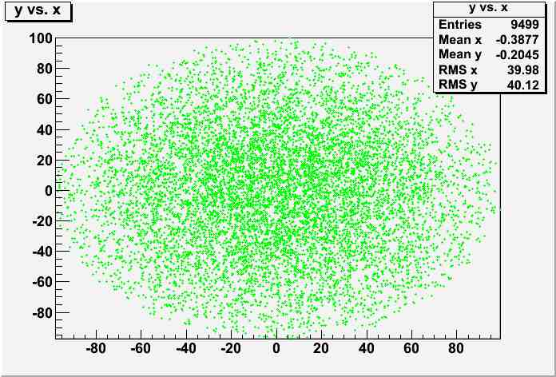
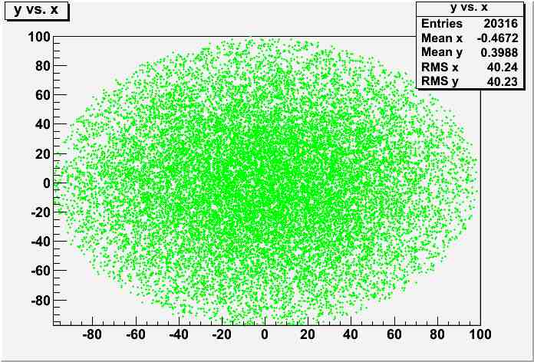
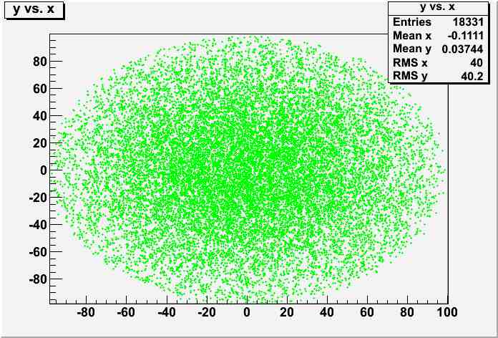
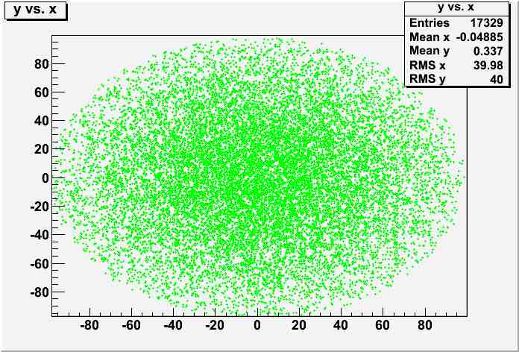
1 mm downstream of Dump
Pz > 0 (no events with Pz < 0)
Cu Z=29 (37 e-)
Al Z=13 (69 e-)
C Z=6 (21 e-)
Be Z=4 (17 e-)
 | Cu | Al | C | Be
e- | 10 | 189 | 337 | 466
γ | 1428 | 2649 | 1966 | 1521
radial edge of Dump

Slide 17
Response versus Z

Slide 18
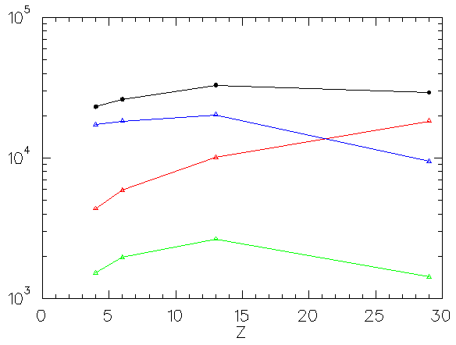
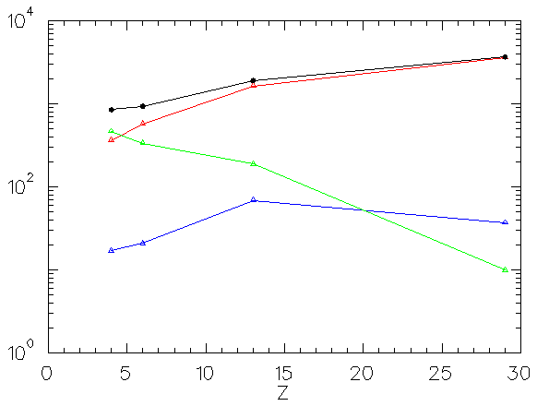
Electrons and Photons traversing surfaces about 1mm outside of a 1” dump flange
upstream means returning from dump
downstream means exiting dump
sidewall means exiting OD surface
Photons
total
Electrons
downstream
upstream
total
upstream
sidewall
sidewall
downstream

Slide 19
Electron and photon back-illuminating target plane

Slide 20
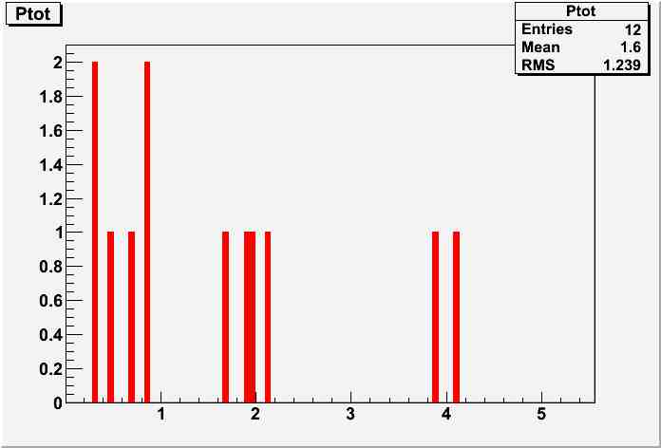
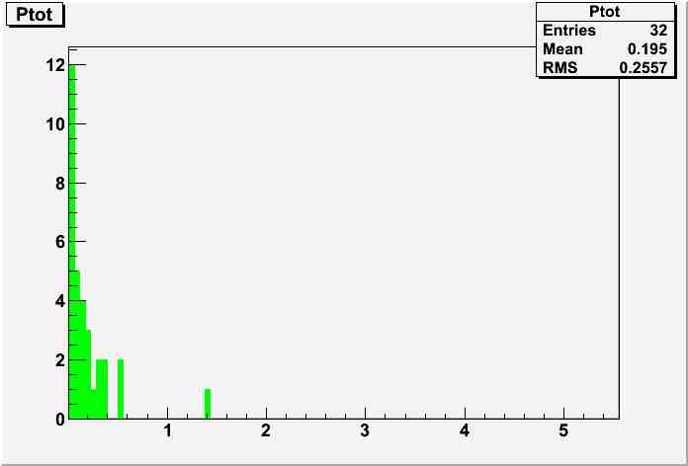
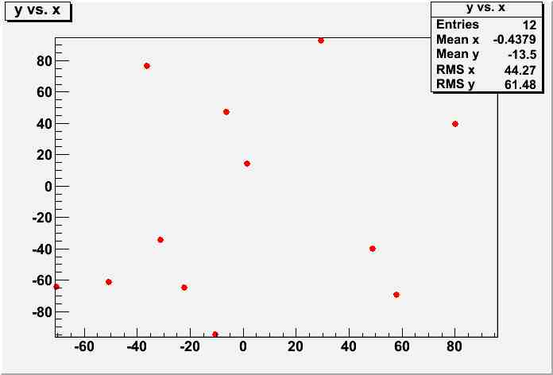
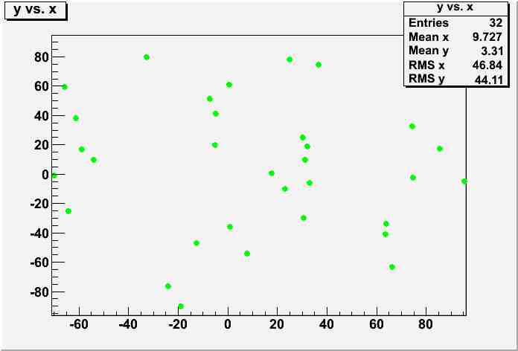
So, what reaches the target plane ?
Assuming “illuminous dump” is uniform in backward 2pi then 324cm² detector plane 1.8m from dump represents 1.5% angular acceptance. Testing for Aluminum…
1.5% * 1644 = 25
1.5% * 10084 = 151
target

Slide 21
Summary
C or Be are similar, both better than Al and by
about 3-4 for e-
about 2-3 for photons
Cu is better absorber of gamma by factor of about 2
Could be a good backing material, but should not be proud in chamber
Simulation rates fine for characterizing dump; poor for back-illuminate target
10⁵ target events (per second) is 16nA or 10⁶ overnight still low stat
Target – Dump distance is about 1.8m so need to bias simulation
More realistic model will be helpful
Use a reasonable e- beam distribution
Verify multiple-scattering distribution
Include dump dipole
About 90% of e- reach the dump, so more careful detail on surfaces
Figure out how to integrate deposited energy using G4Beamline

Slide 22
Mott Progress Report on Schedule, Target Ladder and Beam Dump Plate
Joe Grames
August 14

Slide 23
Schedule
Present work schedule
Sept 28 HCO begins
Nov 1 Mott tunnel work complete
Nov 4 2K recovery begins
Nov 8 Mott commissioning plan ready
Nov 9 HCO ends
Nov 9 Injector setup begins
Nov 11 2K recovery ends
Nov 11 Pulsed beam to FC1
Nov 16 Pulsed beam to FC2
Nov 16 Mott ready for beam
Nov 21 Pulsed beam to INJ spectrometer
Nov 24 Pulsed beam to 0R dump (end of injector)
Nov 28 Run through Thanksgiving
Dec 18 1-pass pulsed beam at 2.2 GeV
Dec 20 Winter shutdown
Feb 5 ACC-II begins
May 7 ACC-II ends

Slide 24
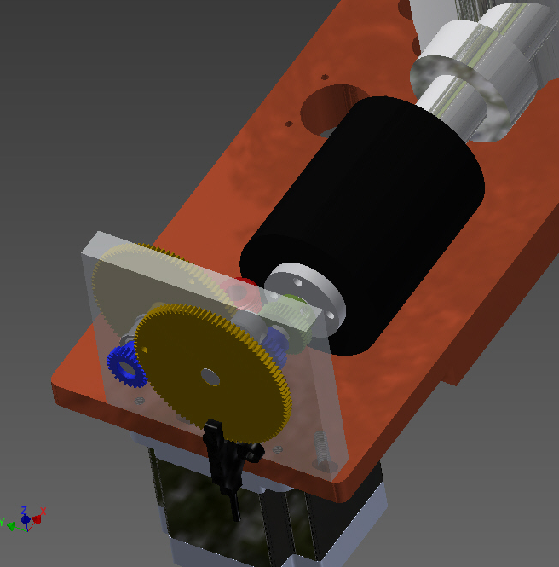
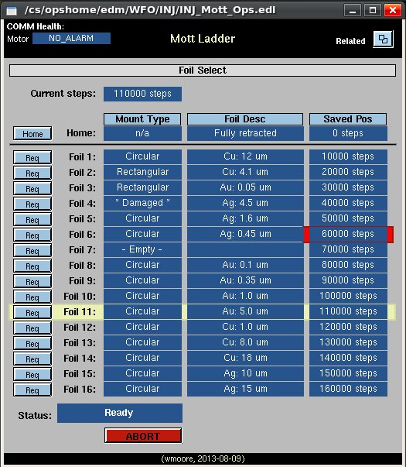
Target Ladder
Budget approved for new target ladder parts and assembly.
Gears and fixture plate for precision position control designed and ordered
STAC-5 stepper motor controller software written and testing = good
Target ladder (0.16”) should be ordered today
Viewer machining and adapter plate requirements known, yet incomplete

Slide 25
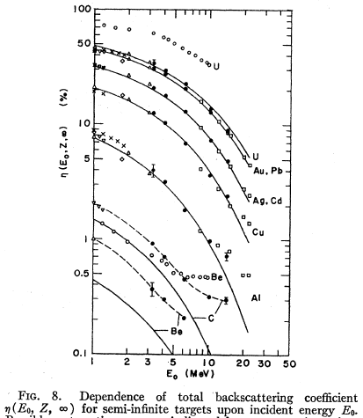
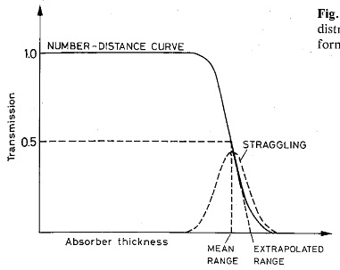
Dump Plate : motivation to reduce backscatter
“…angular distribution of backscattered electrons and the backscattering coefficient were measured for Cu, Ag, and Au targets of various thicknesses at the incident energy of 6.08 MeV, and for Be, C, Al, Cu, Ag, Au, and U targets of effectively semi-infinite thickness in the energy range 3.24-14.1 MeV.”
From Leo

Slide 26
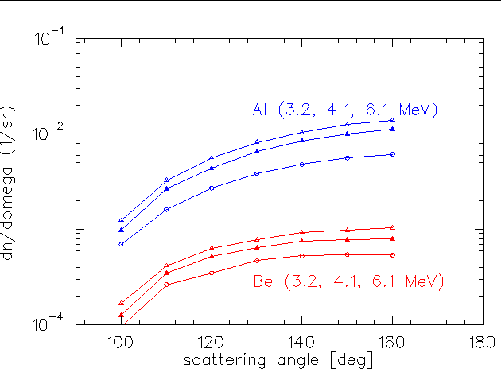
Dump Plate : motivation to reduce backscatter
From same paper, angular distributions for semi-infinite thickness targets.

Slide 27
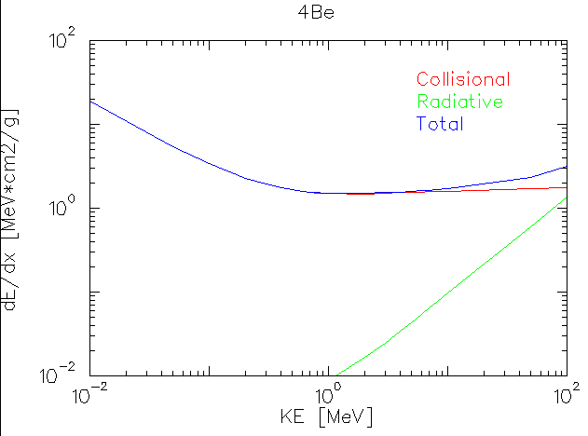
Dump Plate : energy loss
200keV – 8MeV energy loss is nearly all collisional at 1.6 MeV-cm²/g
KE | Uniform Loss (1.6 MeV-cm2/g) | Katz and Penfold Rev. Mod Phys 24 (1952) 28 | Practical Range (ρ_{Be} = 1.848 g/cm3) | Turn-Around Range
3 MeV | 1.88 g/cm2 | 1.48 g/cm2 | 0.8cm | 0.40cm
5 MeV | 3.12 g/cm2 | 2.54 g/cm2 | 1.4cm | 0.70cm
8 MeV | 5.00 g/cm2 | 4.14 g/cm2 | 2.3cm | 1.15cm
10 MeV | 6.25 g/cm2 | 5.14 g/cm2 | 2.8cm | 1.4cm

Slide 28
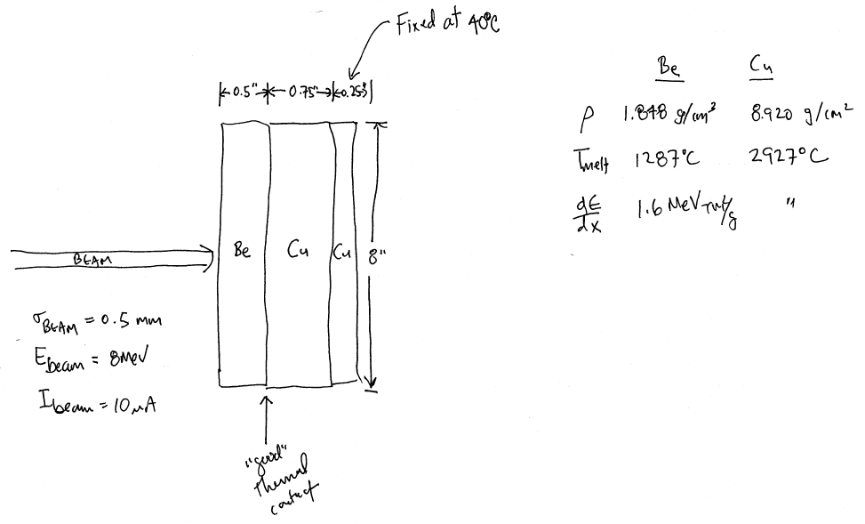
Dump Plate : worst case thermal distribution
I asked Dave Meekins if he would givs us a first pass look at thermal distribution given uniform energy loss in volume (beam radius * E/(dE/dx).

Slide 29
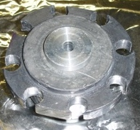
Detector (Air Side)
Existing | Upgrade | Labor | Procure | Status
Collimator position unknown | Survey collimator | S&A | None | Complete
Competing detector acceptance | Test w/ nosepiece removed Modify lead + new nose | TBD | TBD | Riad/Marty to advise
Vacuum window thickness SPIN2000: 0.05mm = 2 mil | Marty suggests 4 or 6 mil better | TBD | TBD | TBD
vs.

