Slide 1
UITF Internal Personnel Safety Review
UITF Overview and Introduction
Matt Poelker
May 10, 2016

Slide 2
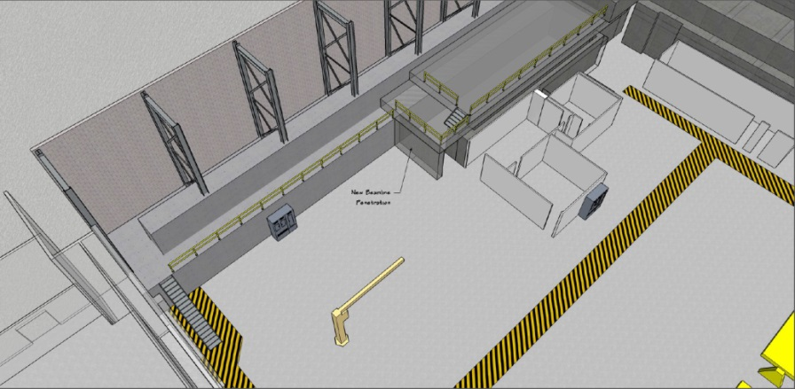
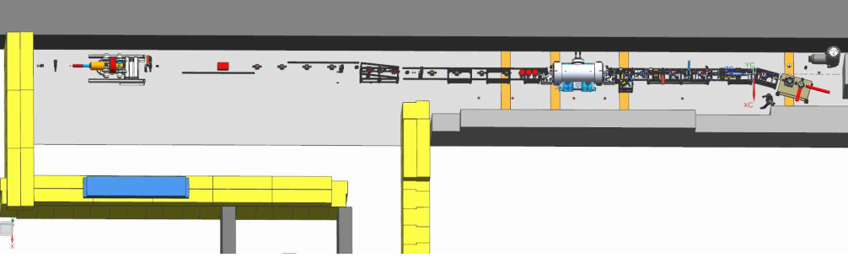
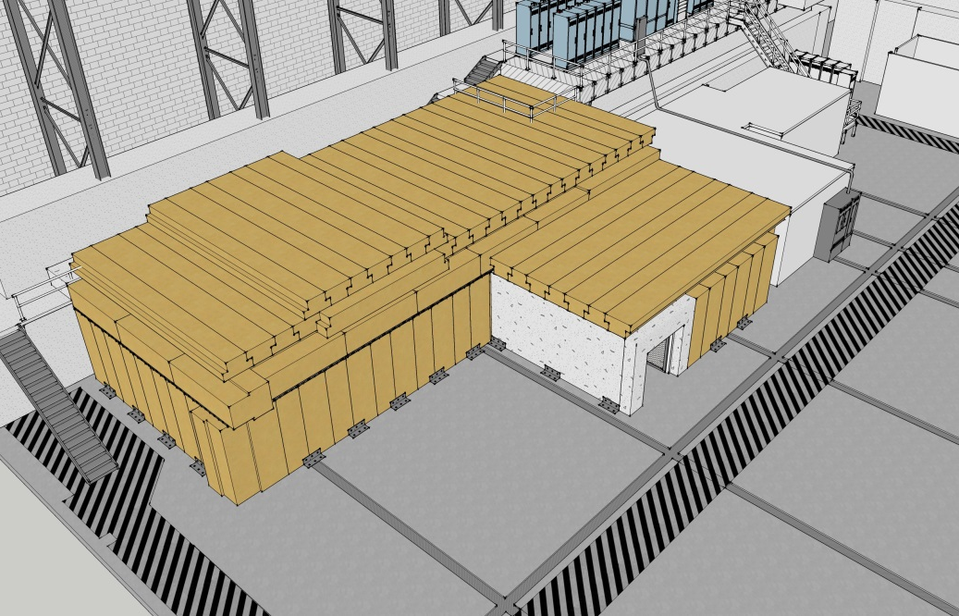
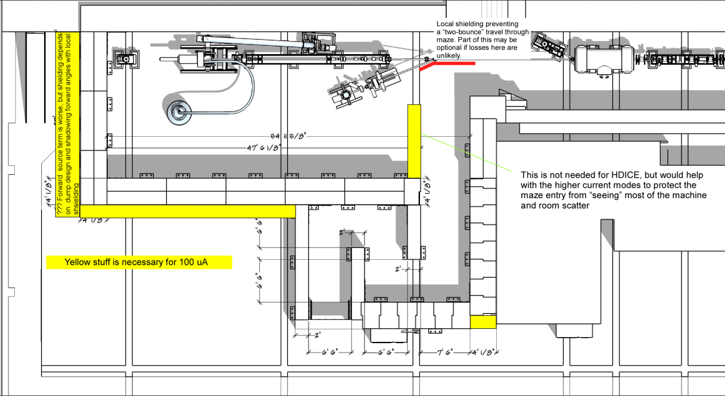
Compact 10 MeV Accelerator….
old injector test cave
What we started with…
UITF as imagined

Slide 3
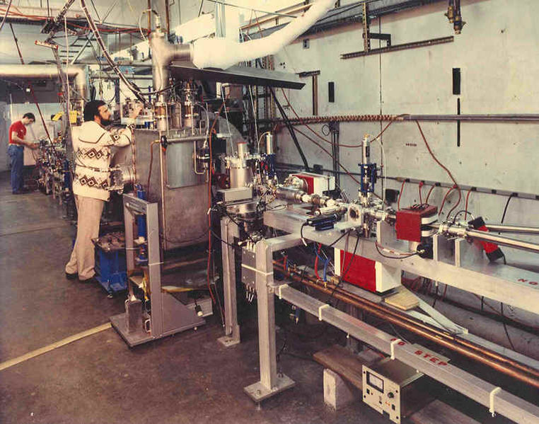
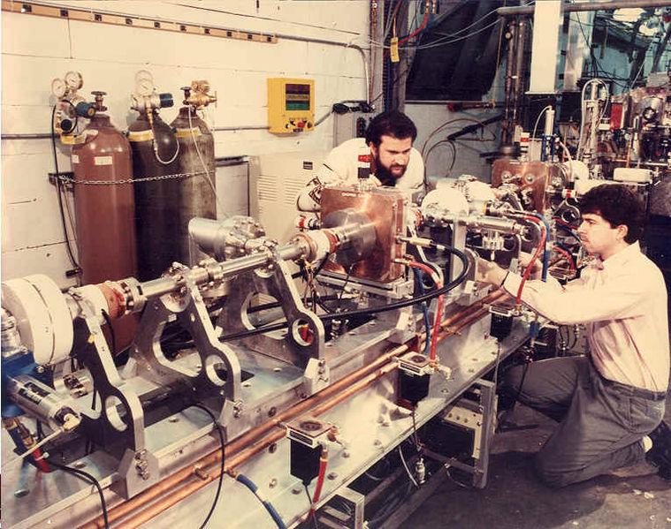
ITC: first tests of CEBAF T-Gun and ¼ CM

Slide 4
Status Reviews
UITF Accelerator Review: beamline design reviewed by Ops/CASA/SRF, March 18, 2016, “Will it work?” review
Geoff Krafft, Mike Spata, Reza Kazimi, Arne Freyberger, Todd Satogata, Fay Hannon
Yes, it will work. Summary distributed, Bruce Lenzer helping to make the review “official”
Internal Safety Review, May 10, 2016
Personnel safety, including radiation protection, assessment will be sent to SCMB
Conduct of Operations Review, June 2016
Commissioning and Operations plans (the SCMB review)
Accelerator Readiness Review, August 2016
Documentation in place, systems ready and checked out, staff trained
Experimental Readiness Review, Nov/Dec 2016

Slide 5
Status Reviews
Internal Safety Review, May 10, 2016
Poelker: UITF overview, from safety perspective
Areti: ODH Assessment
Hansknecht: gun HV, lasers and SF₆
Vashek: Radiation
Henry Robertson: ODH, PSS
Poelker: wrap up
(Bob says don’t forget…..electrical safety for power supplies, ionizing radiation non-ionizing radiation (RF and lasers), PSS: access controls, shielding, and beam containment (Credited Control for limiting beam current) and associated level of redundancy Operational Safety Procedure(s) for maintaining safe operation and maintenance)
Assessment will be sent to SCMB

Slide 6
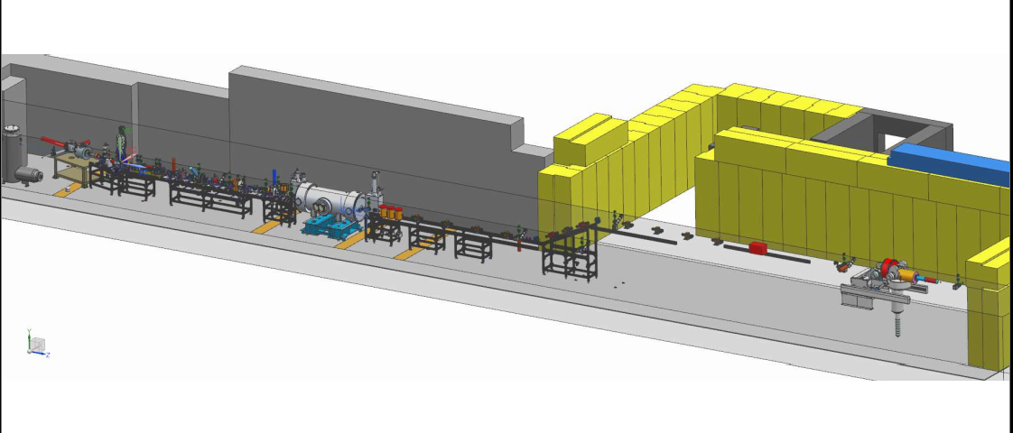
UITF Beamline Layout
keV region
450 kV, 3mA
225 kV, 32 mA
MeV region
Up to 10 MeV, 100 nA
Desire 100 uA at 42” beam height
(i.e., no vertical chicane)

Slide 7
UITF: what will it do? who will use it?
Commission HDIce with electron beam
Tests with MeV beam more challenging than tests with GeV beam
Commission key components of Injector Upgrade: new ¼ CM, 200kV gun, 200kV Wien
High current polarized gun tests at keV energy
Commission new hardware for CEBAF: nA stripline BPMs, low noise BCM for parity violation experiment, magnetron vs klystron, etc.,
Polarized positron source, fast kicker, Bubble Chamber experiment, MeV parity violation experiments…

Slide 8
Outline
Ionizing Radiation
Photogun (photo beam and field emission)
¼ Cryomodule (accelerated beam and field emission)
Buncher, chopper cavities (possible, but unlikely)
Residual radiation? (little activation at beam energy < 10 MeV)
Non-ionizing Radiation
Laser
RF from klystrons and solid-state amplifier
Oxygen Deficiency Hazard (He, N₂, SF₆)
Cryogenic fluids
Unique and “Typical” hazards
Elevated beamline, magnets, ion pumps, vacuum systems
Notes:
RW=Roy Whitney

Slide 9
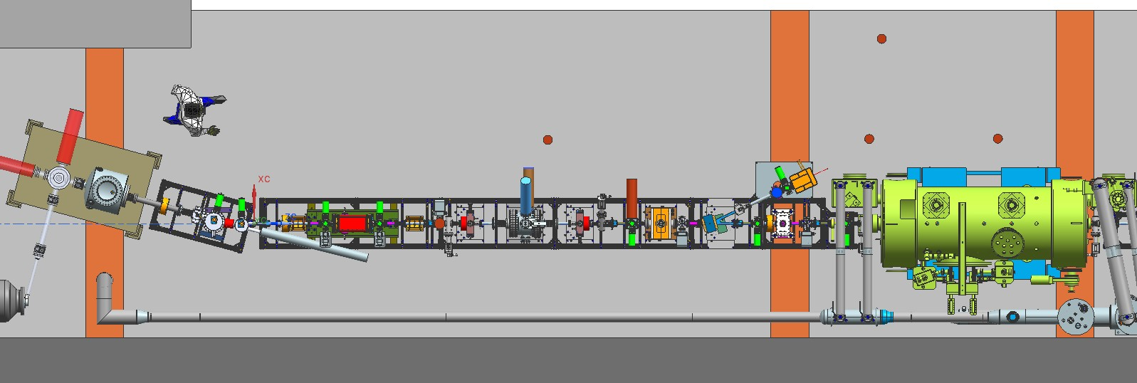
HV power supply inside SF6 tank, cable connection to gun
High current keV beam tests
Relief valves vented to high bay
egress
LHe and LN2 supply
Laser table, alignment mode
RF waveguides

Slide 10
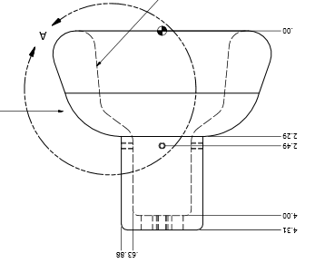
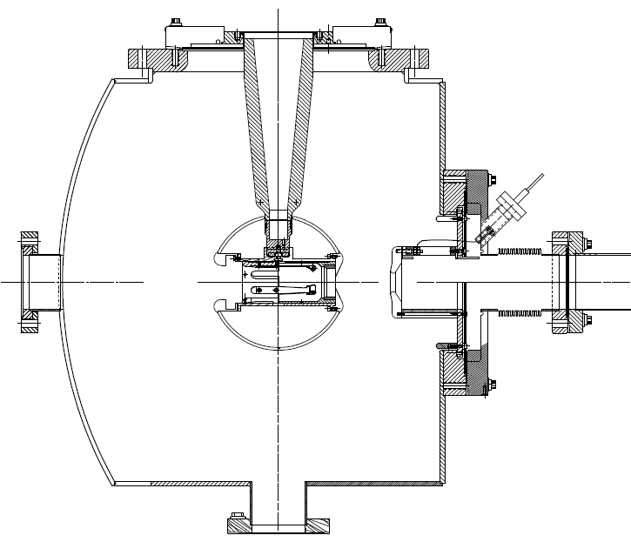
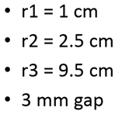
Inverted Insulator Photogun
No exposed high voltage

Slide 11
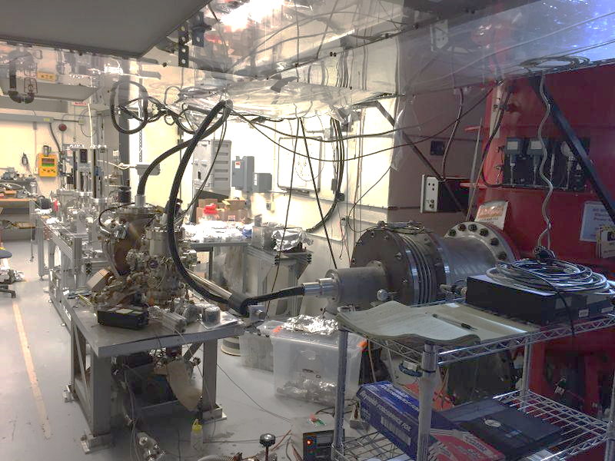
Gun and Beamline at GTS

Slide 12
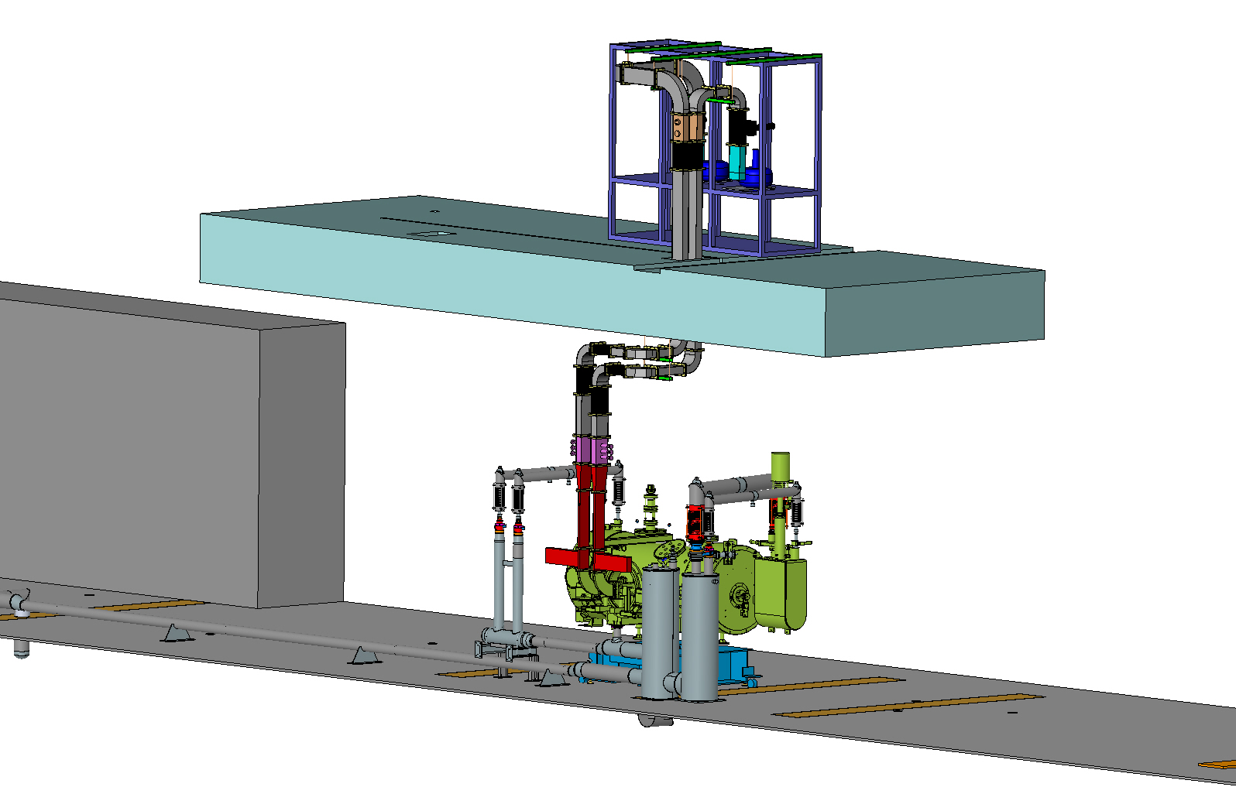
UITF RF
Solid State Amp
Klystron rack
Klystrons and Solid State Amp interlocked to PSS
Choppers
Buncher

Slide 13
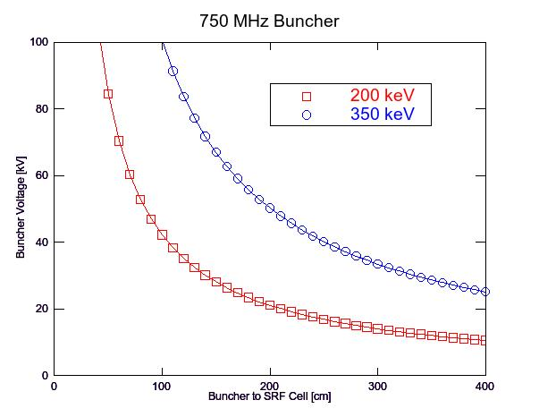
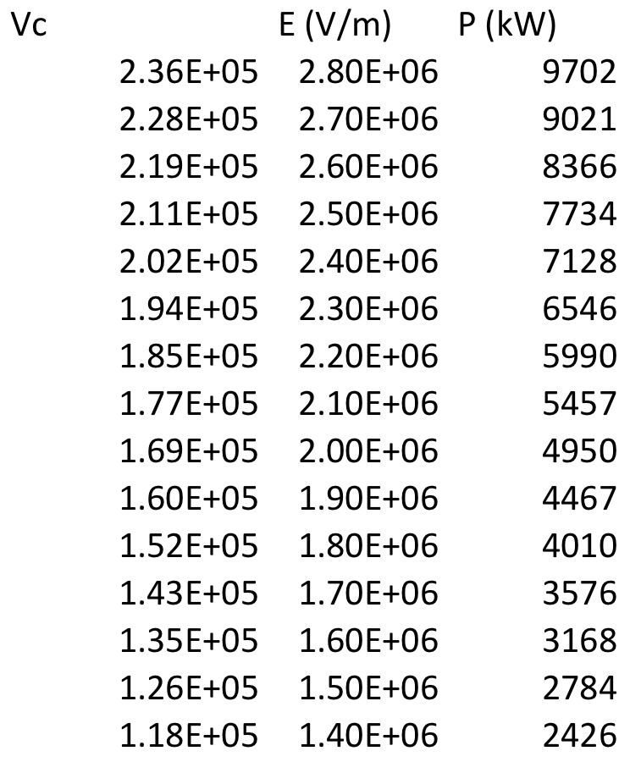
keV region 750 MHz Buncher @ 200 and 350 keV
The LERF 750 MHz buncher will initially be used at UITF.
The voltage V_{b} required to form a longitudinal waist a distance L downstream of the buncher is used (Handbook of Accelerator Physics & Eng. P. 554) to estimate required RF power < 1 kW.
V_{b} = (λ_{RF}/2πL) m_{e}c² γ (γ²-1) where λ_{RF} = c / 750 MHz
Courtesy T. Powers
We won’t be driving the buncher hard, but we will use a powerful Solid State Amp
We are safe because the buncher will be interlocked to PSS, it will not be powered while we are inside the Cave
~36 kV
~15 kV

Slide 14
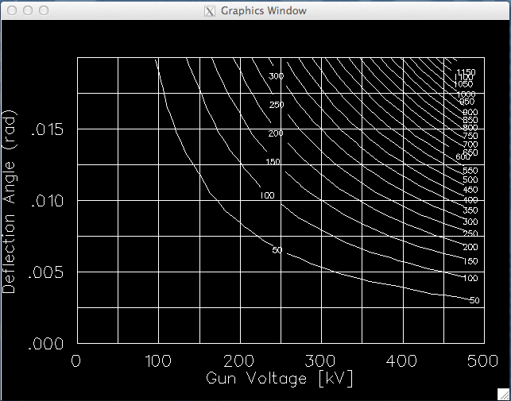
keV region 1497 MHz Choppers @ 200 to 350 keV
Pair of chopping cavities are capable to provide 10 mrad kick to 350 keV
Re-purpose original 1497 MHz X/Y chopper cavities:
TN-90-214, C. Yao – Comparison of measurement and MAFIA (agrees 50%)
TN-90-234, G. Krafft – Includes relativistic correction, deflection equation, cavity parameters
Power ~ (E_{b} * β * θ)² / [ (R/Q) * Q₀ ]
R/Q ~ 12 ohms
Q₀ ~ 14000
= 10 mrad
Chopper tests 2014.
75W
200W
C1
C2
No x-rays detected

Slide 15
keV region operation : dipoles, solenoids, quads @ 350 keV
E0 (MeV) | 0.5110
T (MeV) | 0.3500
E (MeV) | 0.8610
P (MeV/c) | 0.6930
γ | 1.6849
β | 0.8048
β γ | 1.3561
B ρ (G-cm) | 2311.4512
Solenoid | Element Name | Elegant Lattice |  | Elegant Model |  | Focal Length |  | Solenoid
 |  | Strength KS | Length L | Strength KS | Length L | F | B2L | "HMAX" | Current | IMAX
 |  | [rad/m] | m | [rad/m] | m | m | G2-cm | G2-cm/A2 | Amp | Amp
Y Waist | MFH1K01 | 11.00 | 0.07620 | 11.00 | 0.07620 | 0.434 | 492617.4532 | 8.60E+04 | 2.39 | 3.5
Wien Waist | MFB2K02 | 13.40 | 0.07620 | 13.40 | 0.07620 | 0.292 | 731028.0157 | 9.98E+04 | 2.71 | 3.5
Chopping Waist | MFA3K02A | 12.70 | 0.03175 | 12.70 | 0.06350 | 0.391 | 547205.7096 | 1.11E+05 | 2.22 | 2.5
 | MFA3K02B | -12.70 | 0.03175
Before Slit | MFD3K02AA | 11.98 | 0.02500 | 11.98 | 0.05000 | 0.557 | 383400.8695 | 1.43E+05 | 1.64 | 1
 | MFD3K02AB | -11.98 | 0.02500
After Slit | MFD3K02BA | 11.98 | 0.02500 | 11.98 | 0.05000 | 0.557 | 383400.8695 | 1.43E+05 | 1.64 | 1
 | MFD3K02BB | -11.98 | 0.02500
Buncher Waist | MFA3K03B | -12.00 | 0.03175 | 12.00 | 0.06350 | 0.437 | 488546.2346 | 1.11E+05 | 2.10 | 2.5
 | MFA3K03B | 12.00 | 0.03175
Cryounit Waist | MFA4K03A | -11.00 | 0.03175 | 11.00 | 0.06350 | 0.521 | 410514.5443 | 1.11E+05 | 1.92 | 2.5
 | MFA4K03B | 11.00 | 0.03175
Dipole | Element Name | Bend Angle θ |  | Int. Field BL | FMAP BL v. I | Current I | IMAX
 |  | deg | rad | G-cm | G-cm/A | Amp | Amp
15 deg bend | MDS2K01 | -15.0 | -0.262 | -603.410 | 136.300 | -4.427 | 3.5A (41.5C)
45 deg bend | MDI4K02 | -45.0 | -0.785 | -1769.108 | 653.800 | -2.706 | 3.5
Steering Coil | MHB*H | 5.8 | 0.100 | 231.872 | 178.4 | 1.300 | 1.0
Steering Coil | MHB*V | 5.8 | 0.100 | 231.872 | 142.4 | 1.628 | 1.0
Steering Coil | MBH*H | 5.8 | 0.100 | 231.872 | 172.5 | 1.344 | 1.0
Steering Coil | MBH*V | 5.8 | 0.100 | 231.872 | 147.2 | 1.575 | 1.0
Quadrupole | Element Name | Length L | Strength K1 | Int. Gradient B'L | FMAP B v. I | Current I | IMAX
 |  | m | 1/m2 | Gauss | G/A | Amp | Amp
Wien Quad | MQU2K02 | 0.050 | 3.000 | 346.718 | 76.800 | 4.515 | 10.000
 | MQU2K03 | 0.050 | 3.000 | 346.718 | 76.800 | 4.515 | 10.000
Upgrade 15° dipole and evaluate solenoids
Steering coils limited ~60 mrad, or replace w/ e.g. RadiaBeam (STM-01-341-110) BL_{max} = 500 G-cm
These are not large fields

Slide 16
MeV region operation : dipoles and quads @ 10 MeV
Momentum (MeV/c) | 10.00
γ | 19.5695
β | 0.9987
β γ | 19.5439
B ρ (G-m) | 333.56
Function | Quantity | Name | Length L | Strength K1 | Integrated Field B'L | QJ HMAX 59.4 G/A | QD HMAX 321.4 G/A
 | # |  | m | 1/m2 | Gauss | Amp | Amp
Matching from QCM | 1 | Q1 | 0.150 | 1.682 | 84.157 | 1.417 | 0.262
 | 1 | Q2 | 0.150 | -4.566 | -228.455 | -3.846 | -0.711
 | 1 | Q3 | 0.150 | 1.202 | 60.141 | 1.012 | 0.187
 | 1 | Q4 | 0.150 | -0.083 | -4.133 | -0.070 | -0.013
Manage Chicance Dispersion | 2 | QA | 0.150 | -19.919 | -996.622 | -16.778 | -3.101
 | 1 | QB | 0.075 | 4.980 | 124.577 | 2.097 | 0.388
Sets HDIce Beam on Target | 1 | QW | 0.150 | -1.198 | -59.941 | -1.009 | -0.186
 | 1 | QX | 0.150 | 2.520 | 126.086 | 2.123 | 0.392
 | 1 | QY | 0.150 | -5.330 | -266.681 | -4.490 | -0.830
 | 1 | QZ | 0.150 | 2.430 | 121.583 | 2.047 | 0.378
Dipole Function | Element Name | Angle |  | BL | MDL "HMAX" | Current | IMAX
 |  | deg | rad | G-cm | G-cm/A | Amp | Amp
Chicane Dipole | B1 | 25.000 | 0.436 | 14439.120 | 2400.0 | 6.016 | 10
Chicane Dipole | B2 | -25.000 | -0.436 | -14439.120 | 2400.0 | -6.016 | 10
Steering Coil | MHB*H | 5.8 | 0.100 | 3346.085 | 178.4 | 18.756 | 1
Steering Coil | MHB*V | 5.8 | 0.100 | 3346.085 | 142.4 | 23.498 | 1
Steering Coil | MBH*H | 5.8 | 0.100 | 3346.085 | 172.5 | 19.398 | 1
Steering Coil | MBH*V | 5.8 | 0.100 | 3346.085 | 147.2 | 22.732 | 1
Radiabeam (med) | H/V | 5.8 | 0.100 | 3346.085 | 169.3 | 19.764 | 7.5
Evaluate steering coil needs for final layout, e.g. combination of RadiaBeam (STM-01-340-138: 1250 G-cm) and Haimson sufficent, modest deflection, etc.
These are not large fields

Slide 17
Cryogenic Fluids
CTF is oversubscribed: can’t operate the VTA, CMTF, UITF at same time
Cryo Group installing transfer lines, connecting ¼ CM to CTF, and working on controls
Agreed on means to “park” the ¼ CM when not accelerating beam: circulate 80K LN₂ through 35K shield line. That means UITF should not be a burden on CTF 34 wks per year
How to cool HDIce? Purchase LHe dewars and then connect to CTF when Cryo labor available. Capture and return the He boiloff from HDIce to CTF
UITF ODH0 unless we are stabbing U-tubes of swapping dewars

Slide 18
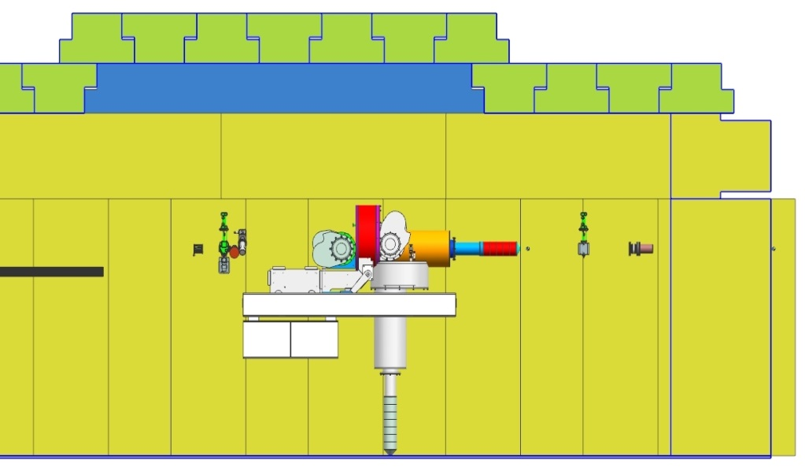
Cave 2
Ceiling not as thick as Cave1, but can add a second layer if measurements indicate this is necessary
Elevated beamline, need safe platform to work
Dedicated review of HDIce to happen later (ERR)
Target here
e-beam
Target rotates

Slide 19
BLM locations
Insertable Faraday Cup
Fixed Dump
PSS BCM
Insertable Faraday Cup
Someday, we want to deliver 100uA to cup or dump

Slide 20
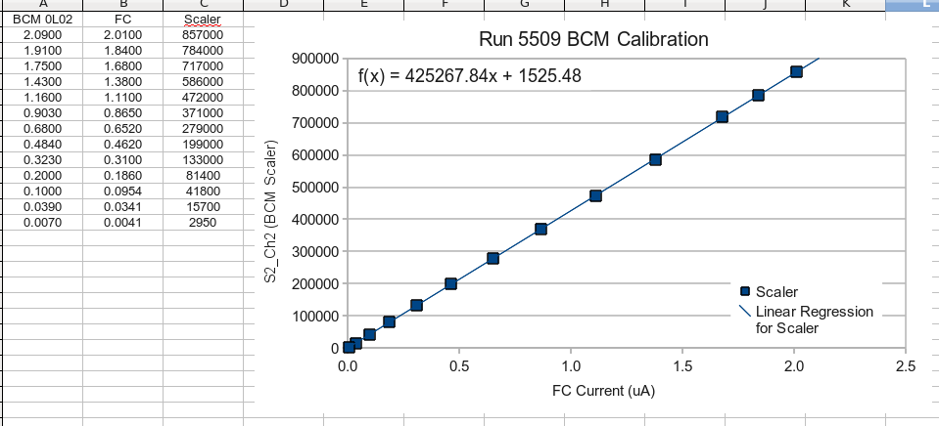
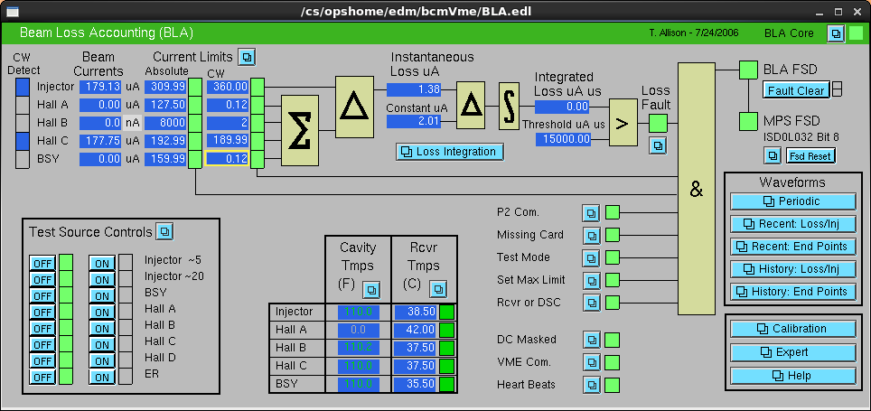
PSS BCM
PSS BCM
Insertable Faraday Cup

Slide 21
PSS BCM
Relevant questions from Trent Allison:
Do you know what is required of the hardware? Does it have to be 99.9% reliable? Do we have to do MTBF calculations and install as many redundant systems as we need to reach 99.9% reliability or something like that? Or is this a 4th level "defense-in-depth" protection with less stringent requirements? How often do we calibrate against a Faraday cup? Where or who are the requirements going to come from?
Guidance from Bob May, paraphrased:
A PSS beam current monitor will be a Critical Device. It's not a 4th level defense-in-depth kind of device. Critical Devices are designed according to the requirements Based on the Conduct of Engineering Manual (CoEM). If the beam current monitor is based on existing PSS technology, then it can leapfrog many CoEM requirements. If it is a technology that is not currently used for credited control, then it likely needs a design review and documentation consistent with the CoEM before its deployed in UITF.

Slide 22
Other Key Points
Generous local shielding at ALL locations where we intentionally stop the electron beam: apertures, slits, faraday cups, dumps
Initial layout + final layout: 200kV gun and new ¼ cryomodule, and then 350kV gun and old ¼ cryomodule (imagine swap in 2018 or 2019)
Preference to visit the top of the cave during beam delivery but only after measurements have been made (penetrations filled, shielding below penetrations, beacon indicating klystrons and/or SSA energized)
Rapid Access Beacon: RadCon interface to CARMs
Notes:
RW=Roy Whitney

Slide 23
Documentation
LSOPs for laser room and for Cave when aligning laser beam into gun
ODH Assessment
OSP for ODH1 conditions
Separate Commissioning Plans for keV MeV operation
OSPs for keV and MeV operation
Sweep and Access protocols
LOTO procedures for gun, klystrons, etc.
List of general hazards: magnets, vacuum, lead shielding, etc.,

Slide 24
Training
At least initially, the CIS group will be operating UITF. At some point, we anticipate OPS getting involved…
Sweeping, accessing the Cave after beam delivery
Aligning the laser into the gun, replacing photocathodes, removing/installing the gun high voltage cable
Delivering beam to keV and MeV destinations
How to respond to ODH alarm, CARM alarm or PSS trip?

Slide 25
Backup Slides

Slide 26
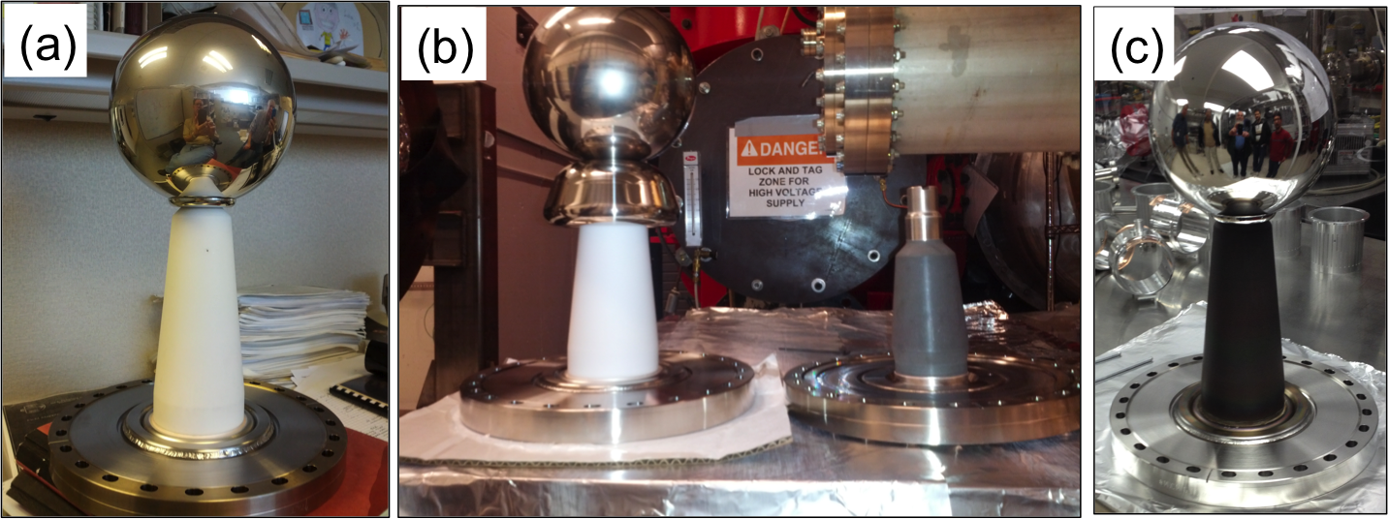
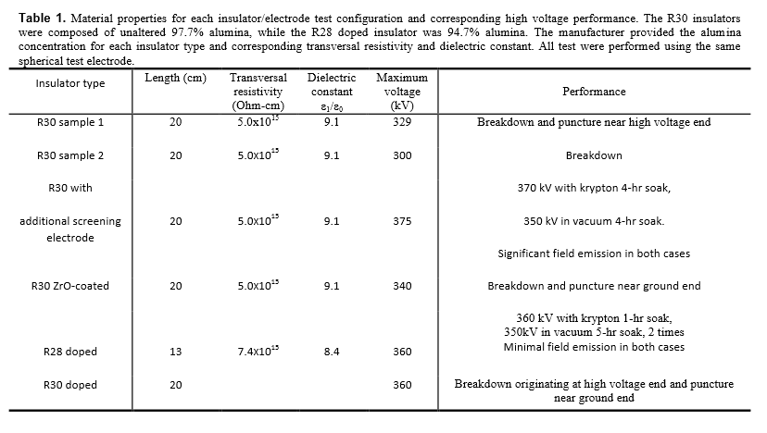
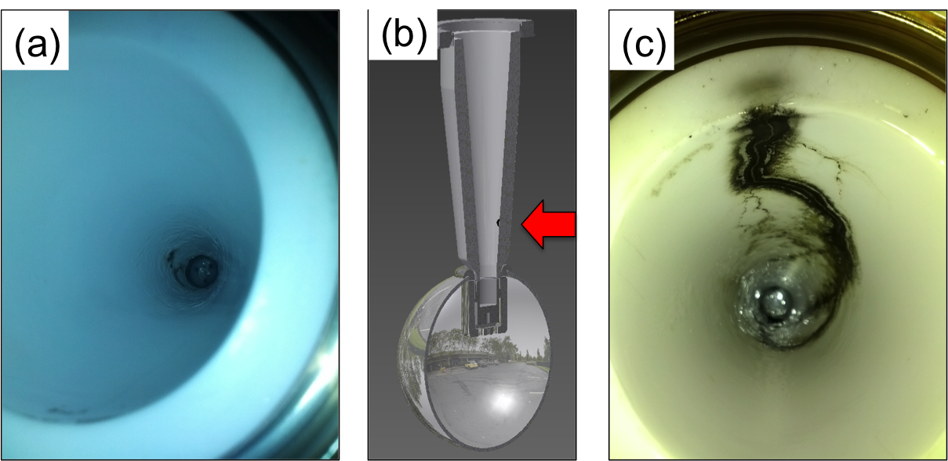
Notes:
Interior Page Design 2

Slide 27
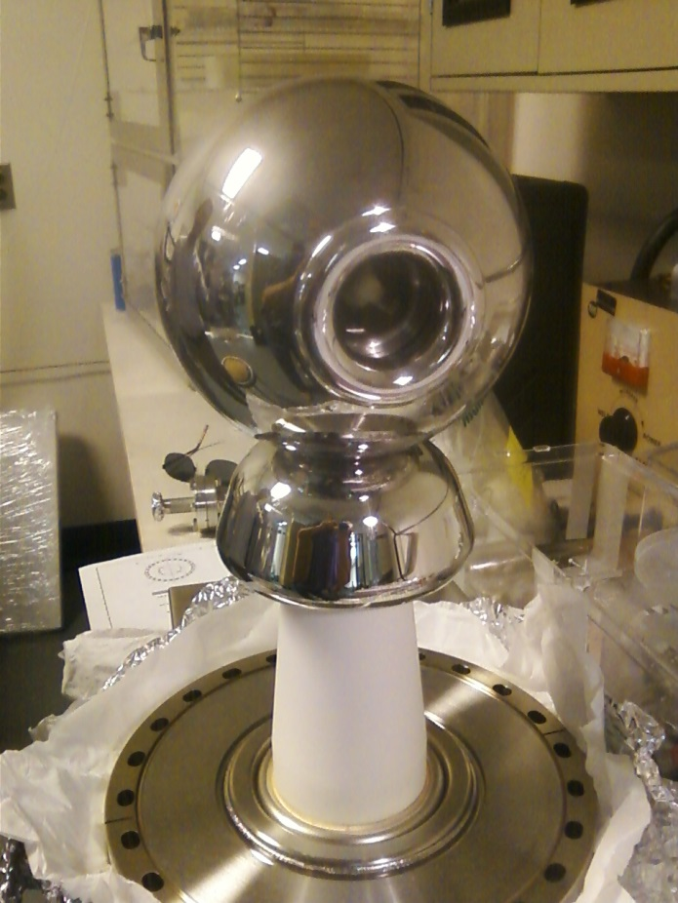
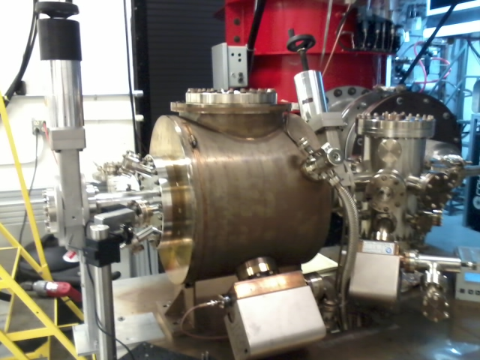
Building the electron gun at LERF GTS
The new gun happy at 325 kV, stopping at this voltage for now. Shifting focus to building the beamline and photocathode deposition chamber (LDRD magnetized beam tests)

Slide 29
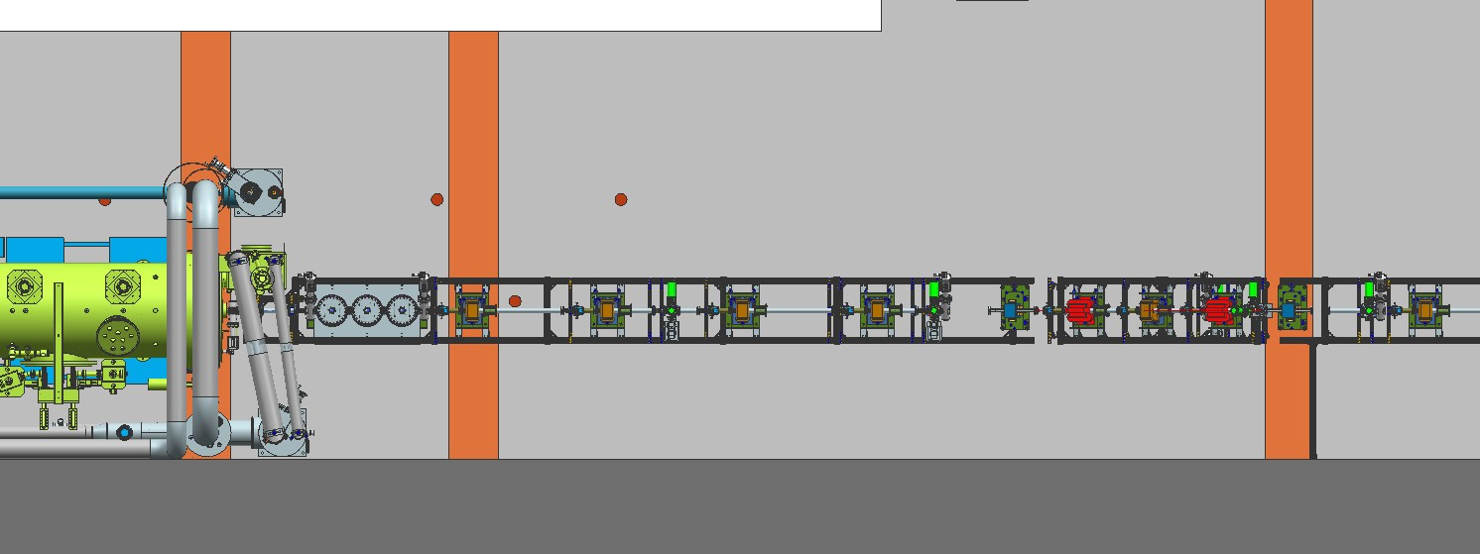
BLM locations
Fixed Dump
PSS BCM
Insertable Faraday Cup
Someday, want to deliver 100uA to cup or dump

Slide 30
BLM locations

Slide 31
UITF MPS – what will it protect?
Protect the ¼ CM
Protect against beam loss and burn-through, maintain UHV
Protect viewers (this is a software interlock – Not FSD)
Protect magnets, ensure proper field for beam transport: comparator interlock, water flow or klixon interlocks
Protect RF beamline components: vacuum and water flow interlocks
Protect cups, apertures and dumps: water flow interlocks
Protect HDIce (mostly, this means putting the beam where it is supposed to go, protect against mis-steered beam)

Slide 32
Hardware configuration
Valves OPEN only when vacuum good
Current limiting resistors in series with magnets
Water flow interlocks at cups, dumps and apertures
Window comparators on dipoles and gun HV
Viewers inserted only when laser in pulsed-mode
Water flow interlocks at buncher and chopper cavities, RF can be applied to chopper and buncher only when vacuum reads “good”
Helium liquid level interlocked to klystron high power RF

Slide 33
FSD Input Signals
An FSD trip will shutter laser and sometimes close all valves
BLMs will shutter laser: CEBAF-style BLM modules (x2)
LLRF control boards with CEBAF-style FSD signals
Vacuum FSD signals from ¼ CM. Helium liquid level interlocked to klystron control panel
All beamline ion pumps ganged together, close laser shutter and close all pneumatic valves when pressure exceeds a setpoint
Window comparators using 16 bit ADC cards designed by EES
HDice “off target” detector (qty 1, suspect it will look like a BLM)

Slide 34
Similar to CEBAF
SSG BLM chassis, x2 units
New LLRF control boards
Cryo and SRF signals from ¼ CM
Window comparators using 16 bit ADC cards designed by EES
FSD signals summed using VME boards with 12 input channels each
FSD signals transmitted via fiber at 5 MHz
SCAM to create low duty factor modes
CEBAF style pockel cell tune mode generator: RTP cell with <250ns response time, backed by shutter that closes 5-10ms later

