Slide 1
Positron Sources, Applications and
the PEPPo Experiment
Joe Grames
Center for Injectors and Sources
Jefferson Lab
I would like to acknowledge those whose work and inspirations are incorporated to this talk: D. Cassidy, S. Chemerisov,
J. Dumas, A. Freyberger, W. Gai, S. Golge, C. Hyde, J. Jonah,
R. McKeown, A. Mikhailichenko, A. Mills, Y. Saquin, E. Voutier
CAS Seminar
Old Dominion University
April 2, 2015

Slide 2
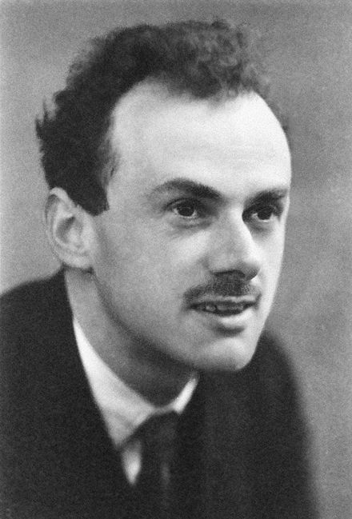
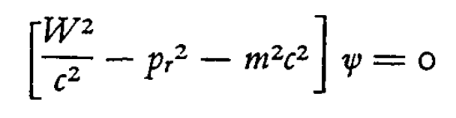
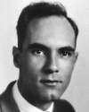
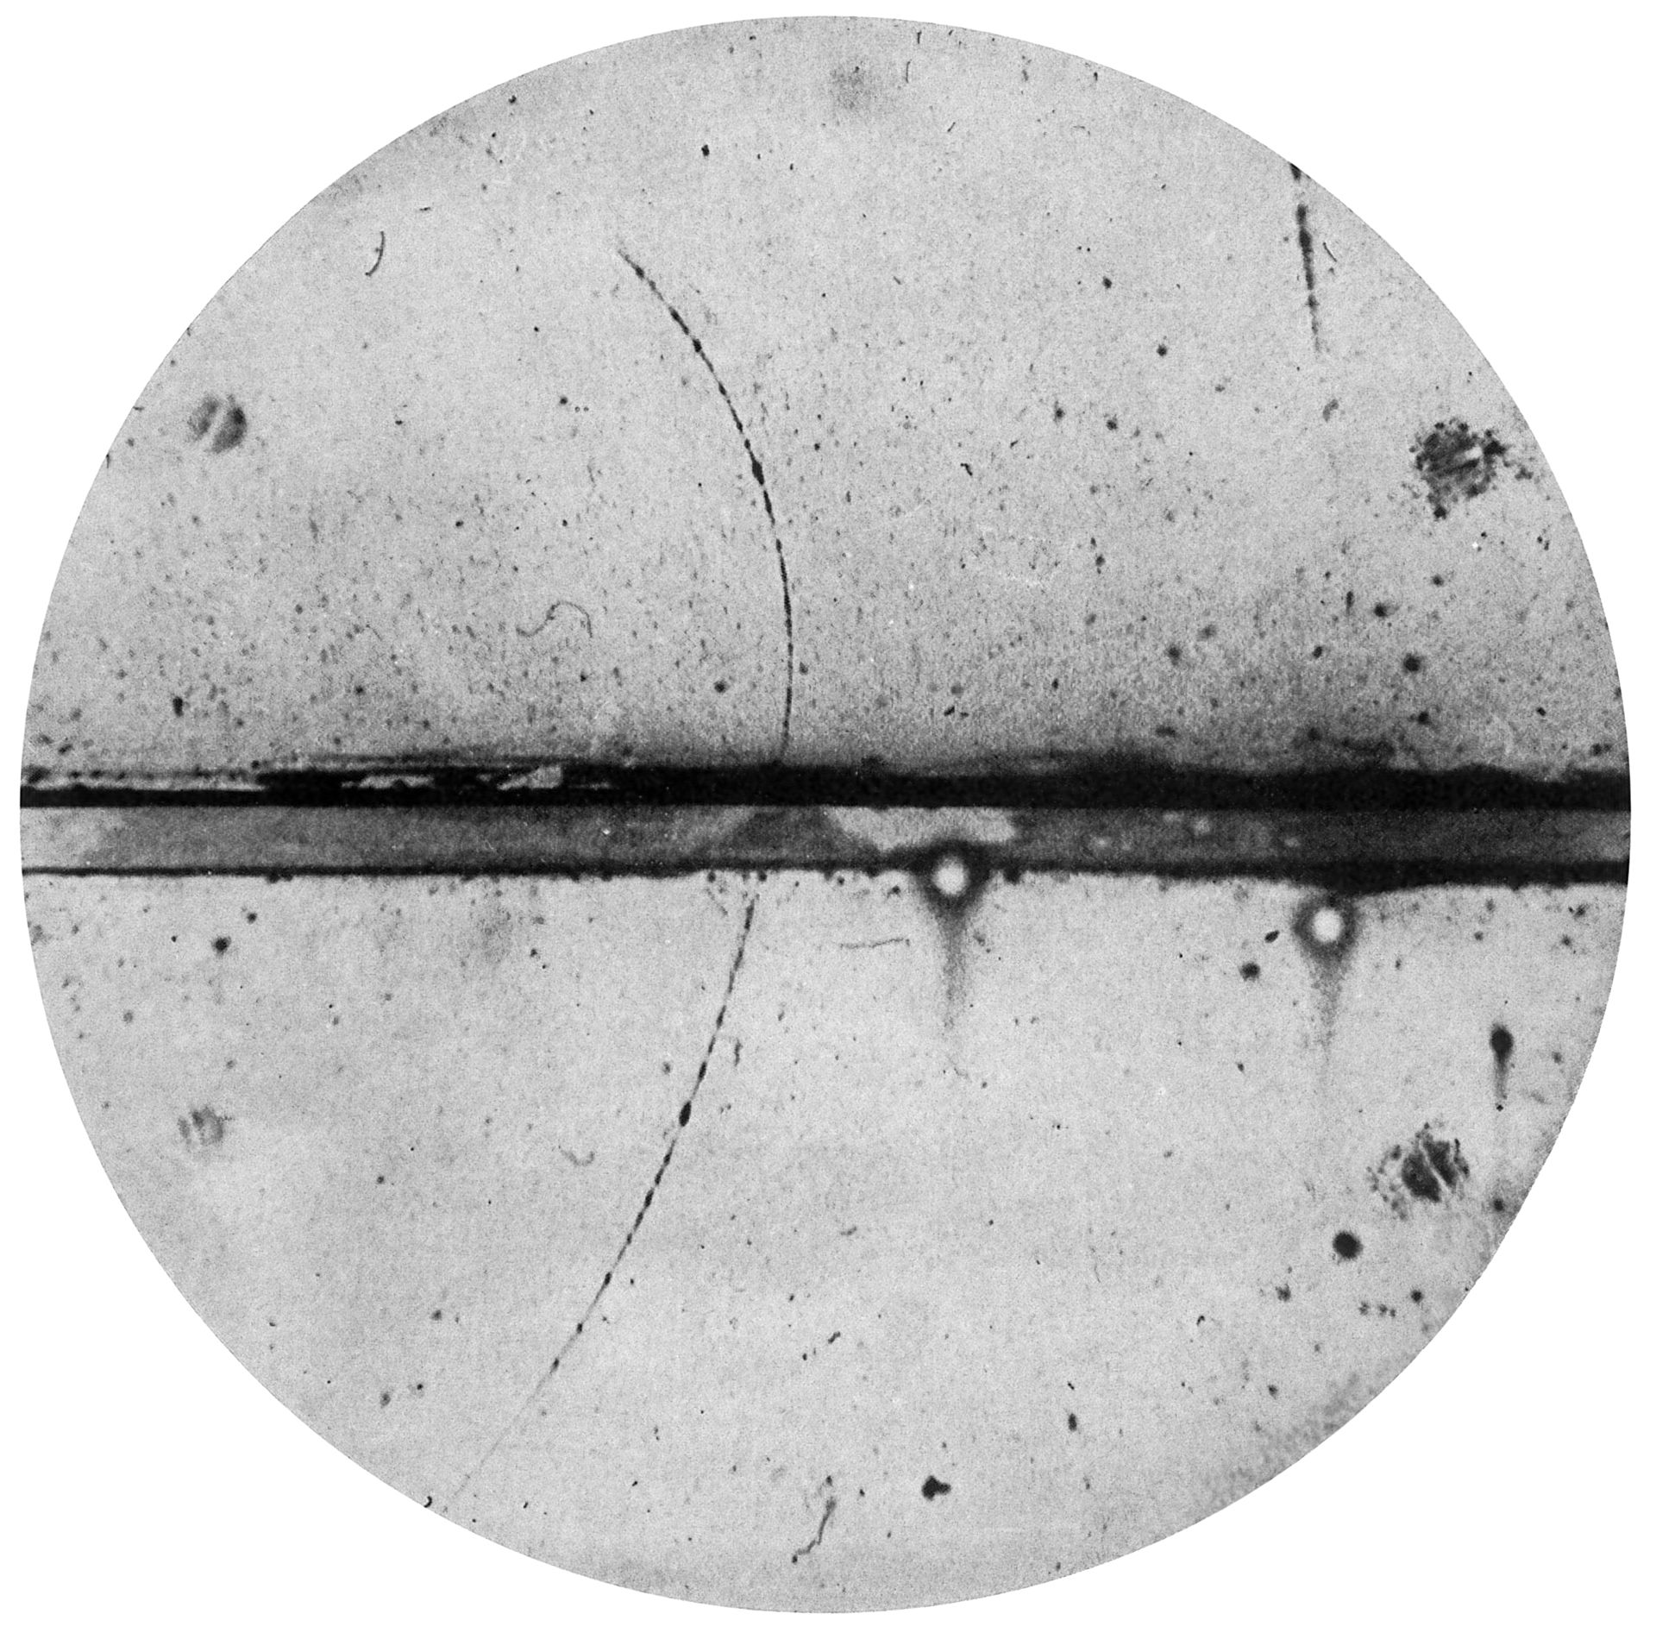
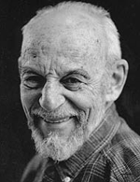
A Distinguished Field
P.A.M. Dirac (1902 – 1984) shared 1933 Nobel prize (with Erwin Schrodinger) for the relativistic wave equation of massive spin-1/2 particles. The theory predicts negative energy “holes” with properties identical to the electron yet having a positive charge!
Carl Anderson (1905 – 1991) shared 1936 Nobel prize (with Victor Hess) for detecting the positron (March 15, 1933, PRL, V. 43, The Positive Electron). The term positron was given by the Physical Review editor! He also co-discovered the muon!
23MeV
Pb, 6mm
63MeV
Martin Deutsch (1917 – 2002) confirmed the existence of bound positron, later named Positronium (Ps) that had been predicted by Anderson.

Slide 3
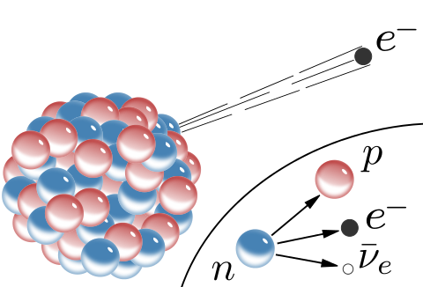
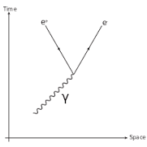

30,000 foot (9144 meter) view
β⁺ emission by radioactive decay
Pair Conversion by energetic photon
e⁺
e⁺
e⁻
n
e⁺
p
ν_{e}
Extended Radioactive Decay
  Nuclear reactors
  Accelerators/Cyclotrons
Lower energy
  Emission <MeV
  Random emission
  Half-life ~months-years
Lower Intensity
  10⁶ - 10⁸ e⁺/s
Prompt Pair Creation (>1.022 MeV)
  Bremsstrahlung
  Synchrotron/Undulator
  Inverse Compton scattering
Higher Energy
  LINAC acceleration >MeV
  Synchronous emission
Higher Intensity
  10¹⁰ - 10¹² e⁺/s

Slide 4
Talk Outline
Applications
  Diverse activities and energy requirements
Radioactive β⁺ decay
  Sources and applications
Pair production by gamma rays
  Accelerator based sources
  Technical challenges
Polarized Positrons
  Methods
  Polarized Electrons for Polarized Positrons (PEPPo)
Outlook
  Positrons at Jefferson Lab (CEBAF, LERF, UITF)
  R&D Opportunities

Slide 5
How are positrons used ?
Applications from 1 eV to 1 TeV
  Medical Diagnosis
  Materials Characterization
  Positronium Creation
  Anti-Gravity Test
  Nuclear Physics Probe
  Precision Standard Model Test

Slide 6
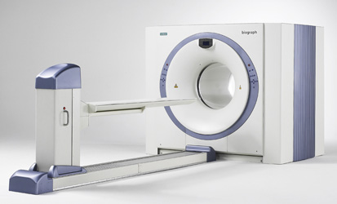
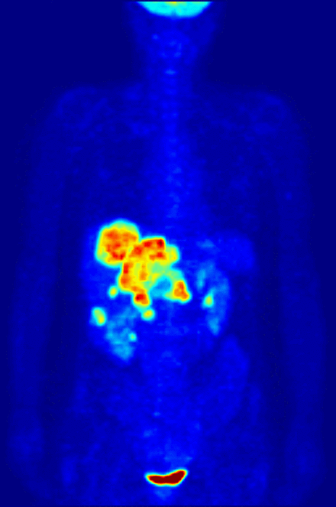
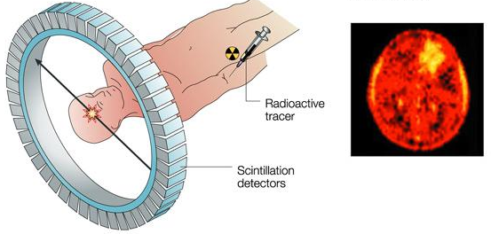
Medicine: Positron Emission Tomography
A short-lived (10’s of minutes) radioactive tracer is incorporated to a biologically active molecule, e.g. fluorodeoxyglucose (¹⁸F)
Injected into the blood tissue becomes concentrated with the tracer after a short waiting period
After travelling up to a few millimeters the thermalized positron annihilates into a pair of oppositely moving gammas
Technique depends upon high energy resolution of photons which arrive in pairs.

Slide 7
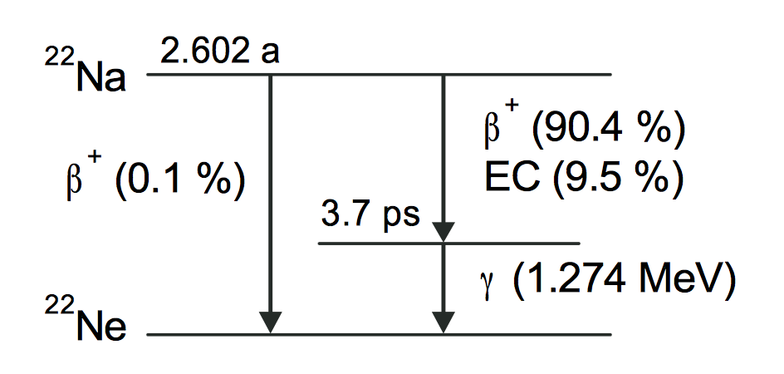
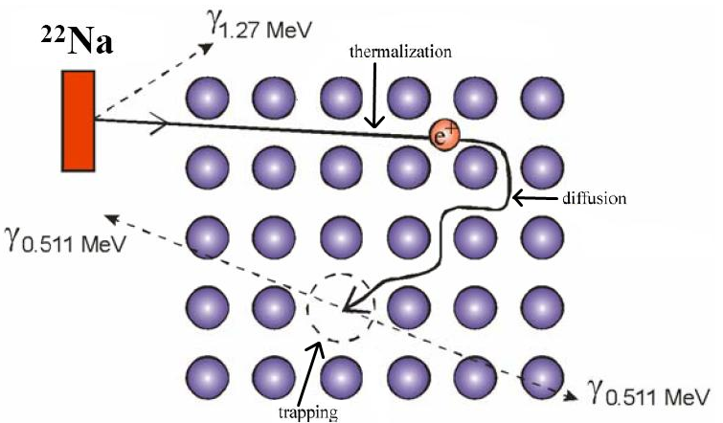
Materials Science: Positron Annihilation Spectroscopy
Probe for semiconductors, electronic structure of metals and alloys, radiation damage, surfaces and interfaces
e⁺ annihilation rate ∝ e⁻ density

Slide 8
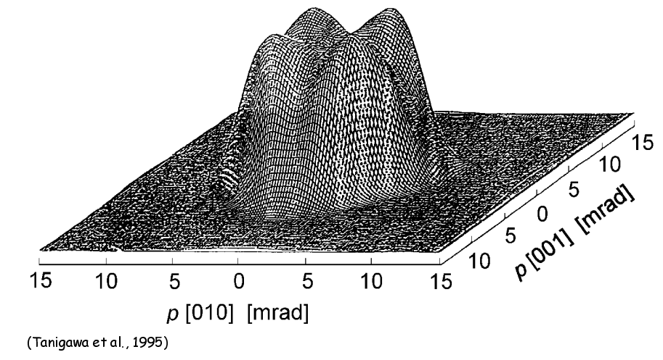
PAS Techniques and Observables
Positron Lifetime (PALS)
Time between trigger and annihilation photon depends on void size and defect density
  Silicon (bulk): 218 ps
  Defect (dopant): 260-330 ps
PALS
Annihilation
Photon
Photon
Trigger
θ
Δt
Angular Correlation (ACAR)
Angular deflection between annihilation photons due to transverse momentum of electrons
θ ∝ p_{x,y}/m_{e-}
Positron
Source
ACAR
Fermi surface
Thermalize
SAMPLE
Doppler Broadening (DB)
Annihilation photon energy shift due to the longitudinal momentum of electrons
E_{γ}=0.511 MeV ± ΔE (ΔE ∝ p_{z}/2)
DB
Annihilation
Photon

Slide 9
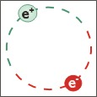
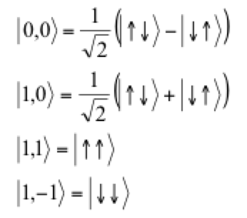
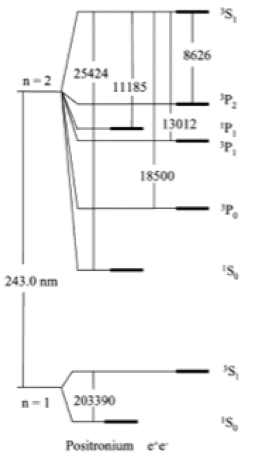
Positronium (Ps) Formation
Although an electron/positron pair are doomed to annihilate they can briefly exist in a bound state described as a hydrogen atom with corresponding reduced mass of e⁺/e⁻
Positrons directed into porous silica can pick up an electron to form Ps in the bulk and then diffuse to the surface or remain in internal voids
Ps can also be become trapped on the surface to form Ps₂ molecules
Ps behaves like atom: provide tool for atomic (QED) or condensed matter physics, or production of anti-matter
Spin
Lifetime
Hydrogen Like Energy Levels
para-Ps (s=0) ~ 125 ps
ortho-Ps (s=1) ~ 142,000 ps

Slide 10
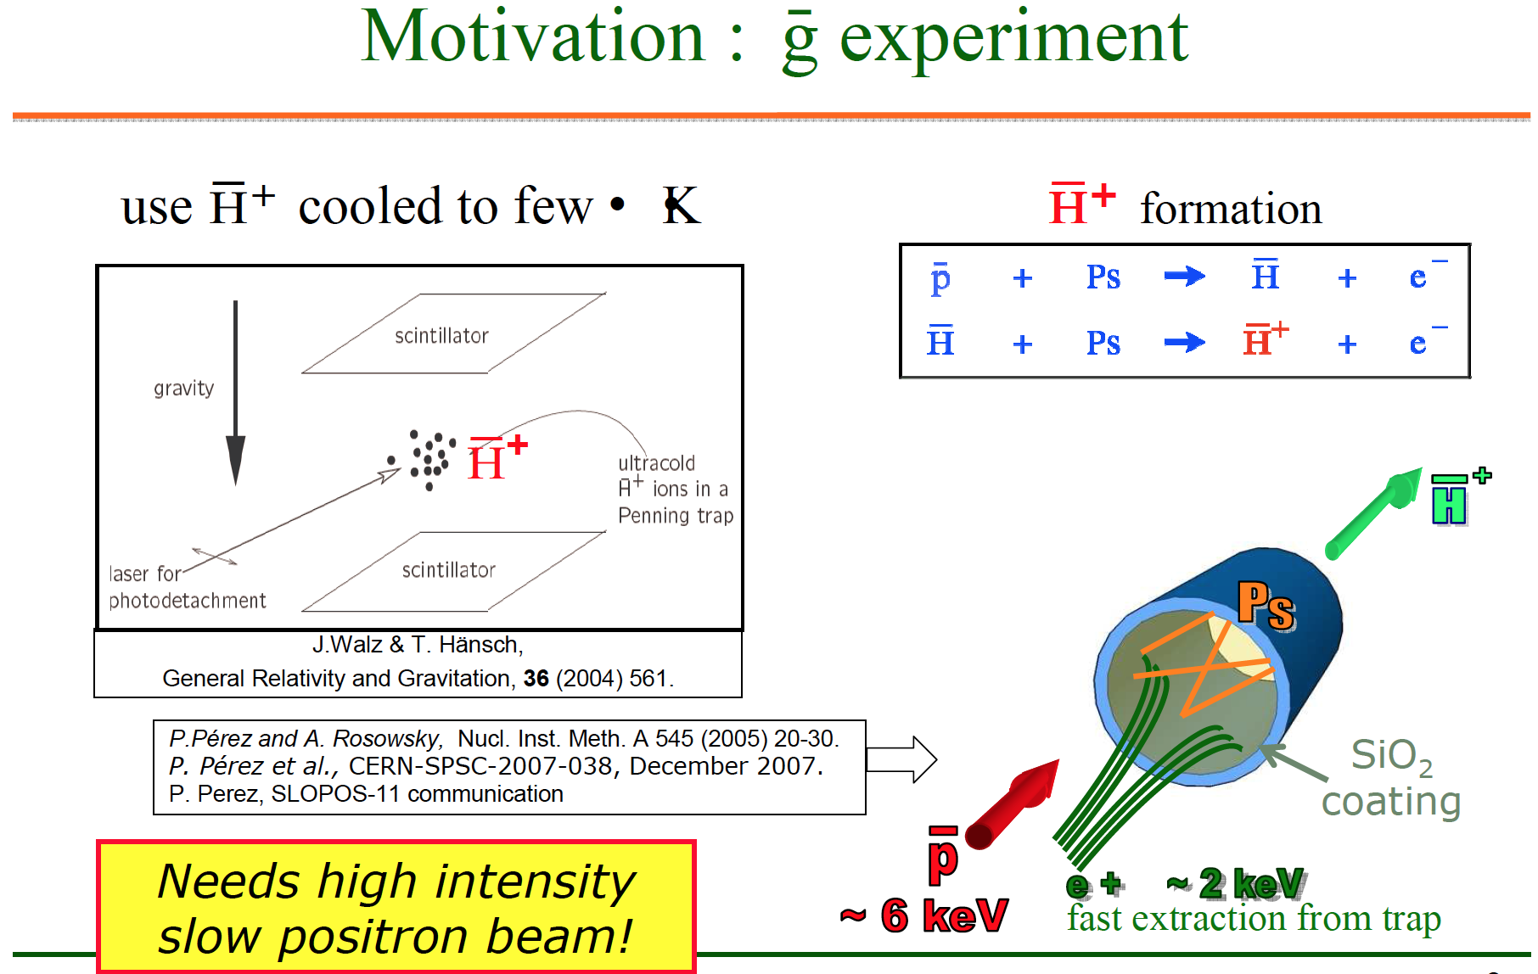

Gravitational Force on Anti-Hydrogen
Measure “free-fall” of H+ cooled to a few μK

Slide 11
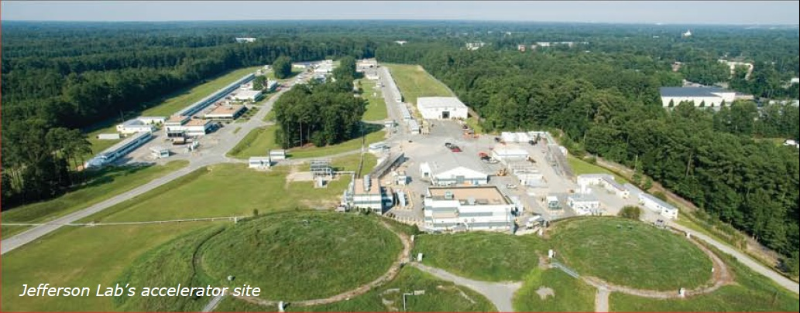
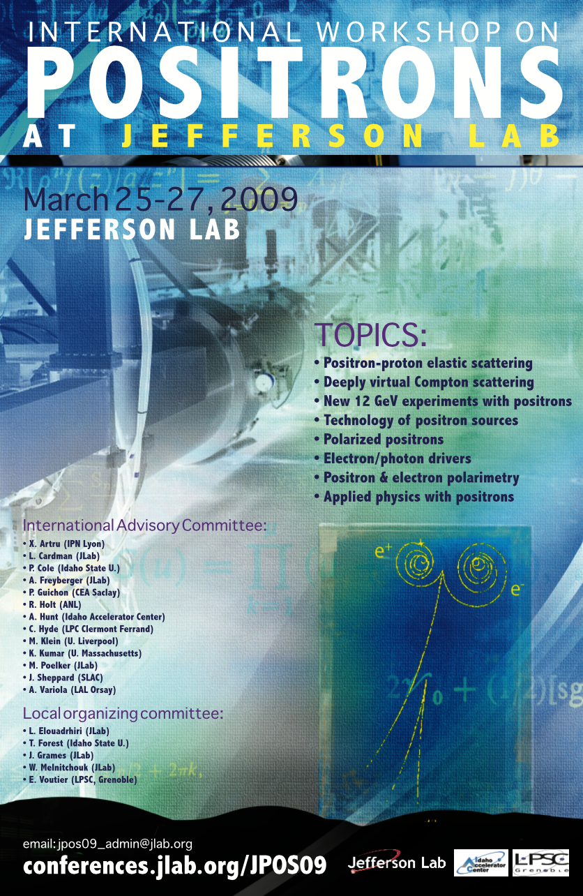
Nuclear Physics
Jefferson Lab’s CEBAF Accelerator
CW electron beam to 3 halls
Electron Polarization ~90%
Max Energy: 11 GeV(ABC) / 12GeV(D)
Max Current: 200 uA
Nuclear physics benefits using a polarized positrons beam:
  Parton Imaging (Nuclear Momentum)
  Deeply Virtual Compton Scattering
  Two Photon Exchange
Other efforts may also benefit:
  Electron Ion Collider
  Materials Science Collaborations
The charge and polarization of the probe beam provide degrees of freedom which constrain physical observables.

Slide 12

Electromagnetic form factors
Eric Voutier
Experimental Observables
M.P. Rekalo, E. Tomasi Gustafsson, NPA 742 (2004) 322 C. Carlson, M. Vanderhaeghen, ARNPS 57 (2007) 171
Unpolarized e± elastic scattering and polarization transfert observables off the nucleon involve up to 5 unknown quantities.
Cross Section
Polarization
Transfer
5 unknown contributions for 6 independent observables
Combining Polarized electrons and positrons allows a model independent separation of the electromagnetic form factors of the nucleon.
Newport News, March 16, 2012
3/18

Slide 13
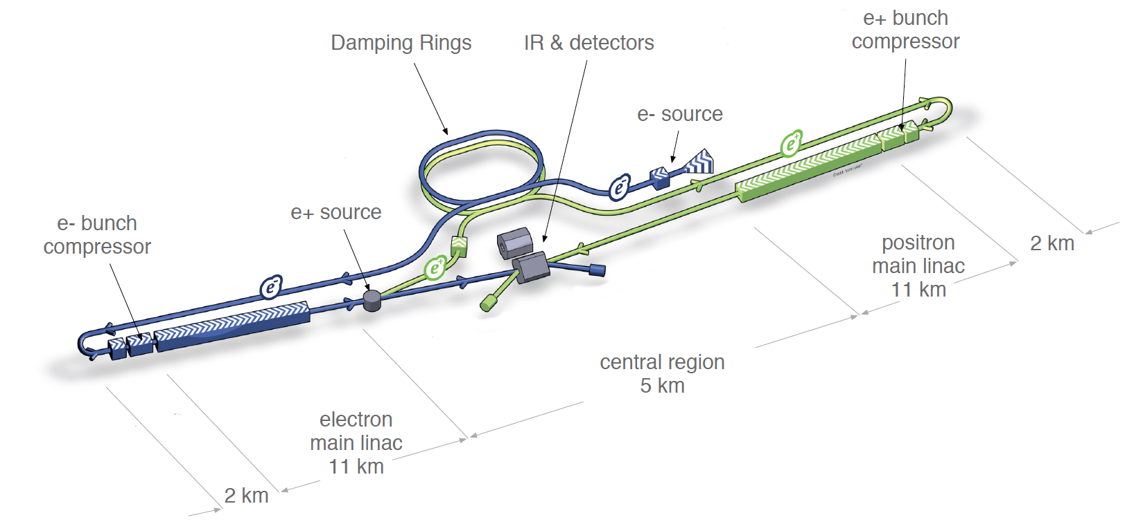
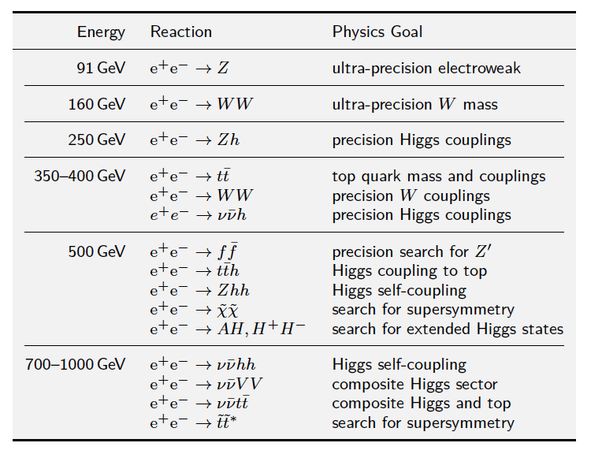
Energy Frontier Tests of the Standard Model (1 TeV)
International Linear Collider design relies on the collision of polarized electrons and polarized positrons resulting in center-of-mass-energies up to 1 TeV
Thrust is to provide precision tests of Standard Model that benefit from model independent reactions that do not depend on the additional “stuff” which results from colliding massive particles, e.g. like that at the LHC.
The polarization of the e+ and e- further isolate spin-dependent channels

Slide 14
Producing Positron Beams
  Application Driven
    energy
    intensity
    polarization
  Source
    yield
    collection
    (de)acceleration
  Beam Quality
    transverse/longitudinal emittance
    time structure
  Technical Challenges
    managing beam power
    thermal loads
    radioactivity

Slide 15
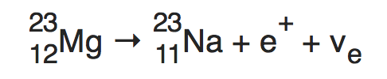
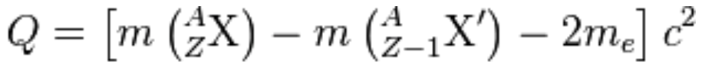
Positron Generation by β Decay
Beta-plus (β⁺) decay occurs when a proton inside a nucleus becomes a neutron via emitting W⁺ (or absorbing W⁻) via the weak interaction.
e⁺
n
The daughter nuclide retains the mass number (A) but the atomic number (Z) decreases by 1 unit.
e⁺
p
ν_{e}
Q > 0 implies
  mass of parent nuclei must exceed mass of daughter by twice m_{e}
  isolated proton cannot decay into a (heavier) neutron
Positron Energy
  typically 10-100 keV but can be as high as ~10 MeV
  Q is partitioned to β⁺ and ν_{e}

Slide 16
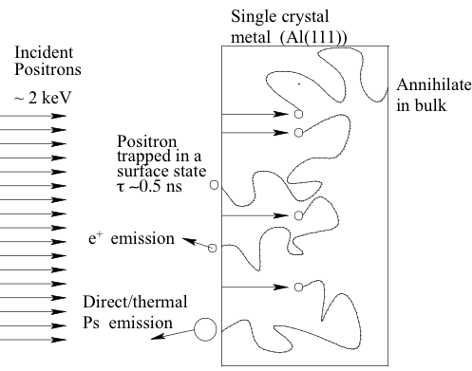
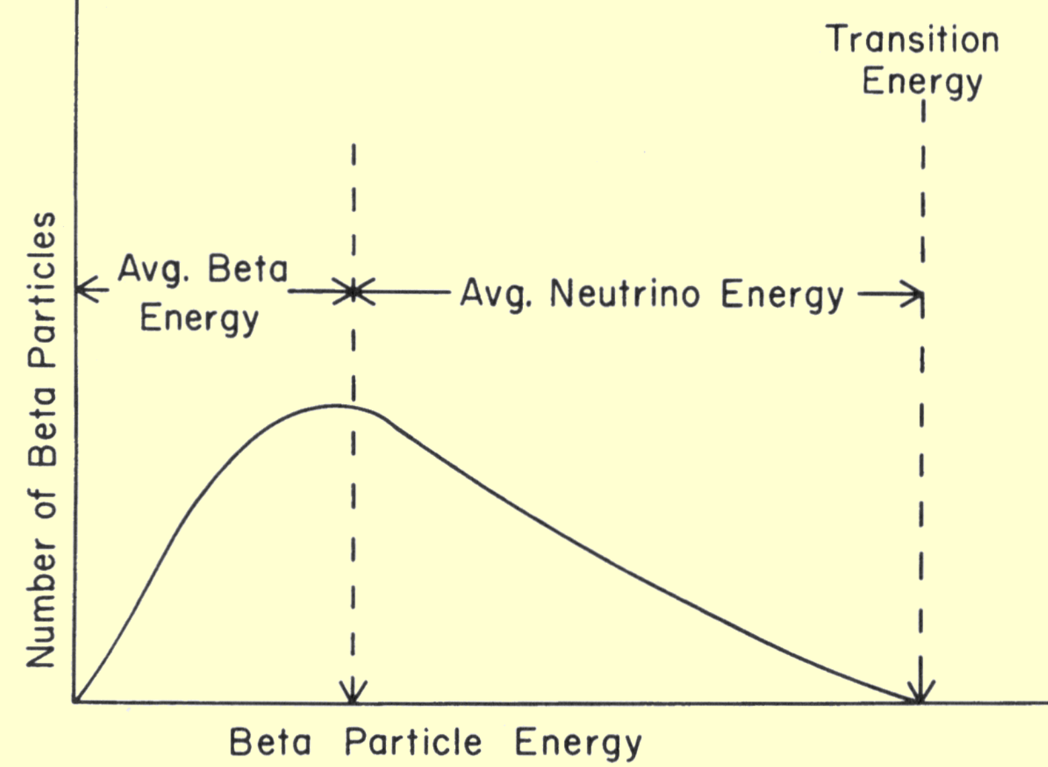
Moderating Radioactive β⁺ Sources
Na²², mean 178keV, endpoint 545keV
ε = L/R * S
ε: efficiency for e+ emission
L: diffusion length ~100 nm
R: range ~15,000 nm
S: surface prob ~ 35%
Use of moderators
Thermalize Positrons (~1 ps)
  inelastic collisions w/ core electrons
  plasmons (optical) ~ 10 V
  phonons (acoustic) ~ 1 V
Their fate is varied
  Most annihilate in bulk
  Some capture at surface and annihilate
  Some pick up e- and leave as Ps
  And some remit !!!!

Slide 17
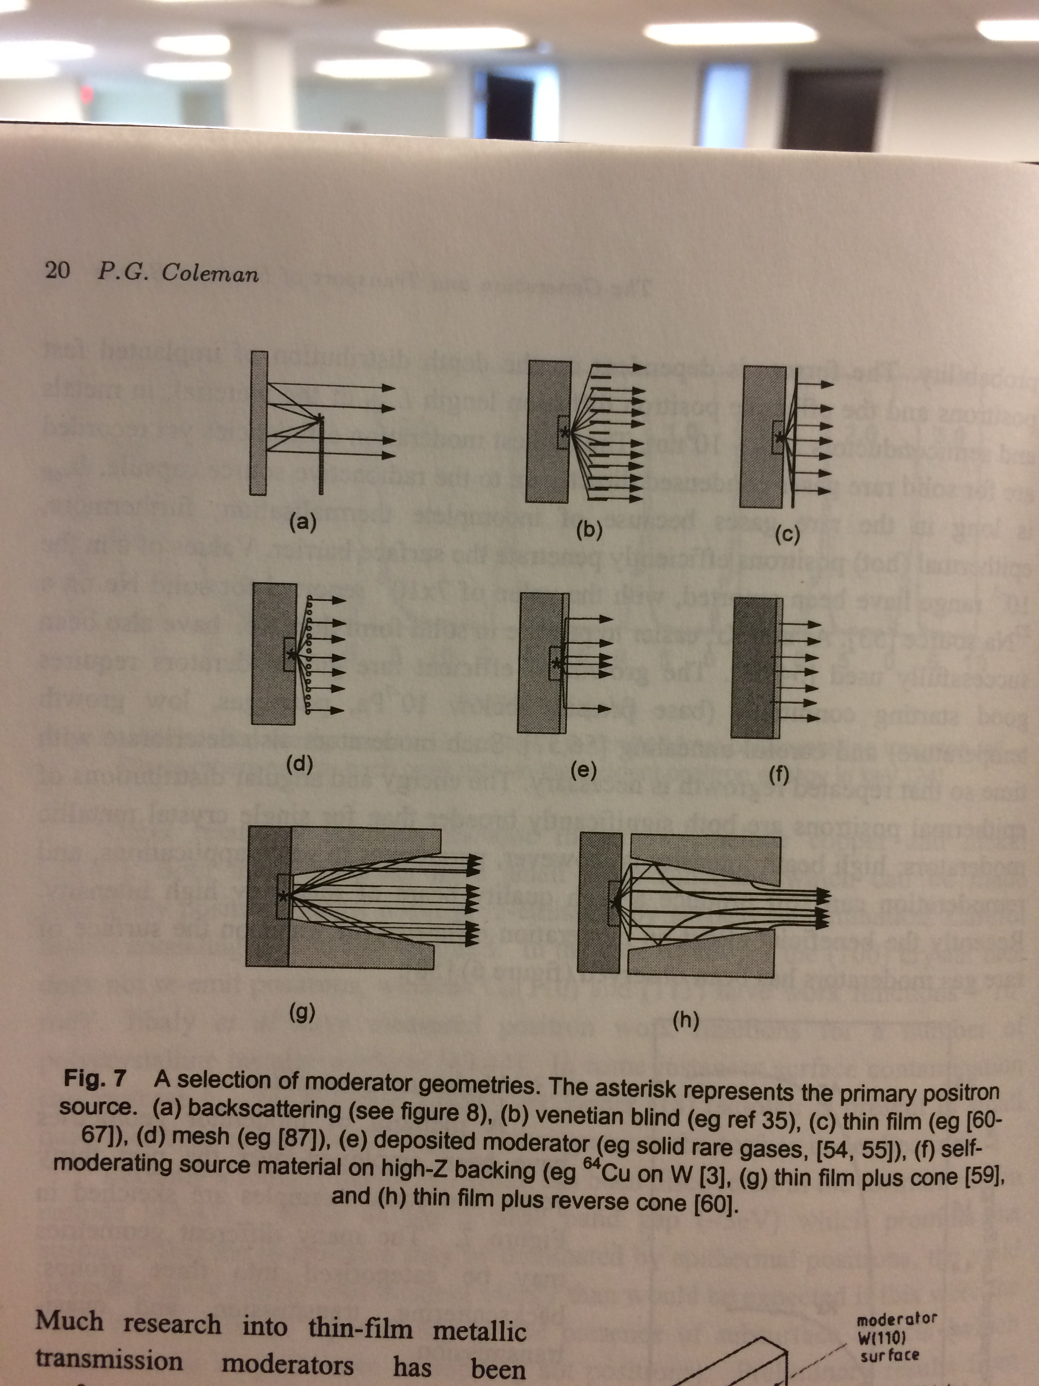
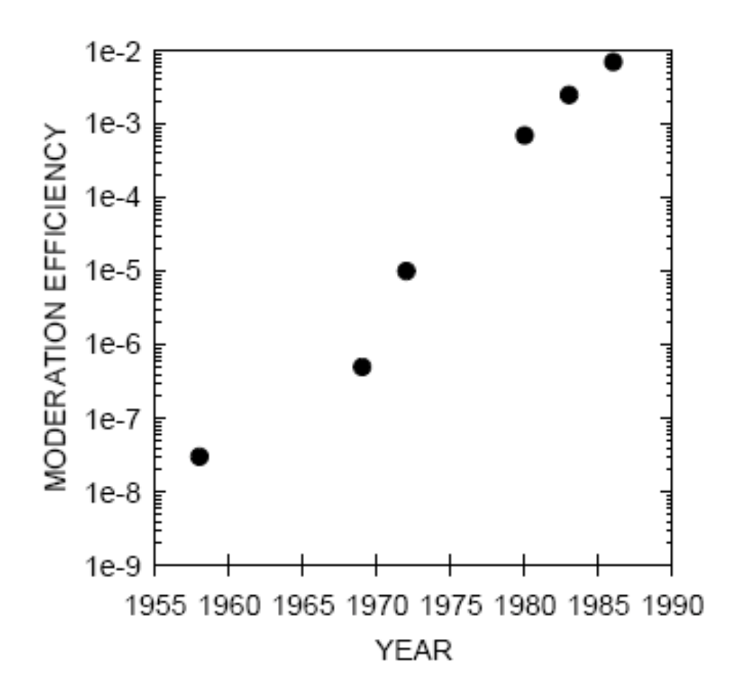
Types of Moderators and Configurations
Moderators based on a negative work-function for positrons.
Thermalized positrons exit with work-function energy e.g. 2-3 V from W(110)/W(100)
Rare gas moderators (e.g Ne, Kr, Ar) limit thermalization so “hot positrons” w/ ~tens of Volts have a greater diffusion length and thus higher escape probability ~1%

Slide 18
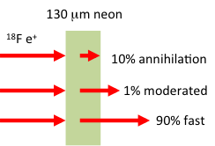
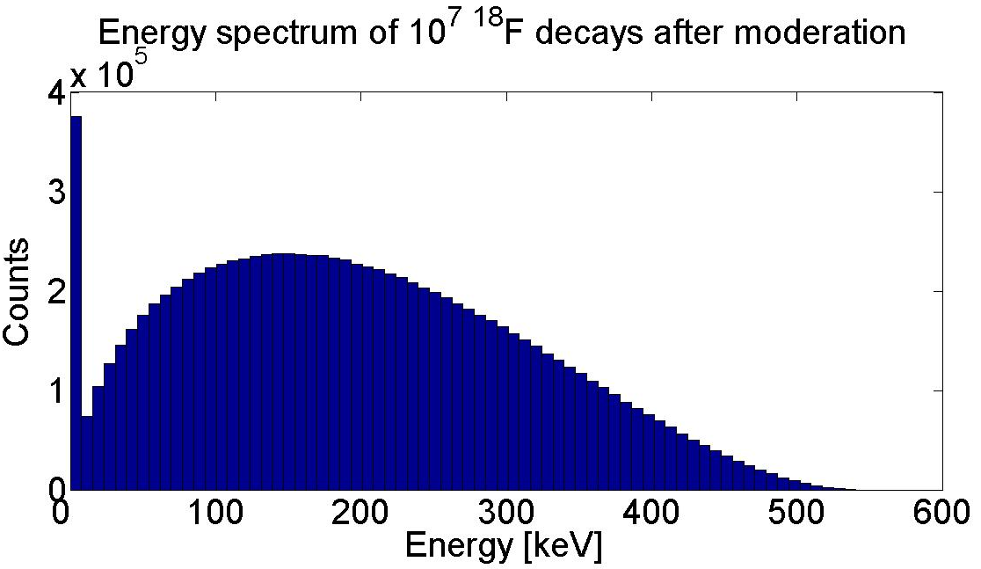
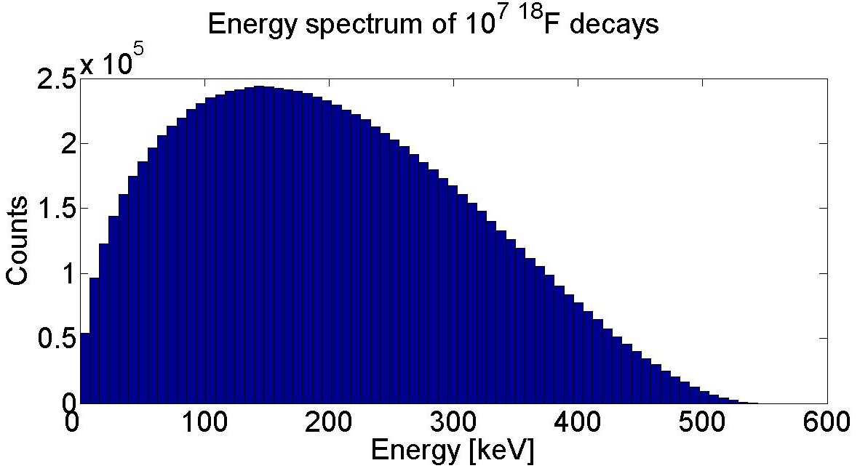
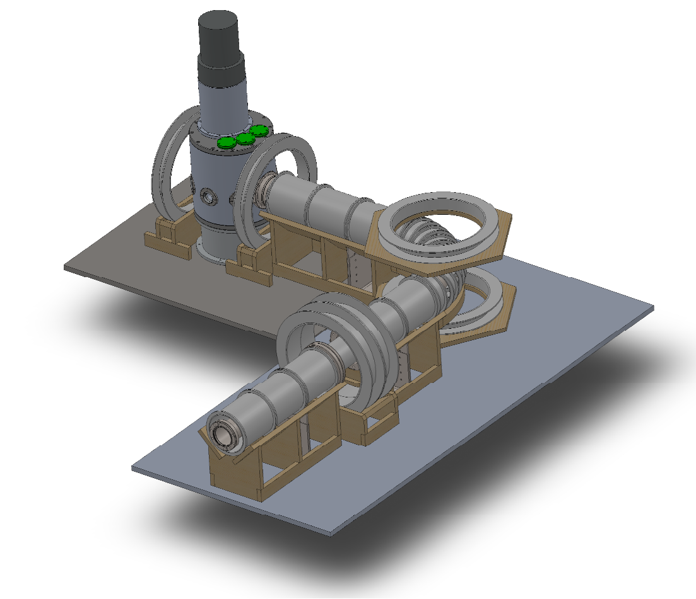
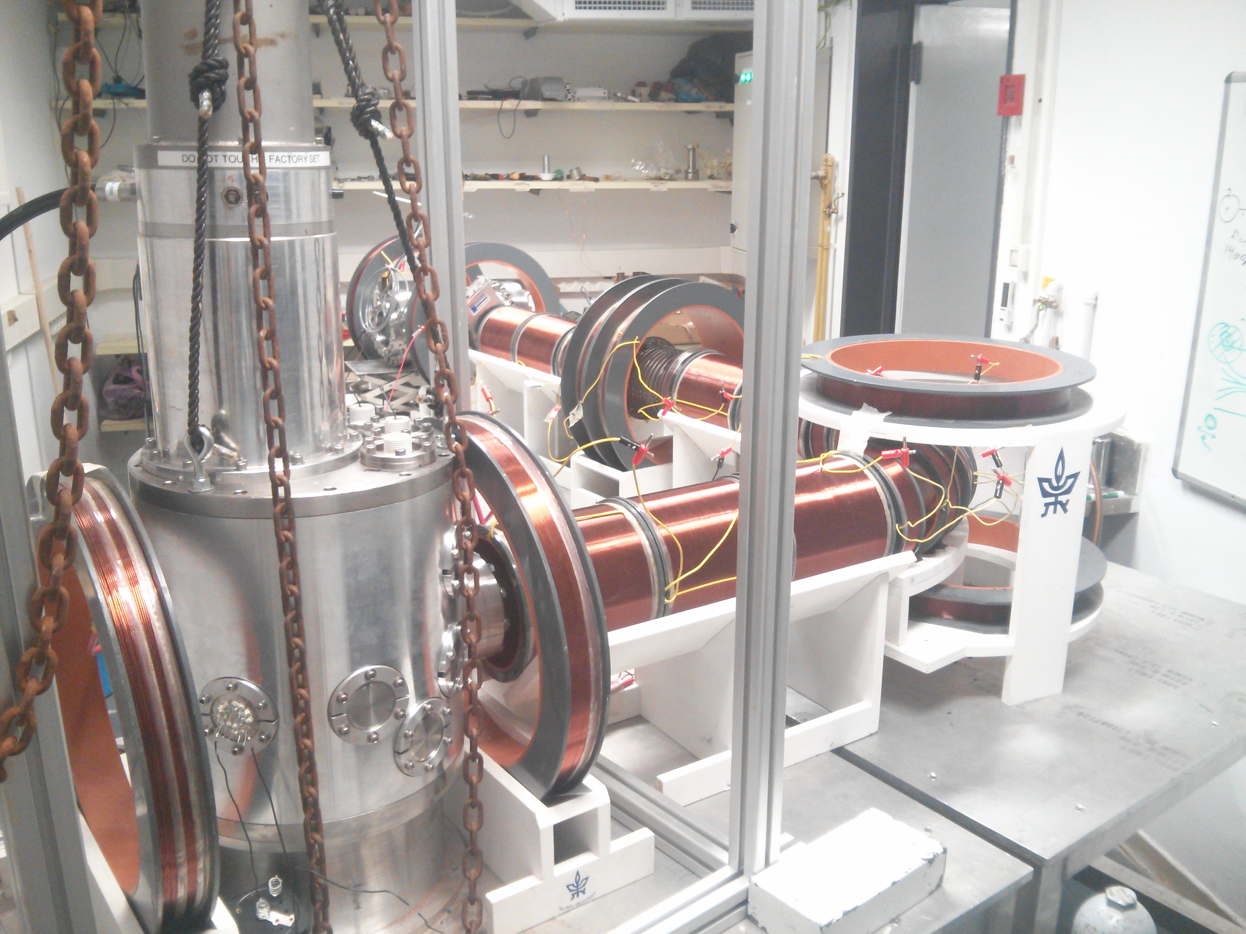
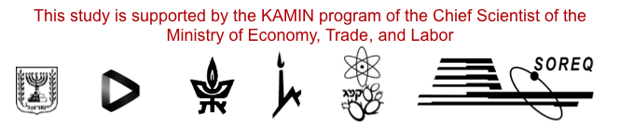
β⁺ beam based on ¹⁸F (30eV - 30keV)
A radioactive source (¹⁸F) is moderated with frozen neon to 2 eV +/- 1 eV
Positrons DC accelerated to 30eV-30keV energy selected produce intense (10⁶ e⁺/s) mono-energetic beam
Slow POsitron faciliTy (SPOT)
(J. Dumas)
Hebrew University of Jerusalem
Racah Institute of Physics

Slide 19
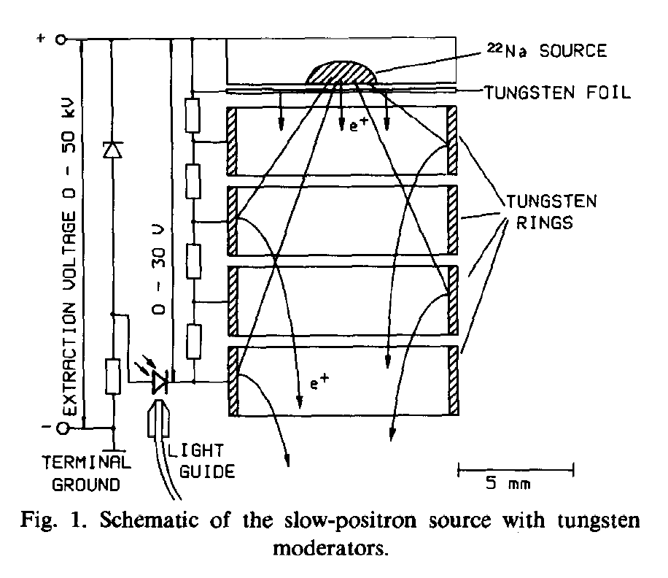
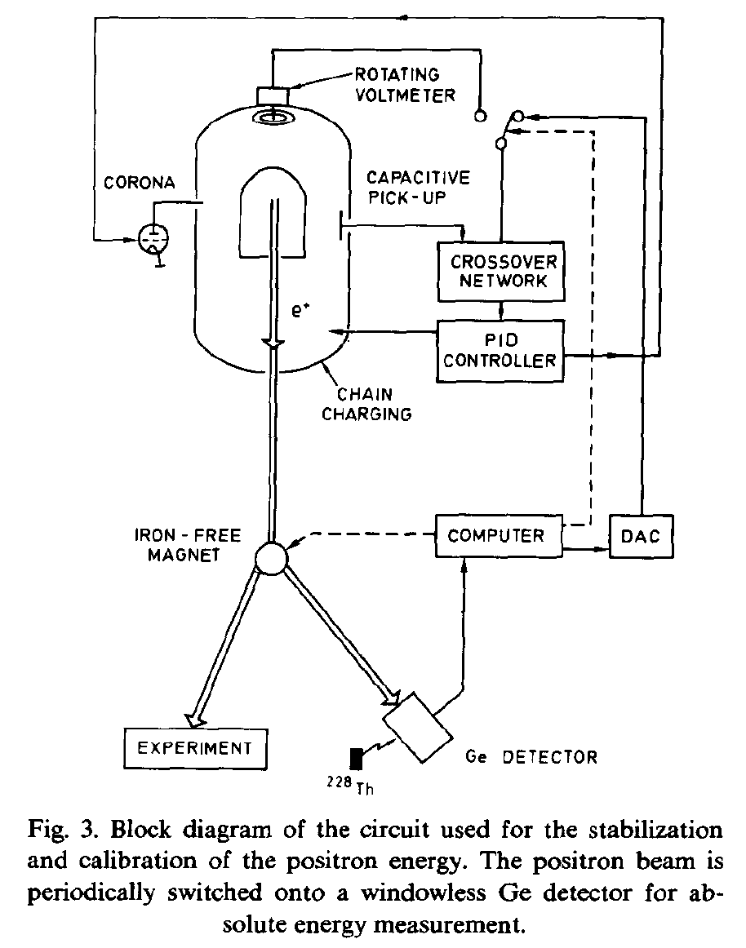
β⁺ beam based on ²²Na (0.5 - 6.5 MV Pelletron)
²²Na source (6 x l0⁸ Bq) moderated by tungsten foil (thickness 3-6 micron) and tungsten rings (height X diameter = 3.3 mm X 10 mm) in a combined transmission-reflection geometry
Intensity 6 x l0⁴ e+/s at target
Pelletron DC acceleration 0.5 - 6.5 MeV
Energy stability ΔE/E < 10⁻⁴

Slide 20
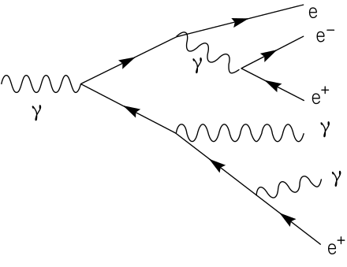
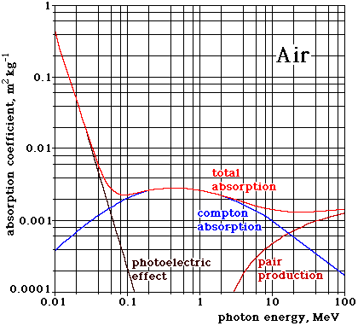
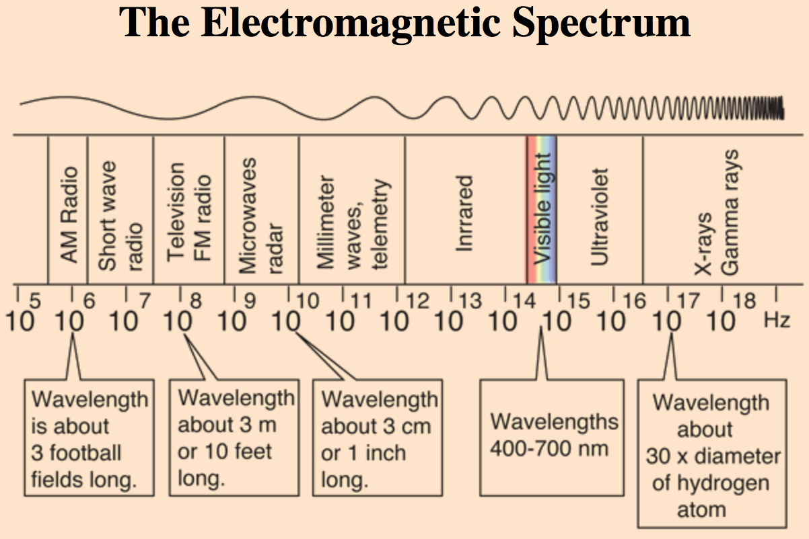
Positron Production by Electromagnetic Showers
An electromagnetic shower is generated by high energy electrons, positrons or photons in matter
e+ and e- primarily emit photons (bremsstrahlung)
Photons > ~few MeV dominate pair production

Slide 21
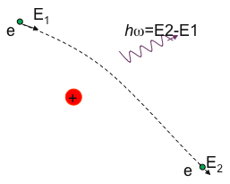

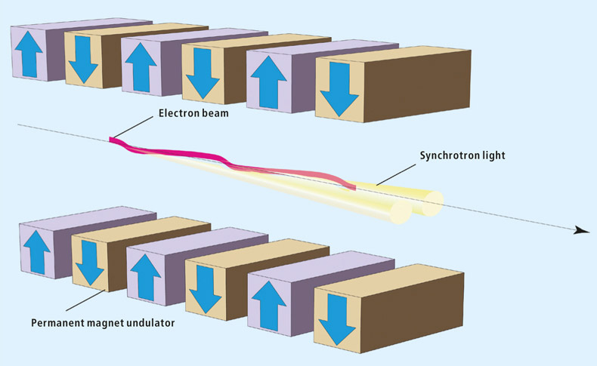
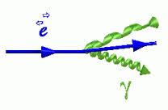
Using Electrons to Generate Gamma Shower
Bremsstrahlung
(E_{γ} < E_{beam})
Coherent Bremsstrahlung
(Yield ~ 20-40 greater)
Undulator
Inverse Compton Scattering
(E_{γ} ~ E²_{beam} * ν)
E_{γ}

Slide 22
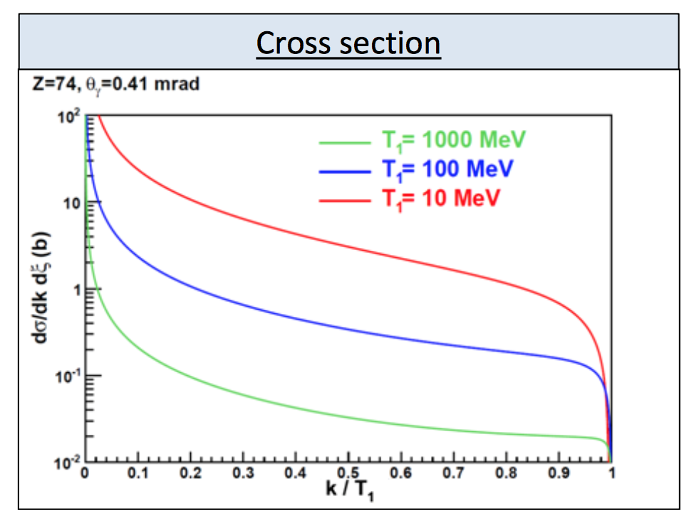
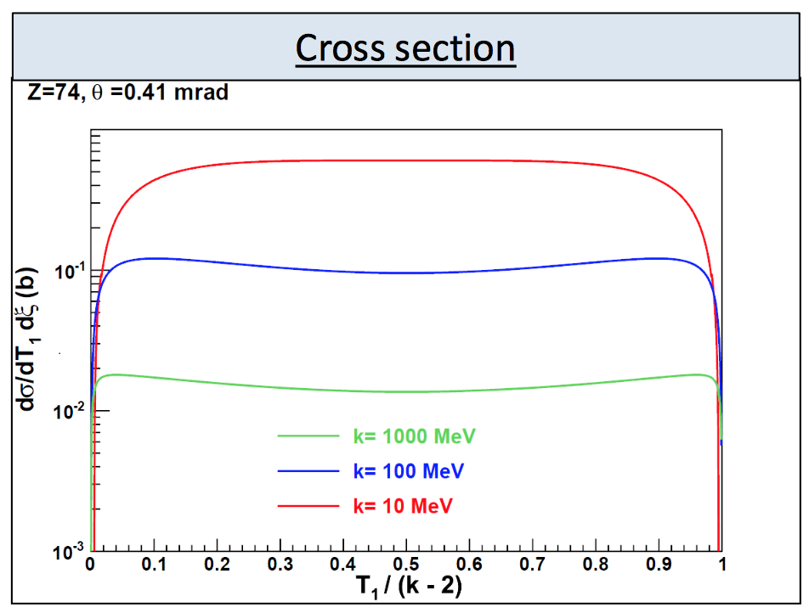
Electromagnetic Shower Cross Sections
Bremsstrahlung
Pair Production
Photon energy k up to electron energy T1
Cross section decreases as 1/k
Positron energy T1 to photon energy k-2mc²
Cross section essentially energy independent

Slide 23
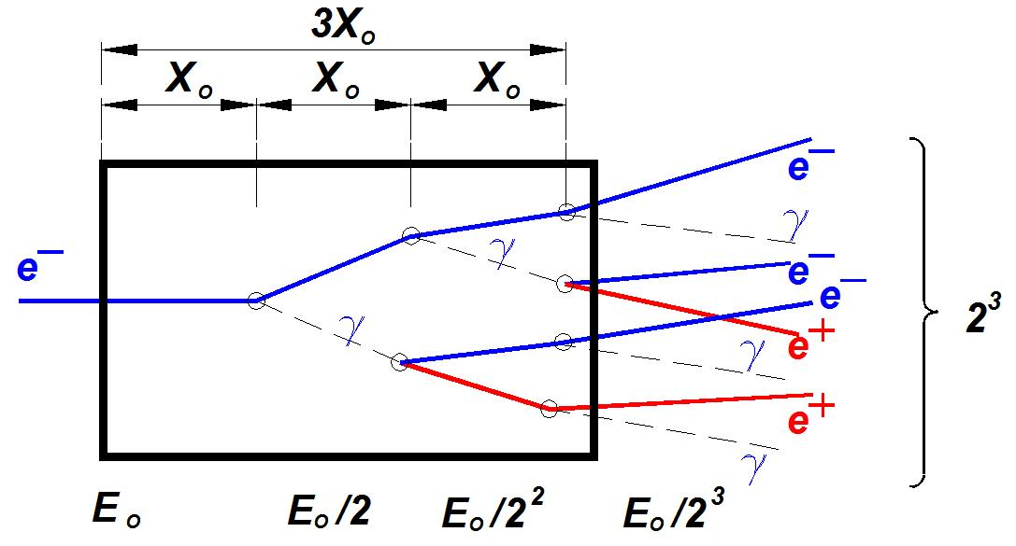
Yield from an Electromagnetic Shower
Positron yield depends on…
  Incident power (energy x intensity)
  Target material (radiation length)
Radiation length
  Mean electron energy loss (1/e)
  7/9 mean path for pair production
Element | C | Al | Ti | Fe | Cu | W
Z | 6 | 13 | 22 | 26 | 29 | 74
A | 12 | 27 | 47.9 | 55.8 | 63.5 | 183.8
E_{c} (MeV) | 84.2 | 42.8 | 26.2 | 22.4 | 20.2 | 8.1
X₀ (g/cm²) | 43.3 | 24.3 | 16.1 | 13.84 | 13 | 6.8
L (cm) | 19.2 | 9 | 3.58 | 1.75 | 1.45 | 0.35

Slide 24
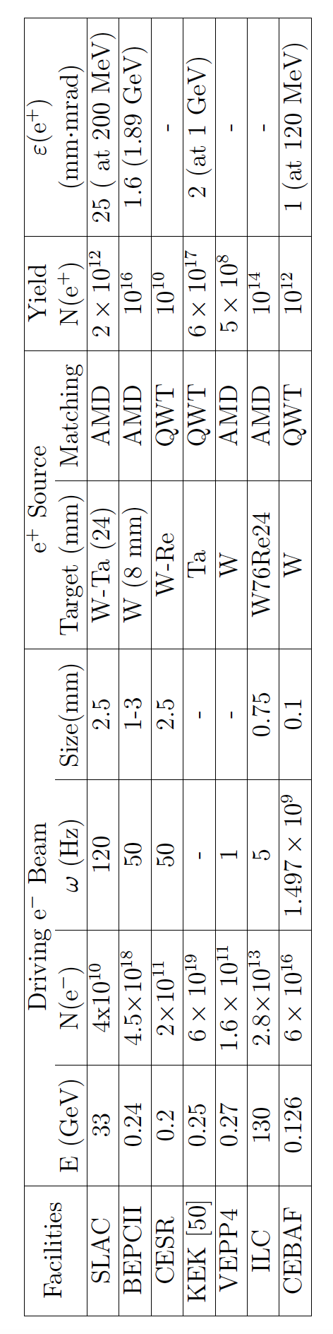
Accelerator Positron Sources
Previous
SLAC – Stanford Linear Accelerator Center (US)
HERA – Hadron Electron Ring Accelerator (Germany)
CESR – Cornell Electron Storage Ring (US)
Present
BELLE/KEK – National Laboratory for High Energy Physics (Japan)
VEPP – Budker Institute of Nuclear Physics (Russia)
BEPCII – Beijing Electron Positron Collider (China)
Proposed
ILC - International Linear Collider

Slide 25
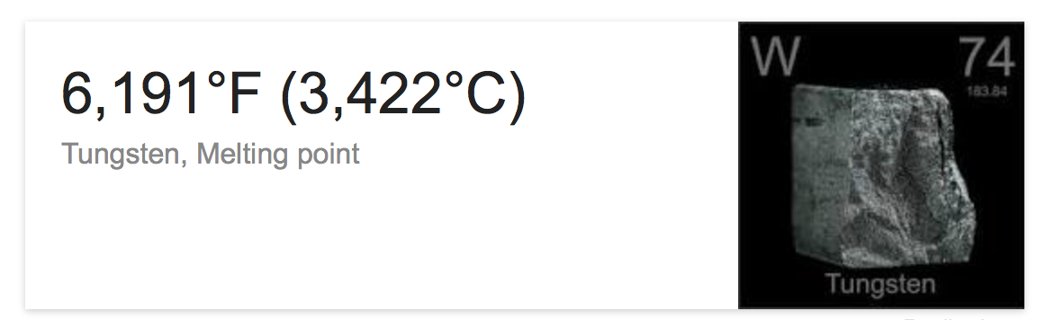
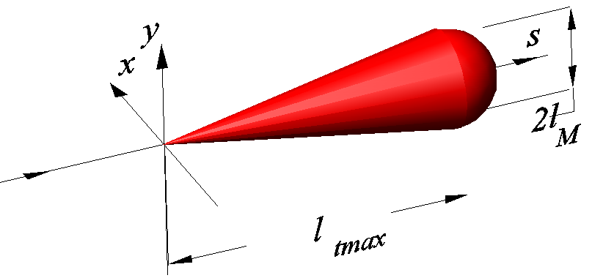
Managing Beam Power
High power deposition in conversion target and surrounding materials
Details depends upon
  Conversion efficiency (number of positrons per incident electron or photon)
  Ultimate positron intensity required
  Target material
  Time structure
It’s not uncommon to require 100’s of kW of beam power.
Consider 20 kW deposited in 1X₀ of tungsten (W) :

Slide 26
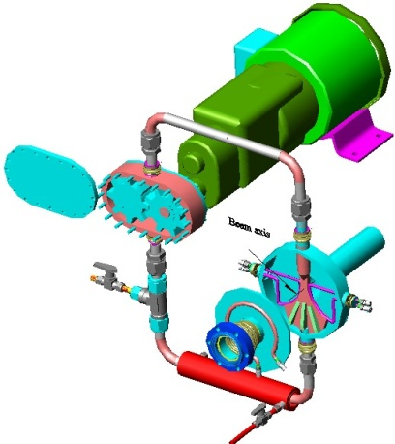
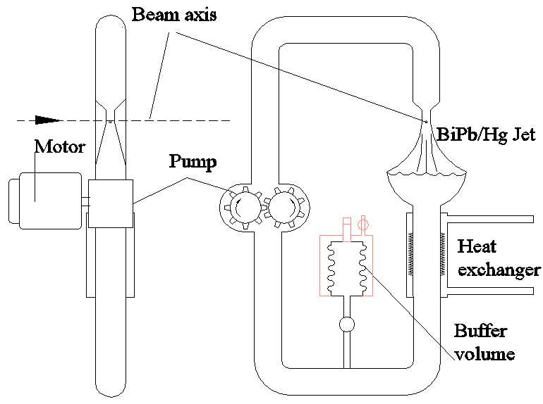
High Power Alternative: High-Z Liquid Jet Target
Jet or stream for rapid mass transfer
  Heat exchangers
  High boiling point metals
    Bismuth-Lead (BiPb) ~ 1670 ºC
    Mercury (Hg) ~ 356 ºC

Slide 27
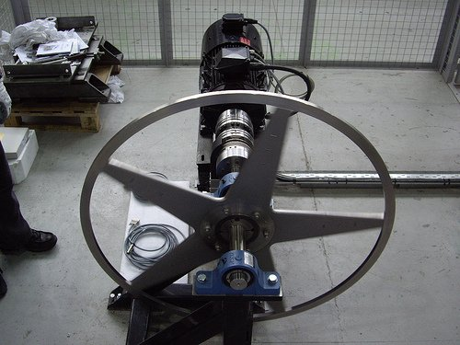
High Power Alternative: Rapidly Rotating Cooled Target
ILC target design schematic and prototype
  1 m diameter Ti-alloy wheel rotating at 2000 rpm
  Target is immersed in magnet field (positron collection)
  Strong eddy-currents are a challenge
  10 kW power deposition @ 130 kW photons

Slide 28
Manage Radioactivity
R.Montalbetti, L.Katz, J. Goldemberg, “Photoneutron Cross Sections”, Phys.Rev. 91, 659 (1953).
Elements → | C | W | Cu | Al | Fe | Pb | U
MeV | 18.72¹ | 6.19 | 9.91 | 13.03 | 11.21 | 6.73 | 6.04
¹Natural Graphite contains 1.1% of C¹⁸ which has a threshold of 4.9 MeV
Neutron dose for electron beam carrying power P[kW] at distance R[m]
W.P.Swanson, “Calculation of Neutron Yields Released by Electrons Incident on Selected Materials”, Health Physics, Vol.35, pp.353-367, 1978.
Neutron shielding and radiological design is integral to overall design

Slide 29

Manage Large Angular & Momentum Distribution

Slide 30





Taming the Positrons
High field solenoid transforms large divergence small radius at radiator to smaller divergence and larger radius
Low field solenoid maintains beam envelope through nearby acceleration sections
angle
position
Quarter Wave Transformer (QWT)
Adiabatic Matching Device (AMD)

Slide 31



Example: Cornell Positron Source (QWT)
W Target
Focusing coil with flux concentrator
This short-focusing lens followed by RF structure immersed in solenoid
Positron rate ~10¹¹ /sec at 50 Hz operation at ~200 MeV
Conversion efficiency~2.5%, DC power consumption ~2.5 kW
J. Barley, V. Medjidzade, A. Mikhailichenko, “New Positron Source for CESR”, CBN-01-19, Oct 2001. 16pp.

Slide 32

Example: Stanford Linear Accelerator Center (AMD)

Slide 33

More Taming: Damping Ring to Reduce Emittance
P :Radiated power
E: Energy of the particle
ρ : Bending radius
e⁺
γ
RF
1) Synchrotron radiation “steals” momentum from all components
2) RF cavities restore energy to off-momentum particles undergoing synchrotron oscillations
SLAC e⁺ (1.2 GeV, ρ=5.6m) damping time ~ 12 milliseconds
Lower energy increases damping time to seconds!
“long” damping times are not suited for CW operation

Slide 34








What about Polarization ?
Polarized β⁺ Decay
L.A. Page & M. Heinberg. Phys. Rev.
106(6):1220-1224 (1957)
Sokolov-Ternov Effect
D. Barber , AIP Conf. Proc. 588, 338 (2001)
HERA 27.5 GeV e+/e-
Polarized due to parity non-conservation in the weak interaction
P(e⁺) ~ 40 %
P(e⁺) ~ 70 %
Inverse Compton Backscattering (KEK)
T. Omori et al, PRL 96 (2006) 114801
Helical Undulator (SLAC E166)
G. Alexander et al, PRL 100 (2008) 210801
47.7GeV
P(e⁺) = 73 ± 15_{(stat)} ± 19_{(syst)} %
P(e⁺) = 80 ± 7_{(stat)} ± 9_{(syst)} %

Slide 35



New Method : Uses Spin Polarized Electron Beam
E.G. Bessonov, A.A. Mikhailichenko, EPAC (1996) A.P. Potylitsin, NIM A398 (1997) 395
Bremsstrahlung
Pair Creation
P_{circ}(γ) / P_{z} (e⁻)
P_{z} (e⁺) / P_{circ} (γ)
E_{γ} / T_{e-}
T_{e+} / (E_{γ} – 2m_{e+})
E.A. Kuraev, Y.M. Bystritskiy, M. Shatnev, E.Tomasi-Gustafsson, PRC 81 (2010) 055208

Slide 36








Polarized Electrons for Polarized Positrons
A Proof-of-Principle Experiment
P. Aderley¹, A. Adeyemi⁴, P. Aguilera¹, M. Ali, H. Areti¹, M. Baylac², J. Benesch¹,
G. Bosson², B. Cade¹, A. Camsonne¹, L. Cardman¹, J. Clark¹, P. Cole⁵, S. Covert¹,
C. Cuevas¹, O. Dadoun³, D. Dale⁵, J. Dumas^{1,2}, E. Fanchini², T. Forest⁵, E. Forman¹,
Freyberger¹, E. Froidefond², S. Golge⁶, J. Grames¹, P. Guèye⁴, J. Hansknecht¹,
P. Harrell¹, J. Hoskins⁸, C. Hyde⁷, R. Kazimi¹, Y. Kim^{1,5}, D. Machie¹, K. Mahoney¹,
R. Mammei¹, M. Marton², J. McCarter⁹, M. McCaughan¹, M. McHugh¹⁰, D. McNulty⁵, T. Michaelides¹, R. Michaels¹, C. Muñoz Camacho¹¹, J.-F. Muraz², K. Myers¹²,
Opper¹⁰, M. Poelker¹, J.-S. Réal², L. Richardson¹, S. Setiniyazi⁵, M. Stutzman¹,
R. Suleiman¹, C. Tennant¹, C.-Y. Tsai¹³, D. Turner¹, A. Variola³, E. Voutier², Y. Wang¹, Y. Zhang¹²
¹ Jefferson Lab, Newport News, VA, US ² LPSC, Grenoble, France ³ LAL, Orsay, France
⁴ Hampton University, Hampton, VA, USA ⁵ Idaho State University & IAC, Pocatello, ID, USA
⁶ North Carolina Central University, Durham, NC, USA ⁷ Old Dominion University, Norfolk, VA, US
⁸ The College of William & Mary, Williamsburg, VA, USA ⁹ University of Virginia, Charlottesville, VA, USA ¹⁰ George Washington University, Washington, DC, USA ¹¹ IPN, Orsay, France
¹² Rutgers University, Piscataway, NJ, USA ¹³ Virginia Tech, Blacksburg, VA, USA
SLAC E-166 Collaboration
International Linear Collider Project
Jefferson Science Association Initiatives Award

Slide 37

PEPPo Concept
J. Dumas, Ph.D. Dissertation, University Joseph Fourier, Grenoble (2010)
Geant4
Polarized Electrons
(<10 MeV) strike production target
Positron Transverse and Momentum Phase Space Selection
E_{e} = 6.3 MeV
I_{e} = 1 µA
T₁ = 1 mm W
P_{e-}
S₁
e⁻
PEPPo
D
T₁
PAIR PRODUCTION
γ produces pairs; P_{γ} transfers to e⁺ into longitudinal (P_{e+}) and transverse polarization averages to zero.
BREMSSTRAHLUNG
Longitudinal e⁻ (P_{e-}) produce elliptical γ whose circular (P_{γ}) component is proportional to P_{e-}.
S₂
P_{e+}
e⁺
D
P_{T}
Calorimeter
T₂
Compton Transmission Polarimeter

Slide 38

PEPPo at the CEBAF Injector
PEPPo measured the polarization transfer from 8.2 MeV/c longitudinal electrons to longitudinal positrons in the 3.1-6.2 MeV/c momentum range.
PEPPo used the CEBAF pre-injector, taking advantage of existing electron beam diagnostics to determine with precision properties of the polarized electron beam.
Low Beam Intensities
1 μA down to 10’s pA
Mott Electron
Polarization Measurement
dP/P<3%
Energy Measurement
dE/E<0.5%
Laser
PEPPo
Beam Energy
Up to 8.25 MeV/c
Pair
Creation
Target
Collection
Magnets
(Princeton/SLAC)
Compton
Polarimeter
(DESY)
Beam Polarization
30 Hz fast helicity reversal (delayed)
Slow laser helicity reversal (waveplate)
4π Spin Rotator

Slide 39


Using Degraded Electrons to Optimize Positron Collection
S₁ current optimization at 5.5 MeV/c
Degraded Electron Collection
S₁
e⁻
p_{e-}= 8.2 MeV/c
D
T₁
Current @ T₂ (arbitrary)
S₂
D
e⁻
T₂
S1 current (A)
“Low Power” exp’t generated pA’s of e+
Degraded electrons allowed optimizing magnets with measurable currents ~10’s nA
e⁻ Momentum [MeV/c]

Slide 40





Positron Detection by Annihilation Coincidence
Two NaI detectors measured coincidence of back-to-back photons emitted by annihilation of positrons in a viewscreen.
Positron Collection
S₁
e⁻
p_{e-}= 8.2 MeV/c
D
T₁
Na²²
S₂
D
e⁺
T₂
Viewscreen
0.011 thick @ 45 deg to beam line
99.5% aluminum oxide Al₂O₃
0.5% chromium doped Al₂O₃/Al₂O₃Cr₂O₃

Slide 41




Measuring Positron Yield
Detected e+ rate (1 e⁺ per 10¹⁰ e⁻)
Solid Angle (0.1 sr)
GEANT annihilation probability (1/400)
Coincidence detector efficiency (0.49 @ 511keV)
1 e⁺ per 10⁶ e⁻
(consistent with proposal)

Slide 42

Measuring Positron Polarization: Compton Transmission Polarimeter
Electrons or Positrons radiate polarized photons by Bremmstrahlung in reconversion target
Energy dependent Compton scattering of photons transmitted through polarized target correspond to polarization of incoming Electrons or Positrons (aligned or anti-aligned).
μ1 - Compton absorption coefficient
L - target length
P₃ - photon polarization (long.)
P_{e-}
e⁻
γ
P_{e+}
e⁺
Reconversion
Target
(Densimet D17K)
90.5% W
7% Ni
2.5% Cu
P_{e} - electron/positron polarization
P_{T} - target polarization
A_{e} - analyzing power
Bremmstrahlung photon spectrum requires energy-dependent analyses
  Energy binning
  Energy integration

Slide 43




Positron Polarimetry
Positrons are detected in coincidence between a thin trigger scintillator placed prior to the reconversion target and the central crystal (PMT5) and tagged by e- helicity.
C
A
L
O
R
I
M
E
T
E
R
Scintillator
e+
γ
PMT5
Reconversion
Target
Coincidence trigger
10mil Al window
Trigger Scintillator
e⁺ Data @ 6.3 MeV/c
Bremsstrahlung
end-point
(beam energy – m_{e+})
511 keV production
from e+ annihilation

Slide 44

Preliminary Positron Results
Positron asymmetry significantly non-zero, increases with momentum and reduction of background (which may have analyzing power itself).
Set 1 (Initial Run)
Set 2 (Improved Shielding)
P_{e+} = Asymmetry/(AP * P_{T})
We are in final stages of analysis and will unveil results Spring 2014.

Slide 45

What about positrons at Jefferson Lab ?
Positrons for JLAB Nuclear Physics
100 nA – 10 μA (CW)
Polarized

Slide 46



What about injecting positrons into CEBAF ?
Energy
X
Current
Low enegy ( GeV) injector requires milli-Amps
High power (100’s kW) target & compoents
Arc dipole power supplies are unipolar
Low beam intensity challenges diagnostics
Quasi-simultaneous electron/positron delivery

Slide 47




CW Positron Source at CEBAF
S. Golge, Ph.D. Dissertation, Old Dominion University (2010)
Combined Function Magnet Solution
p (e-) = 126 MeV/c
p (e⁺) = 126 ± 1.0 MeV/c
σ_{t} = 1.8 ps (to maintain dp/p < 10⁻³)
ε_{x/}ε_{y} = 1.6/1.7 mm.mrad (<5 mm-mrad)
Efficiency is ~ 2.9x10⁻⁴
0.1 – 10 uA => 0.35 – 35 mA
100kW to 1MW !
126 MeV/10 mA

Slide 48


Positron Opportunities at Jefferson Lab ?
CEBAF
Improve conversion efficiency
~100uA / 11 GeV
~1 uA / 12 GeV (Hall D)
Manage high power
Shielded Radiator
Accessible conversion target
LERF
High current : 10 mA @ 200 MeV
Test bed for CW concept
ERL dump : 10 mA @ 10 MeV
Low intensity source
UITF
10 MeV/1 nA facility to test HDIce
Compatible with <1 nA e+ source
Keep energy / photo-neutron yield small
Add local shielding

Slide 49
Outlook & Opportunities
Compelling Motivation
International Workshop on Positrons at Jefferson Lab (2009)
High Energy Nuclear Physics at CEBAF
Dark matter searches
Low Energy Materials Science
Accelerator R&D Track Record
J. Dumas, PhD, PEPPo Conceptual Design (2010)
S. Golge, PhD, CW Positron Source Design (2010)
PEPPo, PAC A Rated E11-105 (2012)
L. Adeyemi, PhD, PEPPo Proof-of-Principle (expected 2015)
Future Directions ?
P. Degtiarenko, J. Grames, E. Voutier, Integrated Conceptual Design (Unfunded 2013 LDRD)
Consideration being given for low energy positron program at LERF
Exploit accelerator expertise & facilities to develop integrated design and address challenges
Some R&D Opportunities…
  High Current Electron or Photon “Driver”
  High Power Conversion Target
  Collection Optimization – Split Radiator : Conversion Target
  Simultaneously managing electrons and positrons

