Slide 1
HV insulator for 500 kV
Exploring the use of the receptacle and the sizes of the SF6 spool
Gabriel Palacios
gabrielp@jlab.org 07/23/2021

Slide 2
Outline
Models
Electrostatics
Discussion

Slide 3
Models
Started from Ron’s model, defeatured it to remove small details like bolt holes. Then added stuff that was missing like separations between metal and insulator in the receptacle and rubber cable.

Slide 4
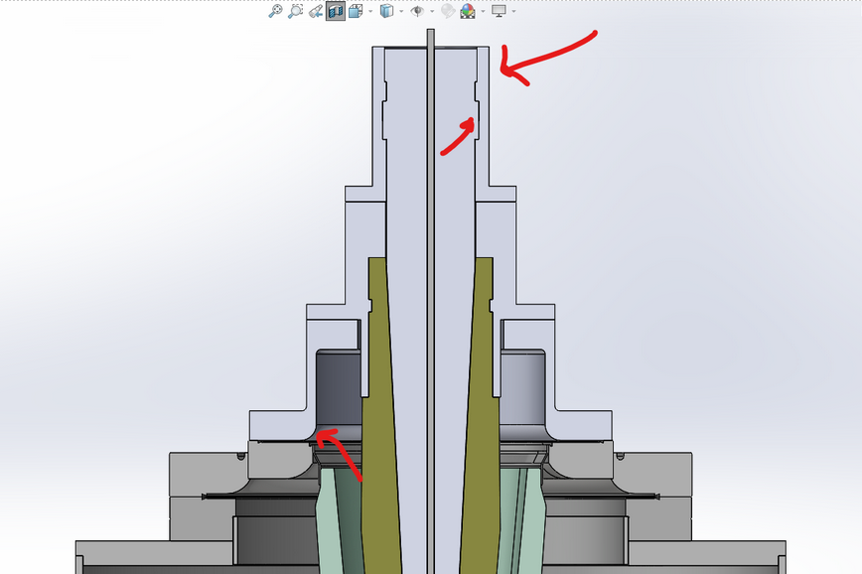
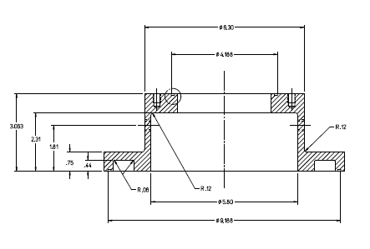
Model
Rubber cable flange
Then added the details to the rubber cable flange, the receptacle, and added the spool using the receptacle spool dimensions in our Drawings and 3D models folder
Rubber cable
Receptacle flange
Receptacle
Spool
Alumina insulator

Slide 5
Electrostatics
Imported the models to CST EM studio, set up closed boundaries everywhere except the top. Materials and dielectric constants are: Rubber cable = 2.37, Epoxy = 4, SF6 = 1.00203, Alumina = 8.4, SF6 = 1.00203. Simulations at -500 kV at the cathode

Slide 6
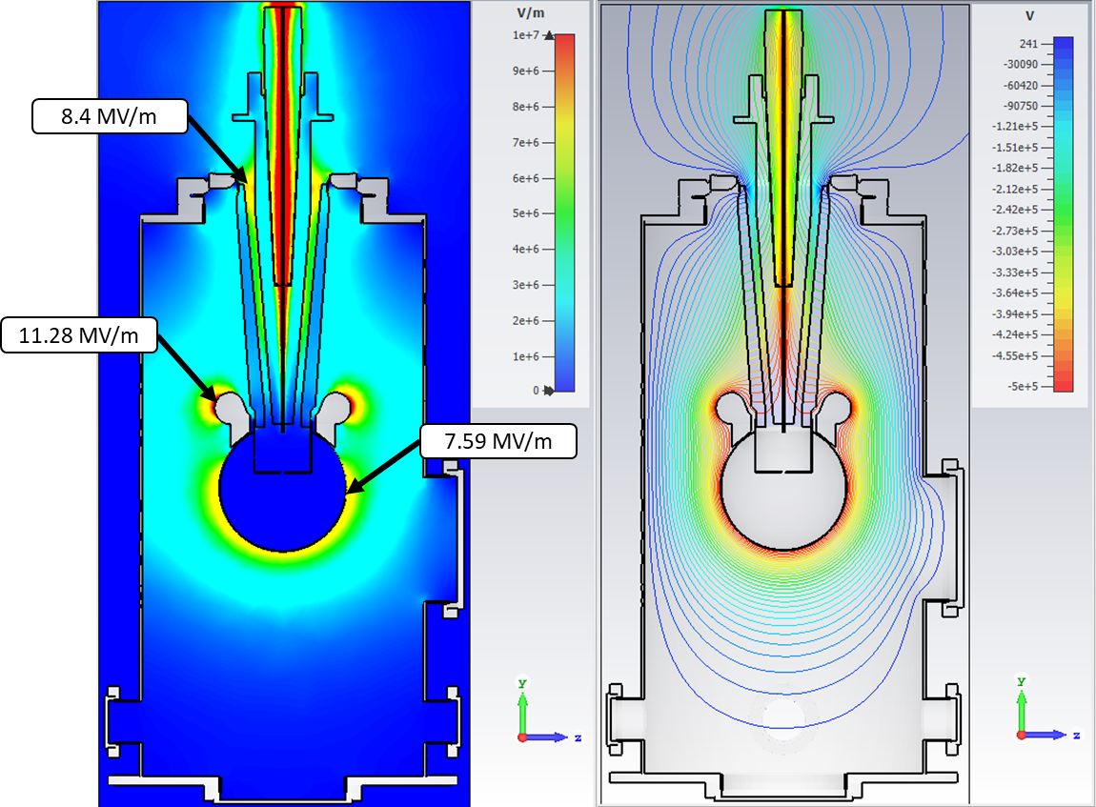
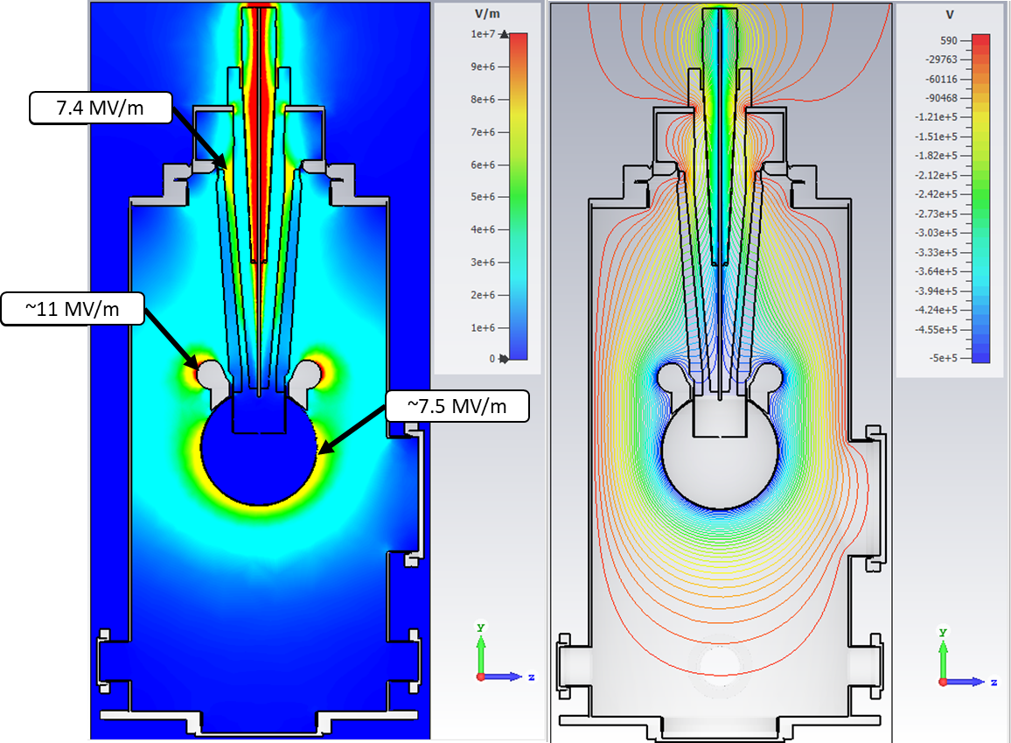
Electrostatics
Ron’s model, but defeatured
Ron’s model, with a simple test spool

Slide 7
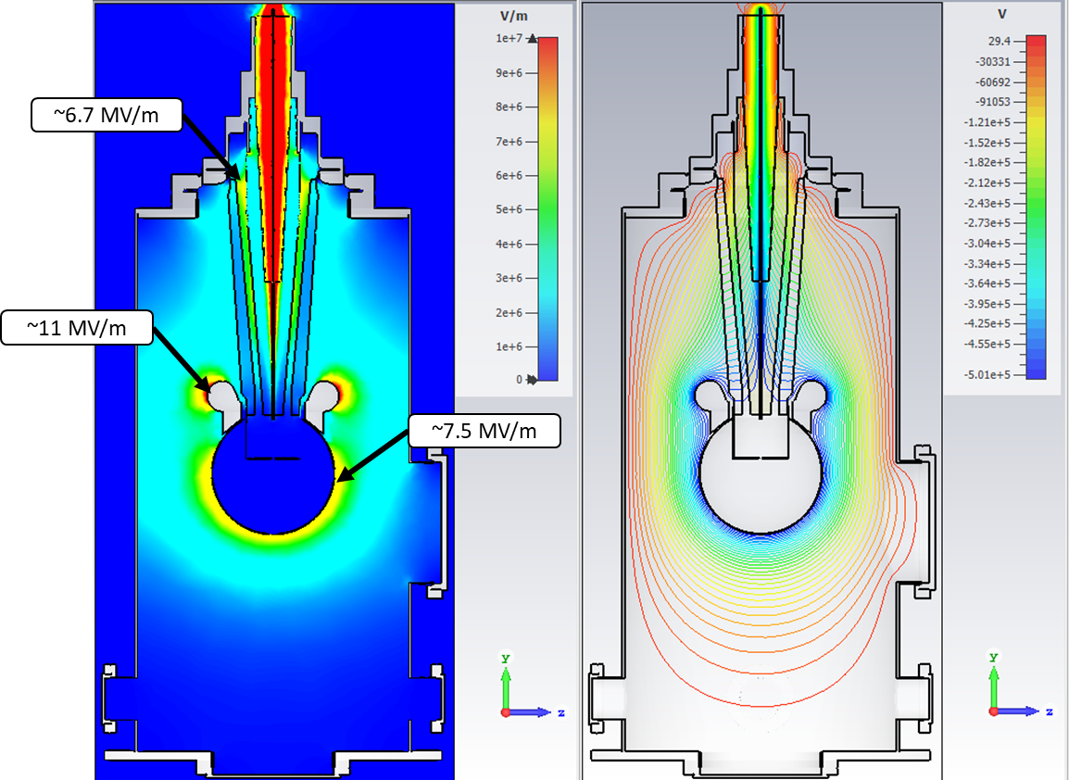
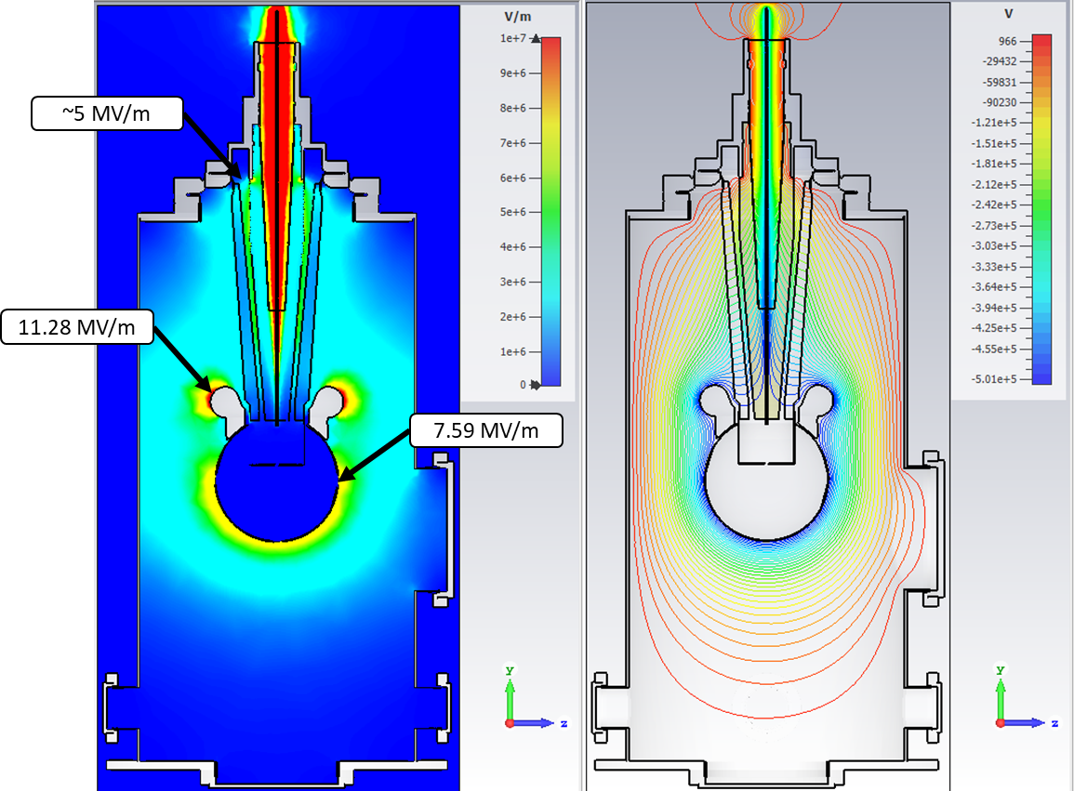
Electrostatics
Ron’s model, with designed spool
Ron’s model, with half-height spool

Slide 8
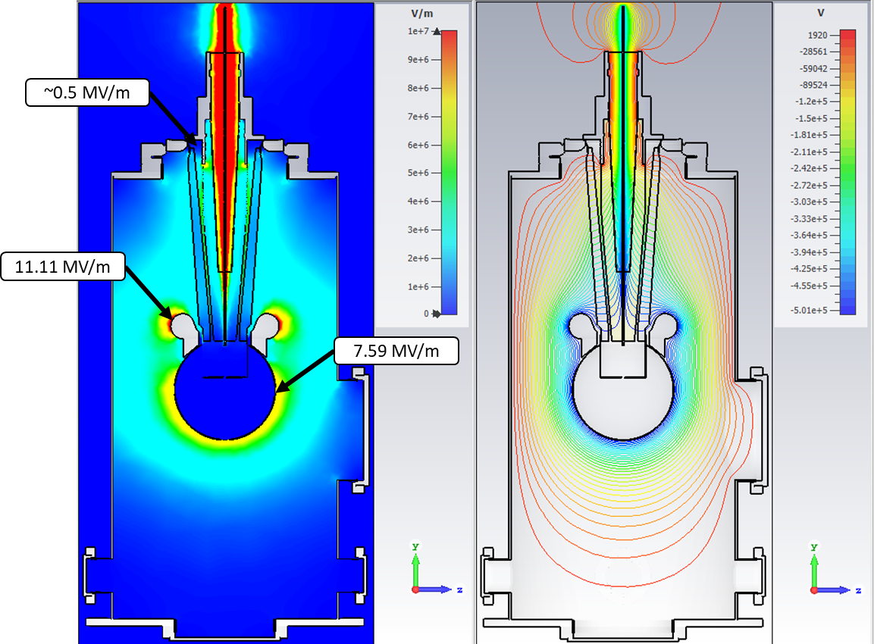
Electrostatics
Ron’s model, with half-height spool
Ron’s model, without spool

Slide 9
Electrostatics
Next up, I removed the receptacle from all the electrostatics simulations and re-ran them to compare.

Slide 10
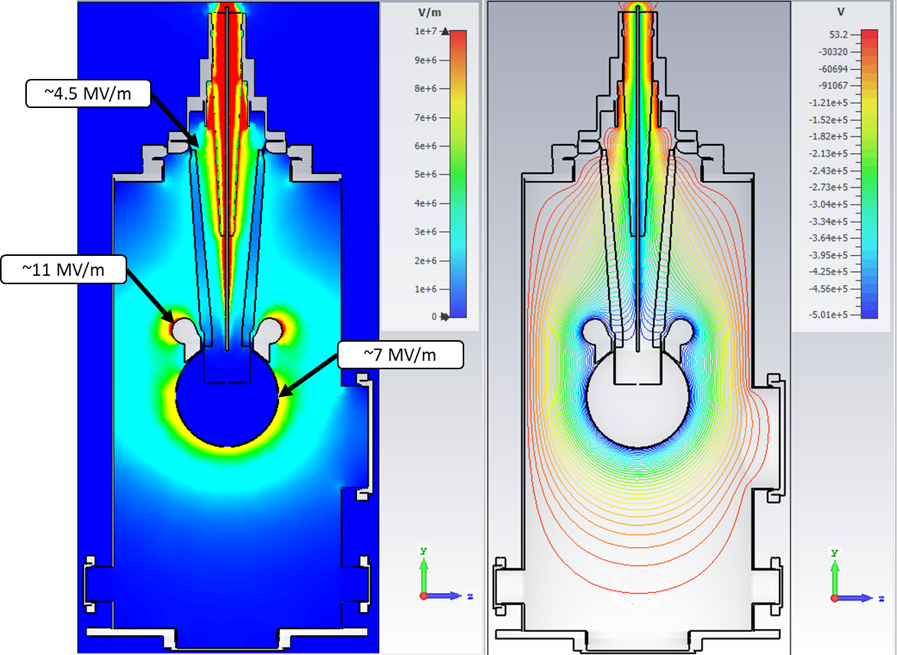
Electrostatics
Ron’s model, with designed spool
Ron’s model, with designed spool and no-receptacle

Slide 11
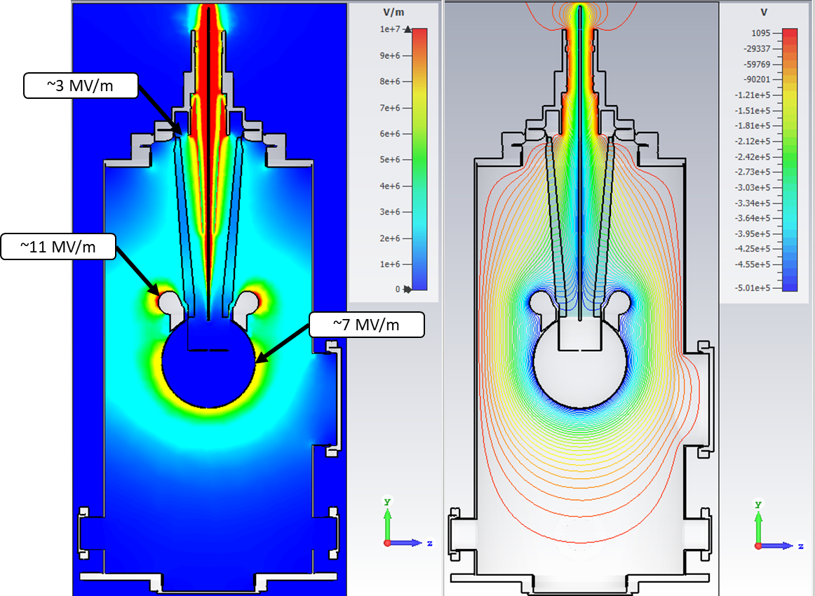
Electrostatics
Ron’s model, with half-height spool
Ron’s model, half-height spool and no-receptacle

Slide 12
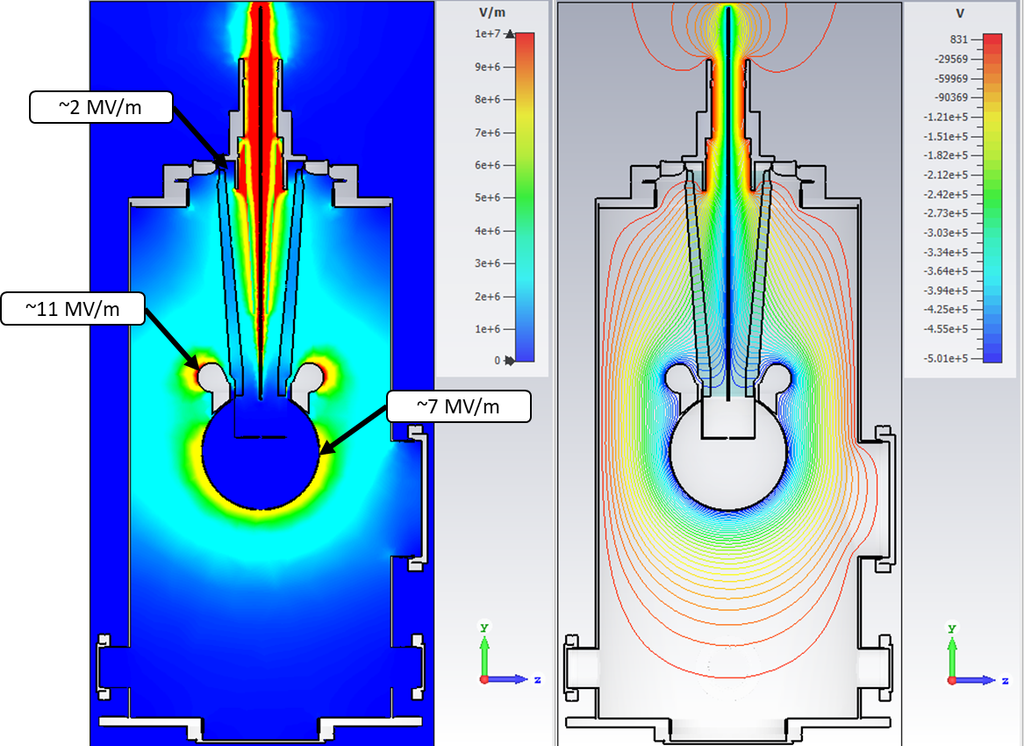
Electrostatics
Ron’s model, without spool
Ron’s model, without spool and no-receptacle

Slide 13
Electrostatics
How does removing the receptacle affect the field on the internal surface of the insulators? What happens on the cable surface? Comparing simulations with and without receptacle for the model with designed spool.

Slide 14
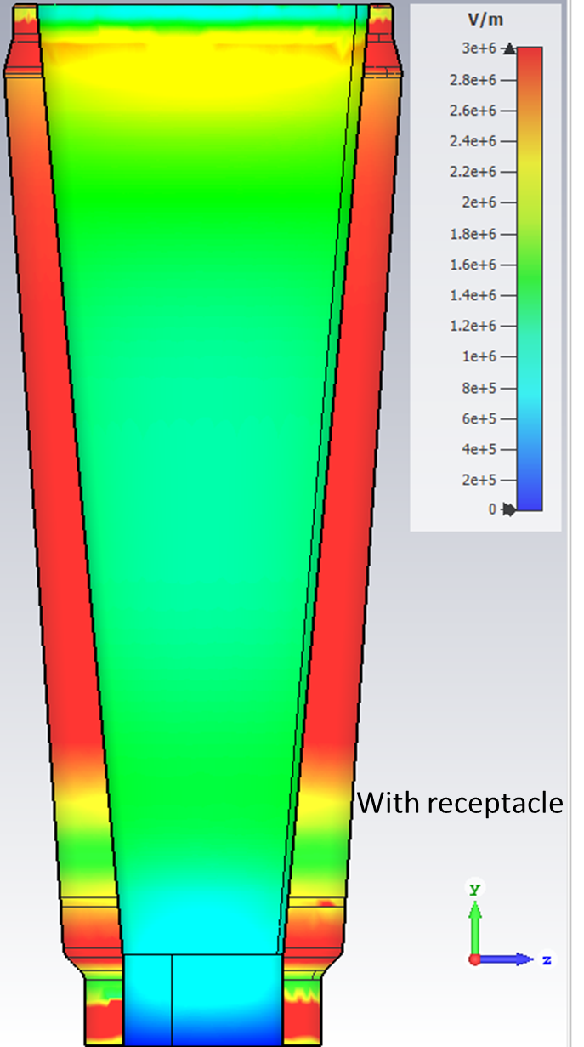
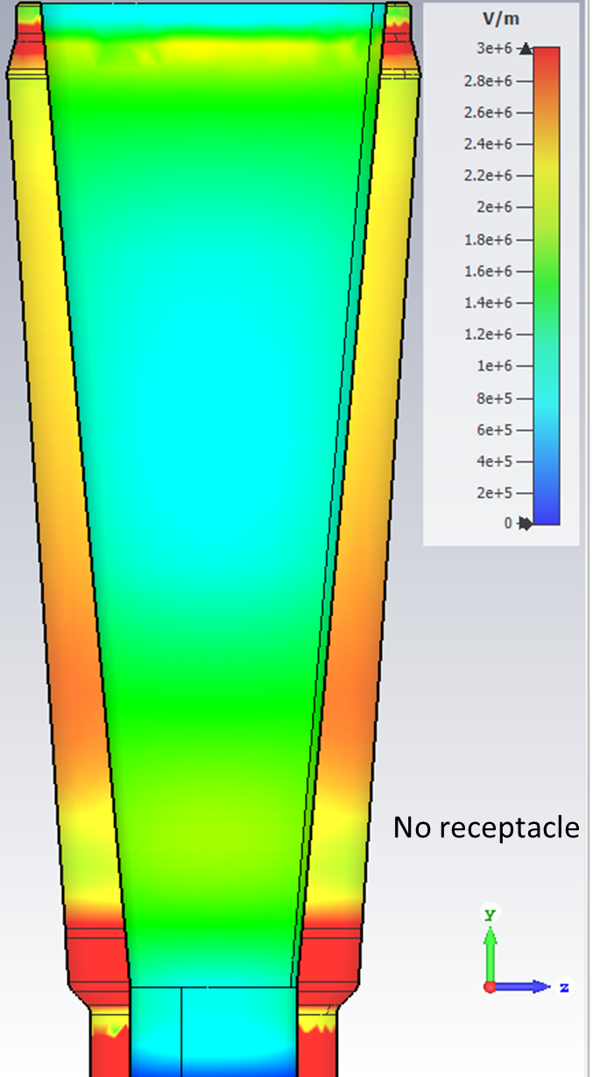
Electrostatics
Ron’s model, with designed spool
Ron’s model, with designed spool and no-receptacle

Slide 15
Electrostatics
Ron’s model, with designed spool
Ron’s model, with designed spool and no-receptacle

Slide 16
Electrostatics
Now plotting the magnitude of the electric field and potential along a line tracing the internal surface of the insulator at 1 mm distance from it

Slide 17
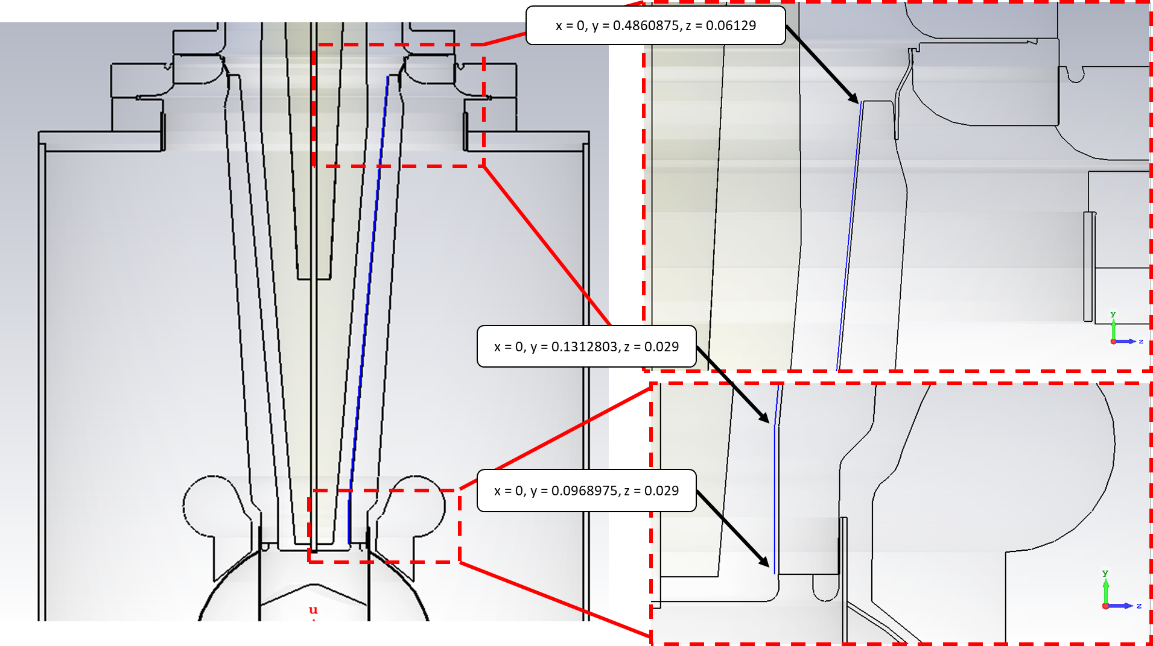
Electrostatics

Slide 18
Electrostatics
With receptacle
Without receptacle

Slide 19
Electrostatics

Slide 20
Electrostatics
With receptacle
Without receptacle

Slide 21
Electrostatics

Slide 22
Discussion
Regarding the avenues for testing our high voltage assembly, these results shine light on part (a) of our plan:
We want to keep the receptacle, to prevent exposing the HV internal conductor. Even though the potential along the insulator internal surface becomes a bit less linear.
Reducing the size of the spool will aid in lowering the electric field magnitude at the upper region near the flange. But, does this have implications regarding SF6?
What’s next?
Now let’s explore the second case in the proposal (b), modifying the rubber cable to make it compatible with the insulator and thus remove the receptacle completely.
This sounds promising to me, as now we have “not soft” transitions between dielectric constants.

