Slide 1
Booster Studies
Y. Wang
April 1, 2021

Slide 2
Partial UITF Beamline
ITVM703
30 deg.
Gun
z
MDS201
Solenoids
Booster
Quads
MDML601
ITVM601

Slide 3
Beam Conditions
Gun HV: 130/200 KeV
Chopper: off
Buncher: negative slope zero crossing
Booster: on crest
Solenoids & quads: beam centered
Apertures #3 & #4: beam centered

Slide 4
Beam to MeV Spectrometer Dump
Gun HV KV | Buncher gset V/m | 2-cell gset MV/m | 7-cell gset MV/m | Beam Momentum MeV/c
130 | 30 | 2.5 | 7.5 | 6.3
200 | 40 | 2.5 | 7.46 | 6.3

Slide 5
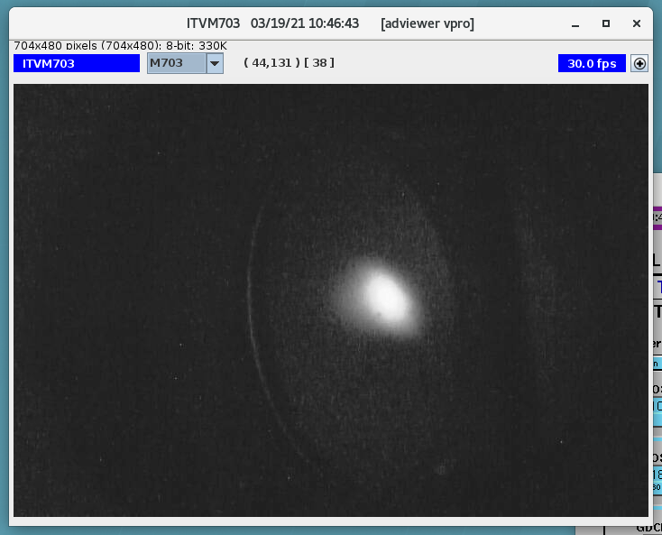
Beam Images with Gun HV at 130 KV
2-cell on (gset at 2.5 MV/m)
7-cell on (gset at 7.5 MV/m)

Slide 6
Stable 6.3 MeV/c Beam with Gun HV at 130 KV (2-cell Gset at 2.5 MV/m, 7-cell Gset at 7.5 MV/m)

Slide 7
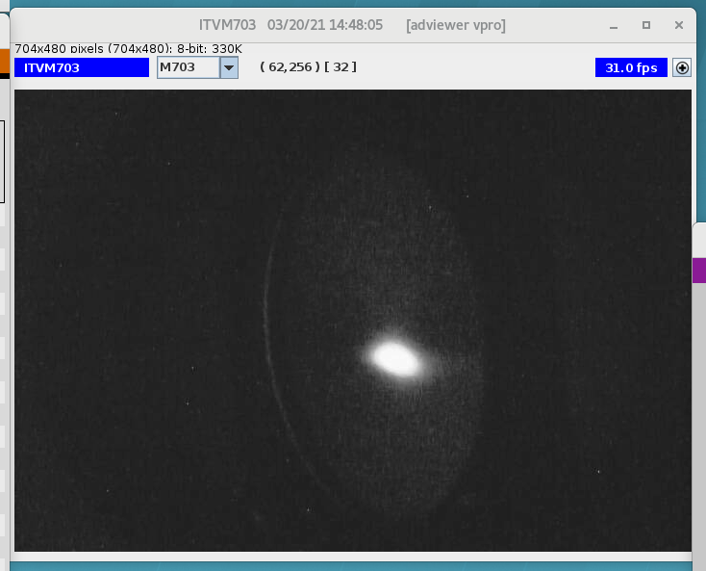
Beam Images with Gun HV at 200 KV
2-cell on (gset at 2.5 MV/m)
7-cell on (gset at 7.5 MV/m)

Slide 8
Stable 6.3 MeV/c Beam With Gun HV at 200 KV (Gu HV at 200 KV, 2-cell Gset at 2.5 MV/m, 7=cell Gset at 7.46 MV/m)

Slide 9
Gradient Calibration of 2-Cell Cavity
Preparation for beam:
All solenoids: beam centered
7-cell cavity: off and detuned
MQJM501/502/503/504: beam centered
MQJM701/703: cycled at zero field
Good beam to ITVM601
Good beam to ITVM703
At each gset: on crest, beam centered, beam path unchanged

Slide 10
Beam Momentum with 2-Cell On (Gun HV at 200, 7-cell Off)

Slide 11
Beam KE Gain from 2-Cell Cavity (Gun HV at 200 KV, 7-cell off)

Slide 12
Calculated Effective Length of 2-Cell Cavity

Slide 13
Beam Momentum vs 2-Cell Gradient (Gun HV at 200 KV, 7-cell Gradient at 12 MV/m)

Slide 14
Nonlinearity of 2-Cell Cavity
Beam is not fully relativistic
at entrance or exit of the 2-cell cavity.
Energy gains from the 2-cell and the 7-cell
are not simple arithmetic.

Slide 15
Gradient Calibration of 7-Cell Cavity
Preparation for beam:
All solenoids: beam centered
2-cell cavity: on crest, gset at 2.5 MV/m
MQJM501/502/503/504: beam centered
MQJM701/703: cycled at zero field
Good beam to ITVM601
Good beam to ITVM703
At each gset: on crest, beam centered, beam path unchanged

Slide 16
Beam Momentum after 7-Cell Cavity (Gun HV at 200 KV, 2-cell Gset at 2.5 MV/m)

Slide 17
Beam KE Gain from 7-Cell Cavity (Gun HV at 200 KV, 2-cell Gset at 2.5 MV/m)

Slide 18
Beam Momentum with 7-cell On (Gun HV at 200 KV, 2-cell Off)

Slide 19
Calculated Effective Length of 7-Cell Cavity

Slide 20
Recommended Settings (Gun HV at 200 KV)
2-cell cavity gradient: 2.5 MV/m
Kinetic energy gain: 334.5 KeV.
7-cell cavity gradient: 7.46 MeV/m
Beam momentum after Booster: 6.3 MeV/c
Beam stability
No beam motion observed on spectrometer viewer ITVM703

Slide 21
Correctors & Viewer Used (for x/y Coupling and Kicks Studies)
MHBK403H&V: 20.5” upstream
ITVM201: 10.5” downstream
No other magnets between MHBK403 and ITVK201
20.5”
90”
10.5”
z
MHBK403H&V
Booster
ITVM201

Slide 22
Booster and Upstream MHB403H&V
Fcup and Viewer
Booster
Ion Pump
MHBK403H&V

Slide 23
Booster and Downstream ITVM201
Booster
ITVM201
Ion pump

Slide 24
ITVM201 Calibration

Slide 25
ITVM201 Calibration
Assume 1 pixel in x plane is equal to 1 pixel in y plane
Rotation angle (deg) | Conversion | factor (mm/px)
wrt x axis | x | y
26.031 | 0.156 | 0.076
θ
z
ITVM201
x

Slide 26
X/Y Coupling Baseline
Booster: off and detuned
MHB403H&V: steer beam horizontally and vertically
Measure beam positions on ITVM201
MHB403H&V
2-cell
7-cell
ITVM201

Slide 27
X/Y Coupling Baseline (Booster Off and Detuned)
Gun HV (KV) | 130 | 200
Rotation wrt x (cw = +, deg) | 4.2 | 3.7
Rotation wrt y (cw = -, deg) | 7.8 | 6.7
y
7.8°
y
6.7°
x
x
4.2°
3.7°
ITVM201
Gun HV at 130 KV
Gun HV at 200 KV

Slide 28
X/Y Coupling Caused By Booster
Gun HV | 2-cell gset at 2.5 MV/m |  | Booster 6.3 MeV/c |  | 7-cell gset at 7.46/7.5 MV/m
KV | x | y | x | y | x | y
130 | -3.2° | -0.5° | -3.1° | -0.6° | 0.1° | -0.1°
200 | -2.5° | -0.1° | -1.9° | -0.6° | 0.4° | -0.5°

Slide 29
Beam Deflection from Booster
Measure beam positions on ITVM201 with cavities on/off
Calculate angular displacements
1946.86
1116.17
 | Distance to ITVM201 (mm)
2-cell center | 1946.9
7-cell center | 1116.2
θ
2-cell
7-cell
ITVM201

Slide 30
Beam Deflection Caused by Booster
Gun HV | 2-cell gset at 2.5 MV/c |  | Booster 6.3 MeV/c |  | 7-cell gset at 7.46/7.5 MV/m
KV | x | y | x | y | x | y
130 | 0.11° | 0.16° | 0.35° | 0.26° | 0.23° | 0.1°
200 | 0.08° | 0.13° | 0.28° | 0.16° | 0.2° | 0.03°

Slide 31
Some Observations with Gun HV at 200 KV
2-cell and 7-cell are not perfectly aligned: need to adjust MHBK403H by 0.1 Gcm, and MHBK403V by 1.6 Gcm after beam centering 2-cell cavity.
When moving the incoming beam horizontally and vertically with the 2-cell cavity on only and on crest, the exit beam moved accordingly. When the cavity phase was adjusted by -16 degrees the exit beam movement started to change polarity. No polarity changes were observed when the phase was increased.
When moving the incoming beam horizontally and vertically with both cavities on and on crest, the exit beam moved in opposite direction. When the 7-cell cavity phase was adjusted by +10 degrees the exit beam movement started to change polarity. No polarity changes were observed when the phase was decreased. And -/+ 20 degrees adjustment of 2-cell phase did not affect it.
When the incoming beam moves horizontally and vertically with the 7-cell cavity on only and on crest, the exit beam move accordingly. When the 7-cell cavity phase was adjusted by -20 degrees, the exit beam movement started to change polarities. No polarity changes were observed when the phase was increased.

Slide 32
To Do list
Bunch Length
Energy Spread
Adiabatic Damping
(Emittances Measurements)

