Slide 1
Re-designing the Helicity Board
Riad Suleiman
Injector Group
March 19, 2009

Slide 2
Current Design

Slide 3
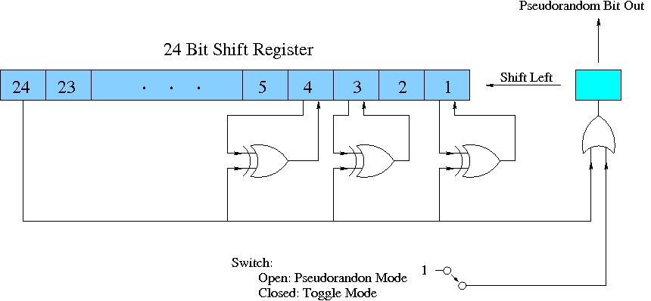
Pseudo-Radom Helicity Generator
Use 24-bit Shift Register
It is Pseudorandom, not “Random” because it is deterministic, once a sequence of 24 helicity states is known, the next states can be predicted, and it repeats its cycle.
For any initial seed, there are 2²⁴ – 1 = 16,777,215 (maximal length) random pairs before the sequence repeats, 13 days for 30 Hz helicity reversal rate.
IB1 = 000000000000000000000001
IB24 = 100000000000000000000000
MASK = 100000000000000000001101
iseed = 101010101010101010101010
If(iseed & IB24)
{ hel = 1
iseed = ((iseed ^ MASK) << 1) | IB1 (Change all masked bits, shift, and put 1 into bit 1) }
else
{ hel = 0
iseed <<= 1 (Shift and put 0 into bit 1) }

Slide 4
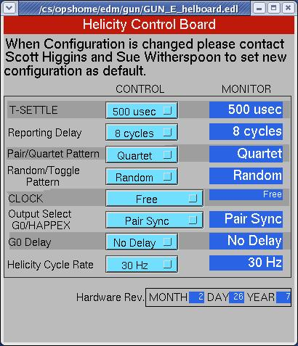
Programming
Software:
MPS (T_Settle): 500, 200, 100, and 60 µs
Reporting Delay: No Delay, 2, 4, or 8 Cycles
Helicity Pattern: Pair (+- or -+) or Quartet (-++- or +--+)
Toggle or Random
Integration Window (T_Stable): 33.3332 ms or 3.920 ms
CLOCK: Free running (f = 29.xx = 1/(T_Settle+33.3332 ms) or 30 Hz Beam Sync (f = 30 = 1/(T_Settle + T_Stable)
Output Select: Pair Sync or Helicity Delay (used with G0 dummy Pockels Cell)
G0 Delay: No Delay, 1, 2, or 4 Cycles. Delay of helicity signal for Helicity Delay
Helicity Cycle Rate: 30 Hz or 250 Hz

Slide 5
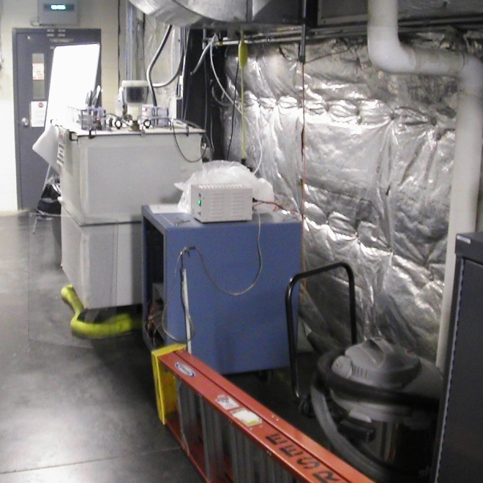
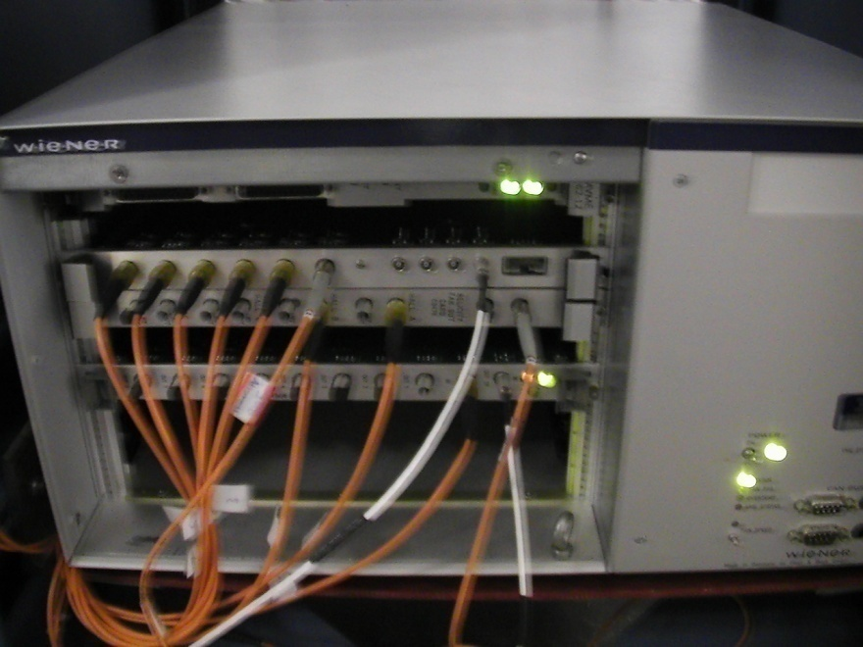
Hardware Signals
Inputs:
LEMO_0: Beam Sync FIBER_9
Outputs (Fiber-optic Signals):
Real time helicity: FIBER_2 to Helicity Magnets, FIBER_10 to Pockels Cell and IAs
QRT: FIBER_3 to Halls and Mott Polarimeters
MPS: FIBER_4 to Halls and Mott Polarimeters
T120: FIBER_5 (¼ T_Stable = 8.3333 ms)
Reporting Helicity: FIBER_6 to Halls and Mott Polarimeters, iocse9 and iocse14
Pair Sync or Helicity Delay: FIBER_7 to Halls and Mott Polarimeters

Slide 6
More Details
We only have two choices of helicity reversal rates at any given time
To change the helicity reversal rate, a new code must be uploaded in the field to the helicity generator ioc
For both helicity reversal rates, a common choice of T_Settle (4 options)
The Helicity Board has 20 MHz internal clock
On March 16, 2009: John floated the Helicity Board Crate and the Helicity Magnets Crate.

Slide 7
Cycle Rae (HZ) | MPS (µs) | MPS (Hz) | QRT (Hz) | Helicity (ms) | Helicity (Hz)
30 | 500 | 29.58 | 7.386 | 33.83 | 14.78
30 | 200 | 29.76 | 7.451 | 33.53 | 14.91
30 | 100 | 29.90 | 7.474 | 33.43 | 14.96
30 | 60 | 29.94 | 7.485 | 33.39 | 14.97
250 | 500 | 226.3 | 56.56 | 4.420 | 113.1
250 | 200 | 242.7 | 60.68 | 4.120 | 121.4
250 | 100 | 248.8 | 62.68 | 4.020 | 124.4
250 | 60 | 251.3 | 62.81 | 3.980 | 125.6
Notes:
These values as measured by a scope
Signals to Parity DAQ: MPS (T_Settle), QRT, Reporting Helicity, and Pair-Sync
The length and frequency of Pair-Sync are identical to Helicity
The length of QRT is identical to Helicity
The integration window is generated by MPS AND Pair-Sync
The integration window for 30 Hz is 33.33 ms and for 250 Hz it is 3.92 ms

Slide 8
Notes:
The 30 Hz Beam Sync signal is missing
On Monday October 13, 2008, the Helicity Board was re-programmed:
T_Settle: 10, 60, 100, 500 µs
Helicity Cycle Rates: 30 Hz or 1 kHz
Integration Window (T_Stable) is 980 µs for 1 kHz
Parity ADC internal programming:
For 30 Hz helicity reversal:
Acquisition starts 40 µs after the gate begins
There are 4 blocks of 4161 samples/block for each gate.
The acquisition time is 33.328 ms
For 250 Hz helicity reversal:
Acquisition starts 40 µs after the gate begins
There are 4 blocks of 485 samples/block for each gate.
The acquisition time is 3.880 ms
For 1 kHz helicity reversal:
Acquisition starts 40 µs after the gate begins
There are 4 blocks of 117 samples/block for each gate.
The acquisition time is 936 µs

Slide 9
Cycle Rae (HZ) | MPS (µs) | MPS (Hz) | QRT (Hz) | Helicity (ms) | Helicity (Hz)
30 | 500 | 29.58 | 7.386 | 33.83 | 14.78
30 | 100 | 29.90 | 7.474 | 33.43 | 14.96
30 | 60 | 29.94 | 7.485 | 33.39 | 14.97
30 | 10 | 29.99 | 7.496 | 33.34 | 14.99
1000 | 500 | 675.7 | 168.9 | 1.480 | 337.8
1000 | 100 | 925.9 | 231.5 | 1.080 | 463.0
1000 | 60 | 961.5 | 240.4 | 1.040 | 480.8
1000 | 10 | 1010 | 252.5 | 0.9900 | 505.1
Notes:
These values as measured by a scope
The integration window for 1 kHz is 0.980 ms

Slide 10
Why Re-designing the Helicity Board
Clean up leftovers from G0. Drop the “MPS” label!
Make it easy to program and easy to choose any reversal rate and any T_Settle time
Change the Shift Register to 30-Bit. The sequence will repeat every 25 days for 1 kHz helicity reversal rate.
Add another pattern: Octet (+-+--+-+ or -+-++-+-)
We will need new fiber output signals:
2 additional outputs for 4-way IA feedback scheme where the applied IA voltage is determined not only from the current helicity state but also from the previous helicity state.
Output of the Helicity Board Clock signal.

Slide 11
New Design

Slide 12
Hardware Signals
Inputs (Fiber-Optic TTL Signals):
30 Hz Beam Sync
Spare input
Outputs (Fiber-Optic TTL Signals):
Real Time Helicity (two outputs):
Standard: Pockels Cell and IAs
Complementary: Helicity Magnets
Delayed Helicity: Halls and Polarimeters, iocse9 and iocse14
T_Settle: Halls and Polarimeters
Pair Sync: Halls and Polarimeters
Multiplet Sync: now QRT - start of a Quartet or Octet, Halls and Polarimeters
IAs Control (two outputs): IA1 and IA2, indicate current and previous patterns
20 MHz Internal Clock: Halls and Polarimeters
Few Spare Fibers

Slide 13
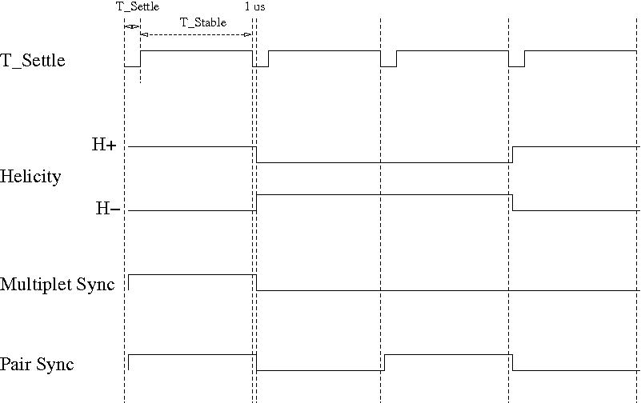
Timing of Signals
The transition to T_Settle should start 1.00 µs before all other signals. Now it is 100 ns; this time is too short

Slide 14
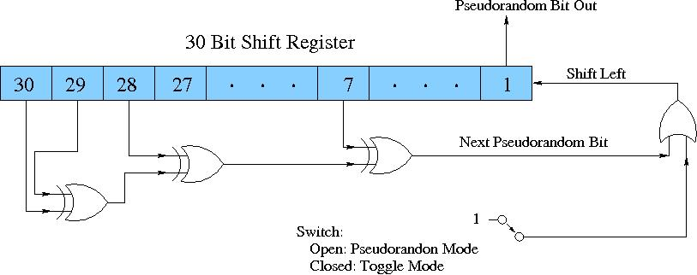
Pseudo-Radom Helicity Generator
Use 30-bit Shift Register
It is Pseudorandom, not “Random” because it is deterministic, once a sequence of 30 helicity states is known, the next states can be predicted, and it repeats its cycle.
For any initial seed, there are 2³⁰ – 1 = 1,073,741,823 (maximal length) random pairs before the sequence repeats, 25 days for 1000 Hz helicity reversal rate.
UInt_t bit7 = (fgShreg & 0x00000040) != 0
UInt_t bit28 = (fgShreg & 0x08000000) != 0
UInt_t bit29 = (fgShreg & 0x10000000) != 0
UInt_t bit30 = (fgShreg & 0x20000000) != 0
UInt_t newbit = (bit30 ^ bit29 ^ bit28 ^ bit7) & 0x1
fgShreg = newbit | (fgShreg << 1 ) & 0x3FFFFFFF

Slide 15
Programming
Select Toggle or Random
Choose Reporting Delay: n Cycles, n = 0 … 1000 cycles
Select Helicity Pattern: Pair (+- or -+), Quartet (-++- or +--+), Octet (+--+-++- or -++-+--+)
Select Clock:
Free:
Choose T_Settle value between 10 µs - 1000 µs
Choose Integration Window (T_Stable) value between 400 µs – 1,000,000 µs
Display Helicity Reversal Rate: f = 1/(T_Settle + T_Stable)
30 Hz Beam Sync: Force phase-lock during T_Settle
Choose T_Settle value between 10 µs - 1000 µs
Choose Helicity Reversal Frequency f: 30, 120, or 240 Hz
Display T_Stable: T_Stable= 1/f - T_Settle

Slide 16
How to Reduce 60 Hz Line Noise?
Choose T_Stable such that: f>1 kHz
Integrate over 60 Hz noise:
Choose T_Stable = 33,333 µs (exactly two 60 Hz cycles).
Choose T_Stable + T_Settle = 8,333 µs (half 60 Hz cycles), select Quartet Pattern, line-phase locked. Then, A = +1-2-3+4.
Choose T_Stable + T_Settle = 4,167 µs, select Octet Pattern, line-phase locked. Then, A = +1-2-3+4-5+6+7-8.

Slide 17
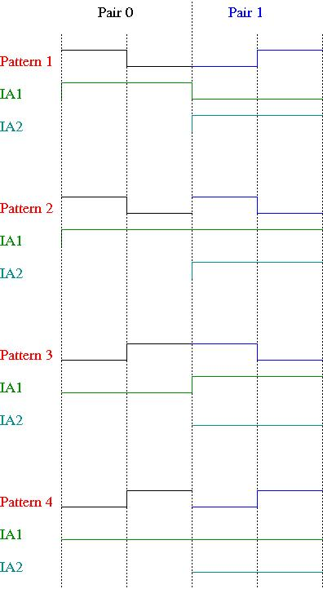
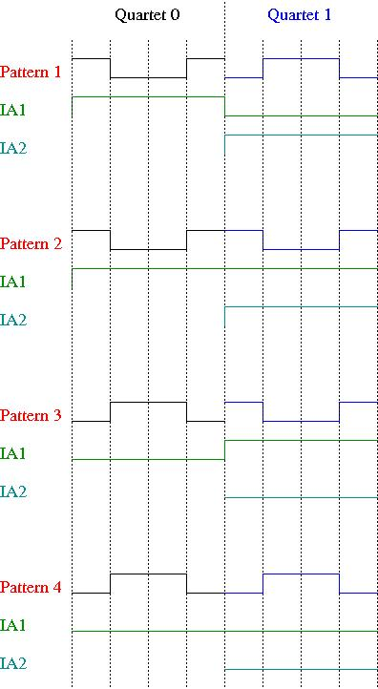
IAs Outputs: Pairs, Quartets, & Octets
…

Slide 18
New Fibers Needed?
2 new fibers needed from IN01B05 to the Laser Table: IA1 and IA2
Use the existing T120 fibers to carry the 20 MHz Clock signal from IN01B05 to the Parity DAQ in IN02B24 and to the Parity DAQ in Hall C

