Slide 1
Extreme High Vacuum: why and how Marcy L. Stutzman Jefferson Lab Center for Injectors and Sources
Notes:
Title Page Design 3

Slide 2
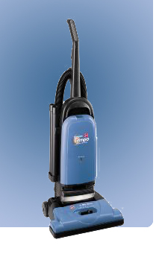
What is vacuum?
Vacuums are nothings. We only mention them to let them know we know they're there.
Middle school student’s answer on a science test

Slide 3
Modern Vacuum History
‘Ultimate’ Vacuum vs. Time
Improvements with pumps
Improvements with gauges
10⁻⁶
10⁻⁸
Ultimate Vacuum (Torr)
10⁻¹⁰
10⁻¹²
10⁻¹⁴
1900
1920
1940
1960
1980
2000
P.A. Redhead Vacuum 53 (1999) 137

Slide 4
Vacuum level definitions
Vacuum | Pressure (Torr) | Molecules/m^3 (bottom of range) | Mean free path
Atomsphere | 760 | 2.7x10²⁵ | 68 nm
Low vacuum | 300 – 1 Torr | 10²² | 100 µm
Medium vacuum | 1 Torr – 1 mTorr | 10¹⁹ | 100 mm
High vacuum | 1 mTorr – 1x10⁻⁷ | 10¹⁵ | 1 km
Ultra High vacuum | 1x10⁻⁷ – 1x10⁻¹² | 10¹⁰ | 10⁵ km
Extreme high vacuum | <1x10⁻¹² | <10¹⁰ | >10⁵ km

Slide 5
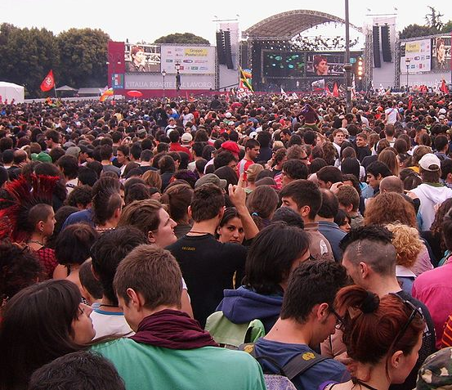
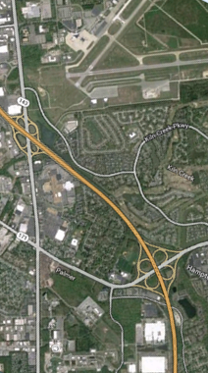
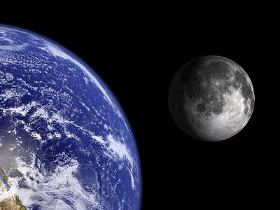
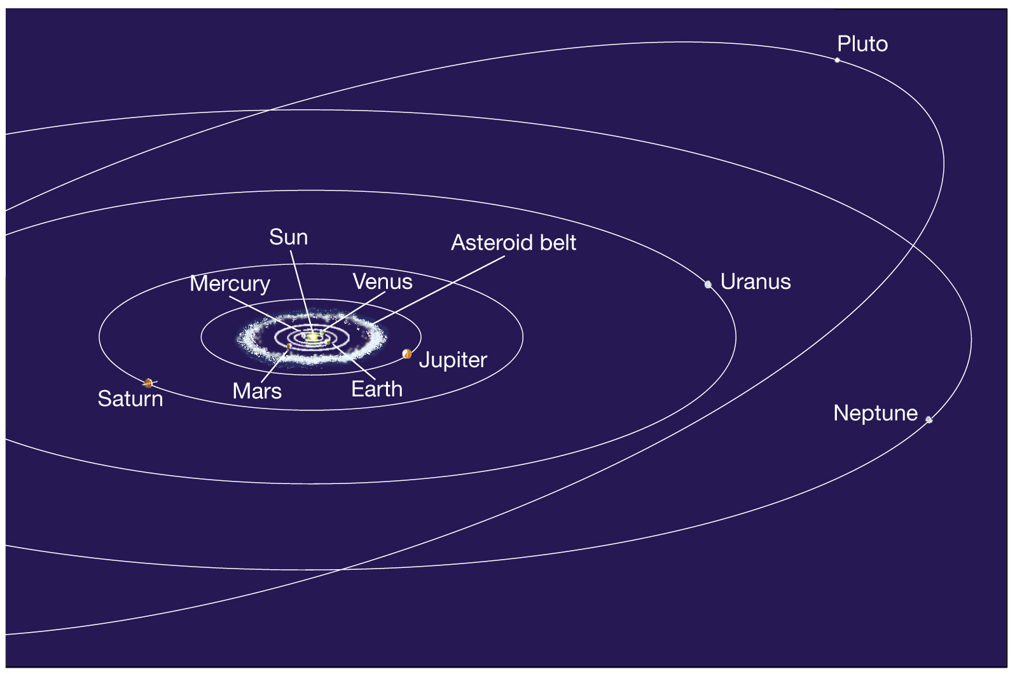
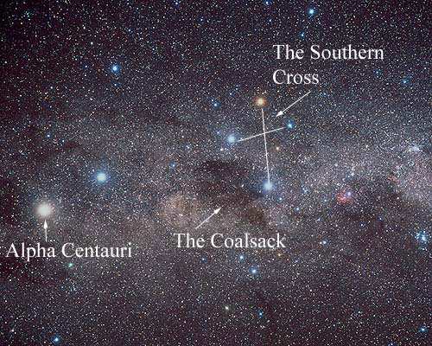
Vacuum Level | Where found | If people were molecules, the your closest neighbor is
Atmosphere | This room | About 1 foot away
Medium Vacuum | Bell jar, scattering chambers | Near the Newport News airport, almost 3 miles
High Vacuum | Low earth orbit, beamline | At the moon, 240,000 miles
Ultra High Vacuum (UHV) | Lunar atmosphere, Electron gun | Near Pluto, 4 billion miles
Extreme High Vacuum (XHV) | Interstellar space, Cryomodules | At the nearest star, Alpha Centauri, 25,000 billion miles
Atmosphere
Medium Vacuum
High Vacuum
UHV
XHV

Slide 7
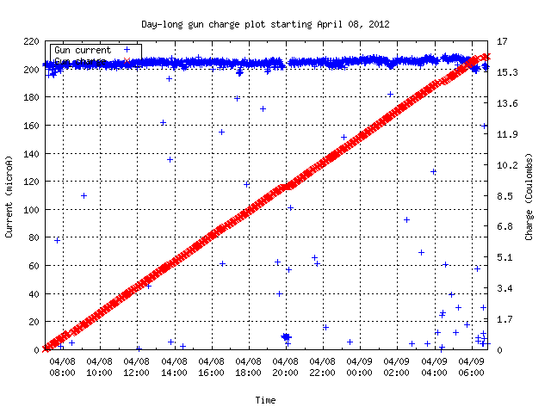
Beam required at Jefferson Lab
Outline
How do we emit polarized electrons?
What is required to keep the electron source working for the duration of experiments?
How do we achieve and maintain the required vacuum
24 Hours
High polarization for 3 (4) experimental halls simultaneously
24/7 beam operation
Beam Current: 200 µA
Charge Delivered: 16 Coulombs polarized electrons / day

Slide 8
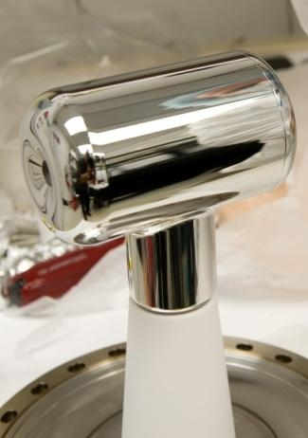
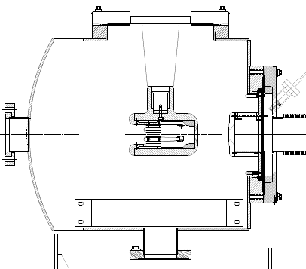
Photoemission Source
-130 kV DC (vs. RF) electrode bias
x-ray standard “inverted” insulator
Pumps with NEG modules and ion pump
Base pressure approaching XHV ≡ P < 1x10⁻¹² Torr
-130kV
light in
electrons out
photocathode

Slide 9
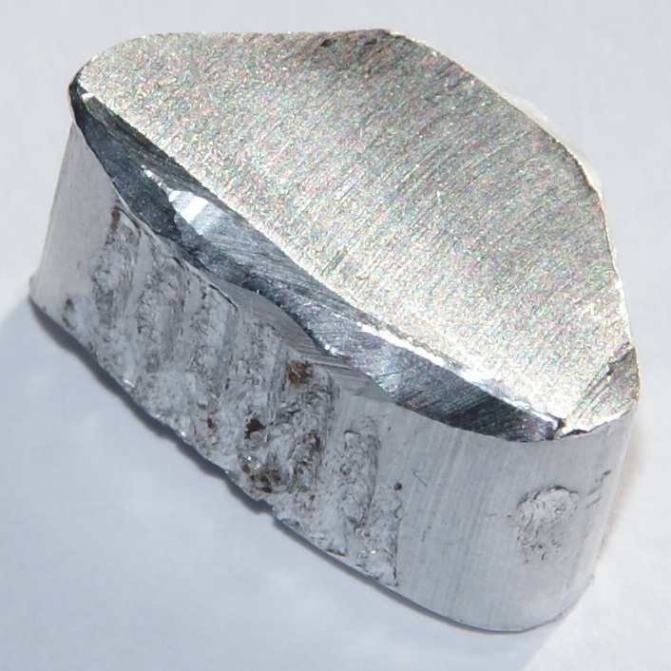
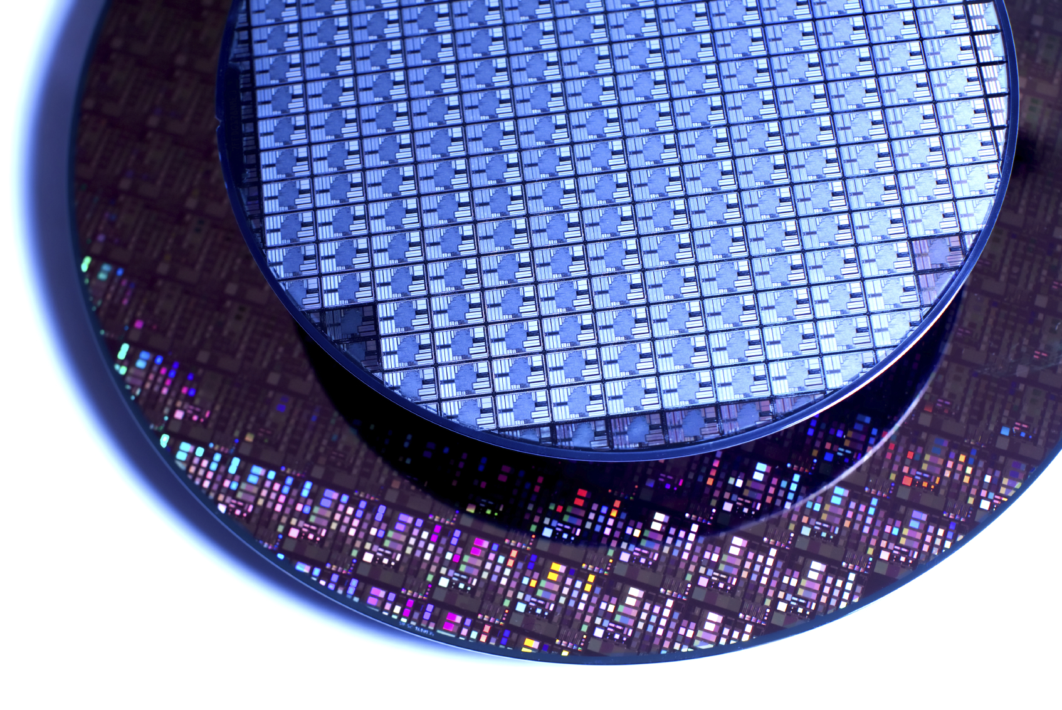
Metals, Insulators and Semiconductors
gap
unfilled
unfilled
unfilled
gap
Fermi
Level, E_{F}
E_{F}
gap
E_{F}
filled
E_{F}
unfilled
filled
filled
Metal:
Unfilled valance band
Insulator:
Large band gap
Semiconductor:
Small band gap

Slide 10
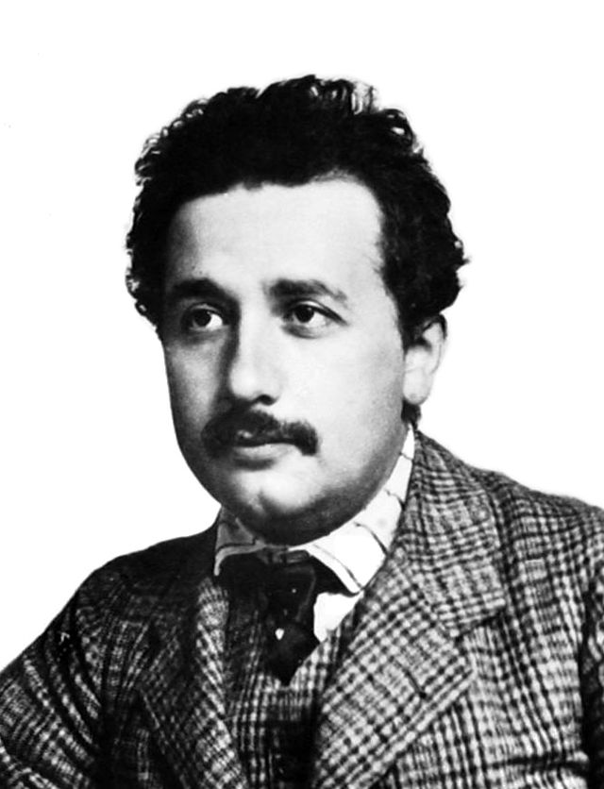
Photoelectric effect
No emission below cutoff wavelength
Increase in photocurrent with increase in intensity of light above cutoff wavelength
Metallic emission: typically UV wavelengths
Particle nature of light
The Nobel Prize in Physics 1921 was awarded to Albert Einstein "for his services to Theoretical Physics, and especially for his discovery of the law of the photoelectric effect".

Slide 11
Photoemission from GaAs
Bare GaAs surface
Large Work Function
Positive Electron Affinity (PEA)
NEA Surface Activation
Dipole layers of Cs + NF₃ or Oxygen
Reduces Work Function
Negative Electron Affinity (NEA)
PEA=4.07 eV
-
Conduction
Band
-
χ^{NEA} ~ 0.2 eV
E_{gap}=1.4 eV
Valence
Band
+
Light
GaAs
Vacuum
GaAs
Vacuum
GaAs Spin Polarized Electron Source, D.T. Pierce, R.J. Celotta, G.-C. Wang, W.N. Unertl, A. Galejs, C.E. Kuyatt, and S.R. Mielczarek, Review of Scientific Instruments 51(4), 478 (1980).

Slide 12
NEA Activation of GaAs
QE
“Activate” GaAs photocathode by applying about one mono-layer of Cesium and NF₃ to very clean surface
NF₃
Cs
0
Time
Vacuum must be “deep-UHV” ≡ < 5x10⁻¹¹ Torr
System baked to remove water vapor
Leak tight, all metal seals, no organics
Heat GaAs prior to activation to remove any surface oxides
Maintain surface activation layer
water vapor, oxygen destroy surface chemistry
Cs
Cs
Cs
Cs
F
F
F
F
GaAs

Slide 13
Polarized electrons using circularly polarized light
Crystalline (bulk) GaAs
Circularly polarized light
780 nm ~ band gap
Helicity reversal: 1kHz
Maximum theoretical polarization: 50%
GaAs Spin Polarized Electron Source, D.T. Pierce, R.J. Celotta, G.-C. Wang, W.N. Unertl, A. Galejs, C.E. Kuyatt, and S.R. Mielczarek, Review of Scientific Instruments 51(4), 478 (1980).

Slide 14
High P: Breaking GaAs Degeneracy
Split degeneracy of P_{3/2} : Introduce strain on GaAs crystal by growing it on substrate (GaAsP) with different lattice constant
High polarization by circularly polarized laser excitation from
P_{3/2} to S_{1/2} : E_{gap} < E_{γ} < E_{gap}+δ
m_{j} = -1/2
+1/2
S_{1/2}
σ+
σ-
E_{gap}
P_{3/2}
m_{j} = -3/2
+3/2
δ=20–50
meV
-1/2
+1/2
Bulk GaAs
Higher QE: Alternating layers of GaAs and GaAsP
Strained Superlattice GaAs
Max 100% theoretical polarization

Slide 15
Strained Superlattice QE and Polarization
m_{j} = -1/2
+1/2
S_{1/2}
σ+
σ-
E_{gap}
P_{3/2}
m_{j} = -3/2
+3/2
δ=20–50
meV
-1/2
+1/2
Highest polarization at wavelength just over the band gap
Higher QE with shorter wavelengths
J.L. McCarter, … M.L. Stutzman et al., NIMA 618 (2010) 30.

Slide 16
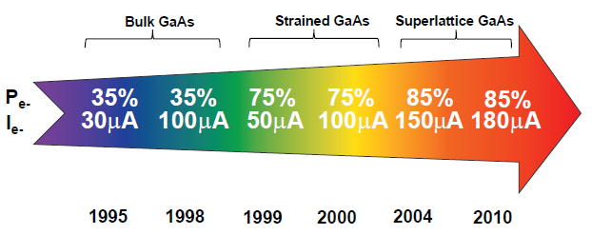
GaAs Photocathode Evolution
Bulk GaAs
Strained GaAs:
GaAs on GaAsP
Superlattice GaAs:
Layers of GaAs on GaAsP
GaAs
GaAs
100 nm
GaAsP
100 nm
14 Layers
0.36
GaAsP
0.36
2 μm
625 μm
GaAs
350 μm
GaAs
350 μm
QE ~ 20%, 120 μA/mW
Unpolarized @ 532 nm
QE ~ 5%, 30 μA/mW
Pol ~ 35% @ 780 nm
QE ~ 0.2%, 1 μA/mW
Pol ~ 75% @ 850 nm
No strain relaxation
QE ~ 1%, 6 μA/mW
Pol ~ 85% @ 780 nm (1.59 eV)
Timeline of Polarized Source at CEBAF

Slide 17
Any gas in chamber can be ionized by electron beam, accelerated back toward the photocathode and
limit photocathode operational lifetime

Slide 18
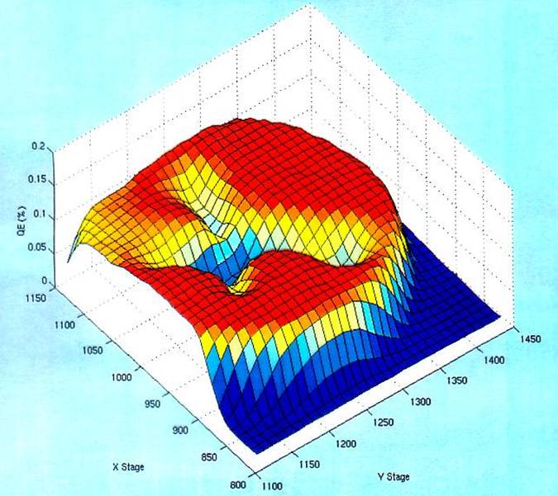
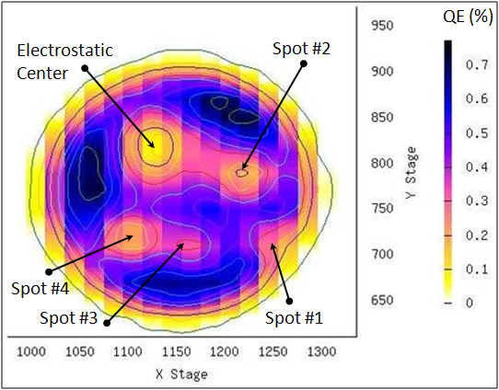
Photocathode Lifetime
Ion bombardment – with characteristic QE “trench” from laser spot to electrostatic center of photocathode – damages NEA of GaAs
High energy ions are focused to electrostatic center: create QE “hole”
Don’t run beam from electrostatic center.
QE can be restored, but takes about 8 hours to heat and reactivate
Photocathode “QE scan”
Active area = 5 mm
Laser size = 0.35 mm

Slide 19
Operational Lifetime Limitations
Static vacuum approaching XHV (1x10⁻¹² Torr)
Baked, leak free, all metal vacuum systems
Ceramic insulators, glass windows bonded to metal
No machining oil, no fingerprints
Bake for 30 hours 250°C to largely eliminate water vapor
Hydrogen outgassing reduction
Pumping for nearly XHV
Dynamic vacuum issues
Eliminate field emission from electrodes
Eliminate beam halo, scraping

Slide 20
How to reach XHV ≡ P < 1x10⁻¹² Torr?
Less gas in
More gas out
Measure pressure

Slide 21
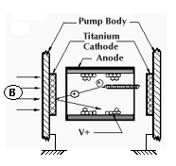
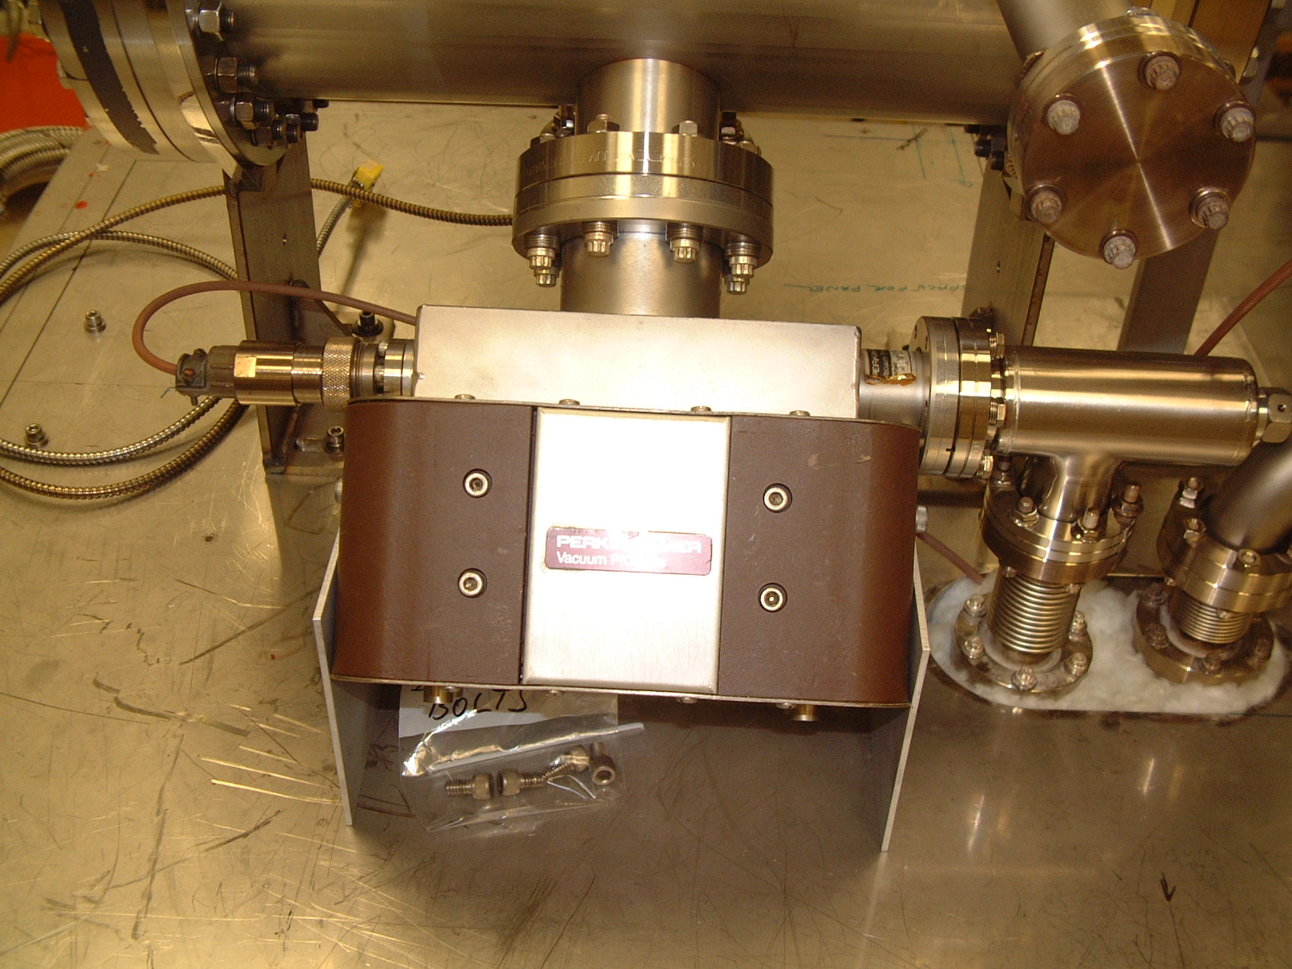
More gas out: improve pumping
Only some pumps suitable for UHV
Ion pumps
High voltage to ionize gas
Magnetic field to direct ionized gas into plates to trap gasses

Slide 22
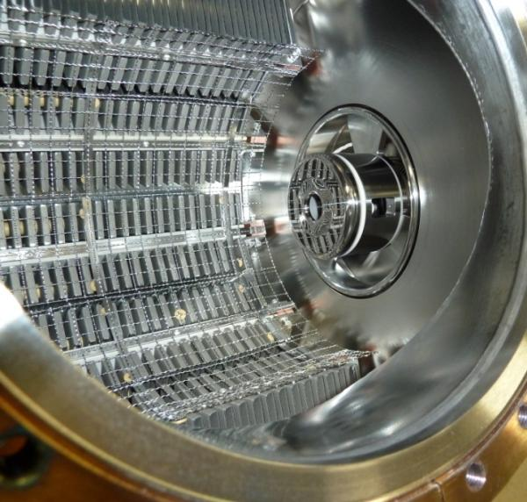
Another proven UHV pump
Getter Pumps
Chemically active surface
Titanium sublimed from hot filament
Non-Evaporative Getters
Molecules stick when they hit
Does not work for inert gasses such as Argon, Helium

Slide 23
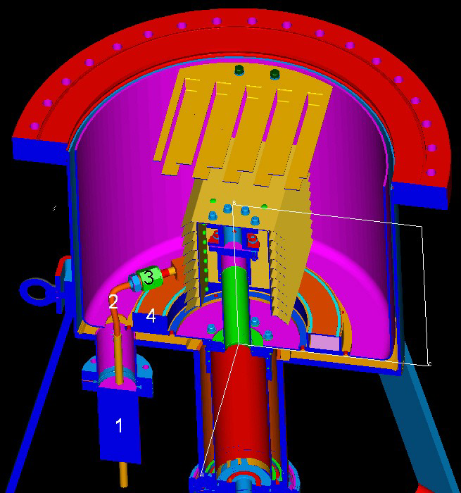
A novel system: Leybold XHV Cryopump
LN₂ chill circuit
cools cryosorber panels and compressor
allows bake of cryopump body
Operation
10K pumping surface
30K baffles
Presented at AVS 55 by Dieter Mueller

Slide 24
Measure Pressure:
Hot cathode gauge operation and errors
True gas ionization
Positive current
X-ray effect
e- on anode -> photons emitted
Photons on collector -> electrons emitted
Extra positive current
Anode
4
+
Inverse X-ray effect
e- on anode -> photons
Photons on walls -> electrons
Electrons to collector
Extra negative current
+
1
3
e⁻
2
e⁻
Electron stimulated desorption
e- strike gas molecules on anode
Gas ionized and reaches collector
can be distinguished with energy analysis
Neutral atom desorbed
Ionized within grid
Indistinguishable from real gas
Must eliminate souce
Cathode

Slide 25
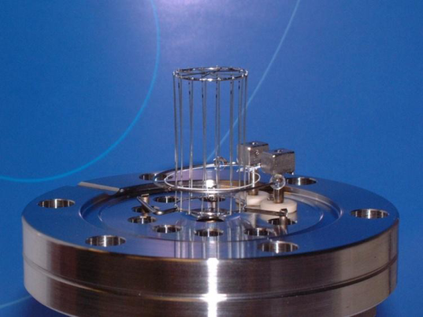
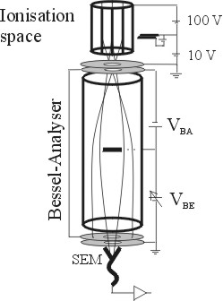
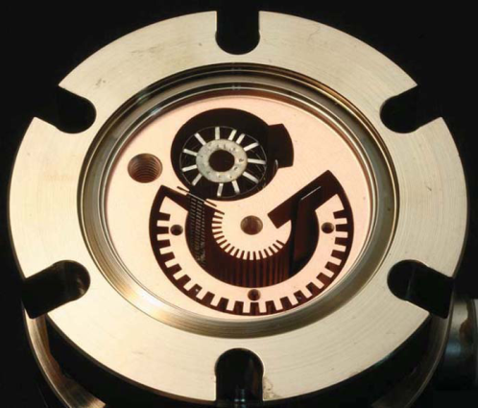
XHV gauges
Hot filament
extractor
Extractor gauge
available commercially for decades
x-ray limit reduced through geometry
x-ray limit quote: 7.5x10⁻¹³ Torr
Axtran gauge
Bessel box energy discrimination
electron multiplier to assist in low current measurements
Quoted limit: 3.75x10⁻¹³ Torr
Watanabe BBB (Bent Belt Beam) gauge
Uses Leybold IE540 controller
230° deflector BeCu housing
JVSTA 28, 486 (2010)
Quoted limit: 4x10⁻¹⁴ Torr
Axtran
BBB

Slide 26
x-ray limit measurement
Extractor Gauge
Bent Belt Beam Gauge
x-ray background
x-ray background

Slide 27
Gauge heating effects

Slide 28
Days to stabilize: minimization of ESD effects?
Bare Steel
Silco on Heated
TiN

Slide 29
Effectiveness of adding a cryopump

Slide 30
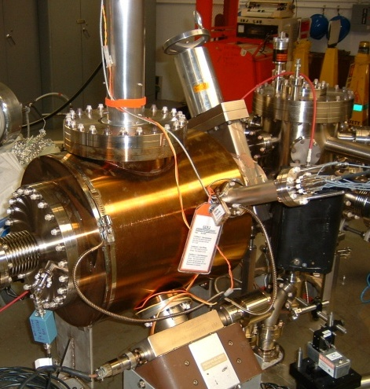
Less gas in: reduce outgassing
Primary source in stainless system: hydrogen outgassing
To reduce outgassing
reduce thick flange area
heat treatment
400°C bake
10+ days
thin dome replaces thick flanges

Slide 31
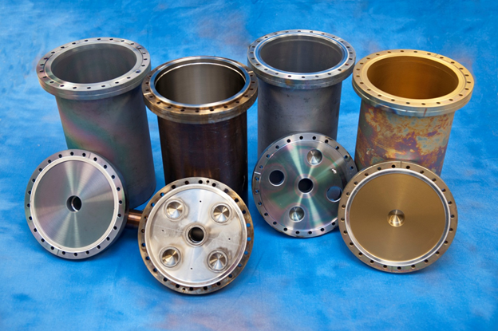
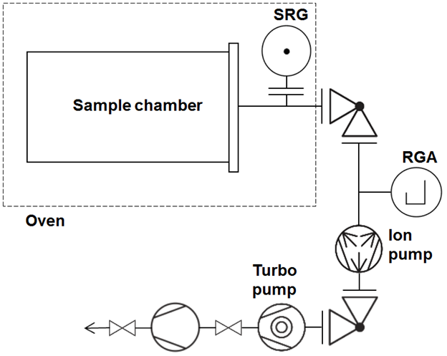
Outgassing rates vs. heat processing and coatings
Identical 304L chambers
Bare steel
TiN coating (9 µm)
a-Si (SilcoGuard-1000®~900 nm)
Outgassing rates
Spinning Rotor Gauge
Accumulation technique
Multiple bakes
Q(T_{room}) after each bake

Slide 32
Outgassing rates: bare and coated chambers
All data at T_{room} = 20°C
Notes:
Steel:
Expected reduction
with 400°C heat
treatment
Silco:
Little variation with
heat treatment
Silco on heated SS:
Retains prior
outgassing rate
TiN coating:
Very low outgassing
rates, consistent with
literature, elemental
Ti pumping?

Slide 33
Coated chambers with NEG & ion pumps Measured vs. calculated pressures
$$P=\frac{qA}{S}$$
Outgassing rate for TiN coating incorrect:
There must be some pumping from elemental
Ti in the system, making accumulation method
invalid (supported by surface analysis)
Notes:
Preliminary conclusions: is the sensitivity correct? Were the outgassing measurements correct? (no for TiN) was the pump speed constant through the three. Work on error bars until the extractor error is more believable. Poor signal to noise on the extractor gauge makes it difficult to use?

Slide 34
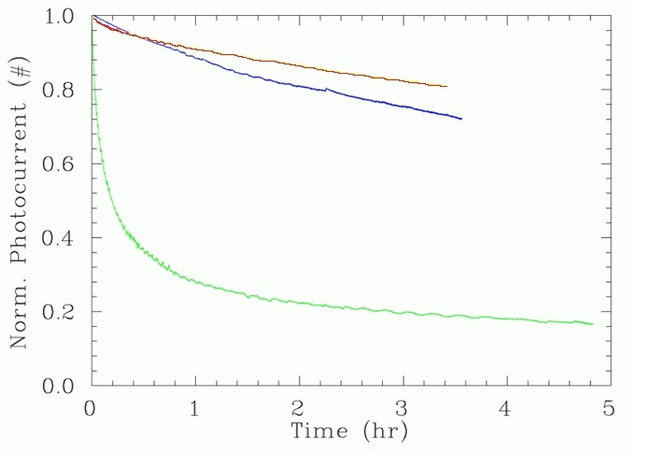
Remember: Better Vacuum, longer lifetime
~2.5x10⁻¹¹ Torr
~5x10⁻¹¹ Torr
System Leak

Slide 35
Summary
High polarization strained superlattice GaAs-GaAsP photocathodes susceptible to ion damage, gun vacuum level
Outgassing reduction, pumping combinations and measurements to verify improvements are being optimized
Vacuum improvements required for future proposed higher current polarized electron sources

Slide 36
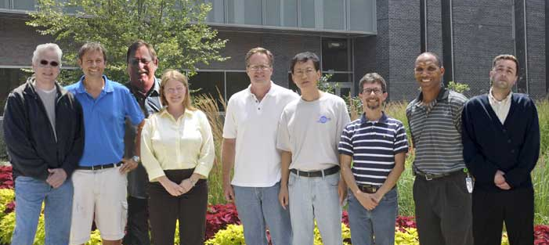
Thank you for your attention
(L-R) Matt Poelker, Joe Grames, Bubba Bullard
Marcy Stutzman, John Hansknecht, Shukui Zhang
Carlos Hernandez Garcia, Phil Adderley, Riad Suleiman
Students: Md. A. Mamun, Edgar Abarca Morales, Wei Liu

