Slide 1

Beam Current Monitor System
Functional Description
J. Kowal, H. Robertson, et al.

Slide 2
Overview
The Personal Safety System (PSS) Beam Current Monitoring (BCM) System is considered the fast electronics of the PSS system located in the Injector, East Arc, Beam Switchyard, and the Tagger/Hall D transport.
The purpose of the BCM system is to protect the Beam Stoppers from seeing errant beam capable of burning through these stoppers.
This is achieved by this system with a pillbox RF cavity in the beam line that monitors the beam current by means of detecting the electron bunches that pass through the cavity and generate an RF signal proportional to the beam current.

Slide 3
Based upon calculations and simulations the BCM system must be fast enough to prevent burn through that can occur as fast as 2.0ms. The BCM system's ability to shut off the beam through the fast beam shutdown devices is independent from the PLC system and is interfaced to the Injector Kicker. The status of the BCM system is monitored by the PSS PLC controller, so that the PSS system is able to shut down the Gun as well.
.

Slide 4
Each of these channels at the three locations consists of the BCM Cavity with two RF Heliax cables connected to redundant systems A & B.
The redundant electronics consists of:
Down Converter
RMS to DC Converter
Equalizer
Integrator
Logic Interface Unit (LIU)

Slide 5
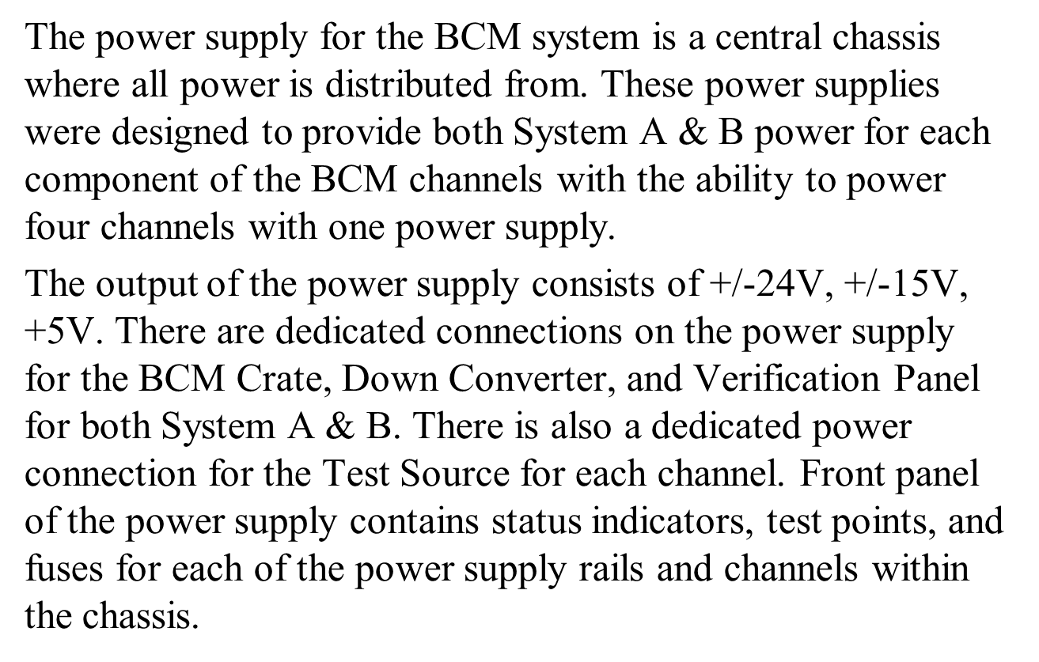

Slide 6
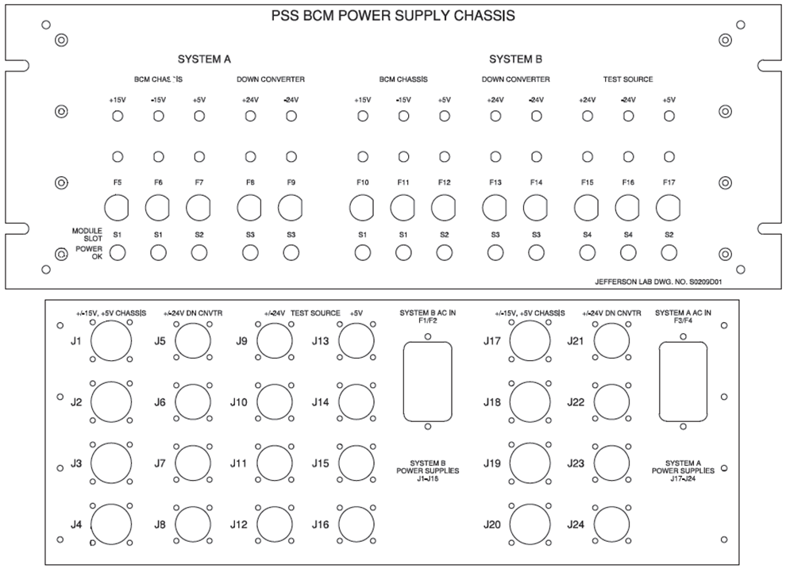

Slide 7
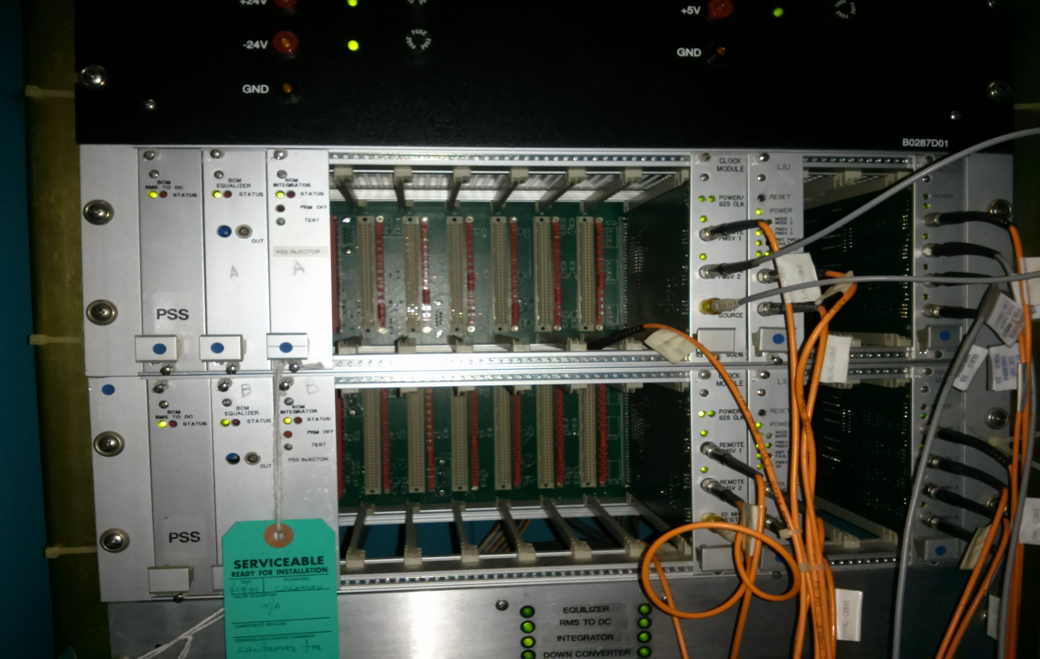

Slide 8
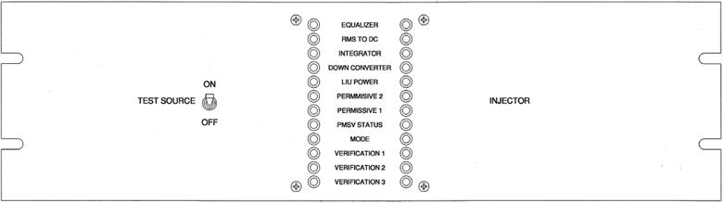
Injector BCM Verification Panel

Slide 9
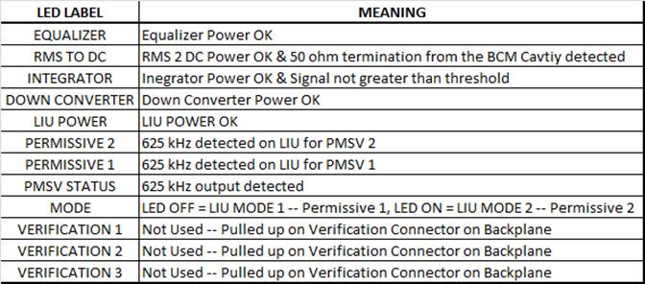
Verification Panel LED Explanation

Slide 10
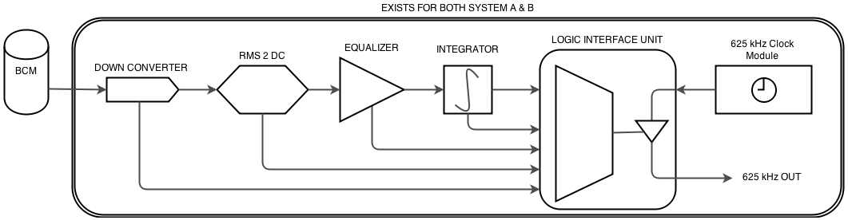
BCM Channel Signal Flow

Slide 11
Cavity
The PSS BCM uses a simple pill box cavity exciting the TM010 downconverter mode at 1497 MHz.
They are constructed of stainless steel.
The Q is approximately 3000 and geometric shunt impedance is 1800.
A lockable stub tuner mounted on a micrometer permits adjusting the resonate frequency of the cavity.
Each cavity has three ports.
The test port is -14 dB with respect to the other two ports.
The other two ports are the sample ports and supply beam current information to the system.

Slide 12
Tuner Port
Port A

Slide 13
Downconverter
The downconverter shifts the 1497MHz spectral component of the cavities to a 1 MHz signal. This is done to avoid signal attenuation due to cable losses.
The DC 010 is designed for a dynamic range of 0 - 10uA.
A summary fault output is included on each downconverter module. Faults include:
  Voltage out of regulation
  Local Oscillator +1- 1% out of tolerance
  RF input cable not connected to cavity
The fault signal goes to the Logic/Interface Unit. If a fault exists beam will be shut off.

Slide 14
Test Source
The test source permits the operators to perform a confidence test of the machine.
When activated it supplies a 1497 MHz signal to the test port of the cavity that is equivalent to a 10 uA beam for the beam stoppers.

Slide 15
RMS to DC Converter
The RMS to DC converter contains a differential input amplifier for noise rejection, a bandpass filter, and a commercial RMS to DC converter I.C.
The input is lMHz from the downconverter and the output is 0 to 5VDC, nominal.
Fault detection circuitry includes:
  Voltage out of regulation
  Down converter cable not attached
The fault signal goes to the Logic/Interface Unit. If a fault exists beam will be shut off.

Slide 16
Equalizer
Permits the technician to adjust signal levels during calibration.
It contains the gain adjustment for the DC current signal.
The gain is adjusted such that:
  Injector BCM DC out 0 - 5V = 0 - 200 uA
  Beam Stopper BCMs DC out 0 - 5V = 0 - 10 uA
Fault detection circuitry includes:
  Voltage out of regulation
The fault signal goes to the Logic/Interface Unit. If a fault exists beam will be shut off.

Slide 17
Integrator
Designed to integrate the signal from the equalizer and generate a fault if the integrated level exceeds 10 volts.
Contains circuitry that integrates the beam current and faults if the current-time product exceeds the threshold.
625kHz permissive signal from the Logic/Interface Unit is routed through a TTL gate controlled by the comparator output.
Fault detection circuitry includes:
  Voltage out of regulation
  Window Comparator Fault
Both faults go to the Logic/Interface Unit. If a fault exists beam will be shut off.

Slide 18
Logic Interface Unit (LIU)
Each card in the BCM chassis sends a health status to the LIU.
If the health is bad the Logic card will remove the 625kHz permissive.
The logic card also contains a latched relay output which is monitored by the local PLC.
  The contacts are open on fault.
  If the local PLC senses a fault it will drop the area out of Beam Permit. All output faults are latched.
  The status of each input is also latched on a fault for diagnostics.
All external inputs and outputs to the Logic Card are optically isolated.

Slide 19
What BCM Faults will shut off the beam ?
Beam current I > 1uA AND > 100uA-ms
Any BCM system card not connected
Voltage out of regulation on any BCM subsystem
Calibration level out of limits
Downconverter local oscillator out of limits
Interconnecting coax or cables not connected
625 kHz permissive signal missing for any reason
Ambiguous PSS mode status indication from the PLCs

Slide 20
Each BCM has an internal threshold detector that will fault if the beam current exceeds 1 uA.
The Beam Current Monitors must shut off the beam within 1 ms of the onset of a worst case fault condition.
Therefore, in addition to the beam current detection system, there is also a fast beam shutoff system which removes beam from the accelerator within 1ms of the hazardous condition being present.

Slide 21
Shut off time will be expressed as an integrated value:
200uA x 1ms = 200,000uA-us
The minimum integration time is driven by the worst case time to fault minus the sum of the propagation times to the beam shut down devices.

Slide 22
Time Allocation:
  Tso = Max Time to Shut off 1000us
  Tsb = Stored Beam 21us
  Trl = Remote Logic Processing 100us
  Txmt = Fault Transmission time 10us
  T11 = Local Logic Processing 100us
  Tso = Beam Shut Off Time 200us
  Time left for integration = 569us
An integration time of 500uS will be used
Integration time = 200uA * 500us = 100,000 uA-us

Slide 23
Questions??

