Slide 1
Magnetized Beam Update
(LDRD)
JLEIC Collaboration Meeting
March 29, 2016
Riad Suleiman and Matt Poelker

Slide 2
Outline
Magnetized Bunched Electron Beam Requirements
Magnetized Sources
JLEIC Magnetized Beam LDRD
Experimental Overview
Progress
Milestones

Slide 3
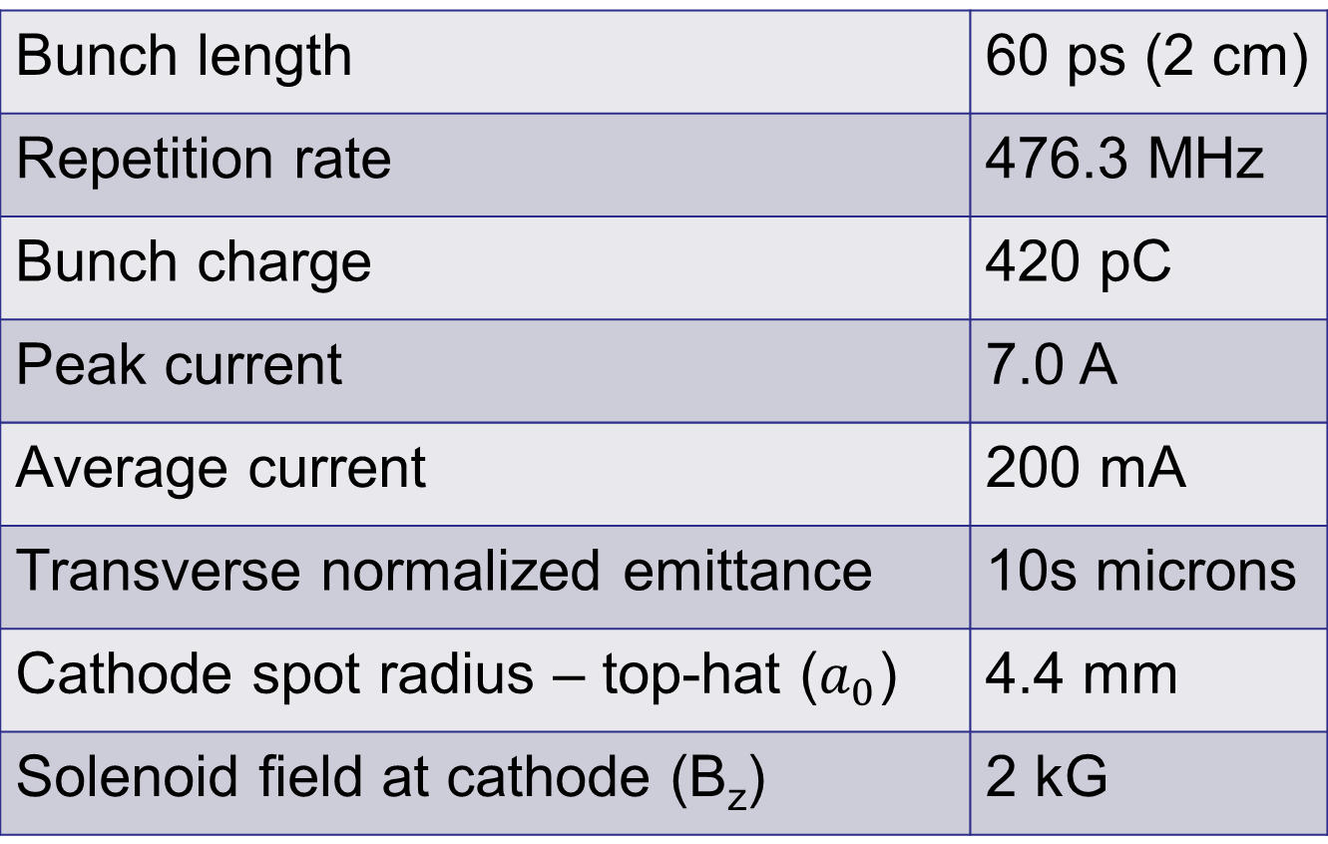
Magnetized Bunched Electron Beam Requirements
Bunch length | 60 ps (2 cm)
Repetition rate | 476.3 MHz
Bunch charge | 420 pC
Peak current | 7.0 A
Average current | 200 mA
Transverse normalized emittance | 10s microns
Cathode spot radius – top-hat ($a_{0}$) | 4.4 mm
Solenoid field at cathode (B_{z}) | 2 kG

Slide 4
Magnetized Sources
Fermilab Photoinjector Laboratory:
  Pulsed NCRF gun
  Cs₂Te photocathode and UV laser (λ=263 nm)
  Bunch charge: 0.5 nC and bunch length: 3 ps
  0.5% duty factor (average current: 7.5 μA)
    Bunch frequency: 3 MHz
    Macropulse duration: 1 ms
    Number of bunches per macropulse: 3000
    Macropulse frequency: 5 Hz
      No CW beam at high average current
Magnetized beam R&D at University Mainz just started
Notes:
Cesium telluride (Cs2Te)

Slide 5
JLEIC Magnetized Beam LDRD
Generate magnetized electron beam and measure its properties
Explore impact of cathode solenoid on photogun operation
Simulations and measurements will provide insights on ways to optimize JLEIC electron cooler and help design appropriate source
JLab will have direct experience magnetizing high current electron beam

Slide 6
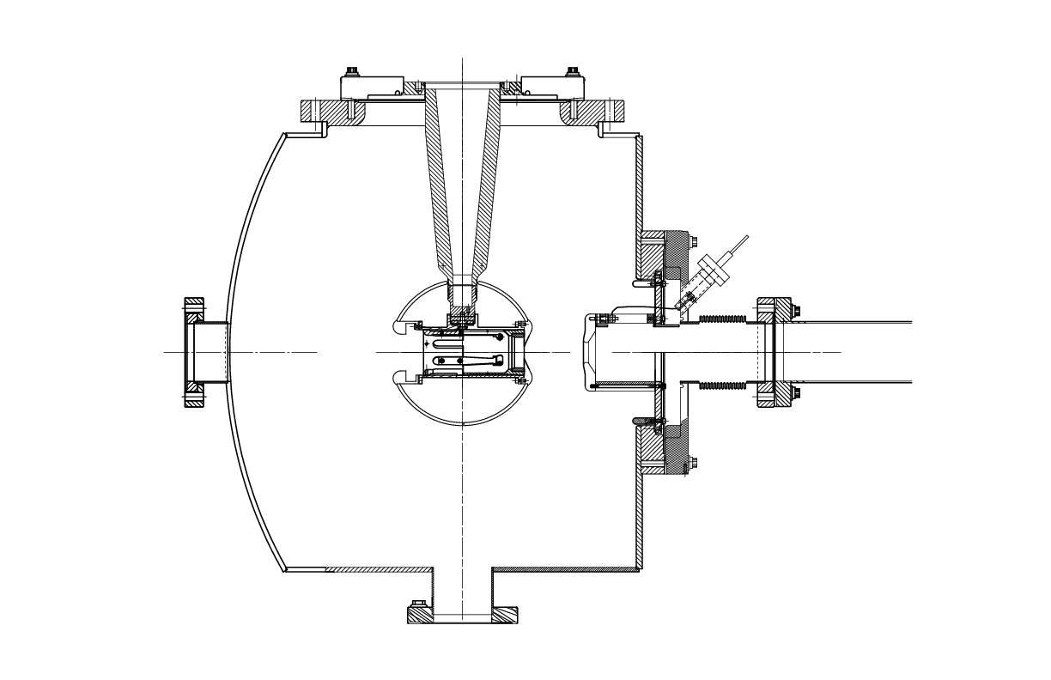
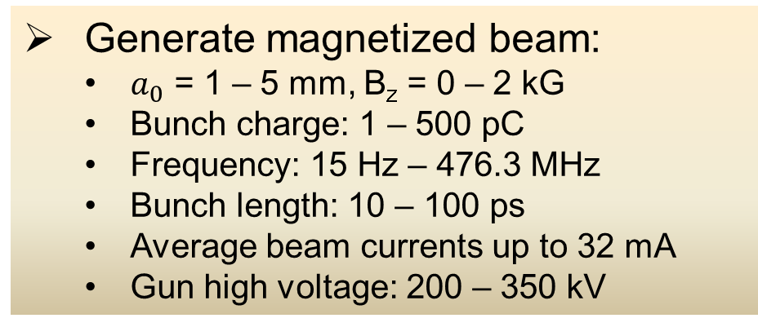
Experimental Overview
Cathode
Solenoid
Diagnostic Cross 3
(YAG Screen)
Cathode
Three Skew Quads
(Round-to-Flat Beam Transformer)
Green
Laser
Anode
K₂CsSb
Photocathode
Injector Focusing Solenoids
Diagnostic Cross 1
(Multislit + YAG Screen)
Diagnostic Cross 2
(H,V slit + YAG Screen)
Generate magnetized beam:
  $a_{0}$ = 1 – 5 mm, B_{z} = 0 – 2 kG
  Bunch charge: 1 – 500 pC
  Frequency: 15 Hz – 476.3 MHz
  Bunch length: 10 – 100 ps
  Average beam currents up to 32 mA
  Gun high voltage: 200 – 350 kV
Simulations will be discussed in Fay’s talk

Slide 7
Planned Measurements
Measure mechanical angular momentum
Measure photocathode lifetime versus solenoid field at high currents (up to 32 mA) and high voltages (200 – 350 kV) limited by in-house HV supplies
Study beam halo and beam loss versus magnetization
Use skew quads – RTFB Transformer – to generate flat beam and measure horizontal and vertical emittances using slit method
Generate very high currents magnetized beam and study beam transport and RTFB versus electron bunch charge

Slide 8
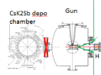
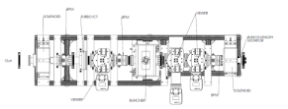
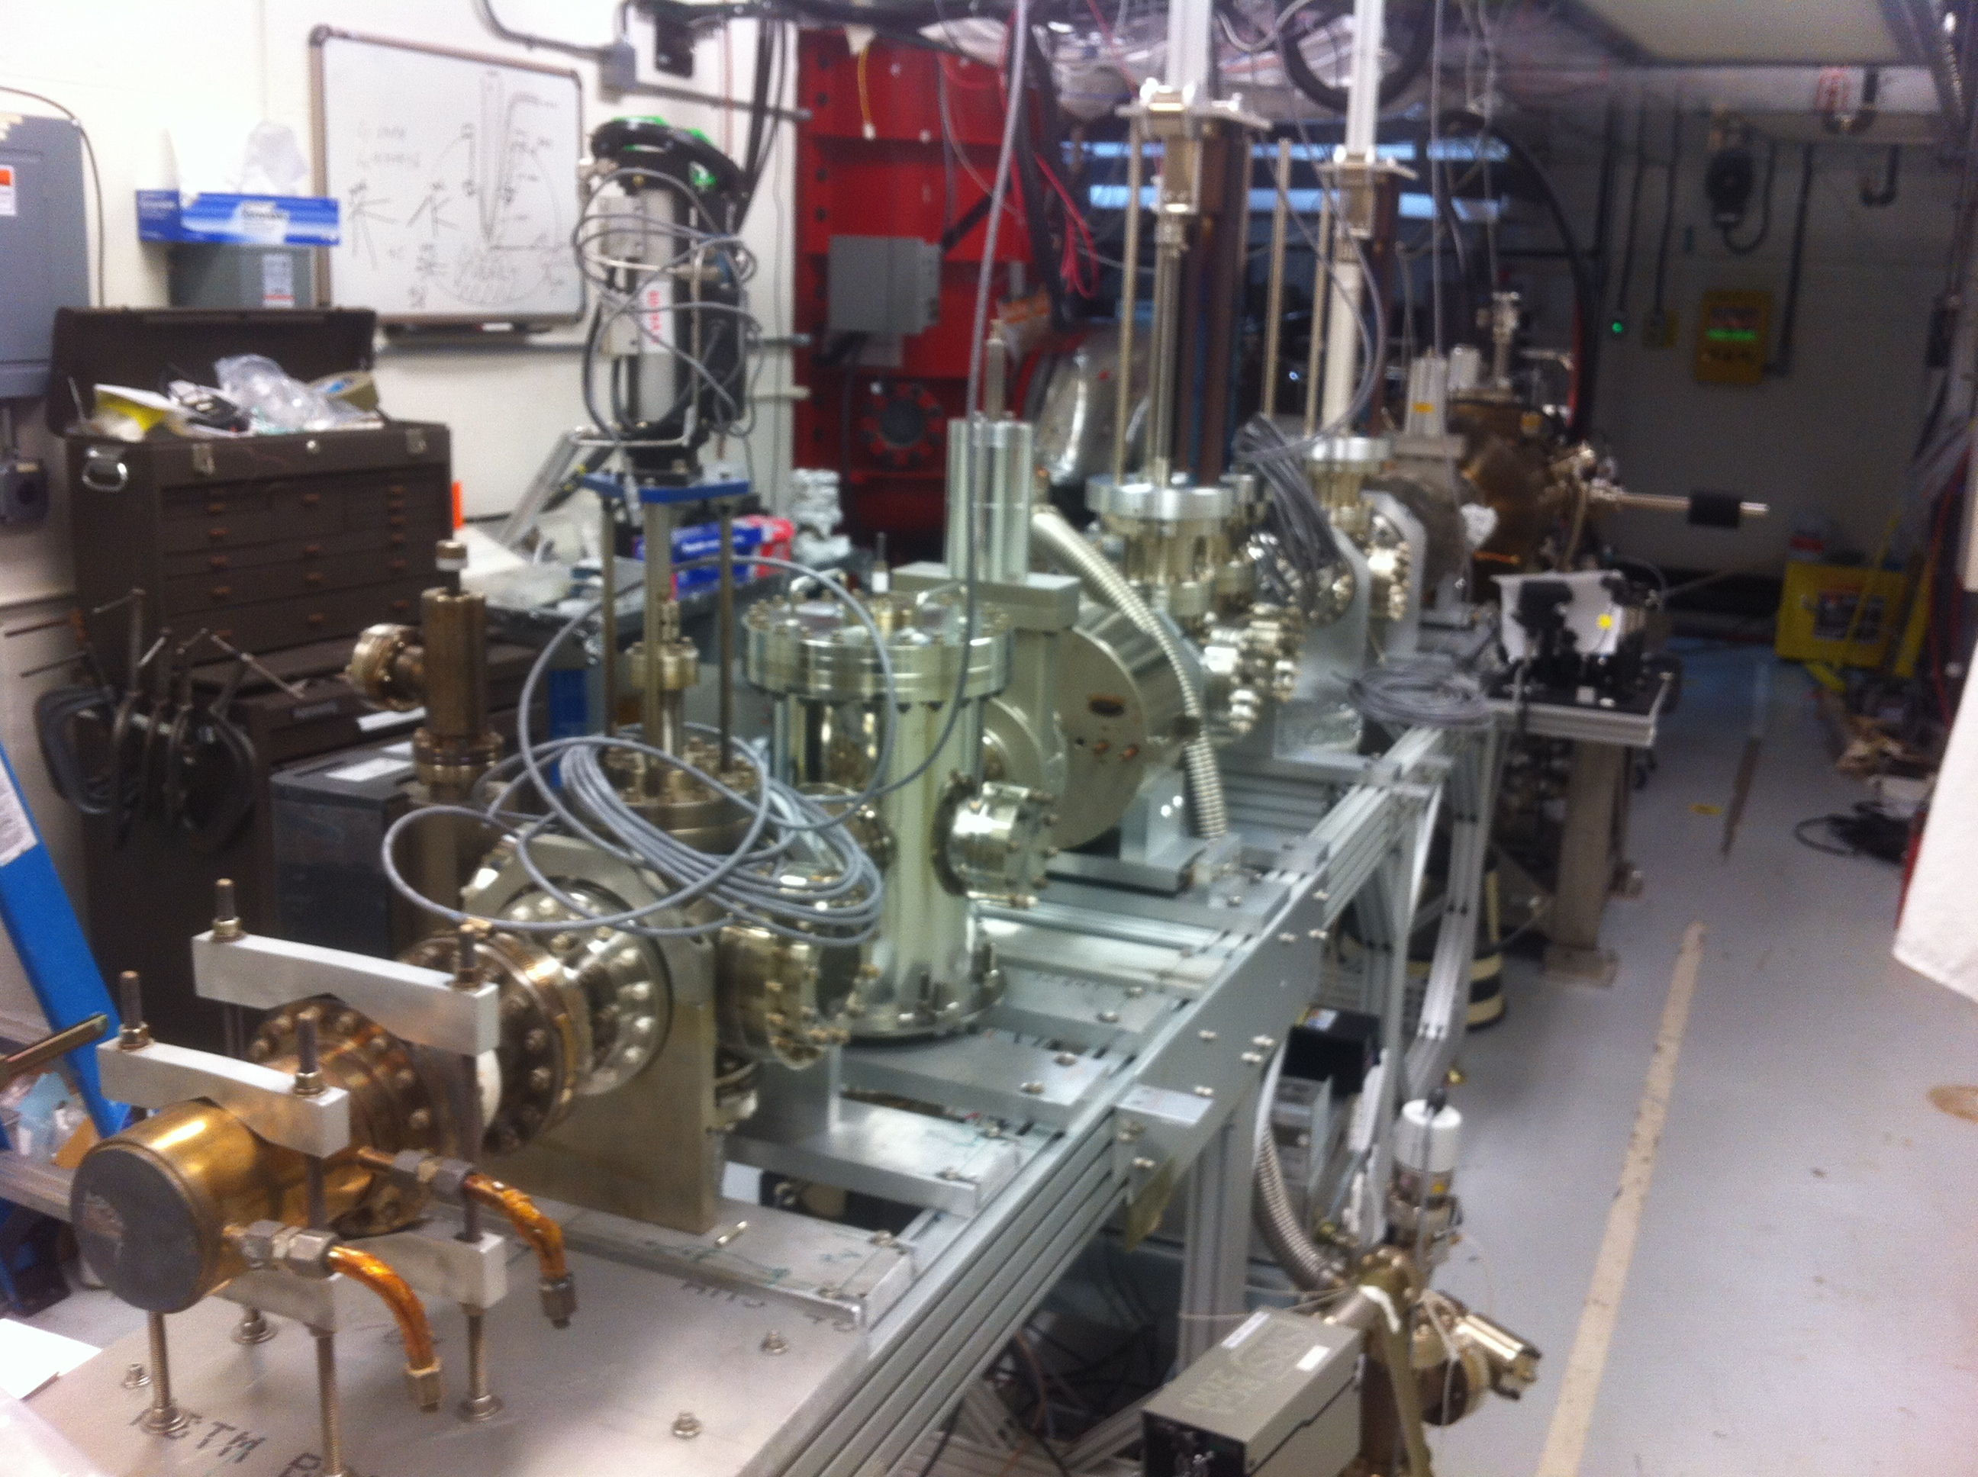
LERF Gun Test Stand

Slide 9
Progress
As of March 29, 2016

Slide 10
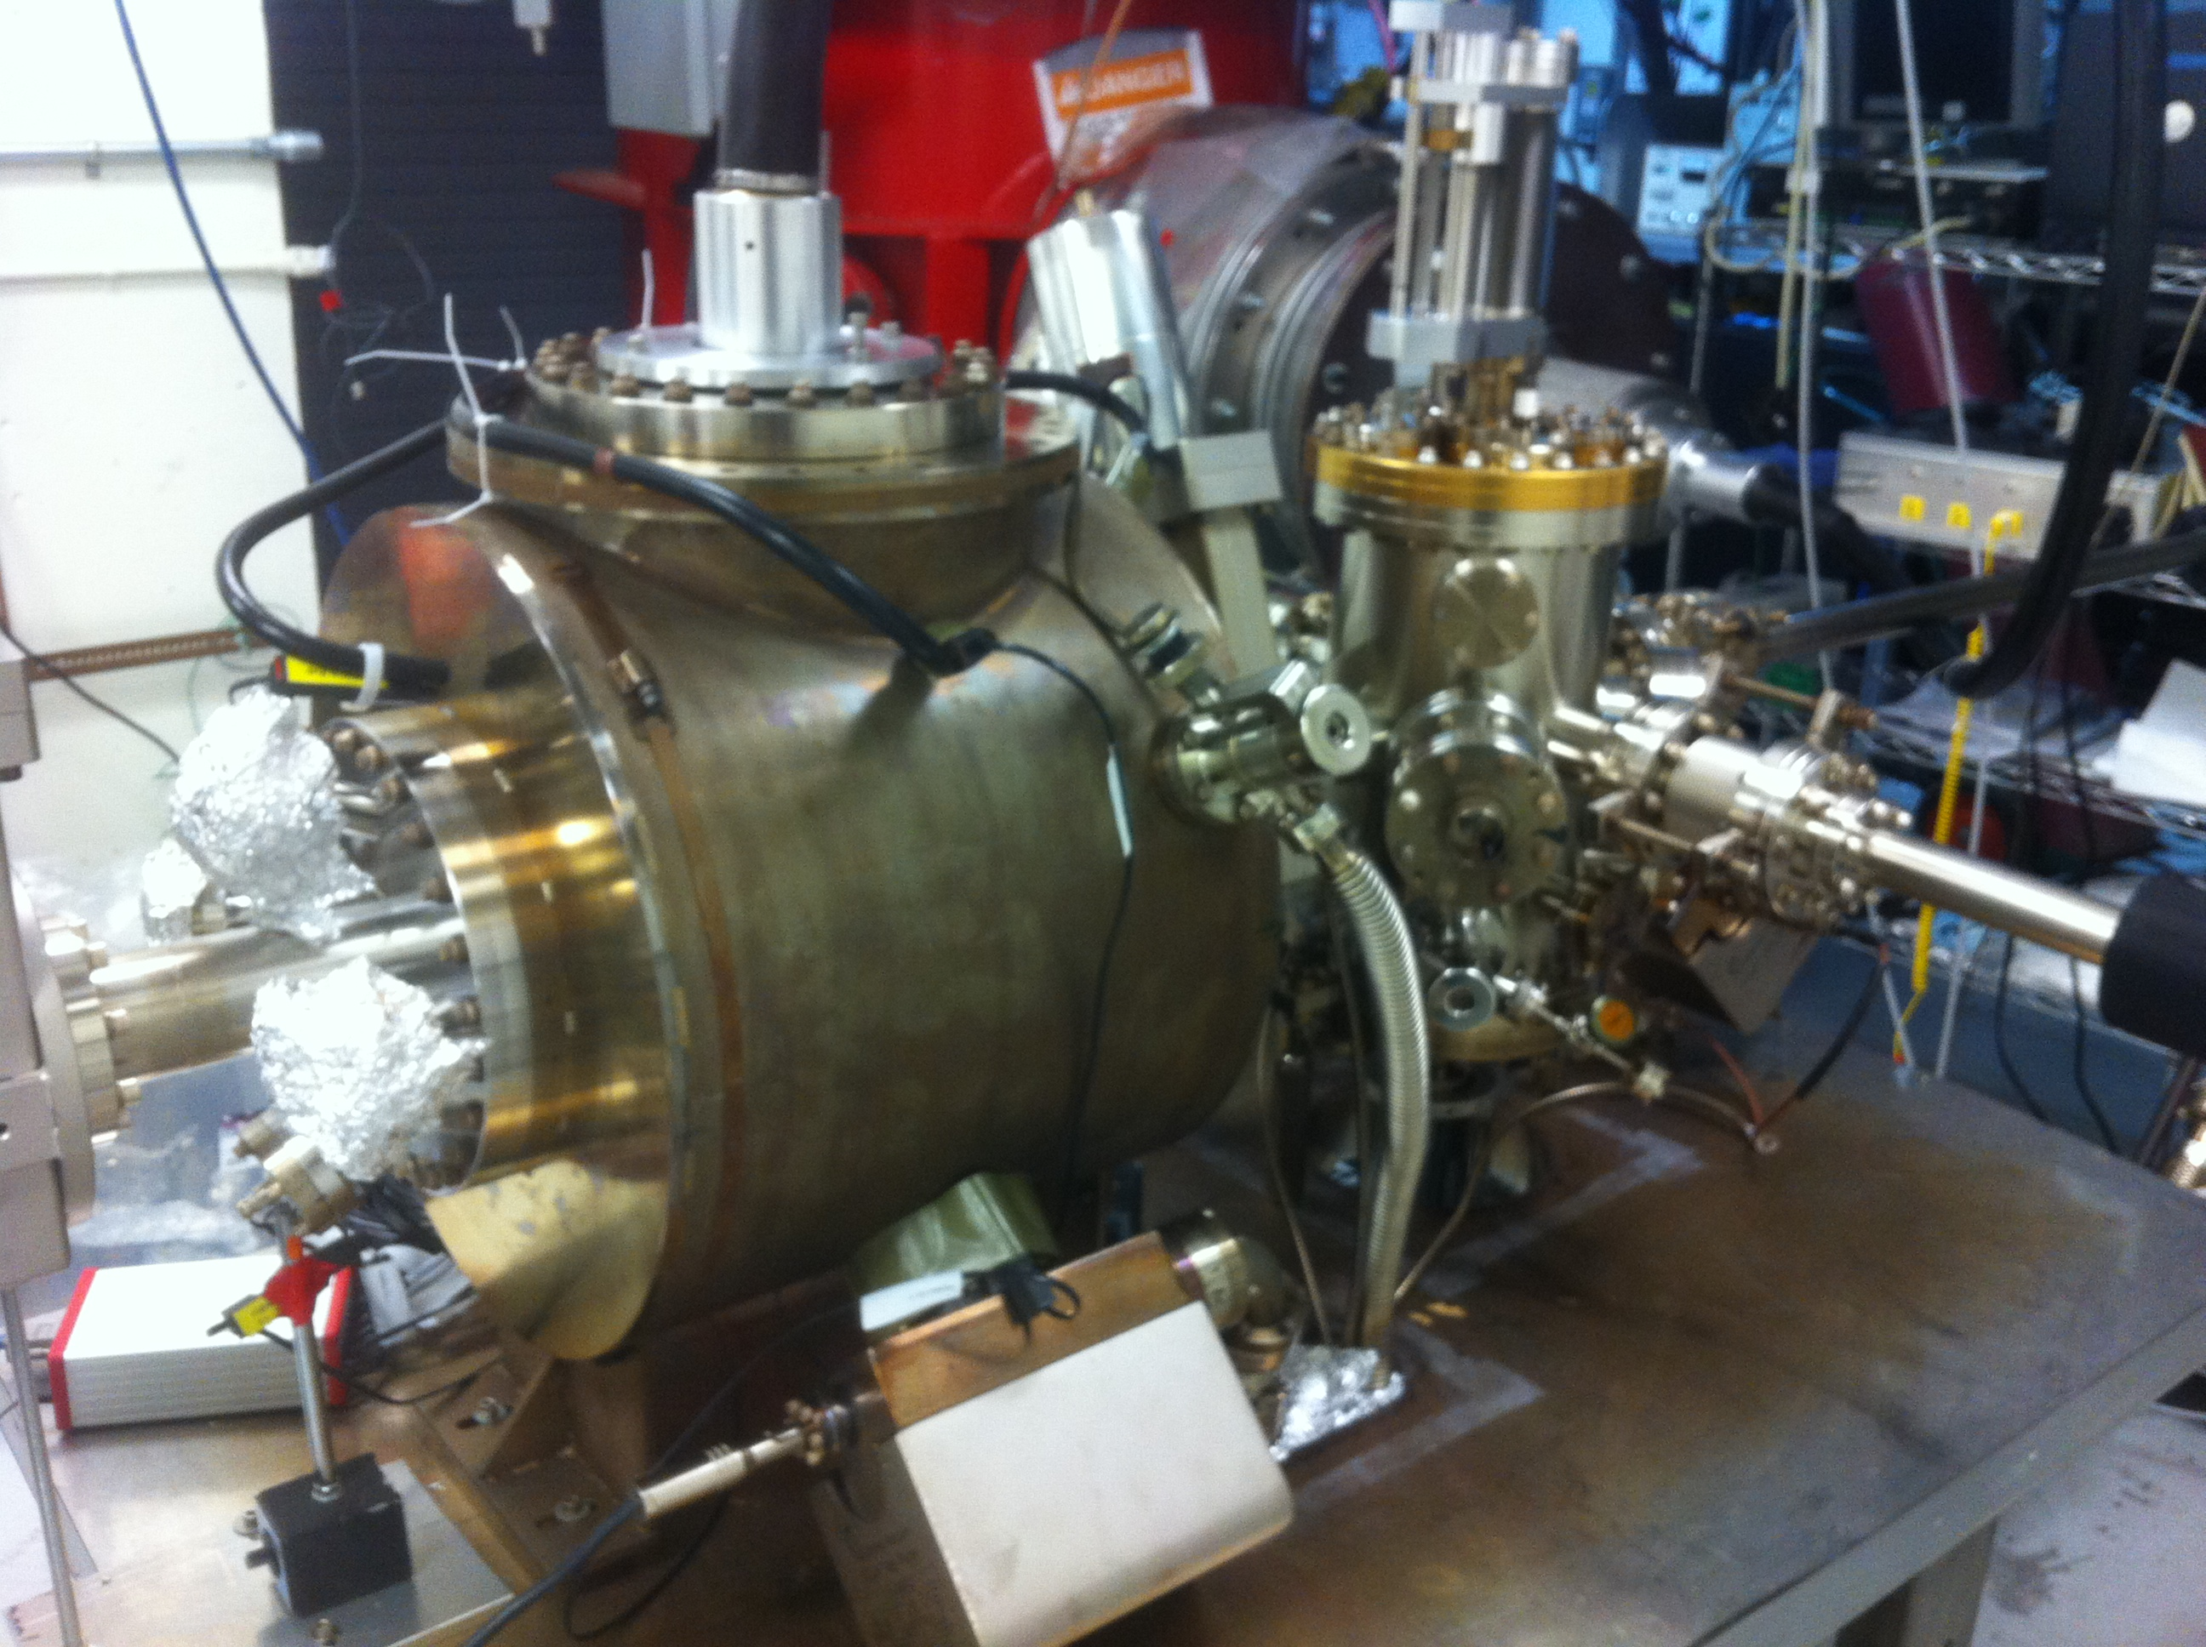
Gun: finished HV conditioning, ready to make beam at 325 kV
K₂CsSb Preparation Chamber
HV Chamber
Thanks to Carlos, Bubba, Phil and Yan
K₂CsSb Preparation Chamber: ready to grow photocathodes

Slide 11
Beamline: connected to gun, baked and now instrumenting steering coils, ion pumps and viewers
Lasers: ready (LOSP approved)
  Amplified Nd:YLF Laser system: 15 Hz, 45 ps, green, 1mJ/pulse energy, ~10 mW (average)
  Verdi Laser: DC, green, 10 W
  Antares Mode-locked Nd:YLF Laser: 74.85 MHz, 60 ps, green, 5 W. To be replaced later with Fiber Laser: 476.3 MHz
Gun Test Stand (GTS) OSP: approved for only 10 nA – working with Radiation Group for approval at full current
Thanks to Carlos, Bubba, Jim Coleman, Phil and Shukui
Notes:
Neodymium-doped yttrium lithium fluoride (Nd:YLF)

Slide 12
Cathode Solenoid Magnet
Modelled by Jay Benesch
Provides 1.4 kG at cathode (at 400A) without carbon steel puck
Bare coil – no cylindrical steel shield/return
Not bakable – will be mounted on rails. To bake gun, push downstream out of oven and run LCW through.
Designer: Gary Hays
Procurement: Tommy Hiatt

Slide 13
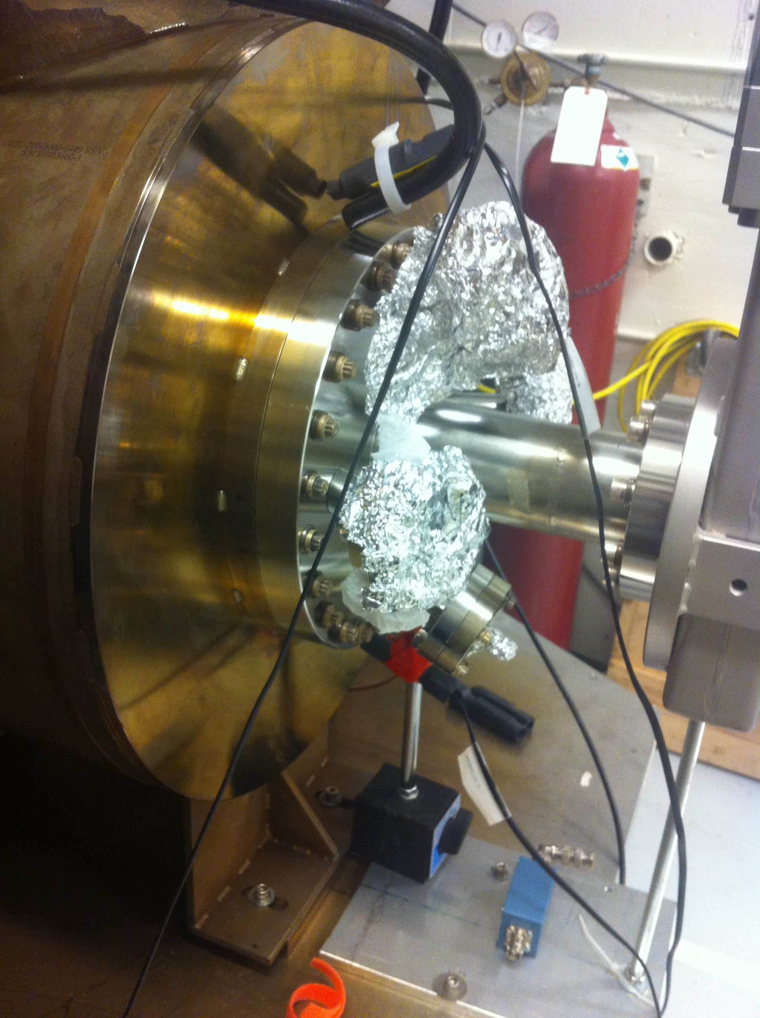
Cathode-Anode Gap
6”
Carbon Steel
9.0 cm
12”
18”
10”
6.4 cm
Molybdenum
8”
7.5”
Gun Table
0.5”

Slide 14
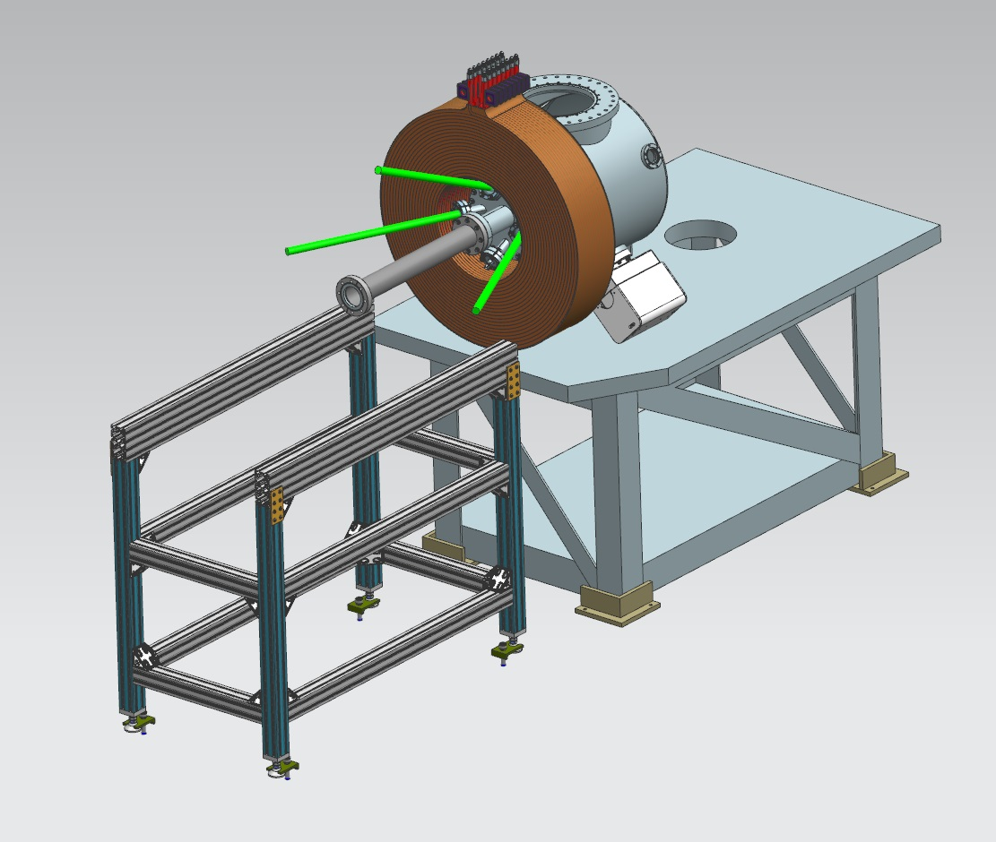
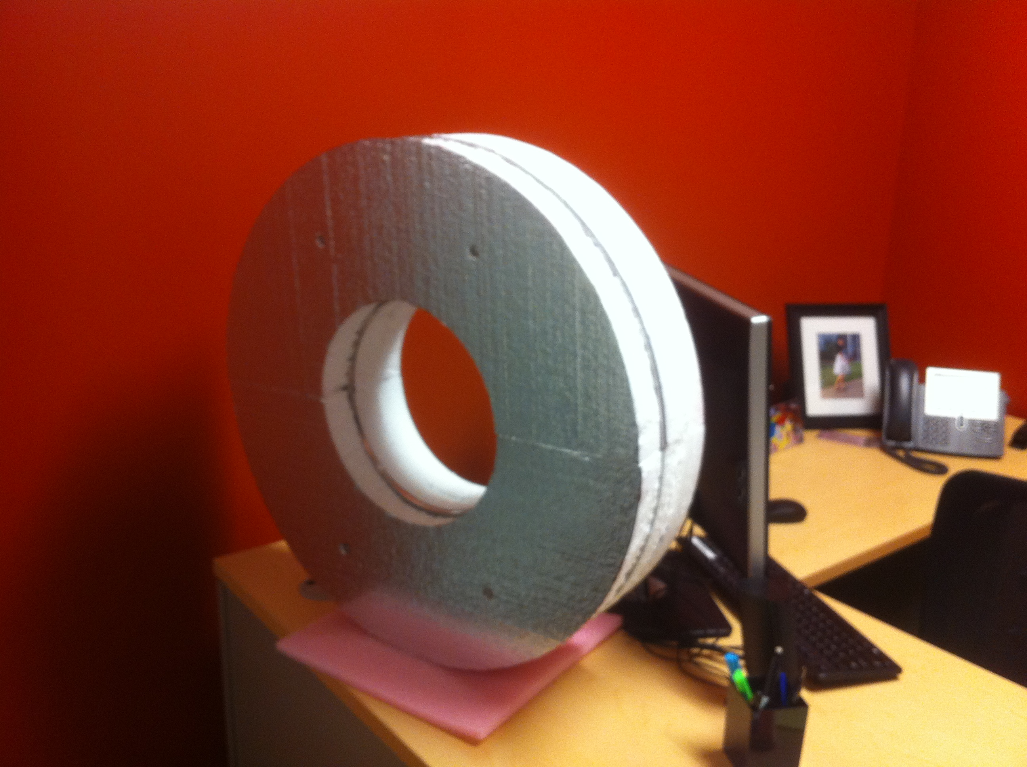

Slide 15
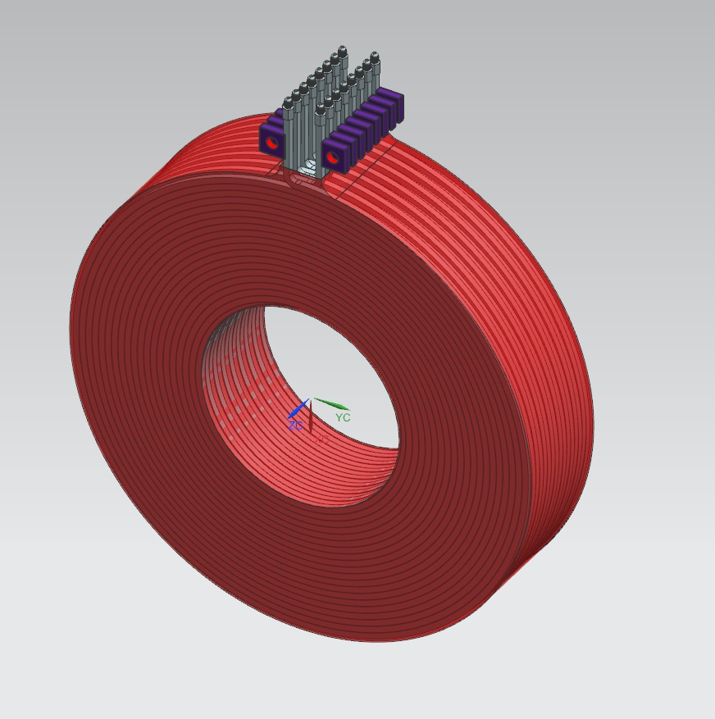
Size | 11.811” ID, 27.559” OD, 6.242” Z
Conductor | L=500 m, A=0.53 cm² 16 layers by 20 turns
Coil Weight | 240 kg
Resistance | 0.18 Ω (65°C average T)
Field at Photocathode | 1.4 kG
Voltage | 72 V
Current | 400 A
Solenoid ESH&Q:
  Measure 5 G magnetic field line and mark with signs
  Add interlocks to concrete shield door and a beacon, to ensure solenoid can only be energized when door is closed

Slide 16
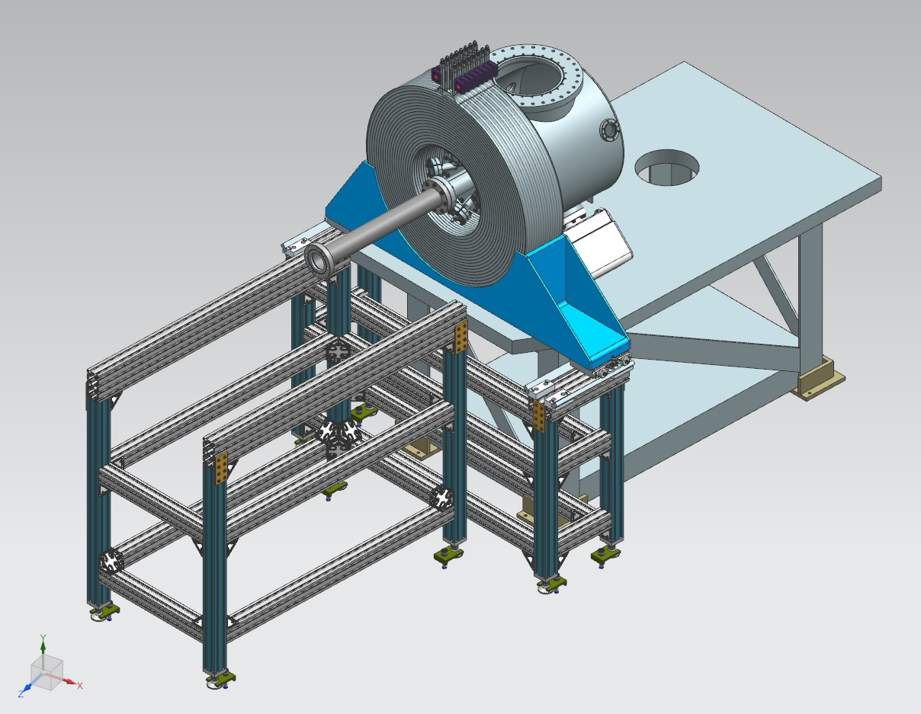
Cathode Solenoid Support
To be able to bake gun – move magnet away from gun and out
of oven
Allow for small adjustments to center solenoid on beam – 5 mm in x and y

Slide 17
Cathode Solenoid Power Supply
Use new spare CEBAF Dogleg magnet power supply (500A, 80V)
If needed at CEBAF, we can use an old Dogleg supply (250A, 50V) to keep going

Slide 18
Carbon Steel Puck
Molybdenum and carbon steel hybrid puck
Designed to enhance field to 2.0 kG at cathode
Use 1010 carbon steel
Re-design new Puck Manipulator End Adapter
Order 4 pucks – map with solenoid (August 2016)
Pucks heat treatment plan – 4 choices:
  Un-heated
  200˚C (Sb growth) and 120˚C (K – Cs growth)
  550˚C (heat cleaning) then 200˚C and 120˚C
  Multiple heat cycles

Slide 19
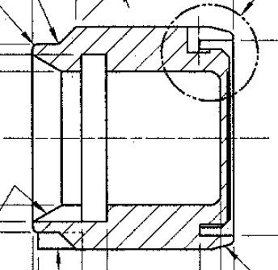
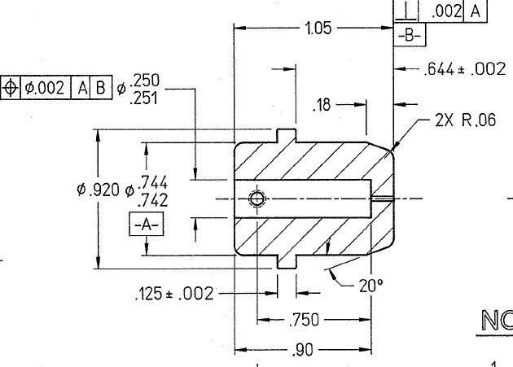
Molybdenum
2 mm
Stainless Steel
10 mm
2 mm
4 mm
Cut this part
Carbon Steel
2 mm

Slide 20
Cathode Solenoid Timeline
Power Supply (new spare Dogleg):
  Build at Magnet Lab: March
  Test: April
  Move to GTS: May
  Ready: May 31, 2016
Cathode Solenoid:
  Designed: December – February
  Procured: March
  On-site by July 8, 2016
  Map (with and w/o puck), check hysteresis and forces: July
  Install: August, 2016
Will have to break gun vacuum. Plan to change HV ceramic insulator and HV shed, replace leaky gate valve and add NEG pumps. Install slits.

Slide 21
Milestones

Slide 22
Year 1 Milestones
Q1 (Oct, Nov, Dec):
    HV condition gun to 350 kV and build K₂CsSb preparation chamber ☑
    Design beamline, locate magnets and diagnostics at optimum positions ☑
    Design cathode solenoid magnet ☑
Q2 (Jan, Feb, Mar):
    Connect existing beamline to gun and instrument beamline ☑
    Procure cathode solenoid magnet ☑
    Design and procure slits
Q3 (Apr, May, Jun):
    Commission exiting beamline with beam
    Measure photocathode lifetime at 5 mA and 350 kV (not magnetized)
    Relocate new spare CEBAF dogleg power supply to GTS
Q4 (Jul, Aug, Sep):
    Install cathode solenoid magnet
    Assemble new beamline and commission with beam
    Design and procure three skew quads

Slide 23
Year 2 Milestones
Q1 (Oct, Nov, Dec):
    Generate magnetized beam
    Measure mechanical angular momentum vs magnetization and laser size
    Benchmark simulation against measurements
Q2 (Jan, Feb, Mar):
    Measure mechanical angular momentum vs bunch charge and bunch length
    Benchmark simulation against measurements
Q3 (Apr, May, Jun):
    Generate very high currents magnetized beam and study beam transport vs electron bunch charge
Q4 (Jul, Aug, Sep):
    Measure photocathode lifetime vs magnetization at 5 mA and 350 kV
    Study beam halo and beam loss vs magnetization

Slide 24
Year 3 Milestones
Q1 (Oct, Nov, Dec):
    Install three skew quads
    Generate flat beam with skew quads – RTFB Transformer – and measure horizontal and vertical emittances using slit method
Q2 (Jan, Feb, Mar):
    Measure RTFB transformation versus electron bunch charge
    Use simulation to quantify how good or complete RTFB transform
Q3 (Apr, May, Jun):
    Change to HV Supply of 32 mA and 200 kV
Q4 (Jul, Aug, Sep):
    Measure photocathode lifetime vs magnetization at 32 mA and 200 kV
    Study beam halo and beam loss vs magnetization

Slide 25
Backup Slides

Slide 26
Magnetized Cooling
JLEIC bunched magnetized electron cooler is part of Collider Ring and aims to counteract emittance degradation induced by intra-beam scattering, to maintain ion beam emittance during collisions and extend luminosity lifetime.
Electrons helical motion in strong magnetic field increases electron-ion interaction time, thereby significantly improving cooling efficiency. Electron-ion collisions that occur over many cyclotron oscillations and at distances larger than cyclotron radius are insensitive to electrons transverse velocity.
Cooling rates are determined by electron longitudinal energy spread rather than electron beam transverse emittance as transverse motion of electrons is quenched by magnetic field
This cyclotron motion also provides suppression of electron-ion recombination

Slide 27
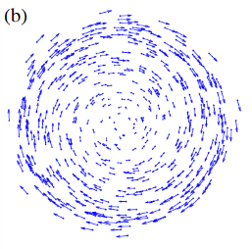
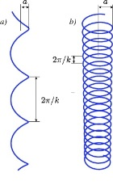
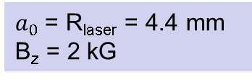
Electron beam is being used inside cooling solenoid where it suffers an azimuthal kick when it enters. This kick is cancelled by an earlier kick at exit of cathode solenoid
Cathode Solenoid
Cooling Solenoid
SRF Linac
electron
ion
Electrons born in strong uniform B_{z}
Upon exit of Cathode Solenoid
Upon entering Cooling Solenoid
r_{e}= 1.4 mm
B_{cool} = 2 T
$a_{0}$= R_{laser} = 4.4 mm
B_{z} = 2 kG
= 284 µm

